Slide 1
An Experiment in Using AI for Cross-Platform App Development with Flutter
March 2025
Norah Kuduk
(advised by Dr. Ed Harcourt)

Slide 2
OBJECTIVES OF THE PROJECT
1.
2.
Explore AI tools' impact on software development
Develop a cross-platform physical therapy/fitness app
Explore AI tools' impact on software development

Slide 3
Section I: App Dev

Slide 4
App Development Process
Ideation & Planning
Minimum Viable Product (MVP)
Implement Database
UI/UX Refinement
AI Usage
💡
☏
💻
📊
📣
Identifying user needs and goals of the app
Core functionality with hardcoded data
PostgreSQL for app info storage in a relational database
Creating an intuitive experience for users
Using ChatGPT & Copilot for development assistance

Slide 5


Why Cross-Platform Development?
Traditional app development requires separate codebases for iOS & Android
Challenges
  Higher cost
  Longer development time
Solution
  Flutter → Write once (in Dart), deploy anywhere (iOS, Android, Web).

Slide 6
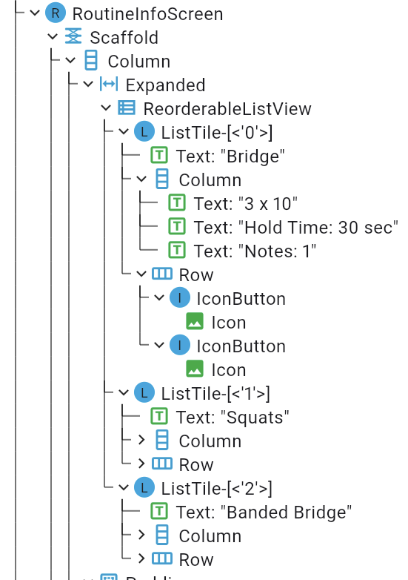
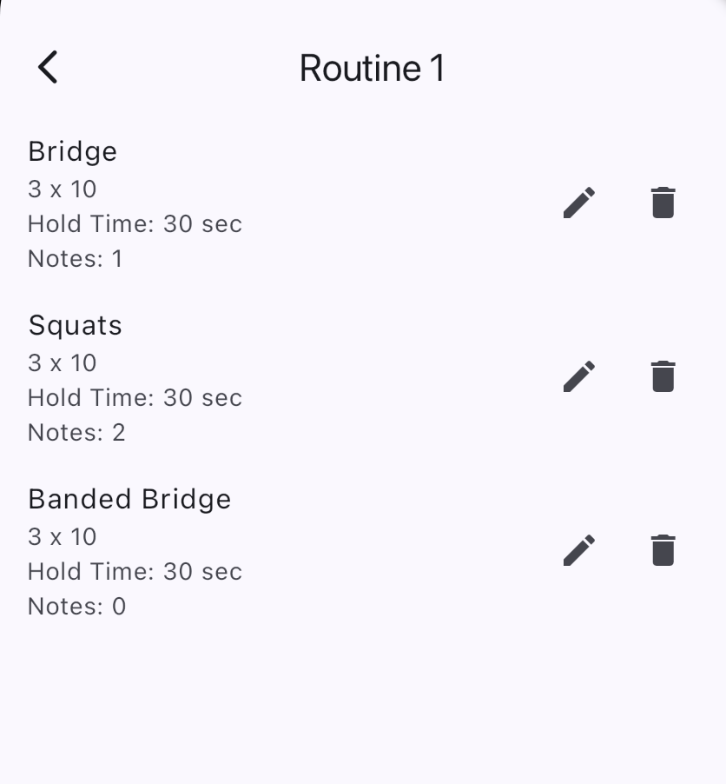
Flutter Development
Build natively compiled cross-platform apps from a single codebase
Key Features:
A “hot reload” to quickly see changes without restarting the app
Pre-designed widgets that already follow platform-specific guidelines
Extensive libraries already tested and developed

Slide 7
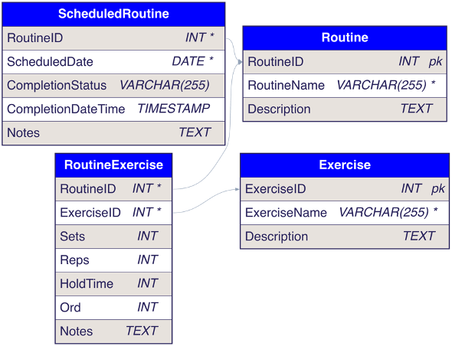
Database & Backend Architecture
Using the official Postgres image from Docker Hub
Running the Postgres Container with a chosen user and password in “detached” mode
Use REST API to enable communication between container and Flutter program using HTTP requests

Slide 8
Key App Screens

Slide 9
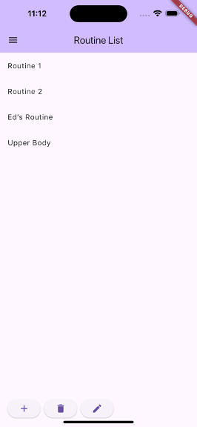
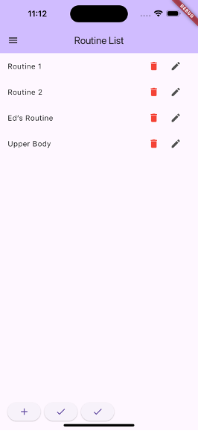
Home Screen
CASE STUDY
View and edit routines

Slide 10



Hamburger Menu/Settings Screen
CASE STUDY
Options for other windows, change settings

Slide 11
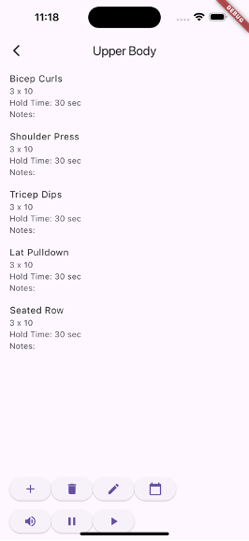
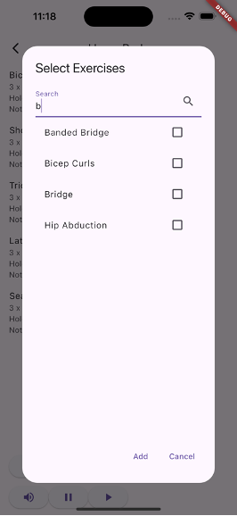
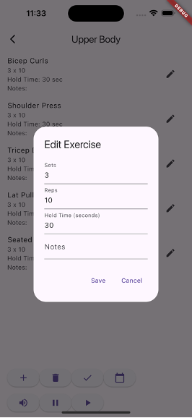
Routine Details
CASE STUDY
Customize exercises, add notes, enable text-to-speech

Slide 12
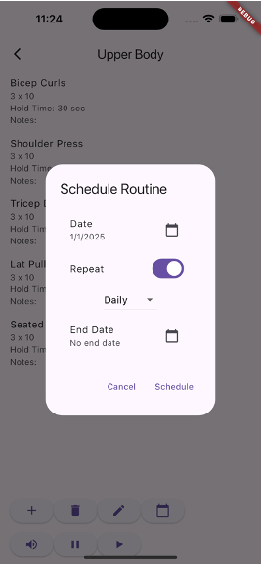
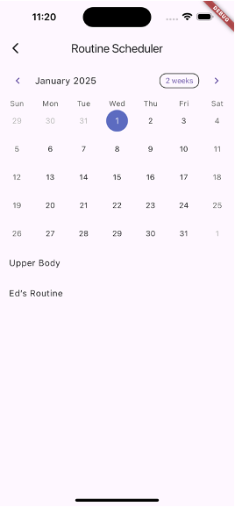
Scheduling View/Calendar
CASE STUDY
Choose options to schedule routines, view the list of scheduled routines for a given day

Slide 13
Section II: Conversations on AI

Slide 14


Role of AI in Development
Code Generation & Debugging
  ChatGPT for snippets & explanations
Autocomplete & Optimization
  GitHub Copilot for inline suggestions
Error Checking
  AI-assisted debugging and troubleshooting

Slide 15


AI in Academia & Industry
AI as a learning tool
  Can aid students in understanding programming concepts
Ethical considerations
  Over-reliance could hinder problem-solving skills
AI enhances, not replaces, human developers
  Still requires expertise for best results

Slide 16
Conclusions…
Flutter is effective for rapid cross-platform development, easy to learn for anyone with previous programming knowledge
AI tools enhance productivity but require oversight
Future Work:
  Add routine completion tracking & analytics
  Integrate with external health data (Apple Health, Google Fit)
  Prepare for deployment with privacy compliance

Slide 17
Thank You
Questions?

