Slide 1
Classification of E-commerce style
Feb/01/21 – Feb/21/21
Goal: Stage of adoption for online shopping
Classify E-commerce style by shopping frequency
Explore the dynamic of E-commerce style before and after the pandemic

Slide 2
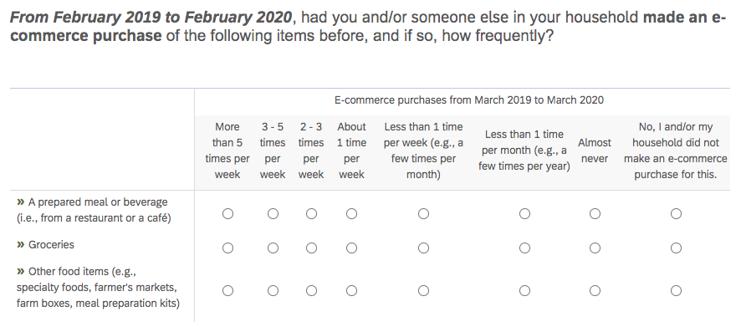
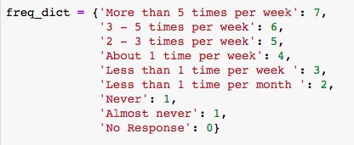
Feb/2019-Feb/2020 E-commerce style
Features: online shopping frequency for 8 categories of items
Data cleaning: Exclude records with at least one ‘No response’ (327 -> 276)
Method: K-means (Elbow method for choosing K w/ criteria: sum of distance squared)
Notes:
Potential problem: the difference in ordered number does not necessarily reflect difference in purchased frequency

Slide 3
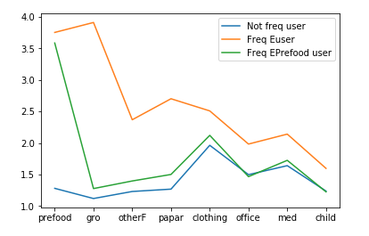
Three Groups of E-style
Frequent E-commerce User (57):
Do online purchase of all categories at a certain frequency, buy prepared food and grocery online about 1 time per week
Frequent Eprefood User (58):
Order prepared food online frequently
Infrequent E-user (161):
didn’t do online shopping much. Use online platform occasionally for clothing and medication.

Slide 4
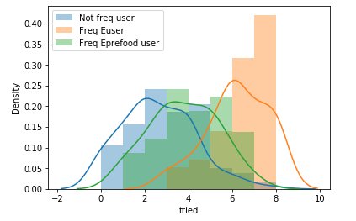
Difference in number of tried categories in E-commerce purchase
Freq Euser (6.2, 57): Grocery (57), prepared food, clothing(54), paper cleaning (53);
Freq Eprefood User (3.8, 58): prepared food (58), clothing (48)
Infreq Euser (2.6, 163): clothing (115), medication (84), homeoffice (71)
Clothing seems like an introductory to E-Commerce. Every Freq Euser have tried Egrocery before. Every Freq Eprefood user have tried Eprefood.
The mean of number of categories tried for different group is significantly different.
Notes:
exposure

Slide 5
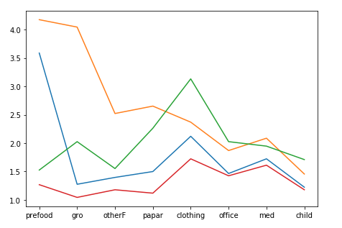
Four Groups of E-style
Identify a new group with high Eclothing frequency
Come from Infrequent Euser (27) and Frequent Euser (11) of the three clustering group

Slide 6
E-commerce style in May
Data cleaning: Exclude records with at least one ‘No response’ (327 ->193)
Imputation of data:
Impute the purchase frequency from number of orders placed during surveyed week
if number of orders > 0, impute frequency as 4: about 1 time per week

Slide 7
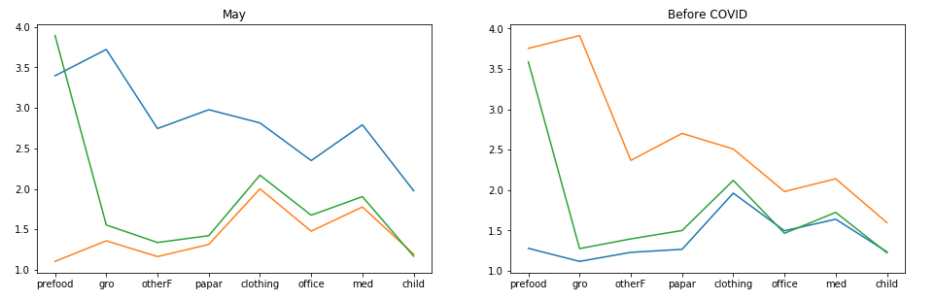
Three Groups of E-style in May
sample size:
Before (Freq Euser: 57; Freq Epreparedfood: 58; Not Freq User: 161; Total: 276)
May (Freq Euser: 43; Freq Epreparedfood: 83; Not Freq User: 67; Total: 193)
Similar styles are identified

Slide 8
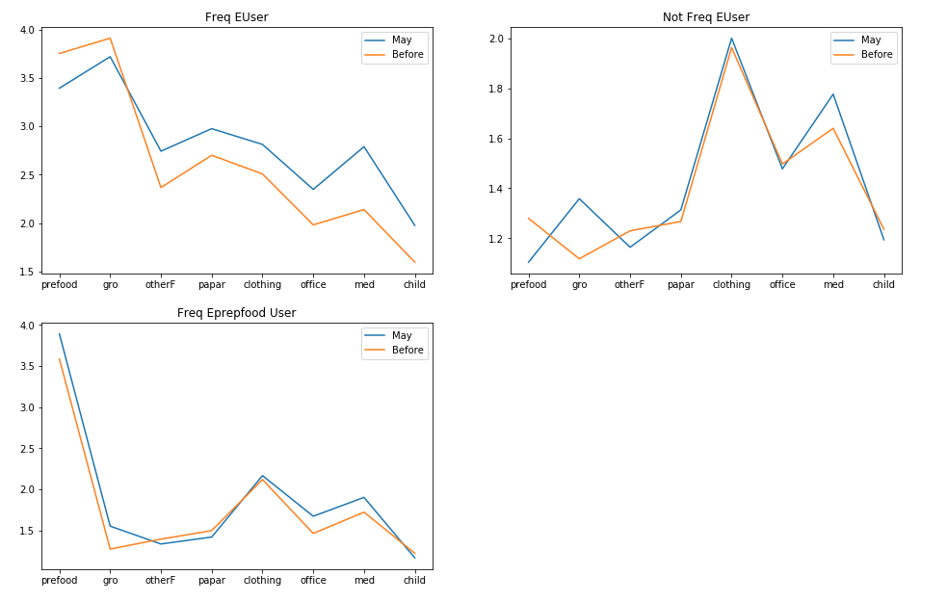
Three Groups of E-style
Increased frequency in
Frequent Euser: Emedication, Ehomeoffice, Echildcare
Not Freq Euser: Eprefood, Egrocery
Freq Eprefood User: Eprefood, Egrocery, EHomeoffice (0.066)
Notes:
Possible reason of not seeing increased frequency of prepared food and grocery online shopping in frequent Euser: imputation of frequency

Slide 9
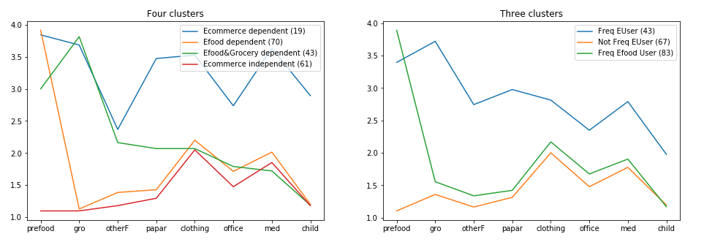
Four groups of E-style
Ecommerce dependent: High frequency in food, grocery, paper, clothing, medication (highly ecommerce dependent) (19)
Efood&Gro dependent: Green Frequent user of online prepared food and grocery; purchase paper, clothing, medication from time to time (43)
Efood dependent: like order prepared food online; purchase clothing, office staff and medication from time to time (70)
Ecommerce independent: Not Ecommerce dependent, buy clothing, office staff, medication from time to time (61)
Compare to three clusters, four clusters distinguish between people who rely on Egrocery during the pandemic and people with high online shopping frequency in both essential (food, grocery, paper, medication) and non-essential (clothing) categories.

Slide 10
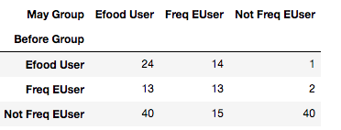
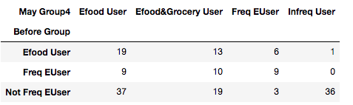
Dynamic of E-Commerce style
Not freq Euser change resort to Eprefood and egrocery during the pandemic

