Slide 1
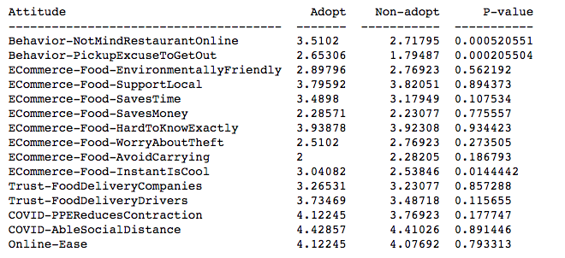
E-Prepared food: Adopt (49) v.s. non-adopt (39)
Adopter:
Not mind restaurant online
Pick up as an excuse to get out (<3)
Think online order save time
Think instant delivery is cool (~3)

Slide 2
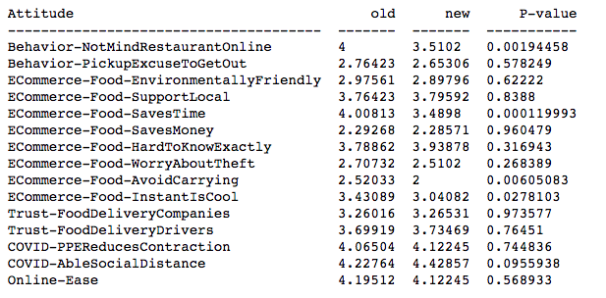
E-Prepared food: Old (123) v.s. new-adopter (49)
Old User:
Not mind restaurant online
Think online order save time
Think instant delivery is cool

Slide 3
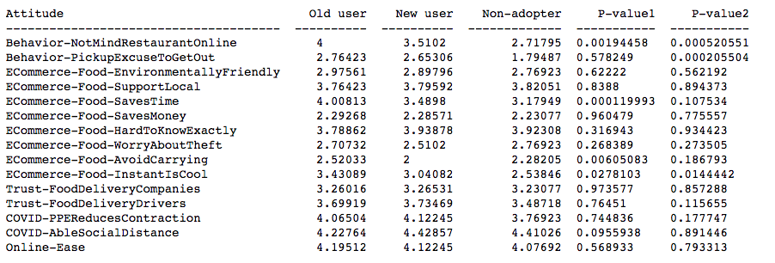
Increased Familiarity lead to more positive attitudes towards the services
There are certain properties of E-food that’s admired by the adopters:
Not might restaurant online
Save time
Instant delivery
As they become more familiar with the service, the advantages of E-food are more likely to be admired (old users are more positive than new users)

Slide 4
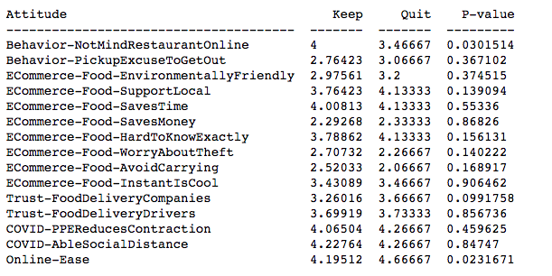
E-Prepared food: Keep (123) v.s. Quit (15)
Keeper:
Not mind restaurant online
Less likely to trust food delivery company
Does it relate to their experience?
Online Ease is not the reason that leads to people quiting the service

Slide 5
E-Prepared Food Summary
The advantage of E-prepared food that can be reinforced as people become more familiar with the service
Not mind restaurant online
Save time
Instant delivery
Issues that might be faced by E-Prepared food service
Trust issue towards delivery company
People who use more of the service (keeper) are more likely to have trust issues towards delivery company

Slide 6
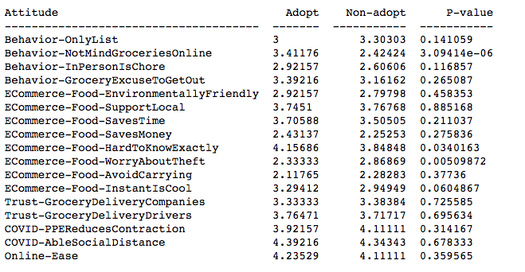
E-Grocery: Adopt (51) v.s. non-adopt (99)
Adopter:
Not mind grocery online
In-person is chore
Hard to know exactly what will get
Think instant delivery is cool
Non-adopter
Worry about theft

Slide 7
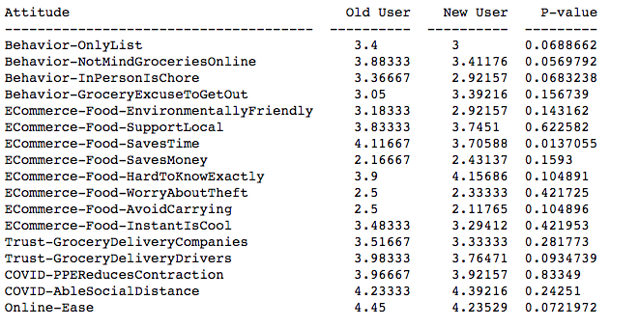
E-Grocery: Old (60) v.s. new-adopter (51)
Old User:
Shop only things on list
Not mind grocery online
In person is chore
E-food save time
Trust grocery delivery drivers
Avoid carrying
New User:
Hard to know exactly what will get

Slide 8
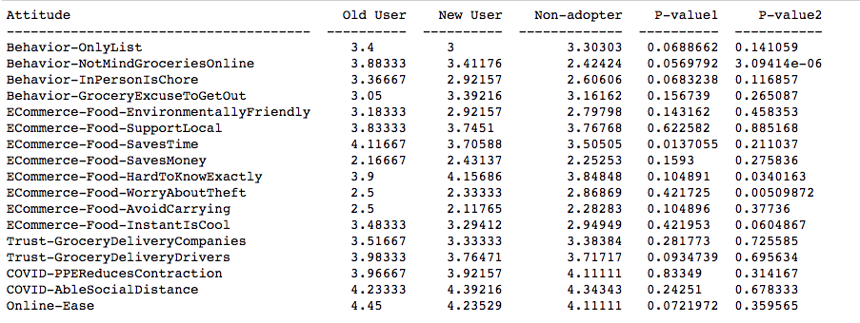
Increased Familiarity lead to more positive attitudes towards the services
Certain attitudes that new adopters start to evolve towards old users:
not mind grocery online
In-person is chore
Experience with E-grocery makes new adopters realize that they might get things different from what they expected
Notes:
What’s more, the convenience brought by eGrocery might make people more likely to think in-person is chore.
However, their trust towards delivery drivers still didn’t improve much. One thing that might drive new user away is that they experience the service and found the things they get might be different than what they expected? Will this factor drive people away from the service or will their get used to this unexpectation and develop a more gentle attitude towards it?
(adopter of E-prepared food is also more likely to indicate being hard to know exactly what they will get, but the score is lower, meaning the discrepancy issue is more severe in E-grocery than E-food)

Slide 9
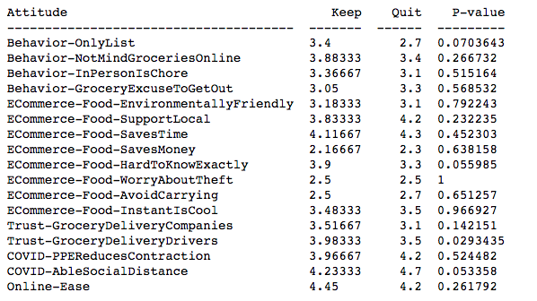
E-Grocery: Keep (60) v.s. Quit (10)
Keeper:
Shop only things on list
Hard to know exactly what will get
More likely to trust grocery delivery drivers
Quit:
Like to shop things not on list
More likely to believe themselves being able to keep social distance

Slide 10
E-grocery summary
Attitudes towards E-grocery / Grocery shopping evolved as people expose to the service
Not mind grocery online
Convenience of E-grocery (in-person is chore) but new adopters still don’t think in-person is troublesome in general (<3)
Non-adopter are more likely to worry about theft
The difference in expectation and experience is greater for new adopter than old users. (hard to know what will get). Will new adopter lower their expectation as the exposure to E-grocery increases?

Slide 11
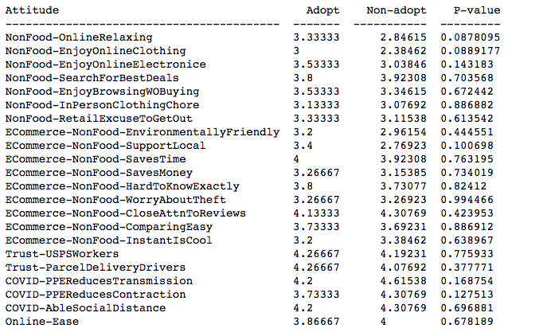
E-Clothing: Adopt (15) v.s. non-adopt (26)
Adopter
Find online shopping relaxing
Enjoy shopping online for clothing
Support local business (?)

Slide 12
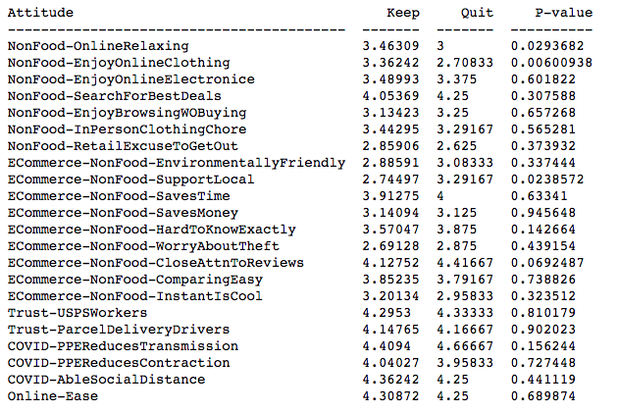
E-Clothing: Keep (149) v.s. Quit (24)
Keeper
Find online shopping relaxing
Enjoy shopping online for clothing
Quiter
Support local business (?)
Pay close attention to product or item reviews when making purchases (more cautious?)

Slide 13
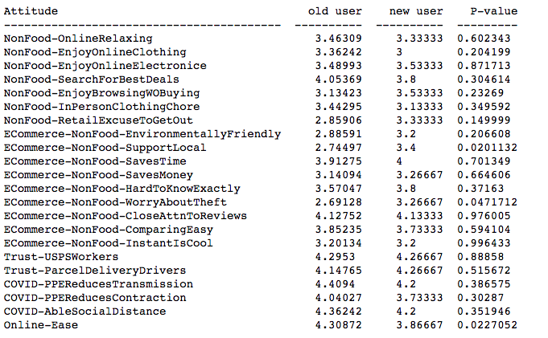
E-Clothing: Old (149) v.s. new-adopter (15)
New Adopter
Worry about theft
Old user
More familiar with online shopping (online ease)

