Slide 1
Trips/orders per week in May, 2020 – Prepared food
Trips/orders per week in May, 2020 – Groceries

Slide 2
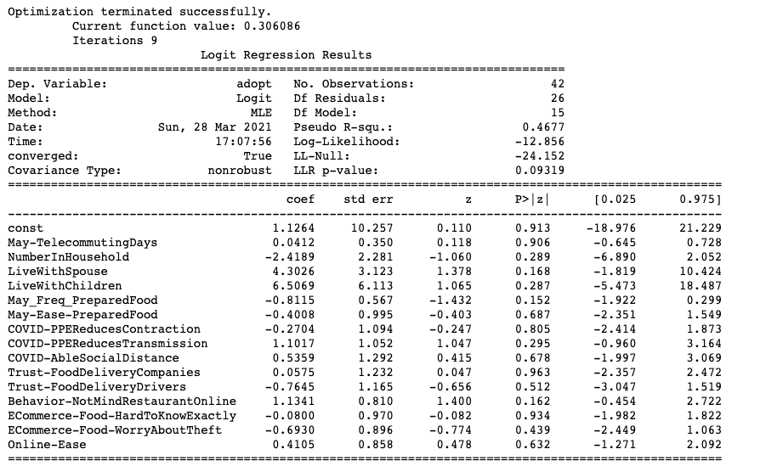
Binary choice model for initial adoption – both attitude and socio-demo
Positive:
Socio-demo:
Live with spouse
Attitude:
Not mind restaurant online
Negative:
Socio-demo:
Frequency of in-store shopping
Notes:
Should I put socio-demographic information and attitude together?
It seems that when including attitudes information, involves some causal inference here. For example, for ‘attitude-have enough food’, people feel like they have enough food so they don’t adopt or because of they don’t adopt, so they are less likely to feel they have enough food?

Slide 3
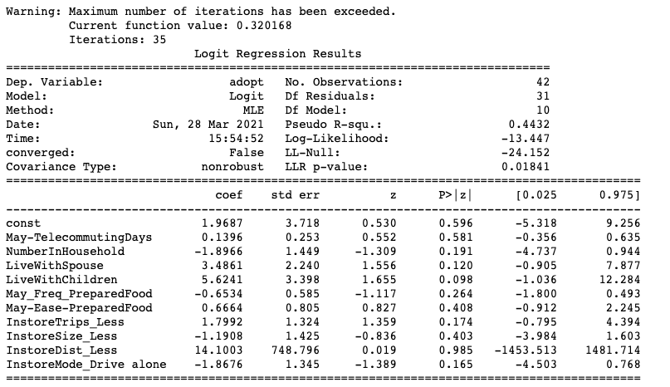
Binary choice model for initial adoption – Only Socio-demo
Positive:
Socio-demo:
Live with spouse
live with children *
Make less in-store trips
Negative:
Socio-demo:
Household size
Drive to store
Notes:
Should I put socio-demographic information and attitude together?
It seems that when including attitudes information, involves some causal inference here. For example, for ‘attitude-have enough food’, people feel like they have enough food so they don’t adopt or because of they don’t adopt, so they are less likely to feel they have enough food?

Slide 4
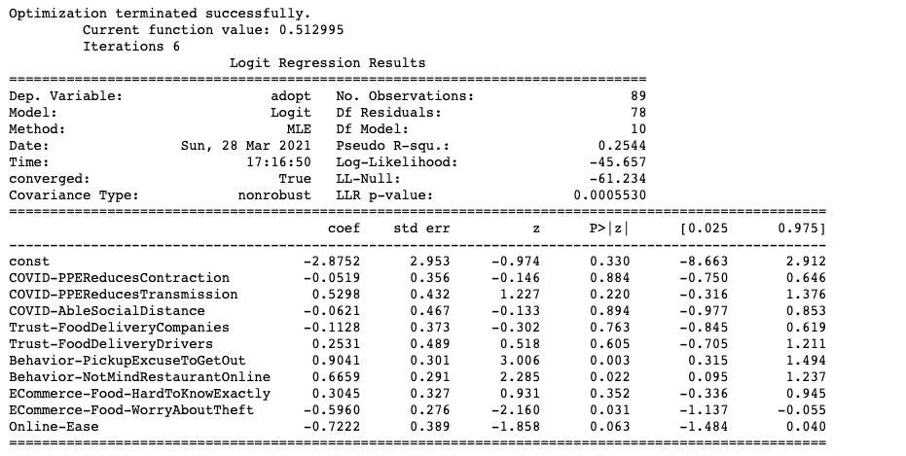
Binary choice model for initial adoption – Only Attitude
Positive:
Attitude:
PPE reduces transmission
Pick up as excuse to get out *
Not mind restaurant online *
Negative:
Attitude:
Worry about theft *
Online ease (?) *
Notes:
Should I put socio-demographic information and attitude together?
It seems that when including attitudes information, involves some causal inference here. For example, for ‘attitude-have enough food’, people feel like they have enough food so they don’t adopt or because of they don’t adopt, so they are less likely to feel they have enough food?

Slide 5
Summary for factors affecting adoption
+:
live with spouse, live with child, make less in-store trips
not mind restaurant online (endogenous?), PPE reduces transmission, pick up as excuse to get out
-:
household size, Drive to store, frequency of in-store shopping
Worry about theft
Notes:
Dri

Slide 6
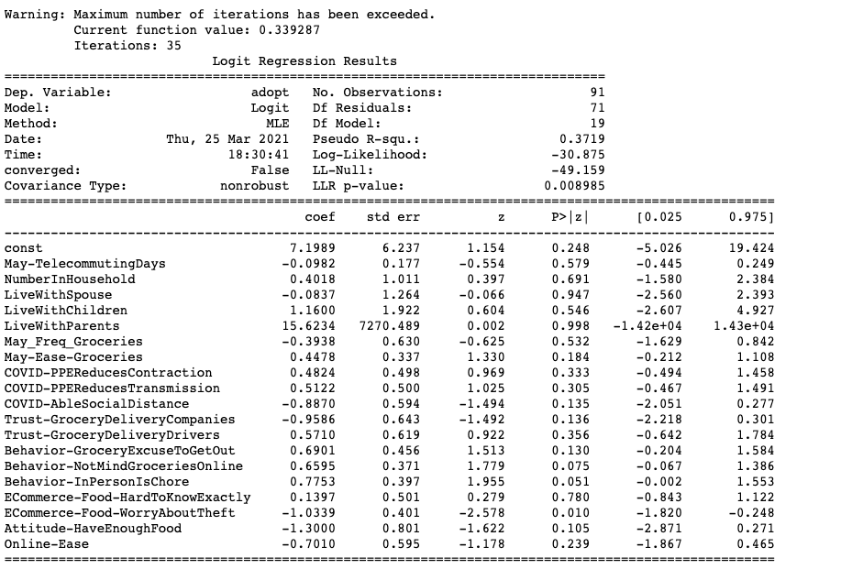
Binary choice model for initial adoption – Both attitude and socio-demo
Positive:
Attitude:
Ease to obtain groceries
Grocery as excuse to get out (?)
Not mind grocery online
In person is chore
Negative:
Attitude:
Maintain social distance
Trust grocery delivery companies (?)
Worry about theft
Have enough food (?)

Slide 7
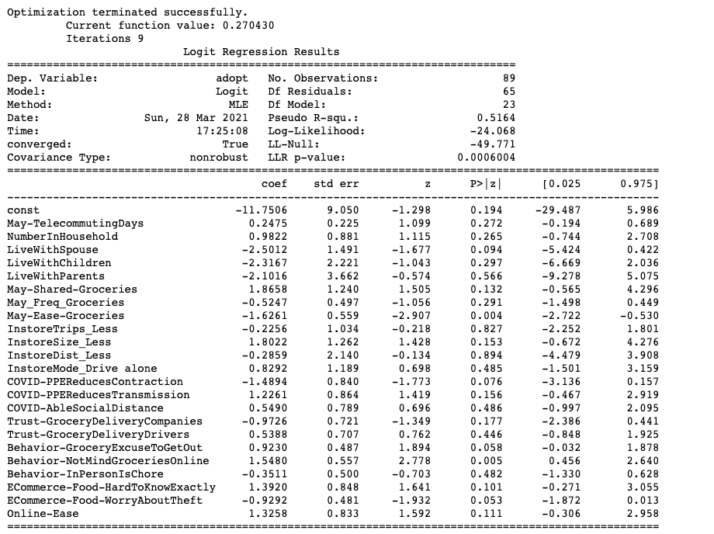
Binary choice model for initial adoption – Both attitude and socio-demo
Positive:
Socio-demo:
Share responsibility
Shop less items in store
Attitude:
PPE reduces transmission
Grocery shopping as excuse to get out *
Not mind grocery online *
Hard to know exactly (?)
Online ease
Negative:
Socio-demo:
Live with spouse *
Ease to obtain groceries *
Attitude:
PPE reduces contraction *
Trust delivery company (?)
Worry about theft *
Notes:
How to deal with no response record?

Slide 8
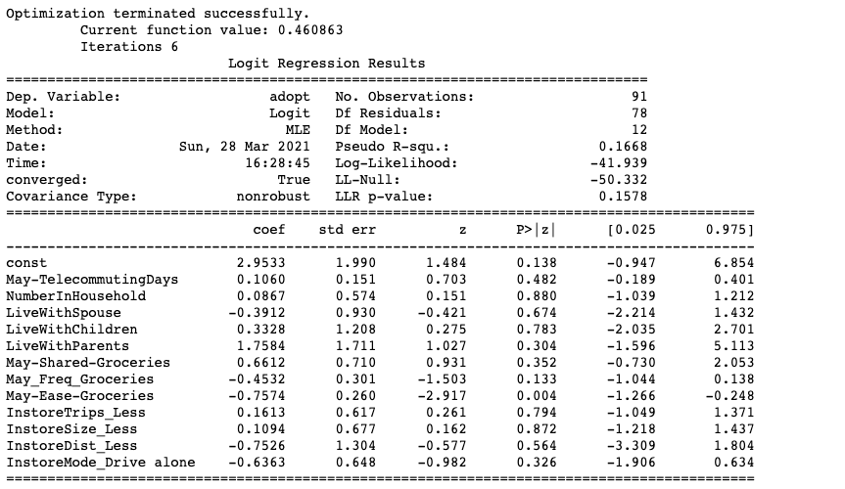
Binary choice model for initial adoption – only socio-demo
Negative:
Socio-demo:
In-store shopping frequency
Ease to obtain grocery *

Slide 9
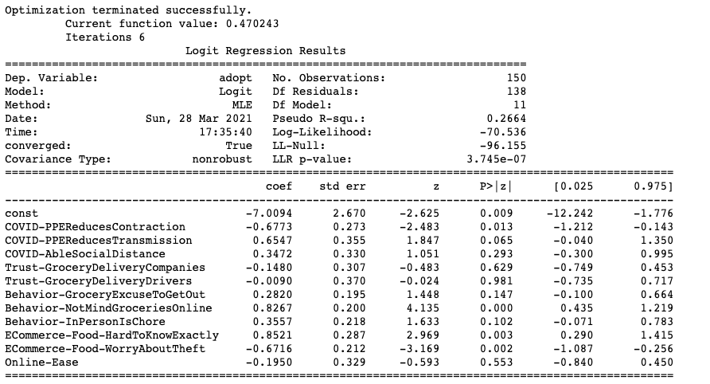
Binary choice model for initial adoption – Only attitude
Positive:
Attitude:
PPE reduces transmission*
Excuse to get out
Not mind grocery online*
In person is chore
Hard to know exactly what will get (?)
Negative:
Attitude:
PPE reduces contraction*
Worry about theft*

Slide 10
Summary for factors affecting Egrocery adoption
+ :
Share responsibility, shop less items in-store,
PPE reduces transmission, not mind grocery online, in person is chore, hard to know exactly what will get (result of adoption?), online ease
- :
Live with spouse, In-store shopping frequency, ease to obtain grocery,
PPE reduces contraction, worry about theft, trust delivery company (?)
Notes:
People who believe PPE reduces transmission more likely to adopt Efood (is it means they are more likely to trust delivery can avoid virus spread?)
People who believe PPE reduces contraction are more likely to go in-store

Slide 11
Questions regarding modeling
Some attitudes have the flipped sign are expected to be the results of adoption (e.g. Hard to know what will get, trust delivery company), how to incorporate the causal relationship here?
How to deal with record with no response?
Encode shopping frequency as ordered categorical variable
Final model should all have expected sign but not necessarily significant coefficient?

