Slide 1
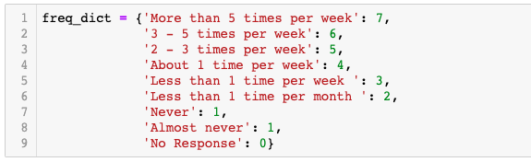
1) Impute online shopping dependency by comparing in-store v.s. online shopping frequency
Based on above frequency (treat no response as never), split style into
0 No shopping: Efreq <= 1 & Freq <= 1
1 In-store only: Efreq <= 1 & Freq > 1
2 More in-store: Freq > Efreq > 1
3 Same: Freq = Efreq > 1
4 More online: Efreq > Freq > 1
5 Online only: Efreq > 1 & Freq <= 1
Notes:
1People who didn’t answer frequency questions might also didn’t answer the trips/orders during survey week questions, their ‘May_Freq_’ == 0 . When calculate the style, ‘May_Freq_’ == 0 will be viewed as never

Slide 2
 | No shopping | In-store only | More in-store | Same | More online | Online only
PreparedFood | 15.9% | 28.7% | 11.0% | 22.3% | 15.9% | 6.1%
Grocery | 2.1% | 62.7% | 15.0% | 11.6% | 5.2% | 3.4%
OtherFood | 48.3% | 30.9% | 4.6% | 4.3% | 3.7% | 8.3%
PaperCleaning | 48.3% | 17.4% | 10.4% | 12.5% | 4.3% | 7.0%
Clothing | 24.2% | 19.9% | 3.7% | 22.0% | 13.1% | 17.1%
HomeOffice | 44.6% | 19.6% | 3.7% | 14.1% | 7.0% | 11.0%
Medication | 28.4% | 29.7% | 4.0% | 16.8% | 10.4% | 10.7%
ChildcareItems | 79.8% | 4.6% | 1.8% | 4.3% | 3.7% | 5.8%
For who shops:
ChildcareItems has the largest portion of customers who only shop online (28.8%) followed by clothing (22.6%) and then home office (19.9%)
47% of customers for Childcareitems prefer online channel, followed by clothing (39.9%) and homeoffice (32.6%). Only 8.8% customers do grocery shopping more online.
For essential items like grocery, food, paper cleaning, medication, people are more likely to prefer in-store format.
 | In-store only | More in-store | Same | More online | Online only | prefer online | prefer instore | Expose to Online
PreparedFood | 34.2% | 13.1% | 26.5% | 18.9% | 7.3% | 26.2% | 47.3% | 65.8%
Grocery | 64.1% | 15.3% | 11.9% | 5.3% | 3.4% | 8.8% | 79.4% | 35.9%
OtherFood | 59.8% | 8.9% | 8.3% | 7.1% | 16.0% | 23.1% | 68.6% | 40.2%
PaperCleaning | 33.7% | 20.1% | 24.3% | 8.3% | 13.6% | 21.9% | 53.8% | 66.3%
Clothing | 26.2% | 4.8% | 29.0% | 17.3% | 22.6% | 39.9% | 31.0% | 73.8%
HomeOffice | 35.4% | 6.6% | 25.4% | 12.7% | 19.9% | 32.6% | 42.0% | 64.6%
Medication | 41.5% | 5.6% | 23.5% | 14.5% | 15.0% | 29.5% | 47.0% | 58.5%
ChildcareItems | 22.7% | 9.1% | 21.2% | 18.2% | 28.8% | 47.0% | 31.8% | 77.3%

Slide 3
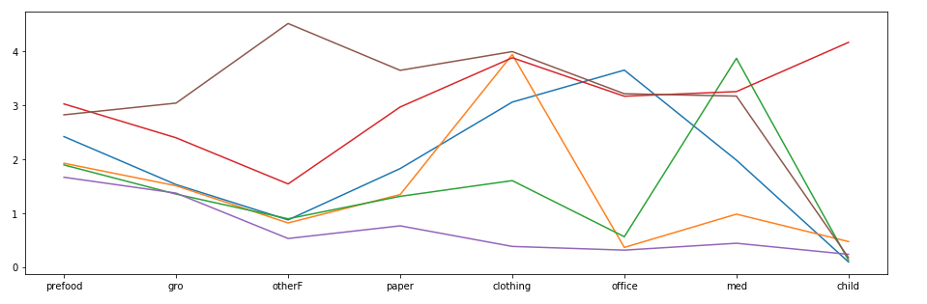
K-Means clustering: Shopping style with channel preference
0 | No shopping
1 | In-store only
2 | More in-store
3 | Same
4 | More online
5 | Online only
Purple (Ecommerce independent): rely on instore shopping more over all categories
Green (Emedication dependent): Prefer online medication shopping
Blue (Eoffice dependent): Prefer online office supplies shopping, shop clothing both instore and online
Orange (EClothing dependent): Prefer online clothing shopping
Red (Partially Ecommerce dependent): Prefer online clothing, office, medication, childcare items shopping.
Brown (Partially Ecommerce dependent): Prefer online shopping across a broad categories including other food, paper cleaning, clothing, office, medication; slightly more likely to prefer online grocery shopping

Slide 4
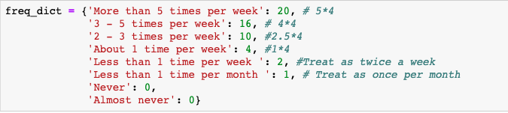
2) Convert categorical encoding of frequency to numerical (trips/orders per month)
Total frequency = instore frequency + online frequency
Proportion of online shopping = online frequency / total frequency
Notes:
If do no shopping, the proportion of online shopping will also be zero. This might lack interpretation.
Does using proportion of purchase frequency make sense? It would be good if we know the amount they spend in-store v.s. online

Slide 5
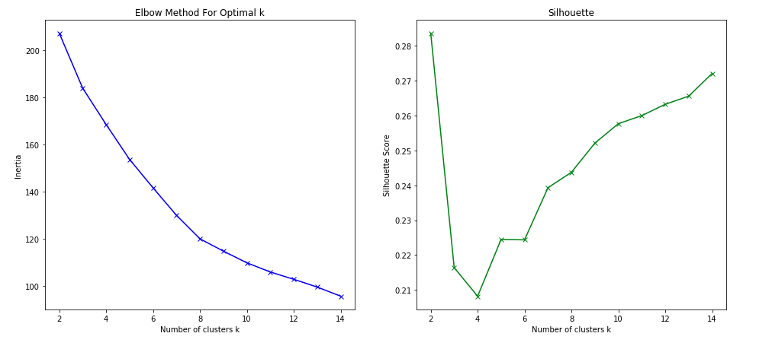
Notes:
Choose 8 groups

Slide 6
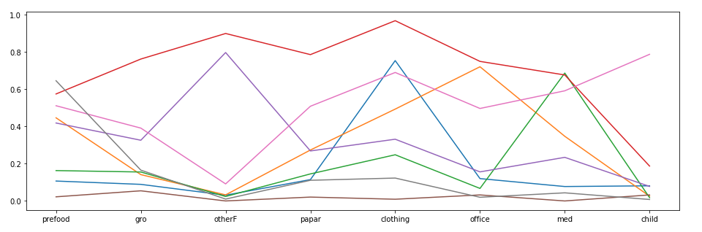
ECommerce dependent (16)
ECommerce partially dependent (28)
EFood dependent (32)
EOffice dependent (47)
EMedication dependent (47)
EClothing dependent (43)
EPreparedFood dependent (42)
ECommerce independent (72)

Slide 7
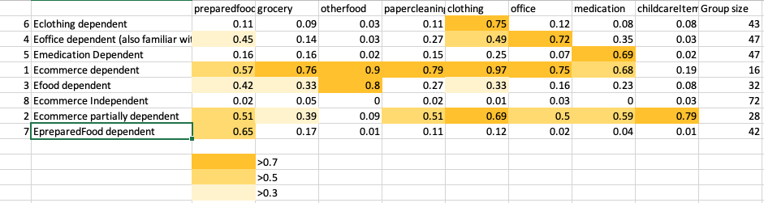
Ecommerce dependent: purchase clothing and other food mostly online, a large portion of essentials like grocery, paper cleaning and medication are also purchased online.
Ecommerce partially dependent: Large portion of clothing and childcare items are purchased online, prefer online format slightly more than in-store for preparedfood, papercleaning, office and medication.
Efood dependent: purchase other food mostly through online platform, do preparedfood, grocery and clothing online shopping from time to time.
Eoffice dependent: purchase office supplies mostly online, do preparedfood and clothing online shopping from time to time.
Emedication dependent: A large portion of medication are purchased online
Epreparedfood dependent: A large portion of prepared food are purchased online
Ecommerce independent: Seldom do online shopping.

Slide 8
Problem with the dataset:
Can’t explore dynamic of shopping style

