Slide 1
Predicting California’s
Electricity Demand
Nora Huntington

Slide 2
Predict Hourly Demand
Using Historical Data
Dataset:
U.S. Energy Information Administration (EIA)
Time series from 7/1/2015 - today
Data point every hour
> 45,000 data points
Extracted year, month, day of the week, hour values
Converted 4 outliers below 15,000 megawatthours by taking the average of similar points

Slide 3
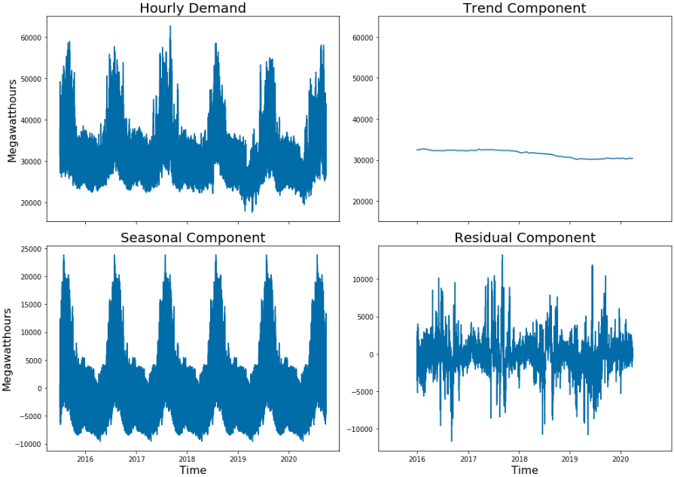
Components of Series

Slide 4
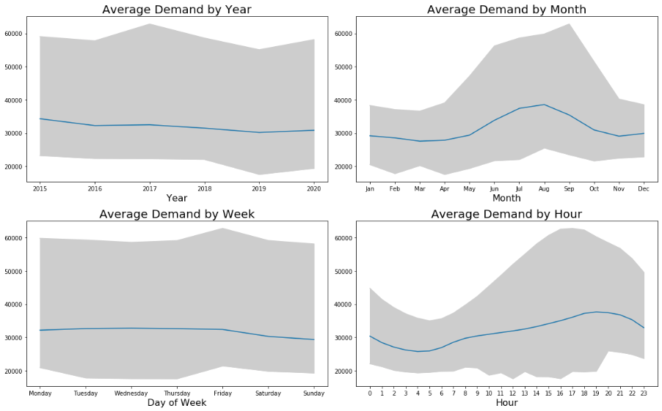
Average Demand & Range

Slide 5
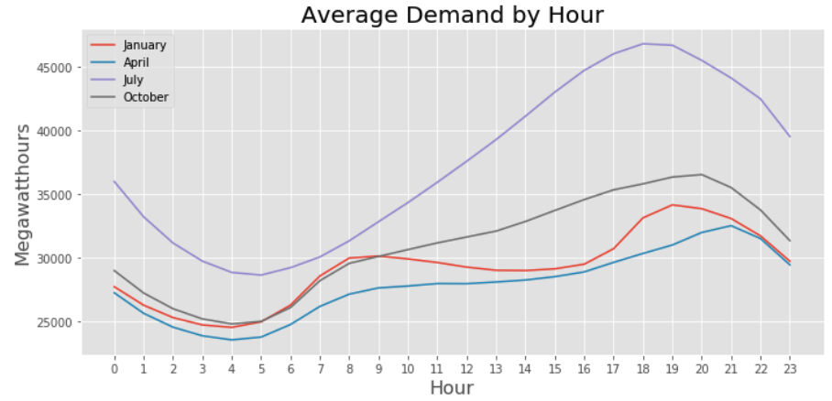
Average Demand - Four Months

Slide 6
Modeling
Predict 7 days out (168 hours)
Test date before Covid 1/29/2019
Score each model by testing them on five dates:
6/03/2018, 12/12/2019, 4/10/2019, 7/15/2019, 10/22/2019
Root mean squared error (RMSE)
Baseline models:
Last week average, Last week data points,
Same week last year
Regression models:
Dummied year, month, day of week, hour
Linear Regression, Lasso, Ridge, Random Forest, Gradient Boosting
Neural Network model:
Long Short-Term Memory (LSTM, sequence to sequence)

Slide 7
Results
Model | Average RMSE | July RMSE
Last Week Average | 4693 | 6429
Last Week Data | 2986 | 4296
Same Week Last Year | 2863 | 5357
Linear Regression | 2962 | 2944
Lasso (alpha= 20) | 2934 | 3286
Ridge (alpha= 260) | 2851 | 3480
Random Forest (n_est=150, min_sample_split=4) | 2348 | 3704
Gradient Boosting (n_est=300, max_depth=4, min_sample_split=4) | 2274 | 2832

Slide 8
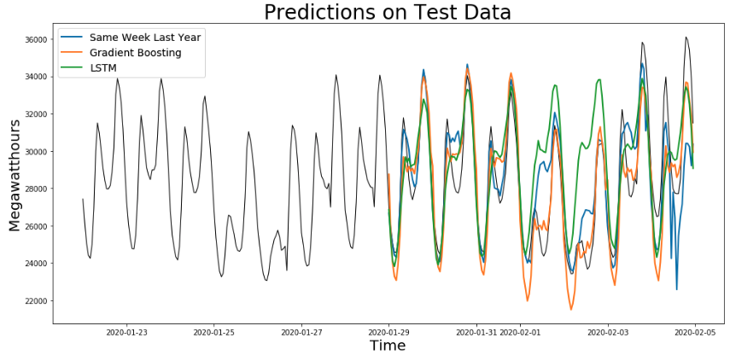
Test Results & LMST Model
Model | 5 Hours RMSE | 1 Day RMSE | 3 Days RMSE | 1 Week RMSE
Gradient Boosting | 1295 | 1217 | 1304 | 1513
LSTM | 600 | 1382 | 1378 | 2519

Slide 9
Next Steps
Use more than 5 dates to test models
Make interaction dummies for month and hour
Add weather data as feature
Test LSTM model on more weeks
Try more LSTM variations & more layers

Slide 10
Thank You!
Slides from PoweredTemplate.com
https://poweredtemplate.com/01989/0/index.html

