Slide 1

Pynocchia: Tales of Floating Off by Just a... Bit
By Nora Küchler
Notes:
Hi there, what a sight to see,
I’m Nora, presenting nervously.
I’m not one for crowds, that’s true,
I’d rather code than face this view.
But I made a vow I couldn’t duck,
So here I am—well, wish me luck!
A colleague dared me, so I commit—
To rhyme my way through every bit.
I chose a tale both weird and slick,
Of floats in Python—fast, not thick.
And Pynocchia, our lead today,
Will show how floats can go astray.

Slide 2
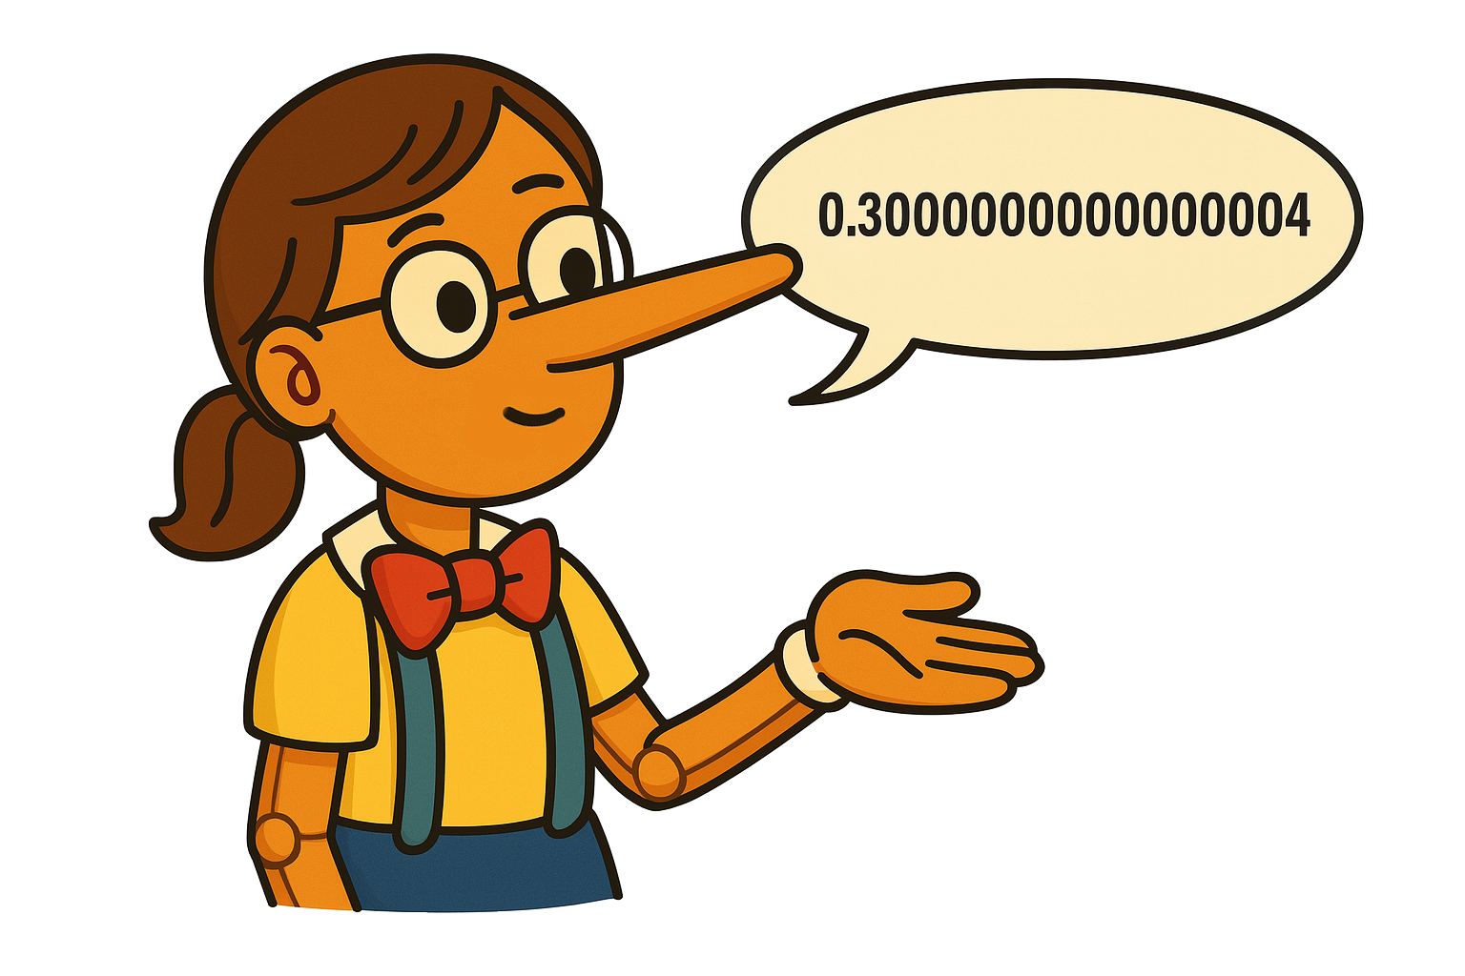
Notes:
She went for toys in Dataland,
And had some change clutched in her hand.
Three coins of copper, stacked up high,
But Python floats? They tell a lie.
'It’s thirty cents!' she says with glee,
But truth be told, it's 0.30000000000000004, you see.

Slide 3
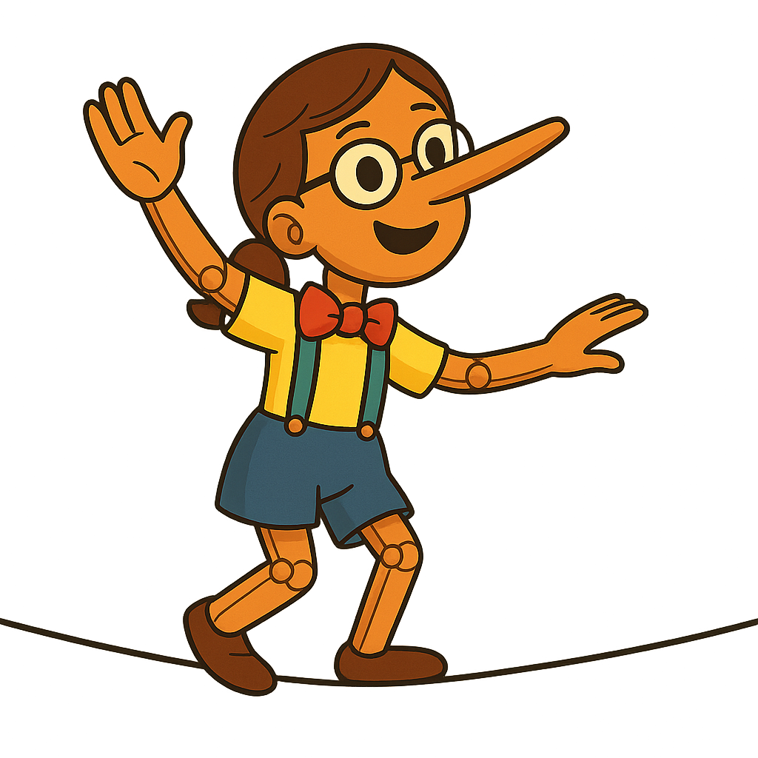
Notes:
Pynocchia grinned, "This feels just right!"
She typed and ran her code in spite:
“Three tenths by one—what will it be?”
The screen said less than three, not three.
Then rounding came—"Behold my feat!"
She cheered, "Two sixty-eight—so neat!"
But eyebrows rose throughout the hall:
“That’s sixty-seven—wrong and all!”
The crowd just frowned, but she stood tall,
"Float math is fast—can’t win 'em all!"

Slide 4

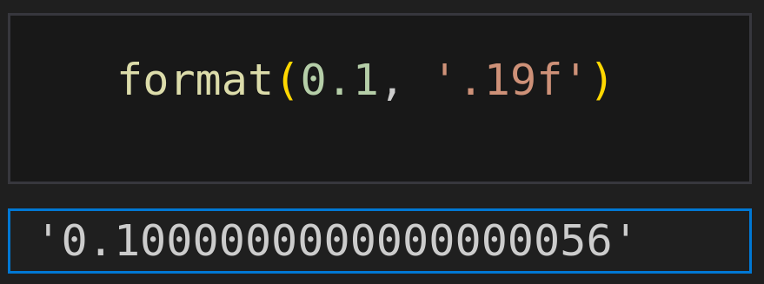
Notes:
Let’s call her out and seek precision,
With nineteen digits' supervision.
Unmasked, the fib is clear to see
-- A tale of false equality.

Slide 5
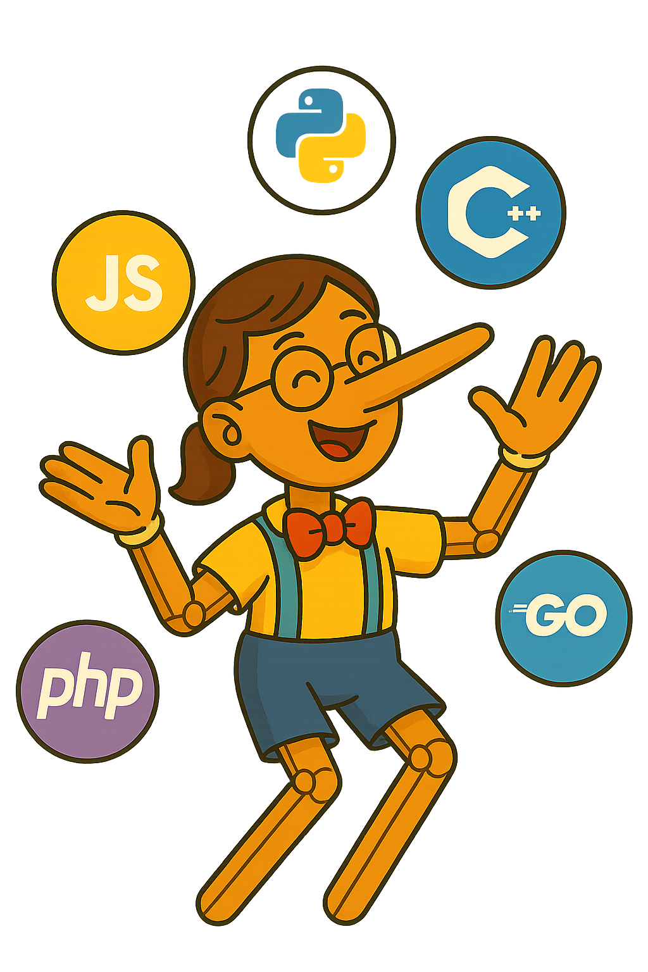
Decimal |  | Binary
0.1 | ≙
0.0001100110011...
Notes:
The truth she tells is not malicious,
Just binary math—precise, yet vicious.
Base ten and two don’t quite align,
So floats misstep from time to time.
In binary, some numbers loop,
So Python rounds—they just don’t group.
It’s IEEE that wrote the code,
A standard all the big ones load.
Not just in Python floats go wrong—
Java, C, Go all play along.

Slide 6
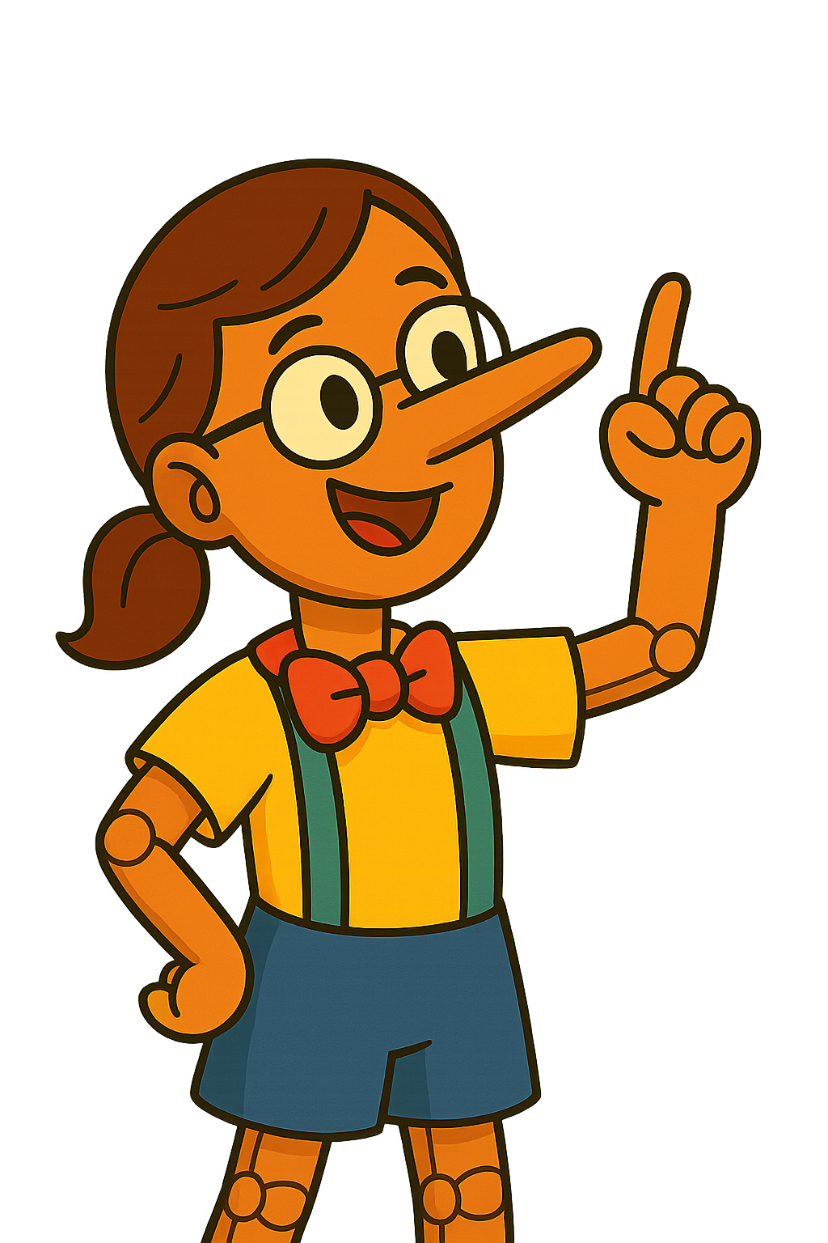
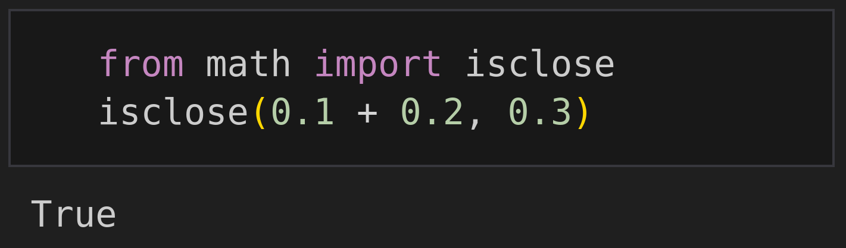
Notes:
Then one bright day,
she gave a shout,
"I’ve found a float that checks right out!
Point-one times one point two, you see—
Returns point-one-two perfectly!"
The crowd just laughed and shook their heads,
'You fooled us once,' the people said.
So Pynocchia, sad and stressed,
Proclaimed: 'Then use isclose() —it's best!'

Slide 7

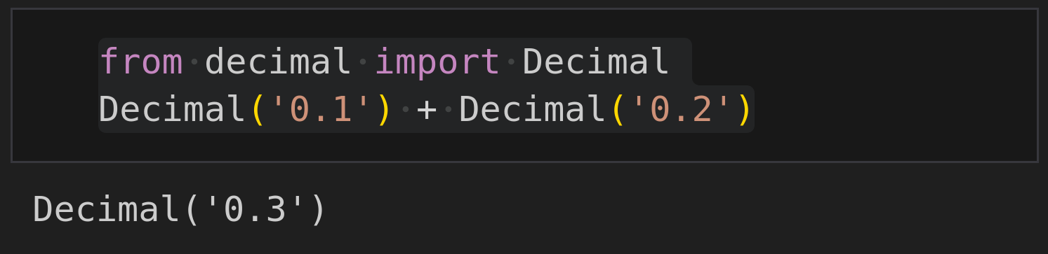
(+1) × 1 × 10⁻¹
0.1 | ≙
Notes:
Bring out the sage, precise and neat,
Who stores each part in clear repeat:
A sign, some digits, then a power—
No base-two fudge, no hidden flower.

Slide 8
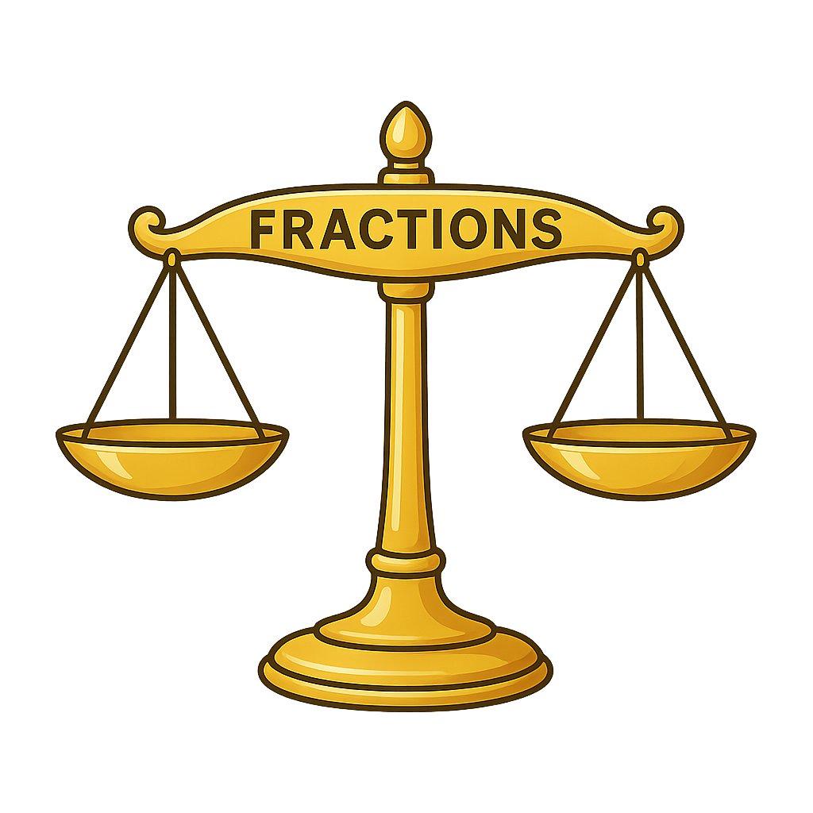
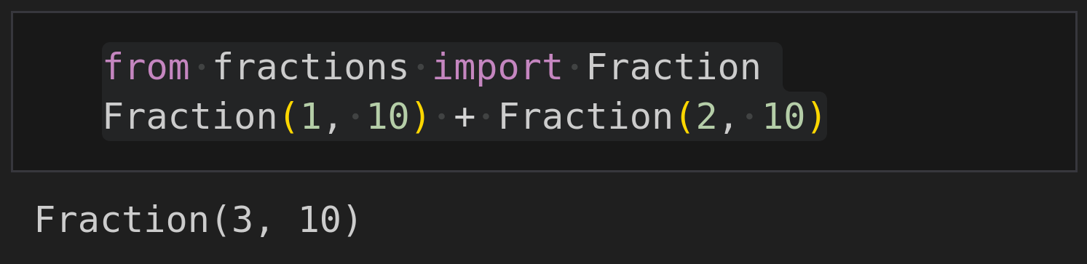
0.1 | ≙
Notes:
Or count with fractions, plain and pure,
Where truth and math can both endure.
With numerator and bottom part,
Fractions keep math sharp and smart.

Slide 9
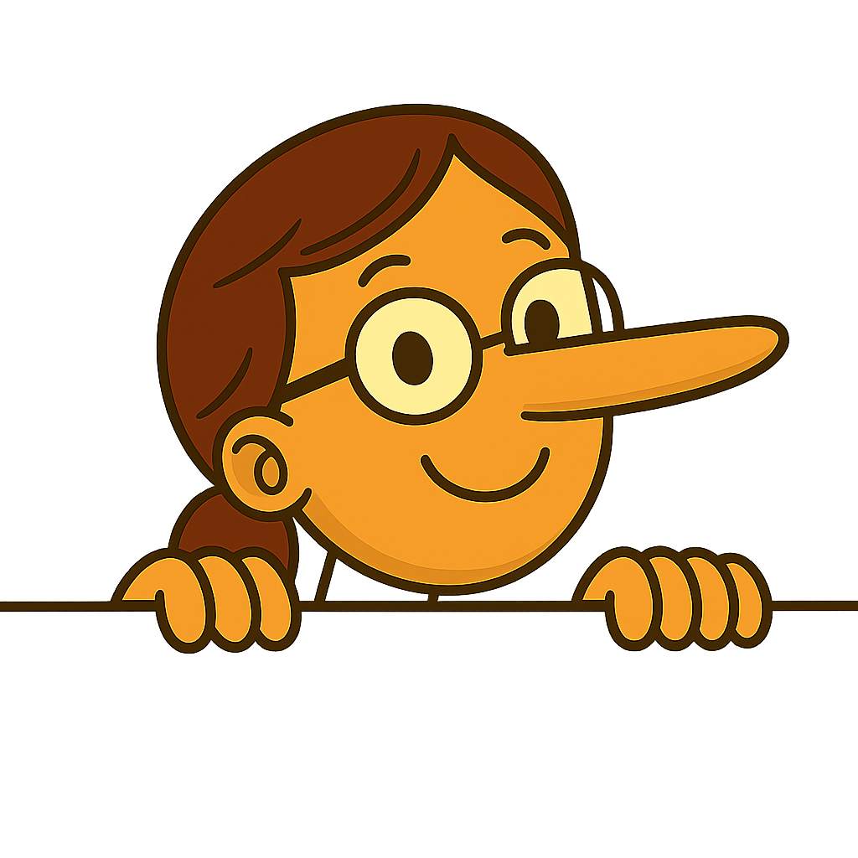
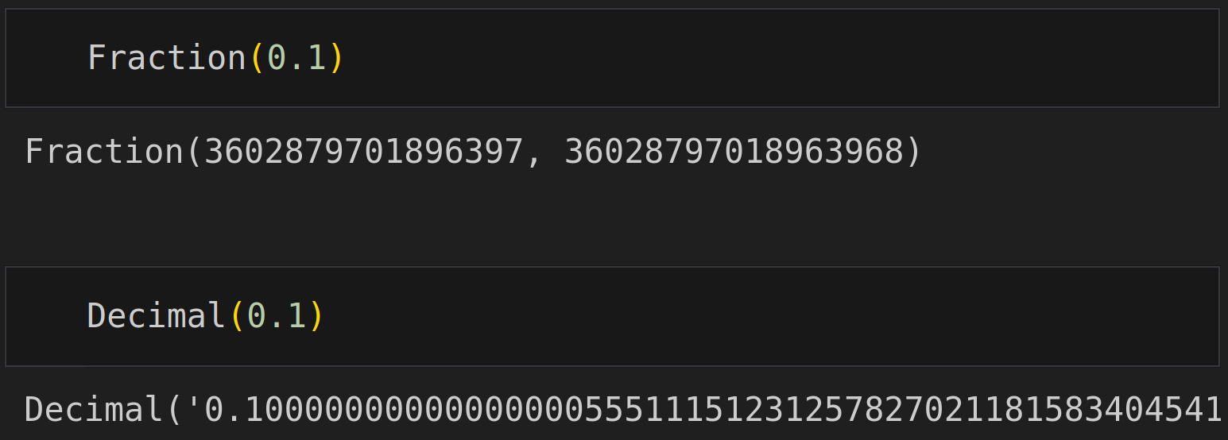
‘0.1’
Notes:
Pynocchia cried, “I’ve got the fix—
I’ll swap in Fractions, clever tricks!
Or Decimals—yes, that is the key—
No more float lies, just honesty!”
But floats once cast still bring their sting—
To tell the truth, just pass a string!

Slide 10
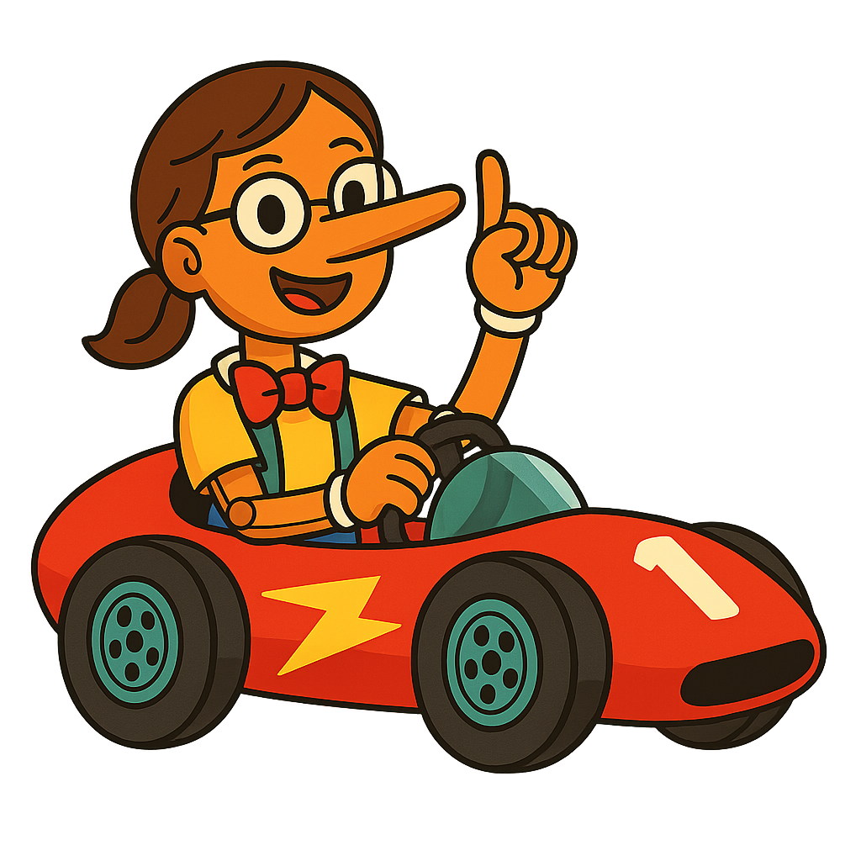
Machine learning
Graphics
Games
...
Notes:
Our floaty friend does have a role,
For speeds and framerates, it's on patrol.
It shines in fields both vast and bright,
In graphics, AI, and data insight.
From pixel shaders to learning weights,
The speed unlocks performance gates.

Slide 11
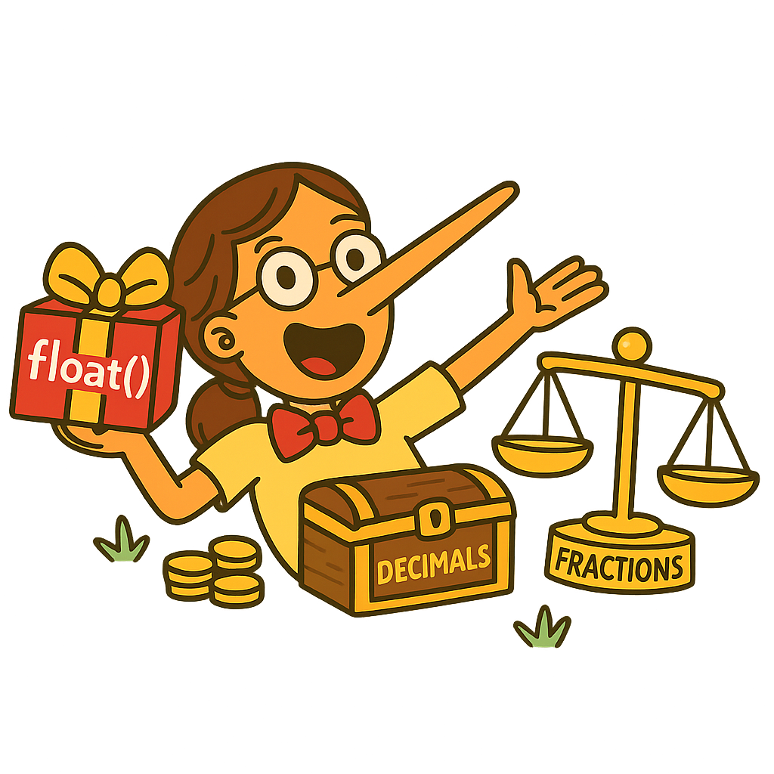
The End
Nora Küchler
Illustrations generated using DALL·E via ChatGPT.
Notes:
And now at last we end our tale,
With moral bright and warning pale:
So when you see a float mislead,
Recall this puppet's fibby deed.
Use decimals for counting cash,
Use fractions when precision's flash.
But if you float, then float with care,
And test your code 'fore you declare.
And now, dear folks, the tale wraps tight,
Thanks for joining this floaty flight.
I'm Nora, that was my send
Thanks for the laughs
this is the end!

