Slide 1
Prediction of The Great Election in 13th April, 2016
Team 33
2011120240 박종훈
2012190716 박봉우
2012190720 황서연

Slide 2
1. Project goal
Topic : Prediction of great election in 13th April, 2016
Problem
- Select 3 candidates for each constituency by polling rate.
- In progress 1, we predict elected person by the amount of search rate.
- In final, we predict elected person by using all the data domains above.
- If possible, we will predict rank of polling rate.
- If possible, we will predict the percentage of polling rate

Slide 3
2. Data Corpus
Data Domain
X1: sggCity X2: queryPoint
X3: sex X4: city
X5: party X6: age
X7: percent
Y1: condition Y2: rank of polling rate
Y3: predicted polling rate (if possible)
Size
253 Constituencies
934 Candidates

Slide 4
2. Data Corpus
Characteristics
sggCity: Constituency
(mapping Korean to integer code)
queryPoint: Amount of search rate
sex: Sex of the candidate (male = 1, female =2)
city: Province (mapping Korean to integer code)
party: Which party the candidate affiliated. (mapping Korean to integer)
age: Age of the candidate
percent: Polling rate
school: Educational background ( +1 point for each word in ‘대학교’, ‘대학원‘, ‘박사‘, ‘석사’, 졸업’)
rank: The rank of polling rate
win: The elected person is 1 and otherwise 0.

Slide 5
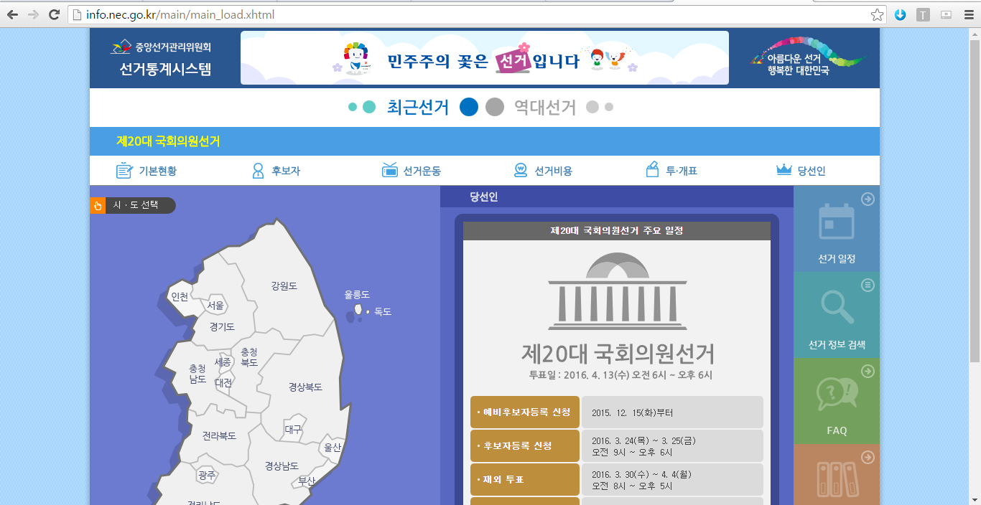
3. Data Sources - Information about election

Slide 6
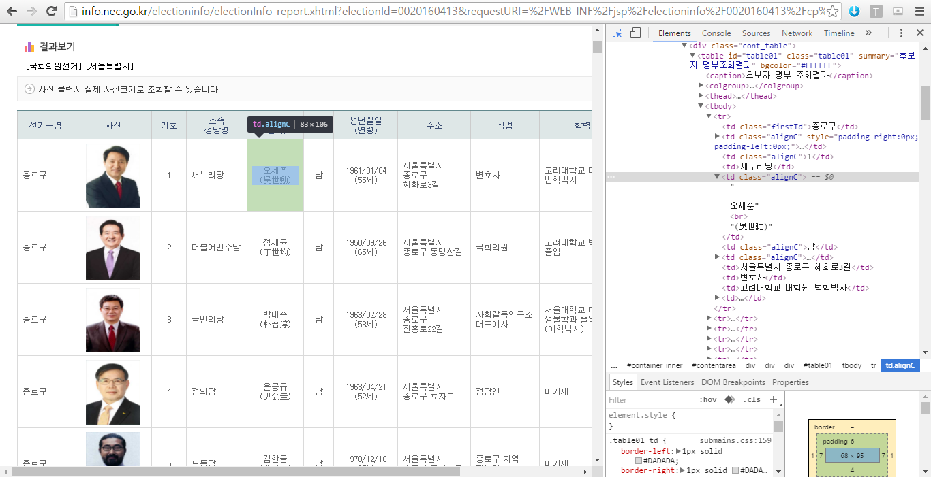
3. Data Sources - Information about Candidate

Slide 7
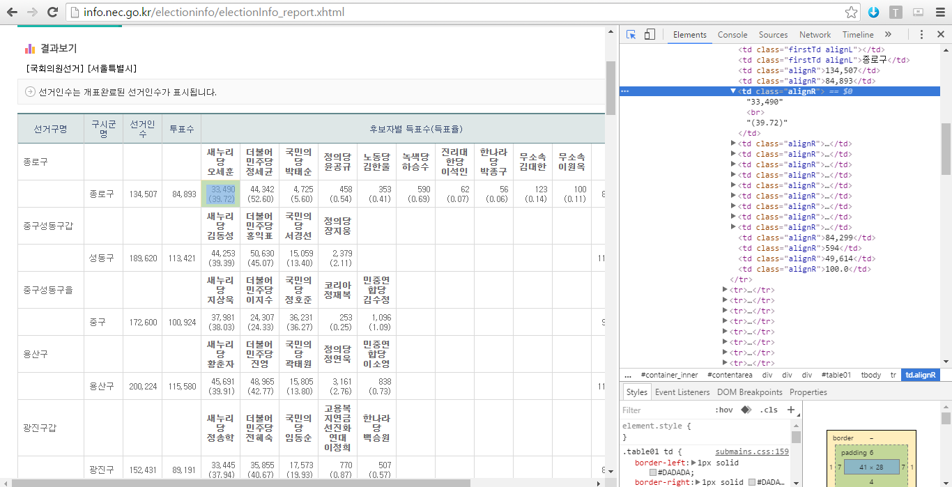
3. Data Sources - Polling rate of each candidate

Slide 8
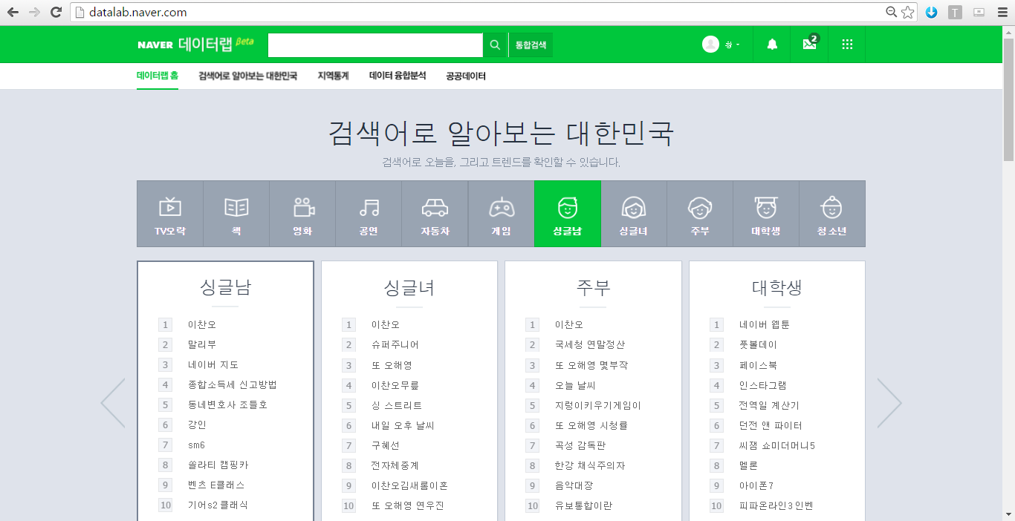
3. Data Sources - Naver Datalab (datalab.naver.com)

Slide 9
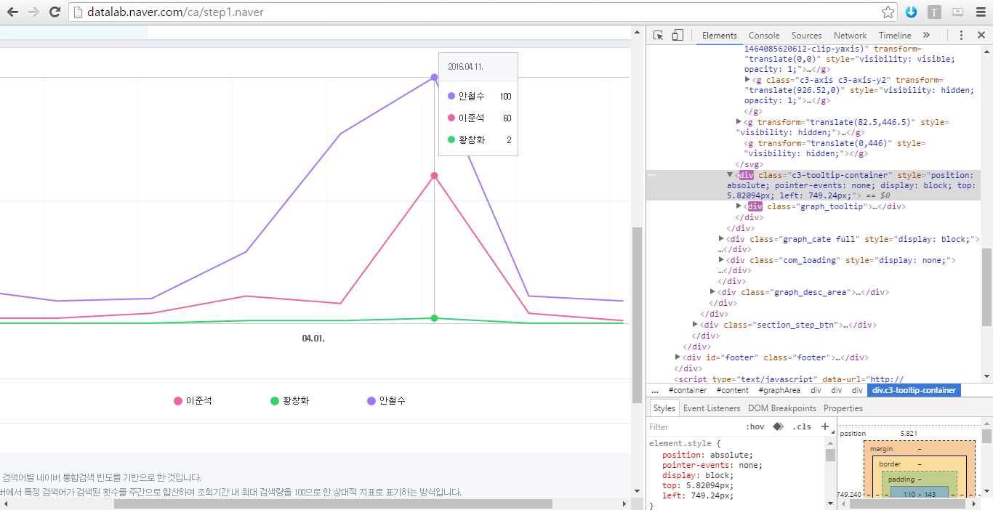
3. Data Sources - Comparing search trend

Slide 10
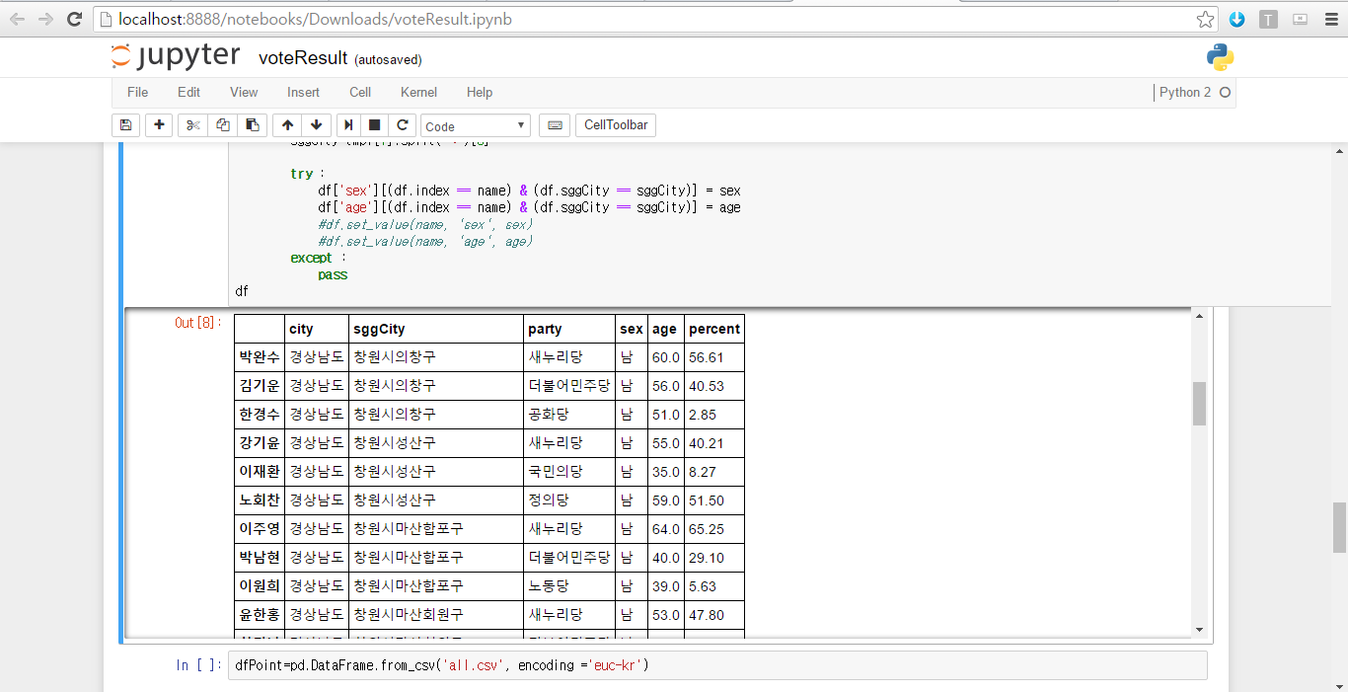
3. Data Sources - Crawling (Info. and polling rate of candidates)

Slide 11
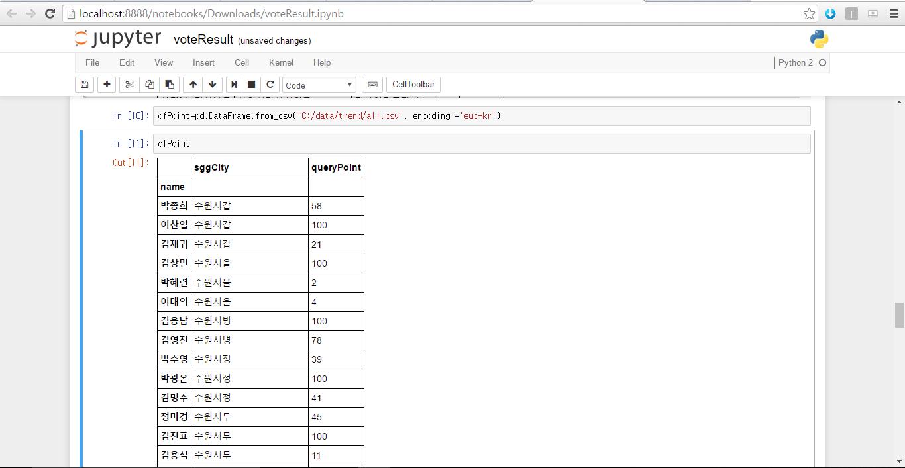
3. Data Sources - Crawling (Search trend of candidates)

Slide 12
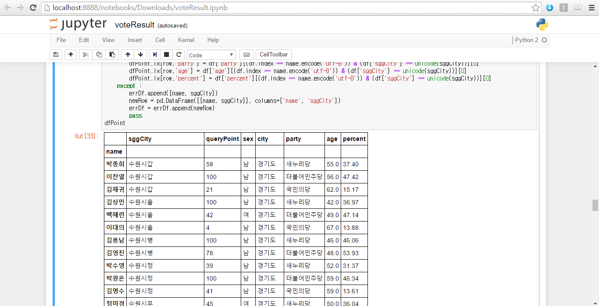
3. Data Sources - Integrate (Search trend, info., and polling rate)

Slide 13
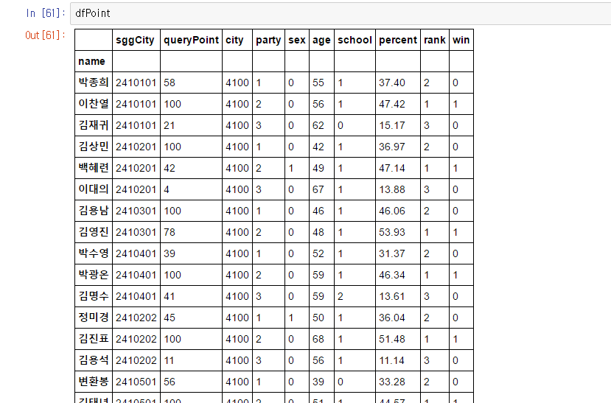
3. Team’s Progress Detail - Preprocessing (int endoding, add rank & win)

Slide 14
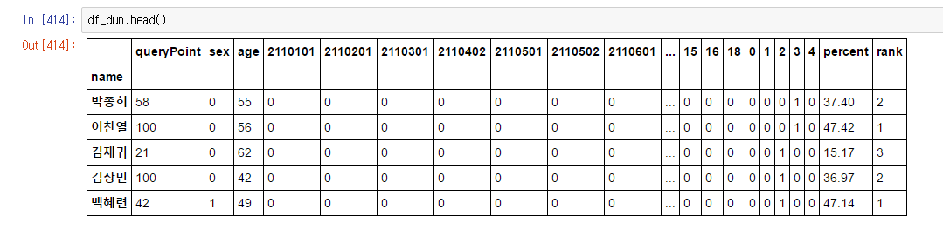
3. Team’s Progress Detail - One-hot encoding

Slide 15
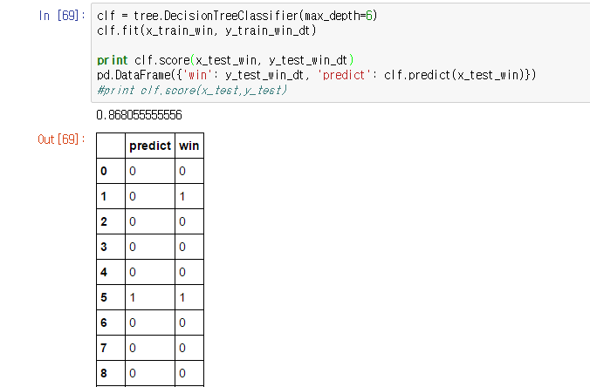
4. Evaluation - Predict elected person with D.T.
The accuracy of this model is 86.8%.

Slide 16
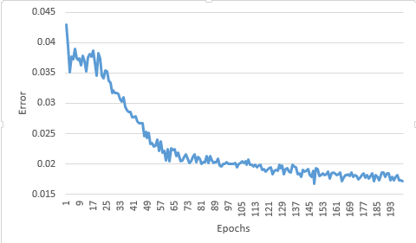
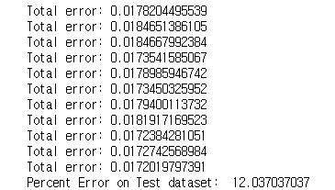
4. Evaluation - Predict elected person with N.N.
According to 200 epochs, the accuracy of this model is 88%.

Slide 17
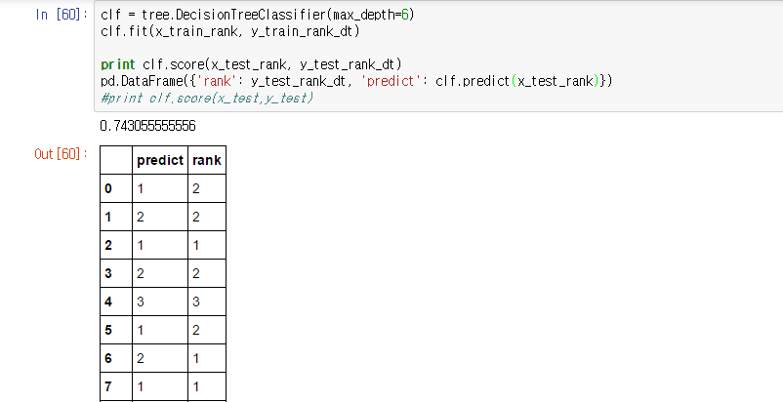
4. Evaluation - Predict rank of polling rate with D.T
The accuracy of this model is 74.3%.

Slide 18
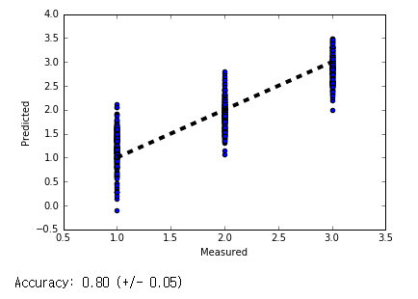
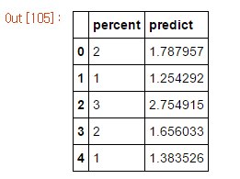
4. Evaluation - Predict rank with Poly.Reg.
The accuracy of this model is 80% (+/-5%).

Slide 19
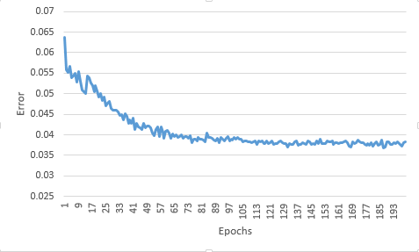
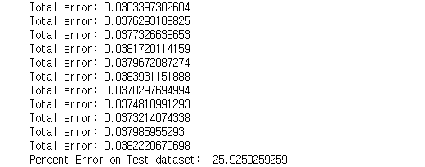
4. Evaluation - Predict rank of polling rate with N.N
The accuracy of this model is 74%

Slide 20
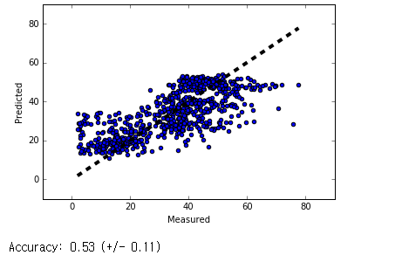
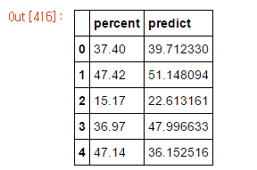
4. Evaluation - Predict polling rate with Poly.Reg.
The accuracy of this model is 53% (+/-11%). It’s not good model.

