Slide 1
AI Impact on Search
Implications for the Market and [Client]
April 2026

Slide 2
Executive summary
Three key AI trends are affecting Search in 2025
AI search is additive, not substitutive¹, with Google queries up ~12% vs 2024, reaching over 5 trillion in 2025²
We expect global traditional search volume to continue growing, but at a slower pace (Scenario 1 - Neutral), increasing from ~5.6T to ~7.1T by 2030 (~5% CAGR)³
Two alternative scenarios remain possible: (2) Revitalization - AI increases search frequency and unlocks use cases⁴, and (3) Delayed impact - material volume declines emerge later as AI substitutes complex behaviors, autonomous agents scale, and search interfaces shift (e.g., toward wearables)⁵
AI Overviews have increased zero click, causing a decline in CTR in the short term – we believe this will stabilize in 2026
~60% to 80% of Google searches already end without a click⁶, with visible declines in CTR in some regions/device types
However, as Google introduces links and ads within AI Overviews⁷, behavior is expected to revert toward historical levels
Search engines are adapting to protect revenue, reintroducing links and ads to AI Overviews and charging higher CPCs due to reduced ad inventory and auction competition⁷
Search revenue will grow at ~15.6% CAGR through 2030 (US = 14.0%, RoW = 16.2%) , driven by:
CPC growth normalizing toward historical levels (~9% increase per year)⁸
CTR recovery as links return to AI Overviews (stabilizes at ~4.6%, on average)⁹
Revenue-generating searches (monetized volume) (~20% of volume)¹⁰ remain resilient, growing ~6.0% annually (vs. 4.8% for non-revenue generating)
Sources: (1) Semrush, (2) ~12%: average of: SQM, TTMS, Unece and DemandSage ; 5T searches: TTMS, Google and Search Engine Land, (3) Average of Mordor and BRI, adjusted to volume, (4) Average of Google’s historical growth and MRA adjusted to volume (5) Average of McKinsey, Gartner and TTMS, (6) Bain, (7) PPC Land, (8) Wordstream data from: 2025, 2024, 2021, 2018, 2016, (9) Details in assumptions slide, (10) Datos

Slide 3
Traditional search engines are still relevant, even as users discover complementary platforms
Theme 1 (AI Search is additive)
Where Users Start When Online Shopping
(% of respondents - 2020, 2024, and 2025)^{1,2,3}
Insights from research
Multi-platform search behavior continues, with users leveraging both specialized and traditional search channels
Traditional search includes Google (51%), Bing and Yahoo (7%), DuckDuckGo (6%) and Other(AOL, Brave, ASK – 5%)³
Social media keeps rising as a significant search channel (75% combined share)³
A notable new entrant in product searches is OpenAI’s ChatGPT, with 5%³. Other AI tools were not cited
Individual social platforms have gained meaningful share - YouTube (20%), Facebook (19%), TikTok (15%), Instagram (14%) and Pinterest (7%)³
4
Retained key relevance
Users use complementary platforms rather than switching entirely, with early signs of AI tool adoption
Sources: (1) Marketingcharts ; (2) Emarketer; (3) Jungle Scout, (4) ChatGPT was the only LLM mentioned
Note: Totals do not equal 100%, as respondents could select more than one option.
Notes:
Sources for all data points are available in the footnotes
This slide illustrates how users have embraced specialized platforms while maintaining core search patterns. The data from 2020 to 2024 shows early signs of multi-platform behavior, with users leveraging both specialized and traditional search channels
The platform landscape has diversified significantly with social media emerging as a major search channel, now capturing 37% of the market compared to just 8% in 2020
Despite more options, traditional search engines at 42% and Amazon at 56% maintain core positions in user behavior. Individual social platforms have gained meaningful share, with YouTube at 13% and Facebook at 10%
This trend suggests users adopt multiple complementary platforms rather than switching entirely, which indicates AI could similarly expand total search activity rather than simply reduce traditional search

Slide 4
AI is reshaping the search ecosystem, expanding beyond traditional search surfaces
Theme 1 (AI Search is additive)
Key Search Segment | Key Features | Market | Expected Growth | Rationale | Business Models
Traditional Search (with AI Overviews) | Uses indexing and algorithms to rank results ¹ Combines LLMs with traditional ranking to summarize results³ | TAM: $355B⁴ (2025) CAGR: 12.7%⁴ (2024-2025) % of searches with AI Overviews: 50%⁸ (Oct 2025) |  | Traditional search remains a core discovery surface, driven by habit, breadth of queries, and high-intent use cases, enabling continued moderate expansion. Google search volumes are up +12% YoY vs 2024¹⁰ Driven by increased use of AI-generated summaries. Google continues to expand AI Overviews, now launched in 100+ countries⁷ | Performance advertising (CPC/CPA) and shopping ads at the intent layer Early tests of sponsored links embedded in Overviews¹³
Social Search | Platform-specific search focused on content discovery, products, and recommendations | TAM: $243B⁹ (2025) CAGR: 7.5%⁹ (2025-2033) |  | Continued growth as users increasingly start shopping journeys within social platforms | Native ads and commerce integrations through discovery-led conversion¹¹
AI Tools | LLMs answer queries, summarize content, or generate responses² | TAM: $254B⁵ (2025) CAGR: 85.4% (2024-2025) 36.7%⁵ (2025-2031) |  | Very strong growth observed in 2025 is expected to continue as users integrate AI-based tools, e.g., ChatGPT into their workflows | Subscriptions and usage-based pricing; emerging sponsored and commerce placements¹²
Search activity fragments across surfaces, with early monetization emerging in AI-driven experiences
Sources: (1) Infidigit, (2) Prerender.io, (3) Google, (4) Statista, $355B reflects a search advertising market report that includes search ad spend across multiple platforms (e.g., Google, Amazon, Alibaba, Baidu), not limited to Google Search, (5) Statista, (6) Statista, (7) Verge, (8) McKinsey, (9) Business Research, (10) TTMS, SQMagazine, (11) Jungle Scout, (12) Bain, (13) Data Slayer
Notes:
We've established three key segments in the search ecosystem:
Traditional search uses indexing and algorithms to rank results based on keywords and relevance. While this segment has seen a slight CAGR decline of 1.36% from 2022-2024, we believe traditional search will remain important despite some volume decline
AI tools use large language models to answer queries directly. This segment is seeing explosive growth with a projected 42% CAGR through 2032. This is evidenced by ChatGPT's weekly active users more than doubling between November 2023 and August 2024
AI-generated summaries integrate LLMs with traditional methods to enhance search results with direct answers. Currently, about 30% of searches include AI overviews

Slide 5
Google has experienced strong growth in search volume and revenue over the last 10 years
Theme 1 (AI Search is additive)
Legend:
Actual
Calculated
Google Search Volume (Trillions)^{1,2}
Google Ad Revenue (USD Billions)³
~+12%
~+13%
~+11% p.a.
~+16% p.a.
Since 2016, Google does not publish annual search volume figures³
All post‑2016 numbers are industry estimates built from the last confirmed Google numbers, global internet growth, and independent datasets^{1,2}
Increasing search volume is in line with Google press statements and showing steady global demand and rising query complexity³
Google ad revenue has grown steadily over the past decade, indicating resilient advertiser demand and monetization
Revenue per search has increased faster than search volume, implying better ad formats and higher advertiser competition
Google has sustained growth while steadily improving monetization, suggesting it can adapt its monetization strategy as AI reshapes search
Sources: (1) InternetLiveStats, (2) DemandSage, ~12% growth of 2025 over 2024: average of: SQM, TTMS, Unece and DemandSage (3) Company Reports, Google total ad revenue including Search, YouTube, and Network ads, search accounts for ~75% of total ad revenue

Slide 6
We predict AI will lead to reduced growth, not collapse. However, two other scenarios could emerge
Theme 1 (AI Search is additive)
Scenario 1: Neutral (Growth slowdown)
Scenario 2: Revitalization
Scenario 3: Delayed Impact
Decline generated by AI is outweighed by growth
Overall trajectory continues, with lower growth rates
Re-acceleration toward historical growth levels, reversing expected deceleration
AI unlocks new use cases, expanding total activity
Incumbents and challengers both grow in a larger market
Incumbents benefit early, then lose share as challengers scale
Overall impact is a sharp redistribution of volume as new entrants, search interface shifts (e.g., AI wearables)⁴, and AI agents³ rapidly dominate search
Projected Search Volume
2025-2030
CAGR
Revenue Generating
6.0% ¹
10.0% ²
-12.0% ³
Non-Revenue Generating
4.8% ¹
8.0% ²
-15.0% ³
Total
5.0% ¹
8.4% ²
-14.4% ³
Our prediction
Scenario 1 is the most likely outcome, as there is no evidence of volume decline or accelerated growth to support alternative scenarios
Sources: (1) Average of: Mordor (11.8% Revenue CAGR (‘30 vs’25) adjusted to remove revenue increase impact, and BRI, (11.0% Revenue CAGR (‘30 vs’25) adjusted to remove revenue increase impact, (2) Average of 30% and 50% of historical growth (11%), and MRA, 14.82% Revenue CAGR (‘33 vs’25) adjusted to remove revenue increase impact; (3) Average of McKinsey - annualized, Gartner, TTMS; additional articles on agentic search: Forbes, Search Engine Land, Evergreen Media (4) AI Certs, Adthena and Forbes

Slide 7
Disruption can slow traditional players, expand markets, or trigger collapse, depending on adoption dynamics
Theme 1 (AI Search is additive)
Scenario 1: Neutral
Scenario 2: Revitalization
Scenario 3: Delayed Impact
Case Study: Movie Theater vs Streaming (Pre-COVID)
Streaming scaled rapidly, shifting viewing behavior and unlocking incremental demand
The box office kept growing in absolute terms, but at a slower pace
Case Study: Retail vs E-commerce
Amazon launched in 1994, but physical retail expanded for nearly two decades
Demand persisted; disruption hit incumbents and formats, not the total market size⁵
Case Study: Netflix vs Blockbuster
Netflix launched in 1997; Blockbuster peaked revenue in 2004
Once streaming scaled, collapse was rapid; Blockbuster went bankrupt in 2010
Phase 1: Non-disrupted growth
Phase 2: Slowdown
Phase 1: Capability expansion
Phase 2: Demand amplification
Phase 3: Ecosystem expansion
Phase 1: Deceptive
Phase 2: Inflection
Phase 3: Rapid Displacement
The neutral scenario is used as the modeling baseline, reflecting moderated growth rather than displacement
Sources: (1) Christensen Institute, (2) HBS, (3) Faster Capital, (4) Fletcher.io, (5) US Census Bureau, (6) Netflix, (7) Box Office Mojo, (8) MPA, The Numbers

Slide 8
Scenarios 1 and 2 predict a growing revenue over the next 5 years, while Scenario 3 projects a decline
Theme 1 (AI Search is additive)
2025-2030 CAGR
Non-revenue-generating
Revenue generating
Scenario 1: Neutral (Growth Slowdown)
Scenario 2: Revitalization
Scenario 3: Delayed Impact
+5.0% p.a.
+8.4% p.a.
7.1
8.3
5.6
-14.4% p.a.
Search Vol (Tr)
5.6
5.6
2.6
+15.6% p.a.
+20.0% p.a.
-6.2% p.a.
Revenue ($ Bn)
Assumptions & Methodology
Revenue-generating increases more than non-revenue-generating due to its competition with AI tools, going from 20% of volume in 2025¹ to 20.7% in 2030 in Scenario 1
Revenue: Total revenue-generating sources² x revenue per search³ (2025: $0.23/search, 2030: 0$0.35/search)
Scenario 1 shows slower volume growth, with monetization gains sustaining revenue growth near historical levels
Note: The revenue (e.g., $249B in 2025, Scenario 1) represents the global Search Engine advertising market only, excluding non-search formats such as video ads (e.g., YouTube) and retail marketplace advertising (e.g., Amazon)
Sources: (1) Datos, (2) Search volume multiplied by % of revenue-generating searches (Datos), (3) CTR multiplied by CPC

Slide 9
Google’s launch of AI Overviews in 2024 has increased zero-click searches... (1/2)
Theme 2 (AI Overviews)
Global Zero-Click Rates (2020–2025⁶) and Primary Drivers for Google
Insights from research
US: +14.5%⁷
RoW: +5.6%⁷
AI Overviews launched first in the US (May 2024) and expanded globally by late 2024
~80% of users rely on AI Overviews at least 40% of the time²
Search impressions grew 49% while CTRs dropped 30% (incl. informational searches)³
Users are increasingly satisfying intent directly on the results page^{4,5}
AI Overviews have declined since their mid-2025 peak, suggesting search engines are approaching a natural ceiling for zero-click outcomes⁸
+18 percentage points
Featured Snippets
Knowledge Panels
Rich Snippets
Instant Answers
Local Packs
Mobile SERPs
Voice Search
Knowledge Graph Expansion
Launch of AI Overviews (AIO)
AIO, Gemini, ChatGPT Search, Perplexity AI
Primary Drivers
However, the introduction of links and ads in the AI Overviews should change this pattern and restore clicks
Sources: (1) Wall Street Journal, (2) Bain, (3) Omnius, (4) BCG, (5) Click-Vision, (6) Click-Vision (based on: SparkToro 2020, 2021, SimilarWeb 2025, Inner Spark Web Report 2022, BrightEdge + Semrush 2023, Ars Technica + Search Engine Land 2024, MarTech + Single Grain 2025), (7) Datos|SparkToro - State of Search Q3 2025 Report, (8) Search Engine Land
Notes:
At 75% zero-click → CTR ≈ 25%
At 83% zero-click → CTR ≈ 17%
That means:
Absolute CTR change: 25% → 17% → −8 percentage points
Relative CTR change: 17% is ~68% of 25%, so this reflects about a 32% relative decline in CTR
(8 ÷ 25 ≈ 0.32)
This matches what we are saying on this slide; however, our CTR slide does not include informational searches, so the CTR impact is much lower

Slide 10


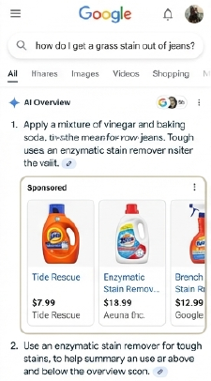


…however, Google has already begun testing links and monetization in AI Overviews; we expect CTRs to normalize (2/2)
Theme 2 (AI Overviews)
Google strategy to increase clicks and monetize AI Overviews
Example
Insights from research
"Google has expanded ads inside AI Overviews and is testing placements in AI Mode…” ³
Our hypothesis is that zero-click rates will decline to previous levels (~60% to 70%), with the introduction of links and ad placements
Google is now re‑injecting clicks via sponsored links, shopping ads, and lead actions
Historical SERP rollouts show that clicks partially rebound once monetized
“Google has tested AI-powered shopping ads and sponsored content within AI responses...new paid opportunities…” ⁴
Google AI Overviews: The End of Traditional CTR and How to Adapt in 2025
7–14% reduction in zero-click rates⁷
As Google adds links back into AI Overviews, zero‑click rates should start to recover
Our model reflects early CTR pressure from AI Overviews, followed by partial normalization
Sources: (1) Search Engine Land, (2) Grand View Research, (3) Media Performance, (4) DataSlayer, (5) LocalFalcon, (6) Google Ads Help, (7) DemandSage, Based on historical SERP feature rollouts (8) Pew Research Center

Slide 11
Brands cited in AI Overviews experience materially higher organic and paid CTRs
Theme 2 (AI Overviews)
Average Click-Through Rates (CTR, incl. informational searches) (Q3 2025)
Insights from research
Organic CTR¹
“AI summaries [AI Overviews] are the new trust standard” “If you’re not featured in these AI-generated answers, you’re not part of the decision journey” ²
Advertisers are increasing spend as AI-powered formats (for example, AI Max) deliver higher conversions^{4,5}
AI-driven traffic converts at a higher rate, and visitors are 4.4x more valuable than organic visitors³
New tools are emerging to track AI visibility, as vendors monitor brand exposure across ChatGPT, Claude, and Google AI Overviews⁴
+35%
Paid CTR¹
+91%
Higher CTRs and conversion value in AI-enabled placements increase advertiser ROI, supporting higher CPCs and incremental spend over time
Sources: (1) Seer Interactive, (2) Xponent 21, (3) Semrush, (4) Financial Times, (5) Media Post, (6) Alphabet IR

Slide 12


AI Overviews disproportionately impact the US due to earlier deployment and broader exposure
Theme 2 (AI Overviews)
Google searches that contains AI Overviews in 2025^{1,2,3,4,5,6}
Insights from research
The rollout of AI Overviews is more robust in the US (~50%) compared to the rest of the world (~30%)
Lower RoW adoption reflects selective rollout rather than lower user demand⁵
The uneven deployment indicates Google is actively controlling exposure, indicating future changes will be incremental rather than abrupt⁵
United States
1
2
Avg: 30.5%
RoW
3
4
Because AI Overviews are not uniformly deployed, we model their impact as gradual and region specific rather than immediate and global
Sources: (1) Averages of sources: Advanced Web , DemandSage, and Semrush, at 60.3%, 50%, and 13%, respectively; (2) Average of sources: DemandSage, Statista, and Pew Research Center, at 50%, 84% and 65%, respectively; (3) Average of sources: AI Search Statistics, Semrush and Similar Web, at 18%, 60% and 16%, respectively; (4) Average of sources: SisTrix, Similar Web and All About AI, at 18%, 53% and 18%, respectively, (5) Collective Measures

Slide 13
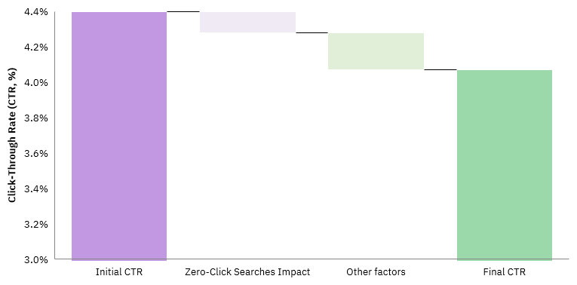
CTR impact is driven by rising zero-click behavior, with pressure from other factors
Theme 2 (AI Overviews)
CTR Decline (illustrative)^{1–10}
Insights from research
AI Overviews materially increased the share of searches that end without a click, particularly for informational queries
Zero-click behavior mechanically reduces observed CTR by lowering the number of searches that generate a click
Other factors that impact CTR includes ad placement changes, new competitors, and query mix shifts
CTR impact varies widely by region, reflecting differences in feature rollout, user behavior
Sources: (1) WordStream, (2) 360OM, (3) Seer Interactive, (4) Advanced Web Ranking, (5) Focus Digital, (6) Dentsu, (7) Karooya, (8) Mordon Inteligence, (9) SEMrush, (10) SQ Magazine

Slide 14
CTR declines emerge in 2025, but impacts are uneven across regions and devices
Theme 2 (AI Overviews)
Average Impact on Click-Through Rates 2025 vs 2024 (CTR, excl. informational searches)^{1–10}
Insights from research
Desktop experiences the largest declines, since AIO replaces a larger portion of traditional link-heavy layouts; AIOs appear more frequently on desktop (across identical keywords)¹³
Mobile remains more resilient, with smaller declines or modest gains, as mobile already limits link density
The effect of the inclusion of links and ad placements in AI Overviews has not yet appeared in publicly available CTR measurements
Earlier AI Overviews tests¹¹ and rollout¹² in the U.S. likely led to earlier CTR impact and partial stabilization by 2025, while later rollout concentrated declines in RoW
United States
RoW
CTRs in the U.S. appear more resilient than in other regions, suggesting earlier stabilization as AI Overviews mature. We use this dynamic to estimate future revenue impacts
Sources: (1) WordStream, (2) 360OM, (3) Seer Interactive, (4) Advanced Web Ranking, (5) Focus Digital, (6) Dentsu, (7) Karooya, (8) Mordon Inteligence, (9) SEMrush, (10) SQ Magazine, (11) Google blog 2023, (12) Google blog 2024, (13) Passionfruit

Slide 15
CPC growth accelerated in 2025 as dynamics shifted, reflecting reduced ad space and Google’s efforts to maintain revenue
Theme 3 (Revenue)
Average Impact on Cost per Click 2025 vs 2024 (CPC)^{1–10}
Insights from research
Reduced ad supply concentrates spend, increasing auction pressure even when click volumes soften¹²
Desktop growth is lower, driven by greater screen real estate and a shrinking user base relative to mobile
Mobile CPC growth reflects structural scarcity, with fewer premium slots and higher advertiser density¹³
“The smaller ad space creates a bigger problem: since budgets usually stay fixed in the short to medium term, advertisers end up competing for fewer clicks with the same investment. This drives up cost-per-click (CPC).”¹⁴
United States
RoW
Rising CPCs offset short-term CTR pressure, supporting revenue resilience. CPCs are expected to continue growing as we estimate future revenue
Sources: (1) Magna Global, (2) ISBA, (3) WPP Media, (4) Dentsu, (5) Karooya, (6) Dentsu, (7) Skai, (8) SQ Magazine, (9) Karooya, (10) Dentsu, (11) Wordstream data from: 2025, 2024, 2021, 2018, 2016, (12) OrangeSEO.net, (13) AdExpert, (14) Hamak

Slide 16
AI overviews disrupt informational search, while revenue-generating search is resilient
Theme 3 (Revenue)
Theme 2 (AI Overviews)
Impact:
Not impacted
Partially impacted
Fully impacted
Revenue / Non-Revenue Generating | Search Type¹ | Use cases | % of trad. Search | % of search revenue | Impact on search volume | Impact on search revenue | What changed? (2024 vs. 2025)
Non-Revenue Generating | Informational | Information retrieval, research and educational content^{6,7} | 53%^{2,10,12} | <5% | High impact - AI Overviews increasingly answer queries on-SERP | Low impact - Informational queries generate minimal ad revenue | Largest traffic and CTR declines as AI absorbed non-revenue queries
Revenue Generating | Transactional | Product/ service exploration, e-commerce platforms, arts and entertainment^{2,3,4} | 15%^{2,10,12} | 75% | Low impact - AI tools rarely complete purchases; users still rely on search for product discovery and conversion | Low-medium impact - AI summaries may shift click mix, but links and monetization remain largely intact; AI Tools are not used to complete purchases. Long-term risk: if agentic AI enables direct transactions, the impact could increase | Remained resilient with limited revenue impact
 | Navigational | Finding a particular website^{,2,5,6} | 32%^{2,10,12} | 15-20% | Low impact - Users continue using search to reach specific brands or sites, with limited AI substitution | Low-medium impact - Direct site-seeking remains resilient, though some queries shift toward internal site navigation | Impact stayed low; AI rarely replaced direct site navigation
AI Overviews primarily displace informational, non-revenue traffic; revenue-generating remains resilient
Sources: (1) Lyftyfy; (2) SparkToro (3) Ahrefs blogs; (4) Search Engine Land; (5) GTech (6) Semrush; (7)Clear voice, (8) The Guardian, (9) Pew Research, (10) Bind Media, (11) Search Atlas
Notes: Based on our research, 80% of search results have no ads, and this corresponds roughly to the % of informational searches, which are least likely to have ads. In absence of more detailed data on % search revenue from transactional and navigational searches, we have assumed 75% of search revenue comes from transactional searches
Notes:
Revenue-generating searches come in two forms: transactional searches, which are used for products and services and generate 75% of search revenue while only representing 10% of volume; and navigational searches, which help users find specific websites and generate 15-20% of revenue
Non-revenue generating searches, primarily informational queries, make up 80% of all search volume but generate less than 5% of revenue
AI tools will have the highest impact on informational searches, as they excel at answering questions directly. The revenue impact will be moderate for transactional searches and low for navigational searches, which play to traditional search's strengths

Slide 17
Market Impact
Updated market model for search growth: from 5.6T searches in 2025 to 7.1T in 2030
Search type |  | Volume (Trillions)
Revenue generating¹
Non-revenue generating¹
Total² | 2025: 5.6T |  | 2030: 7.1T
Legend:
US Desktop
1.1
RoW Desktop
4.5% p.a.
5.1% p.a.
5.8% p.a.
6.7% p.a.
6.0% p.a.
US Mobile
1.5
RoW Mobile
Total
4.5
3.3% p.a.
3.9% p.a.
4.6% p.a.
5.5% p.a.
4.8% p.a.
5.6
5.0% p.a.
By 2030, traditional search volume is projected to grow ~28% over 2025 levels
Sources: (1) Datos, (2) Search Engine Land and Google share of market from Semrush, (3) Average of Mordor, 11.8% Revenue CAGR (‘30 vs’25) adjusted to remove revenue increase impact = 6.4% p.a.; BRI, 11.0% Revenue CAGR (‘30 vs’25) adjusted to remove revenue increase impact = 5.6%

Slide 18
We estimate AI tools & Overviews reduce search growth to 5% per year (vs ~11% historically)
Market Impact
Search volume, Trillions¹
Non-revenue generating
Revenue generating
CAGR (‘25 – ‘30)
Total Growth (‘25 – ‘30)
5.0%
27.8%
6.0%
33.7%
4.8%
26.3%
Key assumptions Revenue Generating |  | Desktop | Mobile
% of total searches¹ |  | 20% (2025) – 21% (2030)
CAGR (2025-2030)^{2,3} | United States | 4.5% | 5.8%
 | Rest of World | 5.1% | 6.7%
Growth is driven by Rest of World and Mobile searches
Sources: (1) Datos, (2) Search Engine Land and Google share of market from Semrush, (3) Akron Legal News
*2024 data: estimated using Google volume and revenue and the 2025 fixed parameters of Rev and Non-Rev generating searches as well as US/RoW/Desktop/Mobile split

Slide 19
CPC expansion is expected to offset slower volume growth, sustaining ~15.6% revenue CAGR through 2030
Market Impact
Search revenue, Billions
US
RoW
CAGR (‘25 – ‘30)
15.6%
14.0%
16.2%
Key assumptions for Revenue Generating Searches | Desktop (2025 – 2030) | Mobile (2025 – 2030)
Click-Through Rate (CTR, US and RoW average)² | 3.45% - 3.77% | 4.59% - 4.62%
Cost Per Click (CPC, US and RoW average)³ | $7.21 - $9.08 | $5.33 - $8.55
Revenue per Search⁴ | $0.24 - $0.33 | $0.24 - $0.39
Search revenue remains resilient, with CPC expansion (driven by reduced ad inventory from AIOs and improved AI-driven efficiency) offsetting slower volume growth and supporting CTR recovery
Sources: (1) Datos, (2) CTR appendix slides 1 and 2; detailed regional data in appendix: US and RoW, (3) CPC appendix slides 1 and 2, (4) CPC multiplied by CTR, considered average of US and ROW data
*2024 data: Google volume and revenue, and the 2025 fixed parameters of Rev and Non-Rev generating searches as well as US/RoW/Desktop/Mobile split, 2019-2024 historical growth of 14.9%, based on Google's revenue growth (Oberlo and GS StatCounter)

Slide 20
Key modeling assumptions driving the revised search revenue forecast and the client model
Client Impact
 | Rationale | Model assumptions
Volume¹ | In contrast with traditional search reduction projections, Google search volume has shown growth in 2025, with sources reporting increases ranging from 4.7% to 20% (12.4% on average) versus 2024, driven by AI Overviews The methodology assumes 2025-2030 Search market grows at a lower pace than its historical average, at 5% CAGR | Revenue Generating growth per year (average 6% CAGR 2025–2030) Volume 2026-2030 growth per year (Scenario 1): US Desktop: 4.5% RoW Desktop: 5.1% US Mobile: 5.8% RoW Mobile: 6.7%
CTR² | The methodology assumes partial CTR recovery from 2025 through 2030, without returning to pre-AI levels One-time ~4% recovery in 2026, with rates held constant for the remainder of the forecast period (2027–2030) | Normalization to 2024 levels CTR 2026 growth: US Desktop: 7.8% RoW Desktop: 10.6% US Mobile: 0.8% RoW Mobile: 0.5% CTR 2027-2030 growth: zero
CPC³ | The methodology assumes a 2025–2030 CPC increase of +3% to +10%, varying by region (US and RoW) and device (desktop and mobile), based on search advertising investment projections for the 2025–2030 period from global sources, and adjusted for historical CPC growth | Average ~7% CAGR (2025–2030), with device and region-specific inputs: CPC 2026-2030 growth per year: US Desktop: 3.6% RoW Desktop: 6.4% US Mobile: 9.9% RoW Mobile: 9.9%
We now expect a revenue uplift driven by sustained search growth, partial CTR normalization after the AI shock, and rising CPCs
Sources: (1) Volume details in appendix, (2) CTR appendix slides 1 and 2; detailed regional data in appendix: US and RoW, (3) CPC appendix slides 1 and 2

Slide 21


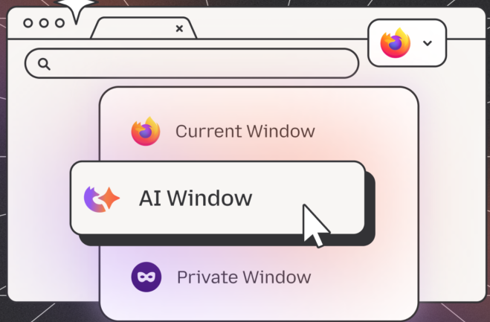

[Client] has been investing in initiatives to make its browser more competitive through new AI features
Competition
Client initiatives
New product initiatives⁵
Launched
Launched
In development
In exploration
AI Sidebar
Shake to Summarize
AI Window
TABS
An AI chatbot sidebar integrated within the browser that enables users to choose from multiple AI providers to summarize webpages or selected text, and brainstorm ideas¹
Shake to Summarize is a feature for iOS that lets users get an AI-generated summary of a webpage by shaking the phone or tapping a thunderbolt icon^{2,3}
AI Window is a feature that displays an always-available AI panel on the side of the browser, letting users ask questions, summarize content, or get quick insights⁴
TABS is an AI‑native browser automation service that lets developers fetch structured data, automate clicks and form submissions, and get live answers from the web
The client’s AI strategy favors trust, choice, and workflow enhancement, in contrast to competitors that prioritize deep AI integration
Sources: (1) [Source], (2) [Source], (3) [Source], (4) [Source], (5) Internal communications

Slide 22
Appendix
Definition of terms
2025 Overview
Key themes 2025
Total Addressable Market (TAM)
What the market got right vs. What the market got wrong
Takeaways
Detailed scenarios
Detailed market impact
Detailed key data:
Volume data
AI Overviews
Detailed CTR
Detailed CPC
Competitive landscape:
Browsers
Search engines
ChatGPT/Atlas
Google:
Google Chrome
AI Max
Google AI strategy
AI future outlook
Parallels: online news, streaming
Notes:
They are seeing a decrease in searches and an increase in CTR
We are seeing more AI summaries in US desktop

Slide 23
Updates from Dec 9th meeting
# | Requests | What we have done
1 | Create a slide with a deep-dive on AI Overviews, as ads present in AIO increase the CTR (more efficient ad clicks) | Created slide with deep-dive on AI Summaries
2 | Include a timeline of ChatGPT and tool releases and the impact on search ad metrics | Created a slide on ChatGPT releases and impact on KPIs
3 | Factor in the model the higher CTR (due to links being added back to AI Overviews) | Factored in the model increase in CTR in 2026
4 | Create a slide with research on DAU | Created a slide with a triangulation of Google’s DAUs
5 | Conduct a research and create a slide with deep dive of ad links (blue links/ sponsored links) in AIO | Created a a deep dive on ad and blue-link performance

Slide 24
Summary | What we learned from last year
 | What We Got Right | What We Got Wrong
AI Overviews | Expected rapid increase in summaries; penetration reached ~50% of searches in early 2025 in select markets¹ | -
Impact on Search Volume | Expected lower declines than aggressive forecasts, due to data-driven approach | Expected decline of 4.2% per year. Search volume grew in 2025, with sources reporting +4.7% to +20% vs. 2024^{2,3}
Impact on CTR | Expected ~10% CTR decline through 2030 as AI Overviews expanded | Declines were steeper than expected for some devices/geographies (e.g., RoW Desktop decreased by ~10% in 2025)⁴
Impact on CPC | Expected CPC increases, though AI impact was unclear in 2024 | CPC rose faster than expected as AI Overviews reduced ad space^{5,6}
Search TAM | Expected lower declines than aggressive forecasts, due to a data-driven approach | Modeled search revenue declining at –1.9% CAGR through 2026. Google revenue grew in 2025, rising from $265B to $298B⁷
AI Tools TAM | We expected strong growth for AI tools but modeled a more conservative CAGR | Growth exceeded expectations. Market estimates now exceed $254B. ChatGPT reached ~800M weekly active users (up from ~300M in Dec 2024)⁸
We maintained a data-driven approach that helped us avoid many of the overstated negative effects seen in external sources
Sources: (1) McKinsey, (2) SQ Magazine , (3) TTMS, (4) average of several sources (details in CTR slide), (5) Mavlers, (6) Seer Interactive, (7) SEC, $298B reflects Google’s total advertising revenue, including Search, YouTube, and Network ads, search accounts for ~75% of total ad revenue, (8) DemandSage

Slide 25
Appendix – Definition of terms
Definition of terms: standardized search and AI terminology for consistency
Term | Description
Traditional search | Traditional search refers to querying databases or search engines for information using specific keywords, returning relevant results e.g., Google search
AI Overviews | Refers to the integration of AI into traditional search engines, such as Google's AI Overviews, which provide direct answers or summaries at the top of search results
AI tools | Applications and platforms that use AI to process, analyze, and generate results or responses, including AI-powered search engines and chatbots like OpenAI's ChatGPT
Search volume | The total number of search queries processed by a search engine over a given period
Click-Through Rate (CTR) | The percentage of users who click on a specific link out of the total users who view ad
Cost per Click (CPC) | The amount paid by advertisers each time a user clicks on one of their ads
Zero-click searches | Searches where users get the desired information directly from the search results page without clicking through to any external website
Multimodal search | A search method that allows users to input queries in various formats, such as text, images, or voice
25

Slide 26



Key themes for 2025: three core drivers explain the impact of AI on traditional search
Appendix – 2025 Overview: Key themes 2025
AI search is additive,
not substitutive
AI Overviews have increased
zero-click behavior, causing a
short-term decline in CTR
Search engines adapt
to protect revenue
Google queries and revenue (~+15%) continue to grow YoY⁴, in line with historical trends
Users increasingly combine Google, AI tools, and social search^{5,11}, AI search grows without replacing traditional search⁶
The discovery journey is fragmented across many surfaces and tools⁷
80% of users rely on zero-click AI results in 40% of their searches¹
AI Overviews absorb a larger share of informational intent, reducing the need for immediate outbound clicks
CTR declines reflect a format shift rather than a loss of user demand, enabling normalization as links and ads are reintroduced
AI overviews adapt to protect revenue by reintroducing blue links and paid placements, partially reversing the CTR impact
CPC increased, reflecting reduced ad space and search engines’ efforts to maintain revenue
AI Max expands ad matching to more queries, improving price realization
These themes define how we interpret changes in engagement, pricing, and revenue across the rest of the analysis
Sources: (1) Bain, (2) Seer Interactive, (3) Seer Interactive, (4) Alphabet Q3 2025 Earnings Call, (5) WSJ, (6) Martech, (7) Orbit Media, (8) Search Engine Land, (9) Digital Marketing Institute and EngageCoders, (10) Search Engine Journal

Slide 27
Global Search Advertising TAM revised upward to $355B in 2025 (+$49B vs. 2024 forecast)
Appendix – 2025 Overview: TAM
 | 2024 | 2025
Traditional Search | TAM: US$306B¹ (2024) CAGR: -1.36%¹ (2022-2024) | TAM: US$355B¹ CAGR: 12.7%¹ (2024-2025)
Social Search | TAM: $226B² (2024) CAGR: 7.5%² (2024-2032) | TAM: $243B² CAGR: 7.5%² (2025-2033)
AI Tools | TAM: $137B³(2024) CAGR: 42%³ (2024-2032) | TAM: $254B⁴ (2025) CAGR: 36.7%⁴ (2025-2031)
All three markets increased compared to 2024 levels
Sources: (1) Statista, (2) Business Research, (3) Bloomberg, (4) Statista

Slide 28
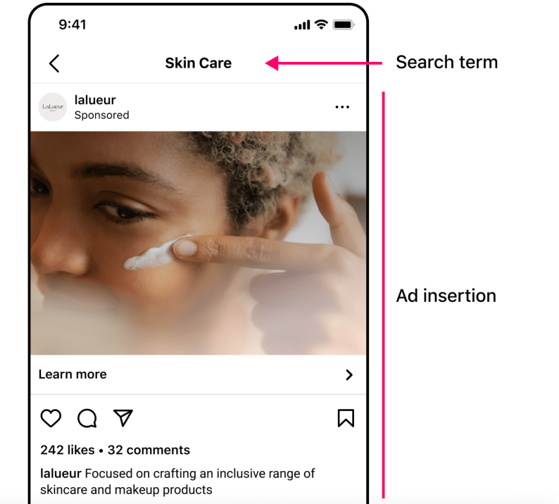
Social Search includes in-stream and all potential commercial value within the social platform
Appendix – 2025 Overview: updates from feedback sessions
Social Search refers to the trend of users (especially Gen Z) using the native search bars of social platforms to find information instead of using Google
Social Search Market is quantifying the ad revenue and engagement value generated by platforms like TikTok, Instagram, YouTube, and Pinterest acting as search engines
$243B~$261B in 2026 captures the massive shift in digital advertising spend
Brands are moving Search Ads budgets from Google to TikTok and Instagram (see right) because users are searching for "best skincare," "travel tips," or "how to..." directly within those apps.
Social Search includes in-platform query-based discovery and intent-driven content retrieval, but excludes broader feed-based and in-stream advertising
Sources: (1) Business Research, (2) Jungle Scout

Slide 29
What the market got right vs. What the market got wrong
Appendix – 2025 Overview: What the market got right vs. What the market got wrong
 | What the Market Got Right | What the Market Got Wrong
AI Overviews | Some sources forecasted that Overviews would become a material share of results. Early estimates (5% – 30%, depending on word count and phrasing), broadly match what occurred this year | –
Impact on Search Volume | – | Many articles warned that AI tools would significantly reduce search volume, often predicting sizable declines by 2025; instead, volume increased 4.7%–20% year over year as forecasts underestimated users' adoption
Impact on CTR | A moderate CTR decline was expected, mainly due to on-page AI modules shifting visibility (CTR expectations ranged from +4% to -30% between 2025 and 2030) | CTR decreased by as much as 25.3%, depending on the source (RoW, Mobile), with informational searches showing even steeper declines (>30%)
Impact on CPC | Sources had mixed predictions on CPC impact | CPC increased faster than anticipated. Multiple sources now explicitly link this to reduced above-the-fold inventory created by AI Overviews
Search TAM | – | Several sources projected declines of up to 25% over two years due to AI substitution. Instead, Google revenue grew in 2025, increasing from $265B to $298B
AI Tools TAM | Sources were partially right, expecting strong growth of around 40 percent | Actual market growth surpassed even those aggressive estimates. The space accelerated faster than any 2024 forecast, increasing 85.4% year over year (from $137B to $254B)
External sources were often directionally wrong – especially on search volume declines and AI cannibalization – overstating negative impacts while understating the acceleration of AI-driven markets

Slide 30
Takeaways
Appendix – 2025 Overview: Takeaways
Traditional search volume grew ~12% in 2025 vs. 2024¹, and Google sessions increased from ~10.5 to ~12.6 per user per week following ChatGPT adoption², strengthening the case for AI being additive, not substitutive.
Three scenarios are modeled for 2025-2030:
Scenario 1 – Neutral (our prediction), where global traditional search volume continues to grow at a slower pace, increasing from ~5.6T³ to ~7,1T searches by 2030 (~5% CAGR⁵; revenue-generating searches rise from 20%⁴ in 2015 to 21% of total searches in 2030)
Scenario 2 - Revitalization, where AI increases search frequency and unlocks new use cases (8.4% CAGR⁵, revenue-generating searches grow to 22% of total searches in 2030)
Scenario 3 - Delayed impact, where material volume declines emerge later as AI substitutes complex behaviors, autonomous agents scale, and search interfaces shift (e.g., toward AI wearables) (-14.4% CAGR⁵, revenue-generating searches reach 23% of total searches in 2030)
AI Overviews have increased zero-click behavior, driving a short-term decline in CTR. We expect partial reversion in 2026, followed by stabilization as Google introduces links and ads within AI Overviews
Search revenue grows in Scenario 1 at ~15.6% CAGR through 2030 (US = 14%, RoW = 16.2%), compared with a CAGR in Scenario 2 of 20.0% and in Scenario 3 of -6.2%. Revenue growth is driven by:​
CPC growth normalizing toward historical levels (~9% increase per year)⁶
CTR stabilization as links return to AI Summaries (averaging ~4.6%)⁷
Sources: (1) ~12% (average of: SQM, TTMS, Unece and DemandSage), (2) Martech and Semrush, (3) Search Engine Land and Google share of market from Semrush, (4) Datos, (5) Slide 8; (6) Wordstream data from: 2025, 2024, 2021, 2018, 2016, (7) CTR details slide

Slide 31
We expect AI to lead to reduced growth, not collapse
Appendix – Detailed scenarios
Scenario 1: Neutral (Growth slowdown)⁴
Scenario 2: Revitalization³
Scenario 3: Delayed impact⁵
AI-driven declines in traditional search are offset by incumbents integrating AI into core search experiences (e.g., AI Overviews)
Overall trajectory continues, albeit at lower growth rates
Re-acceleration toward historical growth levels, reversing expected deceleration
AI unlocks new use cases, expanding total activity
Incumbents and challengers both grow in a larger market
Incumbents benefit early, then lose share as challengers scale
Overall impact is a sharp redistribution of volume as new entrants rapidly dominate
Annual impact on Search Volume through 2030
Scenario 1^{1,2}
Scenario 2^{7,8}
Scenario 3^{5,6}
Avg= -15%
Avg= +6.0% p.a.
Avg= +10.0% p.a.
The historical data points to Scenario 1 as the most likely outcome, with no evidence of volume decline or accelerated growth to support alternative scenarios
Sources: (1) Mordor, 11.8% revenue CAGR (2030 vs2025, adjusted to remove price effects), (2) BRI, 11.0% revenue CAGR (2030 vs 2025 adjusted to remove price effects, (3) Financial Times, (4) Martech and Semrush, (5) McKinsey (annualized), Gartner; (6) TTMS, (7) Google data (2016, 2025), (8) MRA, 14.82% revenue CAGR (2033 vs 2025 adjusted to remove price effects)

Slide 32
Scenario 1: Neutral, growth slowdown across all segments
Appendix – Detailed scenarios
Forecasted Search volume growth (trillions) for Revenue-Generating Searches¹
Methodology
Desktop
Mobile
Since the split by device (desktop vs mobile) and region is not readily available across the 3 scenarios, we used the average expected CAGR for each scenario, and the desktop-mobile search split to triangulate estimated growth by device and region
Global Rev-Gen Search Vol (2025): 1.12 trillion¹
US: 21% (0.23 trillion)
RoW: 79% (0.88 trillion)
Scenario 1 CAGR: 6%
US Devices
Mobile: 58%
Desktop: 42%
RoW Devices
Mobile: 63%
Desktop: 37%
+5.8% p.a.
+4.1% p.a.
United States
+5.1% p.a.
+6.7% p.a.
RoW
Moderate growth, with mobile consistently outpacing desktop under the neutral scenario
Sources: (1) Scenarios assumptions slide for Volume and Revenue Projection and appendix slide with details of region and device methodology and change in the 2025-2030 period

Slide 33
Scenario 2: Revitalization, more robust growth across all segments
Appendix – Detailed scenarios
Forecasted Search volume growth (trillions) for Revenue-Generating Searches¹
Methodology
Desktop
Mobile
Since the split by device (desktop vs mobile) and region is not readily available across the 3 scenarios, we used the average expected CAGR for each scenario, and the desktop-mobile search split to triangulate estimated growth by device and region
Global Rev-Gen Search Vol (2025): 1.12 trillion¹
US: 21% (0.23 trillion)
RoW: 79% (0.88 trillion)
Scenario 2 CAGR: 10%
US Devices
Mobile: 58%
Desktop: 42%
RoW Devices
Mobile: 63%
Desktop: 37%
+8.5% p.a.
+9.8% p.a.
United States
+10.8% p.a.
+9.1% p.a.
RoW
8 to 10% annual growth across all segments and geographies, with mobile growing faster than desktop
Sources: (1) Scenarios assumptions slide for Volume and Revenue Projection and appendix slide with details of region and device methodology and change in the 2025-2030 period

Slide 34
Scenario 3: Delayed impact, steep decline across all segments
Appendix – Detailed scenarios
Forecasted Search volume growth (trillions) for Revenue-Generating Searches¹
Methodology
Desktop
Mobile
Since the split by device (desktop vs mobile) and region is not readily available across the 3 scenarios, we used the average expected CAGR for each scenario, and the desktop-mobile search split to triangulate estimated growth by device and region
Global Rev-Gen Search Vol (2025): 1.12 trillion¹
US: 21% (0.23 trillion)
RoW: 79% (0.88 trillion)
Scenario 3 CAGR: -15%
US Devices
Mobile: 58%
Desktop: 42%
RoW Devices
Mobile: 63%
Desktop: 37%
-13.2% p.a.
-12.1% p.a.
United States
-12.7% p.a.
-11.4% p.a.
RoW
Significant decline across all segments and geographies, with steeper declines in desktop than mobile
Sources: (1) Scenarios assumptions slide for Volume and Revenue Projection and appendix slide with details of region and device methodology and change in the 2025-2030 period

Slide 35
Search volume growth moderates post-2025, with resilience concentrated in revenue-generating segments
Appendix – Detailed market impact
Search Category | 2025 |  |  |  |  | Expected Growth* |  |  |  |  | 2030
Total Searches | 5.6T¹ |  |  |  |  | 5.0% p.a. +27.8% (’25 – ’30) |  |  |  |  | 7.1T
 | Total | US Desktop | US Mobile | RoW Desktop | RoW Mobile | Total | US Desktop | US Mobile | RoW Desktop | RoW Mobile | Total | US Desktop | US Mobile | RoW Desktop | RoW Mobile
Non-Revenue-Generating | 4.5T² | 0.4T | 0.5T | 1.3T | 2.2T | +4.8% p.a.³ | 3.3% | 4.6% | 3.9% | 5.5% | 5.6T | 0.5T | 0.7T | 1.6T | 2.9T
Revenue-Generating | 1.1T² | 0.1T | 0.1T | 0.3T | 0.6T | +6.0% p.a.³ | 4.5% | 5.8% | 5.1% | 6.7% | 1.5T | 0.1T | 0.2T | 0.4T | 0.8T
These dynamics imply slower but positive search volume growth, forming the basis for the detailed volume calculations on the next slide
Sources: (1) Search Engine Land; Google market share from Semrush, (2) Datos, (3) Slower growth in non-revenue-generating searches (≈20% lower growth vs. revenue-generating searches) as users migrate informational queries to chatbots; absolute non-revenue search volume still grows, driven by overall market expansion (Akron Legal News)
* Calculated based on Scenario 1 assumptions (data from Scenarios assumptions slide)

Slide 36
Rest-of-World (RoW) mobile captures incremental share as desktop gradually declines
Appendix – Detailed market impact
Global Search distribution (% of total searches)^{1–12}
Insights from research
Region and Device | 2025 | 2026 | 2027 | 2028 | 2029 | 2030 | Share variation 2030 vs. 2025
US Desktop | 8.8% | 8.7% | 8.6% | 8.5% | 8.4% | 8.2% | -0.6 p.p.
RoW Desktop | 28.9% | 28.7% | 28.5% | 28.3% | 28.0% | 27.8% | -1.2 p.p.
US Mobile | 12.2% | 12.1% | 12.1% | 12.1% | 12.1% | 12.1% | -0.1 p.p.
RoW Mobile | 50.1% | 50.4% | 50.8% | 51.2% | 51.5% | 51.9% | 1.8 p.p.
Mobile devices now generate the majority of global web traffic (>60%), while desktop continues to decline¹⁴
Smartphones are the primary access method for online activity in developing economies, representing ~90% of users¹³
The U.S. internet penetration rate has plateaued above 90%, meaning limited incremental user growth compared with emerging markets¹⁵
Revenue mix continues to shift structurally toward Rest-of-World mobile, while U.S. and desktop shares gradually decline over time
Approach:
A. 2025 region and device split projected by combining the average of RoW Mobile devices share of 63.4% ((1) SQM, (2) Coalition Technologies, (3) DigitalSilk, (4) Tekrevol, (5) GS Statcounter)), Desktop share of 36.6% ((1) SQM, (2) Coalition Technologies, (3) DigitalSilk, (4) Tekrevol, (5) GS Statcounter), US Mobile share of 57.9% ((3) DigitalSilk, (4) Tekrevol, (6) Sem Rush) and US Desktop of 42.1% ((3) DigitalSilk, (4) Tekrevol, (6) Sem Rush), with the US share of global searches of 21% ((7) Exploding topics, (8) World Population Review) and RoW share of global searches of 79% ((7) Exploding topics, (8) World Population Review).
B. 2026-2030 change among the segments: a. US Mobile vs RoW Mobile evolution calculated based on Ericsson mobile data traffic outlook ((9) Ericsson), comparing the 2025-2031 CAGR of RoW vs US (difference of 0.05% per year), b. Mobile vs Desktop evolution: historical shift of Desktop to Mobile (0.3% per year, based on 2025 vs 2024 change, (10) Visual Capitalist and (11) GS StatCounter), c. Search growth US vs RoW: projected difference of 2025-2030 population growth of the US vs RoW ((11) United Nations population projection), adjusted by US higher search intensity and AI investments ((12) Goldman Sachs)
Other sources: (13) VoxDex, (14) Visual Capitalist, (15) Pew Research

Slide 37
The US is expected to maintain ~14% CAGR through 2030
Appendix – Detailed market impact
US Only
Search revenue increase, Billions
Mobile
Desktop
CAGR (‘25 – ‘30)
14.0%
16.5%
9.9%
Key assumptions Rev-Generating Searches | Desktop (‘25 – ‘30) | Mobile (‘25 – ‘30) | Total (‘25 – ‘30)
% of revenue-generating searches¹ | 20% – 21% | 20% – 21% | 20% – 21%
CTR² | 2.89% – 3.12% | 4.23% – 4.26% | 3.56% – 3.69%
CPC³ | $8.76 – $10.43 | $6.56 – $10.53 | $7.66 – $10.48
Revenue per Search⁴ | $0.25 – $0.33 | $0.28 – $0.45 | $0.27 – $0.39
Search revenue growth remains resilient, supported by AI-driven monetization improvements
Sources: (1) Datos - Revenue-generating search share is assumed to be consistent across Desktop, Mobile, and Total, (2) CTR appendix slides 1 and 2, Desktop and Mobile simple average, (3) CPC appendix slides 1 and 2, Desktop and Mobile simple average, (4) CPC multiplied by CTR, Desktop and Mobile simple average ; *2024 data: estimated using Google volume and revenue and 2025 Revenue and Non-Revenue generating searches parameters as well as US/RoW/Desktop/Mobile split, 2019-2024 historical growth of 14.9% based on Google's revenue growth (Oberlo and GS StatCounter)

Slide 38
Rest of World is expected to maintain ~16% CAGR through 2030
Appendix – Detailed market impact
RoW Only
Search revenue increase, Billions
Mobile
Desktop
CAGR (‘25 – ‘30)
16.2%
17.4%
14.1%
Key assumptions Rev-Generating Searches | Desktop (‘25 – ‘30) | Mobile (‘25 – ‘30) | Total (‘25 – ‘30)
% of revenue-generating searches¹ | 20% – 21% | 20% – 21% | 20% – 21%
CTR² | 4.00% – 4.43% | 4.95% – 4.97% | 4.48% – 4.70%
CPC³ | $5.67 – $7.73 | $4.09 – $6.57 | $4.88 – $7.15
Revenue per Search⁴ | $0.23 – $0.34 | $0.20 – $0.33 | $0.21 – $0.33
Rest of World search revenue is expected to grow faster than the U.S., driven by mobile-led adoption and expanding monetization intensity
Sources: (1) Datos - Revenue-generating search share is assumed to be consistent across Desktop, Mobile, and Total, (2) CTR appendix slides 1 and 2, Desktop and Mobile simple average, (3) CPC appendix slides 1 and 2, Desktop and Mobile simple average, (4) CPC multiplied by CTR, Desktop and Mobile simple average ; *2024 data: estimated using Google volume and revenue and 2025 Revenue and Non-Revenue generating searches parameters as well as US/RoW/Desktop/Mobile split, 2019-2024 historical growth of 14.9% based on Google's revenue growth (Oberlo and GS StatCounter)

Slide 39
In Scenario 2, search volume grows 8.4% annually, with Revenue-Generating searches growing 10%
Appendix – Detailed scenarios
Search volume, Trillions¹
Search revenue, Billions²
Non-revenue generating
Revenue generating
CAGR (‘25 – ‘30)
US
RoW
CAGR (‘25 – ‘30)
8.4%
20.0%
10.0%
20.6%
8.0%
18.4%
Search revenue grows ~20% annually, driven by AI-led increases in search frequency and new use cases, with RoW outpacing the U.S.
Sources: (1) Datos, Search Engine Land and Google share of market from Semrush, Akron Legal News ; (2) Datos, CTR appendix slides 1 and 2; detailed regional data in appendix: US and RoW, CPC appendix slides 1 and 2, CPC multiplied by CTR
*2024 data: estimated using Google volume and revenue and the 2025 fixed parameters of Rev and Non-Rev generating searches as well as US/RoW/Desktop/Mobile split

Slide 40
In Scenario 3, search volume declines 14.4% annually, with Revenue-Generating searches declining 12%
Appendix – Detailed scenarios
Search volume, Trillions¹
Search revenue, Billions²
Non-revenue generating
Revenue generating
US
RoW
CAGR (‘25 – ‘30)
CAGR (‘25 – ‘30)
-6.2%
-14.4%
-12.0%
-7.3%
-15.0%
-5.8%
Volume declines as AI chatbots substitute traditional search, while advertiser migration toward AI platforms pressures revenue
Sources: (1) Datos, Search Engine Land and Google share of market from Semrush, Akron Legal News ; (2) Datos, CTR appendix slides 1 and 2; detailed regional data in appendix: US and RoW, CPC appendix slides 1 and 2, CPC multiplied by CTR, 30% reduction to CPC growth rates, reflecting advertiser migration toward AI chatbots (ChannelLife)
*2024 data: estimated using Google volume and revenue and the 2025 fixed parameters of Rev and Non-Rev generating searches as well as US/RoW/Desktop/Mobile split

Slide 41
Search volume remains resilient despite AI, challenging 2024 forecasts
Appendix – Detailed volume data
Search Volume growth over 2024 (annual)
Insights from research
Google search volume grew in 2025, with sources reporting 4.7%¹ to 20%² growth over 2024 (11.85%^{3,8} average), reaching over 5 trillion searches in 2025²
Despite this, none of the sources reviewed in 2024 revised their projections
Negative projections underestimated the uplift from AI Overviews, which emerged as a counter-response from traditional search incumbents^{4,5,6,7}
2024 Sources forecast
2025 Actual
Growth in traditional search volume suggests AI is additive, expanding total TAM rather than cannibalizing it
Sources: (1) SQ Magazine , (2) TTMS; (3) Unece,, (4) Datos; (5) Yahoo; (6) SEJ; (7) SEL; (8) DemandSage

Slide 42
2024–2025 actuals and projections: data sources
Appendix – Detailed volume data
 | Source | Search Volume Growth (%) | Normalized Growth (%) | Included in average? | Comment | Source Credibility
2024 Sources | Traditional Search Volume 2025 – Search Engine Land | 10.72% | 10.72% | Yes | Minimal disruption but early signs of AI‑driven substitution | Medium
 | Gartner | -25% | -25% | Yes | Predicts a steep decline as AI agents begin replacing traditional query volume | High
 | SEO Experts Survey | -7.3% | -7.3% | Yes | Noticeable decline in search traffic as users shift to AI answers | High
 | 2023 Analysis | -0.8% | -0.8% | Yes | Limited disruption observed, with early signs of AI‑driven substitution | Medium
2025 Actuals Sources | SQM | 4.7% | 4.7% | Yes | Modest organic growth despite AI adoption | Medium
 | TTMS | 20% | 20% | Yes | Search demand is expanding strongly | Med-High
 | Unece | 4.7% | 4.7% | Yes | Low‑single‑digit growth suggests traditional search still holds utility | High
 | Demand Sage | 18% | 18% | Yes | Search demand is expanding strongly | Med-High
 | Exploding Topics | 63.9% | 63.9% | No | Considered an outlier – methodology and assumptions unclear | Low
 | Digital Bloom | 7% to 60% | 7% to 60% | No | Considered an outlier – methodology and assumptions unclear | Low
2025 Onwards – Projections Sources | McKinsey | -15.91% | -15.91% | Yes | AI assistants are expected to cannibalize a significant share of routine search queries | High
 | TTMS (5 year CAGR) | -15.66% | -9.5% | Yes | Significant decline as conversational AI takes over | High
 | Mordor (5 year CAGR) | 1.89% | 14.9% | Yes | Slow, steady growth – traditional search remains structurally relevant | Medium
 | Business Research Insights (9 year CAGR) | 1.18% | 17.6% | Yes | Near‑flat future where search stabilizes rather than collapses | Medium
 | Market Report Analytics (8 year CAGR) | 14.8% | 25.5% | Yes | Strong expansion driven by ecommerce, mobile, emerging markets | Medium
 | Morgan Stanley | -4% | -4% | Yes | Mild contraction as AI tools divert low‑intent queries | Medium
Sources have been reviewed to ensure data points are reasonable and reflective of our considerations
Sources: (1) Oberlo (2022) and Exploding Topics (2024); (2)Gartner; (3) SQM, (2) TTMS, (3) Unece, (4) DemandSage, (5) Exploding Topics, (6) Digital Bloom, (7) McKinsey, (8) TTMS, (9) Mordor: USD CAGR of 11.8% adjusted to volume with our model revenue per revenue generating search number, (10) BRI: USD CAGR of 11% adjusted to volume with our model revenue per revenue generating search number

Slide 43
Despite rapid AI adoption, traditional search still accounts for the vast majority of search volume
Appendix – Detailed volume data
Search traffic share on browsers¹
Quotes from research
“More than 1 in 5 Americans now use AI tools heavily – but traditional search engines remain dominant, with usage holding steady at 95% (including Google and other search engines)” ²
“21% of U.S. users access AI tools like ChatGPT, Claude, Gemini, Copilot, Perplexity, and DeepSeek more than 10 times per month. Overall adoption has jumped from 8% in 2023 to 38% in 2025”²
“ChatGPT relies on Google behind the scenes, as it pulls real-time search results via a third-party SerpApi, to supplement its outputs, revealing that ChatGPT is not yet fully self-sufficient in delivering up-to-date search data”³
100%
100%
Meaningful displacement of traditional search would require AI usage to scale far beyond current levels and existing use cases
Notes: (1) 2025 data: Wall Street Journal, Semrush, 2024 data: Wall Street Journal, Stat Counter, (2) Search Engine Land, (3) Sizaria

Slide 44
User exposure to AI-generated results is already significant, led by the U.S.
Appendix – Detailed AI Overviews
% of Google searches that contain AI Overviews^{1–6}
Insights from research
Avg: 41.1%
Avg: 66.3%
The rollout of AI Overviews is much more consistent in the U.S. (~50%) compared to the rest of the world (~30%)
Lower rest of the world (RoW) adoption reflects selective rollout rather than lower user demand⁵
The uneven deployment indicates Google is actively controlling exposure, implying future changes will be iterative rather than abrupt⁵
Desktop
Mobile
United States
Avg: 31.3%
Avg: 29.7%
Desktop
Mobile
RoW
Because AI Overviews are not uniformly deployed, we model their impact as gradual and region-specific rather than immediate and global
Notes: (1) Advanced Web , (2) DemandSage, (3) Semrush, (4) Statista, (5) Pew Research Center, (6) AI Search Statistics, (7) Search Engine Land, (8) SimilarWeb,

Slide 45
Zero-click data: Methodology & Source Validation
Appendix – Detailed AI Overviews
Year | Avg. global zero-click rate (%) | Sources | Additional sources/insights | Source Credibility
2019 | 50.3% | SparkToro: 50.3%² Industry Summarize: 49% | Half of all searches ended without a click | High
2020 | 64.8% | Statista: 65%⁷ SparkToro: 64.8%² | Most users reduced click-through behavior, relying on SERP features for instant answers Mobile: 77%, Desktop: 47%⁸ | High
2021 | 66% | Click Vision¹ | Zero‑click became a dominant search behavior | Medium
2022 | 59.3% | Inner Spark: 68% Semrush: 57%³ | Mobile‑heavy markets drove higher zero‑click behavior SemRush³: mobile: 57%, desktop: 26% | Medium
2023 | 70% | Click Vision¹ | Google’s expanding answer boxes and featured snippets captured the majority of user queries | Medium
2024 | 64.2% | Click Vision¹: 70% Search Engine Land: 58% | Zero‑click stabilized but remained high SparkToro/Datos⁴ - US: 60%, EU: 59% | Med-High
2025 | 70.5% | SimilarWeb: 80%⁵ Digital Bloom: 60%⁹ | AI Overviews absorbed most informational queries, dramatically reducing clicks to external sites | Medium
Notes from research
To ensure consistency for projections, we utilized the Click Vision 2025 Meta-Analysis Report for Zero-click Search Statistics¹ that consolidates several datasets from trustworthy sources such as SparkToro, Search Engine Land, MarTech
The meta-analysis report data were cross-validated with additional research sources
We triangulated several reputable sources and believe the numbers are directionally reliable; however, year‑to‑year precision is low due to differing datasets and methodologies
Notes: (1) Click Vision, (2) Spark Toro, (3) SemRush, (4) SparkToro, (5) SimilarWeb, (7) Statista, (8) Similar Web

Slide 46

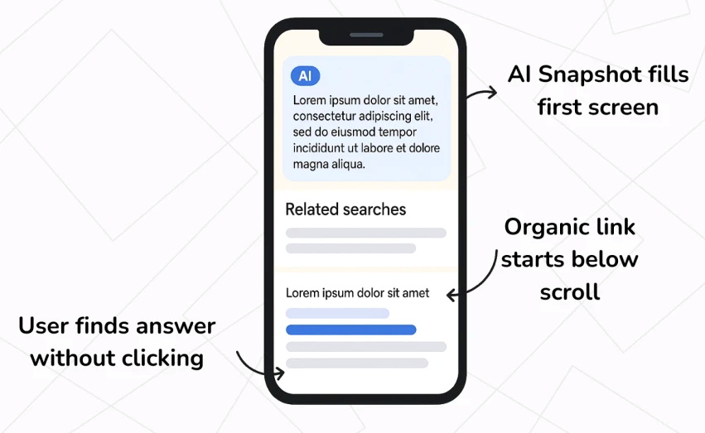




AI Overviews are pushing ads down the page, reducing near-term ad visibility
Appendix – Detailed AI Overviews
AI Overviews are impacting ad views
Schematic of current AI Overview impact⁴
“Mobile ad visibility is shrinking: multiple industry experts are reporting noticeable dips in top ad impression share on mobile, often 20% or more”¹
“AI Overviews push ads further down the page or satisfy users’ informational needs directly”²
“Ads may need to fight harder for visibility when overviews take up prime space”³
"Google’s AI Overview takes up significant space at the top of the search results — and on mobile, that means it often dominates the entire screen”⁴
AI Overviews temporarily reduce ad views, with revenue impact mitigated by rising CPCs and emerging ad placements
Sources: (1) Mavlers, (2) Seer Interactive, (3) Two99, (4) ThemeWinter, (5) Search Engine Land

Slide 47
Google introduced inline links and ads in AI Overviews to ensure users can easily reach relevant websites and maintain revenue
Appendix – Detailed AI Overviews
Meeting Customers in the Moment of Need
Insights from research
Query: A user asks, “how do I get a grass stain out of jeans?”
AI Overview Response: The overview provides helpful solutions, from household products to commercial stain removers
The Ad Integration*: Instead of requiring a second search, relevant Shopping ads for stain removers appear directly within the AIO, clearly marked as “Sponsored”
This solution is available now in the U.S. and expanding to desktop
Google is experimenting with different formats, showing ads above, below, or within AI Overviews², depending on the query and content relevance
7-14% reduction in zero-click rates is expected with the introduction of links into AI overviews⁴
Google is expected to roll out ads in AI Overviews to select English-speaking markets beyond the U.S by the end of 2025³
For informational queries, AI Overviews penetration is likely to continue growing, with traffic impacts remaining meaningful
With links now embedded, AI Overviews stabilize informational traffic, reducing disruption
Notes: (1) Semrush, (2) Google, (3) Search Engine Land
Notes:
We've established three key segments in the search ecosystem:
Traditional search uses indexing and algorithms to rank results based on keywords and relevance. While this segment has seen a slight CAGR decline of 1.36% from 2022-2024, we believe traditional search will remain important despite some volume decline
AI tools use large language models to answer queries directly. This segment is seeing explosive growth with a projected 42% CAGR through 2032. This is evidenced by ChatGPT's weekly active users more than doubling between November 2023 and August 2024
AI-generated summaries integrate LLMs with traditional methods to enhance search results with direct answers. Currently, about 30% of searches include AI overviews

Slide 48
CTR declines emerge in 2025 with uneven impacts across regions and devices
Appendix – Detailed CTR
Impact on Click-Through Rates (CTR), 2025 vs. 2024^{1–10}
Insights from research
Avg: -0.5%
Avg: +1.6%
Desktop sees the largest declines, since AIO replaces a larger portion of traditional link-heavy layouts
Mobile remains more resilient, with smaller declines or modest gains, likely because mobile already limits link density
The effect of the inclusion of links and ad placements in AI Overviews has not yet appeared in publicly available CTR measurements
Desktop
Mobile
United States
Desktop
Avg: -10.6%
Mobile
Avg: -0.5%
RoW
Higher
Sources credibility
Lower
CTRs in the U.S. appear more resilient than in other regions, suggesting earlier stabilization as AI Overviews mature; this dynamic is used to estimate future revenue impacts
Sources: (1) WordStream, (2) 360OM, (3) Seer Interactive, (4) Advanced Web Ranking, (5) Focus Digital, (6) Dentsu, (7) Karooya, (8) Mordon Inteligence, (9) Semrush, (10) SQ Magazine

Slide 49
We have triangulated and normalized several sources to determine the average CTR growth
Appendix – Detailed CTR
Region & device | Source | CTR variation (2025 vs. 2024) | Normalized % | Definition | Source Credibility
United States Desktop | WordStream | 3.74% | 3.74% | 16,000 campaigns running from April 2024 through March 2025 of US-based WordStream client accounts in all verticals. Data reflects search behavior across desktop and mobile | High
 | Focus Digital | 1.9% | 1.9% | Focuses on B2B/Tech that dominate desktop usage. US Google Ads across 23 industries from over 16,000 campaigns from Jan through Sep 2025 | Medium-Low
 | Wordstream Dec 2025 | -7% | -7% | Data based on Google’s US rollout of AI Overviews. AIOs have decreased CTRs by about 7% in desktop click-through rates for top-ranking sites | Medium
United States Mobile | WordStream | 3.74% | 3.74% | Averages out CTR across several industries but does not split for mobile vs desktop; assumption of equal growth for mobile and desktop. 16k campaigns from Apr/2024 to Mar/2025 of US client accounts | Medium
 | Focus Digital | 2.2% | 2.2% | Averages out CTR across 17 industries but does not split for mobile vs desktop; assumption of equal growth for mobile and desktop. Report uses US-centric industry classifications (e.g., "Advocacy," "Auto," "Home Goods") and cites US-based sources | Medium
 | SemRush | -1% | -1% | Source states that the mobile behavior justifies CTR's minor decline. Article mentions several US based examples | Medium
RoW Desktop | Rankfuse | -25.3% | -25.3% | Paid CTR without AI Overviews has fluctuated but shows an overall downward trend from 23.07% to 17.24%, a 25.3% reduction. Considered RoW, as article frames it as a global behavior change. Article states that paid ads still maintain visual prominence, a technical language used for Desktop SERP architecture | Medium
 | SEO Clarity | -0.66% | -0.66% | Position 1 Desktop CTR decline in 2025 compared to 2024: 0.66%. Methodology included UK in the data set, suggesting it is RoW | High
 | Advanced Web Ranking | -1.52% | -5.94% | Websites ranked first on desktop witnessed a 1.52 pp. drop in CTR. Thousands of sites and millions of Keywords CTR averages, Q3 2025 vs Q2 2025. The data set is international and comprises all the available markets | Medium–High
RoW Mobile | SEO Clarity | -0.13% | -0.13% | Position 1 Mobile CTR decline in 2025 compared to 2024: 0.13%. Methodology included UK in the data set, suggesting it is RoW | High
 | Advanced Web Ranking | -0.79% | -0.79% | Mobile query CTRs drop on average 0.79% in 2025. The data set is international and comprises all the available markets | Medium–High
There are limited reputable sources for this data, and we have used the most reliable available sources to determine the trend
Sources: Each source name in the table contains an embedded hyperlink to the original publication

Slide 50



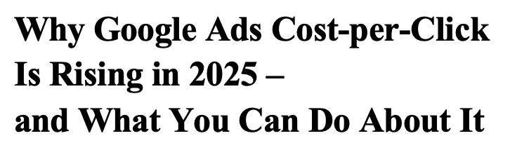


CPC is increasing due to reduced available ad space as AI-generated summaries occupy more of the results page
Appendix – Detailed CPC
Reduced ad space is the primary driver of CPC increases from AI Overviews
Meanwhile, CPC has seen a steeper increase⁵
“The smaller ad space creates a bigger problem: since budgets usually stay fixed in the short to medium term, advertisers end up competing for fewer clicks with the same investment. This drives up cost-per-click (CPC).”⁽¹⁾
“AI Overviews often push ads below the fold. Advertisers must pay more for visibility because the number of ad placements is shrinking”²
Google’s U.S. CPC has been on an upward trend since 2016, growing at ~9% p.a⁷. However, since the launch of AI tools in 2022, the incremental impact on CPC remains unclear.
“The presence of AI Overviews has reshaped how ads appear in the SERPs: traditional search ads, which used to sit above organic listings, are now often pushed below AI Overviews content. Advertisers must now pay more for visibility.”³
CPC % increase vs 2024⁶
“With AIOs taking prime SERP real estate, competition is driven up as advertisers fight harder and bid more to maintain visibility, especially for ad placements with high-value keywords.”⁴
CPC has risen largely due to reduced ad space driven by AI Overviews; however, the precise long-term impact remains unclear
Sources: (1) Hamak ; (2) OrangeSEO.net, (3) AdExpert, (4) USIM, (5) Search Engine Land, Dream Data, Wordstream, Quimbydigital, (6) Wordstream, Growth-onomics, Search Engine Land, Tinuiti, Wordstream 2, OrangeSEO, (7) Wordstream 2025, Wordstream 2024, Wordstream 2021, Wordstream 2018, Wordstream 2016

Slide 51
CPC growth accelerated in 2025 as ad space tightened and Google moved to protect revenue
Appendix – Detailed CPC
Cost per Click (CPC) growth, 2025 vs. 2024^{1–10}
Insights from research
Avg: +6.9%
Avg: +13.1%
CPC dynamics reflect multiple overlapping forces. AI Overviews could contribute by tightening visible ad inventory, while market competition, algorithmic bidding, and platform updates also influence pricing¹¹
Desktop growth is lower, reflecting a smaller and more mature user base relative to mobile¹¹
“AI Overviews often push ads below the fold. Advertisers must pay more for visibility because the number of ad placements is shrinking”¹²
“AI Overviews have reshaped how ads appear in the SERPs, pushing ads below the AIO content. Advertisers must now pay more for visibility”¹³
Desktop
Mobile
United States
Desktop
Avg: +9.1%
Mobile
Avg: +11.3%
RoW
Higher
Sources credibility
Lower
Rising CPCs partially offset CTR pressure, supporting revenue resilience. CPCs are expected to continue growth assumptions when we estimate future revenue impacts
Sources: (1) Magna Global, (2) ISBA, (3) WPP Media, (4) Dentsu, (5) Karooya, (6) Dentsu, (7) Skai, (8) SQ Magazine, (9) Karooya, (10) Dentsu, (11) Wordstream data from: 2025, 2024, 2021, 2018, 2016, (12) OrangeSEO.net, (13) AdExpert
Notes:
9

Slide 52
CPC 2025 vs 2024 variation: data sources and normalization
Appendix – Detailed CPC
Region & device | Source | CPC 2025 vs 2024 variation | Normalized % | Comment | Source Credibility
United States Desktop | Magna Global | 7.00% | 7.00% | Search and Retail Media ads (e.g., Google, Amazon, Walmart) is used to represent search revenue | Medium
 | ISBA | 6.30% | 6.30% | Uses media inflation rate and digital channels (search, social video, retail media) to reflect price growth | Medium
 | WPPMedia | 5.60% | 5.60% | Uses ad revenue growth through searches and socials to represent search revenue | Medium
 | Dentsu | 6.70% | 6.70% | Uses Paid social (ecosystem that blends shopping, video, search, and gaming capabilities) as a proxy to represent search rev | Medium
 | Karooya | 7.00% | 7.00% | Leveraging anonymized campaign data, this report provides a platform-by-platform breakdown—including Google, Meta, and Amazon | High
United States Mobile | Karooya | 13.00% | 13.00% | Uses Shopping [via Mobile] CPC as a proxy for search revenue assuming clicks led to purchase | Medium
 | Magna Global | 12.00% | 12.00% | Search and Retail Media ads (e.g., Google, Amazon, Walmart) is used to represent search revenue | Medium
 | Skai | 18.00% | 18.00% | Uses increase in CPC for Amazon Sponsored Brands | Medium
 | WPP Media | 13.50% | 13.50% | Uses ad revenue growth through searches and socials to represent search revenue | Medium
 | Dentsu | 9.00% | 9.00% | Uses Paid social (ecosystem that blends shopping, video, search, and gaming capabilities) as a proxy to represent search rev | Medium
RoW Desktop | Dentsu | 8.30% | 8.30% | Uses Paid social (ecosystem that blends shopping, video, search, and gaming capabilities) as a proxy to represent search rev | Medium
 | ISBA | 11.00% | 11.00% | Uses media inflation rate and digital channels (search, social video, retail media) to reflect price growth | Medium
 | Magna Global | 8.00% | 8.00% | Uses keyword Search in digital advertising as a proxy for search revenues | Medium
 | WordStream | 8.9% | 8.9% | Average of all RoW countries in the report. Benchmarked CPCs by running a 15,000‑keyword dataset through Google Keyword Planner and indexing each country against the US | High
RoW Mobile | Dentsu | 13.90% | 13.90% | Retail media (advertisers capitalizing on the high value of retailer consumer data ) | Medium
 | SQ | 12.30% | 12.30% | Proxy: Global mobile ad spend to represent majority of revenue through mobile segment | Medium
 | WPP Media | 10.00% | 10.00% | Uses ad revenue growth through searches and socials to represent search revenue | Medium
 | WordStream | 8.90% | 8.90% | Average of all RoW countries in the report. Benchmarked CPCs by running a 15,000‑keyword dataset through Google Keyword Planner and indexing each country against the US | High
Sources: (1) Magna Global, (2) ISBA, (3) WPP Media, (4) Dentsu, (5) Karooya, (6) Dentsu, (7) Skai, (8) SQ Magazine, (9) Karooya, (10) Dentsu, (11) Wordstream data from: 2025, 2024, 2021, 2018, 2016, (12) OrangeSEO.net, (13) AdExpert

Slide 53
2026–2030 projection: data sources and normalization
Appendix – Detailed CPC
Region & device | Source | CPC growth (2026-2030) | Normalized % | Comment | Source Credibility
United States Desktop Avg: 8.2% | Grand View Research | 13.7% | 13.7% | Uses digital ad market growth to represent search revenue (incl. Amazon in calcs) | Medium
 | ISBA | 6.30% | 6.30% | Uses inflation increase in US Paid Search – proxy for search revenue across several ads | Medium
 | Magna Global | 4.60% | 4.60% | Uses digital ad market growth to represent search revenue (incl. Google, Amazon, Walmart) | Medium
United States Mobile Avg: 11.2% | Grand View Research | 14.70% | 14.70% | Uses digital ad market growth to represent search revenue (incl. Amazon in calcs) | Medium
 | Dentsu | 8.30% | 8.30% | Uses Paid social (ecosystem that blends shopping, video, search, and gaming capabilities) as a proxy to represent search revenue | Medium
 | Mordor Intelligence | 10.61% | 10.61% | Uses the online Advertising Market Size and Share to represent searches as the largest share of ad spend comes from this segment | Medium
RoW Desktop Avg: 17.9% | Mordor Intelligence | 20.32% | 20.32% | Uses advertising to represent searches as the largest share of ad spend comes from this segment | Medium
 | Grand View Research | 15.40% | 15.40% | Uses digital ad market growth to represent search revenue (incl. Amazon in calcs) | Medium
RoW Mobile Avg: 19.0% | Grand View Research | 17.00% | 17.00% | Uses digital ad market growth in Asia Pacific to represent search revenue globally | Medium
 | Mordor Intelligence | 20.97% | 20.97% | Uses the online Advertising Market Size and Share in the Middle East to represent search as the largest share of ad spend comes from this segment | Medium
Sources: (1) Grand View Research, (2) ISBA, (3) Magna Global, (4) Grand View Research, (5) Dentsu, (6) Mordor Intelligence, (7) Mordor Intelligence, (8) Grand View Research, (9) Mordor Intelligence, (10), Grand View Research, (11) Mordor Intelligence, (12) Mordor Intelligence

Slide 54







Browsers competitive landscape: capabilities and monetization
Appendix – competitive landscape: browsers
 | Firefox + AI chatbot sidebar^{16,17} | Brave + Leo AI^{1,2} | Chrome + Gemini AI³ | Edge + Copilot^{9,10} | Opera + Aria AI⁴ | Atlas (ChatGPT)^{11,12} | Comet (Perplexity)^{13,14}
1. Model variants (multiple sizes and versions) | ✔ | ✔ | ✔ | ✔ | 🗶 | 🗶 | 🗶
2. Browser & OS integration (works seamlessly across devices | ✔ | ✔ | ✔ | ✔ | ✔ | 🗶 | 🗶
3. Safety focus (strong guardrails/reliability) | ✔ | ✔ | ✔ | ✔ | 🗶 | ✔ | 🗶
4. Privacy guarantees (user data protected) | ✔ | ✔ | ✔ | 🗶 | ✔ | ✔ | 🗶
5. Developer tools (SDKs, API tools for building) | ✔ | 🗶 | ✔ | ✔ | 🗶 | ✔ | 🗶
6. Production integration (APIs for real products) | 🗶 | 🗶 | ✔ | 🗶 | ✔ | ✔ | ✔
7. Coding assistance (help writing and fixing code) | 🗶 | ✔ | ✔ | 🗶 | ✔ | ✔ | 🗶
8. Extensions/Add-ons (supports plugins) | ✔ | ✔ | ✔ | ✔ | ✔ | 🗶 | 🗶
AI Monetization | NA / BYO Key | Leo Premium ($15/mo)⁵ | Gemini Advanced ($20/mo), Direct ad monetization, Sponsored ads in AI overviews^{6,7} | Microsoft 365 Copilot ($10/mo) | Opera Neon ($20/mo), AI-driven ad revenue | Plus ($20/user/mo), Pro ($200/user/mo) | Plus ($5/mo), Pro ($20/mo), Max ($200/mo), Ads + sponsored revenue
Firefox leads on privacy, safety, and extensibility, but lacks built-in AI capabilities such as coding assistance and production-grade APIs, leaving it behind more integrated AI browsers like Chrome + Gemini
Sources: (1) Brave: link, (2)Brave: link, (3)Google: link, (4) Opera: link, (5) Brave: link, (6) Google: link, (7) Search Engine Land, (8) Seeking Alpha, (9) Edge and Edge, (10) Microsoft, (11) Open AI, (12) Gen AI, (13) Perplexity and Perplexity, (14) Comet and Comet. (15) Firefox, (17) Mozilla AI Chatbot

Slide 55
Monetization strategies reflect core business models: ads, subscriptions, and ecosystems
Appendix – competitive landscape: browsers
 | Firefox¹ | Brave² | Chrome³ | Edge⁴ | Opera⁵ | Atlas (ChatGPT)⁶ | Comet (Perplexity)⁷
1. Primary monetization model | Search Engine Royalties: 85% of revenue comes from Google (and others) for default search status | Privacy Ad-Network & Premium AI: Users earn BAT tokens for viewing ads; Leo AI Premium subscription | Search Ads & First-Party Data: Feeds Google's $300B+ ad engine | Search Ads (Bing) & Enterprise Ecosystem: Monetizes via Bing and as a "front door" for Microsoft 365 commercial subscriptions | Ads (65%) & Search (35%): Monetizes via its own ad network, speed dials, and technology licensing | Subscriptions & Data Pipeline: Tiered model (Free/Pro/Plus); monetizes via high-value Agent Mode tasks and user signals | Revenue Sharing & Subscriptions: Comet Plus ($5/mo) funds a $42.5M pool to pay publishers for AI citations
2. Key differentials^{8,9} | Privacy Sovereign Tech: Only major independent engine (Gecko); non-profit mission-driven focus on "Trustworthy AI" | Native Ad-Blocker: Extreme privacy-by-default; integrated crypto wallet and decentralized features | Deepest integration with Google Workspace and Gemini 2.0/3.0; largest extension ecosystem | Edge for Business: Specialized enterprise security and native Microsoft 365 Copilot integration | Specialized Browsers: Opera One (Main) and Opera GX (Gaming) with built-in sidebar apps and VPN | "Agentic UI": A browser built around the "OWL" architecture that allows the AI to "see" and "click" on pages | Publisher-First Model: Directly compensates creators when their content is used to answer a query or complete a task
3. Price (Consumer) | Free | Free / $15/mo (Leo Premium) | Free | Free | Free | Free (Basic) / $20/mo (Agent Mode) | Free (Basic) / $5-20/mo (Comet Plus)
4. Agentic capabilities (future AI differentiators) | Privacy-Focused AI: Local LLM integration for summarization that doesn't send data to the cloud | Brave Leo: Uses "Trusted Execution Environments" (TEEs) for verifiably private AI research and automation | Integrated Gemini: Contextual on-page assistance, automated tab management, and research synthesis | Copilot Agents: Directly executes tasks within M365 apps (drafting emails, organizing files, planning meetings) | Opera Neon: An experimental "agentic" version that handles multi-project tasks and form-filling automation | Agent Mode: Autonomously navigates the web, fills out forms, books travel, and manages shopping carts | Comet Assistant: Multi-step research across tabs; synthesizes information from disparate sources into a single action
Traditional (Firefox/Chrome/Edge) are bundling AI to protect their differential moats, while AI-native entrants (Atlas/Comet) are charging for 'time-saved' through task automation
Sources: (1) Firefox: Mozilla, TechWire Asia, (2) Brave: Brave, Rewards, (3) Chrome: Google, Google, (4) Edge: Microsoft, Microsoft, (5) Opera: Investor, Freedom24, (6) Atlas: Intuition Labs, OpenAI . (7) Comet: Perplexity, Search Engine Journal, (8) Smartexe,
(9) Scribd

Slide 56



Privacy and safety have become a key battleground, with Firefox and Brave leading the charge
Appendix – competitive landscape: browsers
Privacy and Safety Distribution^{1,2,3,4,5,6,7}
Insights from research
“Responsible AI” is becoming a real differentiator, users and enterprises increasingly value trust, control, and reliability^{8,9}
AI-native entrants bring additional risk, as their safety systems are early-stage and privacy policies remain vague or untested^{10,11}
The incumbents have the most mature guardrails and infrastructure, but their business models depend on data aggregation, reducing user confidence in their privacy claims¹²
Firefox and Brave occupy a premium, high-trust niche. This positions them to capture users who want AI without sacrificing control or privacy^{13,14}
High Privacy, High Safety
Strong privacy posture, open-source trust, and explicit user data protection guarantees, with cautions but reliable integration
Privacy Focus
Mid-Tier
Positioned in the middle, without the strong privacy narrative of Brave/Firefox or the deep safety systems of Google/ Microsoft
Low Privacy, High Safety
Ambiguous
Privacy and safety models are still in early stages and not yet proven at scale
Strong guardrails and production-ready systems, but significant privacy concerns due to data aggregation for models
Safety Focus (Guardrails/Reliability)
Firefox and Brave are emerging as clear leaders, while AI-native entrants lag in reliability and incumbents lag in privacy
Sources: (1) Brave: Brave, Brave, Brave (2) Chrome: Proton, DealFront, Google, Support Google, Search Engine Land (3) Opera: Opera, Seeking Alpha; (4) Edge: Kahana, Microsoft, (5) Comet: Perplexity, Perplexity, Comet, Comet, (6) Firefox: Mozilla, Cyber Insider, Tech Radar, (7) Atlas: Proton, Quartz, Tuta, (8) McKinsey, (9) E&Y, (10) Security Brief, (11) ITLawCo, (12) Data Law trends, (13) Lead Advisors, (14) Gupta Deepak,

Slide 57

AI leaders are pulling away, and the maturity gap is now structural
Appendix – competitive landscape: browsers
Degree of AI–Browser Integration
Weakest
(not a full browser)
Inconsistent
but powerful
Strongest
(deeply embedded)
Emerging
Mid-tier
Comet +
Perplexity
Firefox
Atlas +
ChatGPT
Brave +
Leo AI
Opera +
Aria AI
Edge +
Copilot
Chrome +
Gemini
Gartner’s AI Maturity Model
Level 5 | Transformational | AI becomes core to business strategy and operating models AI drives new products, revenue streams, and competitive advantage
Level 4 | Systemic | AI is integrated across multiple business functions Shared platforms, reusable components, and enterprise‑wide standards emerge
Level 3 | Operational | AI is deployed in production for specific use cases Governance, data pipelines, and monitoring begin to formalize
Level 2 | Active | Teams begin running pilots and proofs‑of‑concept AI is still isolated, with inconsistent value and no enterprise governance
Level 1 | Awareness | Organizations are exploring AI but have no formal strategy Activities: ad‑hoc experiments, learning, early discussions
Leading organizations (Google, Microsoft) operate at a transformational level where AI defines their entire product and business strategy, while everyone else is still climbing the maturity curve
Sources: (1) Gartner

Slide 58
Alternative platforms grow but Google’s core search remains resilient
Appendix – competitive landscape: search engines
Monthly Active Users of alternative search platforms (millions) and Google Ad Revenue (billions), 2019–2025^{1,2,3,4,5,6,11}
Insights from research
Alternative search platforms have sustained user growth since 2019, with YouTube reaching ~2.3B and Facebook ~3.0B monthly active users; however, TikTok has not seen comparable growth^{1,2,3,4,5,6}
During the same period, Google’s Ad Revenue is expected to increase from $265 billion to $298 billion¹¹
Google's daily search volume has increased from 8.3B to 8.9B searches per day in 2025. alongside growth in alternative platforms^{7,8,9,10}
Monthly Active Users (Millions)
Google Ad Revenue (Billions)
2019
2020
2021
2022
2023
2024
2025
Facebook
YouTube
TikTok
Google
New search platforms have expanded TAM rather than taking market share from traditional search engines
Sources: (1) DemandSage, (2) DemandSage, (3) SEO, (4) Demand Sage, (5) Demand Sage, (6) SQ, (7) Financesonline, (8) ExplodingTopics, (9) Oberlo, (10) SQ [11) Statista, Statista, DemandSage, (12) Investing.com
Notes:
Sources for all data points are available in the footnotes
This chart further supports the view that alternative search platforms have expanded the total addressable market rather than purely taking share from traditional search
Alternative search platforms have sustained strong growth since 2019. YouTube has reached 2.5 billion monthly users, Amazon's MAUs have grown 44%, and TikTok has seen 400% growth to 1.6 billion users
Meanwhile, Google's daily search volume has declined only marginally from 8.5 billion to 8.3 billion searches between 2022 and 2024. And importantly, during the same period, Google's ad revenue has actually increased from $224 billion to $265 billion.
This demonstrates that new search platforms are expanding the overall market rather than simply cannibalizing Google's business, a pattern we believe may repeat with AI-driven search

Slide 59
Different surfaces win across user needs and moments
Appendix – competitive landscape: search engines
Key for user needs:
Not met
Partially met
Fully met
User need | Traditional Search | AI Overviews | AI Tools | Social Search | Rationale | What changed? (2025 vs. 2024)
Direct Answers & Personalization |  |  |  |  | AI tools better at providing direct and tailored responses^{1,3} | AI Tools improved and Overviews rolled out globally, increasing coverage and consistency of instant answers⁶
Enhanced Query Understanding |  |  |  |  | AI algorithms improve interpretation of search queries; they identify and prioritize high-quality, relevant content² | AI Overviews and Tools improved slightly with better handling of complex queries, though hallucinations still limit reliability⁷
Multimodal Search Options |  |  |  |  | AI Tools enable users to initiate searches using multiple input types (voice, images, videos), whereas traditional tools remain more limited^{1,2} | AI Tools improved significantly with broader support for images, screenshots and PDFs, widening the gap with traditional search⁸
Response Quality |  |  |  |  | AI tools and Overviews provide high-quality and relevant responses; traditional tools results require sifting, keywords^{2,3} | Public perception worsened as AI errors and hallucinations became more visible with AIO appearing in ~50 percent of searches¹²
Discovery & inspiration |  |  |  |  | Users increasingly start shopping, travel, and lifestyle exploration on social platforms and creator-led content | Social platforms expanded in-search discovery features
Commerce & Product Eval. |  |  |  |  | Social and AI-assisted surfaces increasingly complement traditional search for evaluation | AI Overviews, shoppable social formats, and in-chat comparisons improved evaluation workflows
Real-Time Information |  |  |  |  | Traditional tools and Summaries provide real-time and up-to-date responses; AI tools continue to have cut-off dates^{2, 14} | AI Tools improved with more real-time grounding and live web retrieval, but accuracy on fast-changing information remains inconsistent, so traditional search remains more reliable, including Google’s AI Overviews ^{9,14}
Privacy / Trust |  |  |  |  | Traditional search trustworthy; AI tools & Overviews are known to hallucinate / privacy concerns^{2,3} | AI declined as user trust dropped due to more public hallucination cases and concerns around opaque sourcing¹⁰
Accessibility |  |  |  |  | Traditional tools and summaries are accessible to most users while AI tools more advanced and often paid for⁴ | AI Tools continues to require login or paid tiers, while Overviews and traditional search remained universally accessible¹¹
Dynamic/Static |  |  |  |  | AI tools provide dynamic and tailored responses; traditional search results are more static and less personalized, Overviews sit in between^{4,5} | AI improved, offering more adaptive and conversational responses, while traditional search remained unchanged, Summaries are still improving¹³
AI strengths
Social strengths
Traditional strengths
Mixed
Search is no longer one experience. Different surfaces win at different moments, with AI Overviews acting as the connective layer
Sources: (1) Cmswire]; (2) Medium]; (3) Perplesity.ai; (4) Prerender.io; (5) Matthew Edgar; (6) Digital Marketing Institute, (7) ResearchGate, (8) NoGood.io, (9) OpenAI, (10) KPMG, (11) Silicone Angle, (12) LinkedIN, (13) Omnious, (14) Entail AI

Slide 60


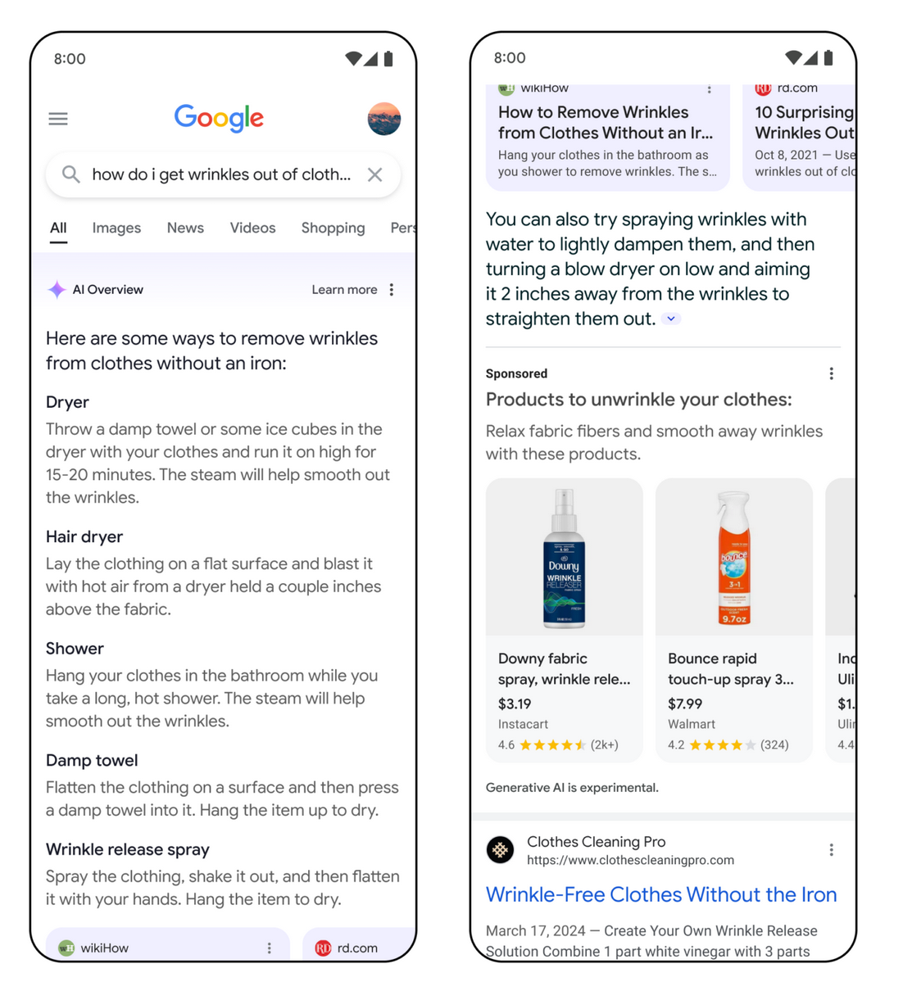
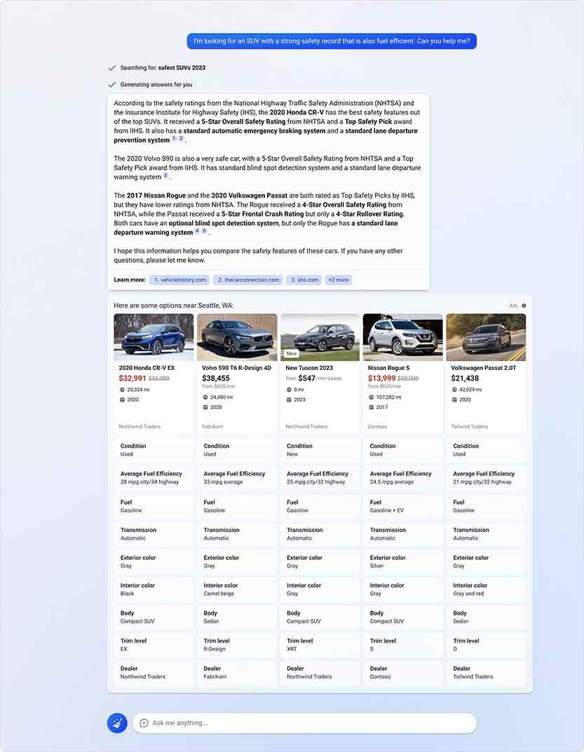
AI answers come with a price tag in monetized search (1/2)
Appendix – competitive landscape: search engines
Google
Bing
Ads inside AI Overviews (text, Shopping, local, app ads)^{1,2}
New AI Overview ad formats & performance measurement³
AI Max monetizes “net-new queries” surfaced by AI⁴
Global rollout of ads in AI Overviews by end of 2025⁵
Search ads on generative AI experiences (Copilot)⁶
New Compare & Decide ads inside chat⁷
Higher conversion intent in AI journeys: 76% higher than traditional search surfaces⁸
Bing turns AI answers into shoppable, comparison-style ad canvases with higher conversion rates
Google AI answers carry ads and shopping links
Search platforms are embedding ads and commerce directly into AI summaries
Sources: (1) Google, (2) SEO, (3) Groas, (4) Search Engine Land, (5) Search Engine Land, (6) Microsoft, (7) Adweek, (8) Bing, (9) Brave, (10) Brave Blog, (11) Brave , (12) Support Brave, (13) DuckDuckGo, (14) Vizologi, (15) Perplexity, (16) Perplexity pricing, (17) Reuters

Slide 61



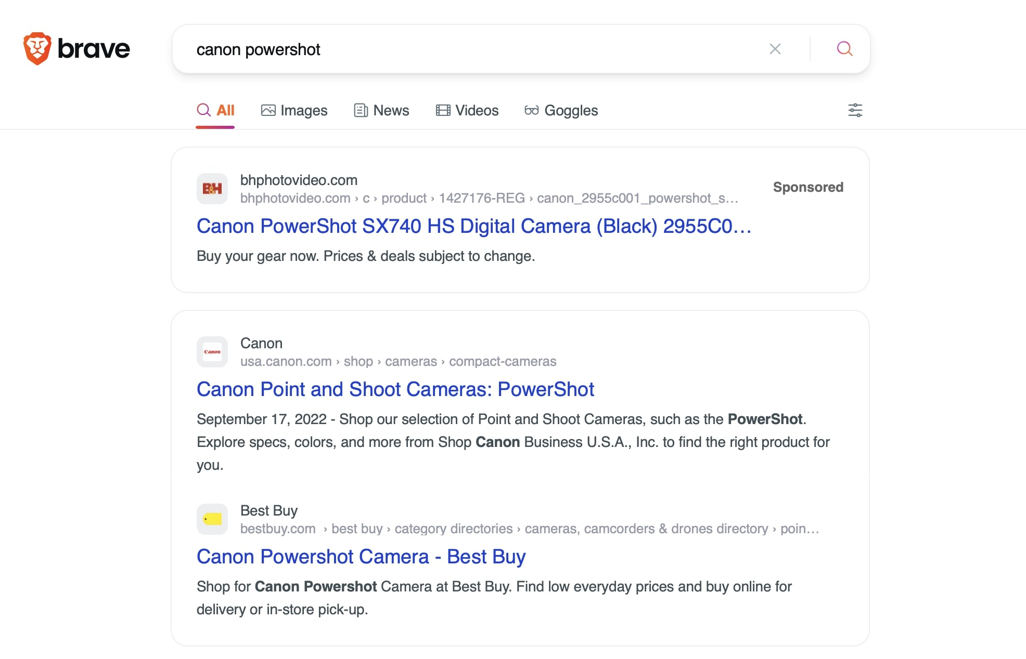
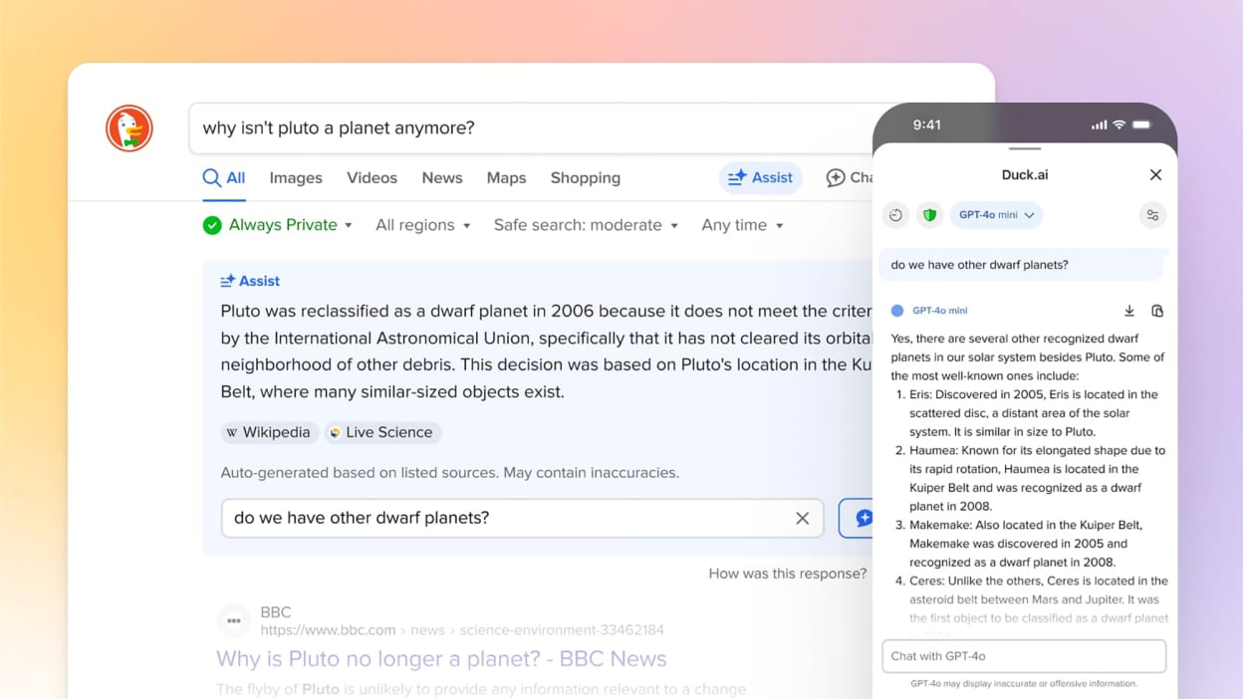
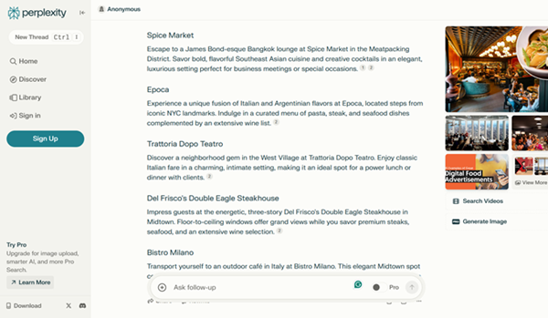
AI answers come with a price tag in monetized search (2/2)
Appendix – competitive landscape: search engines
Brave
DuckDuckGo
Perplexity
Ask Brave/Answer with AI: AI results with rich elements^{9, 10}
Search ads on Brave Search¹¹
Dual model: ad-supported and subscription-based; users can pay for Premium to remove ads¹²
Contextual ads and subscriptions: private, keyword-based ads and Privacy Pro subs¹³
New Compare & Decide ads inside chat¹⁴
Subscriptions & enterprise pricing¹⁶
AI commerce: integrated PayPal checkout directly inside Perplexity’s chat interface¹⁷
Brave monetizes AI answers via classic search ads with an optional paid, ad-free AI search
DDG monetizes AI answers with contextual ads and affiliate product links, while still pitching privacy
Perplexity links AI answers to direct commerce and subscriptions instead of classic search ads
Across AI-native and privacy-led platforms, AI answers are monetized through ads, subscriptions, and commerce
Sources: (1) Google, (2) SEO, (3) Groas, (4) Search Engine Land, (5) Search Engine Land, (6) Microsoft, (7) Adweek, (8) Bing, (9) Brave, (10) Brave Blog, (11) Brave , (12) Support Brave, (13) DuckDuckGo, (14) Vizologi, (15) Perplexity, (16) Perplexity pricing, (17) Reuters

Slide 62







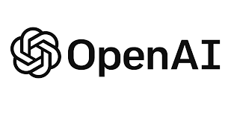

How major search players are adapting, compared with native AI players
Appendix – competitive landscape: search engines
 |  | Traditional Search Players |  |  |  |  |  | Native AI Players
 |  |  | Bing | Yandex | Yahoo | DuckDuckGo | Opera | Perplexity | OpenAI | Claude
AI Integration | How deeply AI is embedded into the search experience | ✔ | ✔ | ✔ | 🗶 | 🗶 | ✔ | ✔ | ✔ | ✔
AI Answer Engine | Whether they offer conversational, synthesized answers | ✔ | ✔ | 🗶 | 🗶 | 🗶 | ✔ | ✔ | ✔ | ✔
Search Index Ownership | Do they own their own index or rely on another provider | ✔ | ✔ | ✔ | 🗶 | ✔ | 🗶 | 🗶 | 🗶 | 🗶
Personalization & Context | Use of user context, history, or device signals | ✔ | ✔ | ✔ | 🗶 | 🗶 | 🗶 | 🗶 | 🗶 | 🗶
Browser / OS Integration | Where the search/AI is embedded | ✔ | ✔ | 🗶 | 🗶 | 🗶 | ✔ | 🗶 | 🗶 | 🗶
Developer Ecosystem | APIs, plugins, extensions, and agent frameworks | ✔ | ✔ | 🗶 | 🗶 | 🗶 | 🗶 | ✔ | ✔ | ✔
Search engines are absorbing AI faster than AI players are absorbing search, as search is an ecosystem that can be added on to compared to AI-only which is a feature
Sources: (1) Google and Google, (2) Bing and Bing, (3) Yandex and Yandex, (4) Tech Crunch, (5) Beebom and Techcrunch, (6) OpenAI

Slide 63
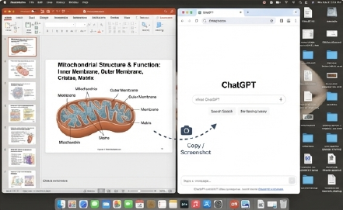
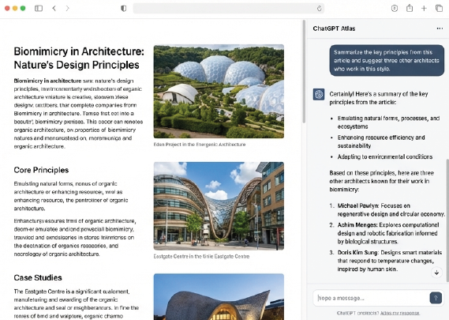
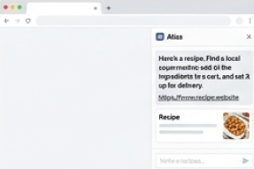
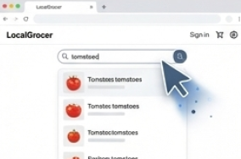
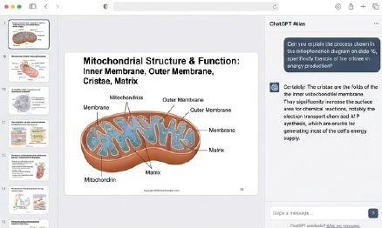
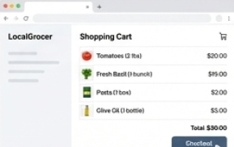
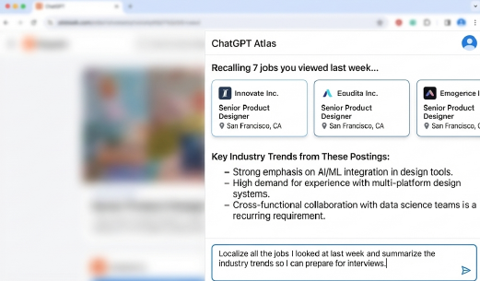
Atlas adds ChatGPT to the browser, understands context, and completes tasks with no switching or copy-pasting
Appendix – ChatGPT/Atlas
High-level App Overview^{1,2,3,4}
AI assistance on any webpage
“Browser Memory”
Optionally recalls past sites to help with new, related tasks
Organization via Agent Mode
For instance: ask for a recipe, locate a nearby supermarket, add the ingredients to the cart, and schedule delivery.
Atlas is emerging as the first AI browser with sufficient reach to challenge Google’s dominance, forcing other AI players to respond or risk losing the internet's interface layer
Sources: (1) OpenAI, Open AI, (2) EfficientApp, (3) The Guardian, (4) APNews

Slide 64

The key difference between traditional browsers and ChatGPT Atlas is Agent Mode, which can complete multi-step workflows
Appendix – ChatGPT/Atlas
Feature^{1,2,3,4} | ChatGPT Atlas | Firefox
Core | AI-powered “super-assistant” that aims to complete tasks | Traditional web browser focused on user control, privacy, and an open-source model
AI Integration | Deeply integrated; the AI can read, summarize, act on content, fill forms, and automate tasks in real time with Agent Mode | AI is a secondary feature, primarily available via add-ons or sidebar chatbots (e.g., Gemini or Perplexity), that access the web page
Browser Engine | Built on the Chromium engine, ensuring compatibility with most Chrome extensions. It was developed with the OpenAI Web Layer (OWL), a new, customized architecture that decouples the UI from Chromium | Uses its own Gecko/Quantum browser engine, making it unique among major non-Apple browsers and an alternative to Google’s dominance
Memory | Builds a persistent “memory” of browsing history and tasks to learn your workflow and provides continuity across sessions | Does not have a built-in AI memory, though it offers features like bookmarking and syncing between devices
Data Privacy | Offers clear privacy controls, including opting out of AI training and incognito mode, however, the AI layer processes page data for synthesis, which may concern some privacy advocates | Known for strong, built-in privacy features like robust ad and fingerprinting blocking, with a development focus on on-device, privacy-preserving AI
Deployment | Only available as a dedicated application for macOS, with Windows and mobile versions planned | Supports web-based deployment and is available across a wide range of platforms (desktop and mobile)
Challenges | Early-stage with limited availability; requires a paid ChatGPT subscription and has unproven user adoption, raising questions around scale, monetization sustainability, and privacy | Lacks native, deeply integrated AI and agent-based workflows; AI remains secondary and fragmented, limiting competitiveness versus AI-native browsers despite strong privacy and cross-platform reach
Atlas introduces agent-based browsing concepts, but remains early-stage, limited in availability, and unproven at scale; traditional browsers offer independence, privacy, and cross‑platform reach
Sources: (1) OpenAI, Open AI, (2) EfficientApp, (3) The Guardian, (4) APNews

Slide 65
Appendix – ChatGPT/Atlas
ChatGPT’s timeline: how conversational AI is being systematically integrated into search and tasks to strengthen its platform position
ChatGPT Weekly Active Users (WAU), 2022-2025^{1–7}
Insights from research
ChatGPT is increasingly used as a research and task-orchestration layer—synthesizing information, coordinating tools, and guiding multi-step workflows rather than answering isolated queries¹⁰
By integrating with third-party tools and services, conversational AI extends monetization beyond the search moment into creation, execution, and transactional flows¹¹
ChatGPT reached ~800M weekly active users by late 2025, achieving the scale required to meaningfully influence search and discovery behavior⁸
Chat-based queries are higher-intent and more contextual than traditional keyword searches, unveiling new monetization formats⁹
2025
ChatGPT user base and traffic growth
Jul 26, 2024
ChatGPT Search (SearchGPT) launched to a limited test group¹²
2026 (expected)
ChatGPT Advertising launch (announced)
Nov 30, 2022
ChatGPT (GPT-3.5) Public Launch
Dec 16, 2024
ChatGPT Search rolled out broadly to users¹³
By expanding use cases beyond search, ChatGPT is positioning itself as a multi-purpose platform increasingly rivaling traditional search engines
Sources: (1) OpenAI 2022, (2) Reuters 2023, (3) Reuters 2024, (4) The Verge 2024, (5) Reuters 2025, (6) CDN 2025, (7) Business Insider 2025, (8) OpenAI 2026, (9) OpenAI, (10) New York Times, (11) OpenAI GPTs, (12) OpenAI SearchGPT Jul 2024, (13) OpenAI Search GPT Oct 2024
65

Slide 66
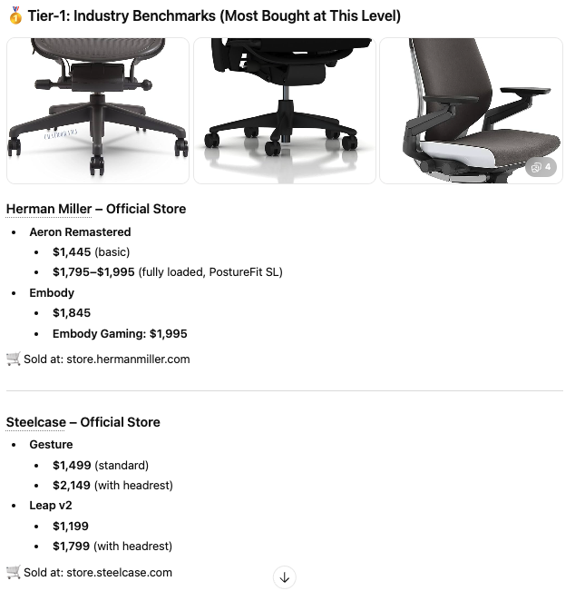
Appendix – ChatGPT/Atlas
The launch of ChatGPT advertising
ChatGPT current results
What we know
Query: "find high-end ergonomic chairs to buy"⁵
Timeline: Gradual rollout is expected to begin in early 2026¹, with focus on Free and Go tiers
Strategic rationale: Sustains free-tier access and affordable Go subscriptions by offsetting high computational costs of advanced AI models⁶
Scale: OpenAI projects $1 billion in ad revenue in 2026, growing to nearly $25 billion by 2029². The platform has ~800 million weekly active users³
Potential formats: Ads will be contextual and integrated, likely appearing as⁴:
Sponsored recommendations woven into responses
Embedded links like traditional search ads
Visual carousels for product queries
OpenAI
AI is shifting the entire digital economy from “monetizing clicks” to “monetizing intent,” and sectors like news, music, and entertainment must adapt accordingly
Sources: (1) Mashable (2)Search Engine Land (3) Almcorp (4) Design Musketeer (5) ChatGPT query on Jan 12th 2026: “find me some high-end ergonomic chairs to buy in the USA”, (6) OpenAI and OpenAI
66

Slide 67
AI adoption at scale remains loss-making, as free and premium users fail to cover compute costs
Appendix – ChatGPT/Atlas
Tier
Free Users
Plus Users ($20)
Pro Users ($200)
Share of Users*
~98.5%
~1.4%
<0.1%
Est. User Count
~788 Million¹
~11 Million¹
~100,000¹
Revenue / User
$0.00²
$20.00²
$200.00²
Est. Cost / User
-$1.50³
-$11.60⁴
-$225.00⁵
Net P&L / User*
-$1.50 (LOSS)
+$8.40 (PROFIT)
-$25.00 (LOSS)
Total Monthly Impact*
-$1.1 Billion Burn
+$92 Million Profit
-$2.5 Million Burn
Cash burn implies tighter free usage limits or higher pricing over time, which may constrain AI tool adoption and keep traditional search as the primary option
* Metrics are calculated based on the estimated user count, revenue / user, and estimated cost / user
Sources: (1) DemandSage, Nerynav and Backlinko, (2) ChatGPT, (3) The Information, (4) Washington Post, (5) SemiAnalysis

Slide 68
The exponential decline in intelligence costs (2024–2026)
Appendix – ChatGPT/Atlas
AI Cost Deflation
5× to 10×
annual increase in performance per dollar for frontier AI models¹
75%
3× per year
speed of "Algorithmic Progress" —making models smarter without even changing the hardware¹
-92%
projected year-over-year decline in the cost of AI compute (Wright’s Law)²
Cost decline per inference of GPT-4-32k compared to GPT-4 Turbo⁴
"We find that the amount of compute needed to reach a set performance level on LLMs has been halving every 8 months... a rate significantly faster than Moore’s Law.”³
“The cost to use a given level of AI falls about 10× every 12 months … You can see this in the token cost from GPT-4 in early 2023 to GPT-4o in mid-2024, where the price per token dropped about 150×.”⁵ – Sam Altman, OpenAI CEO
AI quality, performance, and cost are being optimized simultaneously, pushing AI toward commoditization similar to electricity
Sources: (1) Cornell University Arxiv, (2) Ark-Invest, (3) Epoch AI, (4) Ark-Invest report page 28, (5) Business Insider

Slide 69
ChatGPT cost-efficiency simulation: conservative assumptions would turn $1.1bn loss into a $191m gain within 3 years
Appendix – ChatGPT/Atlas
Simulation of ChatGPT P&L based on efficiency gains ($ million)^{1,2}
Simulation assumptions
-$1,092
-$204
$92
$191
Legend:
Cost & efficiency²
3× annual reduction in inference cost (conservative vs. published ranges of 5–10× annual performance improvements)
Efficiency gains driven by algorithmic progress only, no step-change from new hardware generations
Demand & usage³
Constant active user base (800M MAU) – No growth from new users
Flat usage intensity per user – No potential decline in tokens/task from smarter models
Revenue & pricing⁴
Static pricing across tiers (Free / Plus / Pro)
No advertising or other potential revenue included
Pro users ($200/mo)
Plus users ($20/mo)
Free users ($0/mo)
Base year
Year 1
Year 2
Year 3
Even conservative AI cost-decline assumptions are sufficient to structurally flip ChatGPT’s economics within a few years
Sources: (1) Base year: ChatGPT P&L estimate slide, (2) Efficiency gain assumed at 3x per year (Cornell University Arxiv), (3) DemandSage, Nerynav and Backlinko, (4) ChatGPT

Slide 70
Chrome’s global user base has reached 3.8 billion in 2025 with 1.7 billion Daily Active Users (DAU)
Appendix – Google Chrome
Global Chrome Users (Billions), 2019-2025^{1,2}
Estimated Chrome DAU (Billions), 2019-2025^{3,4}
Insights from research^{1,2}
Chrome’s user base expanded from 2.7 billion to 3.8 billion users (2019–2025), delivering ~5.7% CAGR despite near-saturation in global browser markets, suggesting sustained growth
The browser has evolved into a strategic interface shaping access to Search, AI Overviews, Gemini, Google Workspace, and future AI-native experiences
Sustained mid-single-digit DAU growth at this scale signals structural usage expansion, not just user-base saturation.
The steady trajectory indicates Chrome is increasingly embedded in daily workflows, particularly in mobile-first and emerging markets
+5,7% CAGR
+5,7% CAGR
Chrome’s daily active user base is growing at +5.7% CAGR, reinforcing its role as a core engagement and distribution platform
Sources: (1) DemandSage (2) Backlinko, (3) DAU modeled using industry-standard engagement assumptions; Chrome does not publicly disclose DAU. (4) CleverTap

Slide 71
Chrome’s growth and daily engagement are concentrated in mobile-first regions
Appendix – Google Chrome
Chrome Regional Market Share (%), 2024-2025^{1,2,3,4}
Insights from research
Europe:
59% Market Share
Strong adoption, but more competition
South America and Asia-Pacific are the primary usage engines. These regions combine high penetration with high daily usage intensity, driven by mobile-first behavior⁵
Mature markets such as Europe and North America remain large in absolute users but exhibit lower incremental DAU growth due to stronger competition and entrenched alternatives⁵
Other regions remain structurally supportive, rather than leading⁴
North America:
53% Market Share
Lower relative adoption vs. global average
Asia:
72% Market Share
Dominant in large,
mobile-heavy populations
South America:
79% Market Share
High adoption, mobile-first
Other regions:
65% Market Share
Oceania:
55% Market Share
Chrome’s future DAU growth is being shaped outside North America. South America and Asia-Pacific now define where engagement,
AI adoption, and monetization will scale fastest.
Sources: (1) VenueLabs (2) Cropink (3) SciTech (4) All in One (5) DemandSage

Slide 72

AI Max (PMax) is supercharging search campaigns with smarter, automated, and more efficient optimization
Appendix – AI Max
AI Max for Search is an AI-driven optimization layer for Google Search campaigns that improves performance by expanding query matching, adapting creatives, and optimizing landing pages¹
Key Features^{2,3}
Key Benefits^{3,4,5}
Search-Term Matching (Query Expansion): Uses AI to identify relevant queries beyond your keyword list to capture incremental intent
Text Asset Customization (Dynamic Creative): Automatically generates and adapts ad copy from existing assets and landing pages
Final URL Expansion (Landing Page Optimization): Routes users to the most relevant page based on query intent
Controls & Transparency: Advertisers retain control over bids, budgets, match types, and reporting
One-Click Experiments: Enables direct comparison versus standard campaigns
Improved conversions: AI Max can drive ~14% more conversions or conversion value at similar CPA/ROAS. Campaigns previously relying on exact or phrase-match keywords may see uplifts of up to ~27%
Small business advantage and competitiveness: By automating keyword expansion, ad copy generation, and landing-page optimization, AI Max allows smaller advertisers to compete more effectively and capture incremental traffic
Ease of use and efficiency: Reduces the need for manual management, making it easier for teams with limited expertise to maintain high-performing Search campaigns
AI Max increases search revenue by optimizing campaigns to raise auction competition and ad relevance, driving higher CPCs, stronger conversion rates, and increased advertiser spend
Sources: (1) Search Engine Land, (2) Search Engine Land, (3) Google Blog, (4) PPC Juice, (5) Naira Metrics, (6) CMOtech

Slide 73
AI Max (PMax) unifies creative, targeting, and bidding to shift budgets into automated formats
Appendix – AI Max
Features
What AI Max introduces
Impact on Advertisers & Competitors
How the market shifts
Revenue Effects
How it benefits Google
Unified automation across Search, Shopping, YouTube, Display, and Discover
Generative-AI creative assets (images, text, product variations)
AI-driven audience expansion and real-time bidding optimization
Auto-improved landing pages with AI optimization for conversions
Cross-channel attribution and performance modeling powered by Google AI
For advertisers:
Stronger ROI vs. manual campaigns leads to budgets shifts toward AI Max
Reduced creative bottlenecks and faster campaign launch cycles
More conversions from the same spend due to better targeting + creatives
For competitors:
PMax centralizes more ad spend inside Google’s ecosystem and raises the barrier to compete with Google
However, as Google reduces transparency through Pmax, it pushes advertisers to diversify toward other platforms
More creative players (Meta and TikTok) dominate creative‑led performance
CPC may rise because Google’s AI is willing to pay more for inventory that converts
Blends Search, YouTube, Display, Maps, Discover, and Gmail into one unified supply pool - increasing Google’s total monetizable inventory
Increases advertiser lock‑in through opacity as switching costs rise
Higher operational efficiency, more scalable ad delivery, and stronger yield optimization across all surfaces
PMax drives higher revenue for Google as it expands usable inventory, locks advertisers deeper into Google’s ecosystem, and gives Google full control over yield optimization across all surfaces
Sources: (1) Google Support, (2) Google Marketing Live 2024, (3) Alphabet IR

Slide 74
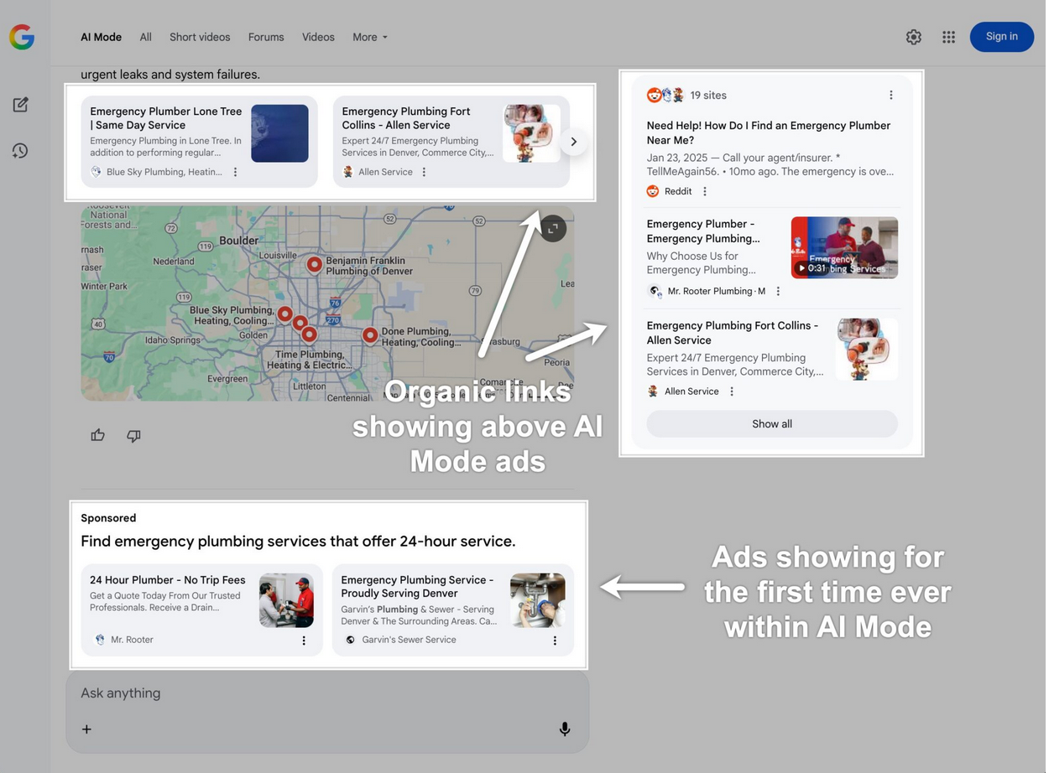
Google’s AI integrations span the full search stack, expanding query volume, engagement, and monetization surfaces
Appendix – Google AI strategy
Google AI Overviews and AI Mode are increasing query volume
AI Max unlocks net new queries and monetization¹
Monetization is also integrated into AI Mode
“In the Q2 call, we shared that overall and commercial queries continued to grow year-over-year. This growth rate increased in Q3, largely driven by our AI investments in Search, most notably AI Overviews and AI Mode”¹
Q2 2025: AI Mode was rolled out globally across 40 languages and now has over 75 million daily active users¹
“In Q3 alone, AI Max unlocked billions of net new queries. It helps advertisers discover new customers at the exact moment they need their product or service”
Google client case: after turning on AI Max in Search, conversion grew by 12%
Google is integrating ads in AI Mode in late 2025⁸
Ads in AI Overviews mark a pivotal shift in search monetization, one that blends paid content into the core of Google’s AI search experience
Google ad revenue (billions)^{1,6,7}
Growth |  | 10% | 42% | 7% | 6% | 11% | 13%
Google’s AI strategy in search is a coordinated system: AI creates more searches, captures higher-intent moments, and monetizes them directly within the AI experience.
Sources: (1) Alphabet Q3 2025 Earnings Call, (2) Search Engine Land, (3) Companies Market Cap, (4) AI Max image: Google, (5) Ads in AI Mode: TechCrunch, (6) Investing.com, (7) Demand Sage; (8) Search Engine Land

Slide 75








How Gemini 3 in Chrome raises the bar for AI browsers
Appendix – Google AI strategy
The rise of standalone AI browsers
Chrome + Gemini: a structurally advantaged combination
Google’s foundational advantages
A new way to search
Standalone AI browsers aim to replace traditional search with fast, conversational answers and deeply synthesized reasoning from web content
Native multimodal search
Users can search using images, screenshots, and photos, leveraging Google’s powerful Lens technology without leaving the browser
An audience of billions
With 3,83 billion internet users, Chrome is the world’s default browser, meaning new AI features get instant, massive adoption
The key challenges
Atlas acts as an AI research assistant, while Comet delivers conversational results with cited sources and live web data
Real-time camera search on mobile
On mobile devices, Gemini can analyze your live camera feed to identify objects, answer questions, and troubleshoot issues in the real world
The power of an existing ecosystem
Users don’t need to migrate bookmarks, passwords, or extensions. Gemini is also integrated across Android, Workspace, and other Google Apps
Key Players
Deeper reasoning, right in your search bar
An ‘AI Mode’ in Google Search uses Gemini 3 to break down complex questions, find sources, and synthesize clear answers directly in Chrome
OpenAI’s Atlas
AI research assistant
Perplexity’s Comet
Conversational results with live web data
Instant webpage summaries & insights
A core feature of rival AI browsers is now native to Search: users can ask Gemini to summarize a page, list key points, or explain steps
In-House hardware edge: the TPU advantage
Google’s new Tensor Processing Units (TPUs) rivals NVIDIA, enabling efficient, proprietary neural network development without relying in competitors
!
Reports from The Wall Street Journal indicate OpenAI’s leadership declared a “code red” to accelerate development as Google threatens its AI lead
Seamless planning for complex tasks
Gemini can handle multi-step reasoning for planning trips, comparing products, creating recipe timelines, and drafting research outlines
Google has already integrated Gemini deeply into Chrome and it now performs more tasks, more seamlessly, directly inside the browser
Sources: (1)Tomguide (2) Wired (3)Wall Street Journal (4) Forbes

Slide 76




Appendix – Google AI strategy
Search becomes an agent that executes tasks for users, not a list of links
There are three pillars to illustrate progressive control over the full user journey:
Insights from research^{1,4,5}
Google is moving “beyond information to intelligence”. The next frontier is agentic AI, where Search will not just answer users’ questions but actively complete tasks on their behalf
Google is planning to capture research time, not just clicks
Agentic Search enables Google to monetize before the click, instead of the click, and after the decision
Deep Search¹
Goes beyond simple query fan-out to issue hundreds of searches, reason across information, and generate an expert-level, fully cited report in minutes
Search Live
Uses your camera (Project Astra²) to become a real-time learning partner that can see what you see, explain concepts, and offer suggestions
Agentic Capabilities
Integrates Project Mariner³ (Google’s AI agent designed to navigate the web and automate workflows) to save time by purchasing tickets, making reservations, and booking appointments through option analysis and automated form-filling
Search can evolve from a human-driven discovery tool into a machine-driven execution engine, where AI agents act as intermediaries: summarizing information and completing tasks (e.g., booking, buying, researching) without the user visiting a brand’s website
Sources: (1) Google, (2) Project Astra, (3) Project Mariner, (4) Google I/O developer conference, (5) Google AI in Search
76

Slide 77




Appendix – Google AI strategy
AI has shifted from Google’s biggest threat to its biggest growth lever
A calculated game
$265 Billion
Google ad platform revenue (2024)¹
Over two-thirds of this comes from traditional search ads
Deny & Deflect^{1,2,4,7}
Publicly refute plans for chatbot ads to appease users and regulators
Integrate & Monetize⁶
Systematically embed ad formats into high-intent, AI-driven search experiences (AI Overviews, AI Mode)
Expand & Adapt^{8,9}
Leverage AI to increase query volume and to create and strengthen new revenue streams (ads in Gemini, AI Max)
Protect the revenue engine
while reinventing search
With ~75% of Alphabet’s revenue still coming from search advertising, Google is executing a deliberate strategy to defend and expand its core business in the AI era
Google is evolving search monetization beyond traditional links by embedding ads into AI-generated experiences such as AI Mode and AI Overviews
Sources: (1) Uproas and Statista, (2) PPC (3) Search Engine Journal (4) The Verge (5) SEC (6) Search Engine Land (7) Search Engine Land, (8) AdWeek, (9) Verkeer
77

Slide 78





Appendix – Google AI strategy
Google deliberately separates “AI adoption” from “AI monetization” to avoid disrupting its ad business
Google Search Ecosystem
Cannibalization Risk^{2,6}
AI Overviews increase engagement, but in the short term compresses traditional ad clicks, forcing new formats (that will reverse the trend)
The Gemini App (Chatbot)
A standalone conversational AI product. This is the experience Google publicity vows to keep ad-free… for now.
Grew from 450M (July’25) to 650M (Oct ‘25) monthly active users²
AI Overviews (in Search)
AI-generated summaries that appear at the top of traditional search results for certain queries.
AI Mode (in Search)
A more conversational, multi-turn search experience powered by Gemini, designed for complex queries.
-8% to -12%
Paid Search CTR
decline when AI Overviews appear in results⁶
Ads are already live within and below these summaries
Ads are actively being tested and briefed to brands for a scaled rollout
This separation allows Google to scale AI (Gemini) usage without prematurely disrupting its $300B+ ad engine, deploying new AI monetization inside Search^{3,4,5}
Sources: (1) Google Ads Help (2) PPC before that year Gemini was a beta version called BARD and without MAU disclosure, (3) Search Engine Journal (4) The Verge (5) Search Engine Land (6) Adthena
78

Slide 79
Appendix – Google AI strategy
Increased AI features are leading to increased searches and reduced clicks
More searching, less clicking
The impression-click paradox¹
+10%
Increase in query volume for searches that show AI Overviews^{3,5}
15%
+49%
8%
Total search impressions have skyrocketed since AI Overviews launched¹
CLICKS
SERP without AI⁴
SERP with AI⁴
IMPRESSIONS
-30%*
Organic click-through rates have declined sharply in the same period*^{1,2}
“We are also seeing that our AI features cause users to search more as they learn that Search can meet more of their needs.”⁶
- Sundar Pichai, Google
According to Google, many users get the information they need from Google’s AI results without ever leaving Google’s platform. This accelerates the trend of “zero-click searches,” particularly for informational searches
AI Overviews reduce clicks while expanding search overall, as sessions become shorter but more frequent – creating more total searches
*Including informational queries
Sources: (1) BrightEdge (2) Gettheclicks (3) Search Engine Journal (4) Pew Research (5) Google Q2 Earnings
79

Slide 80
Appendix – Google AI strategy
Google's long-term timeline of systematic AI integration
Google starts using machine learning at scale in Search
Google applies deep neural networks to speech recognition
RankBrain deployed in Search and Ads
TensorFlow released as an open‑source ML framework
Google Photos launched, using AI for images
Bard launch
Google enters the GenAI assistant race
Mar 25: AI Mode search experience introduced
Sep 25: ‘Ads in AI Mode’ launched officially as a capability at Think Week 2025
Dec 25: Adweek reports on 2026 Gemini ad plans, including potential ads in the Gemini app – claim Google denies
2001
2012
2015
2023
Mar-Sep 2025
Dec 2025
Launch of Open AI
2006
2014
2018-2022
2024
Oct 2025
Launch of Google Translate
Google acquires DeepMind, cementing a long‑term bet on frontier AI research
AI-first deployment
Google leans into “AI‑first” branding, infusing ML into Maps, Photos, Assistant, Ads optimization, and cloud services
Feb 24: Bard rebranded as Gemini; Pro subscription tier launched
Oct 24: Initial tests of ads within AI Overviews begin for U.S. mobile users
Oct 25:Gemini MAUs hit 650M; AI Mode DAUs exceed 75M
Nov 25: Ads Advisor & Analytics Advisor tools (powered by Gemini) roll out
Google has been building its AI capabilities for two decades, showing a deliberate march toward making AI the core engine of its products and monetization strategy
Sources: (1) Google Ads Help (2) PPC (3) Search Engine Journal (4) The Verge (5) Search Engine Land (6) Adthena
80

Slide 81
Appendix – Google AI strategy
Google’s AI value chain powers a monetization ecosystem generating billions in revenue
Build AI infrastructure
Develop frontier models
Integrate AI into core products
Sell AI infrastructure & tools
Deploy AI agents & enterprise solutions
Capture ecosystem revenue
Google invests heavily in custom AI chips (TPUs) and hyperscale data centers optimized for training and inference¹
Google DeepMind and Google Brain produce frontier models (Gemini family) that power Search, Workspace, Android, and Cloud¹
Google embeds AI into its highest-traffic products²:
Search: AI Overviews
Workspace: Gemini for Docs, Gmail, Sheets
Android & Chrome: on‑device and cloud‑based AI features
Google Cloud sells:
AI compute (TPUs, GPUs)
Gemini models
AI agents
Data platforms
Google Cloud revenue: $13.6B in Q2 2025²
Google sells autonomous AI agents for:
Customer service
Data analysis
Workflow automation
AI agents are a major driver behind Cloud’s 29% YoY revenue growth to $10.3B in Q2 2025³
Google monetizes AI through:
Developer APIs
Third‑party integrations
Android ecosystem
Chrome extensions
YouTube AI tools
Google’s AI value chain spans from custom chips to enterprise AI agents, generating billions in revenue through consumption, subscriptions, and increased ad activity
Sources: (1) The Outpost (2) CNBC (3) Web Pro News
81

Slide 82
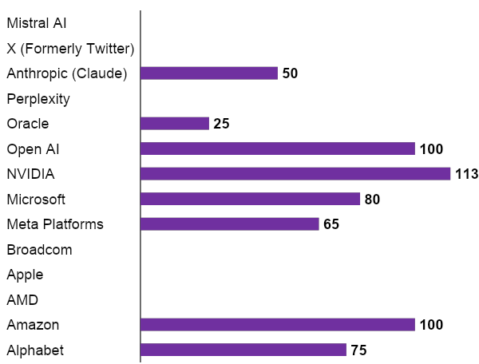
Big Tech has heavily invested in AI infrastructure in the past years and plans to keep investment levels elevated
Appendix – AI future outlook
AI Investments in 2025/26 from Big Tech, Leading AI Firms and Chipmakers (USD Billions)^{1,2,8,9,10}
Insights from research
Not reported
“Meta, Amazon, Alphabet, and Microsoft are expected to spend a combined $350 billion this year, and Goldman Sachs estimates global AI-related infrastructure spending could reach $4 trillion by 2030”³
“Big Tech is on pace to spend more than $500 billion on AI infrastructure in 2026 – a 34% jump that signals the next phase of the supercycle”⁴
However, the business case for AI remains untested, and it is unclear whether the revenue from AI products will justify the ever-growing spending⁴
Profitability remains uncertain and uneven: Despite increased investments, current cash flows cover only about half of required investments, signaling mounting financial pressure and bubble-like conditions⁷
Risk of correction is rising: Analysts warn the AI boom shows classic bubble indicators like heavy debt-financed CAPEX, unclear monetization, and overly optimistic revenue expectations, raising the likelihood of an investment slowdown or consolidation if returns fail to materialize⁶
Not reported
Not reported
Not reported
Not reported
Not reported
AI has transitioned to a fundamental utility, requiring industrial-scale physical assets to sustain growth, while returns remain unproven
Sources: (1) The Economic Times for, Microsoft, Meta, Amazon and Alphabet; (2) Statista – Nvidia’s R&D budget and CNBC – investment in OpenAI]; (3) Reuters] [4) Investorplace] , (5) Business Insider, (6) The Guardian , (7) WSJ and WSJ, (8) Open AI, (9) Anthropic, (10) Digwatch, (11) Spyglass

Slide 83
The AI landscape is shifting from experimentation to industrialization
Appendix – AI future outlook
Hype cycle for Artificial Intelligence²
Insights from research^{1, 2}
Market is moving beyond GenAI hype, with investment shifting toward core AI‑enabling capabilities that ensure scalable, reliable value delivery
Generative AI has entered the Trough of Disillusionment, reflecting a clearer understanding of its limits and driving more pragmatic, grounded implementation
New technologies such as AI Agents and AI‑Native Software Engineering are now at the Peak of Inflated Expectations, pointing to a future where autonomous systems and AI‑driven development transform how businesses operate
AI Agents
AI-Ready Data
New Priorities: Foundational data and autonomous agents are the new focus of heightened interest and investment
Sovereign AI
AI Engineering
Multimodal AI
AI TRiSM
Responsible AI
Composite Al
ModelOps
Artificial General Intelligence
Market Correction: GenAI moves from peak hype to a phase of pragmatic application and disillusionment
FinOps for Al
Neurosymbolic Al
Foundation Models
Decision Intelligence
Synthetic Data
Expectations
World Models
Edge AI
Al Simulation
Embodied Al
Generative AI
Causal Al
Operational Reality: New entrants show a shift in focus toward risk, cost, and scalable management
Al Governance Platforms
First-Principles Al
Pragmatic season
Model Distillation
Quantum Al
Knowledge Graphs
Cloud AI Services
Al-Native Software Engineering
As of June 2025
Innovation Trigger
Peak of inflated
Expectations
Trough of
Disillusionment
Slope of
Enlightenment
Plateau of
Productivity
Time
Plateau will be reached:
<2 yrs.
2 – 5 yrs.
5 – 10 yrs.
>10 yrs.
Obsolete before plateau
The 2025 hype cycle points to a maturing AI market where expectations reset, investment becomes more disciplined, and long-term value depends on scalable foundations rather than pure model hype
Sources: (1) Sequoia Capital, (2) Gartner

Slide 84
AI is showing classic bubble signs driven by overheated expectations and capital
Appendix – AI future outlook
Why the AI market is a bubble…
…but the underlying tech remains real and durable…
We will likely see in the next 2-5 years
Massive overinvestment relative to revenue (founders, VCs, cloud capex)
Extreme expectations (AGI soon/every industry fully disrupted)
Valuations detached from monetization (startups priced before having products)
Crowded vendor landscape with little differentiation
Large losses from hyperscale AI infrastructure not matched by enterprise demand
High customer churn as many AI tools fail to integrate into workflows
Model quality is improving rapidly (efficiency, multimodality, autonomy)
AI is already embedded into search, productivity tools, dev workflows, CRM, ads, etc.
Infrastructure advances in chips, inference optimization, and edge computing are compounding
Enterprise adoption continues, but at a slower and more rational pace
Productivity gains exist, but are uneven and difficult to measure short-term
Market correction: consolidation, shutdowns, repricing of many AI startups
Survival of a few strong platforms (OpenAI, Anthropic, Google, Meta)
Vendors shift from “frontier hype” to “workflow and ROI-based AI”
AI becomes a feature of products, not a standalone category
Chip supply stabilizes and margins improve leading to more efficient inference
Regulation and safety frameworks mature
…and this happens because
AI already solves real problems at scale
Current proven use cases are real-world (fraud detection in finance, automated customer support, code generation boosting developer productivity, logistics automation)
AI is becoming embedded into workflows
AI is no longer a standalone product, it is being integrated into operating systems, browsers, productivity suites, CRM, e-commerce, and marketing tools
Strategic upside is significant
AI unlocks new revenue streams and markets, and even if the business case is unproven, the option value is significant
AI players are overestimating applications and impact today, but the market will likely rebalance into a more sustainable structure
Sources: (1) Sequoia Capital, (2) Gartner

Slide 85
Some AI players are on track to reach profitability faster than OpenAI
Appendix – AI future outlook
Projected free cash flow for OpenAI and Anthropic, 2025-20301
…but the underlying tech remains real and durable…
Anthropic edges ahead: Anthropic has released new financial projections that estimate $70 billion in revenue by 2028, supported by increasing enterprise demand and major partnerships across the technology and consulting sectors²
OpenAI’s escalating losses: OpenAI is expected to accrue about $143 billion in negative cumulative free cash flow between 2024 and 2029 before it starts turning a profit³
2025 (p)
2026 (p)
2027 (p)
2028 (p)
2029 (p)
2030 (p)
Anthropic is one of the only AI players projecting positive cash flow by 2028, positioning it as the most financially disciplined and sustainability‑oriented player in the AI market
Sources: (1) Wall Street Journal, (2) Techcrunch, (3) eMarketer (via Deutsche Bank )

Slide 86



AI investment timeline from near-term wins to long-term transformation
Appendix – AI future outlook
Priority Matrix
Insights from research
The matrix shows an AI landscape dominated by high or transformational benefit, with a clear pivot from GenAI focus to the foundational enablers that support sustainable delivery at scale
Now the real work begins: success is no longer about experimentation but about systematic, disciplined execution
As foundation models become more accessible, true differentiation comes from your proprietary data, robust governance frameworks, efficient financial operations (FinOps), and disciplined AI engineering
The next wave of value will come from AI platforms that can autonomously plan and execute complex tasks, reshaping workflows and job roles
Neuro Symbolic AI
Self-supervised Learning
Transformational
Generative AI
AI-Ready Data
First-principles AI
Multimodal AI
AI TRiSM
AI Simulation
AI Governance Platforms
FinOps for AI
Federated Learning
High
AI Engineering
World Models
Digital Twins of the Organization
Foundation Models
Artificial General Intelligence
Edge AI
ModelOps
Synthetic Data
Quantum AI
Composite AI
First-principles AI
Moderate
Neuromorphic Computing
Responsible AI
Smart Robots
Casual AI
Autonomous Systems
Generative Design
Low
Focus now:
0-2 years
Prepare for Next: 2-5 years
Strategic Horizon:
5-10+ years
Less than 2 years
2 to 5 years
5 to 10 years
More than 10 years
Search is being redefined by AI-native systems: from query-based lookup to autonomous task execution, powered by proprietary data and delivered through agentic interfaces like Atlas
Sources: (1) Gartner - Hype Cycle for Artificial Intelligence

Slide 87
The economic move from training to inference
Appendix – AI future outlook
The rise of the AI inference economy¹
Insights from research¹
Inference has overtaken training as AI’s biggest cost center, driving a massive shift in investment, infrastructure design, and competitive strategy across the industry
Efficiency is now the core battleground, with startups, hyperscalers, and chipmakers racing to reduce cost per token, latency, and GPU dependency
Search engines will be forced to optimize inference at scale, because every AI‑generated answer (vs. a traditional link) dramatically increases compute cost per query
New startups are solving the cost problem
"Companies like Impala AI create platforms for results like “13x lower cost per token” on the same unmodified models by running models efficiently within the customer's cloud”
- Impala AI press release
90%
Inference accounts for up to 90% of a Model’s Lifetime Cost
“Inference will be the driving force behind the next wave of innovation.”
- Noam Salinger, CEO, Impala AI
$250Bn +
Efficiency is the new currency of AI success
“Winners will run models most efficiently: lower costs, less latency, better scaling”
- Rachel Brindley, Senior Director, Canalys
Inference market cap by 2030
Inference, not training, is now the real economic engine, cost center, and competitive battleground of AI
Sources: (1) Forbes

Slide 88






World Models are the key to the next big AI leap towards real-world understanding
Appendix – AI future outlook
The Next Frontier¹
Insights from research¹:
What is a world model?
Why world models matter?
The current AI excels at processing text and images, but lacks real-world understanding (physics, time, interactions)
World Models are being developed to overcome AI’s poor performance in spatial reasoning, robotics, and physical intuition
Focus on learning like a human – understanding causality and physics organically by observing simulations and videos, similar to learning by playing a video game
The impact on searches will be:
From link retrieval to agentic task execution
From query-based to anticipatory
Becoming visual, generative, and immersive
AI Builds an internal “World”
Models create simulations to understand physics, time, and object interactions.
Overcoming AI’s Blind Spots
World Models fix AI limitations by giving AI a mental model of reality, not just text patterns
The Shift from “Book Smart”
to “Street Smart”
Moves AI beyond pattern matching to gain practical, real-world intuition
The Industry is Racing Ahead
Tech giants like Google and xAI have made multi-billion-dollar commitments/investments in this technology
Learning Like a Gamer
AI leans causality and physics from videos, much like humans learn from video games
A Potential Path to AGI
Many leaders see world models as a critical step toward artificial general intelligence (AGI)
World Models fundamentally change what “search” is. Instead of retrieving information,
search becomes simulation, prediction, and action
Sources: (1) Forbes

Slide 89






Appendix – AI future outlook
How AI is expanding search - not replacing
Core thesis: curiosity is boundless
How user behavior is evolving
“Human curiosity is boundless.”
- Elizabeth Reid, Head of Google Search
More queries,
not fewer
Queries are becoming longer and more complex
Search remains anchored in trust
“why is the weather pattern changing in the PNW this year?”
“weather”
Easier questions lead to more questions
It’s a volume game, not a zero-sum game
Total search queries are at an all-time high
Users are moving beyond simple keywords to ask multi-step, conversational questions that explore “why” and “what if” questions
Users want to see sources, confirm information, and dig deeper, often using Google to verify answers
Google's AI-powered response
Implications for the digital ecosystem
Higher quality traffic for publishers
Traffic is more diverse and of higher-quality clicks. Pulishers remain concerned about the overall click reduction
Preserving the monetization model
To maintain revenue, ads are now placed above, below, and inside the new AI Overview sections
Future multimodal and personalized
Search will continue to evolve towards an effortless experience combining voice, text, and visuals, while remaining anchored in trust at its core
AI Overviews
AI-generated summaries reorganize information from across the web
Balancing accuracy and creativity
Following early mistakes, Google prioritizes factuality and only surfaces AI Overviews when they add verified value
AI is driving more search because it makes searching easier, more conversational, and capable of handling complex questions
Sources: (1) Financial Times Article
89

Slide 90
The new consumer journey powered by AI: McKinsey consumer survey on AI-powered search behavior
Appendix – AI future outlook
What the research shows (McKinsey survey)¹
Insights (McKinsey survey)¹
Baby boomers prefer traditional search engines over AI-powered search (45% vs. 31% of sample average)
"GEO performance of industry leaders may lag behind SEO by anywhere from 20 to 50%. Brands that have spent years building a dominant presence in traditional search results may find themselves significantly underrepresented in AI-generated answers”
“Winning in AI-powered search... requires brands to rethink their approach to both digital content and organic search... This needs to address the breadth of content types that AI-powered search answers are built on, including owned content, third-party content, and communities"
of respondents report using AI-powered search tools during early discovery and research,
How consumers use AI-powered search:
73%
Discovery (Awareness)
AI synthesizes category-level information before users visit any brand or publisher
particularly for broad category learning and idea generation
Consideration
AI performs comparison, explanation, and shortlisting tasks traditionally done through multiple site visits
44%
rank AI tools as their preferred source to inform purchasing decisions,
ahead of traditional search engines and retailer or brand sites
Purchase decision
AI summarizes trade-offs and reviews, reducing direct exposure to brand-controlled surfaces
While the McKinsey survey indicates higher AI search usage than the baseline assumed in our model, it confirms a critical shift: consumers are increasingly using AI for discovery and comparison, forcing brands to adapt
Sources: (1) McKinsey article “The new front door to the internet”, based on McKinsey’s AI Discovery Survey, August 2025, n= 1,927

Slide 91
Brand power and traditional SEO leadership no longer guarantee visibility in AI-driven search
Appendix – AI future outlook
The change in brand visibility
Insights from research
The SEO rank #1 on a results page, focusing on keywords, backlinks, technical site structure, and the result is a list of links for the user to research. While GEO delivers a synthesized, authoritative answer that often bypasses information presented on the company websites, drawing from multiple sources (reviews, articles, forums)²
Search is shifting from ranking links (SEO) to being cited inside AI answers (GEO), meaning visibility will depend less on Google results and more on whether AI models choose your content¹
20-50% gap
Only
16%
of brands track their AI performance¹
AI relies on new content sources
SEO visibility is mature and well‑measured. GEO visibility is emerging, fast‑growing, but inconsistent
GEO has major room to improve in measurement, citation consistency, and AI‑friendly content structure²
A vast majority of companies are not monitoring their visibility in this critical new channel
Over 65% of AI-generated content in CPG and finance comes from publishers and user-generated content, not just brand websites¹
About 75% of the links cited within an AI Overview come from websites that already rank in the top 12 organic positions
Sources: (1) McKinsey (2) Search Engine Land

Slide 92
Optimizing for LLMs goes beyond classic SEO
Appendix – AI future outlook
Optimization type | Answer Engine Optimization^{1,2} | Generative Engine Optimization^{3,4} | Artificial Intelligence Optimization⁵
Optimization scope | Optimize for AI answers | Optimize for LLM output surfaces | Optimize for semantic LLM output surfaces
Structure | Q&A formats | Entity-first architecture | Semantic relevance (embeddings)
Output | Direct answers | Multi-surface visibility | Structured, machine-readable content
Key focus changes:
Optimization adapts to LLMs and reasoning models: Traditional SEO signals (keywords and backlinks alone) are insufficient, as LLMs prioritize semantic relationships, entities, and reasoning over keyword matching⁶
Content is designed for machine interpretation: AI-facing content requires explicit entities, clear intent framing, and question–answer patterns that models can parse and reason over.⁷
Optimization focus shifts from pages to influence surfaces: Success depends on how content is interpreted across AI answers, summaries, citations, and third-party references — not just page rankings⁸
AI optimization becomes a system-level discipline: It combines content architecture, entity strategy, third-party authority signals, and distribution across multiple AI-driven surfaces^{9,10}
Visibility is no longer earned through rankings alone, but through inclusion in AI-generated answers
Notes: (1) Answer Engine Journal, (2) OWDT, (3) Greenbook, (4) Built in, (5) Exposure Ninja, (6) Nielsen Norman, (7) Semrush, (8) BCG, (9) WSJ, (10) Econsultancy

Slide 93
To survive, companies need to learn from the Online News and Music industries
Appendix – Parallels
ONLINE NEWS
MUSIC
AI
2000s
Mostly free
2000s
Piracy, Free MP3
2023
Free ChatGPT, Gemini
2010s
Metered paywalls (limited number of free articles)
2010s
Paid downloads
2025
Free (to gain market share) + Subscription
2020s
Subscription, Free + Ads
10–12M paying ChatGPT subs
Most advanced features across multiple LLM platforms are now paywalled
2015s
Hard Paywalls (most of the content blocked)
2020s
Subscription + Ads
600M+ streaming subs (e.g., Spotify, Apple Music)
Streaming represents 84% of industry revenue and 78% of total listening volume
Future Models
Free (Ads + Dumber models) + Subscription (Harder caps on plans)
69% of top outlets are paywalled (e.g., NYT, WSJ, FT)¹
Studies show that newspapers lost, on average, 17-30%^{4,5} of daily pageviews after introducing paywalls
Study of Spotify paid subscribers faced with another price increase: 19% may cancel, and 4% would definitely cancel⁶
Ad revenue from Spotify Free feeds the royalty pool that pays rights holders^{7,8,9}
Even with efficiency gains, inference stays costly at scale^{10,11,12}
Unlimited or very cheap tiers become unsustainable as usage grows
To protect margins, providers will rely on paywalls, rate limits, tiered plans, or usage-based pricing
Revenue/ free user | ~$0.01 - $0.02 /day¹³ | ~$0.014 / day¹⁴ | $0.00 / day¹⁵
Cost/ free user | $0.00¹³ | $0.005¹⁴ | $0.02 - $0.05¹⁵
When a business becomes expensive to run, the model shifts from free to paid; AI is following the same path, with usage limits and paywalls likely to constrain adoption over time
Sources: (1) Reuters Institute, (2) Exploding Topics, (3) Demandsage and Nerdynav, (4) SSRN, (5) ScienceDirect, (6) YouGov, (7) KosignMusic, (8) Spotify, (9) MusoSoup, (10) Forbes, (11) Nvidia, (12) Cornell University Arvix, (13) New York Times, (14) Music Business Worldwide, (15) Washington Post and The Register

Slide 94
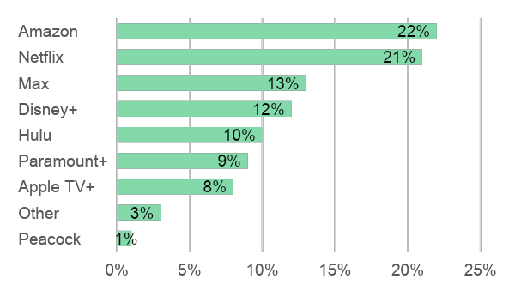




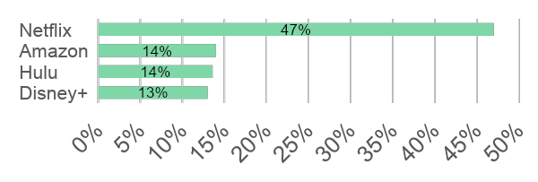


Netflix case: price increases alongside subscription growth
Appendix – Parallels
Netflix increases prices, profits and subscribers
Streaming services market share⁴
“50% of Netflix subscribers who canceled in 2023 rejoined within six months, and 61% did so within a year”¹
Amazon bundle includes Prime shipping
“Despite price increases, Q4-2024 saw a record 19+ million net new paid subscribers^{2”}
“The price increases contributed to higher profitability, with the operating margin climbing to 31.7%—nearly four percentage points higher”³
Americans' preference over other platforms⁴
“The plan [ad-supported] now accounts for more than half of all new Netflix sign-ups in regions where it is available.”⁵
ChatGPT pricing has limits – as Netflix shows, price increases work only when users clearly perceive added value
Sources: (1) Business Insider, (2) Los Angeles Times, (3) EuroNews, (4) DemandSage, (5) Reuters, (6) NscreenMedia

Slide 95
Prime Video goes ad-supported, powering Amazon’s ecosystem and unlocking a major new profit pool
Appendix – Parallels
Key Features
Market & User Impact
Introduced ads in 2024 across all Prime Video users by default
Ad-free experience now requires an extra monthly fee
Integrated first-party shopping data for targeting
Expanded premium ad inventory (e.g., sports, MGM content, originals)
Minimal churn: Prime’s multi-benefit bundle keeps users subscribed
High ad reach: Tens of millions of U.S. households instantly exposed to ads
Advertiser pull: Brands attracted by commerce-linked attribution
Content flywheel: Ad revenue helps fund higher-quality originals and sports rights
Revenue Impact
Sustainability of the Model
$5B–$7B estimated annual ad revenue in mid-term
Improved Prime ARPU without raising core membership fee
Increased ROI for advertisers through closed-loop measurement
Higher engagement leads to more shopping, strengthening overall Prime economics
Amazon has structural advantages (commerce data, low churn, huge user base)
Ads enhance (not cannibalize) the Prime value proposition
Continues Amazon’s strategy of monetizing attention within its ecosystem
Strong long-term runway: global expansion + sports + shoppable video formats
The success of Prime Video’s ad rollout reinforces that the key monetization lever is not pricing, but sustained user attention within trusted, high-engagement environments
Sources: (1) AdTV, (2) Advert on Click, (3) TV Tech, (4) Media Marketing, (5) Subscription Inside, (6) eMarketer

Slide 96
Feedback sessions summary
What we learned
AI adoption remains additive in 2025: based on Google’s Q4’25 results, search revenue grew ~17% YoY (Q4’25 vs. Q4’24), and Google continues testing novel ways to protect revenue through AI¹
“The combination of Traditional Search, AI Overviews, AI Mode, and Gemini App creates an expansionary moment in the type of queries people make. We see it as a growth opportunity, and we haven't seen any evidence of cannibalization.” — Sundar Pichai, Google’s CEO¹
“We have significantly increased our focus on AI Mode monetization, testing ads below the AI response.” — Philipp Schindler, Google’s Chief Business Officer¹
Disruption in search could emerge from agentic AI search² and entirely new search interfaces³ (e.g., AI wearables), though it remains early
AIOs appear ~39% more frequently on desktop for identical keywords⁴. Additional research suggests search results can vary by device and region, supporting differences in click-through rates
What changed (and what didn’t)
Core thesis reinforced: new evidence supports the view that AI search remains additive rather than purely substitutive, and that search engines continue to adapt to protect revenue
Downside refined: Scenario 3 is now more explicitly linked to agentic search (previously mapped in the appendix) and search interface shifts (e.g., wearable AI)
Sources: (1) Alphabet’s Q4 2025 Earnings call, (2) McKinsey, Gartner, Forbes, Search Engine Land, Evergreen Media, (3) AI Certs, Adthena and Forbes, (4), Passionfruit, (5) Press Gazette, The Guardian, Media Leader, Barron’s

Slide 97
What changed & What we learned (1/2)
Topic | What new things we learned | Impact: answers changed or become stronger
Shift toward autonomous search agents | Recent 2026 coverage (Forbes¹, Search Engine Land², Evergreen³) highlights accelerating interest in agentic search Impact remains uncertain; brands are still formalizing measurement frameworks to understand the impact | Incorporated into Scenario 3 to further specify potential disruption drivers Not a near-term risk given early-stage adoption
Interface disruption from desktop/mobile to new interfaces (e.g., AI wearables) | AI wearables prominently featured at CES 2026 Global AI wearable market projected to grow ~14.5% CAGR (2025-2036), from ~$61B to ~$270B | Incorporated into Scenario 3 as a shift in search entry point and intent capture Not a near-term risk given early-stage adoption
Differences in click-through rates and search results across devices and regions | AIOs appear ~39% more frequently on desktop for identical keywords Search results are impacted by device, region, and other factors such as time, user behavior, browser vs app, etc. | Reinforced that CTR declines are steeper on Desktop Confirmed that CTR differences across region and devices are expected
Google’s Q4’25 results | +17% YoY Google Search revenue growth AI Search appears additive rather than cannibalistic, expanding the market Explicit AI monetization focus (testing ads below AI responses) AI enhances Search Ads effectiveness | Reinforces that Google adapts to protect revenue and that AI improves search ads effectiveness 2025 Ad Revenue growth of 11.4% (vs. ~12.7% projected), Search Revenue growth of 13.4%
Google’s 2025 revenue FX impact | Google’s 2025 results reflect primarily organic growth; FX impact was ~0.4% of total revenue and 0.5 p.p. of the 15.2% total growth | No material FX impact, revenue growth remains primarily organic
AI Overviews impact on publishers | Overall decline in Publisher Referral Traffic from Google Search due to AI Overviews: -33% Global (-38% in U.S.) | Confirms pressure on informational publisher traffic Does not alter Google revenue assumptions
AI search budget dynamics | Market leaders plan to allocate ~15% of their digital marketing budgets into AI optimization (AEO/GEO), vs. ~12% industry average in 2025 Early AI-referral performance is promising: 23% decrease in bounce rate, 41% increase in time on site, and 12% increase in page views | Reinforces that AI enhances ad effectiveness Supports assumption of sustained CPC expansion
Sources: (1) Forbes, (2) Search Engine Land, (3) Evergreen Media,

Slide 98
What changed & What we learned (2/2)
Appendix – 2025 Overview: updates from feedback sessions
Topic | What new things we learned | Impact: answers changed or become stronger
Bing and Yahoo growth trends | As of February 2026, Bing has ~3.9% (vs. 3.7 in 2024) of search engine market share, presenting a modest growth YuY Yahoo! ~1.3% (vs. 1.2 in 2024), has been steadily declining in recent years | No change, additional context only

Slide 99




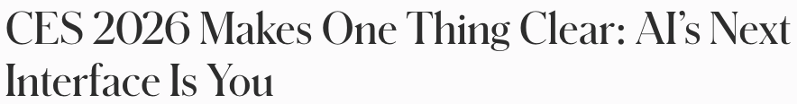

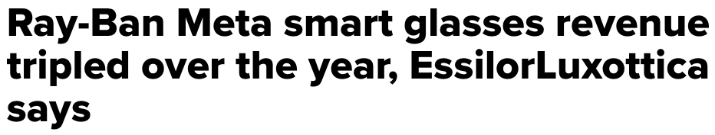
Interface shift: AI wearables as the new entry point for search intent
Appendix – AI future outlook
Some believe wearable AI assistants will significantly impact search
Global AI Wearable Device Market³
"The maturity of AI wearables creates a new default layer for interaction... creating a 'Great Decoupling’, where intent is intercepted at the source before it ever reaches a browser.”¹
14.5% p.a.
“On-device neural engines now run sophisticated generative models locally. Developers are already deploying contextual translation, hands-free search...”⁵
“Wearable AI is becoming the next battleground... the future of assistants will not live just on screens, but on the body, embedded into objects people carry and wear throughout the day”⁶
Global AI Glasses Shipments⁴
+250%
YoY growth in AI glasses shipments (H1 2025)
“Glasses will be the next computing platform, where AI, sensory tech, and a data-rich healthcare infrastructure will converge to empower humans”²
AI wearables introduce a potential shift upstream in search, where some intent is captured before reaching traditional search engines
Sources: (1) Adthena (Jan 2026), (2) CNBC (Jul 2025), (3) Meticulous Research (Feb 2026), (4) Counterpoint (Aug 2025), (5) AI Certs (Dec 2025), (6) Forbes (Jan 2026)

Slide 100



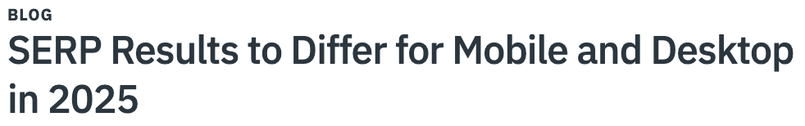

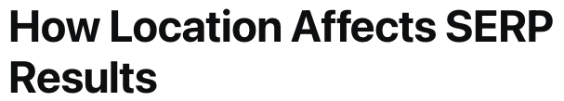

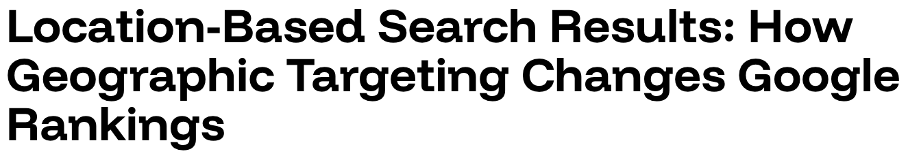
Search results vary across devices and geographic locations, even when logged into the same account and searching for the same query
Appendix – Detailed CTR
Search results vary by device and geography
Drivers of Search Result Customization
“The same Google query on my phone and desktop often shows different results, even when logged into the same account.”¹
User Identity (Who you are)³
Google account data
Account preferences
Behavioral Signals (What you’ve done)⁴
Search and browsing history
Click behavior
Engagement with prior results
Geographic & Language Context (Where you are)⁵
IP-based location
GPS (mobile)
Country and language settings
Device & Technical Context (How you are searching)⁶
Device type (mobile vs desktop)
Browser vs App
Mobile-first indexing
Cookies
Time & Session Context (Current situational factors)⁷
Current query sequence
Time-sensitive trends
Ongoing session behavior
“This change means that users searching for the same query on desktop and mobile devices could see very different outcomes.”⁸
“Even changing from one city to another can alter 50–60% of visible results, even for non-local queries.”²
“Study analyzed a single high-value keyword across all 50 U.S. states and their largest cities, revealing dramatic visibility shifts based on how specific Google’s location signal becomes.”⁹
Search results are influenced by a variety of factors, including device, geography, user identity, behavior, and time and session context
Sources: (1) Google Search Help, (2) SerpiApi, (3) Google Support, (4) Google data in search, (5) Google location, (6) Google Search Central, (7) Google Search Help, (8) Matrix, (9) Go Fish

Slide 101
Google’s Q4’25 Search revenue grew +17%, reinforcing that AI search is additive and monetization remains protected
Appendix – Google’s 2025 results
Google Search Revenue ($ Billions)
Insights from research²
AI is expanding query types. “The combination of Traditional Search, AI Overviews, AI Mode, and Gemini App creates an expansionary moment in the type of queries people do. We see it as a growth opportunity, and we haven't seen any evidence of cannibalization.” — Sundar Pichai, Google’s CEO
AI improves ad effectiveness & monetization. “Gemini models are improving query understanding and driving better query matching, ranking, and quality, making Search Ads even more effective.” — Philipp Schindler, Google’s Chief Business Officer
Google is testing monetization in more AI surfaces. “We have significantly increased our focus on AI Mode monetization, testing ads below the AI response” — Philipp Schindler, Google’s Chief Business Officer
~+10%
~+12%
~+15%
~+17%
Steady acceleration in YoY growth through Q4’25 supports that search monetization is resilient as AI unlocks new query types and improves ad effectiveness
Sources: (1) Alphabet Investor Relations; Q4 2024 YoY growth (vs. Q4 2023): 12.5%, (2) Alphabet’s Q4 2025 Earnings call

Slide 102
Google's 2025 financial results (released Feb 4, 2026) do not materially impact our 2025 TAM projections
Appendix – 2025 Overview: Assumptions review
Key assumptions for Search TAM (Billions) | 2025 Projected | 2025 Actual⁴ | Variance
Google Ad Revenue¹ | $ 298.2 | $ 294.7 | -$3.5 (1.2%)
Google Search Revenue Share of Google Ad Revenue² | 74.9% | 76.2% | 1.3%
Google Search Revenue | $ 223.2 | $ 224.5 | $1.3 (0.6%)
Search Market Revenue³ | $ 249.0 | $ 250.4 | $1.4 (0.6%)
Lower actual Ad Revenue was offset by a higher Google Search share within Ad Revenue, resulting in a $1.4B (0.6%) impact to Search Market Revenue
Sources: (1) 2025 Projected average of Statista1, Statista2, DemandSage and Oberlo, (2) 2025 Projected: Google’s 2024 share from Alphabet IR 2024 results, (3) Google’s Search Revenue divided by Google’s market share, (4) Alphabet IR 2025 results

Slide 103






AI Overviews and direct answers are contributing to declines in publisher traffic and click-through rates globally
Appendix – Detailed AI Overviews
Publishers report declining referral traffic
Decline in Publisher Referral Traffic from Google Search (includes organic searches)¹
“Google’s AI Overviews, as well as the AI Mode tab, have prompted fears of a “Google zero” future where traffic referrals dry up.”²
“Half of all publishers report at least some search traffic decline over the past year. AI overviews are cannibalizing website visits.”³
“The next three or four years will be incredibly challenging for publishers everywhere. No one is immune to the AI summaries storm gathering on the horizon.
Publishers need to build their own shelters or risk being swept away.”⁴
While AI answers create global downward pressure on referrals, the current impact is more pronounced among U.S. publishers
Sources: (1) May differ from other estimates in this material due to the inclusion of organic searches, Press Gazette – percentage change from November 2024 to November 2025, (2) The Guardian, (3) Media Leader, (4) Barron’s

Slide 104
Currency fluctuations did not materially impact Google’s 2025 revenue, as regional FX gains and losses were largely offsetting
Appendix – 2025 Overview: Assumptions review
Google’s Revenue by Geography (Millions) | Year Ended December 31, |  | FX Effect | Constant Currency | % Change from Prior Period
 | 2024 | 2025 |  |  | As reported | Less FX Effect | Constant Currency
United States | $ 170,447 | $ 194,229 | $ 0 | $ 194,229 | 14.0% | 0% | 14.0%
EMEA | $ 102,127 | $ 117,152 | $ 2,755 | $ 114,396 | 14.7% | 2.7% | 12.0%
APAC | $ 56,815 | $ 67,680 | -$ 314 | $ 67,994 | 19.1% | -0.6% | 19.7%
Other Americas | $ 20,418 | $ 23,902 | -$ 834 | $ 24,736 | 17.1% | -4.1% | 21.1%
Revenue, excluding hedging effect | $ 349,807 | $ 402,963 | $ 1,607 | $ 401,356 | 15.2% | 0.5% | 14.7%
Total FX impact on 2025 revenue |  | 0.40%
Impact on Google’s growth rate
Growth was led by the U.S. in absolute terms, while APAC and Other Americas delivered the strongest constant-currency growth rates at 20%+
Sources: (1) Alphabet IR 2025 earnings release, page 10
Note: Alphabet reports Constant Currency growth at the consolidated level. As Google Advertising accounts for ~73% of Alphabet’s total revenue (Alphabet’s 10-K), the consolidated FX impact for FY 2025 is used as a reliable proxy for organic performance

Slide 105
Organizations allocate budget for new AI formats to test, learn and build early capabilities
Appendix – AI future outlook
Organizations testing behavior
Early AI-referral performance
75%
of organizations plan to increase the budget for new AI formats over the next two years (conditional on stabilized performance benchmarks and improved integration)¹
23%
Decrease in bounce rate³
41%
Increase in time on site³
72%
100%
Increase in conversion rate⁶
12%
Increase in page views³
of advertisers now use cross-platform measurement to track the rapid acceleration of agentic AI-driven campaigns²
15%
or above digital marketing budget allocation to AEO/GEO for market leaders in 2026, scaling up from the 12% 2025 industry average^{4,5}
The industry is shifting from experimental testing to high-intent AI-referral traffic that delivers superior user engagement
Sources: (1) BCG, (2) IAB, (3) Marketing Agent, (4) DemandGenReport, (5) Martech, (6) Conductor

Slide 106


Growth remains strong across core markets (13–15% CAGR), while India, Brazil, Japan, and Australia lead in acceleration
Appendix – AI future outlook
Regional market insights
Growth Forecast³
Country | Digital Ads Market ($B) |  | Market share (2024) | CAGR 2025-2030
 | 2024 | 2030
Australia | 12.9 | 35.7 | 2.6% | 18.4%
Japan | 43.2 | 114.5 | 8.8% | 17.5%
Brazil | 14.3 | 34.4 | 2.9% | 15.7%
UK | 40.2 | 95.7 | 8.2% | 15.4%
India | 13.6 | 32.3 | 2.8% | 15.3%
Germany | 32.5 | 75.0 | 6.6% | 14.8%
Canada | 51.6 | 119.2 | 10.5% | 14.8%
Europe | 114.1 | 257.3 | 23.3% | 14.4%
U.S. | 101.5 | 220.0 | 20.8% | 13.6%
France | 10.3 | 21.2 | 2.1% | 12.7%
Media Inflation Forecasts 2025 - 2027
Global Ad Forecast
Advertising intensity (ad spend per capita) reflects local purchasing power and the advertising ecosystem maturity
US: $1,100, Switzerland & UK: $800, Australia: $700, Germany: $500, India: $11
Mature markets show steady inflation: US (+3–4%), UK (+3%), Western Europe (+4–5%)
Emerging markets lead with sharper increases: Eastern Europe (+11%) and India (+9%)
Digital channels (search, social video, retail media) now match global inflation rates (~+4–5%)
Europe shows strong sub-regional contrasts; APAC splits between steady Japan and accelerating India & Hong Kong
Rank | Country | 2025 Market Share
1 | U.S. | 41%
2 | China | 16%
3 | UK | 6%
4 | Japan | 5%
5 | Germany | 4%
6 | France | 2%
7 | Australia | 2%
8 | Canada | 2%
9 | Brazil | 2%
10 | S. Korea | 2%
Regional differences in ad intensity and maturity should inform market-specific investment prioritization
Sources: (1) ISBA, (2) Magna, (3) Grand View Horizon – Country-level digital advertising market projections (hyperlinked within each country name)

Slide 107
AI Impact on Search – use cases by team
Appendix – 2025 Overview: updates from feedback sessions
Team | Use cases
 | 2025 | 2026
Strategic Finance | Heavily informed the LRP | Incorporate search revenue, volume, CTR, and CPC forecasts into LRP
Product Strategy | Integrated assumptions and forecasts into AI partnership and product viability models | Integrate AI impact on search assumptions and scenarios into product viability models and investment gating decisions
Marketing |  | Prioritize regional investment and assess long-term CAC/LTV Identify partnership opportunities where AI shifts distribution dynamics
Revenue |  | Evaluate structural shifts in monetization driven by AI (zero-click, CPC trends, ads in summaries) and their impact on long-term revenue
Business Development |  | Inform partnership strategy and negotiation positioning based on projected scenarios
Firefox Product (Desktop & Mobile) |  | Assess user migration risk toward AI wearables and agentic apps, including implications for mobile and desktop growth
Competition and Regulation | Used to prepare for the Google trials
Sources: (1) Based on feedback from stakeholder reviews; reflects current and projected applications

Slide 108
Bing leverages AI to stabilize market share while Yahoo’s footprint continues to erode
Appendix – competitive landscape: search engines
 | Search Engine Market Share (%)¹
 | Bing | Yahoo!
2016 | 2.79% | 2.62%
2017 | 2.76% | 2.12%
2018 | 2.82% | 2.15%
2019 | 2.44% | 1.83%
2020 | 2.70% | 1.63%
2021 | 2.58% | 1.49%
2022 | 3.19% | 1.36%
2023 | 2.97% | 1.16%
2024 | 3.70% | 1.20%
2025 | 3.88% | 1.32%
Insights from research
Bing is the clear #2 global search engine (~5% share), while Yahoo ranks third (1.4%), having lost approximately two-thirds of its market share over the past decade³
Bing’s growth has been supported by Microsoft’s ecosystem, including Edge as the default browser on Windows and the integration of Microsoft Copilot, which positioned Bing as the first major search engine to integrate generative AI and helped strengthen its U.S. desktop market share³
Yahoo search is powered by Bing, with differentiation mainly through its content-driven homepage (news, weather, personalization) rather than proprietary search technology⁴
Bing-powered search and news advertising revenue is projected to reach ~$19.5B by 2026 (~10% YoY growth)²
Yahoo’s ownership shifted in 2021 when Verizon sold 90% of Yahoo and AOL to Apollo for $5B⁵
AI integration and Windows defaults have turned Bing into a viable challenger, while Yahoo pivots from search engine to content portal
Sources: (1) Search Ensurance, G2, (2) SQ Magazine, (3) Search Endurance, (4) Bloggers Passion, (5) Apollo

Slide 109
AI adoption is accelerating, but primarily enhances performance within existing ad ecosystems
Appendix – 2025 Overview: updates from feedback sessions
Global Market for AI-Driven Advertising Tools & Optimization ($B)¹
Insights from research
AI adoption is embedded within existing ad platforms (e.g., Google, Meta), rather than creating new standalone channels
Primary use cases focus on optimization (targeting, bidding, creative), improving ROI within current channels
Advertiser adoption is driven by performance gains, not a reallocation of budgets across channels
Programmatic and automated buying continue to dominate, with AI enhancing rather than replacing these models
Limited evidence of scaled monetization in AI-native environments (e.g., conversational interfaces)
28.4% p.a.
AI is accelerating performance within existing ad channels, but not materially shifting budget allocation away from incumbent platforms
Sources: (1) market.us, (2) Fluence Inc., (3) SQ Magazine, (4) StackAdopt, (5) Datareportal

Slide 110













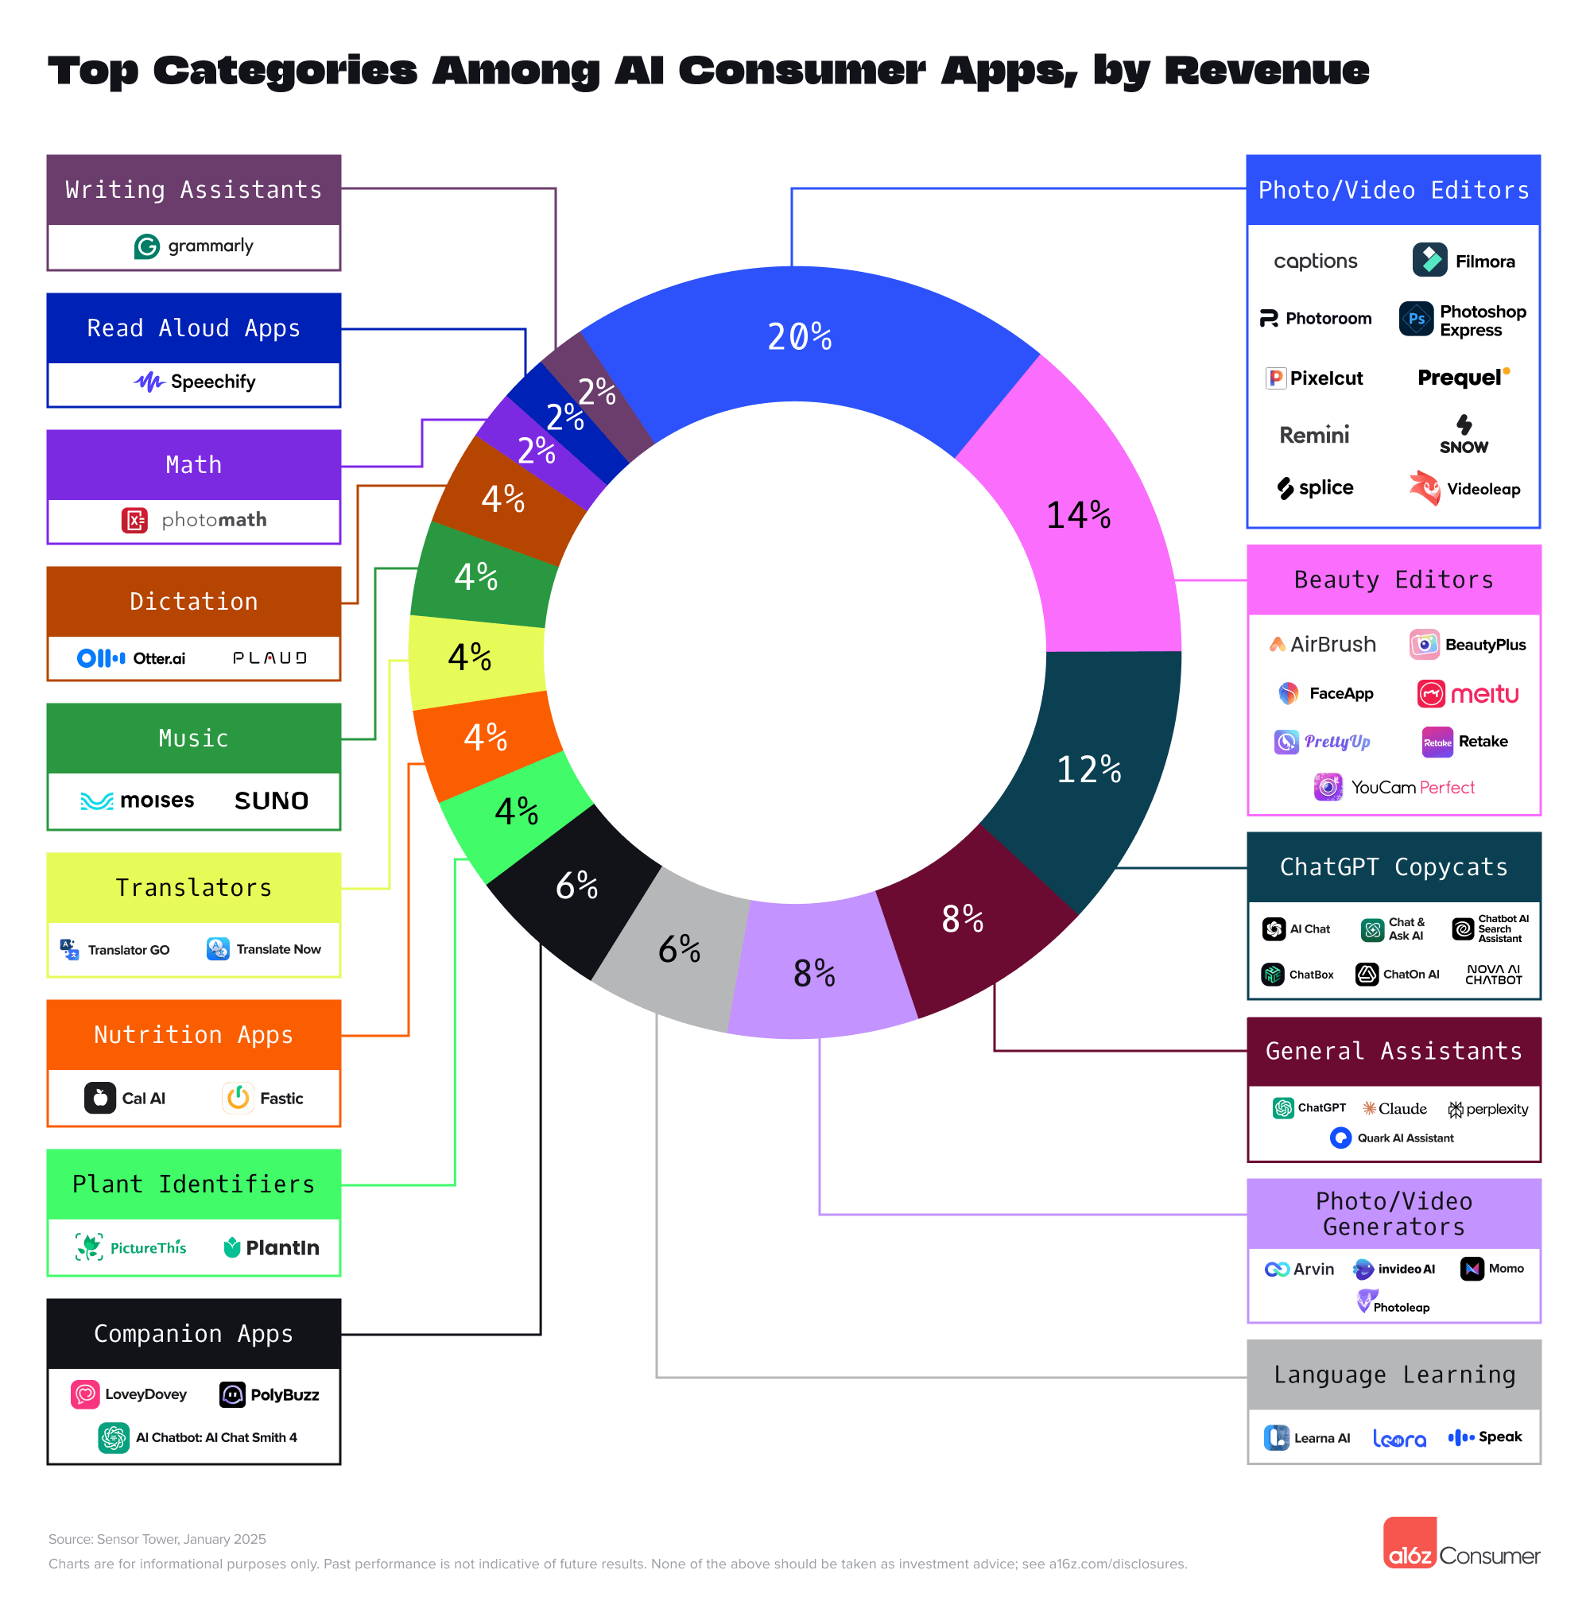
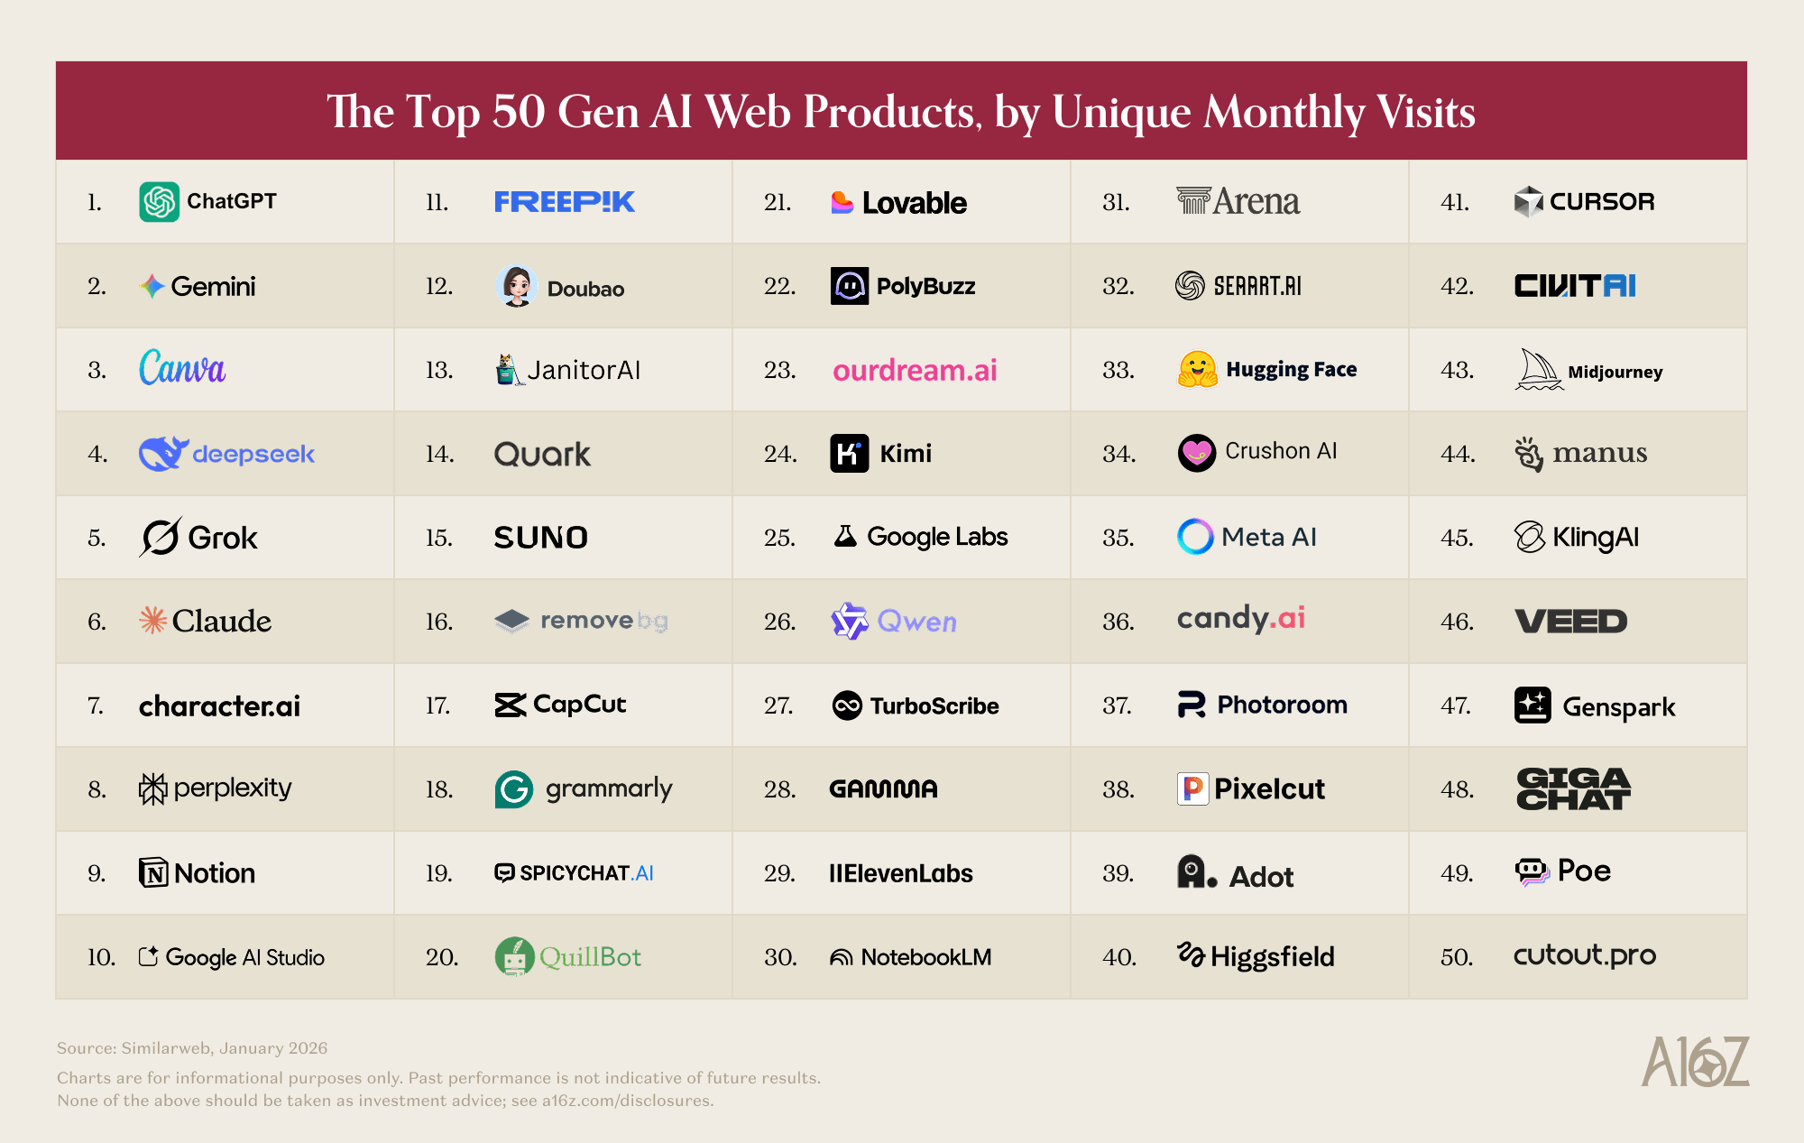


















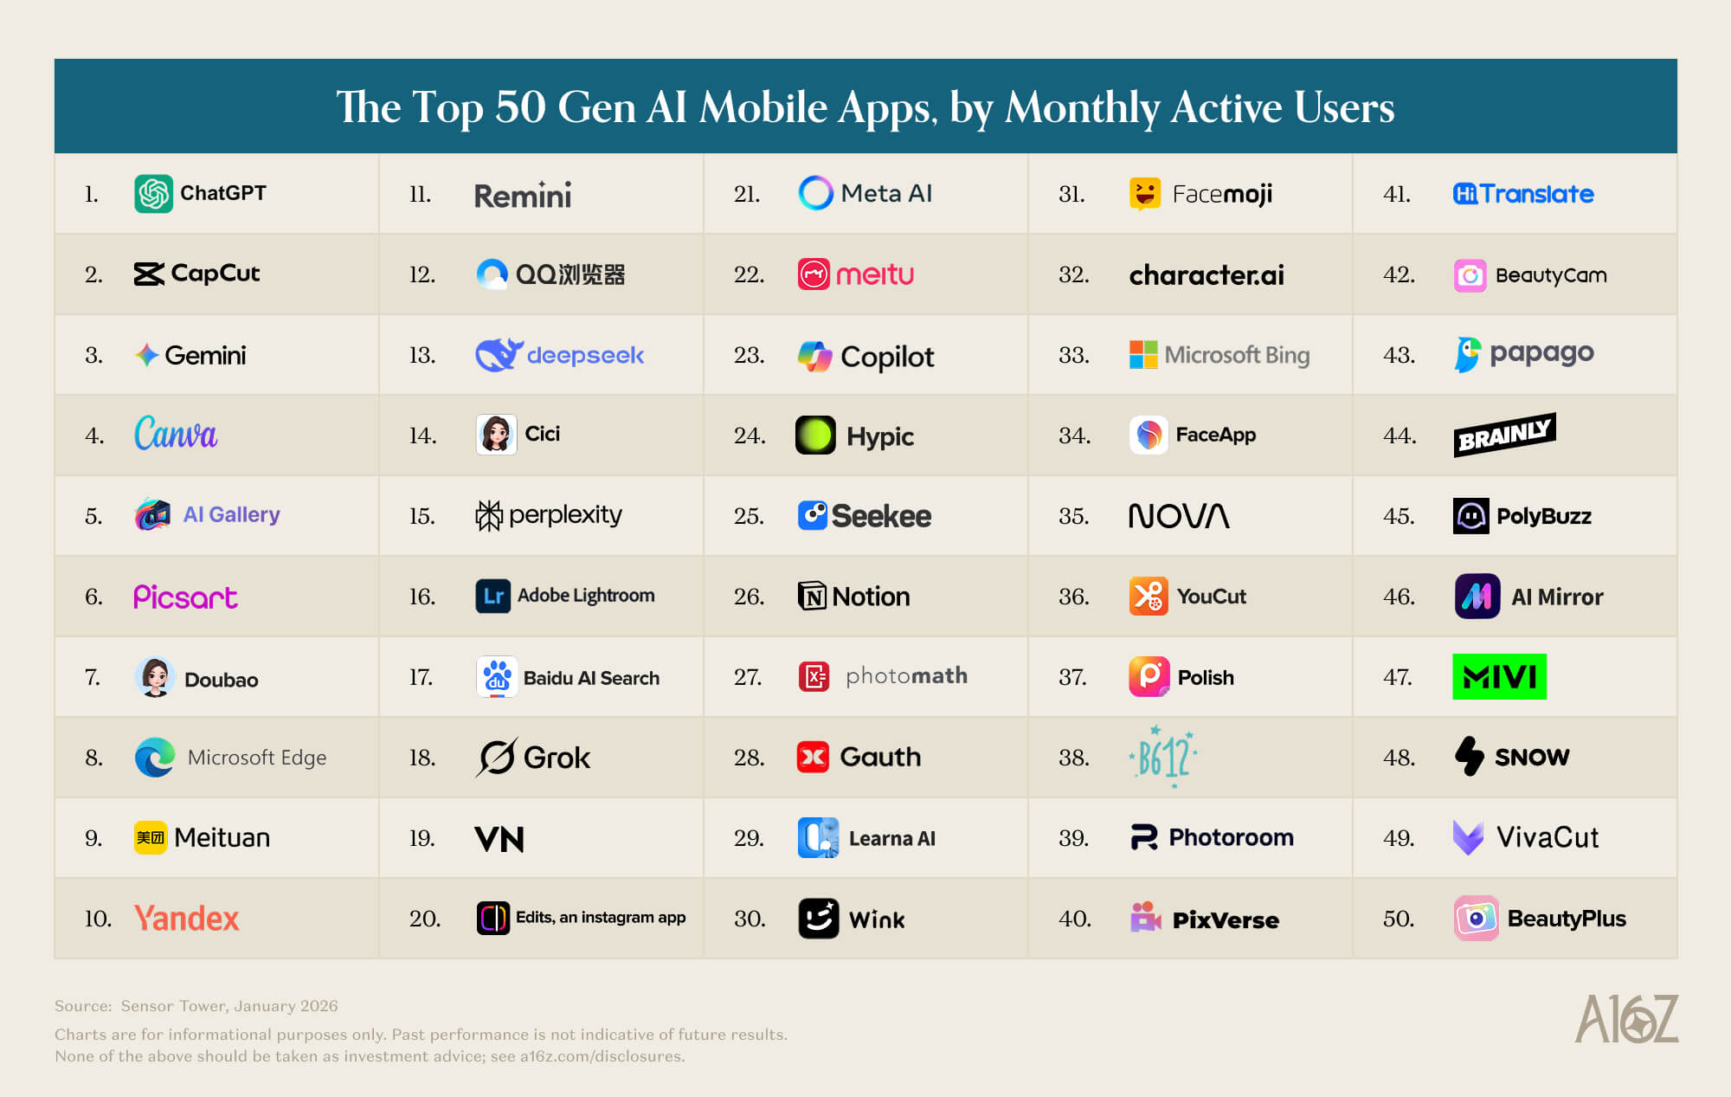
Top AI apps with high commercial value are mainly visual gen & editing; the top 50 list is fluctuating more in mobile apps than web
[Stakeholder feedback session]
Action Items 1
Conduct additional research on integrating AI-driven features into client products (Slide - 1 page)
Provide ideas of how to commercialize them
We have some relevant info from the main deck page 50-60.
Context
To identify the next driver for the future growth of the client
Appendix – 2025 Overview: updates from feedback sessions
1
2025 Top Categories Among AI Consumer Apps, by Revenue
All Time Top 50 AI Web & Consumer Apps, by MAU (2024-2026)
Visual gen & editing – 42%
web
mobile
T1
T1
T2
T2
AI assistants – 20%
T3
T3
T4
T4
T5
T5
Visual gen & editing apps contribute over 40% revenue in this segment
*Chat GPT copycats offer the same premium model at a lower price, but App Stores have taken down those apps
Andreessen Horowitz (a16z) updates the top 50 per half-year; the list remains more fluctuating in mobile apps.
Mar 2026: Web (41 remains), Mobile App (33 remains)
AI visual-gen & editing apps are among the top verticals the client can grow in; AI Assistant can be secondary
SLIDE
Sources: Andreessen Horowitz (1) Aug 2024, (2) Mar 2025, (3) Aug 2025, (4) Mar 2026

Slide 111
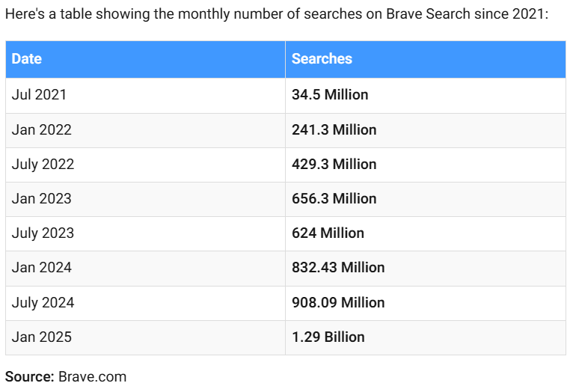
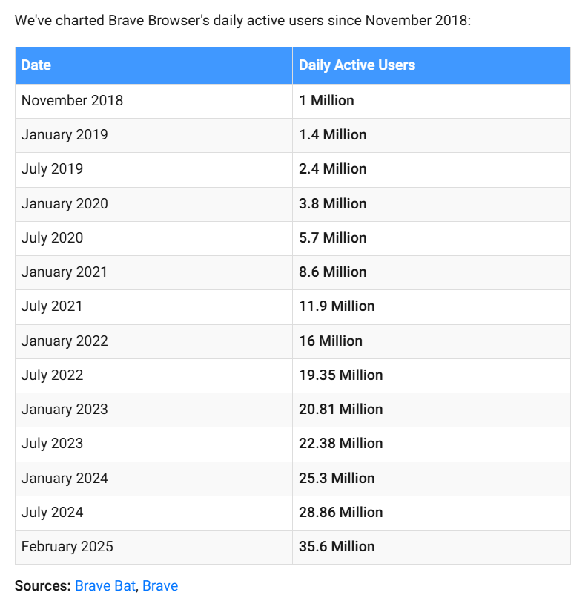
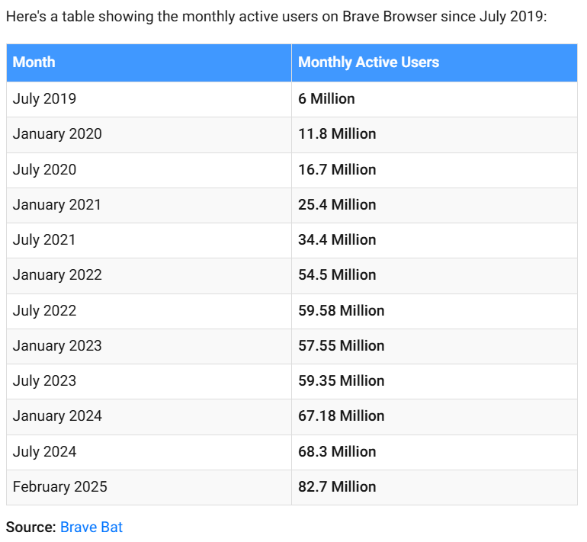
Brave Search outpaced the market and Google’s growth since its first launch in 2021
[Stakeholder feedback session]
Action Items 2
Investigate Brave search engine published query data as a potential data source and evaluate its growth versus Google assumptions (Slide - 1 page)
Emerging players (niche market proxy)
Context
Use this data as an emerging players (niche market proxy)
Appendix – 2025 Overview: updates from feedback sessions
2
Queries Annually (Billion)
Active Users (Million)¹
MAU
DAU
CAGR (‘20 – ‘25)
82.5% p.a.
56.0%
Queries Monthly (Million)¹
48.0%
Although Brave Search's annual queries outpace Google’s CAGR (83% vs. 12%), its share (0.27%⁵) is too small to serve as a proxy for the entire market
SLIDE
Sources: (1) Taptwicedigital.com: Brave Usage, (2) Brave.com, (3) X.com: Brendan Eich, (4) Brave BAT (5) ResourceEra → 15B (Brave annual queries) / 5T (Google Annual queries) / 90% (Google Market Share) = 0.27% (Brave Market Share)

Slide 112
Emerging modalities (e.g., Lens) expand access to search, but continue to funnel into Google’s core monetizable workflows
[Stakeholder feedback session]
Research the breakdown of search activity across traditional search, image search, and other search formats (e.g., voice, visual) (Slide)
Context
Question: Does the analysis take into account multimodal searches? For example, Google has previously shared how quickly image- and voice-based searches are growing. Traditional SERP searches may not be expanding at the same pace, while formats like visual search, such as Google Lens, which now processes around 20 billion visual searches per month, are seeing very strong growth. Does the analysis account for this shift toward image-initiated or multimodal search experiences?
Answer: Our current estimation includes multimodal entry points
Appendix – 2025 Overview: updates from feedback sessions
1
Google Search vs Google Lens Queries (Billion) Per Year
Insights from research
Visual and multimodal queries typically resolve into standard Google results (e.g., Shopping, Maps, SERP), maintaining monetization pathways
Text: Primary search modal; estimated 5.6T queries in 2026, grow at 12% CAGR
Visual: Enabled by Google Lens, estimated 300B¹ queries in 2026 (5.4% share of total queries), grows at ~30% CAGR
Voice: Growing usage (~20% of users), but still routes through search ecosystems with limited standalone monetization
Google Search (text)
Google Lens (visual)
Google Lens Share (%)
Emerging modalities (e.g., Lens) increase search entry points, but largely resolve into SERP-based experiences, reinforcing Google’s monetization model
Sources: (1) AR Insider (annualized), (2) Circle to Search , (3) Data Reportal, (4) Google Multisearch

