Slide 1

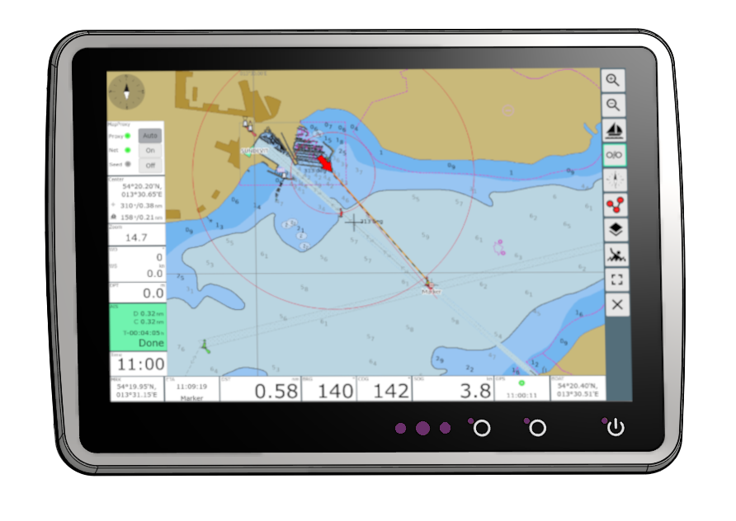
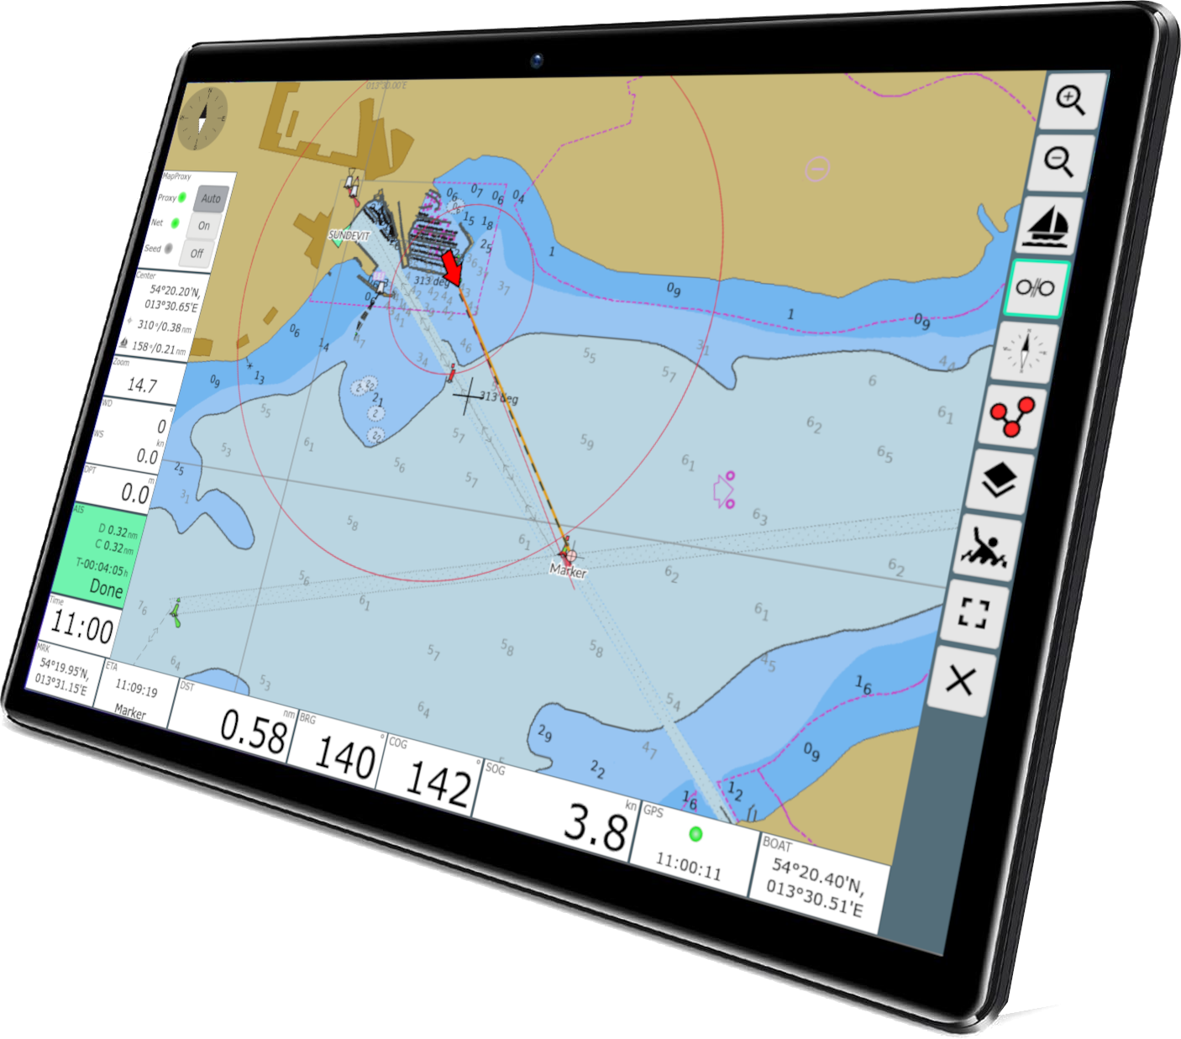
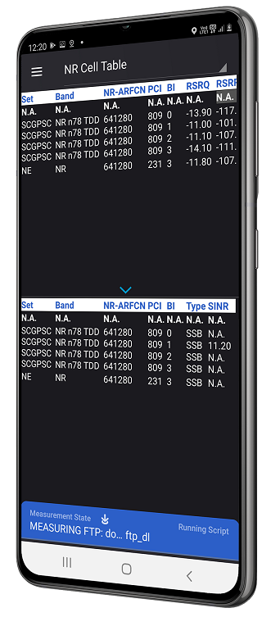
WiFi 2.4/5.0 GHz
OBP-Plotter
Second
Display
Tablet
GPS-Receiver

