Slide 1
Credit One data analytics problem
Julio, 2019

Slide 2
Agenda.
The goal(s).
Data science process framework.
Related data sources.
The data.
Flowchart.

Slide 3
The goal(s).
Reduce the loss of customers of credit rating agency Credit One.
Propose a prediction model of detection of clients that will fall into non-payment.

Slide 4
Data science process framework.
Business Question. Begin with traditional questions about what, who, where, when, why and how to help identify the problem in context.
Analysis Plan. Business problems and questions can be large in scope so narrowing the objectives or breaking it into parts, where each has its own set of analysis goals is important.
Data Collection. The data specification describes the data that will be needed to prove or disprove the hypothesis and support the chosen methodology. It's important to only collect relevant data.
Derive Insights. This step is the execution portion of the process where data meets methodology. Derive insights using machine learning & stattistics.
Recommendations.

Slide 5
Related data sources.
Name | Description.
X1 | Amount of the given credit (NT dollar): it includes both the individual consumer credit and his/her family (supplementary) credit.
X2 | Gender (1 = male; 2 = female).
X3 | Education (1 = graduate school; 2 = university; 3 = high school; 0, 4, 5, 6 = others).
X4 | Marital status (1 = married; 2 = single; 3 = divorce; 0=others).
X5 | Age (year).
X6 - X11 | History of past payment. We tracked the past monthly payment records (from April to September, 2005) as follows: X6 = the repayment status in September, 2005; X7 = the repayment status in August, 2005; . . .;X11 = the repayment status in April, 2005.
The measurement scale for the repayment status is: -2: No consumption; -1: Paid in full; 0: The use of revolving credit; 1 = payment delay for one month; 2 = payment delay for two months; . . .; 8 = payment delay for eight months; 9 = payment delay for nine months and above.

Slide 6
Related data sources (Cont.)
Name | Description.
X12-X17 | Amount of bill statement (NT dollar). X12 = amount of bill statement in September, 2005; X13 = amount of bill statement in August, 2005; . . .; X17 = amount of bill statement in April, 2005.
X18-X23 | Amount of previous payment (NT dollar). X18 = amount paid in September, 2005; X19 = amount paid in August, 2005; . . .;X23 = amount paid in April, 2005.
Y | Client's behavior; Y=0 then not default, Y=1 then default"

Slide 7
The data.
Number of observations.
Variables.
30000.
1 to 12.
Name | Description | Min. | Max. | Type
X1 | LIMIT_BAL | 10000 | 1000000 | Integer
X2 | SEX | 1 | 2 | Integer
X3 | EDUCATION | 0 | 6 | Integer
X4 | MARRIAGE | 0 | 3 | Integer
X5 | AGE | 21 | 79 | Integer
X6 | PAY_0 | -2 | 8 | Integer
Name | Description | Min. | Max. | Type
X7 | PAY_2 | -2 | 8 | Integer
X8 | PAY_3 | -2 | 8 | Integer
X9 | PAY_4 | -2 | 8 | Integer
X10 | PAY_5 | -2 | 8 | Integer
X11 | PAY_6 | -2 | 8 | Integer
X12 | BILL_AMT1 | -165580 | 964511 | Integer

Slide 8
The data (Cont).
Number of observations.
Variables.
30000.
13 to 24.
Name | Description | Min. | Max. | Type
X13 | BILL_AMT2 | -69777 | 983931 | Integer
X14 | BILL_AMT3 | -157264 | 1664089 | Integer
X15 | BILL_AMT4 | -170000 | 891586 | Integer
X16 | BILL_AMT5 | -81334 | 927171 | Integer
X17 | BILL_AMT6 | -339603 | 961664 | Integer
X18 | PAY_AMT1 | 0 | 873552 | Integer
Name | Description | Min. | Max. | Type
X19 | PAY_AMT2 | 0 | 1684259 | Integer
X20 | PAY_AMT3 | 0 | 896040 | Integer
X21 | PAY_AMT4 | 0 | 621000 | Integer
X22 | PAY_AMT5 | 0 | 426529 | Integer
X23 | PAY_AMT6 | 0 | 528666 | Integer
Y | default_payment_next_month | 0 | 1 | Integer

Slide 9
Known issues.
Name | Description. | Decision
X3 | Education (1 = graduate school; 2 = university; 3 = high school; 0, 4, 5, 6 = others). 0 1 2 3 4 5 6 14 10585 14030 4917 123 280 51 | Eliminate the observations marked with red
X4 | Marital status (1 = married; 2 = single; 3 = divorce; 0=others). 0 1 2 3 54 13659 15964 323

Slide 10
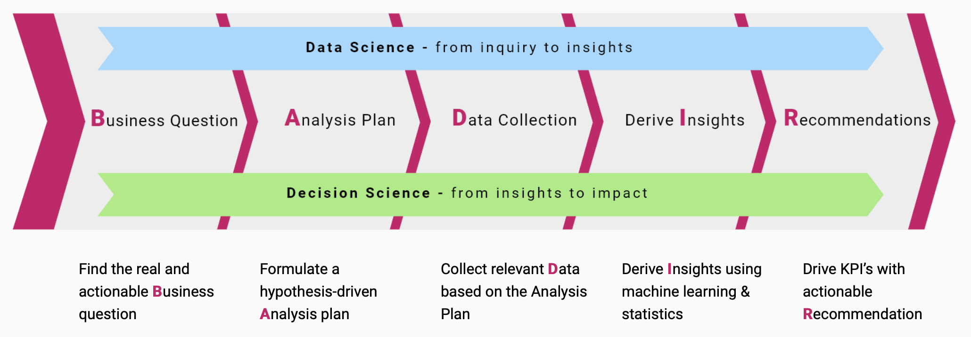
Flowchart.

Slide 11
Initial insights.
Discretize some variables such as, for example:
LIMIT_BAL
AGE
BILL_AMT1 to BILL_AMT6
PAY_AMT1 to PAY_AMT6
Selection of variables using techniques such as:
Correlation
Covariance

Slide 12
Credit One data analytics problem
Julio, 2019

