Slide 1
Graph Search Algorithms
Made by
Norbert Posan
Artificial Intelligence project

Slide 2
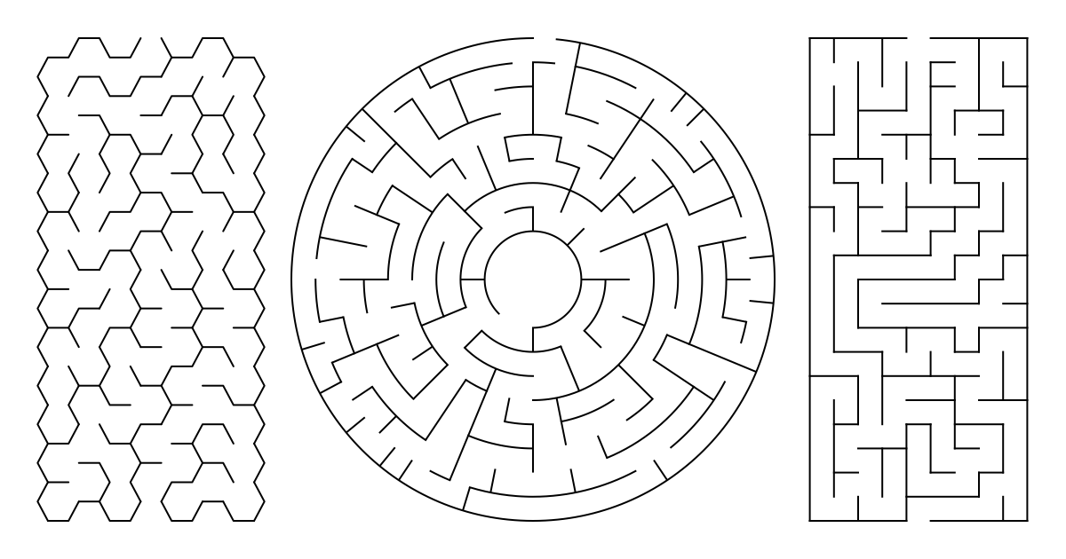
Scope of project
I will create a “Packman” like game to simulate a maze
Will be created one labyrinth and it will be able to generate new one randomly

Slide 3

Scope of project
It will search in the graph and animation will show what is happening in the memory

Slide 4
Scope of project
DFS (depth first search)
BFS (breadth first search)
A*

Slide 5
SUmmary
I will create a “Packman” like game to simulate a maze
The labyrinth will he a Start point and End point
It will able to generate labyrinth by itself randomly
Will animated illustrate different graph search algorithms
Basic statistics about memory and time consuming

Slide 6
Thank you for attention

