Slide 1

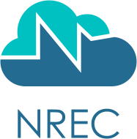


Norwegian Research and Education Cloud
Norwegian Research and Education Cloud
Community Infractructure-as-a-Service (IAAS) for the Norwegian higher education sector since 2016
OpenStack: Self-managed Linux and Windows virtual machines and containers
Ceph: Distributed block and object storage
HPC, AI and DNS infrastructure
Active support team
Servers in Norway
Run by University of Bergen and University of Oslo
What runs in NREC?
1800 private/collaborative projects and 1400 users in research and education (January 2024)
HPC for CERN: NREC is a Tier 1 compute center for ATLAS and ALICE experiments, as part of the Worldwide LHC computing grid. Computing: 35 million CPU hours yearly, 12 PiB (hot/cold) data and 160+ TiB cached job data
Get a demo project now from access.nrec.no with Feide login
Apply for more resources at request.nrec.no

