Slide 1
Connecting Communities with Open Data
Team: norchain
July 23, 2018

Slide 2
BACKGROUND
“Diversity, Our Strength.” - The diversity among its people has strengthened Toronto economy growth.
COMPLICATION
Generic recommendation system
Local businesses are facing challenges from large online businesses.
QUESTION
In the data-driven era, how would local services and businesses gaining exposure to their supporters and being connected with the communities.

Slide 3
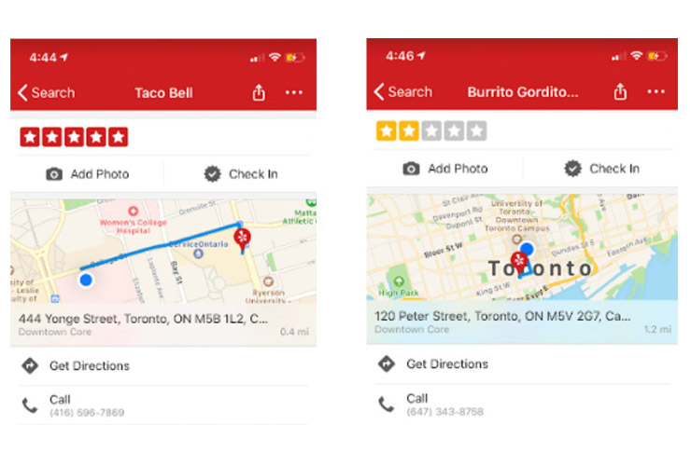
Mexican Friend visits Canada

Slide 4
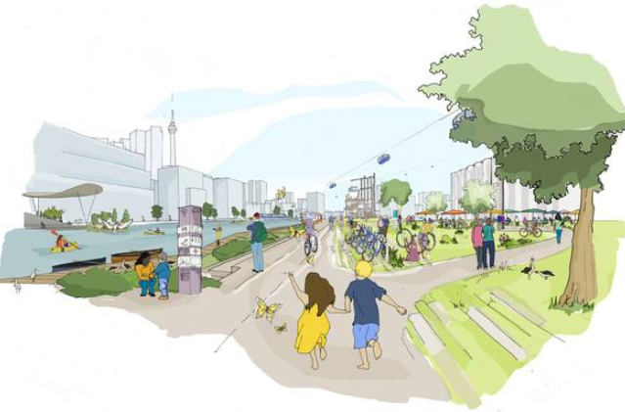
Our Goal: Enable a better community

Slide 5
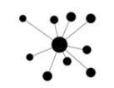
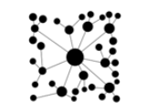
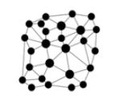
Step 1: Data Decentralization Revolution
Centralized
Decentralized
Distributed
5

Slide 6
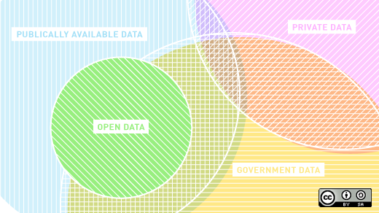

Step 2: Decentralized Database will enable better apps

Slide 7

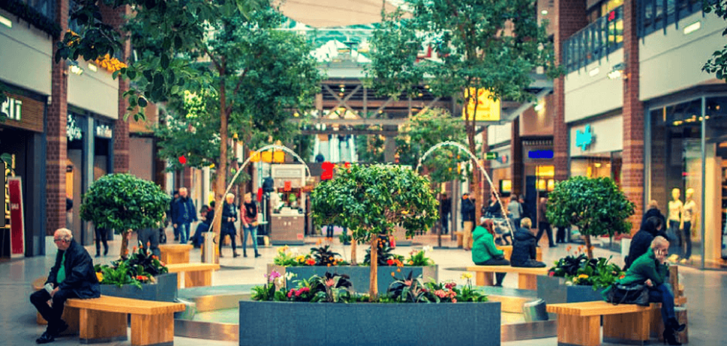
Step 3: Better apps leads to a more connected community

Slide 8


Step 4: More secured than ever

Slide 9

Conclusion: Next step actions
1. Packaging, Sales and Delivery:
Putting together a package of our services.
2. Engaging advisors for feedbacks for our services.
Advisors.
University of Toronto Business professors.
University of Toronto Business School Alumni networks.
3. Engage customers to test market.
Universities data mining and statistics department. Small business owners.

