Slide 1
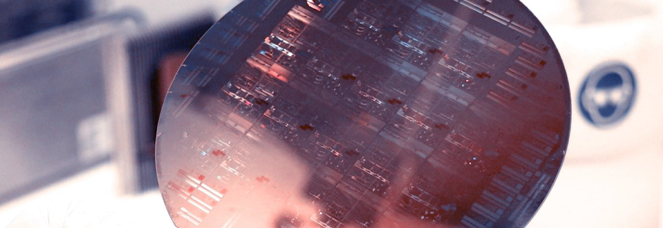
Lab Book 0.2. Couplers
Student:

Slide 2
Instructions General
SOFTWARE
Python notebook supplied by instructors
SCRIPTS
From Poliformat → download the 020_COUPLERS_v2025_Student.ipynb
Either run locally or at Google Collaboratory
Cross-Sections to be studied:
w (width)
w (width)
h
(height)
Core
Core
h
(height)
MMI Body
g
(gap)
Cladding
Cladding
Directional coupler (DC)
Multimode Interference (MMI) coupler

Slide 3

Learning outcome #1 – Directional coupler cross-section in GDSFactory
INSTRUCTOR:
Present Python and GDSFactory implementation of DC cross-section
Describe how to obtain the beating length $L_{π}$
Describe the outputs.
ALL EXAMPLE #1: waveguide width 1.2 µm, gap between waveguides 0.6 µm, deep wvg, wavelength start and end same 1.55 µm → all ”Run”
ALL: Follow instructor, that will show how to 1) plot mode, 2) explore the results (neff …)
Document all your results (neff, plot fields of different modes, comparison between different polarizations…)

Slide 4
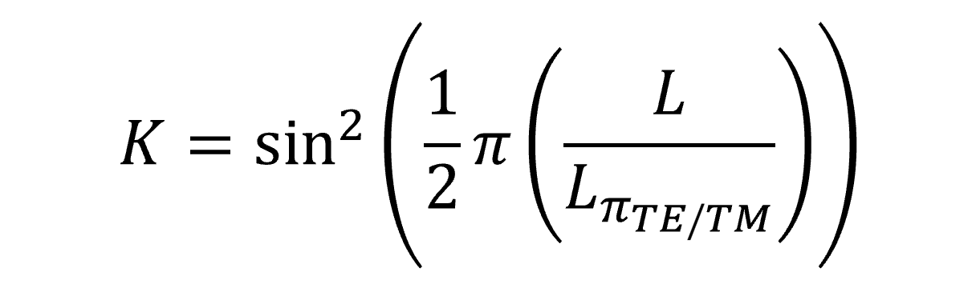
Learning outcome #2 – Directional coupler length and coupling coefficient Wavelength 1.5 µm – width 1.2 µm – gap 0.6 µm
deep waveguide
Paste L/Lpi vs K plot here
Comment results (distance needed for a complete energy transfer between waveguides, distance needed for splitting power in half.. )

Slide 5
Learning outcome #3 – 2x2 Directional Coupler Waveguide width 1.2 µm, Gap between waveguides 0.6 µm – Wavelength 1.55 µm
deep waveguide
Paste propagation plots and output text here
Comment results (Coupling relationship, Lpi, losses, … )

Slide 6

Learning outcome #4 – Multimode Interference (MMI) Coupler cross-section
INSTRUCTOR:
Present Python and GDSFactory implementation of DC cross-section
Describe how to obtain the beating length $L_{π}$
Describe the outputs.
ALL EXAMPLE #1: waveguide width 12 µm, gap between waveguides 0.6 µm, deep wvg, wavelength start and end same 1.55 µm → all ”Run”
ALL: Follow instructor, that will show how to 1) plot mode, 2) explore the results (neff …)
Document all your results (neff, plot fields of different modes, comparison between different polarizations…)

Slide 7
Learning outcome #5 – 2x2 Multimode Interference Coupler Body width 6 µm and 12 µm – Wavelength 1.55 µm
deep waveguide
Paste propagation plots and output text here
Comment results (Coupling relationship, Lpi, losses, comparison with Directional Coupler… )

Slide 8

Learning outcome #6 – 2x2 coupler transfer matrix Consider LO3 and LO5 results and complete the transfer matrix for each case.
Transfer Matrix equation
$$T_{C}(λ)= \left[\begin{matrix}e^{iφ_{00}(λ)}\sqrt{T_{00}(λ)} & e^{iφ_{01}(λ)} \sqrt{T_{01}(λ)} \\ e^{iφ_{01}(λ)} \sqrt{T_{01}(λ)} & e^{iφ_{00}(λ)}\sqrt{T_{00}(λ)}\end{matrix}\right]$$
Comment results

Slide 9
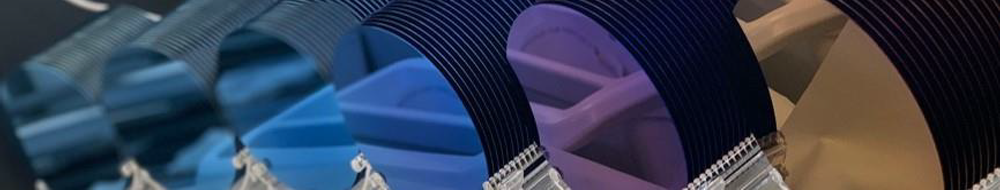
Thank you

