Slide 1
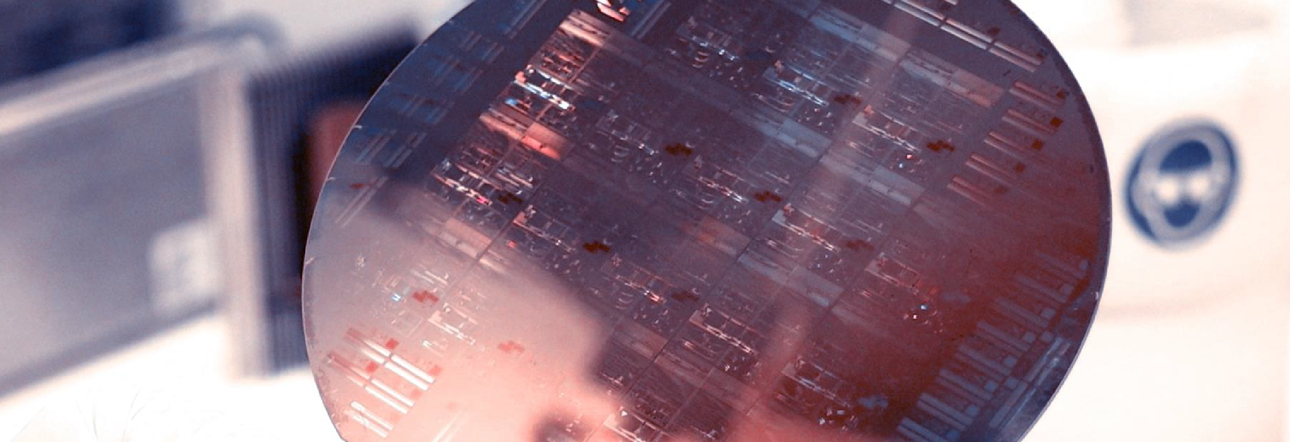
Lab Book 0.3. Circuits and Compact Models
Student:

Slide 2
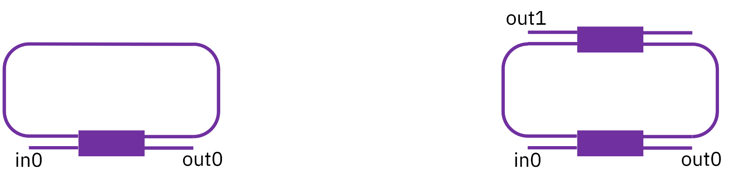
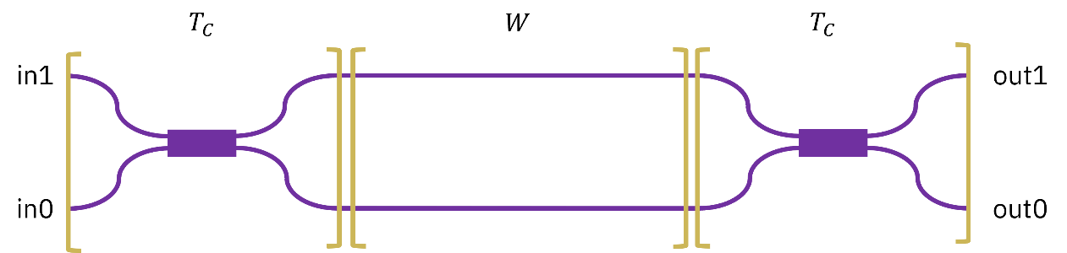
Instructions General
SOFTWARE
Python notebook supplied by instructors
SCRIPTS
From Github Desktop → Open in Visual Studio Code
Navigate to training/IPSP/Lab3/030_Circuits_&_CompactModels.ipynb
Either run locally or Cloud
Devices to be studied:
Mach-Zehnder Interferometer (MZI)
Ring Resonators (RR)

Slide 3
Learning outcome #1a – Perfectly balanced MZI
INSTRUCTOR:
Present Python and GDSFactory implementation of the Compact Models and Circuit Model
Describe how to simulate usin SAX library
Describe the outputs.
ALL EXAMPLE #1:
wvl [1500-1600] step 0.001
dL = 0
Kin = Kout = 0.5 for all wvl
MZI transfer functions
Paste plot here
Document and comment your results

Slide 4
Learning outcome #1b – Unbalanced MZI
HINTS:
wvl [1500-1600] step 0.001
dL = 100 µm
Kin = Kout = 0.5 for all wvl
MZI transfer functions
Paste plot here
Comment results: describe the transfer function, which is the FSR? How is it related to the length difference among arms?
Show a numeric calculation of the FSR and length difference matching the results in the graph,

Slide 5
Learning outcome #2 – MZI Design
Design a MZI with FSR = 10 nm at 1550 nm
Hints:
wvl [1500-1600] step 0.001
dL = ? µm calculate for FSR = 2 nm
Ka = Kb = 0.5 for all wvl
Your design justification
Write equations / numbers
MZI transfer functions
Paste plot here
Comment results:

Slide 6
Learning outcome #3 – Delay imbalance with loss
Fringe visibility
Hints:
wvl [1550-1550.5] step 0.0000005
Silicon waveguide model:
n_eff = 2.38,
n_g = 4.25,
D=0,
L_base=1000
dL = L_base + 55960.0840224255;
loss = 4 dB / cm
Case 1. Simulate for Ka = Kb = 0.5 for all wvl
Case 2. Simulate for Ka=0.1 for all wvl
Kb=0.5 for all wvl
MZI transfer functions
Paste plot here
Comment results: describe the transfer function, is there any interference pattern in case 1? Is there any interference pattern in case 2? Explain the difference between both cases. Compare the Extinction Ratio of both variations.
Extra: What coupling coefficient will you select for the input coupler if you want to match the losses of the longer arm? Simulate and extract the ER.

Slide 7
Learning outcome #4 – Ring Resonator
Single ring resonator – most simple case Constant coupler K (no wavelength variation)
Hints:
None ☺
Single ring
transfer functions
Linear units
Single ring
transfer functions
Logaritmic units
Comment results: describer the transfer functions. which is the FSR? How is it related to the ring perimeter?
Show a numeric calculation of the FSR and length difference matching the results in the graph,

Slide 8
Learning outcome #5 – Ring resonator design
Design the perimeter for a FSR = 15 nm.
Hints:
Design the perimeter for a FSR = 15 nm.
Use equations given in class that relate FSR and perimeter.
Single ring
transfer functions
Linear units
Single ring
transfer functions
Logaritmic units
Comment results: describer the transfer function. How’s the dependence on the coupler coefficient? Calculate the Extinction Ratio. How would you achieve critical coupling for the latter design? Justify your answers.

Slide 9
Learning outcome #6a – Effect of K
Change K value between 0.1 and 0.9 in steps of 0.1
Single ring
transfer functions
Linear units
K=
Single ring
transfer functions
Linear units
K=
Single ring
transfer functions
Linear units
K=
…
Comment results: Try to classify the resonances, in which case are you close to critical coupling? Why?

Slide 10
Learning outcome #6b – Effect of loss
Change losses value between 0 and 8 dB/cm in steps of 1
Single ring
transfer functions
Linear units
alpha=0 dB/cm
Single ring
transfer functions
Linear units
alpha=1 dB/cm
Single ring
transfer functions
Linear units
alpha=2 dB/cm
Single ring
transfer functions
Linear units
alpha=2 dB/cm
Comment results. Try to classify the resonances, in which case are you close to critical coupling? Why?

Slide 11
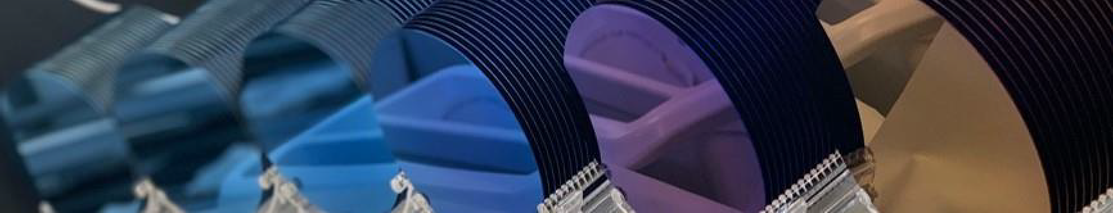
Thank you

