Slide 1
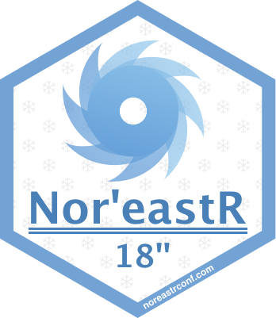



Nor’eastR Conference
October 26, 2018
Providence, RI
Gold Sponsors:

