Slide 1

DATA ANALYSIS & MACHINE LEARNING
Crop Yield Prediction
Turning environmental and agricultural data into actionable yield forecasts
An end-to-end pipeline: Data → Cleaning → Analysis → Dashboard → ML → Web App
Notes:
Welcome the audience. Introduce the project as an end-to-end data science pipeline that predicts crop yield from environmental and agricultural inputs, built to support farmers and agricultural planners with data-driven decisions. Preview the six stages of the pipeline shown at the bottom of the slide.

Slide 2








ROADMAP
What We'll Cover
01
02
03
04
Objectives
Dataset
Data Cleaning
EDA
Problem statement & goals
Source, size & features
Preprocessing pipeline
Patterns & correlations
05
06
07
08
Dashboard
ML Models
Web App
Conclusion
Interactive visual exploration
Training & evaluation
Live prediction demo
Impact & future work
Crop Yield Prediction
2
Notes:
Walk through the eight sections of the presentation, from objectives through to conclusion. This gives the audience a map of the full pipeline before diving into details.

Slide 3
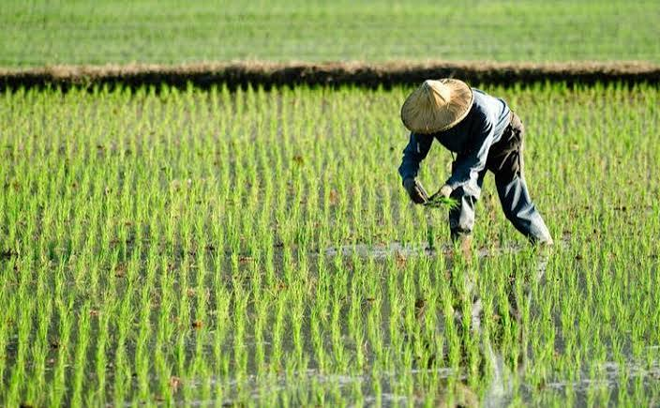

SECTION 01 — OVERVIEW
Project Objectives & Problem Statement
Predict crop yield from environmental and agricultural factors such as rainfall, temperature, and soil quality.
[IMAGE PLACEHOLDER:
farmer working in field]
Support decision-making give farmers and agricultural planners a data-driven basis for planning.
Build an end-to-end pipeline covering collection, cleaning, analysis, dashboarding, modeling, and deployment.
Crop Yield Prediction
3
Notes:
State the problem: agricultural yield depends on many interacting environmental and human-controlled factors. The project builds a full pipeline, from raw data to a deployed prediction tool, to give farmers and planners actionable, data-driven guidance.

Slide 4
SECTION 02 — DATASET
Dataset Overview & Source
An agricultural dataset combining climate, input-usage, and soil measurements collected across crops and seasons, with crop yield as the prediction target.
6
1
Mixed
Multi-
Season
Feature Columns
Target Variable
(Yield)
Numerical &
Categorical
Coverage
Crop Yield Prediction
4
Notes:
Describe the dataset at a glance: eight feature columns plus the yield target, mixed numerical and categorical types, spanning multiple crops and seasons. Point out that a raw data sample would be shown here as a screenshot.

Slide 5
SECTION 02 — DATASET
Data Dictionary & Features List
Feature | Type | Description
Rainfall | Numerical | Total rainfall recorded for the growing period (mm)
Temperature | Numerical | Average temperature during the growing period (°C)
Pesticide Usage | Numerical | Quantity of pesticide applied (kg/ha)
Year | Numerical | Year of growing crop
Item | Categorical | Crop grown (e.g. wheat, rice, maize)
Area | Categorical | Growing area (e.g. Albania, India)
Yield (Target) | Numerical | Crop yield achieved — the variable being predicted
Crop Yield Prediction
5
Notes:
Walk through the eight input features plus the yield target. Highlight the mix of numerical measurements (rainfall, temperature, input usage) and categorical fields (crop type, season, soil quality) that the model needs to handle.

Slide 6




SECTION 03 — PREPROCESSING
Data Cleaning & Preprocessing Pipeline
1
2
3
4
Missing Values
Duplicates &
Outliers
Encode
Categoricals
Train / Test
Split
Impute or remove, with justification
Detect and remove
One-hot encoding
Partition for evaluation
Crop Yield Prediction
6
Notes:
Explain the five-stage cleaning pipeline in order: handling missing values, removing duplicates and outliers, encoding categorical variables, scaling numerical features, and finally splitting into training and testing sets.

Slide 7
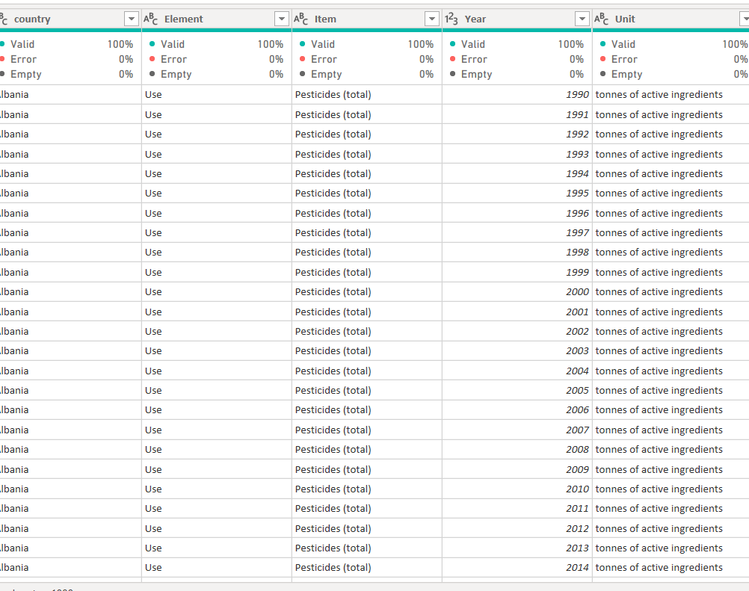
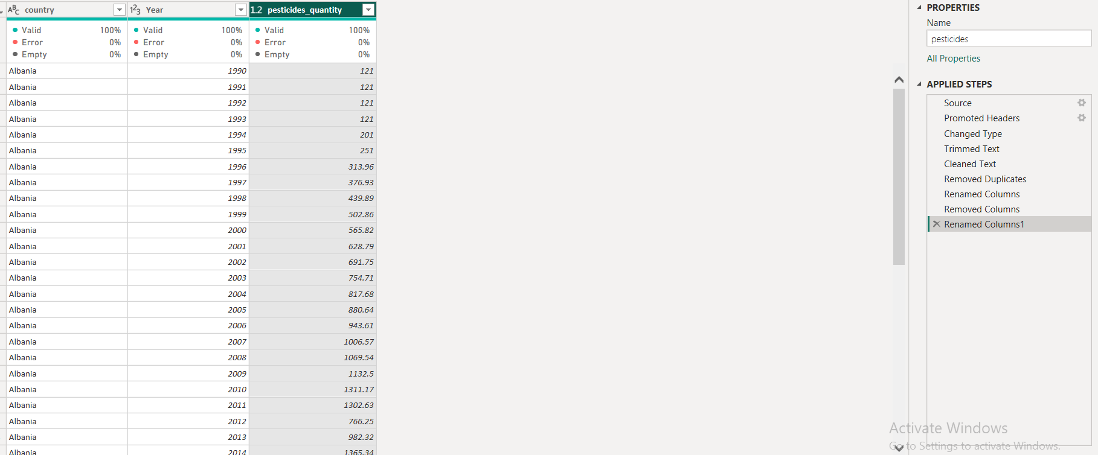
Pesticides data

Slide 8
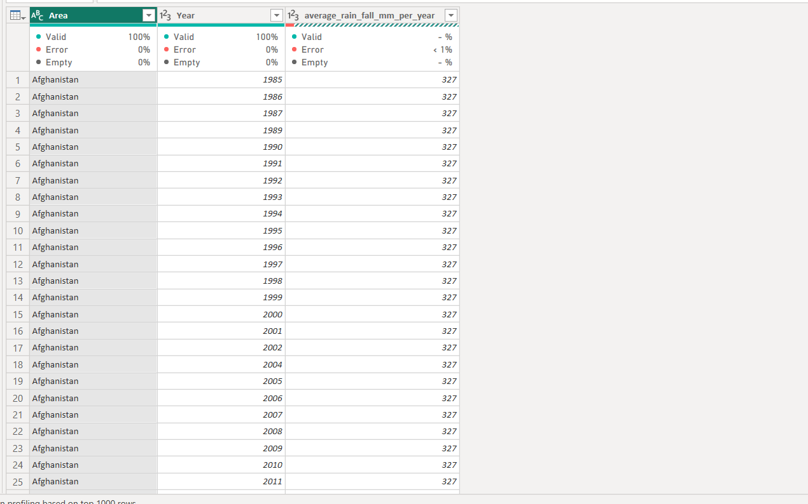
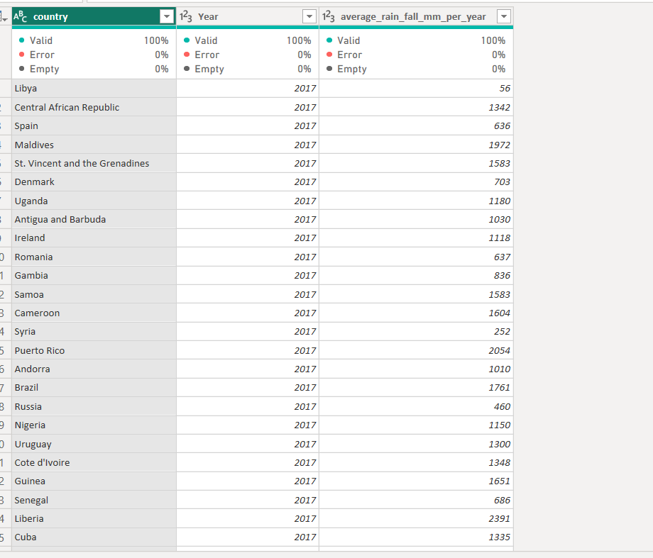
Rainfall data

Slide 9
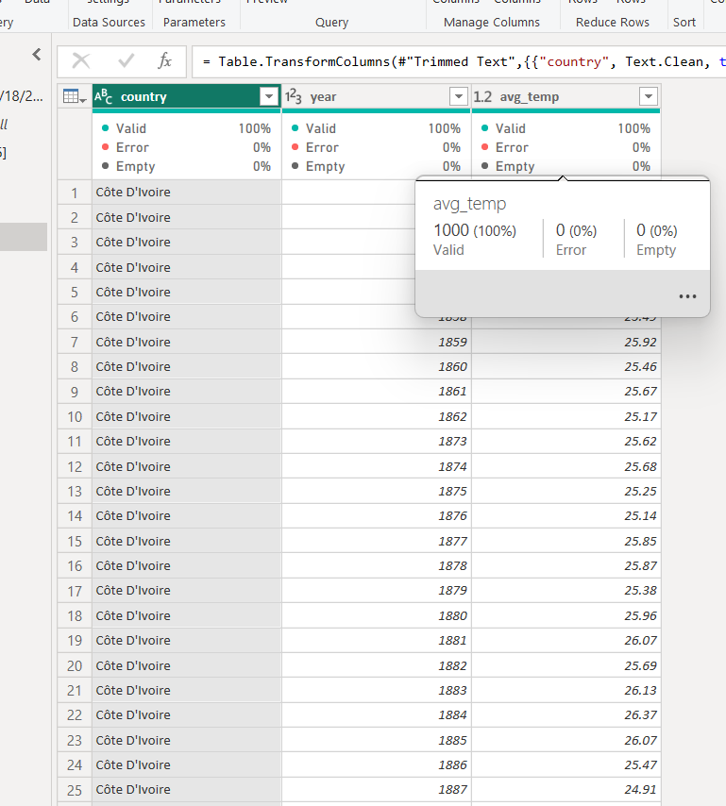
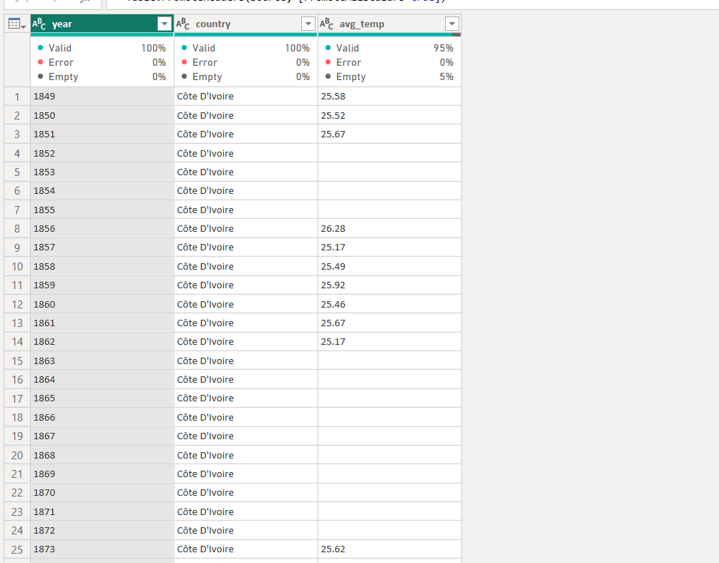
Temp data

Slide 10
SECTION 03 — PREPROCESSING
Missing Values: Detection & Handling
BEFORE
AFTER
Rainfall
1% error
Rainfall
0.0% error
Temp
5% missing
Temp
0.0% missing
Strategy: median imputation for skewed numerical fields, mode imputation for categorical fields; rows missing the yield target are dropped.
Result: a complete, model-ready dataset with no null values remaining, imputations justified by feature distribution.
Crop Yield Prediction
7
Notes:
Show the before/after picture of data quality. Explain the justification for each imputation choice: median for skewed numeric fields to avoid outlier distortion, mode for categoricals, and dropping any row missing the target variable.

Slide 11
SECTION 04 — EXPLORATORY DATA ANALYSIS
Statistical Summary of Features
Numerical Feature | Mean | Std Dev | Min | Max
Rainfall (mm) | 1149.05 | 709.8 | 51 | 3240
Temperature (°C) | 20.54 | 6.31 | 1.3 | 30.65
Pesticide (kg/ha) | 37076.9 | 59958.70 | 0.04 | 367778
Year | 2002 | 7.05 | 1990 | 2013
Yield (ha/hg)(Target) | 77053.33 | 84956.61 | 50 | 501412
4
Numerical
Features
2
Categorical
Features
Crop Yield Prediction
8
Notes:
Present the descriptive statistics for the key numerical features: rainfall, temperature, pesticide and fertilizer usage, and yield itself. Note the wide range in rainfall and yield, which motivates deeper distribution analysis next.

Slide 12
DATA ANALYSIS & MACHINE LEARNING
Business Questions
Turning environmental and agricultural data into actionable yield forecasts
Notes:
Welcome the audience. Introduce the project as an end-to-end data science pipeline that predicts crop yield from environmental and agricultural inputs, built to support farmers and agricultural planners with data-driven decisions. Preview the six stages of the pipeline shown at the bottom of the slide.

Slide 13
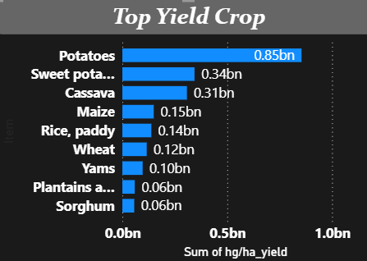
SECTION 05 — DASHBOARD
Which crops generate highest total yield?
Observation
Potatoes have the highest total yield at approximately 0.85bn.
Sorghum have the lowest yield among the displayed crops at approximately 0.10bn.
Insights
Potatoes are a major contributor to production.
Business implication :
Potatoes could be considered a priority crop for agricultural investment, resource allocation, and production planning.
9
Notes:
Show the distribution shapes of two key drivers. Rainfall is right-skewed with most observations between 600 and 1000mm; temperature is roughly bell-shaped, centered around 24-30 degrees Celsius, matching typical growing-season conditions.

Slide 14
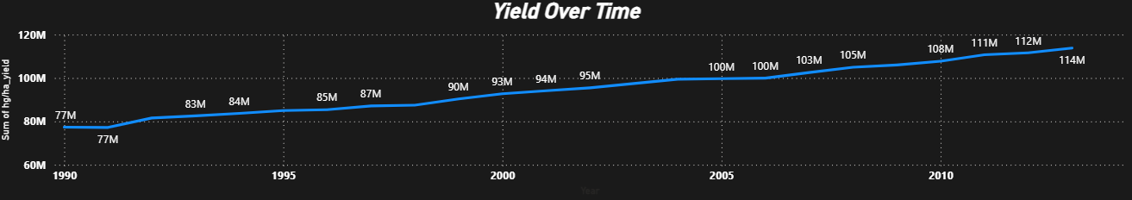
SECTION 05 — DASHBOARD
How does crop yield change over time?
Insights
Observation
Total yield shows an overall upward trend from around 77M in 1990 to around 114M in 2013.
There are some periods where growth is relatively slow or stable.
Agricultural production has improved over time.
Business implication :
The agricultural sector has experienced long-term
growth, which could indicate improvements in farming practices, technology, or resource utilization.
9
Notes:
Show the distribution shapes of two key drivers. Rainfall is right-skewed with most observations between 600 and 1000mm; temperature is roughly bell-shaped, centered around 24-30 degrees Celsius, matching typical growing-season conditions.

Slide 15
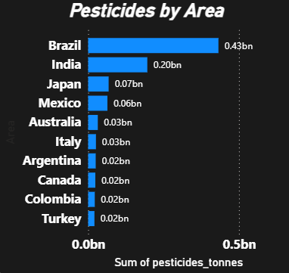
SECTION 05 — DASHBOARD
Which areas use the most pesticides?
Observation
Brazil has the highest pesticide usage at approximately 0.43bn.
Turkey have the lowest pesticide usage among the top displayed areas at approximately 0.02bn .
Insights
Brazil has significantly higher pesticide usage.
Business implication :
Brazil may require closer monitoring of pesticide consumption and more sustainable agricultural practices.
9
Notes:
Show the distribution shapes of two key drivers. Rainfall is right-skewed with most observations between 600 and 1000mm; temperature is roughly bell-shaped, centered around 24-30 degrees Celsius, matching typical growing-season conditions.

Slide 16
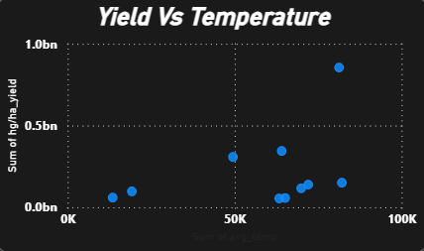
SECTION 05 — DASHBOARD
Is there a relationship between Temp and crop yield?
Observation
The scatter plot does not show an obvious relationship
between temperature and yield.
But , there is a weak negative linear relationship of correlation = -0.11
Insights
Temperature alone may not explain yield differences.
Business implication :
Decision makers shouldn't rely on temperature alone when predicting crop yield. Other factors such as rainfall, crop type, area, and farming practices should also be considered.
9
Notes:
Show the distribution shapes of two key drivers. Rainfall is right-skewed with most observations between 600 and 1000mm; temperature is roughly bell-shaped, centered around 24-30 degrees Celsius, matching typical growing-season conditions.

Slide 17




SECTION 05 — DASHBOARD
Key Insights
Agricultural production has improved over time.
Temperature does not show a strong visible relationship with yield suggesting that multiple factors influence crop productivity
Potatoes are the highest-yield crop should be prioritized for agricultural investment.
Brazil has the highest pesticide usage.
13
Notes:
Summarize the four headline findings from exploratory analysis: rainfall dominance, the negative effect of heat stress, meaningful differences between crop types, and the amplifying effect of season timing.

Slide 18
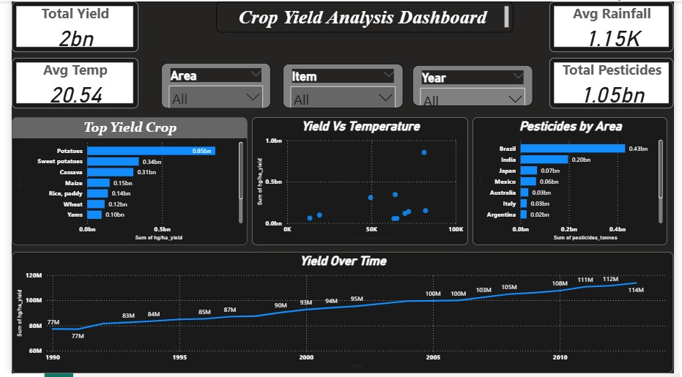
SECTION 05 — DASHBOARD
Interactive Dashboard Overview
[IMAGE PLACEHOLDER: dashboard main screen]
Yield Trends by Region
Correlation Heatmap
Feature Importance
Rainfall
Fertilizer
Crop Type
Temp
Crop Yield Prediction
14
Notes:
Show the interactive dashboard mockup: a yield-trends line chart on the left, and a correlation heatmap plus feature-importance panel on the right. This is the exploratory front-end analysts and planners use to explore the data themselves.

Slide 19



SECTION 05 — DASHBOARD
Dashboard Interactions & Filters
Dynamic Filters — Filter by Area , Item , year
Live Recalculation — Summary statistics and charts update instantly as filters change.
Live Recalculation — Summary statistics and charts update instantly as filters change.
Exportable Views — Export any filtered view or chart for reporting and further analysis.
15
Notes:
Highlight what makes the dashboard interactive: filtering by crop/season/region, drilling into individual records, live recalculation of summary statistics, and the ability to export any filtered view.

Slide 20
DATA ANALYSIS & MACHINE LEARNING
ML Models
Turning environmental and agricultural data into actionable yield forecasts
Notes:
Welcome the audience. Introduce the project as an end-to-end data science pipeline that predicts crop yield from environmental and agricultural inputs, built to support farmers and agricultural planners with data-driven decisions. Preview the six stages of the pipeline shown at the bottom of the slide.

Slide 21
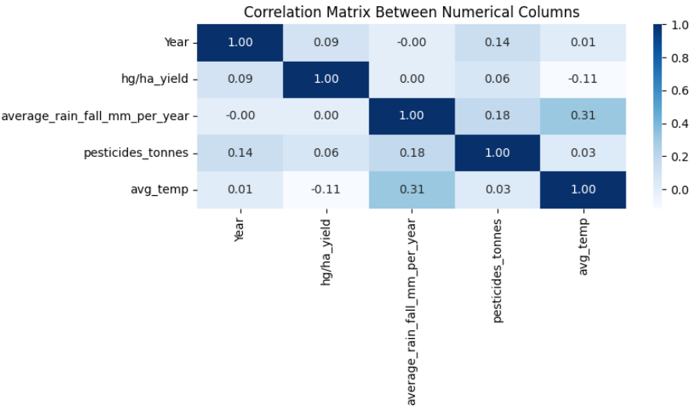
SECTION 06 — ML model
Correlation Analysis
Notes:
Walk through the correlation matrix. Rainfall and fertilizer usage have the strongest positive relationships with yield, while higher temperatures are associated with lower yield, likely reflecting heat stress on crops.

Slide 22
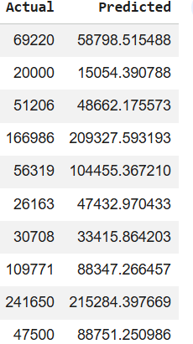
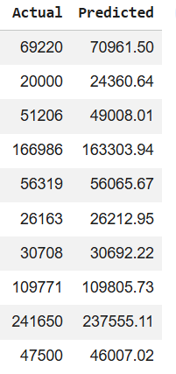

SECTION 06 — MACHINE LEARNING
Model Overview & Comparison
Linear Regression :
Random Forest :
Model | R² | MAE | RMSE
Linear Regression | 0.64 | 31791.64 | 50757.59
Random Forest | 0.98 | 3466.64 | 9467.50
Random Forest wins
Highest R² (0.98) with the lowest error across MAE and RMSE.
All models trained on the same 80/20 train-test split with identical preprocessing, then evaluated on held-out test data for a fair comparison.
16
Notes:
Compare four regression models on the same held-out test set. Random Forest achieves the best R² and lowest error metrics across the board, making it the selected model for deployment.

Slide 23
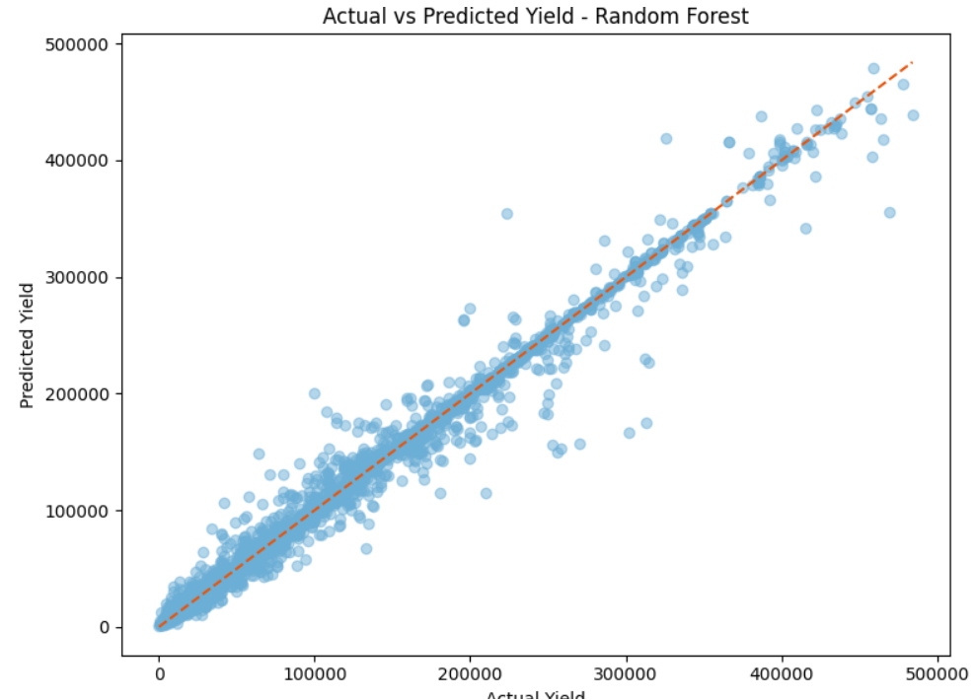
SECTION 06 — MACHINE LEARNING
Best Model: Random Forest Regressor
0.98
R² Score
Variance explained
9467.50
Root Mean Sq. Error (t/ha)
MSE
RMSE
RMSE
RMSE
3466.64
MAE
Mean Absolute Error (t/ha)
Trained and validated on a held-out 20% test set — metrics reflect true out-of-sample performance, not training fit.
17
Notes:
Drill into the winning model’s test-set metrics: an R² of 0.89 means the model explains 89% of the variance in yield, with a mean absolute error of just 0.34 tonnes per hectare.

Slide 24
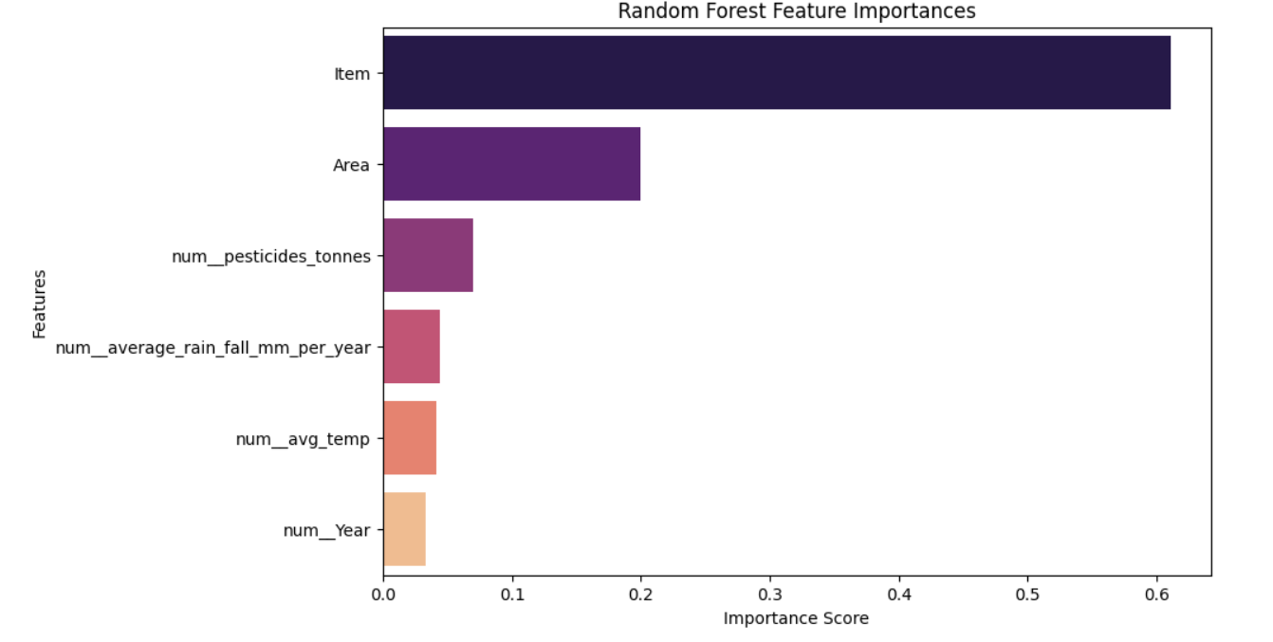
SECTION 06 — MACHINE LEARNING
Feature Importance Analysis
18
Notes:
Rank the features by importance from the Random Forest model. Rainfall dominates at 29%, followed by fertilizer usage and pesticide usage — confirming the correlation analysis from earlier and giving farmers a clear priority order for the factors within their control.

Slide 25
DATA ANALYSIS & MACHINE LEARNING
Web APP using streamlit
Turning environmental and agricultural data into actionable yield forecasts
Notes:
Welcome the audience. Introduce the project as an end-to-end data science pipeline that predicts crop yield from environmental and agricultural inputs, built to support farmers and agricultural planners with data-driven decisions. Preview the six stages of the pipeline shown at the bottom of the slide.

Slide 26



SECTION 07 —web app
Streamlit Web App: Live Prediction
Crop Yield Predictor
User Inputs Farmers enter rainfall, temperature, fertilizer/pesticide use, crop type, and season.
Rainfall (mm)
850
Model Inference The trained Random Forest model runs instantly in the background.
Temperature (°C)
27
Year
120
Instant Prediction Expected yield is displayed immediately, in tonnes per hectare.
Crop Type
Maize
Predict Yield
Production-Ready Deployed as a lightweight, shareable Streamlit application.
Predicted Yield
6.1 t/ha
19
Notes:
Demo the bonus deliverable: a Streamlit web app where a user enters environmental and agricultural parameters and receives an instant predicted yield, powered by the trained Random Forest model, ready for production deployment.

Slide 27
CONCLUSION & FUTURE WORK
From Data to Decisions
[IMAGE PLACEHOLDER: future roadmap]
KEY FINDINGS & IMPACT
FUTURE WORK
Area and Item are the strongest levers on yield.
Expand feature set with satellite imagery & soil sensors
Random Forest predicts yield with R² = 0.98 on unseen data.
Explore deep learning models for higher accuracy
The Streamlit app puts predictions directly in farmers’ hands.
Integrate real-time weather and IoT data streams
Thank you
20
Notes:
Close with the headline findings and business impact: better-informed planting and input decisions for farmers. Preview the roadmap — richer features like satellite imagery, deep learning experiments, and real-time data integration — then thank the audience.

