Slide 1
Project Presentation Noreen Ward 25 April 2015
Main technologies explored:
Xamarin Studio, Visual Studio, REST, SOAP, SQLite, GitHub, Postman, C#, ASP.NET MVC, WCF, JSON, JavaScript, XML.

Slide 2
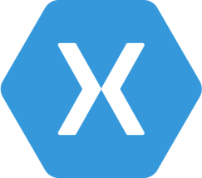


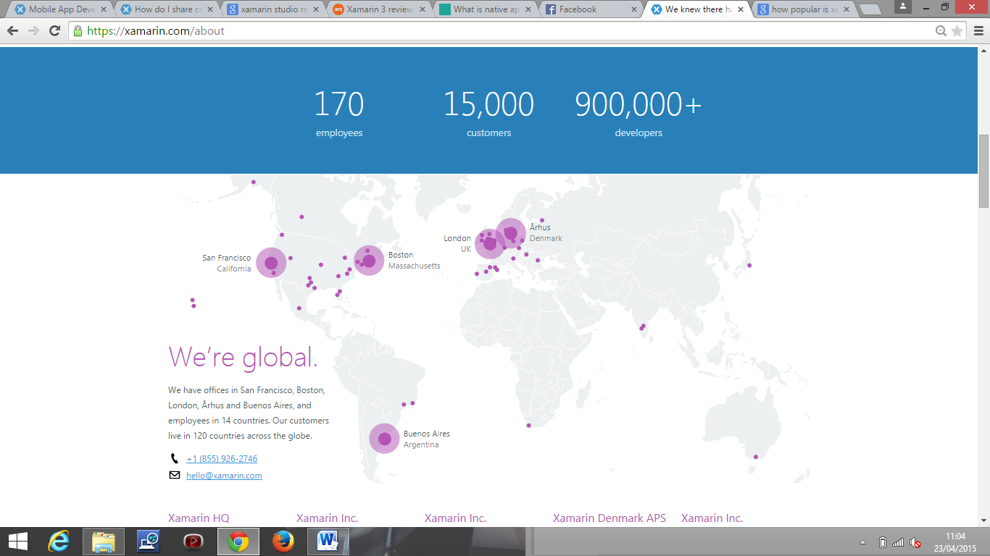
amarin
Founded 2011 by Nat Friedman (CEO and Co-founder) and Miguel de Icaza (CTO and Co- founder) who also created Mono, MonoTouch and Mono for Android
It allows developers to write iOS, Android and Windows apps with native user interfaces using a C# shared codebase
Can be created on Windows with either Xamarin Studio or Xamarin for Visual Studio
Xamarin Studio is a standalone IDE for mobile app development
Xamarin for Visual Studio is a plug in for VS, there is no free starter version

Slide 3
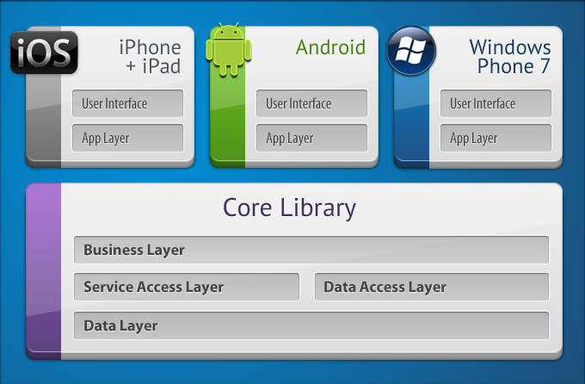
How it works
Shared C# code base but the UI’s for each platform must be built separately (unless using Xamarin.Forms)
Cordova (PhoneGap)- create UI once in HTML and used across all devices
Xamarin.Forms- work in progress, code sharing over a highly polished UI
Up to 90% code sharing if suitable for app = writing unit tests once only, fixing bugs on the three platforms simultaneously, less code to maintain.
The same code will vary in appearance from device to device. Onscreen presentation of the UI is dictated by renderers that are responsible for the actual drawing and onscreen.
There are also built in controls that allow you to access the underlying native platform control to apply platform specific options as well

Slide 4
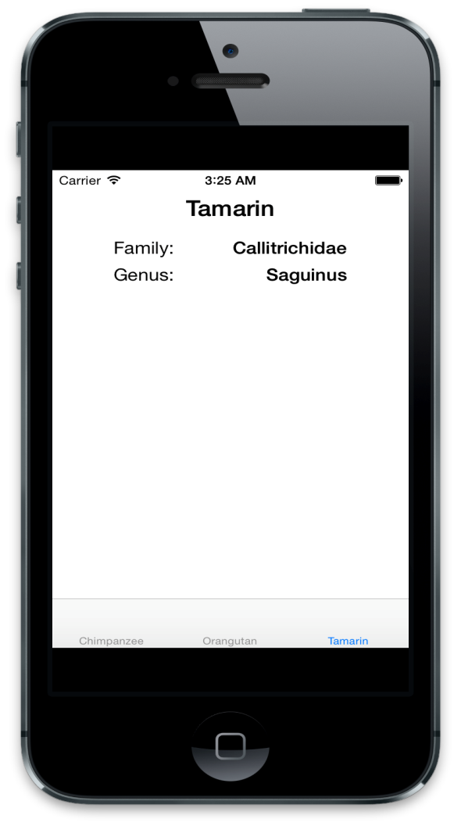
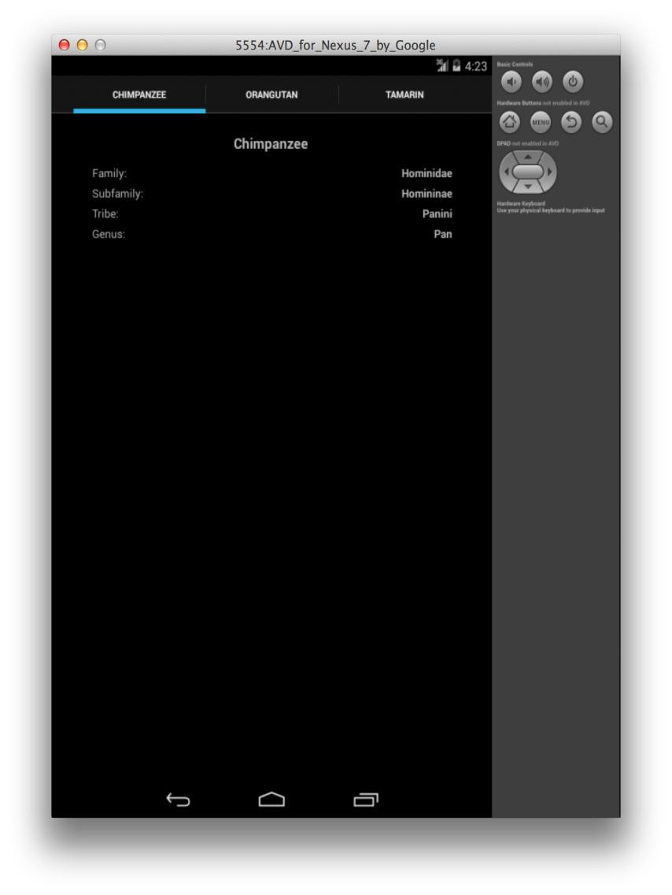
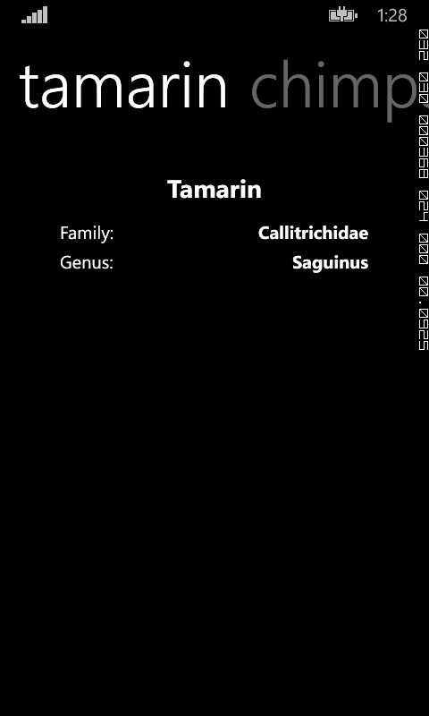
Xamarin.Forms example
iOS
Android
Windows

Slide 5
Xamarin Review
Steep learning curve and very buggy particularly when new updates are installed
Starter version quite limited i.e. restrictions on app size, no access to Windows.Forms
Everything was excruciatingly slow especially trying to deploy the app to an emulator for debugging and testing
Downloaded separate emulator Xamarin Android Player and Oracle VirtualBox which produced a new OpenGL error apparently common with Windows8 OS
**Quick demo**

Slide 6

WinForms - WCF - SQLite using REST
SOAP
Car WCF Service
WinForms Client
SQLite
REST
REST WCF Service
Maths ASMX Service h

Slide 7
Representational state transfer- REST
REST is an architectural style, a set of constraints that can be used to build software in which clients can make requests of services
Roy Thomas Fielding first coined the term REST as a concept in his PhD dissertation. He was one of the people who worked on the specification that drives most of the Internet today: Hypertext Transfer Protocol (HTTP)
The constraints of REST are based on the same underlying principles that govern the Web i.e.
1. Clients interact with resources. Resources are anything that can be named and represented. Each resource can be addressed via a unique Uniform Resource Identifier (URI).
2. Interaction with resources (located through their unique URIs) is accomplished using a uniform interface of the HTTP standard verbs. Also important in the interaction is the declaration of the resource's media type, which is designated using the HTTP Content-Type header.
3. Resources are self-descriptive. All the information necessary to process a request on a resource is contained inside the request itself (which allows services to be stateless i.e. the server doesn’t have to retain any information).
4. Resources contain links to other resources (hyper-media).

Slide 8
Basically…
6 constraints: Client-Server, Stateless, Cache, Interface/Uniform Contract, Layered System, Code-On-Demand
3 steps to design the RESTful service/endpoint:
1. What are your resources going to be?
2. What URIs are going to be used to represent those resources?
3. What parts of the uniform interface/which HTTP verb is each URI going to support?
**Show some code**

Slide 9
Windows Communication Foundation- WCF
WCF is the Microsoft framework for building applications that communicate over a network, regardless of the style or protocol
Generally geared towards SOAP (a remote procedure call (RPC)) technology but since .NET Framework 3.5 in particular WCF has had the ability to expose and consume REST services
This is because of the programming model that was added to it which centres around two new attributes: WebGet and WebInvoke. Also added was a URI template mechanism that enables you to declare the URI and verb to which each method is going to respond (OperationContract tags)
Why WCF?
1. Security and reliability provided by a lot of authentication and authorization
2. Flexibility- has support for plain XML, Ajax and REST, not just SOAP
3. Interoperability- can exchange information using various network protocols and platforms. With ASP.NET the client has to support the .NET framework.

Slide 10
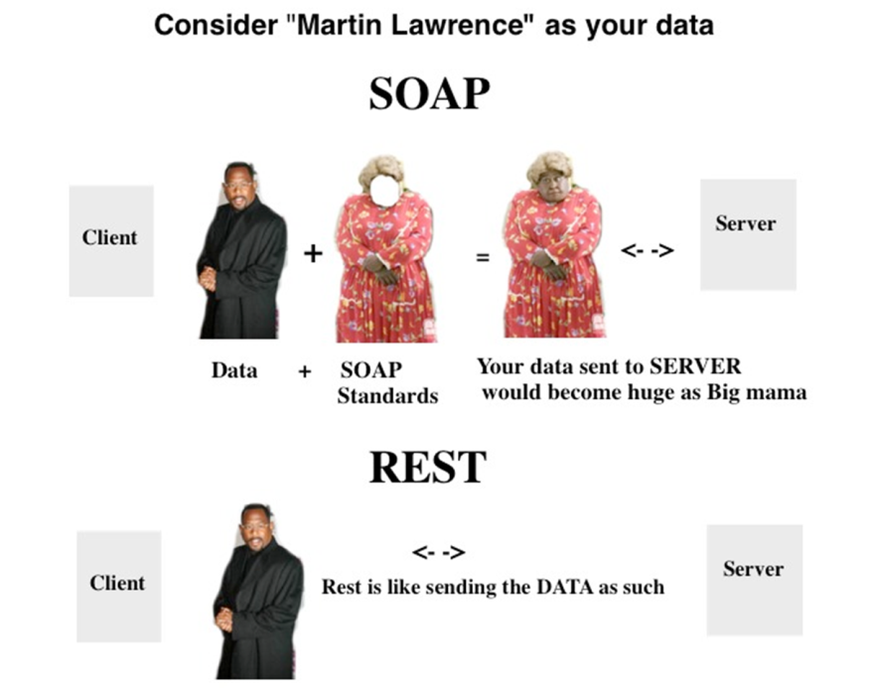
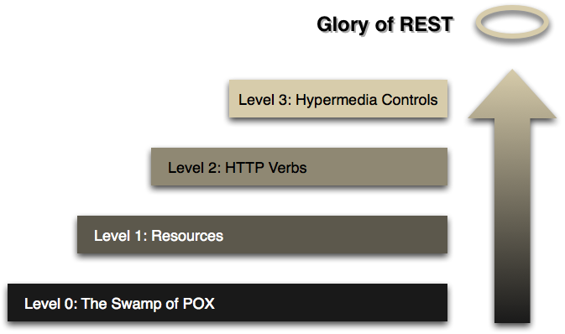
SOAP Vs REST

Slide 11

SQLite is a software library that implements a self-contained, server-less, zero-configuration, transactional SQL database engine
SQLite is the most widely deployed SQL database engine in the world and the source code for SQLite is in the public domain
Used from the command line but you can also use plug ins to provide a GUI interface for you databases. I used the Firefox one as the Chrome one was very poorly built. Makes sense as Mozilla sponsors it’s ongoing development and maintenance
Why SQLite? It wouldn’t put pressure on my laptops resources.
- Client/server SQL database engines such as MySQL, Oracle, PostgreSQL strive to implement a shared repository of enterprise data. They emphasis scalability, concurrency, centralization, and control.
- SQLite strives to provide local data storage for individual applications and devices. SQLite emphasizes economy, efficiency, reliability, independence, and simplicity.

Slide 12
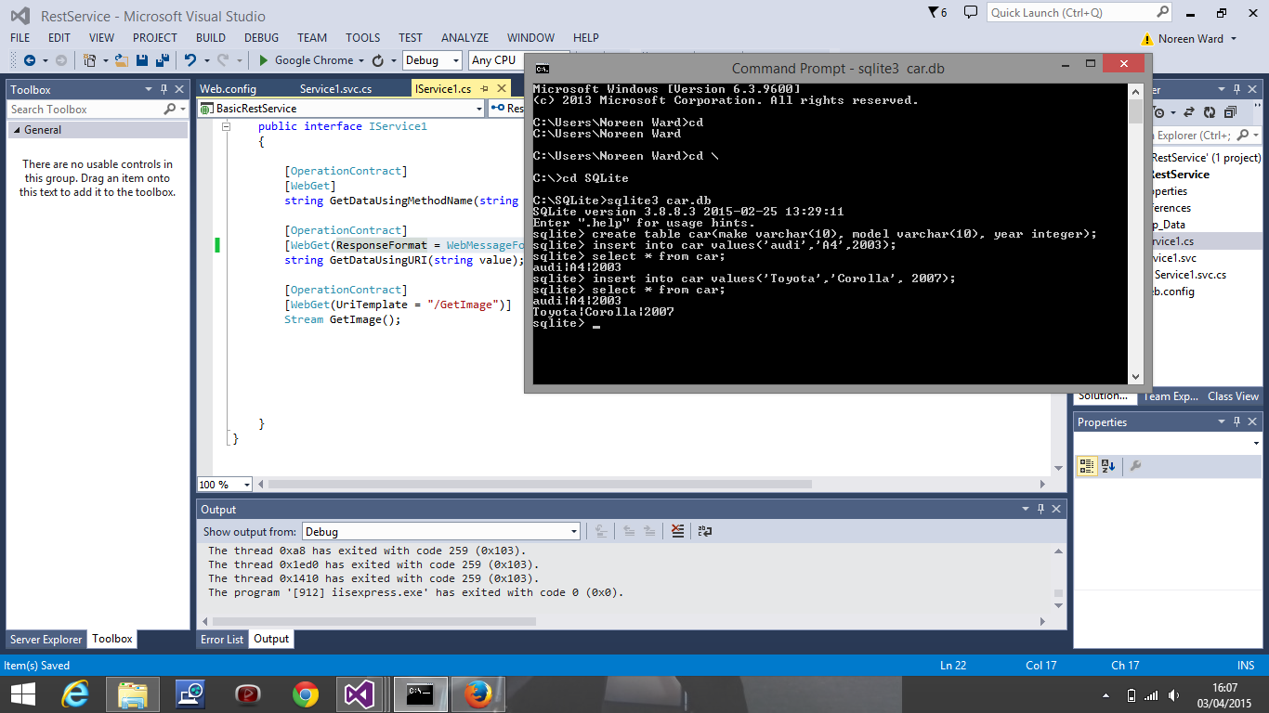
**Demo**

Slide 13
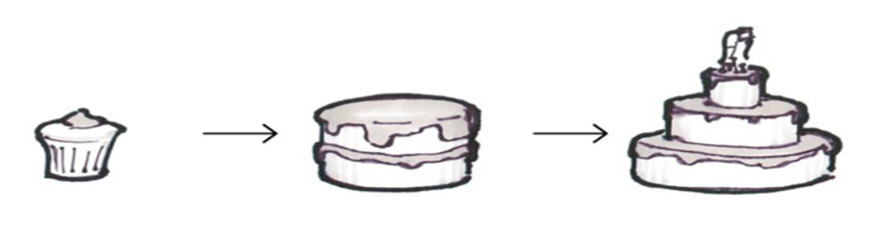
Project Methodology
I adopted the minimum viable product (MVP) approach

Slide 14
Learning curves
Three Tier Architecture
UI/Presentation Layer, Business/Logic Layer, Data Access Layer
Layer 1: Presents data to the user, optional data entry.
Layer 2: Not tied to a specific client- exists on server, contains the code i.e. algorithms, business rules etc.
Layer 3: Consists of data access components
Separate functionality benefits: reusability results in quick development. Easy to maintain, transform system. Parallel development of tiers.
Debugging
Learned how to use break points
Made it easier to pinpoint bugs in the code

Slide 15

Other technologies
GitHub
Open source version control, promotes code sharing, largest code host in the world
Started using it on 30 January and have regularly pushed my code to repositories
Postman- REST Client
Helped me test my API
Introduced me to status codes
Briefly:
MongoDB- Non-SQL database
Fiddler- a free web debugging proxy for any browser, system or platform
Pair programming- sat in on some work with Marta

Slide 16
Special thanks to Catherine and Marta ☺

