Slide 1

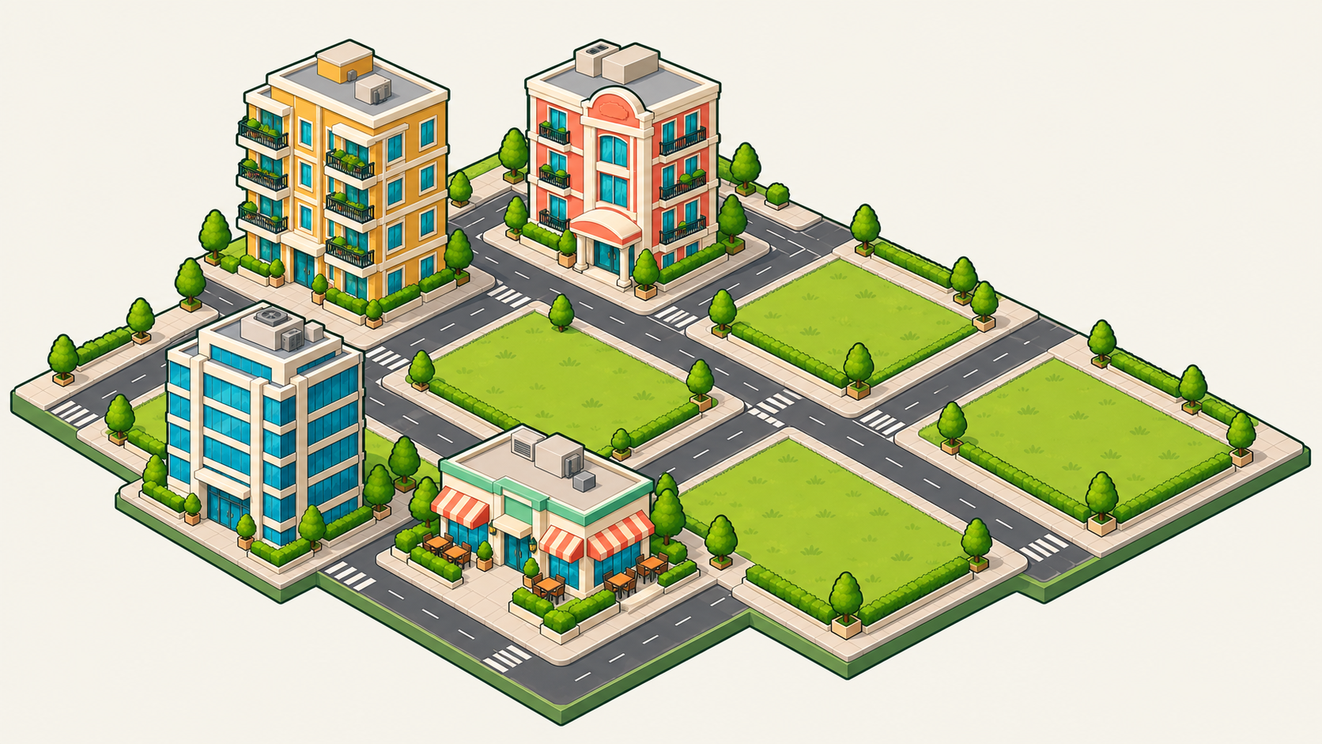
Building Management Tycoon
01 / 16
01 Game identity
Building Management
Tycoon
Build and manage your district.
Start a district
2D district map
Floor-by-floor management
Game design reference. Economy values and district names are examples.

Slide 2
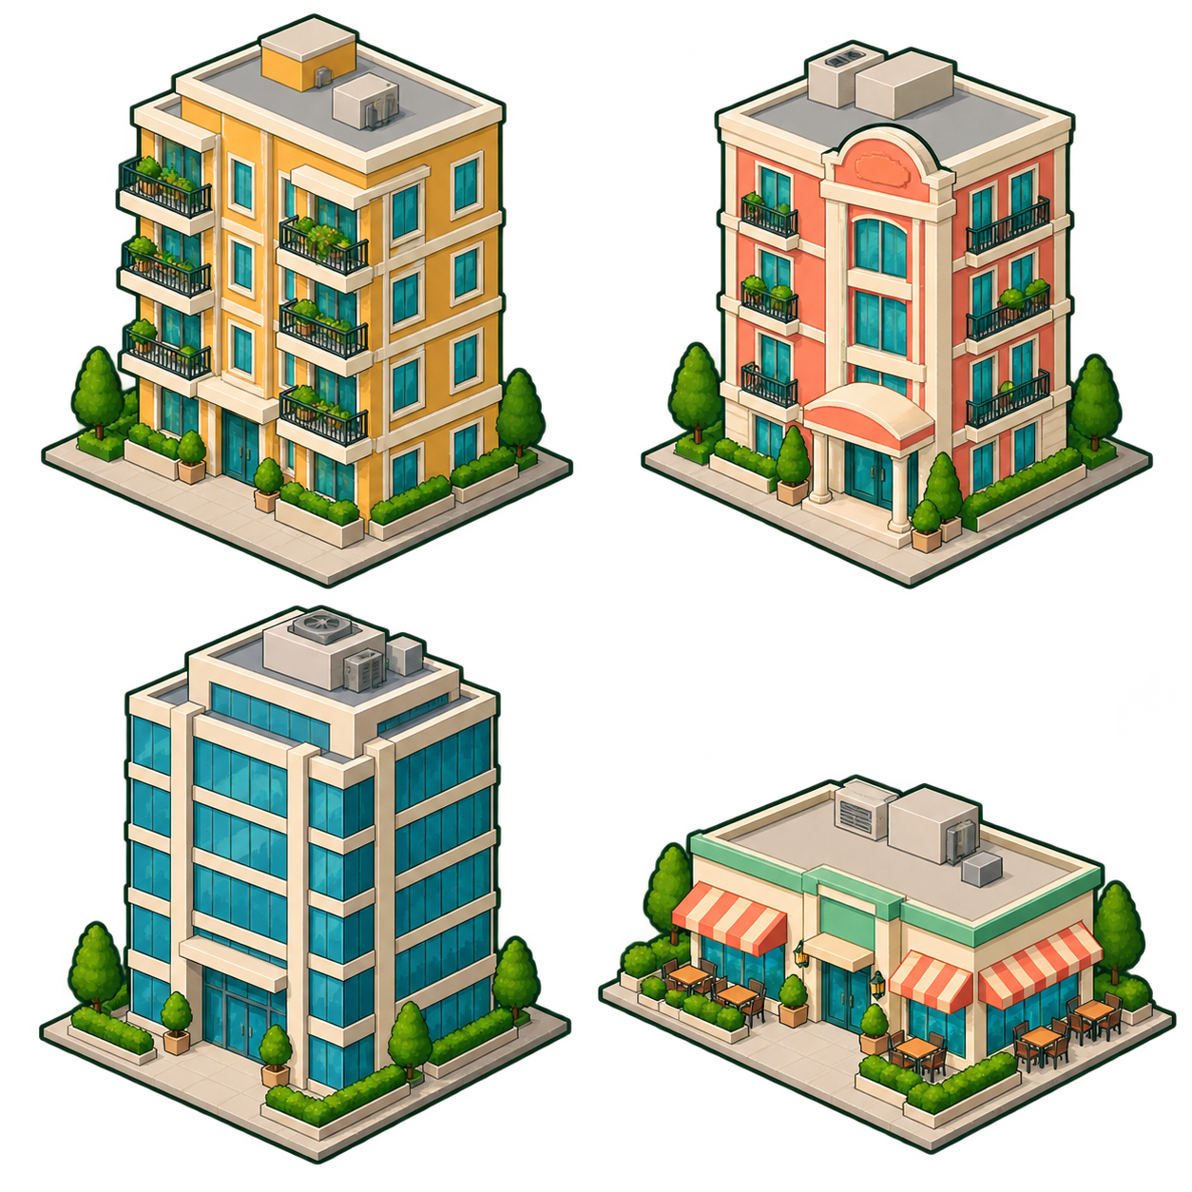
Building Management Tycoon
02 / 16
02 Building exteriors
Apartment
Hotel
Office tower
Food court
Long-term room rentals
Daily room occupancy
Whole-floor corporate leases
Daily customer sales
Shared view angle, outlines, roof materials and window treatment.
Game design reference. Economy values and district names are examples.

Slide 3
Building Management Tycoon
03 / 16
03 District tiles and placement
Placement grid
3 × 2 plots
Office + food court
Drag across empty land.
+30% sales example
Overlap: choose another plot.
Game design reference. Economy values and district names are examples.

Slide 4
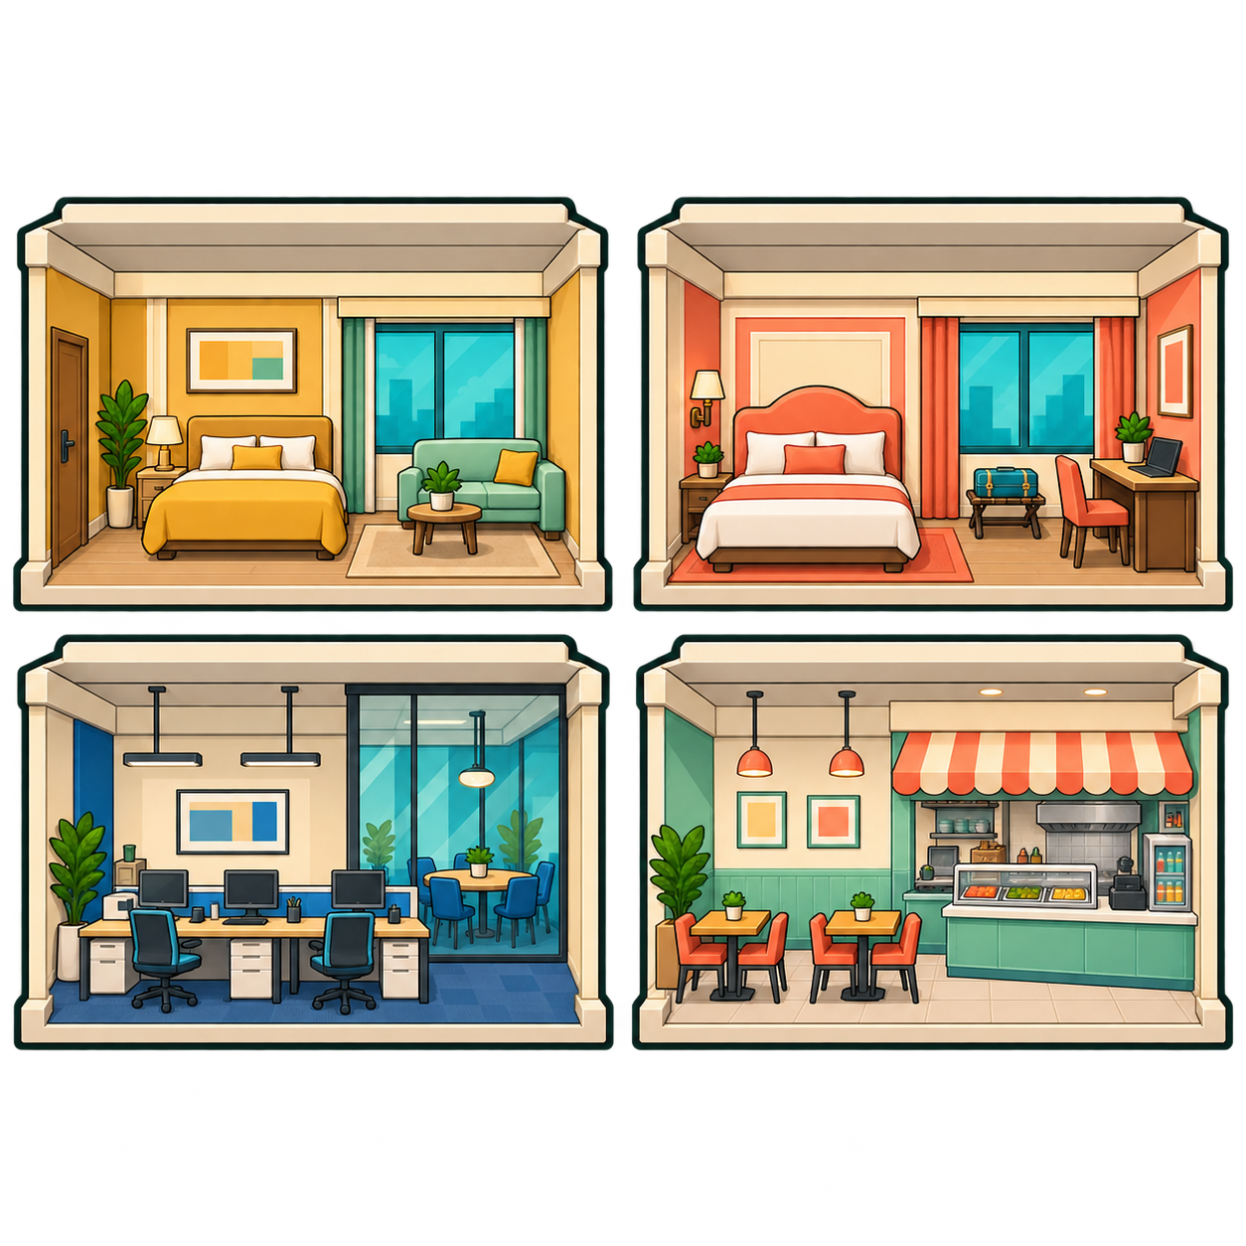
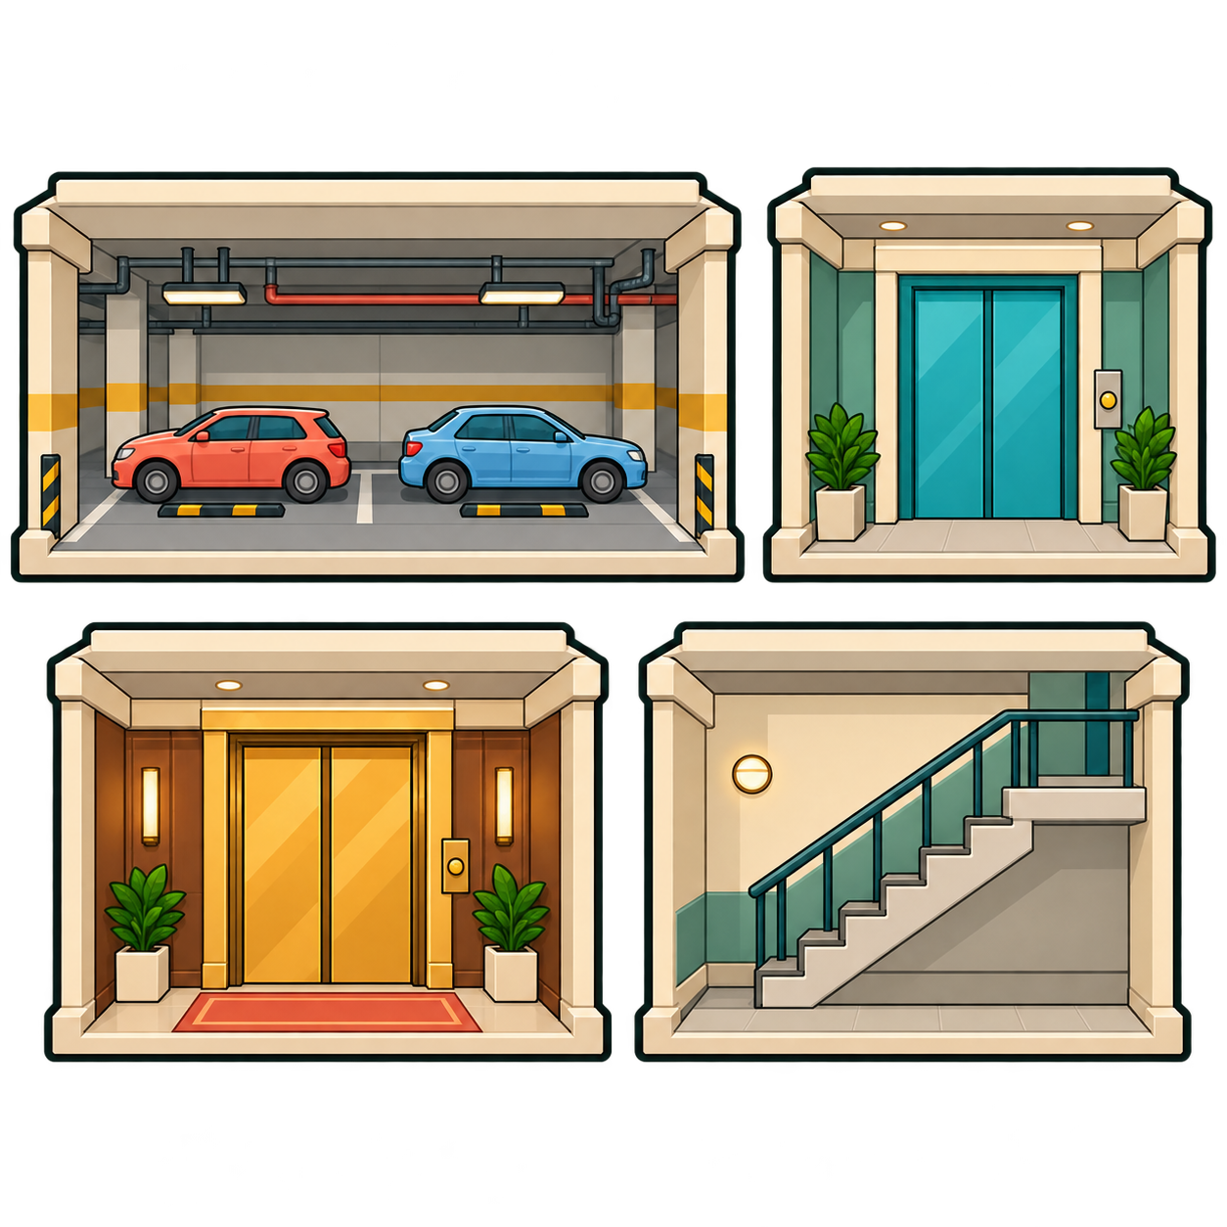
Building Management Tycoon
04 / 16
04 Rooms and transport
Apartment room
Hotel room
Office floor lease
Food court
Basement parking
Standard lift
Executive lift
Default stairs
Game design reference. Economy values and district names are examples.

Slide 5
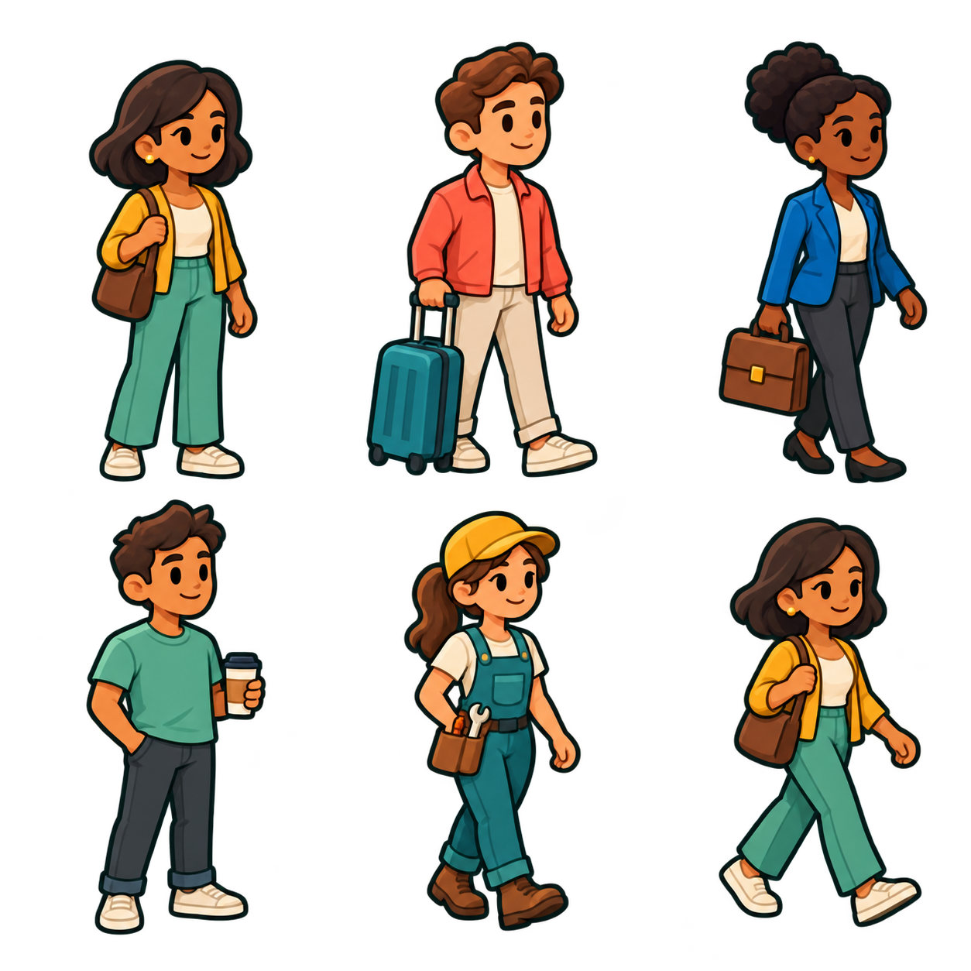
Building Management Tycoon
05 / 16
05 Residents and visitors
Resident
Hotel guest
Office tenant
Customer
Maintenance
Walking pose
Tenant needs
Happy
Needs a lift
Parking full
Lift access affects happiness. Parking limits new occupancy.
Game design reference. Economy values and district names are examples.

Slide 6
Building Management Tycoon
06 / 16
06 Controls and navigation
Central District
$12,000
80 gems
Day 12 / Morning
Default
Pressed
Focused
Disabled
Build
Build
Build
Build
District name
District name
District name
Central District
Central District
Enter a district name.
Achievement progress
320 / 1,000
Build
Tenants
Upgrades
Morning / Day / Afternoon / Night / Noon
Earn gems offline.
Decorations
Game design reference. Economy values and district names are examples.

Slide 7
Building Management Tycoon
07 / 16
07 Local profiles
Choose a district
01
Central District
Load
Saved on this device
02
Riverside
Load
Saved on this device
03
Empty slot
New
Start a new district
04
Empty slot
New
Building Management Tycoon
Start a new district
05
Empty slot
New
Progress saves on this device.
Start a new district
Game design reference. Economy values and district names are examples.

Slide 8
Building Management Tycoon
08 / 16
08 CBD map
Central District
$12,000
80 gems
Day 12 / Morning
North Offices
Office tower
Leased floors
2 / 4
Parking
60 / 100
Projected net
+$600
View building
Build
Tenants
Upgrades
Game design reference. Economy values and district names are examples.

Slide 9
Building Management Tycoon
09 / 16
09 Construction / building type
1 Type 2 Footprint 3 Floors 4 Review
Apartment
Hotel
Office tower
Food court
Rooms
Daily rooms
Floor leases
Customer sales
Selected
Select
Select
Select
Game design reference. Economy values and district names are examples.

Slide 10
Building Management Tycoon
10 / 16
10 Construction / land footprint
1 Type 2 Footprint 3 Floors 4 Review
Apartment footprint
Width
3 plots
Length
2 plots
Valid footprint
3 × 2 plots
Use this footprint
Drag across empty plots to set the land area.
Back keeps your plan.
Game design reference. Economy values and district names are examples.

Slide 11
Building Management Tycoon
11 / 16
11 Construction / floors and review
1 Type 2 Footprint 3 Floors 4 Review
Above-ground floors
Apartment
Review construction
Number of floors
Construction cost
Estimate
4
Daily upkeep
Estimate
−
+
Current funds
$12,000
Footprint
3 × 2
Footprint and floors lock
Room capacity
Calculated
Confirm construction
Rooms follow the footprint.
Sizing stays fixed after building.
Review the estimate before building.
Game design reference. Economy values and district names are examples.

Slide 12
Building Management Tycoon
12 / 16
12 Building and floor management
Amber Apartments
Floor 02 / Room 0201
Tap a room / drag to pan
03
02
Occupied
01
Tenant
Maya
Parking
Available
B1
View tenant
Game design reference. Economy values and district names are examples.

Slide 13
Building Management Tycoon
13 / 16
13 Tenants and parking
Maya / Apartment resident
Parking capacity
Used spaces
80 / 100
Happy
At full capacity, new occupancy stops.
Room 0201 / Amber Apartments
Expand parking before adding tenants.
Game design reference. Economy values and district names are examples.

Slide 14
Building Management Tycoon
14 / 16
14 Building upgrades
Luxury
Parking
Standard lift
Executive lift
Level example
0 / 3 levels
0 / 3 lifts
1 / 1 lift
Rating upgrades
Basements only
Better floor access
Executive access
Cost: estimate
Cost: estimate
Cost: estimate
Cost: estimate
Daily upkeep: estimate
Daily upkeep: estimate
Daily upkeep: estimate
Daily upkeep: estimate
Review upgrade
Review upgrade
Review upgrade
Maximum reached
Game design reference. Economy values and district names are examples.

Slide 15
Building Management Tycoon
15 / 16
15 Daily finances
Noon closing
Offline return
Loss day
Day 12
2 simulated days
Day example
Gross revenue
$1,000
Gross revenue
$2,000
Gross revenue
$200
Maintenance
−$300
Maintenance
−$600
Maintenance
−$300
Tax
−$100
Tax
−$200
Tax
−$100
Net
Net
Net
+$600
+$1,200
−$200
Added at daily closing.
Already applied to your balance.
Deducted at daily closing.
Continue
Continue
Continue
Game design reference. Economy values and district names are examples.

Slide 16
Building Management Tycoon
16 / 16
16 Portrait, landscape and web
Portrait
Landscape
Web / tablet
Central District
Central District
$12,000
Central District
$12,000
$12,000 / 80 gems
North Offices
North Offices
Day 12 / Morning
Parking
60 / 100
2 / 4 floors
View
60 / 100 parking
View building
North Offices
Parking 60 / 100
Same world, same controls
View building
Portrait opens a bottom sheet. Wide views use a side panel.
Build Tenants Upgrades
Selection and construction plans survive rotation.
Game design reference. Economy values and district names are examples.

