Slide 1
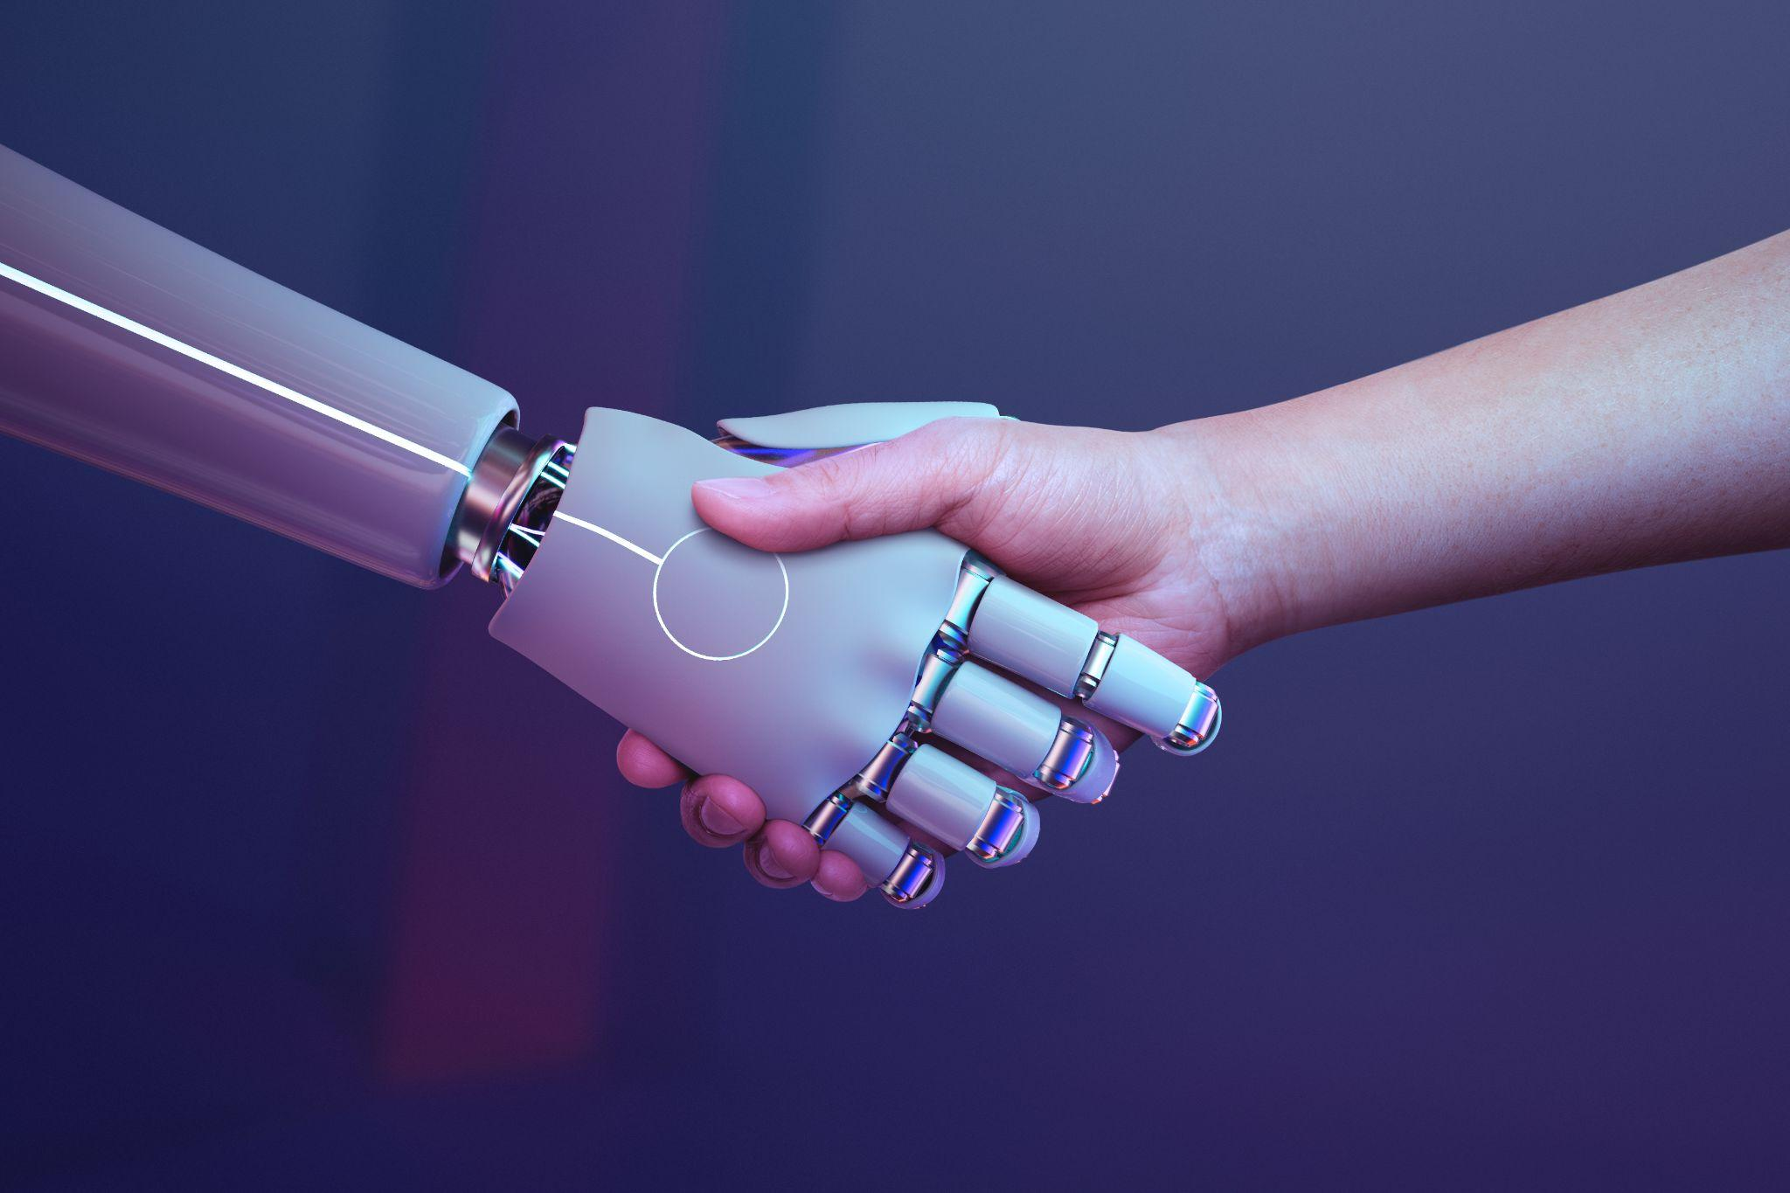

AI insights in job market

Slide 2
Table of contents
01
02
03
04
Team
Project idea & Objectives
Process of development
Dashboard

Slide 3
Team :
Ahmed Mohamed Abdel-Qawi
Nourhan Mohamed Abdel-Rahman
Senior student at the Faculty of Commerce at Sadat city university.
Junior Computer Science student at Benha university.
Karim samy El-sayed
Layla Ismail Ibrahim
Level 2 Student at faculty of commerce Georgia Program at Cairo University.
Second level Computer Science student at Modern Academy.
Mohammed Ashraf Mokhtar
Level 2 Computer Science student at O6U.

Slide 4

02
Project idea & Objectives
Defining the Vision: What the AI Dashboard Will Achieve

Slide 5
Research Question
What are the actual measurable effects of AI on:
→ Job creation vs job displacement
→ Automation risk and productivity
→ Skill requirements and career progression
→ Business performance and employment growth?

Slide 6
Why this matters?
Everyone says “AI will change everything” — but by how much, where, and for whom?
This dashboard uses real-world data to move the conversation from fear and hype to facts.
Objective of this capstone project
Build a fully interactive Power BI dashboard that quantifies the short- and medium-term effects of AI across millions of jobs and thousands of companies.

Slide 7

03
Process of development
From Concept to Curation: The Development Lifecycle

Slide 8
The development process
01 Sourcing
02 Preparation
03 Analysis
04 Final stage
Using AI Models.
Cleaned and transformed data using Power Query.
Built the data model and visualized insights in Power BI.
Finalized project reporting in Microsoft Word.

Slide 9
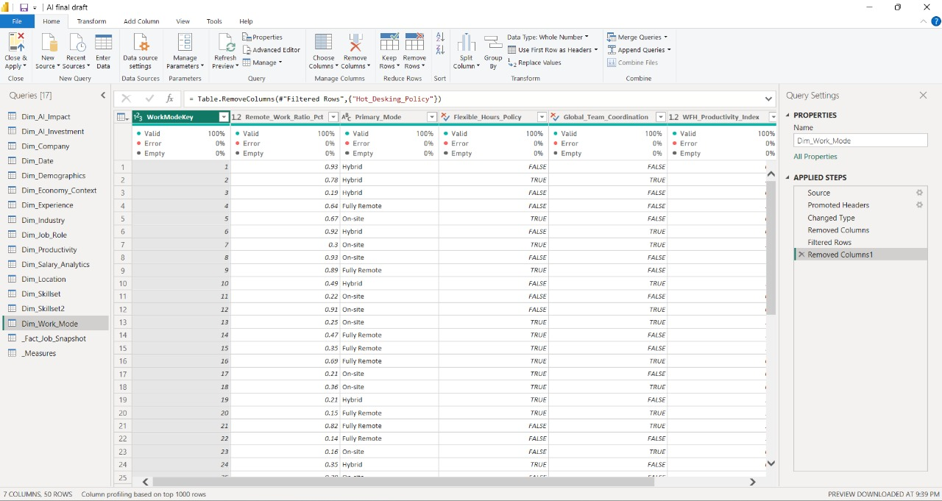
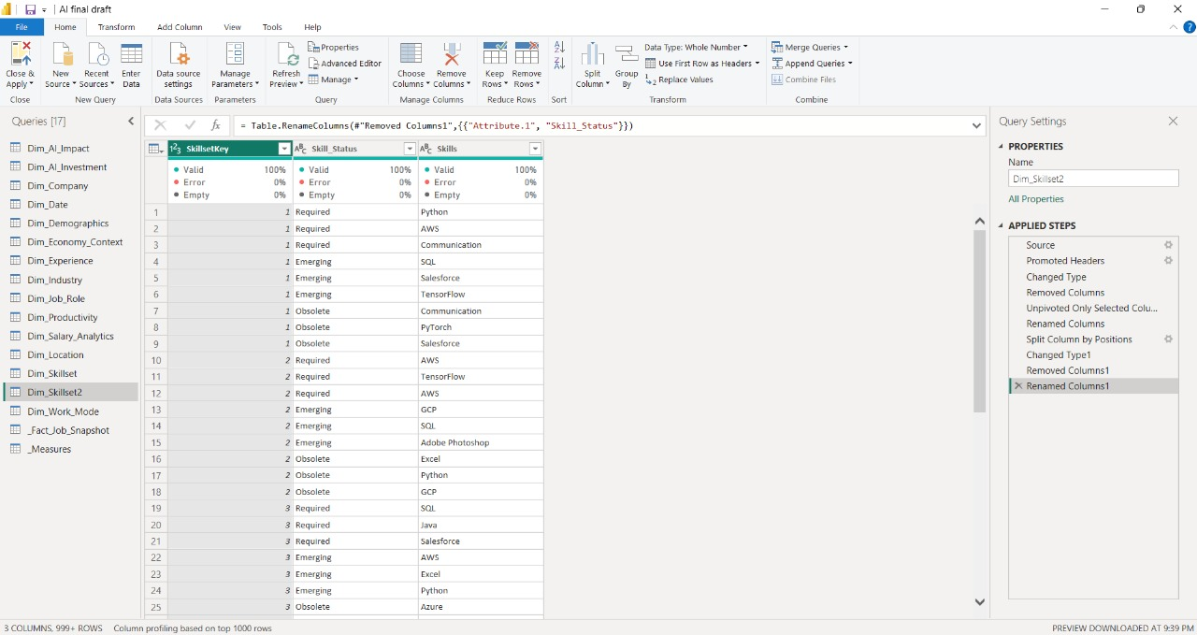
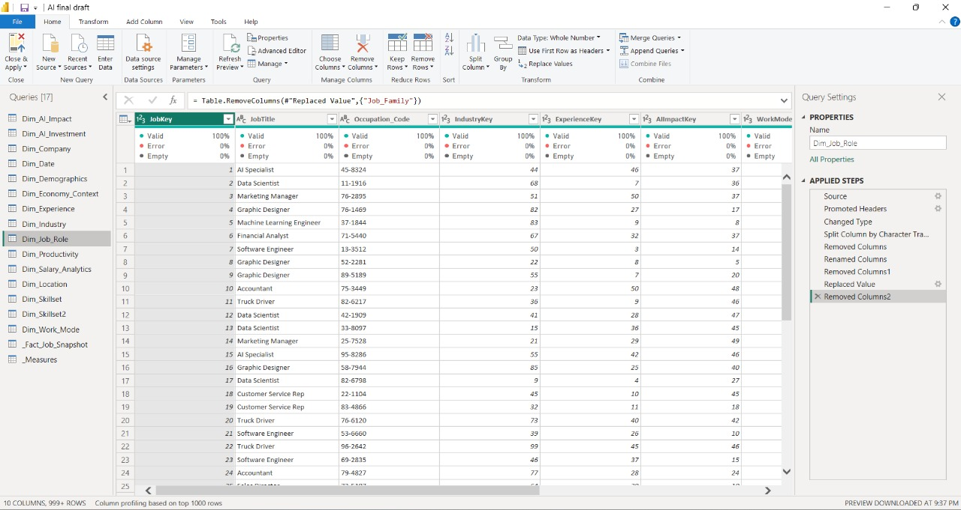
power query

Slide 10
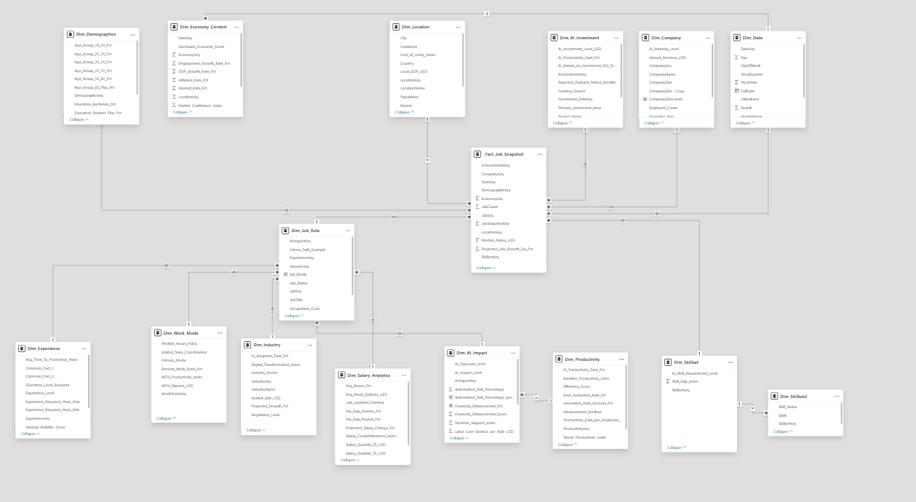
Data Model

Slide 11
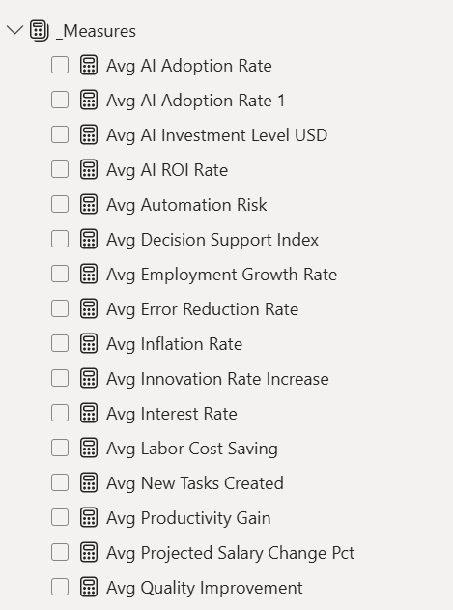
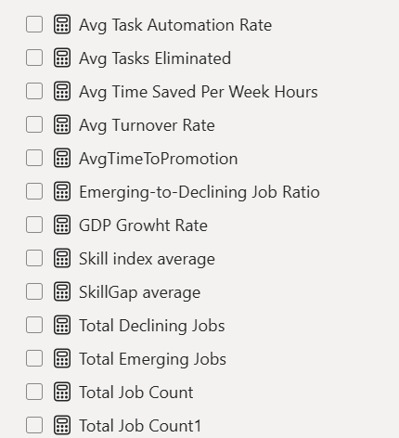
Measures

Slide 12
Timeline
Week 1–2
Week 3–4
Week 5–6
Week 7
Week 8
Research question + public dataset collection
Data cleaning & modeling (14 tables)
Visual design + interactivity + 4 tabs
Peer & professor testing
Final documentation

Slide 13
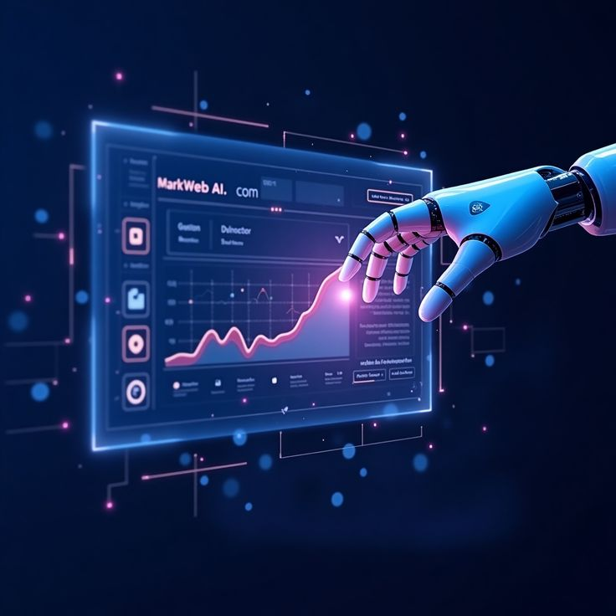
04
Let’s have a look
Visualizing Real-Time AI Performance and Impact

Slide 14
Recommendations
For students: Focus on tech skills, projects, and certifications
For universities: Teach AI-augmented versions of every subject
For policymakers: Support reskilling in high-emergence fields (Technology, Service Design, AI literacy)

Slide 15
Thank you

