Slide 1
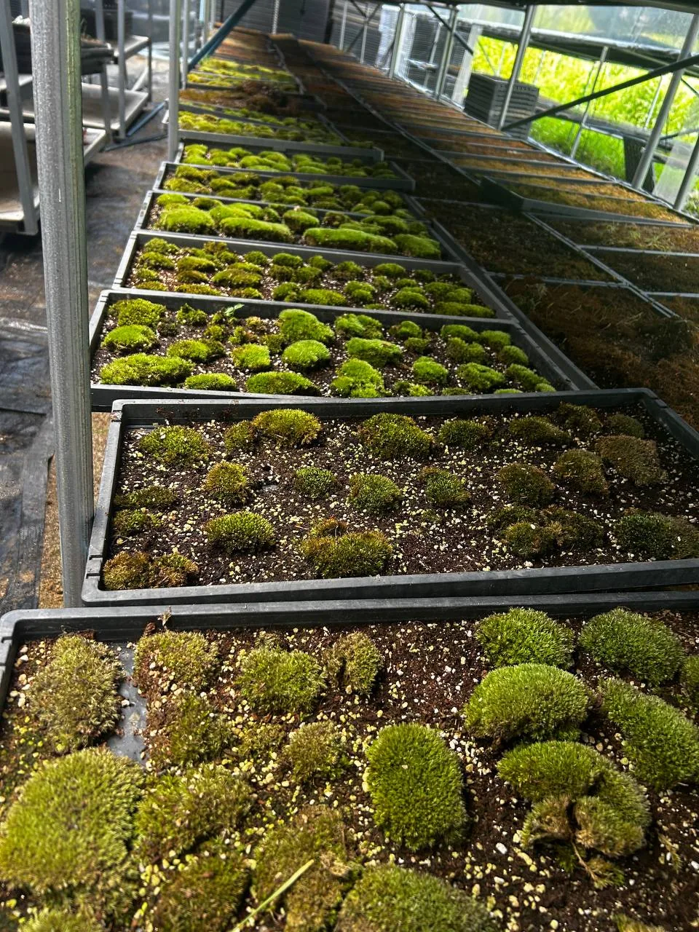
HACKER FARM
S T U D I O
INTRODUCTION
Ask the land.
Make with your hands.
Observe, repair and create at a shared farm in Goyang,
South Korea.
playworkgrow.club/en/
2026-10-10 · v08 / Introduction & presentation · operating plan
01

Slide 2
HACKER FARM
S T U D I O
THE QUESTION
From a solo pastime
to a shared inquiry.
A farm where questions and projects continue beyond a single visit.
01
Record a change and compare it on your next visit.
02
Repair a tool and leave instructions for the next person.
03
Explore technology and art on their own terms.
2026-10-10 · v08 / Introduction & presentation · operating plan
02
Notes:
A farm where questions and projects continue beyond a single visit.
Record a change and compare it on your next visit.
Repair a tool and leave instructions for the next person.
Explore technology and art on their own terms.
2026-10-10 · v08

Slide 3
HACKER FARM
S T U D I O
OUR DIFFERENCE
The farm is where
the work begins.
Weather, materials, signs of use and human perception raise new questions each time.
01
Place — return to the same spot and notice what changes
02
Continuity — pair repair with useful documentation
03
Expression — value artistic inquiry in its own right
2026-10-10 · v08 / Introduction & presentation · operating plan
03
Notes:
Weather, materials, signs of use and human perception raise new questions each time.
Place — return to the same spot and notice what changes
Continuity — pair repair with useful documentation
Expression — value artistic inquiry in its own right
2026-10-10 · v08

Slide 4
HACKER FARM
S T U D I O
01 / OBSERVE
Read the farm’s
less visible changes.
Put photographs and impressions alongside readings of light, temperature and soil.
01
Source principle: TechRice links places, devices, sensors and readings
02
Adaptation: add timestamps, units, missing data and human observations
03
Your starting point: three sentences about light and colour in one place
2026-10-10 · v08 / Introduction & presentation · operating plan
04
Notes:
Put photographs and impressions alongside readings of light, temperature and soil.
Source principle: TechRice links places, devices, sensors and readings
Adaptation: add timestamps, units, missing data and human observations
Your starting point: three sentences about light and colour in one place
2026-10-10 · v08

Slide 5
HACKER FARM
S T U D I O
02 / REPAIR
Think of the next
person using a tool.
Explain where a tool is, its condition and how it can be used again.
01
Source principle: QR Inventory connects an item ID with its status
02
Adaptation: add photos, checks, repair history and short instructions
03
Your starting point: a name, location and condition card for one object
2026-10-10 · v08 / Introduction & presentation · operating plan
05
Notes:
Explain where a tool is, its condition and how it can be used again.
Source principle: QR Inventory connects an item ID with its status
Adaptation: add photos, checks, repair history and short instructions
Your starting point: a name, location and condition card for one object
2026-10-10 · v08

Slide 6
HACKER FARM
S T U D I O
03 / CREATE
Express light through
the folds of paper.
Explore structure, material and energy to give your question a physical form.
01
Source idea: Solar Paper Lantern brings light, paper and energy together
02
Adaptation: begin with paper models, then assess current components and safety
03
Your starting point: sketch a paper structure and mark a path for light
2026-10-10 · v08 / Introduction & presentation · operating plan
06
Notes:
Explore structure, material and energy to give your question a physical form.
Source idea: Solar Paper Lantern brings light, paper and energy together
Adaptation: begin with paper models, then assess current components and safety
Your starting point: sketch a paper structure and mark a path for light
2026-10-10 · v08

Slide 7
HACKER FARM
S T U D I O
YOUR JOURNEY
Begin with curiosity,
not expertise.
Choose an interest, try a small action and leave yourself a next question.
01
01 Discover — choose a question about observation, tools or light
02
02 Prepare — start on your own with a photo, note or sketch
03
03 Work together — join a small team in the planned first season
04
04 Continue — use what you record to begin the next experiment
2026-10-10 · v08 / Introduction & presentation · operating plan
07
Notes:
Choose an interest, try a small action and leave yourself a next question.
01 Discover — choose a question about observation, tools or light
02 Prepare — start on your own with a photo, note or sketch
03 Work together — join a small team in the planned first season
04 Continue — use what you record to begin the next experiment
2026-10-10 · v08

Slide 8
HACKER FARM
S T U D I O
FIRST SEASON / PLAN
Twelve weeks of
small experiments.
Six three-hour sessions, every other week. Designed around three teams of four.
01
Sessions 1–2 · explore the setting and choose questions and roles
02
Sessions 3–4 · build small prototypes, compare records and revise
03
Sessions 5–6 · test again and document the next steps
2026-10-10 · v08 / Introduction & presentation · operating plan
08
Notes:
Six three-hour sessions, every other week. Designed around three teams of four.
Sessions 1–2 · explore the setting and choose questions and roles
Sessions 3–4 · build small prototypes, compare records and revise
Sessions 5–6 · test again and document the next steps
2026-10-10 · v08

Slide 9
HACKER FARM
S T U D I O
MEMBERSHIP / PLAN
A clear group size
and membership fee.
First-season capacity: 12 people · KRW 360,000 per person for 12 weeks
01
Planned inclusions: six sessions, basic shared tools and consumables, documentation guidance
02
Outside the plan: personal equipment, specialist materials, meals and transport
03
Membership covers scheduled sessions, not unrestricted access to the premises.
04
Start dates, facilitators, detailed support and refund terms will be published before enrolment.
2026-10-10 · v08 / Introduction & presentation · operating plan
09
Notes:
First-season capacity: 12 people · KRW 360,000 per person for 12 weeks
Planned inclusions: six sessions, basic shared tools and consumables, documentation guidance
Outside the plan: personal equipment, specialist materials, meals and transport
Membership covers scheduled sessions, not unrestricted access to the premises.
Start dates, facilitators, detailed support and refund terms will be published before enrolment.
2026-10-10 · v08

Slide 10
HACKER FARM
S T U D I O
OUR PRINCIPLES
A shared farm.
Shared commitments.
Membership fees support preparation and the running of shared activities.
01
Our operating model does not rely on property rental revenue.
02
Different contributions through technology, art and observation are valued.
03
You choose whether to share your work, photos and records.
04
We distinguish sources from adaptations, and plans from actual results.
2026-10-10 · v08 / Introduction & presentation · operating plan
10
Notes:
Membership fees support preparation and the running of shared activities.
Our operating model does not rely on property rental revenue.
Different contributions through technology, art and observation are valued.
You choose whether to share your work, photos and records.
We distinguish sources from adaptations, and plans from actual results.
2026-10-10 · v08

Slide 11
HACKER FARM
S T U D I O
YOUR NEXT STEP
Bring your
first question.
Enrolment is being prepared. Read the material and choose a personal starting point.
01
Explore the three projects and the preparation suggested for each role.
02
Write your question and save a personal note.
03
Twelve is the planned capacity. No members have been recruited yet.
04
Reading this material or saving a note does not submit an application or booking.
2026-10-10 · v08 / Introduction & presentation · operating plan
11
Notes:
Enrolment is being prepared. Read the material and choose a personal starting point.
Explore the three projects and the preparation suggested for each role.
Write your question and save a personal note.
Twelve is the planned capacity. No members have been recruited yet.
Reading this material or saving a note does not submit an application or booking.
2026-10-10 · v08

Slide 12
HACKER FARM
S T U D I O
REFERENCES / EDITION 08
Sources and
what comes next.
Build on the questions in earlier work, then test the adaptations in our own setting.
01
FarmLab · TechRice · Python workshops · QR Inventory · Solar Paper Lantern
02
These are external reference projects, not Hacker Farm Studio’s completed work.
03
Next checks: runtimes, components, licensing, field safety and facilitators
04
2026-10-10 · v08 / Introduction, presentation and first-season operating plan
2026-10-10 · v08 / Introduction & presentation · operating plan
12
Notes:
FarmLab: https://hackerfarm.jp/projects/farmlab/
TechRice: https://github.com/Hackerfarm/techrice
Python workshops: https://github.com/Hackerfarm/python-workshops
QR Inventory: https://github.com/Hackerfarm/qrinventory
Solar Paper Lantern: https://github.com/Hackerfarm/solar-paper-lantern
First-season capacity: 12 people · KRW 360,000 per person for 12 weeks

