Slide 1
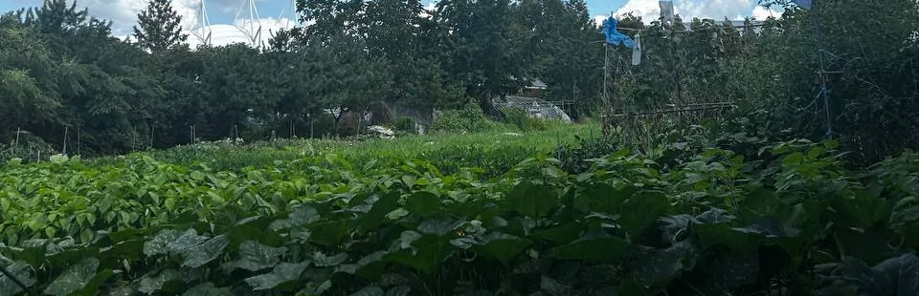
HACKER FARM / STUDIO
Hacker Farm
A shared farm in Goyang
2026-10-10 · v09 / Season plan · not open yet
01 / 12
Notes:
Observe, repair and create at a shared farm in Goyang, South Korea.
Farm photo archive · first season in preparation
No members have been recruited. Applications and payments are not open. See the introduction for detailed terms.
FarmLab: https://hackerfarm.jp/projects/farmlab/
TechRice: https://github.com/Hackerfarm/techrice
Python workshops: https://github.com/Hackerfarm/python-workshops
QR Inventory: https://github.com/Hackerfarm/qrinventory
Solar Paper Lantern: https://github.com/Hackerfarm/solar-paper-lantern
2026-10-10 · v09

Slide 2
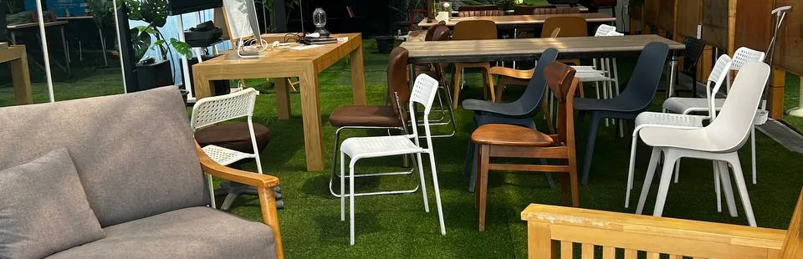
HACKER FARM / STUDIO
A shared place.
Begin at a shared farm
2026-10-10 · v09 / Season plan · not open yet
02 / 12
Notes:
A farm where questions and projects continue beyond a single visit.
Record a change and compare it on your next visit.
Repair a tool and leave instructions for the next person.
Explore technology and art on their own terms.
Farm photo archive · first season in preparation
No members have been recruited. Applications and payments are not open. See the introduction for detailed terms.
FarmLab: https://hackerfarm.jp/projects/farmlab/
TechRice: https://github.com/Hackerfarm/techrice
Python workshops: https://github.com/Hackerfarm/python-workshops
QR Inventory: https://github.com/Hackerfarm/qrinventory
Solar Paper Lantern: https://github.com/Hackerfarm/solar-paper-lantern
2026-10-10 · v09

Slide 3
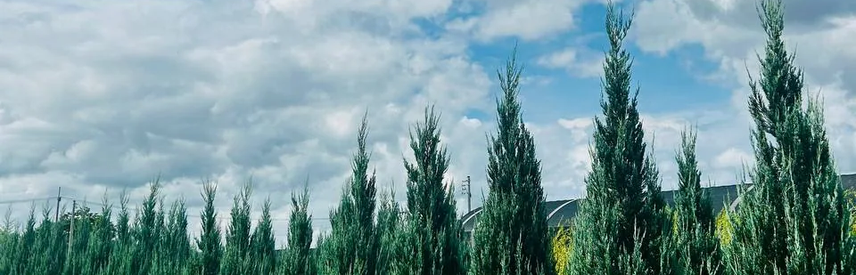
HACKER FARM / STUDIO
Look closer.
One place. A different light.
2026-10-10 · v09 / Season plan · not open yet
03 / 12
Notes:
Put photographs and impressions alongside readings of light, temperature and soil.
Source principle: TechRice links places, devices, sensors and readings
Adaptation: add timestamps, units, missing data and human observations
Your starting point: three sentences about light and colour in one place
Farm photo archive · first season in preparation
No members have been recruited. Applications and payments are not open. See the introduction for detailed terms.
FarmLab: https://hackerfarm.jp/projects/farmlab/
TechRice: https://github.com/Hackerfarm/techrice
Python workshops: https://github.com/Hackerfarm/python-workshops
QR Inventory: https://github.com/Hackerfarm/qrinventory
Solar Paper Lantern: https://github.com/Hackerfarm/solar-paper-lantern
2026-10-10 · v09

Slide 4
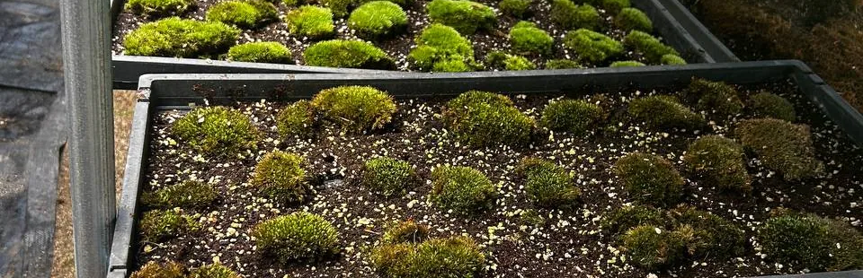
HACKER FARM / STUDIO
Keep a note.
One photo. Your own words.
2026-10-10 · v09 / Season plan · not open yet
04 / 12
Notes:
Put photographs and impressions alongside readings of light, temperature and soil.
Source principle: TechRice links places, devices, sensors and readings
Adaptation: add timestamps, units, missing data and human observations
Your starting point: three sentences about light and colour in one place
Farm photo archive · first season in preparation
No members have been recruited. Applications and payments are not open. See the introduction for detailed terms.
FarmLab: https://hackerfarm.jp/projects/farmlab/
TechRice: https://github.com/Hackerfarm/techrice
Python workshops: https://github.com/Hackerfarm/python-workshops
QR Inventory: https://github.com/Hackerfarm/qrinventory
Solar Paper Lantern: https://github.com/Hackerfarm/solar-paper-lantern
2026-10-10 · v09

Slide 5
HACKER FARM / STUDIO
Use it again.
Ready for the next person
2026-10-10 · v09 / Season plan · not open yet
05 / 12
Notes:
Explain where a tool is, its condition and how it can be used again.
Source principle: QR Inventory connects an item ID with its status
Adaptation: add photos, checks, repair history and short instructions
Your starting point: a name, location and condition card for one object
Farm photo archive · first season in preparation
No members have been recruited. Applications and payments are not open. See the introduction for detailed terms.
FarmLab: https://hackerfarm.jp/projects/farmlab/
TechRice: https://github.com/Hackerfarm/techrice
Python workshops: https://github.com/Hackerfarm/python-workshops
QR Inventory: https://github.com/Hackerfarm/qrinventory
Solar Paper Lantern: https://github.com/Hackerfarm/solar-paper-lantern
2026-10-10 · v09

Slide 6
HACKER FARM / STUDIO
Make light.
A small experiment with paper
2026-10-10 · v09 / Season plan · not open yet
06 / 12
Notes:
Explore structure, material and energy to give your question a physical form.
Source idea: Solar Paper Lantern brings light, paper and energy together
Adaptation: begin with paper models, then assess current components and safety
Your starting point: sketch a paper structure and mark a path for light
Farm photo archive · first season in preparation
No members have been recruited. Applications and payments are not open. See the introduction for detailed terms.
FarmLab: https://hackerfarm.jp/projects/farmlab/
TechRice: https://github.com/Hackerfarm/techrice
Python workshops: https://github.com/Hackerfarm/python-workshops
QR Inventory: https://github.com/Hackerfarm/qrinventory
Solar Paper Lantern: https://github.com/Hackerfarm/solar-paper-lantern
2026-10-10 · v09

Slide 7
HACKER FARM / STUDIO
Come curious.
No experience needed to begin
2026-10-10 · v09 / Season plan · not open yet
07 / 12
Notes:
Choose an interest, try a small action and leave yourself a next question.
01 Discover — choose a question about observation, tools or light
02 Prepare — start on your own with a photo, note or sketch
03 Work together — join a small team in the planned first season
04 Continue — use what you record to begin the next experiment
Farm photo archive · first season in preparation
No members have been recruited. Applications and payments are not open. See the introduction for detailed terms.
FarmLab: https://hackerfarm.jp/projects/farmlab/
TechRice: https://github.com/Hackerfarm/techrice
Python workshops: https://github.com/Hackerfarm/python-workshops
QR Inventory: https://github.com/Hackerfarm/qrinventory
Solar Paper Lantern: https://github.com/Hackerfarm/solar-paper-lantern
2026-10-10 · v09

Slide 8
HACKER FARM / STUDIO
12 weeks
Six sessions · three hours each
2026-10-10 · v09 / Season plan · not open yet
08 / 12
Notes:
Six three-hour sessions, every other week. Designed around three teams of four.
Sessions 1–2 · explore the setting and choose questions and roles
Sessions 3–4 · build small prototypes, compare records and revise
Sessions 5–6 · test again and document the next steps
Farm photo archive · first season in preparation
No members have been recruited. Applications and payments are not open. See the introduction for detailed terms.
FarmLab: https://hackerfarm.jp/projects/farmlab/
TechRice: https://github.com/Hackerfarm/techrice
Python workshops: https://github.com/Hackerfarm/python-workshops
QR Inventory: https://github.com/Hackerfarm/qrinventory
Solar Paper Lantern: https://github.com/Hackerfarm/solar-paper-lantern
2026-10-10 · v09

Slide 9
HACKER FARM / STUDIO
12 people
Planned capacity · 3 teams
2026-10-10 · v09 / Season plan · not open yet
09 / 12
Notes:
Six three-hour sessions, every other week. Designed around three teams of four.
Sessions 1–2 · explore the setting and choose questions and roles
Sessions 3–4 · build small prototypes, compare records and revise
Sessions 5–6 · test again and document the next steps
Farm photo archive · first season in preparation
No members have been recruited. Applications and payments are not open. See the introduction for detailed terms.
FarmLab: https://hackerfarm.jp/projects/farmlab/
TechRice: https://github.com/Hackerfarm/techrice
Python workshops: https://github.com/Hackerfarm/python-workshops
QR Inventory: https://github.com/Hackerfarm/qrinventory
Solar Paper Lantern: https://github.com/Hackerfarm/solar-paper-lantern
2026-10-10 · v09

Slide 10
HACKER FARM / STUDIO
₩360,000
Per person · 12-week plan
2026-10-10 · v09 / Season plan · not open yet
10 / 12
Notes:
First-season capacity: 12 people · KRW 360,000 per person for 12 weeks
Planned inclusions: six sessions, basic shared tools and consumables, documentation guidance
Outside the plan: personal equipment, specialist materials, meals and transport
Membership covers scheduled sessions, not unrestricted access to the premises.
Start dates, facilitators, detailed support and refund terms will be published before enrolment.
Farm photo archive · first season in preparation
No members have been recruited. Applications and payments are not open. See the introduction for detailed terms.
FarmLab: https://hackerfarm.jp/projects/farmlab/
TechRice: https://github.com/Hackerfarm/techrice
Python workshops: https://github.com/Hackerfarm/python-workshops
QR Inventory: https://github.com/Hackerfarm/qrinventory
Solar Paper Lantern: https://github.com/Hackerfarm/solar-paper-lantern
2026-10-10 · v09

Slide 11
HACKER FARM / STUDIO
Share. Care.
A shared farm. Voluntary sharing.
2026-10-10 · v09 / Season plan · not open yet
11 / 12
Notes:
Membership fees support preparation and the running of shared activities.
Our operating model does not rely on property rental revenue.
Different contributions through technology, art and observation are valued.
You choose whether to share your work, photos and records.
We distinguish sources from adaptations, and plans from actual results.
Farm photo archive · first season in preparation
No members have been recruited. Applications and payments are not open. See the introduction for detailed terms.
FarmLab: https://hackerfarm.jp/projects/farmlab/
TechRice: https://github.com/Hackerfarm/techrice
Python workshops: https://github.com/Hackerfarm/python-workshops
QR Inventory: https://github.com/Hackerfarm/qrinventory
Solar Paper Lantern: https://github.com/Hackerfarm/solar-paper-lantern
2026-10-10 · v09

Slide 12
HACKER FARM / STUDIO
One question.
Preparing for our first season
2026-10-10 · v09 / Season plan · not open yet
12 / 12
Notes:
Enrolment is being prepared. Read the material and choose a personal starting point.
Explore the three projects and the preparation suggested for each role.
Write your question and save a personal note.
Twelve is the planned capacity. No members have been recruited yet.
Reading this material or saving a note does not submit an application or booking.
Farm photo archive · first season in preparation
No members have been recruited. Applications and payments are not open. See the introduction for detailed terms.
FarmLab: https://hackerfarm.jp/projects/farmlab/
TechRice: https://github.com/Hackerfarm/techrice
Python workshops: https://github.com/Hackerfarm/python-workshops
QR Inventory: https://github.com/Hackerfarm/qrinventory
Solar Paper Lantern: https://github.com/Hackerfarm/solar-paper-lantern
2026-10-10 · v09

