Slide 1

Company & Product
Introduction
Intellect Pioneering Battery Tech Co., Ltd.

Slide 2
Agenda
I、Company Introduction
II、Lithium-ion polymer cell Character & Performance
III、IP Product Introduction
1）RC Li-ion polymer Battery
2）LiFePO4 Power battery
3）Li-NMC Power battery
4）High Capacity Digital Li-ion polymer Cell
IV、Safety Performance

Slide 3
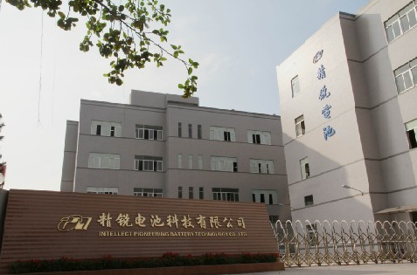
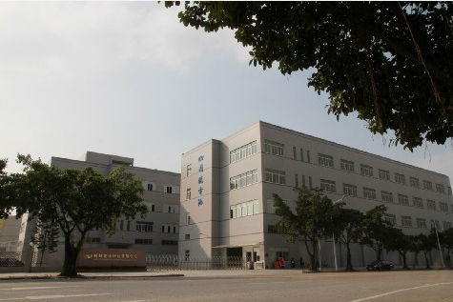
I、Company Introduction

Slide 4
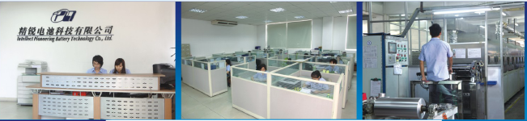
Company Introduction
Established in 2007,Intellect Pioneering Battery Technology Co.,Ltd (IP) is having our headquarters in Hongkong ,and our production plant is located in Shunde District,FoShan ,GuangDong province, PRC, by which we enjoy the geographic convenience and fast transportation infrastructure.The company is having production space of 20,000 square meters and with daily production volume over 100,000Ah.
IP is an innovative Hi-Tech corporation with independent intellectual-property and core technologies, which is specialized in high power, high energy and environmental-friendly Lithium-ion polymer battery’s R&D ,Production and management. And our batteries are sold across Europe, America, Asia, and so on . Our product range includes high-rate RC battery series, high-power battery series ,high capacity digital products series. Our batteries are widely used in the remote-control electric airplane and cars,electric model-gun, power motorcycle starter battery, UPS power facilities devices,electric bicycle,electric motorcycle, and mobile phone,MP3/MP4,bluetooth,PDA,GPS,notebook PC, military products,and so on .
Since foundation , IP was growing with an annual turnover of 30-50% ,and has passed the ISO9001: 2008 system certification. And our products had passed the UN, UL, CE, ROHS certifications.

Slide 5
Mission and Vision
It is our mission to offer high quality batteries, to strive as a leading brand in the same trade, creating real and long-lasting value for our customers, prompting career growth for our staff, and supplying clear and safe energy for society. Our vision is to turn ourselves as a prestige and worldwide leading battery export.
IP will be an international, high-tech and service-oriented enterprise in future.
Your Energy Partner!

Slide 6
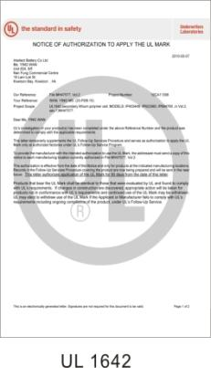
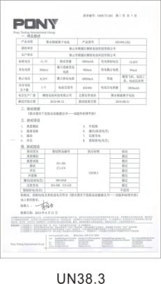
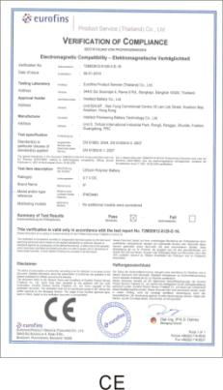
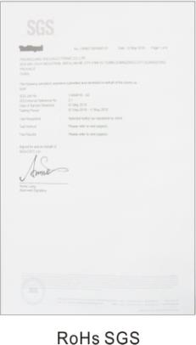
Certification

Slide 7
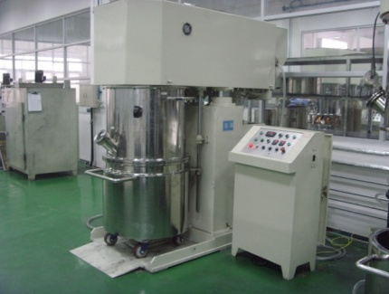
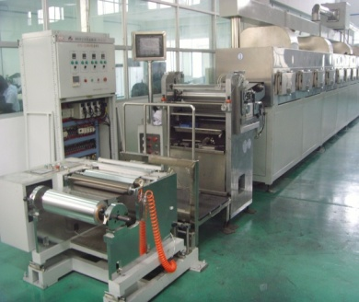
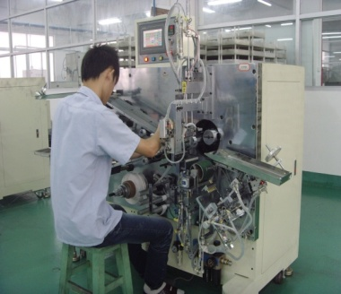
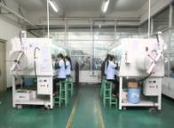
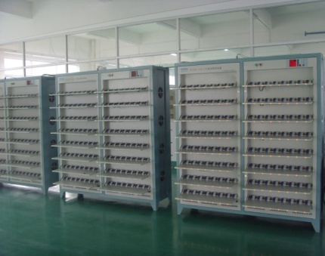
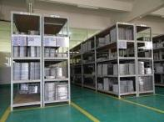
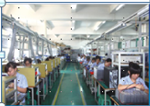
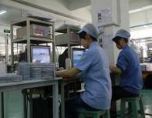
Production Process
Materials Mixing and coating
Electrode-making
Winding & Stacking
Injection
And Sealing
Formation
And Grading
Storage
Packing
Final inspection

Slide 8

Quality Control
Co-R&D with suppliers for main raw-materials
ISO9001:2008 Quality-Control System
Product Quality-control
Quality plan
Procedure Quality-control
Supplier’s Quality-control
CE、UL、UN Certification
Raw-materials Quality-control
QC Improvement System
ISO9001: 2008
CE
U_{L}
UN
RoHS
Notes:
8

Slide 9
Quality Control
Co-R&D with suppliers for main raw-materials
ISO9001:2008 Quality-Control System
Product Quality-control
Quality plan
Procedure Quality-control
Supplier’s Quality-control
CE、UL、UN Certification
Raw-materials Quality-control
QC Improvement System
ISO9001: 2008
CE
U_{L}
UN
RoHS

Slide 10
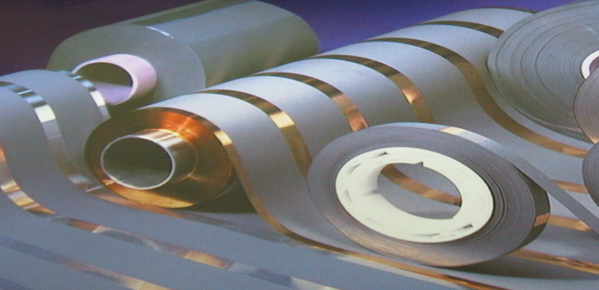
II、Lithium-ion polymer cell Character & Performance

Slide 11
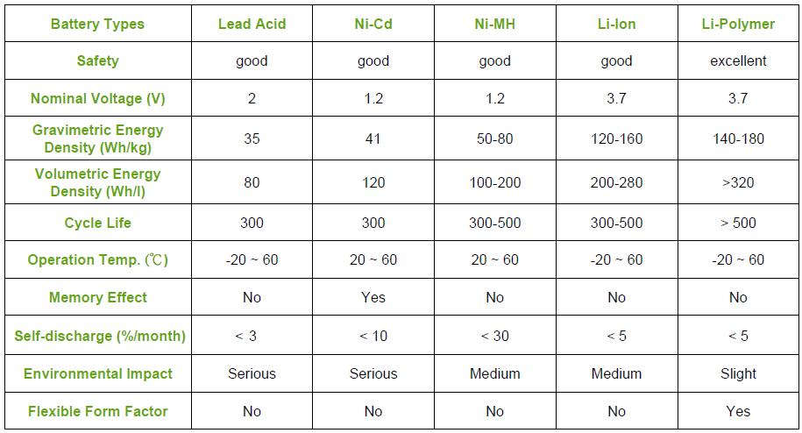
Comparison of different types battery

Slide 12
Performance Comparison different Positive electrode
Item | LiFePO4 | Li(NiaMnbCoc)O2 | LiMn2O4 | LiCoO2
Theoretical specific energy (mAh/g) | 170 | >190 | 148 | 274
Actual specific energy (mAh/g) | 130 | 150 | 90 | 145
Discharge platform (V) | 3.2-3.3 | 3.6-3.7 | 3.7-3.8 | 3.6-3.7
Cycle life (times) | >2000 | >1000 | >300 | >500
High temperature performance(℃) | >75℃ | >65℃ | ~45℃ | ~80℃
High rates performance | better | good | bad | better

Slide 13

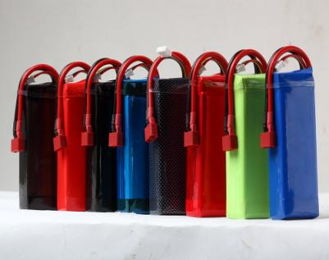
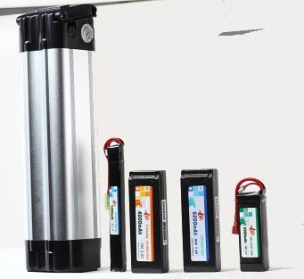
III、IP Product Introduction

Slide 14
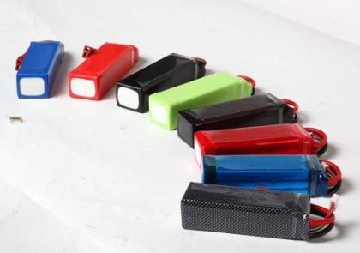
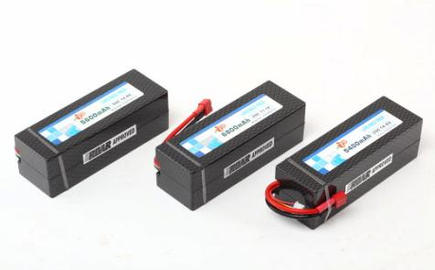
High Rate RC battery introduction

Slide 15
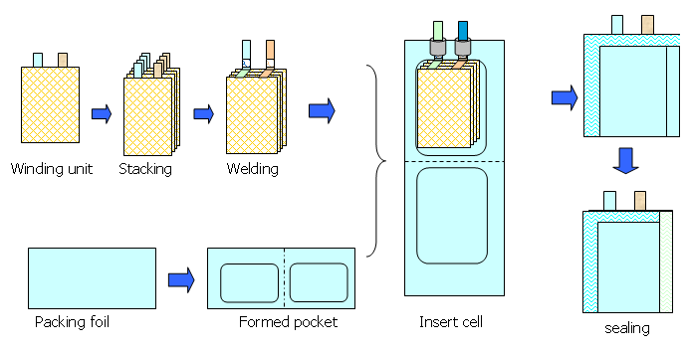
Unique Technical Structure
----Winding & Stacking
Integrate and consolidate advantages of the winding structure and the stacking structure , avoid and reduce the negative factors of both

Slide 16
Advantages of IP high rate battery
Unique Technical Structure：Winding & Stacking
Integrate and consolidate advantages of the winding structure and the stacking structure ,avoid and reduce the negative factors of both
Technical Structure | Advantages | Application | Disadvantages
Stacking | Low internal resistance（parallel connection structure） High energy density | Stable high voltage and high power Small volume ,light weight | High probability of internal short-circuit Bad consistency
Winding | Low probability of internal short-circuit Good consistency | High reliable quality ；high yield rate | High internal resistance（series connection structure） Energy density is lower than 5%

Slide 17
Power character of High Rate battery
High Rate Range: 10C--50C
Typical 40C cell design
Continuous Discharge ：5000Wh/kg and 10000Wh/L
Pulse Discharge： 8000Wh/kg and 16000Wh/L

Slide 18
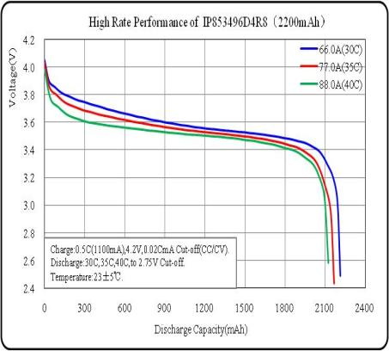
IP high rate battery character

Slide 19
IP high rate battery cycle life character

Slide 20
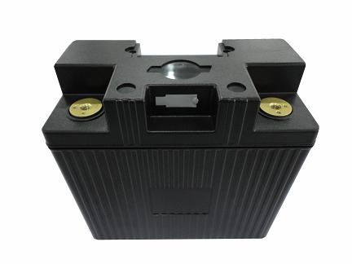
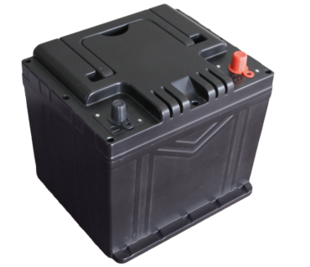
IP LiFePO4 Power Battery Introduction

Slide 21
Features of IP LiFePO4 Power Battery
Long Cycle Life
Outstanding rated discharge performance
Excellent low temperature performance

Slide 22
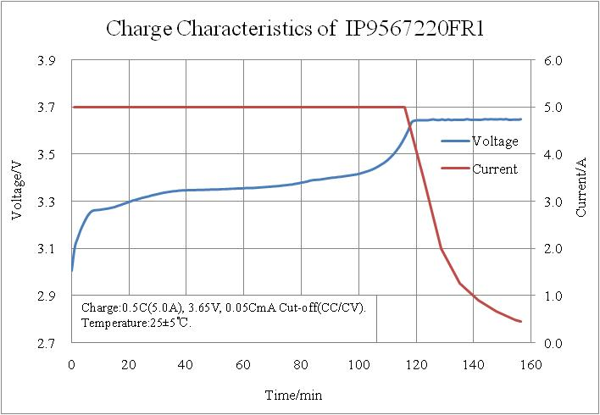
Typical Charging Curve

Slide 23
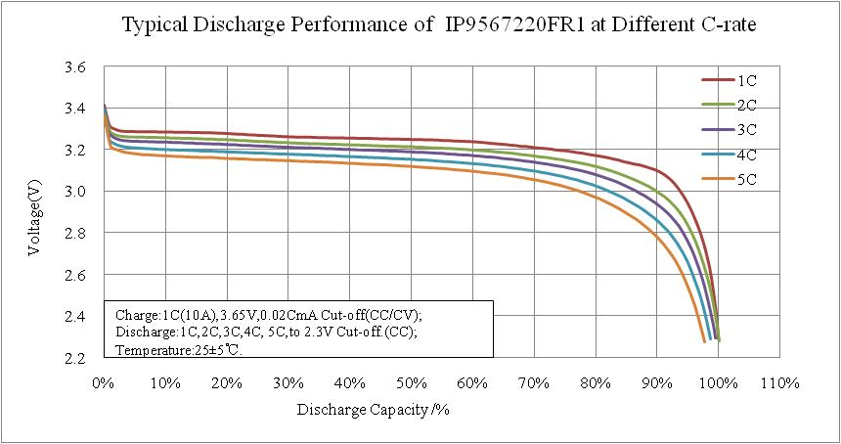
Typical Rated Discharging Curve

Slide 24
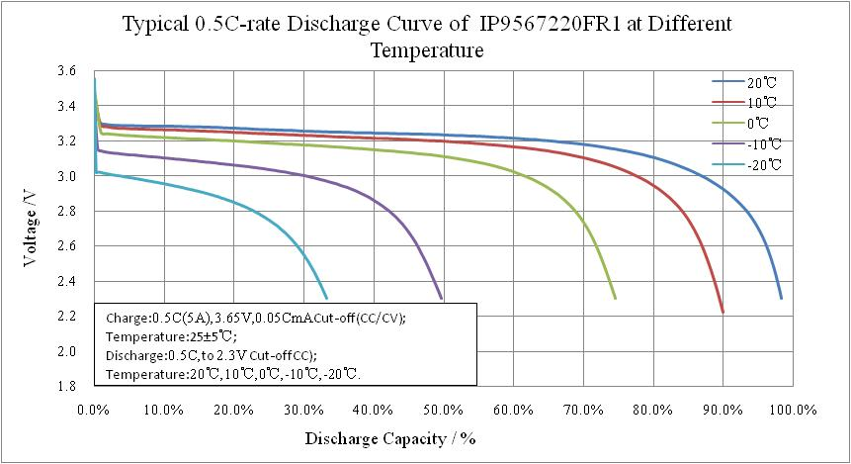
Excellent low temperature performance

Slide 25
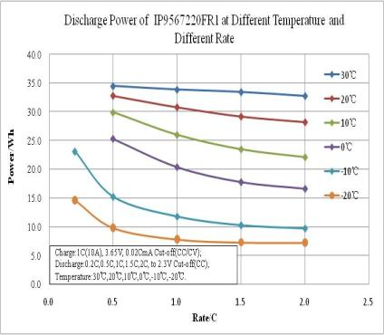
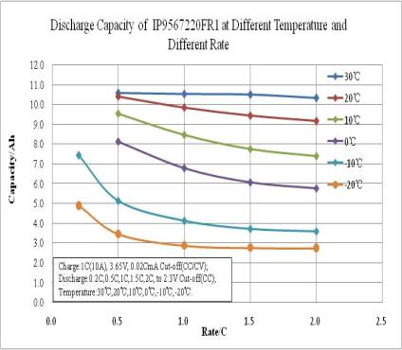
Comparison under different Temperatures at different Rates
Even at low Temperature, IP battery is still strong powerful！

Slide 26
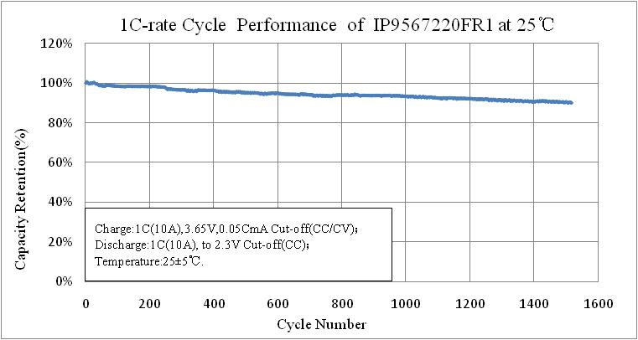
Single cell charge-discharge at 1C Cycle Performance＞1500 times (room temperate )

Slide 27
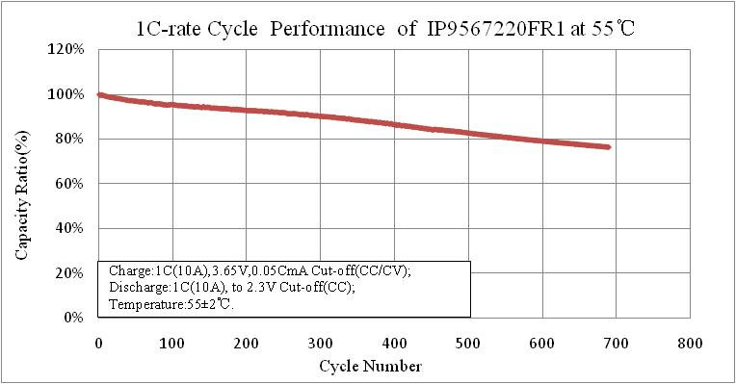
Single cell charge-discharge at 1C Cycle Performance＞500 times (55℃)

Slide 28
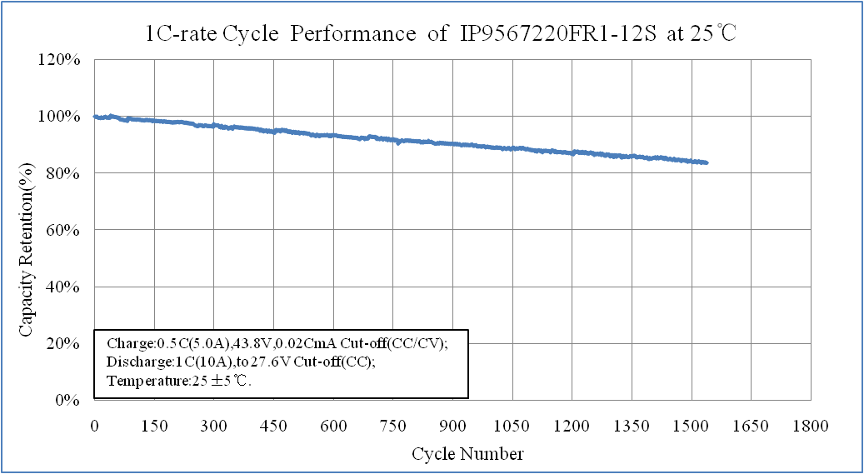
12S battery pack discharge at 1C Cycle Performance＞1500 times (room temperate )

Slide 29
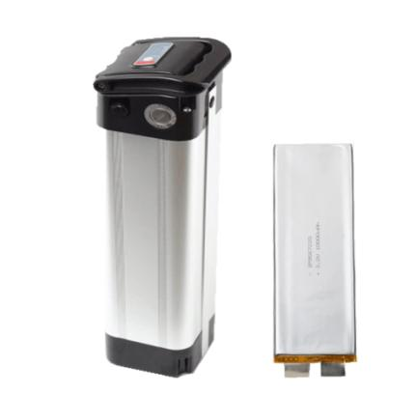
Li-NMC Power battery Introduction

Slide 30
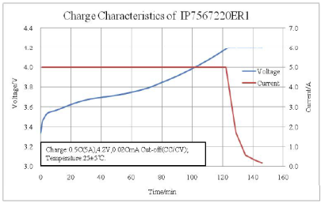
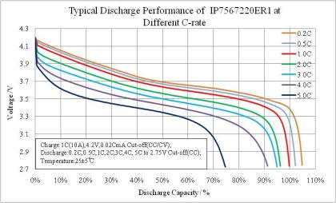
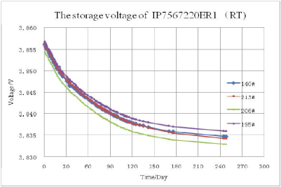
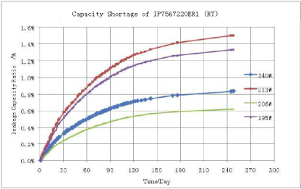
Cell Performance curve
Charge curve
Discharge curve
storage
The capacity decrease at app. 0.15% per month

Slide 31
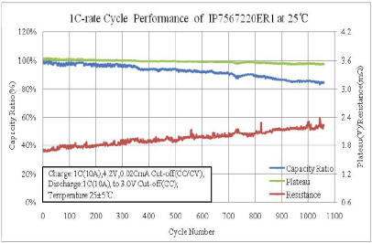
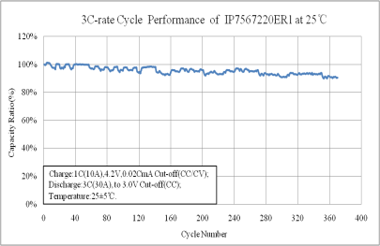
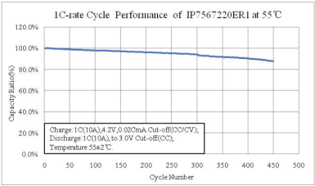
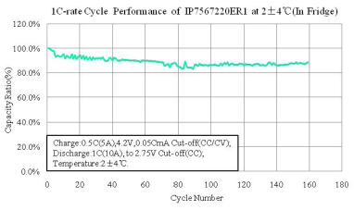
Cell Performance curve
1C Cycle Performance @25℃c
3C Cycle Performance @25℃
1C Cycle Performance @55℃
1C Cycle Performance @5℃

Slide 32
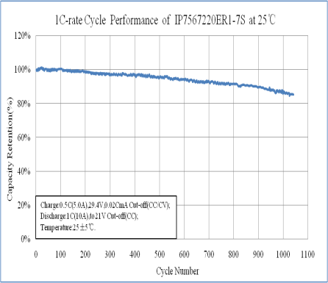
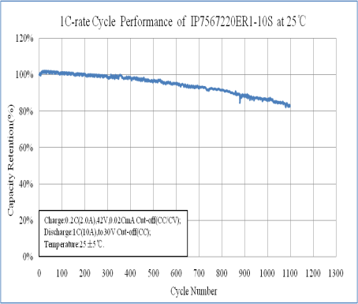
Battery Pack Performance curve

Slide 33
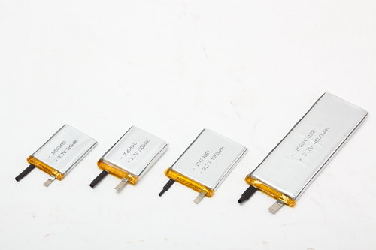
High capacity digital cell introduction

Slide 34
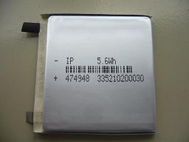
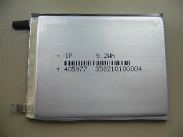
Features：High、Hard、Smooth
High-High Volumetric Energy Density、High Safety
1、High energy density, high gram capacity, high safety materials
2、Highly active substances content formula
3、High security structure design
Hard- The body of cell is so hard that it can be wrapped directly by sticker instead of the Plastic shell.
1、Special Ageing technology
2、Special Sealing technology
Smooth-The body of cell is smooth as mirror surface
1、Special winding structure
2、Special electrode design
Notes:
34

Slide 35
Energy Density Road Map
Note: calculated by model of 454261
Notes:
35

Slide 36
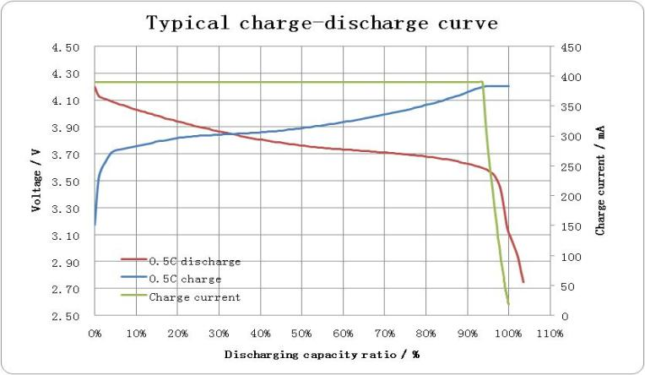
Typical charge-discharge Curve
At 0.5C , charged into 90% capacity already only after CC.
Notes:
36

Slide 37
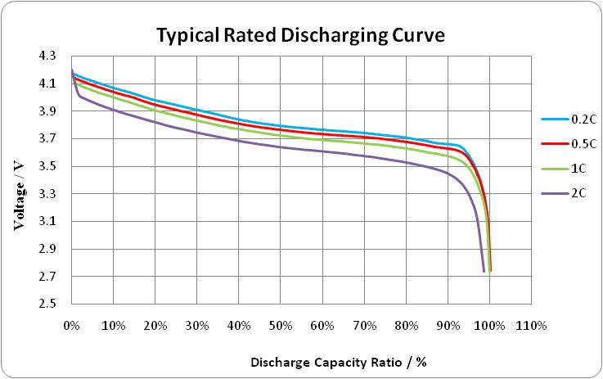
Typical Rate Discharging Curve
Notes:
37

Slide 38
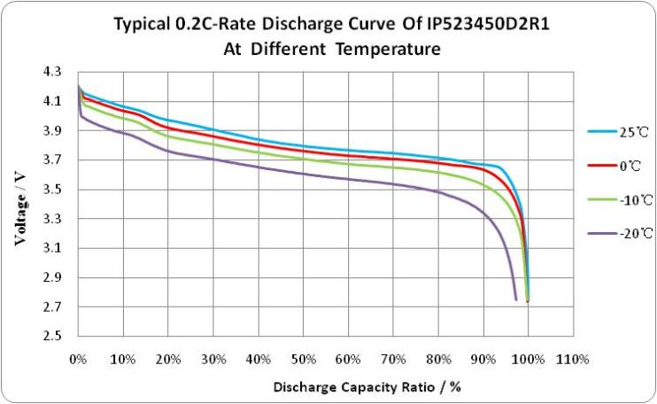
Low temperature Performance
Notes:
38

Slide 39

Cycle life Performance
Notes:
39

Slide 40

IV、Safety Performance

Slide 41
Standard Safety Testing Demo（LiFePO4)
Nail Test
Short-Circuit
Overcharge

Slide 42








Nail Test Demo of IP standard power battery
A. Before Testing
B.1minute later after Nail Test（punctured 3 nail rapidly）
C.5 minutes later after Nail Test
D.10 minutes later after Nail Test
E.30 minutes later after Nail Test
F.60 minutes later after Nail Test
G.120 minutes later after Nail Test
H.Finish Nail Test (242 minutes later)
Notes:
42

Slide 43




Short-circuit Demo of IP standard power battery
A Before Test
B In Short-circuit
C After Test 1
D After Test 2
★★★ Note:
Directly short circuit，the highest temperature is 30.3℃，the temperature increased 4.7℃and the voltage decreased 0.146V。

Slide 44
Overcharge Demo of IP standard power battery

Slide 45
IP will grow with you!

