Slide 1
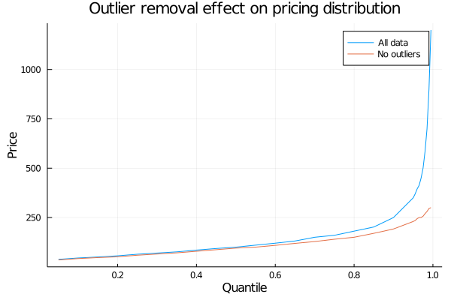
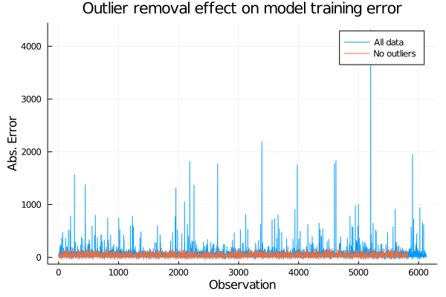

Slide 2
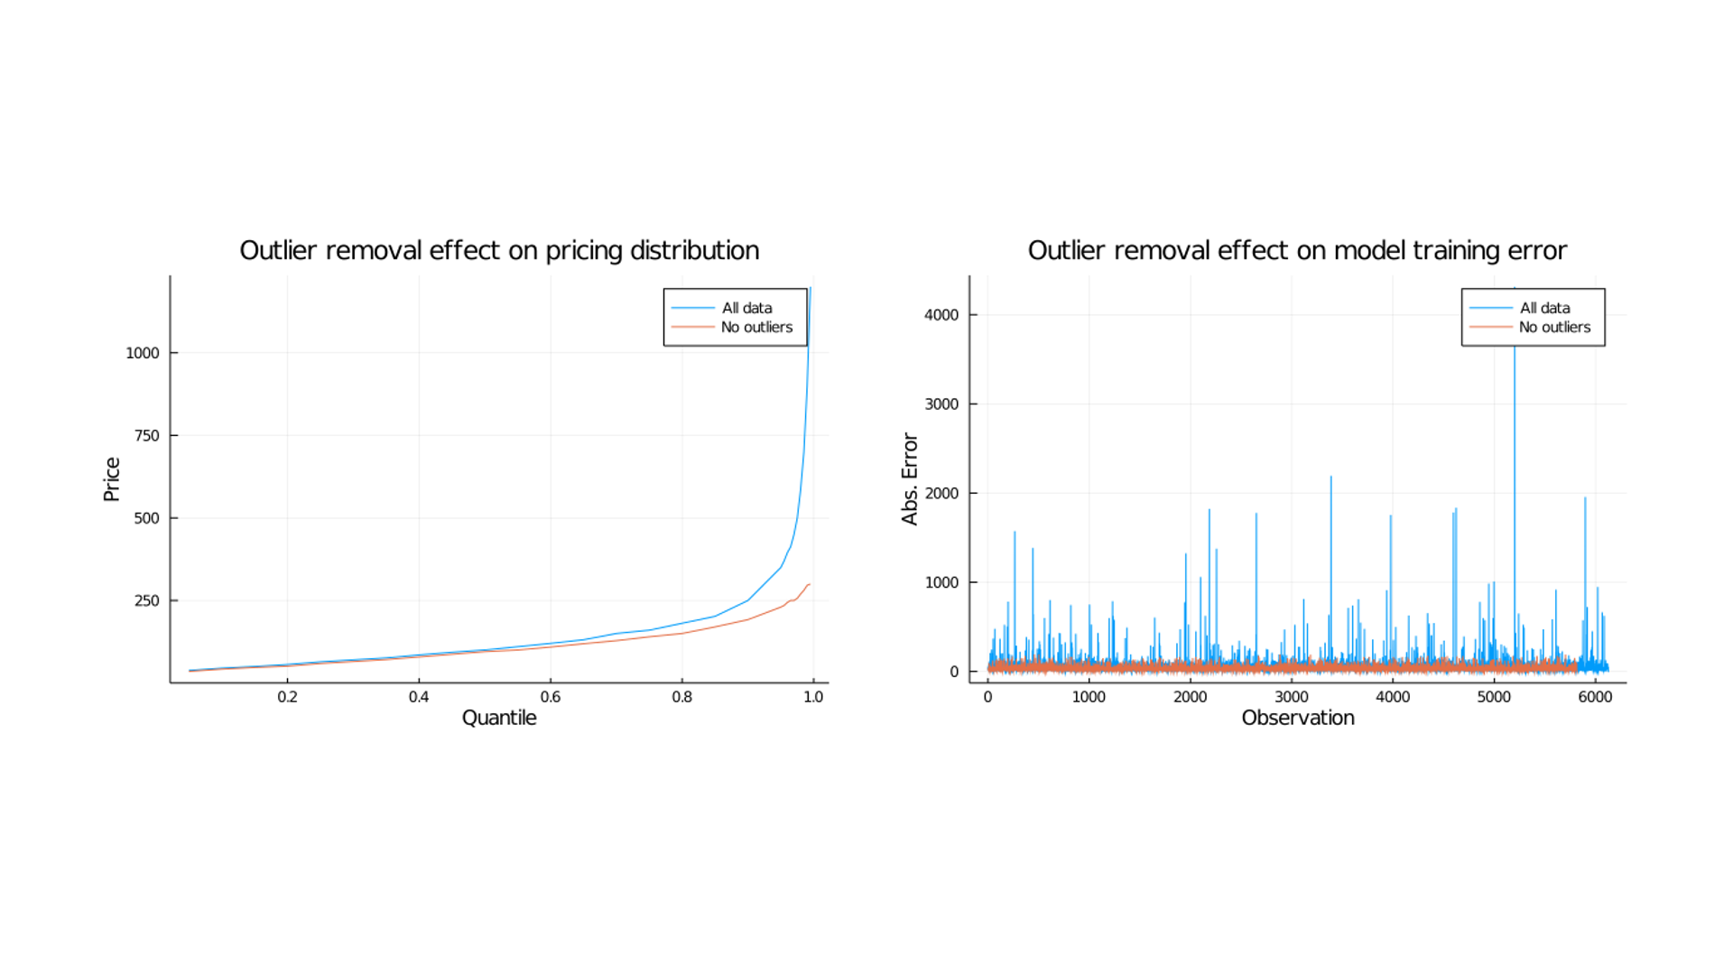

Slide 3









Data processing
Data analysis
Development
Model selection
Mapping
Raw data from Airbnb dataset (data/initial data) | Files with cleaned and encoded data | Files with cleaned and encoded data | Training and testing datasets obtained from cleaned datasets | Best model from previous step is selected
Clean dataset and perform feature transformations | Study data and provide insights regarding features and pricing distributions | Plot listings in NY map comparing different areas and time periods | Build three parallel models with different procedures | Adjust and change parameters if needed to improve final model
Files with encoded data (data/treated data) | Visualizations, graphs and plots added to final report | Visualizations, graphs and plots added to final report | Performance of the three models for comparison | Final model for drawing conclusions
1. Data Mining and Cleaning | 2. EDA | 3. Airbnb data visualization | 5.1-3 Model Development | 5.1-3 Final model
Input
Process
Output
File

Slide 4
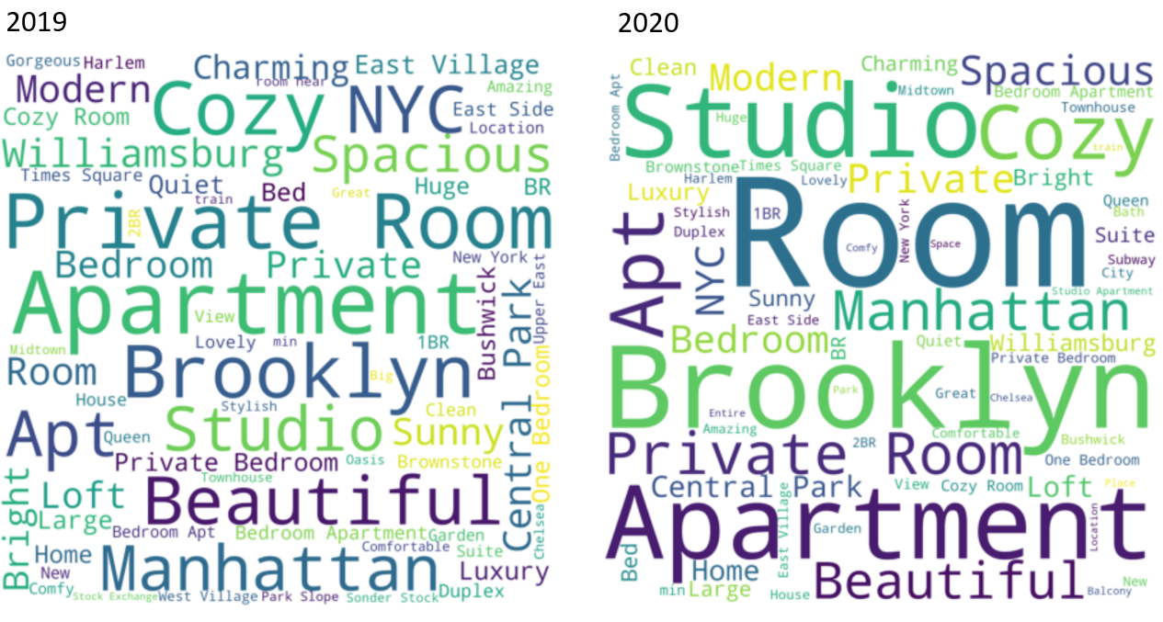
Figure 3. 2019 Listing descriptions word cloud
Figure 4. 2020 Listing descriptions word cloud

Slide 5
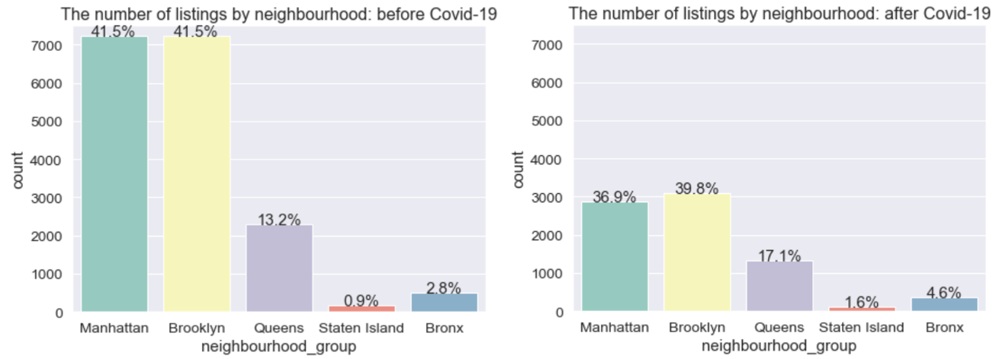
Figure 5. Neighborhood Listings before Covid-19
Figure 6. Neighborhood Listings after Covid-19

Slide 6
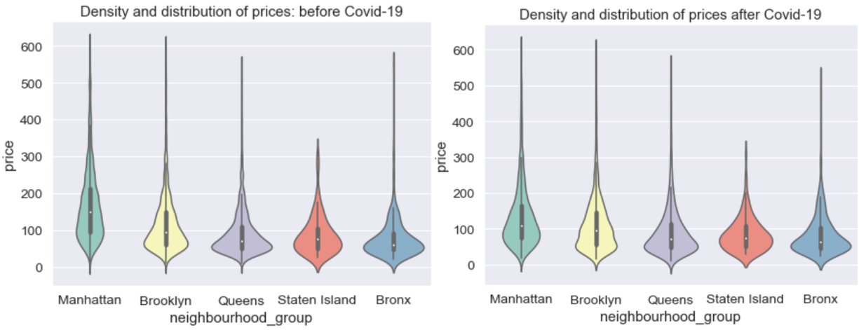
Figure 7. Price distribution before Covid-19
Figure 8. Price distribution after Covid-19

Slide 7
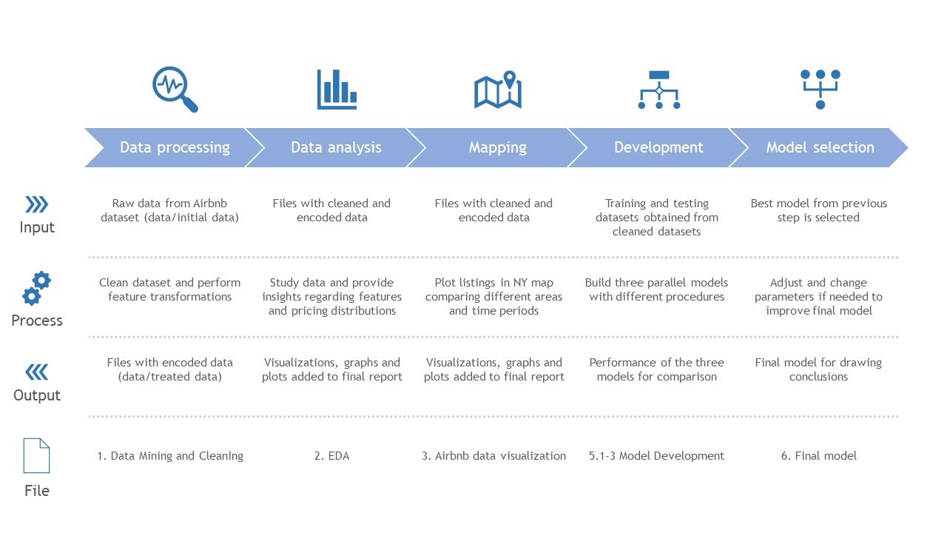
Table 1

Slide 8

Figure 11. Quantile distribution of prices
Figure 12. Model improvements with data treatment

