Slide 1
Creating, Joining, Detach Thread
7/27/2021-7/30/2021

Slide 2
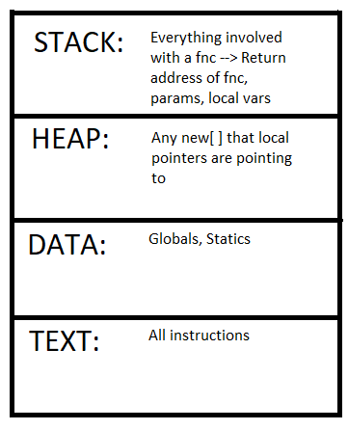
Review

Slide 3
General Info
If not using threads, main is the only default thread
Creating threads helps reduce time by running fncs in parallel

Slide 4
Thread Creation
Fnc Pointers
Lambda Functions
Functors
Member Functions
Static Member Functions

Slide 5
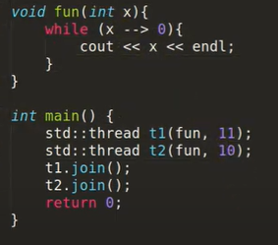
Function Pointers Method
Don’t forget #include <thread>
Join: Once a thread is started, we wait for the thread to finish before proceeding to the rest of the code with join( )
Can’t do a double join on same thread
Have to join to get results of thread before main ends
Before joining, can check if t1.joinable ( )
Can make multiple threads, but they may be run in different orders than you wrote.

Slide 6
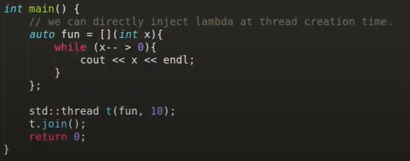
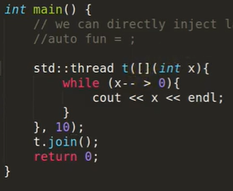
Lambda Functions
Lambda: a convenient way of defining an anonymous function object (a closure) right at the location where it's invoked or passed as an argument to a function.
Lambda functions can be within or inside the thread creation moment

Slide 7
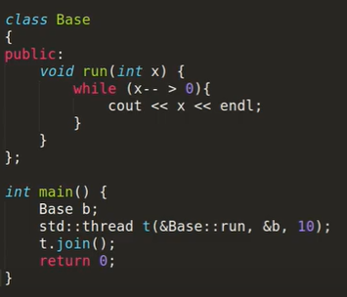
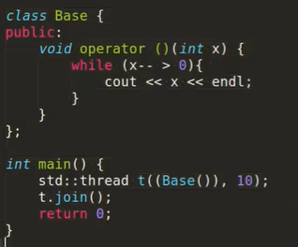
Functors Member Functions

Slide 8
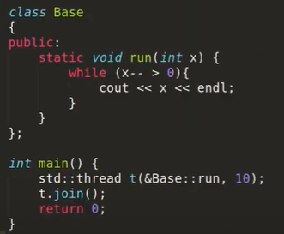
Static Member Functions

Slide 9
Sleep & Detach
SLEEP
std:: this_thread::sleep_for(chrono::seconds(3)) ---> to make a thread sleep
DETACH
Detach newly created thread from parent thread
ALWAYS check if joinable( ) here
Double detach on same thread not allowed
Detached thread execution might be suspended if main returns first
Either join or detach MUST be attributed to a thread

