Slide 1
Asynch
08/08/2021

Slide 2
When you want to return something from a thread → difference bw promise and future?
Used to asynchronously run a function and return a future
Lunch policy is the parameter (how to launch)
Asynch → creates a thread (Eager)
Deferred → thread not created (Lazy)
Third way → Computer chooses if Asynch or Deferred
Until fnc returns, we can’t move further if we use the return of the fnc

Slide 3
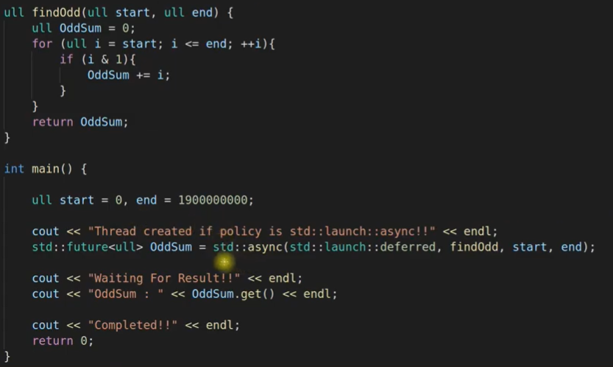
Example (Syntax)

