Slide 1
Mutex
07/11/2021

Slide 2
Critical Section
A shared resource between 2 processes is read or written
Must be exclusively accessed (not in parallel)
Mutual Exclusion Principle
Mutex
Binary Semaphore
If two processes are running, the shared resource has to be within OS or create shared memory

Slide 3
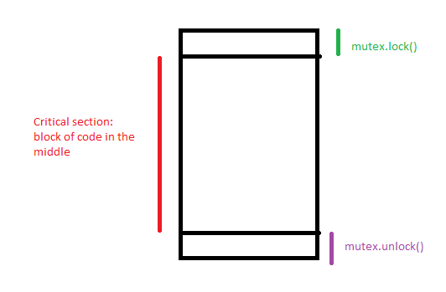
Mutex
Lock: no one else except for the one that locked mutex can use the critical section
The shared resource itself can automatically be a mutex, so lock can be called without creating a mutex object
Shared resource can automatically lock itself w/o having to call a lock sometimes as well (and without creating a mutex object)

