Slide 1
Deadlock
08/07/21

Slide 2
What is a Deadlock?
No compilation error, it may even run correctly (deadlock doesn’t necessarily happen each time, but a code should have 0 probability of a deadlock happening)
Process A locks mutex B, Process B locks mutex A
Process A wants to lock mutex A, Process B wants to lock mutex B
We’re stuck in a waiting situation bc mutex B was already locked by A and Mutex A was already locked by B → Both can’t lock both

Slide 3
Solutions
Add sleeps bw situations
Keep orderings of mutex locks the same → This way if T1 locks M1 it can continue to lock M2, but T2 will be stuck waiting for M1 till T1’s fnc is full done.

Slide 4
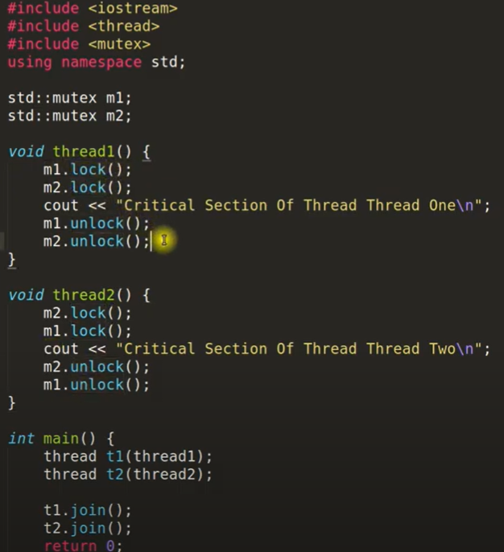
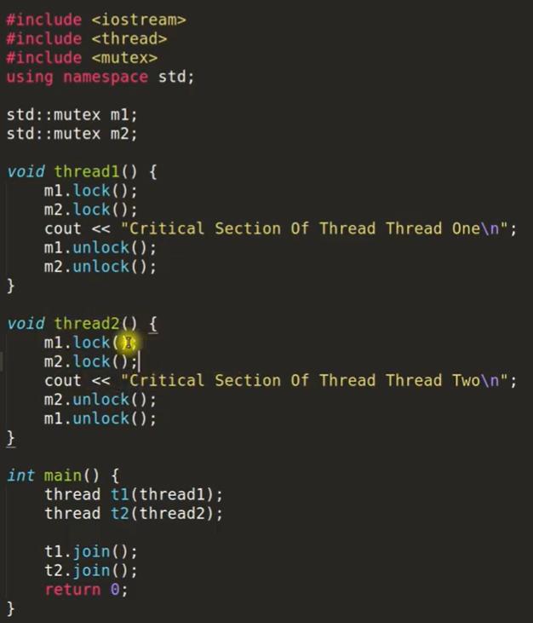
Problem V Soln.

