Slide 1
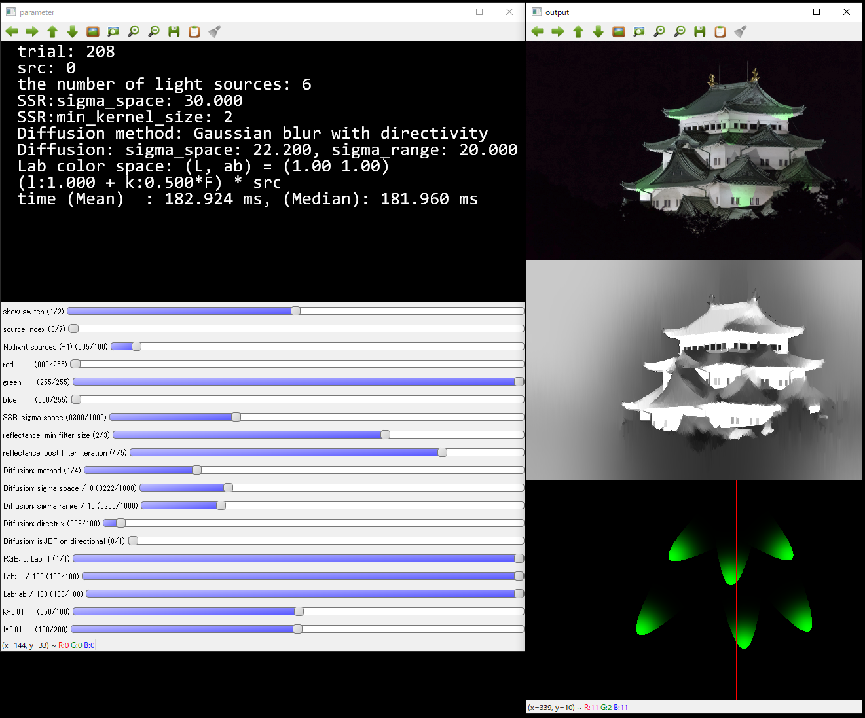
Console Output
the number of trials
selected images number
the number of light sources
sigma for SSR
min filter size for SSR’s reflectance
No. postfilters for SSR’s reflectance
diffusion method
diffusion parameters
light control parameters
time (ms)
result
Trackbar
switch for output view
0: result only, 1: v-concat, 2: h-concat
select images
parameter of light sources
the number of light sources
select color of light (r,g,b)
parameters for SSR and its reflectance
sigma for SSR
min filter size for reflectance
No. postfilters for reflectance
parameters for diffusion
diffusion method switch
diffusion parameters
light control for blending light and source image
reflectance of SSR
vanishing
point
light

