Slide 1
Group Name: ISHI-Kai LNA Project: Low noise amplifier(23)
Noritsuna IMAMURA
noritsuna@ishi-kai.org

Slide 2
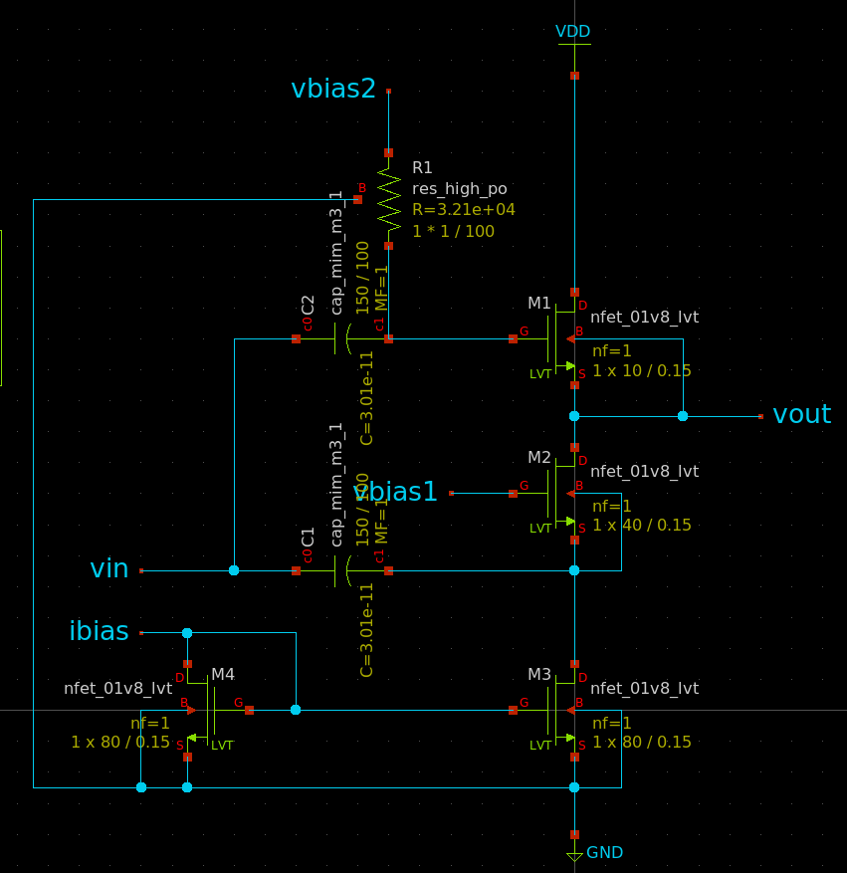
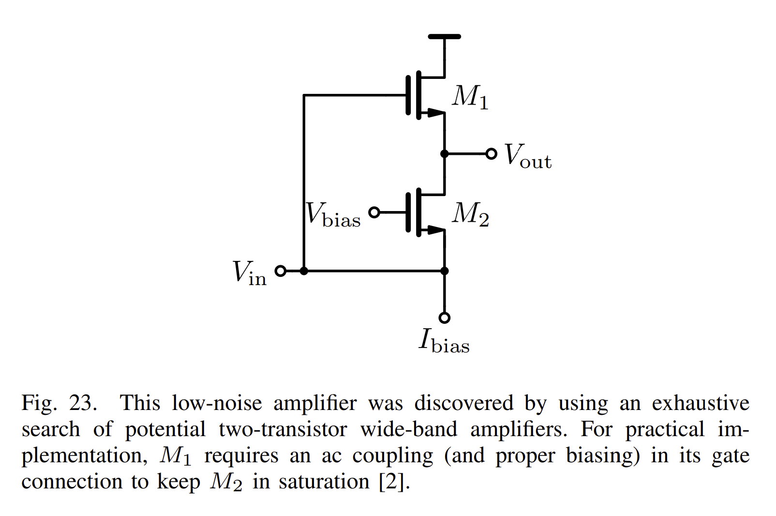
Low noise amplifier(23)
Extra Parts
Target
(LNA)
Evaluate Metrics
Gain[dB]
gm/ID Methodology
NF(Noise Figure)[dB]
Noise Rate from ngspice’s noise command.
Target Specification
Search “Max Gain(= Gain – NF)”
Extra: power consumption
Fix Metrics
Frequency = [TBD]Hz
Bandwidth = [TBD]Hz (Full or Narrow)
I will decide it by my PC’s CPU power.
Vbias1,2 = Fix Value
vin is the input signal with different biasing
C1,C2,R1 = Fix Value
Ibias = from Ibias PAD
Special Point
Fix Circuit
(Ibias)

Slide 3
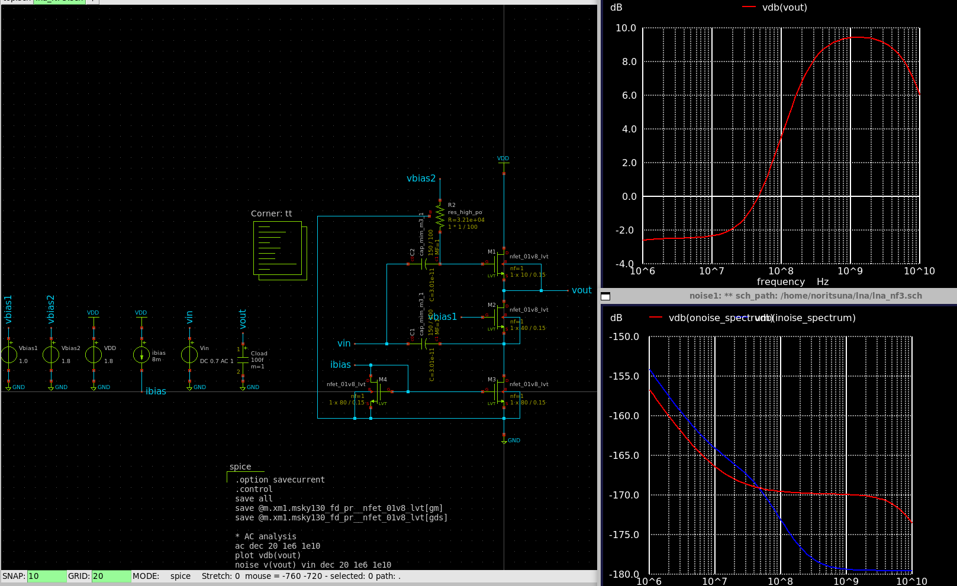
Test Try: Target Evaluate Metrics
Evaluate Metrics
Gain[dB]
10dB
Target Frequency: 2GHz
Bandwidth: 100MHz
NF[dB]
Under: 0.1dB
Target Specification
10dB

Slide 4
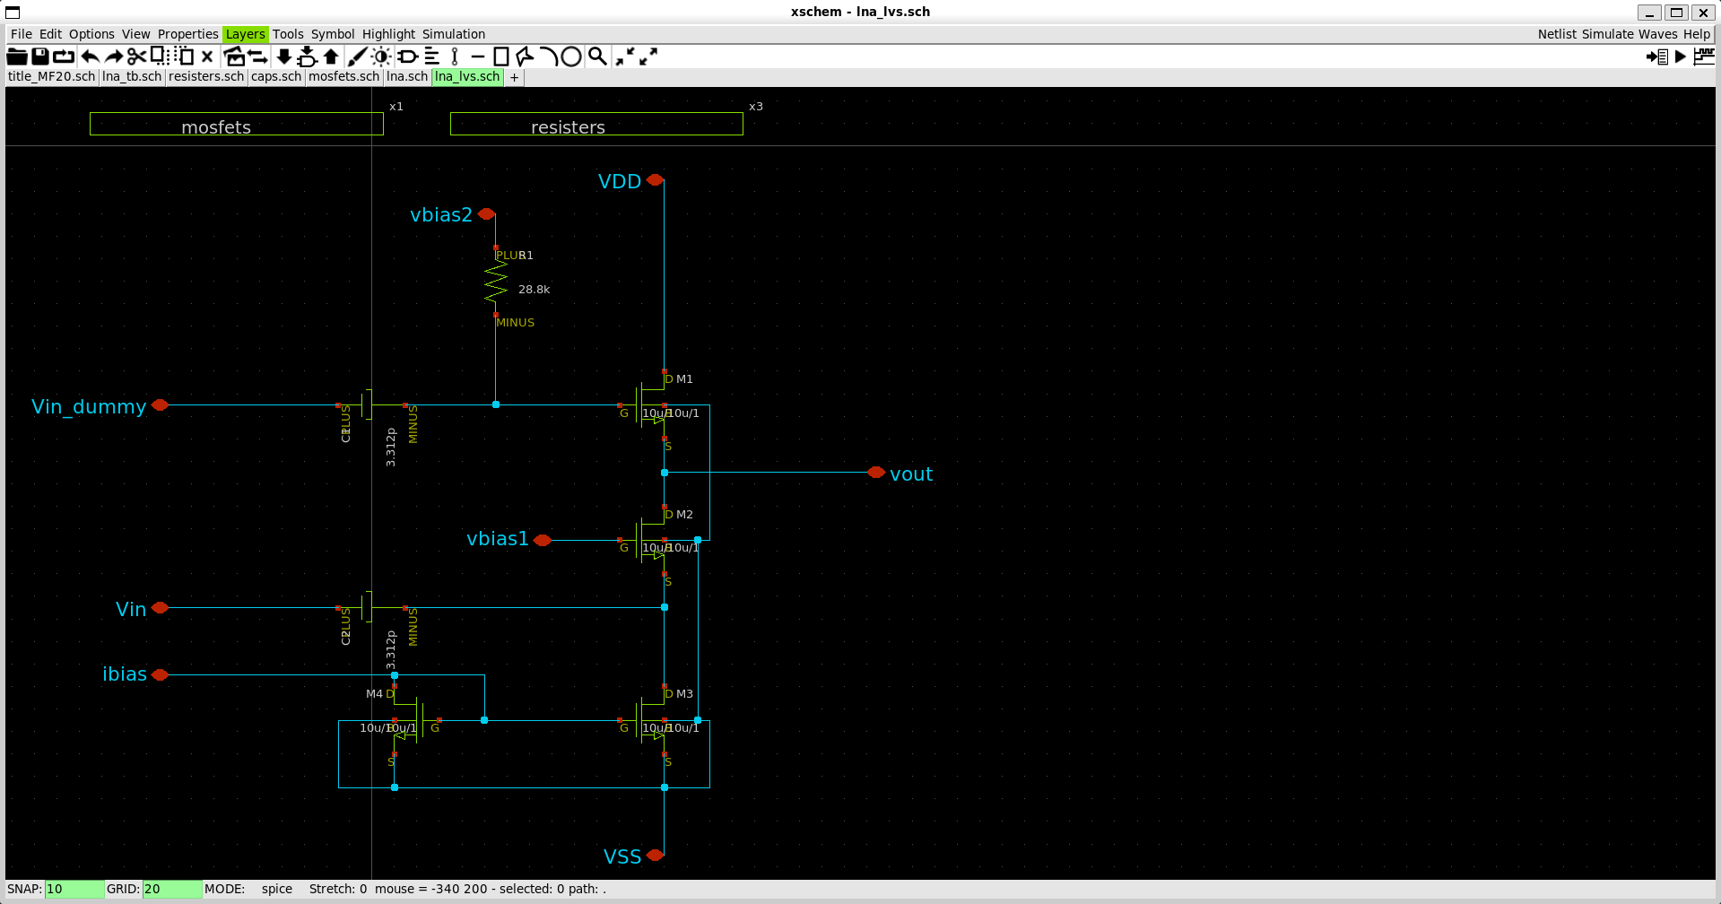
PLUSを分離して
1ピン増やした

Slide 5
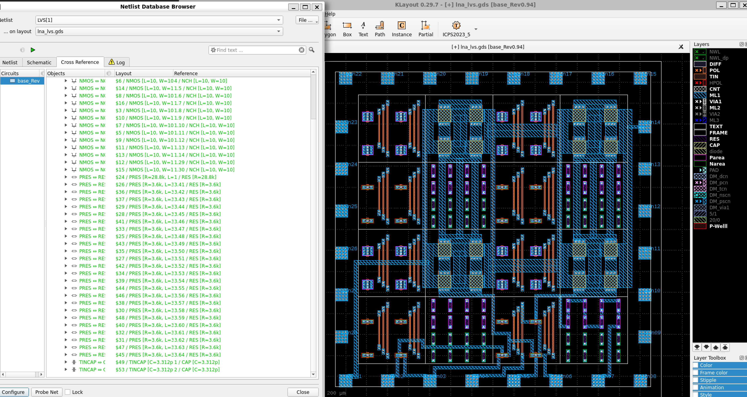
ここを切断して
1ピン増やした
LVS OK！

Slide 6
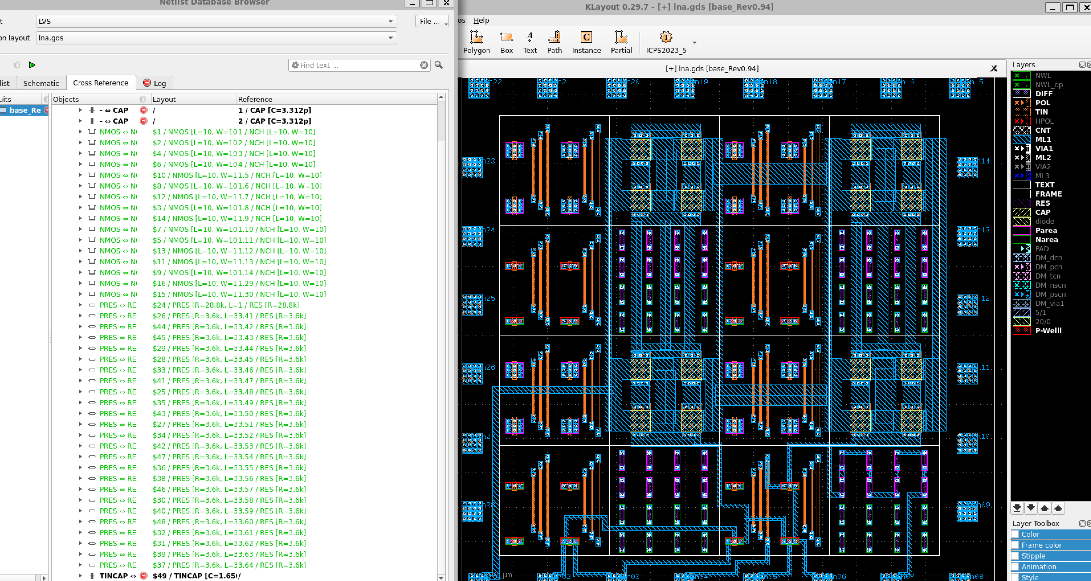
2つあるはずだが
直列に接続された判定になる

