Slide 1
Content-Centric Embedded ～Treasure Hunting Robot～
Noritsuna Imamura
Notes:
Nice to meet you, everybody. I’m Nori.
Today, I speak about THR.
THR is a robot which we made. Our team is called SIProp project.
It’s a small OSS project. Our members are 3 people.
We have made a lot of fun things. This is one of them.

Slide 2
Agenda
1st
About me
Today’s goal
2nd
Auto Chasing Turtle
Treasure Hunting Robot
Little how to make

Slide 3
My Bio
Special
Networking technology (P2P)
Community (OSS)
SIProp.org
Japan Android Group
Linaro
Company
NPO OESF (Open Embedded Software Foundation)
Notes:
In fact, my speciality is networking technology. P2P. Like Skype.
Now I’m a community cordinator. I usually create & support OSS community
I explain them later.
I’m from OESF. OESF is NPO. OESF has a lot of member companies.
OESF’s members work in WGs. WGs are STB, Car Navi and Edu.
They are making a standard spec & liblary, framework for application. And release as OSS.
I almost cordinate WGs.
In fact, my robot is one of this WG’s work. I explain about it later.

Slide 4
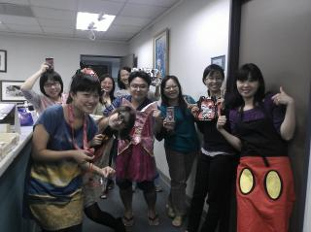

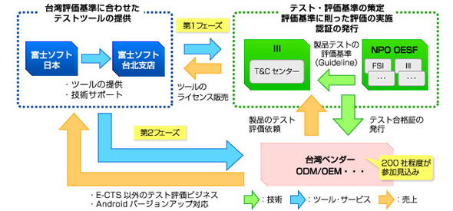
Current work
Work
Industrial Technology Research Institute.
Making a testing center for Android Devices.

Slide 5
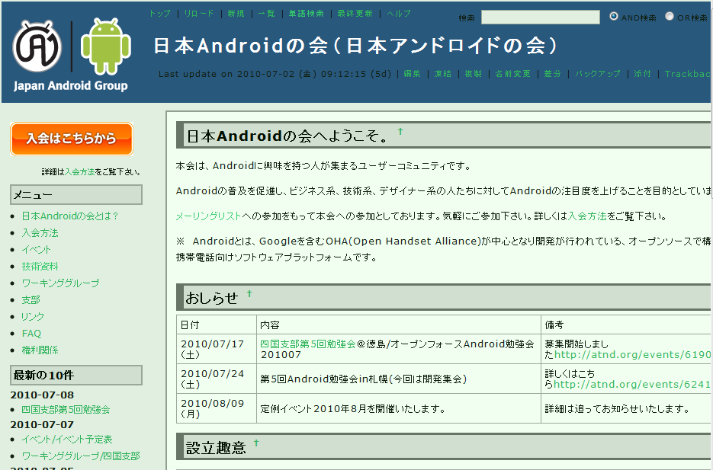
Japan Android Group : 2008-
Prof.Maruyama & I started up this community.
At Apr/2008
Detail
The most famous & largest Community in Japan
URL: http://www.android-group.jp/
Since: Sep/2008
Members: over 20,000
Branch: over 20
Notes:
Maybe now, It’s the most famous community in Japan.
Resign

Slide 6

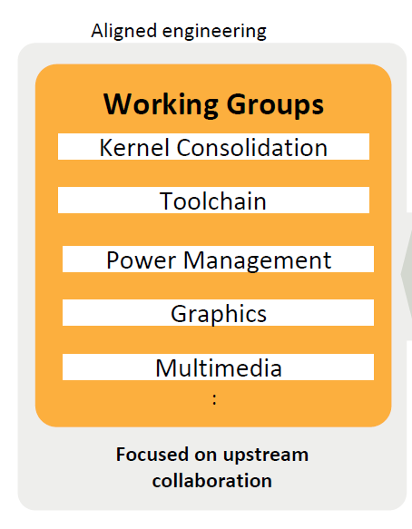
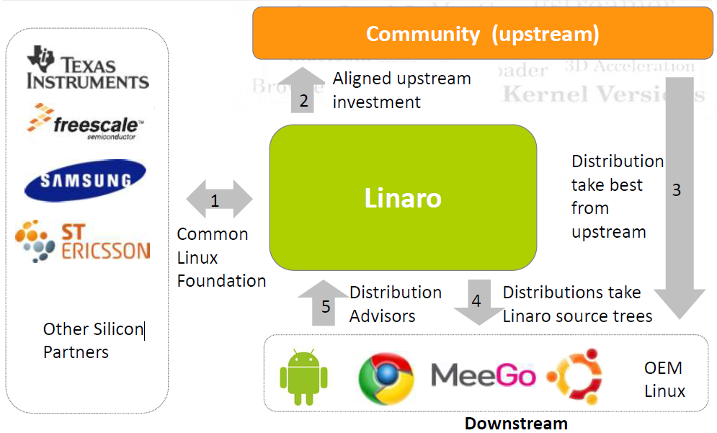





Linaro: 2010-
http://linaro.org/
Mission
Optimize for each SoC & Platform
Contributor for community!
Notes:
ただ、これらのハードウェアを動かすには、各種センサーのドライバ開発や
オプティマイズをきちんと行わないと、期待した動作になりません。
そこで、去年にLinaroプロジェクトというOSSが立ち上がり、この手のSoC用の
ドライバやオプティマイズを行っています。
我々は、そこのコミッターとして、Android周りのサポートを行っています。
ちなみに、そこのコンペティションに、このカメさんを出しまして、１位になりました。

Slide 7
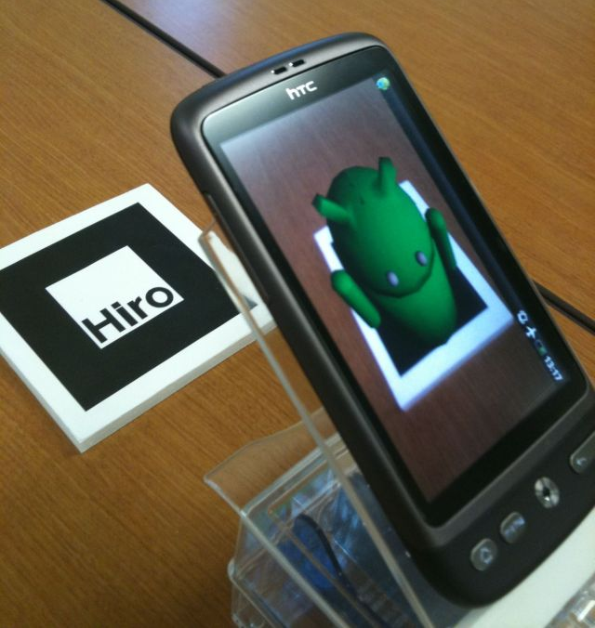
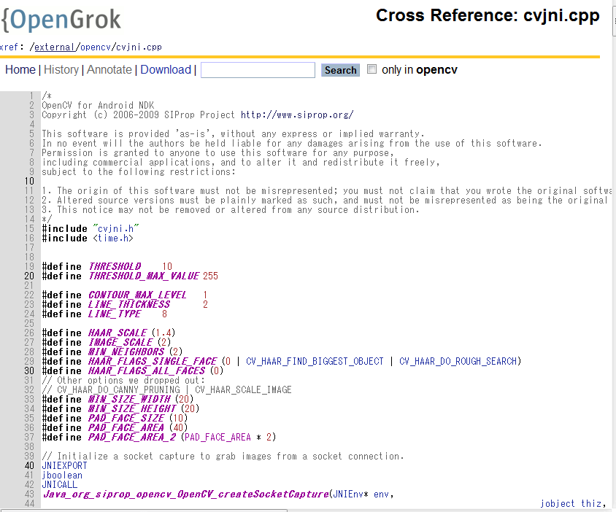
Android’s tools
NyARToolkit for Android
I made a based-program for this OSS community
http://en.sourceforge.jp/projects/nyartoolkit-and/
OpenCV for Android NDK
This program is included in Android 4.0.1 .
http://tools.oesf.biz/android-4.0.1_r1.0/search?q=SIProp
Notes:
My small wokrs.
However Google doesn’t notice me it.
I knew it, when my friend sent me e-mail about it☺

Slide 8
Today’s Topic
Noritsuna Imamura
Notes:
And we made this robot by thinking of DIwO.

Slide 9
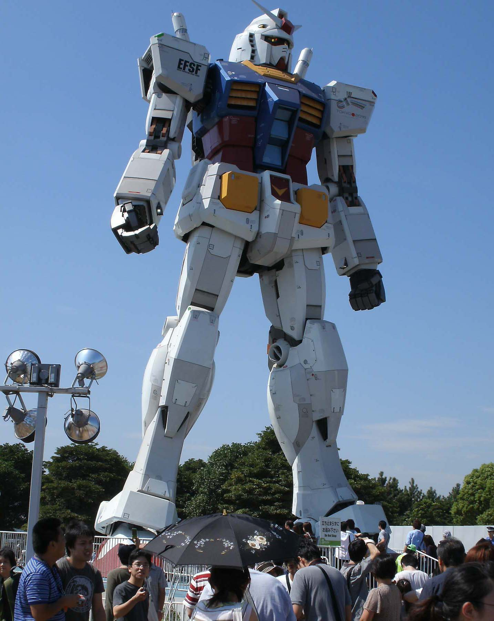
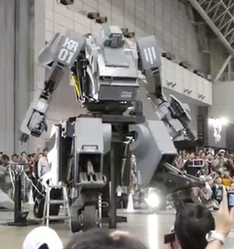
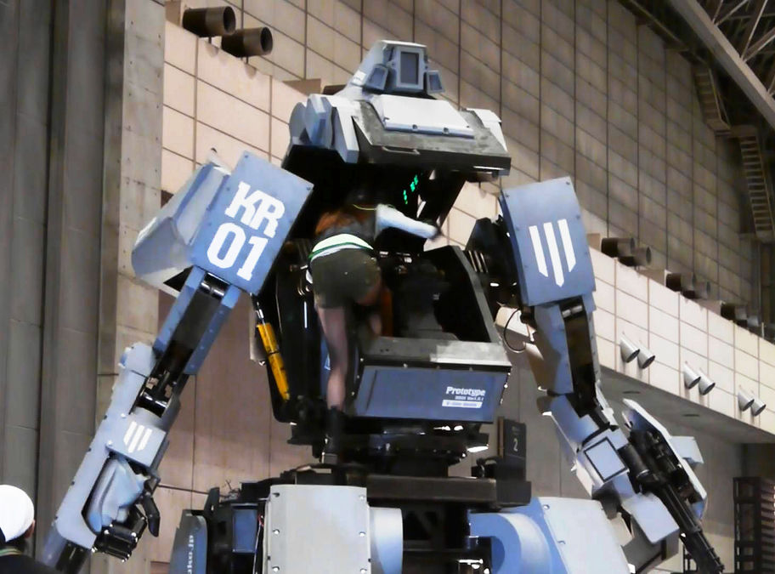
What do you want to make?

Slide 10
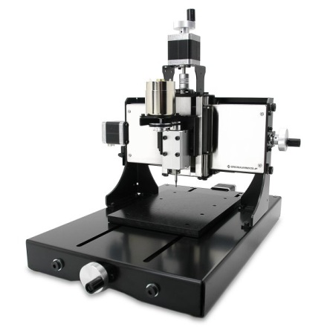

Need a lot of money…
How to get?
Make a Startup Company
Get a Sponsor
Kinds of Sponsors
Product Sponsors
Sale their products
Service Sponsors
Expand their service
Patron
Support a cool guy (Ex. Kickstarter)

Slide 11
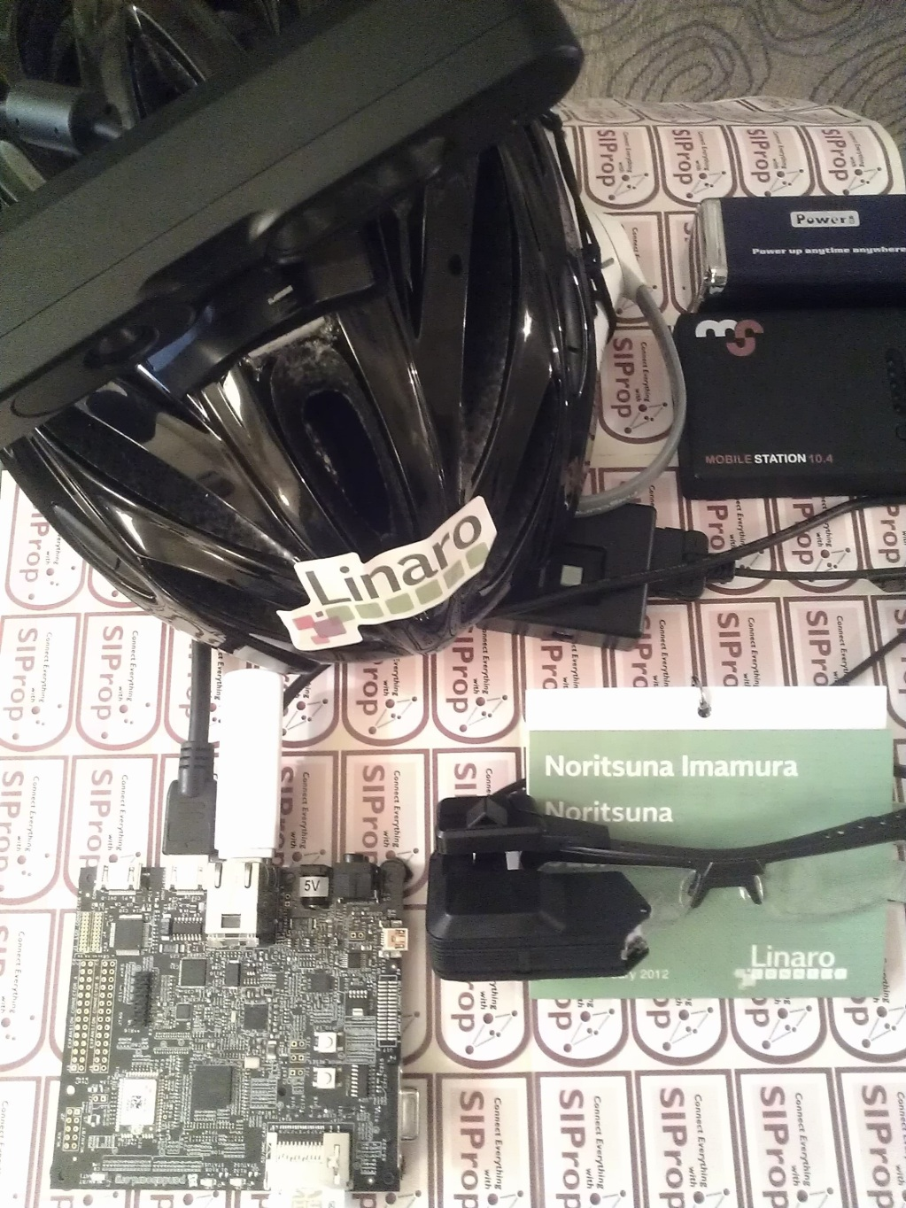
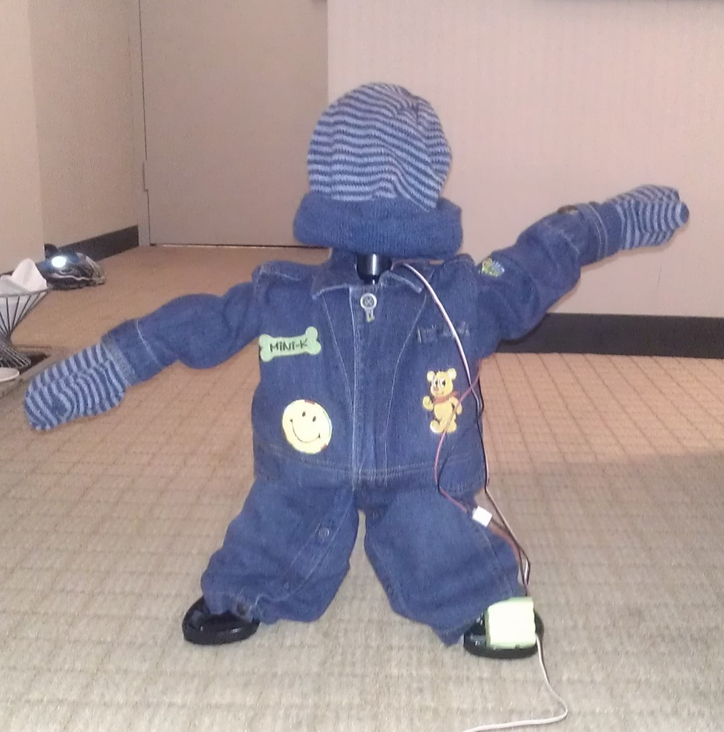
Treasure Hunting Robot
Xtion
MindWave
AiRscouter
Pandaboard

Slide 12
Hardwares & Softwares
Hardwares
Base computer
Pandaboard
TI
Brain Wave Sensor
MindWave
Depth Sensor
Xtion pro live
Display
AiRscoter
Brother Industries
Walking Robot
KHR-3WL
Kondo science
Softwares
Ubuntu & Android
Linaro11.11
Linaro
Depth Sensor
OpenNI
Bone skeleton tracker
NITE for ARM
UI Framework
openFrameworks
Android
OESF

Slide 13
Important point
Quick making a prototype!
Almost people can NOT image a new product without a real device.
Do It Yourself ⇒Do It With Others!
！Reinventing the wheel.
MAKE:style
Hardware
beagleboard-xM
Arduino
Kinect
Software
Linux Kernel
Android
Notes:
combine , suggest
It’s important point to make about that.
One of answer is for this point.
DIY is made by yourself, only you or only your company.
DIwO is made by all of the world engineers!
You use the engineer’s result and make your prototype quickly!
OSS, Open hard, knowledge
You don’t need to make your SoC.
This is applied also to an engineer.

Slide 14
Content-Centric Embedded
Content-Centric Networking
It was pioneered by Ted Nelson in 1979 and later by Brent Baccala in 2002.
The old internet finds servers by IP-Address.
This philosophy finds them by Contents.
Content-Centric Embedded
When make products, it thinks from hardware.
This philosophy thinks them from Contents.
Ex: Kindle
http://en.wikipedia.org/wiki/Content-centric_networking
Notes:
About Content-Centric Embedded.
Ex.
When you use SNS service, you find new information from your friend’s information.
Key word is NOT url or IP, it’s friend as contents.
You sale it to your customer. Maybe consumers.
First you are looking for service & content providers.
And you suggest your idea for their service to them.
And you get order from them.

Slide 15
What do you want to make?

Slide 16
Auto Chasing Turtle
Noritsuna Imamura
Notes:
And we made this robot by thinking of DIwO.

Slide 17
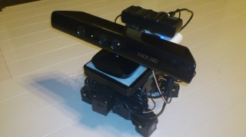
Summary
This product is an "Auto Chasing Turtle".
By autonomous control, this robot recognizes people's face and approaches to the detected human.
Notes:
I explain about special parts.
I used a Kinect & Beagleboard-xm in the robot.
The Kinect is Xbox’s option controller. It has a RGB camera, a Depth camera and an Audio.
I used thing to get camera view & distance as this robot’s eyes.
A specail point is the kinect is a next generation controller for game console.
However I used as sonser.

Slide 18
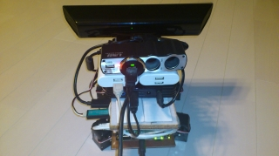
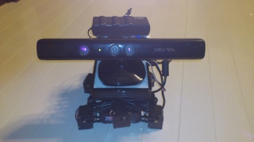
Movie
YouTube
http://www.youtube.com/watch?v=8EgfAk5RBVo
Source Code & detail explanation
http://www.siprop.org/ja/2.0/index.php?product%2FAutoChasingTurtle
Keyword
AutoChasingTurtle
Notes:
These urls are download pages.
If you don’t remember this url, please search for Google by using keyword.
Maybe you will be able to find these pages quickly!

Slide 19
Hardwares & Softwares
Hardwares
Base computer
Beagleboard-xM
TI
Depth Sensor
Kinect
Robot
KONDO Animal
Kondo science
Softwares
Ubuntu & Android
Linaro10.03
Linaro
Depth Sensor
ofxKinect
UI Framework
openFrameworks
Android
OESF

Slide 20
How to make

Slide 21
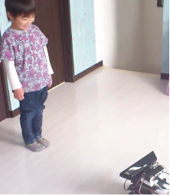


3 Points for Developing
Detect the Face
Calculate the course
Calculate the distance
1. detect
3. distance
2. course
Notes:
This part is Kinect part.
I’ll explain 3 things.

Slide 22
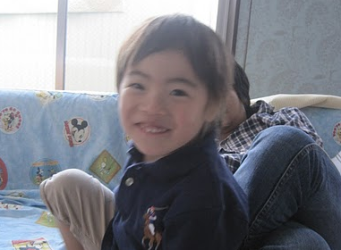
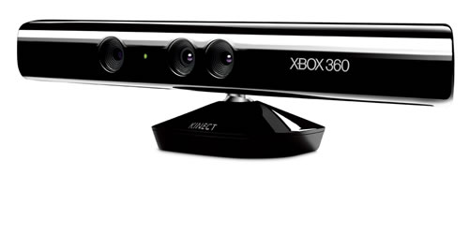
Detect the face
How to recognize a human’s face?
Using KINECT RGB Camera as Sensor
KINECT Image
Notes:
Important things are 2 points.
I explain about those.

Slide 23
How to recognizing a human’s face
FaceDetector detector = new FaceDetector(w, h, faces.length);
int numFaces = detector.findFaces(bitmap, faces);
Android’s APIs.
60-80% Product!
Notes:
But this has a big problem. So you can’t use for real product.
However this is prototype. So it’s important point to make quickly!
Detect the face source code is only this!
In fact, first, I thougt to use OpenCV which is in the openFrameworks.
But It is necessary a lot of memory to use OpenCV.
But Beagleboard-xm has no enough memory.
That’s why I use this function.
However this function is too slow and bad recognization acceptable rate.
If I make next version, I will use OpenCV and make an original algorithm for Face Detector.
Because currently ARM’s boards have more memory then Beagleboard.
I can use OpenCV now.

Slide 24
3 Points for Developing
Detect the Face
Calculate the course
Calculate the distance
1. detect
3. distance
2. course
Notes:
This part is Kinect part.
I’ll explain 3 things.

Slide 25
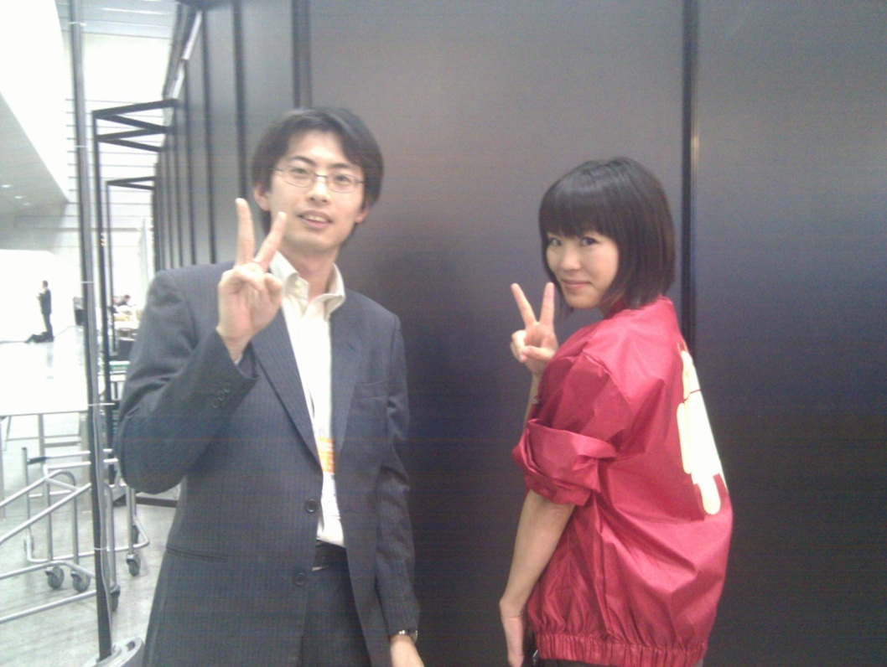
Calculate the course
Calculate a center position of face.
Calculate a position of the face from 4-sections separation KINECT’s image.
640px
160px
Notes:
What I do is only two things.
I explain more.
(click!)
If image width is 640px, In that case 1-section is 160px.
(click!)
If face position is 400px. Face is in a 3rd section.
In that case, Robot is center, it dosen’t turn.
if it’s a 1st or 4th section, robot turn to right or left.

Slide 26
Calculate the course
faces[0].getMidPoint(midPoint); //get center position of face
int pointX = (int)midPoint.x;
if (pointX > 0 && pointX < w/4) {
DroidBot.getInstance().turnRight(); // right position
} else if (pointX >= w/4 && pointX <= 3*w/4) {
; // center position
} else if (pointX > 3*w/4 && pointX <= w) {
DroidBot.getInstance().turnLeft(); // left position
}
Notes:
It’s a source code.
It’s too difficulet to me. I can’t explain it!

Slide 27
3 Points for Developing
Detect the Face
Calculate the course
Calculate the distance
1. detect
3. distance
2. course
Notes:
This part is Kinect part.
I’ll explain 3 things.

Slide 28
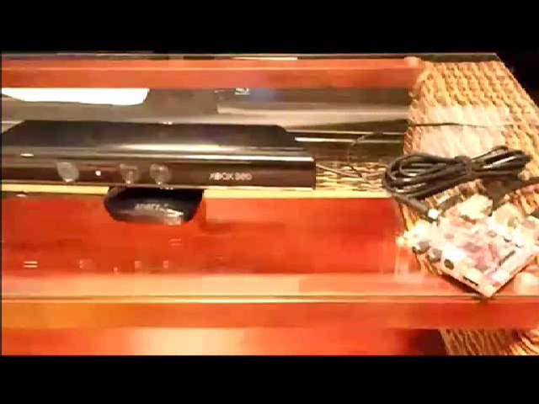
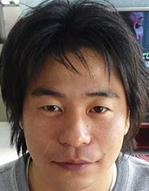
Calculate the distance
Distance of from Robot to detected human
Can be gotten by KINECT.
Notes:
What I do is only two things
It’s over!
Please see source code.

Slide 29
Calculate the distance
int dist = OFAndroid.getDistance(pointX, pointY); // Use depth camera
if (dist < 100) DroidBot.getInstance().walkBack4();
else if (dist >= 100 && dist < 150) DroidBot.getInstance().walkToward4();
else if (dist >= 150 && dist < 200) DroidBot.getInstance().walkToward8();
else if (dist >= 200 && dist < 300) DroidBot.getInstance().walkToward16();
else if (dist >= 300) DroidBot.getInstance().walkToward32();
Depth camera’s range is 0~65565.
Notes:
It’s a source code.
this function can get distance of argument.
And argument is the center point of face.
I finished to explain software part.
Incidentally, Tatal source code lines are 167 lines.

Slide 30
Treasure Hunting Robot
Noritsuna Imamura
Notes:
And we made this robot by thinking of DIwO.

Slide 31
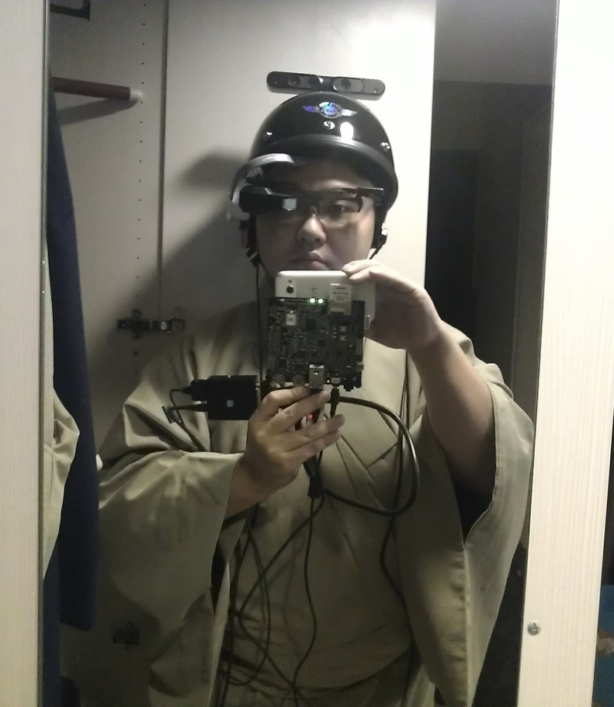

Summary
This is an
"AR(augmented reality) Treasure Hunting Game“
You get virtual treasures by controlling real robot!

Slide 32
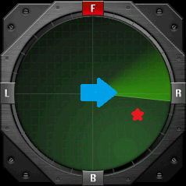
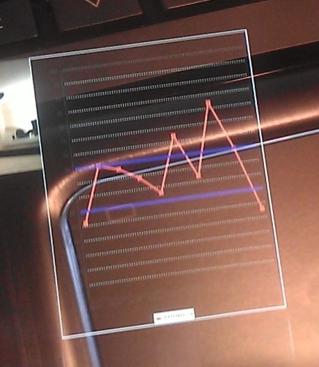
Manual
Look at radar window like dragon radar.
Show the treasure on radar as red star.
Center is a place in which a robot is present.
The Blue arrow is direction of robot..
Look at line graph. This is brain wave line graph.
You control the robot to the treasure point by your brain wave.
Exciting -> Turn left
Normal -> Go toward
Relax -> Turn right

Slide 33
Hardwares & Softwares
Hardwares
Base computer
Pandaboard
TI
Brain Wave Sensor
MindWave
Depth Sensor
Xtion pro live
Display
AiRscoter
Brother Industries
Walking Robot
KHR-3WL
Kondo science
Softwares
Ubuntu & Android
Linaro11.11
Linaro
Depth Sensor
OpenNI
Bone skeleton tracker
NITE for ARM
UI Framework
openFrameworks
Android
OESF

Slide 34
Hardwares’ photo
Xtion
MindWave
AiRscouter
Pandaboard

Slide 35

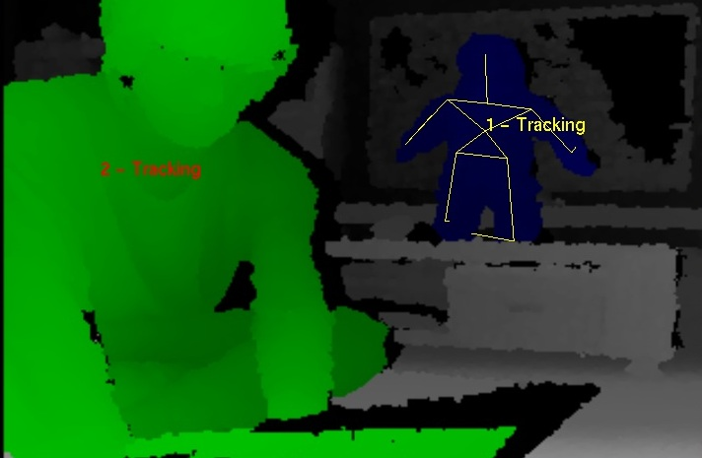
Softwares’ photo
Brain Wave
Line Graph
Bone skeleton
Tracking Window

Slide 36
Some Problems・・・
Cool UI
Library
Mobile
Connect Sensors

Slide 37
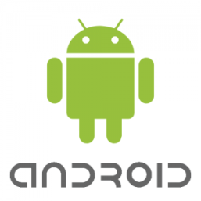


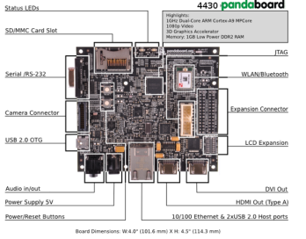
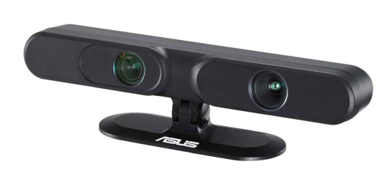
Made by ofxDroidLinaro 1/2
An ALL in ONE developing environment.
Made by 3 Layers
App Framework :
Library&Driver :
Device :
Notes:
This is an Android Application Framework which has openFrameworks’ APIs & Kinect APIs.
And, I made it to combine these things.
By this, you can make media art programs easily and battery-operated is possible.
Linaro is OSS project. They make a Linux kernel for ARM and porting to Android.

Slide 38


Made by ofxDroidLinaro 2/2
Make Program easily&quickly by Android
Make Cool UI by openFrameworks
Use a lot of Libraries&Drivers for Linux
Mobile & Connect to sensors (Ex,Kinect) by ARM
App Framework :
Library&Driver :
Device :
Notes:
This is an Android Application Framework which has openFrameworks’ APIs & Kinect APIs.
And, I made it to combine these things.
By this, you can make media art programs easily and battery-operated is possible.
Linaro is OSS project. They make a Linux kernel for ARM and porting to Android.

Slide 39
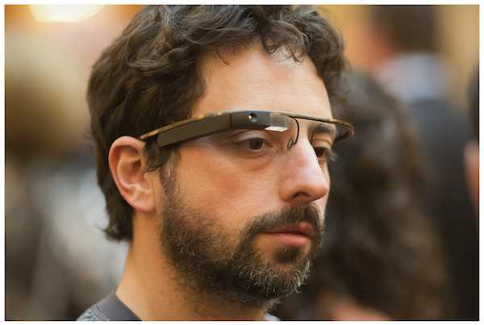
Download source code
We release all source code on our site.
http://www.siprop.org/en/2.0/index.php?product%2FTreasureHuntingRobot
Do It Yourself ⇒Do It With Others!
If you want to try it, please ask me!
You can experience like Google Glass!

Slide 40
Events & Conferences
～Show Demonstration & Speech～
Notes:
But if only made it, they can’t know about that.
So I show that demonstration & give a speech in some events & conferences.
Last part, I will report about that quickly.

Slide 41
China

Slide 42
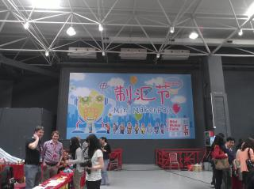
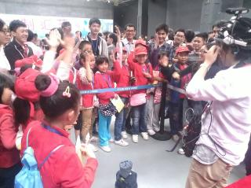
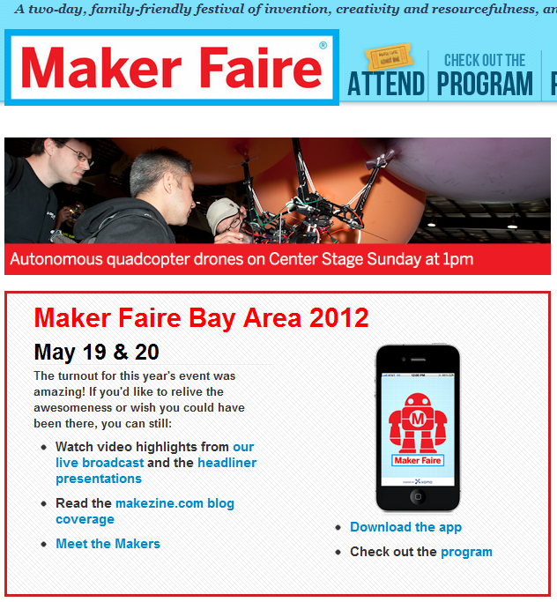
Mini Maker Faire 2012 ShenZhen
The first Maker Faire in China
Target
DIY(DIwO) Engineer
About Maker Faire
The most famous DIwO
conference
Notes:
Makers show robot, car, hardware and etc…

Slide 43
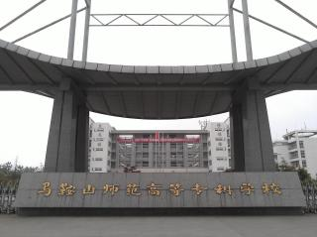
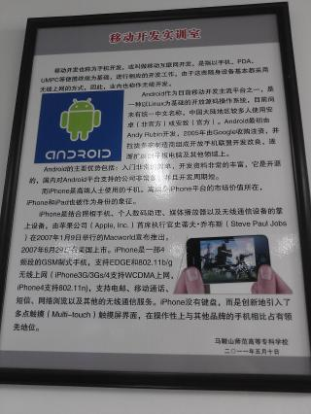
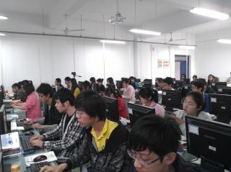
Ma An Shan Univ.
Target
Chinese Students
Education
Notes:
I gave out 2 snowball & 1 beagle bone as educational kit for Linaro.
Maybe they will study how to develop Linaro.

Slide 44
Taiwan

Slide 45
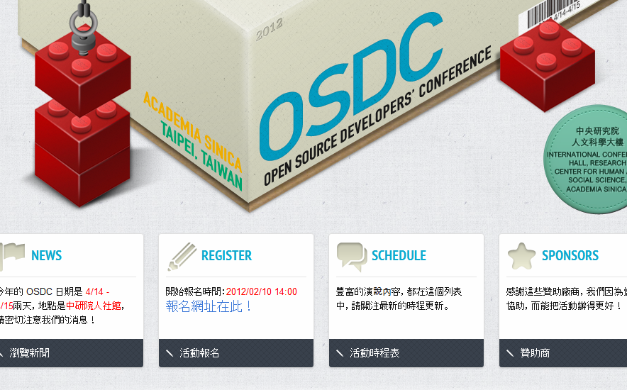
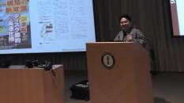
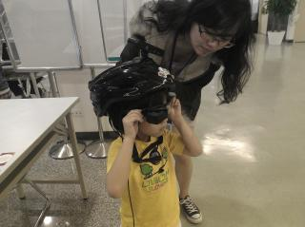
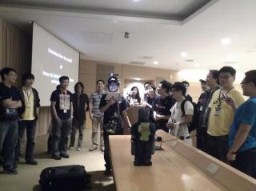
OSDC.tw 2012 (Apr/2012)
One of the largest OSS conference in Taiwan
Target
Taiwanese Engineer
Notes:
Software & hardware engineers, OSS engineers, and researchers came here.
Maybe almost famous Taiwanese engineers came here.

Slide 46

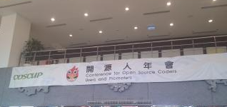
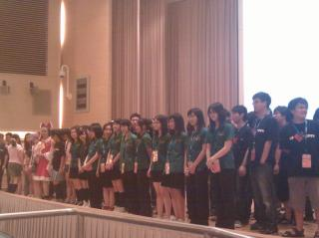
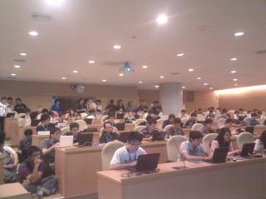
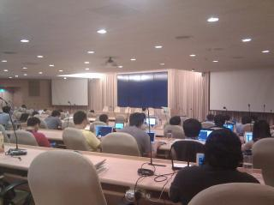
COSCUP 2011&2012 (Aug)
One of the largest OSS conference in Taiwan
Target
Taiwanese Engineer

Slide 47

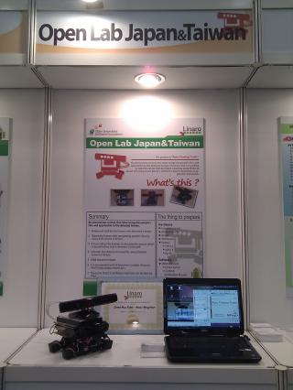
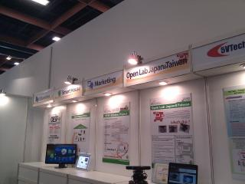
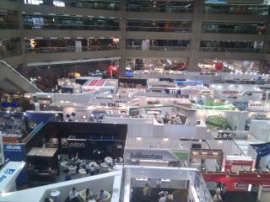
Computex 2011&2012 (June)
The largest hardware business show.
Target
Hardware Engineer & Company
Notes:
Probably everybody know it better than me.

Slide 48
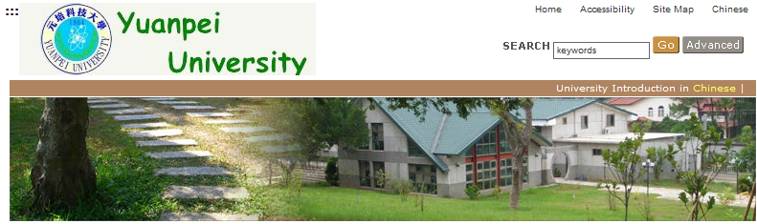
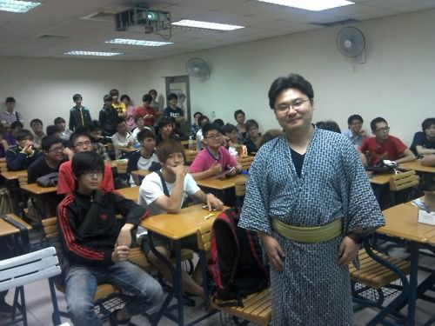
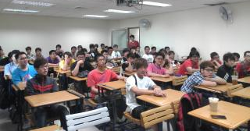
Yuan Pei Univ.
Target
Taiwanese Students
Education
Notes:
I gave out 2 snowball & 1 beagle bone as educational kit for Linaro.
Maybe they will study how to develop Linaro.

Slide 49
Singapore

Slide 50





Mini Maker Faire 2012 Singapore
The first Maker Faire in Singapore
Target
DIY(DIwO) Engineer
About Maker Faire
The most famous DIwO
conference
Notes:
Makers show robot, car, hardware and etc…

Slide 51
Hong Kong

Slide 52
Mini Maker Faire 2012 Hong Kong
The first Maker Faire in Hong Kong
Target
DIY(DIwO) Engineer
About Maker Faire
The most famous DIwO
conference
Notes:
Makers show robot, car, hardware and etc…

Slide 53
USA

Slide 54



Linaro Demo Friday 2012.Q2
The Making Linux Kernel for ARM Project
Target
ARM Embedded Engineer

Slide 55


Embedded Linux Con 2012
Target
Linux Embedded Engineer

Slide 56




Maker Faire 2012 BayArea
The biggest Maker Faire
Target
DIY(DIwO) Engineer
About Maker Faire
The most famous DIwO
conference
Notes:
Makers show robot, car, hardware and etc…

Slide 57
Japan

Slide 58


ABC 2012 Spring
The largest Android User Community in Japan
Target
Japanese Android Engineer

Slide 59


NicoNico Gakkai
The largest Otaku
conference in Japan.
Target
Japanese DIY(DIwO)
Engineer

Slide 60


LinuxCon Japan 2012
Target
Linux Embedded Engineer

Slide 61
One more thing
Notes:
I’m usually asked …

Slide 62
Why do you work?
For money?
Notes:
No. This work is NOT consumer product. For demonstration.

Slide 63
No money economy
The money economy is made by single value.
One thing has one price
No physical thing has no price
True???
Notes:
No thing is for spiritual.
I don’t think so.

Slide 64

Ex: Simeji 1/2
One of Android application
Made by 2 Japanese guys.
As hobby work.
Taken over by 百度
2-3M UDS
.

Slide 65

Ex: Simeji 2/2
Why did 百度 take over it?
A technology for input method?
Developers don’t have a technology for input method.
Because base is OpenIME as engine.
Installing user base?
Only used by developers. No used by normal people.
Their strong point
One of most famous developer in Japanese Android Community.
百度 wants to get respect in Japanese community.
Notes:
Because Community is a strong tool for viral marketing.
They changed community work&contribution to big money.
Probably, it’s a new generation developer.
Their own work. No company work.
And they do it, because it’s fun.

Slide 66
This was predicted in 2006
IBM Global Innovation Outlook 2.0 (06’)
http://domino.research.ibm.com/comm/www_innovate.nsf/pages/world.gio2004.html
The "one man company" will appear billions.
Collaboration environment based on a contribution.
The role of a company is supporting to an individual creator and group.
A new product is made by them.
Notes:
I got a first impression from this paper.
According to this paper.
I think it has 2 important points.
No angel & investor. Don’t need big money to make it.
Simeji’s developers’ job is making relationship to community. Not for 百度 directoly.
百度 gives only environment for their work.
They are NOT ordered from 百度. They do only their work they need.

Slide 67
Why are they free?
MAKE:style (Do It With Others Style)
Hardware
beagleboard-xM
Arduino
Kinect
Do It Yourself ⇒Do It With Others!
Software
ofxDroidKinect
Linaro Kernel
Android
Notes:
So I am acting based on DIwO soul.
Today’s robots were made by this soul. So I used a lot of projects!
Because today’s product is complexed. So you can’t make it by only you.
If you want to make a big project, You have to collaborate with others.
And if you give your work to over the world, you are given a lot of work from world.
It’s called 「give and given(与え与えられる)」. not give and take.
one in a thousand

Slide 68
Thank you!

