Slide 1
Radiation Test –Raspberry Pi Zero-
Noritsuna Imamura
noritsuna@siprop.org

Slide 2
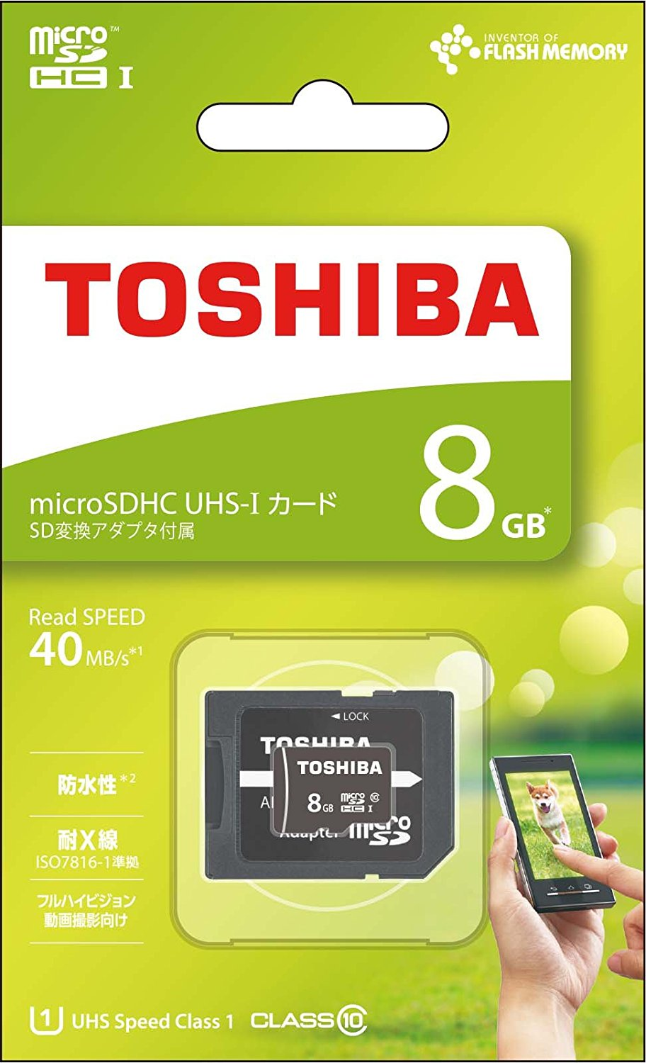
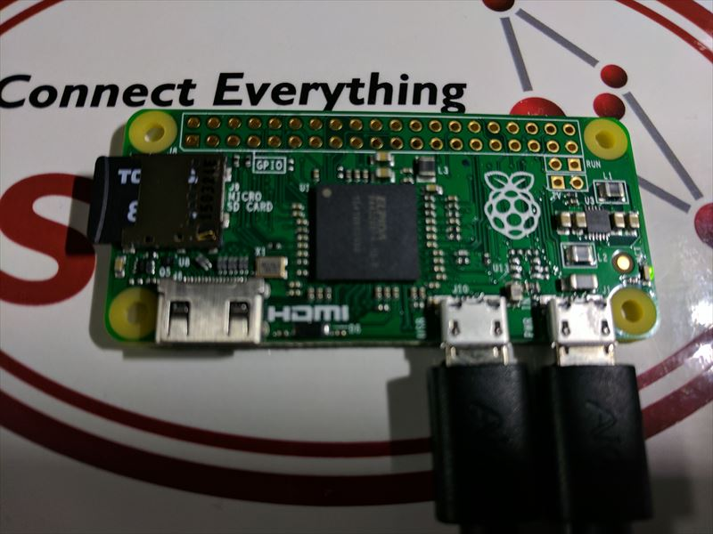
Purpose
Testing Total Dose for Raspberry PI Zero
Target Devices
Raspberry PI Zero: Ver.1.2
MicroSD Card: TOSHIBA 8GB Class10(TOSHIBA MSDAR40N08G)

Slide 3
Regulation
Target Radiation Dose
ISS(International Space Station) Orbit
SSP 30512 Revision C from NASA
Heat Sink： 0.5[mm] Thickness of Aluminum Plate
8773[rad/year] = 87.73 [gray/year]
Mission Period: 2.6[year]
87.73[gray/year] * 2.6[year] = 228.10 [gray]
Testing Radiation Dose
Radioactivity: Cobalt-60
Distance of the Radioactivity: 80[cm]
Testing Date: 22/Mar/2017
Irradiation Time: 5[h]
46[ray/h] * 5[h] = 230 [gray]

Slide 4
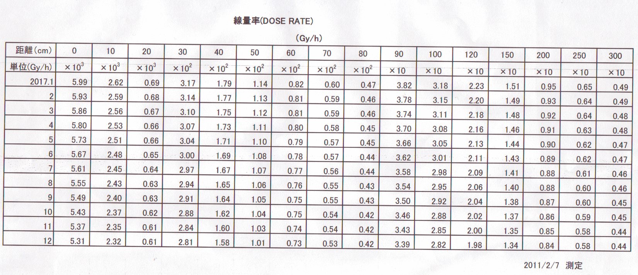
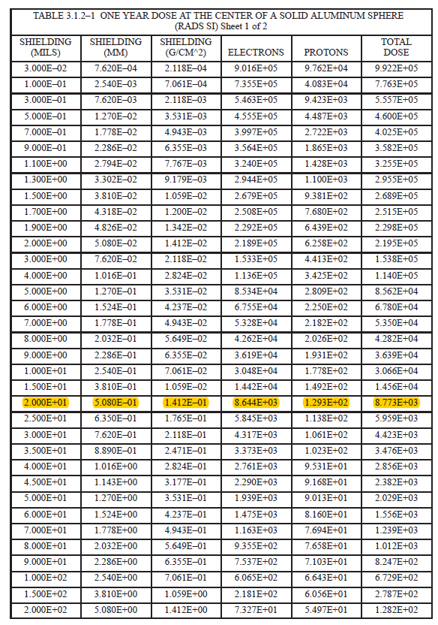
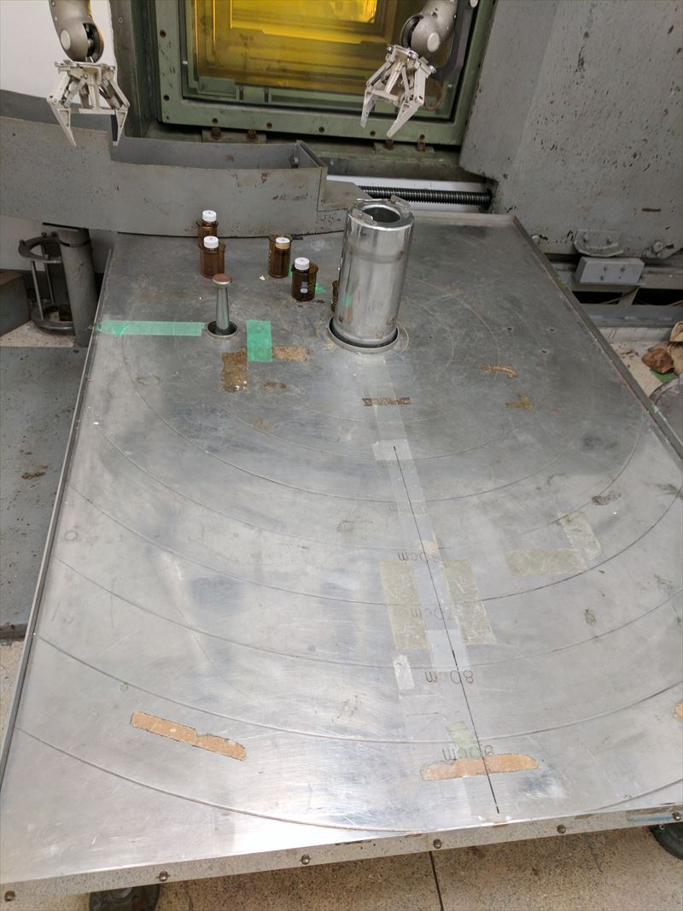
Calculation Tables
Table１．SSP 30512 Revision C
Table2．Dose Rate

Slide 5
Test Method
Phase | No. | Task
Before Test | 1 | Setup Raspberry PI Zero, Consumption Current Logger, Power Supply.
 | 2 | Set Current Date on Raspberry PI Zero.
 | 3 | Run the Testing Application on Raspberry PI Zero.
During Test | 4 | Get CPU’s Temperature & Current Time in Every Minute.
 | 5 | Create Current Time as File and Write Current Temperature in this File.
 | 6 | Get & Save Current Consumption Current by Logger.

Slide 6
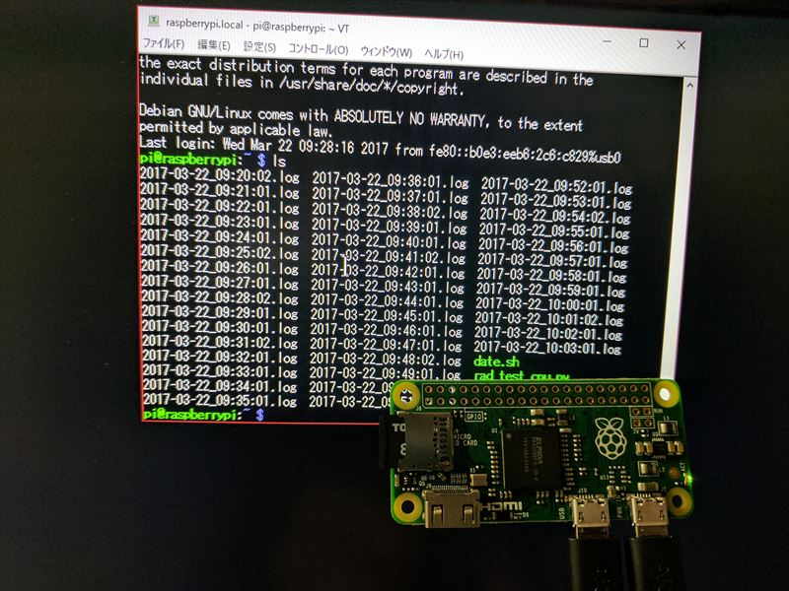
Test Application 1/2
Check Targets & Reason
CPU
Raspberry PI Zero’s parts are a CPU & a voltage regulator only.
Clock
The clock shifts by a radioactive noise.
MicroSD Card
MicroSD Card has a micro computer.
NAND Flash is weak in radiation.

Slide 7
Test Application 2/2
#!/usr/bin/python
#coding:utf-8
import os
import commands
import datetime
import locale
d = datetime.datetime.today()
temp = commands.getoutput("vcgencmd measure_temp").split('=')
date_form_body=d.strftime("%Y-%m-%d %H:%M:%S ")
s=date_form_body + temp[1] + '\n'
date_form_file=d.strftime("%Y-%m-%d_%H:%M:%S")
filename=date_form_file + '.log'
f = open(filename,'a')
f.write(s)
f.close()
Operations
Get CPU’s Temperature
Get Current Time
Create File by Current Time
Write CPU’s Temperature & Current Time in this File.
Close the File
Exit the Application
Run this Appli Every Minute by cron

Slide 8
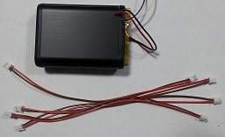
Consumption Current Logger
Reason
Consumption current goes up by total dose degradation.
Operation
Get & Save Current Consumption Current Every 30 seconds.

Slide 9
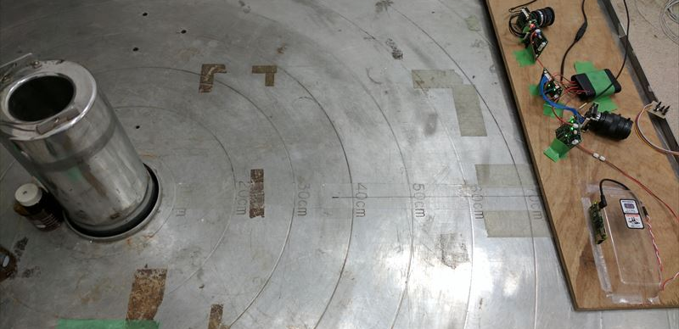
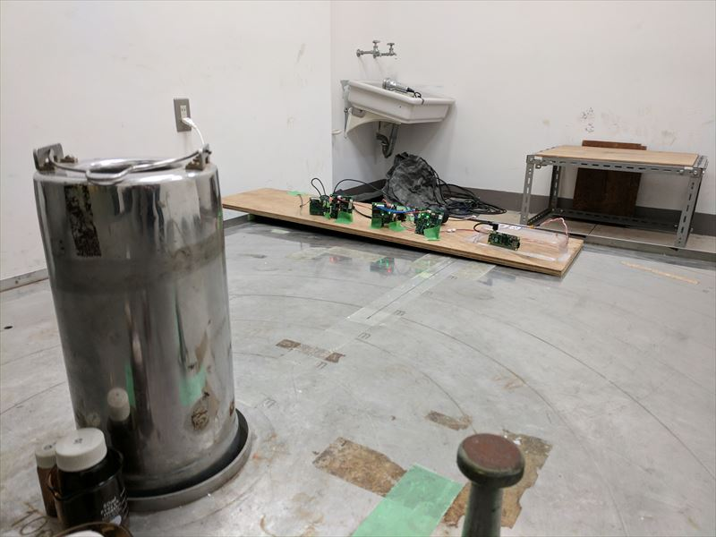
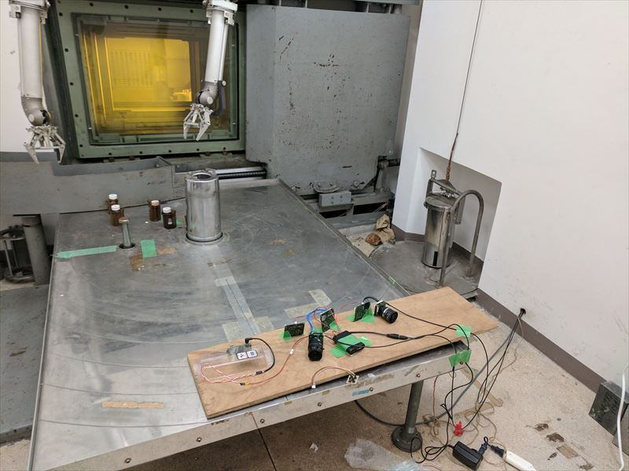
Test Environment
Top: Upper-Surface Figure, Lower Left: Front Figure, Lower Right: Rear Figure
Red Circle: Raspberry PI Zero
Blue Circle: Irradiation Point

Slide 10
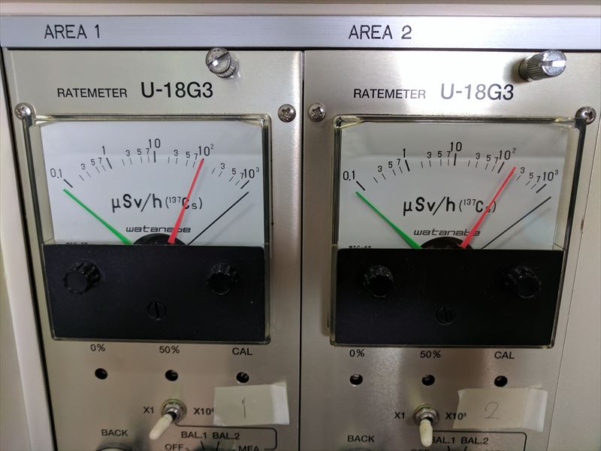
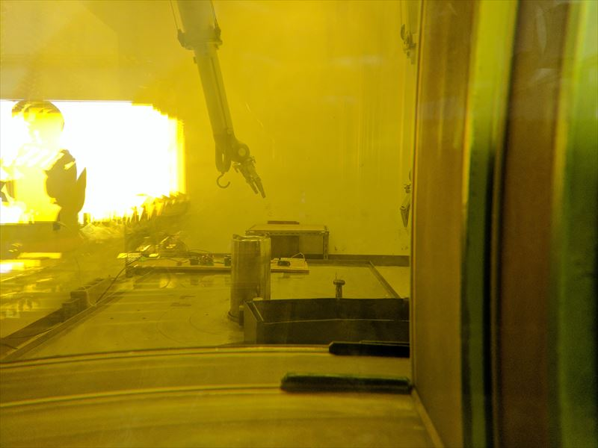
During Test
The value of radioisotope, and an inside situation

Slide 11





Test Result: CPU Temperature
Check Point | Check Target | Result | Success / Failure
Are the files made for every minute? | MicroSD Card | The files were created with the error for 1 second every minute. | Success
Were the files for 5 hours of test time made? | Clock | Just files existed. (Last – First) timestamps = 0:02. | Success
Isn't there any inaccurate temperature data? | CPU | Almost all the data was 25.0[C]. Occasional the data is 24.5[C]-26.0 [C]. | Success
By the above-mentioned test result, I judged that Raspberry PI Zero passed this test.

Slide 12
Test Result: Consumption Current
By the above-mentioned test result, I judged that Raspberry PI Zero passed this test.
But Consumption Current is increasing after 230min. It will be expected that radiation breaks if it is longer time.

Slide 13
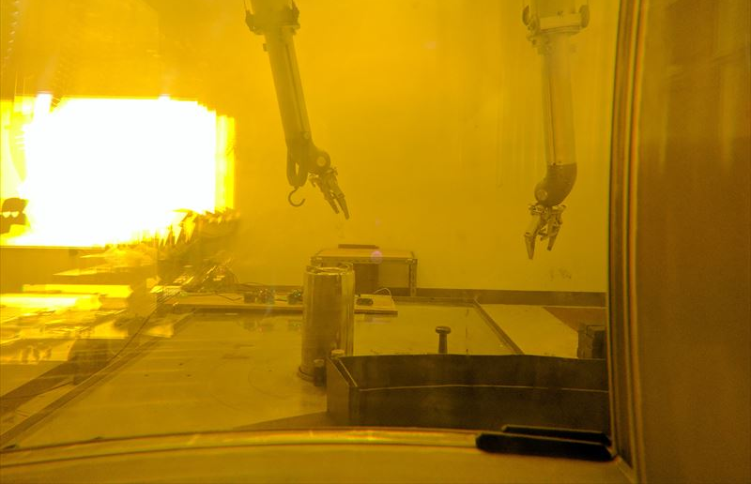
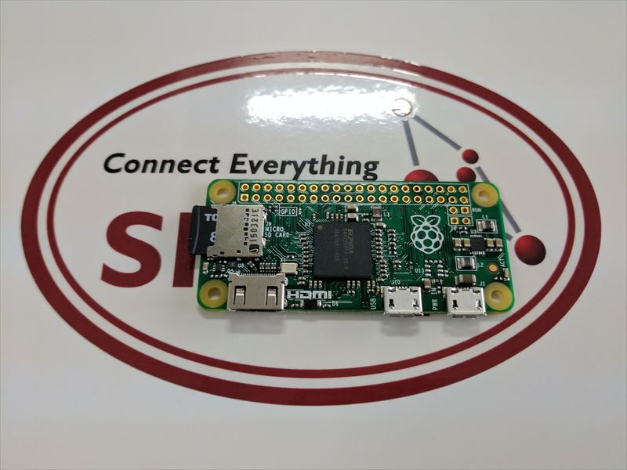
Test Result: Conclusion
By these test results, I judged that Raspberry PI Zero had radiation resistivity.
It will be expected that radiation breaks if it is longer time.

