Slide 1
About Android
Noritsuna Imamura
noritsuna@sirop.org

Slide 2
Agenda
About me
My works
About Android
Outline of Android
History of Android
Structure of Android
Development Tips of Android
Hands On
Setup Android Environment for OpenCV
What’s Android App?
Notes:
という形で進める

Slide 3
summary
SIP engineer
IPv6 based IP Phone as chief developer
SIProp project
HITOH project as project owner
HOTARU project
IPv6 based IMS/SIP OSS project as main designer
Japan Android Group
One of most famous community in Japan as Start up member
OESF
Non-profit company for Android as Start up & Board member

Slide 4
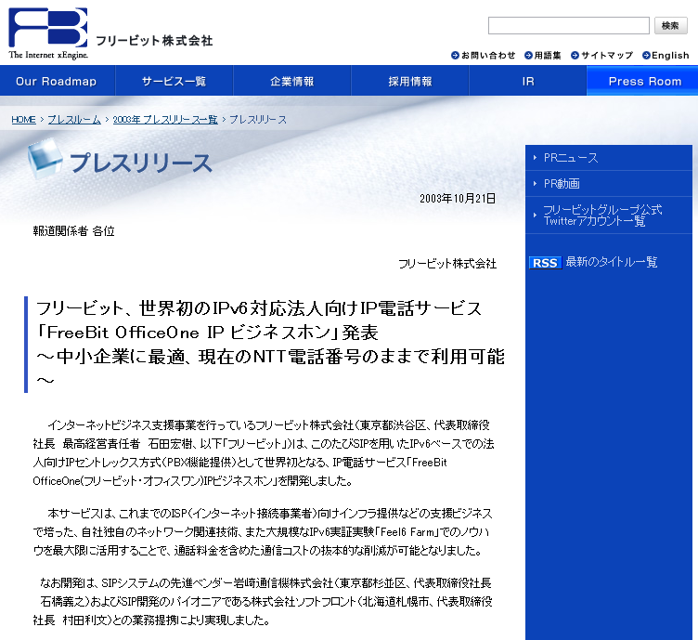

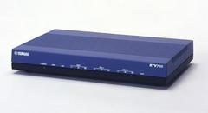
SIP&IPv6 engineer: 2002-2004
「FreeBit OfficeOne IP business phone」
This is a IPv6&SIP based company phone.
I made a SIP proxy server, SIP router & SIP hard phone.

Slide 5
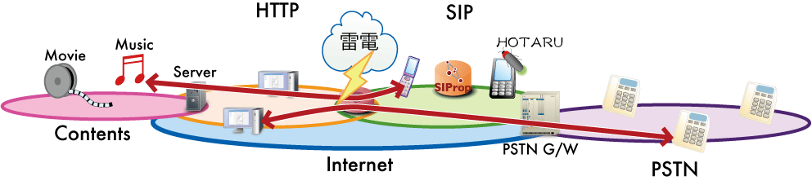
SIProp project in MITOH : 2006-2007
B2BUA solution for connecting M2M.
This project is supported by MITOH program.
IPA:INFORMATION-TECHNOLOGY PROMOTION AGENCY, JAPAN is established an incorporated Administrative Agency.
IPA undertakes the Exploratory IT Human Resources Project (The MITOH Program) for actively identifying and developing outstanding persons with creativity who can play key roles in creating next-generation IT markets.
http://www.ipa.go.jp/english/humandev/third.html
Notes:
2006年スタート。およそ、2年ほどの活動。

Slide 6


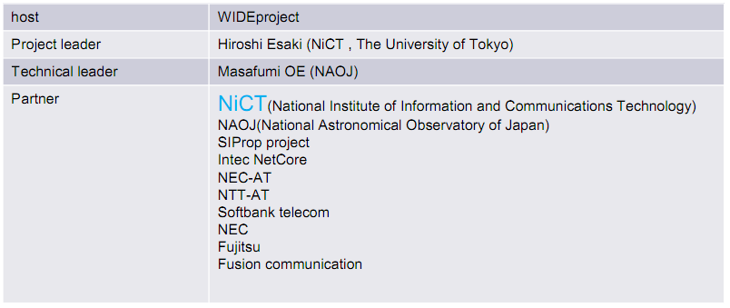
HOTARU project : 2007-2008
IPv6 based IMS/SIP open source project
Knowledge sharing by real-IMS implementation
http://www.luciola.net/

Slide 7
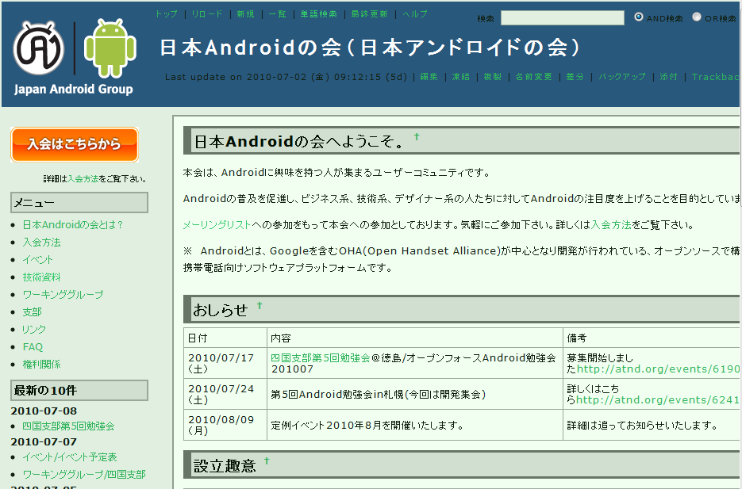
Japan Android Group : 2008-2010
Prof.Maruyama & I started up this community.
At Apr/2008
Detail
One of most famous Community in Japan
URL: http://www.android-group.jp/
Since: Sep/2008
Members: over 20,000
Branch: over 20

Slide 8
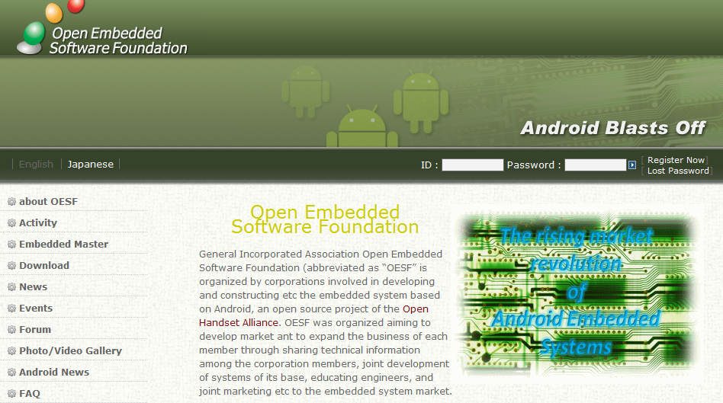
OESF : 2009-present
Mr.Miura(chairman) & I started up this non-profit campany.
I’m working in ITRI now. And we are making a testing framework & certification center for Android.
Detail
Non-profit company for Embedded Android.
URL: http://www.oesf.biz/
Since: Feb/2009
Members: over 120 companies
Branch: 6(in Asia countries)

Slide 9
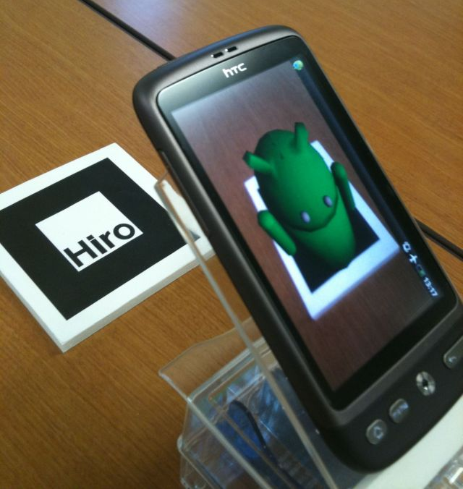
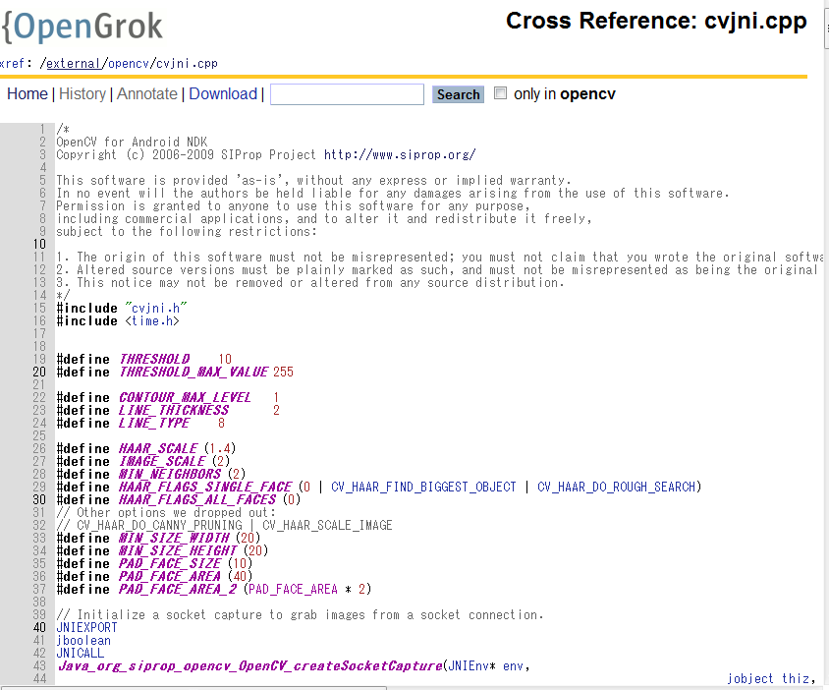
Android’s tools
NyARToolkit for Android
I made a first program for this OSS community
http://en.sourceforge.jp/projects/nyartoolkit-and/
OpenCV for Android NDK
This program is included in Android 4.0.1 .
http://tools.oesf.biz/android-4.0.1_r1.0/search?q=SIProp

Slide 10

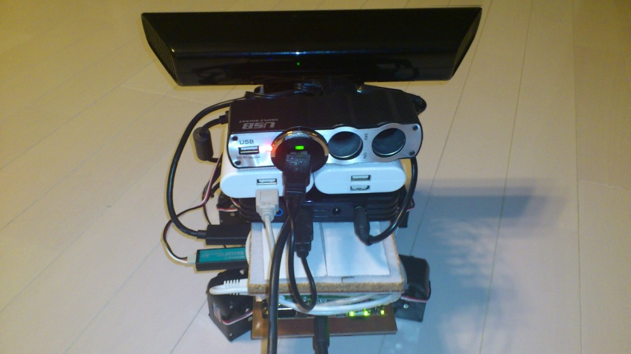
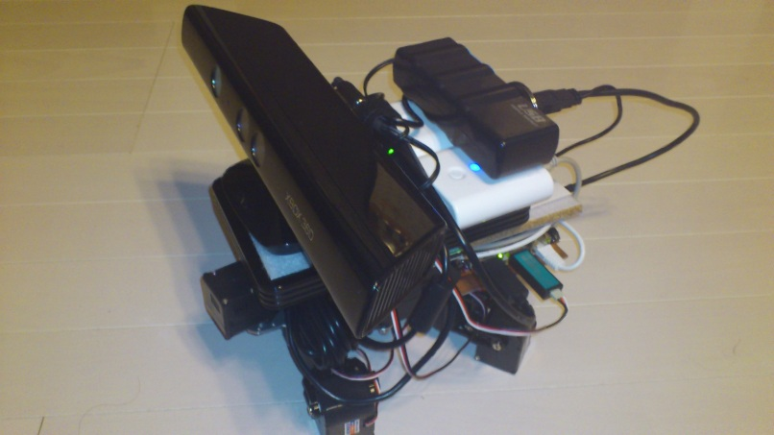
Other Products
Feel sketch
AR solution
with porting OpenCV to Android
http://code.google.com/p/feelsketch/
Auto Chasing Turtle
Face detecting Robot
with porting Kinect to Android & controlling Robot
http://www.siprop.org/ja/2.0/index.php?product%2FAutoChasingTurtle

Slide 11
Agenda
About me
My works
About Android
Outline of Android
History of Android
Structure of Android
Development Tips of Android
Hands On
Setup Android Environment for OpenCV
What’s Android App?
Notes:
という形で進める

Slide 12
Outline of Android

Slide 13

What’s Android?
I don’t explain the following things:
About Android
As OS for SmartPhone & Tablet PC.
Basically Android for Development
Activity, Intent, Service
I explain knowledge that Standard Android Developers don’t know.
Made by Google…?
When is Release Android SDKs & Devices?
How Many Versions?
What’s Functions?
What’s Called Android?

Slide 14
History of Android

Slide 15

2003.10 Startup Android inc.
2005.08 Google Acquired

Slide 16
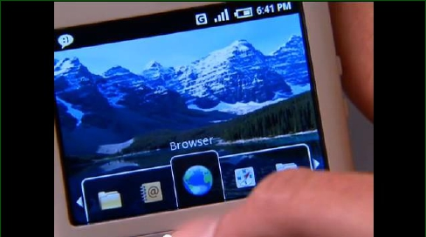
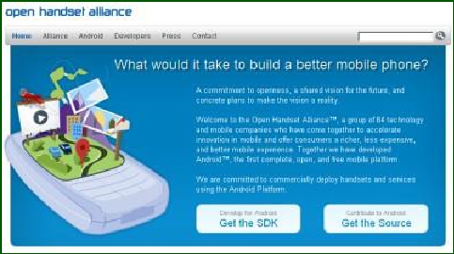
2007.11.05 Android Announced
2007.11.06 OHA Organized

Slide 17
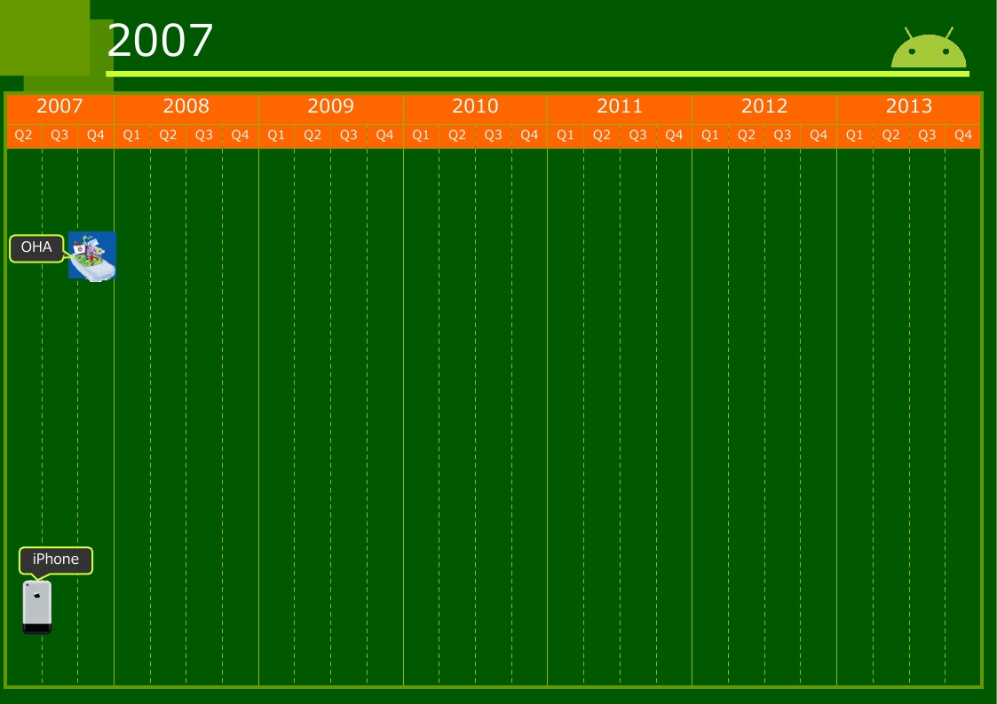

Slide 18
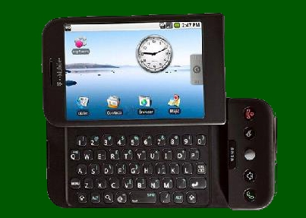
2008.09.23 1.0 SDK Released
2008.10.21 AOSP
2008.10.22 G1

Slide 19
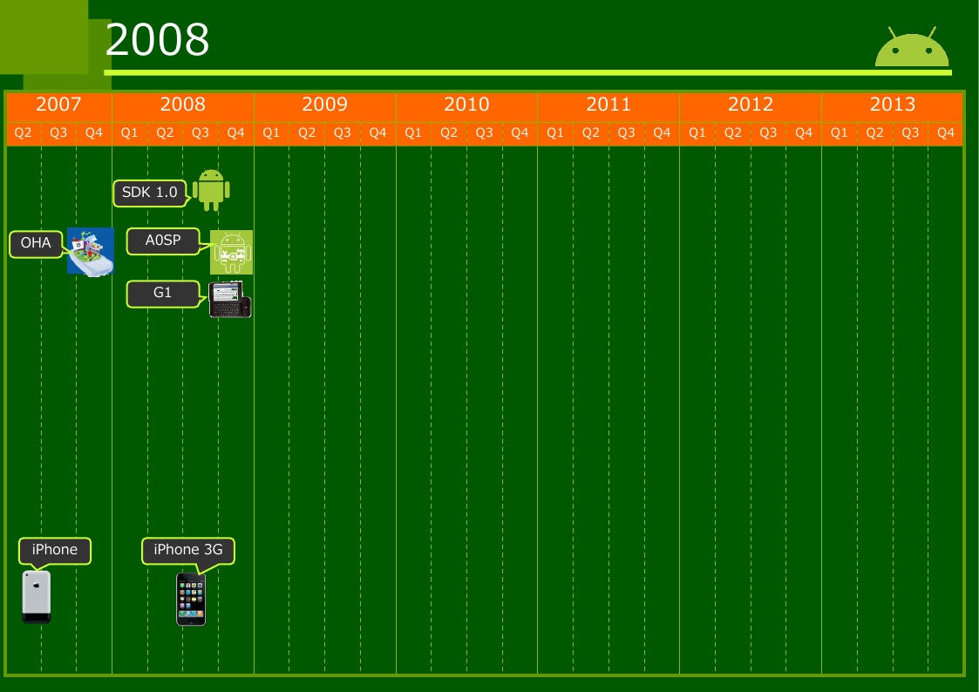

Slide 20
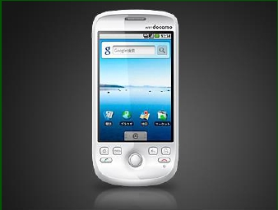
2009.04.29 HTC Magic

Slide 21

2009.04.30 1.5 Cupcake
New Software Keyboard with Auto Complate
Support Bluetooth A2DP
New Desktop & Widget
Support Animation
Linux: 2.6.27

Slide 22

2009.09.15 1.6 Donut
Available new Android Market
Available Voice Search & Quick Search
Available User Accessibility
Available User Data Password
Support CDMA/EVDO, IEEE802.1x, VPN
Support Gesture, Text Speech Engine
Support WVGA
Linux: 2.6.29

Slide 23






2009.10.26 2.0 Eclair
2009.12.03 2.0.1
2009.01.02 2.1
Optimized Hardwares
Available Multi Touch
Available Live Wallpaper
Support any Screen size & Resolution
Support HTML5
Support Camera's Flash & Digital Zoom
Support Bluetooth 2.1
Linux: 2.6.29

Slide 24
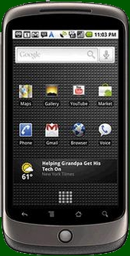
Nexus One
Name | NexusOne
Vendor | Google(HTC)
Release Date | 2010.01.05
OS | Android2.1Eclair
Screen | 3.7inchi 800x480 AMOLED
Size | 59.8x119.0x11.5mm
Weight | 130g
Camera | Rear：5MPw/Flash
CPU | QualcommSnapdragon QSD82501GHz
RAM | 512M
Storage | 512M＋SD
12

Slide 25
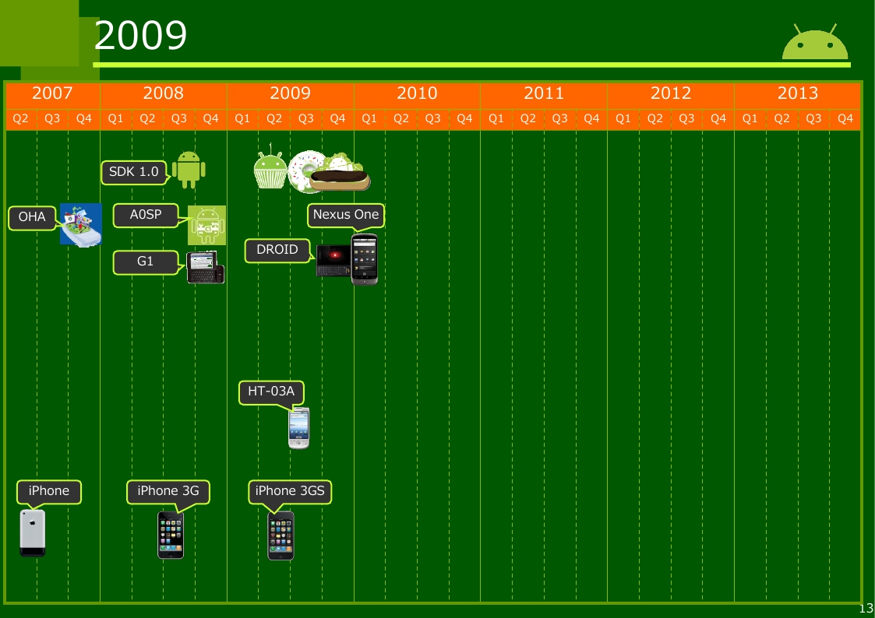

Slide 26

2010.05.20 2.2 Froyo
Available JIT Compiler in Dalvik VM
Available V8 JavaScript Engine
Available Cloud API
Support Hardware(GPS, Acerolameter, etc) in Browser
Support Auto Update from Android Market
Support Bug Report
Linux: 2.6.32

Slide 27

2010.12.06 2.3 Gingerbread
2011.02.09 2.3.3
Available G sensor, Atmospheric Pressure Sensor, Gyro Scope
Support Parallel GC (Response Time >3ms)
Support NFC
Support Multi Camera(Rear, Front)
Support SIP
Support OTG-USB(USB Host)
Linux: 2.6.35

Slide 28
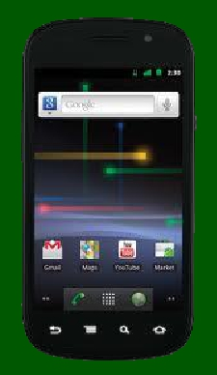
Nexus S
Name | NexusS
Vendor | Google(Samsung)
Release Date | 2010.12.16
OS | Android2.3Gingerbread
Screen | 4.0inchi 800x480 SuperAMOLED
Size | 63.0x123.9x10.88mm
Weight | 129g
Camera | Rear：5MPw/Flash Front：VGA
CPU | SamsungHummingbird 1GHz
RAM | 512M
Storage | 16G
16

Slide 29
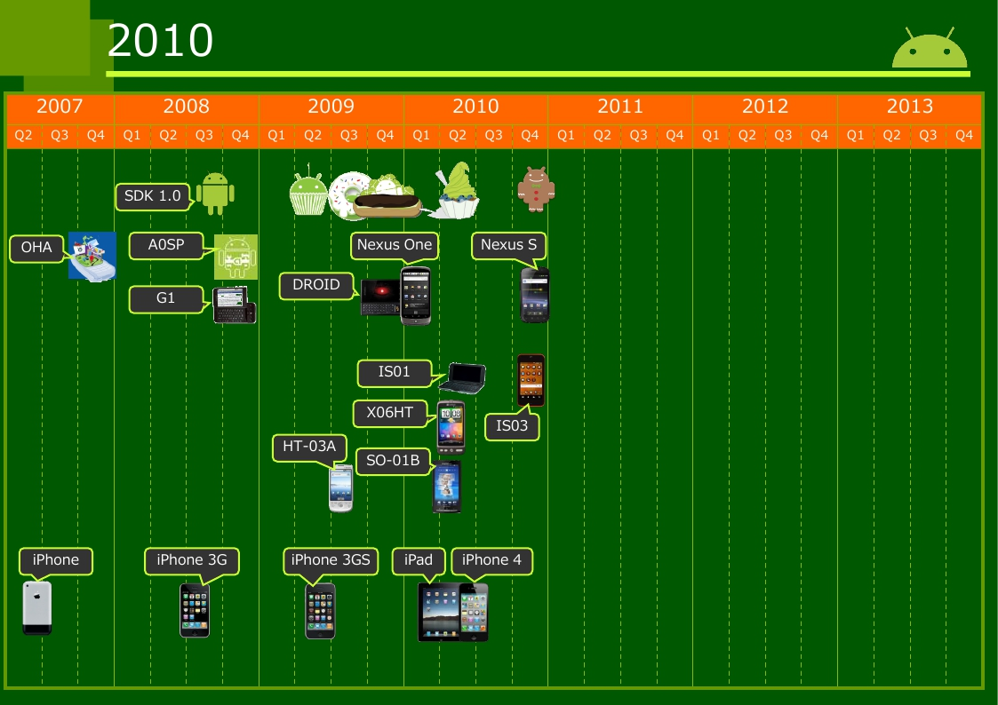

Slide 30

2011.02.22 3.0 Honeycomb
2011.05.10 3.1
2011.07.15 3.2
This Version is For Tablet (New UI&Large Resolution)
Available DRM Framework
Available ADK(Open Accessory API)
Support 2D Hardware Rendering
Support Multi Core CPU(SMP)
Support HID(Mouse, Game Pad, Joy Stick)
Support Media Transfer Protocol, MTP
Support Real-time Transport Protocol, RTP
Linux: 2.6.36

Slide 31
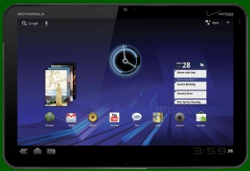
XOOM
Name | XOOM
Vendor | MOTOROLA
Release Date | 2011.02.24
OS | Android3.0Honeycomb
Screen | 10.1inchi 1280x800
Size | 249.0x168.0x12.8mm
Weight | 726g
Camera | Rear：5MP Front：2MP
CPU | NVDIATegra21GHz DualCore
RAM | 1GB
Storage | 32GB＋SD
19

Slide 32

2011.10.19 4.0 IceCreamSandwich
2011.12.16 4.0.3
Merge SmartPhone & Tablet UI
Available New Communication Func
Android Beam(P2P NFC)
WiFi Direct
Bluetooth Health Device Profile
Available Recognized Face Func by OpenCV
Support Stylus Input
Linux: 3.0

Slide 33
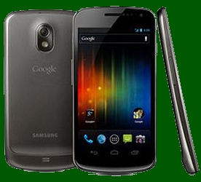
GALAXY NEXUS
Name | GALAXYNEXUS
Vendor | Google(Samsung)
Release Date | 2011.11.17
OS | Android4.0
Screen | 4.65inchi 1280x720
Size | 68x136x8.8-11.5mm
Weight | 135g
Camera | Rear：5.1M Front：1.3M
CPU | TI OMAP44601.2GHz DualCore
RAM | 1GB
Storage | 16G
21

Slide 34
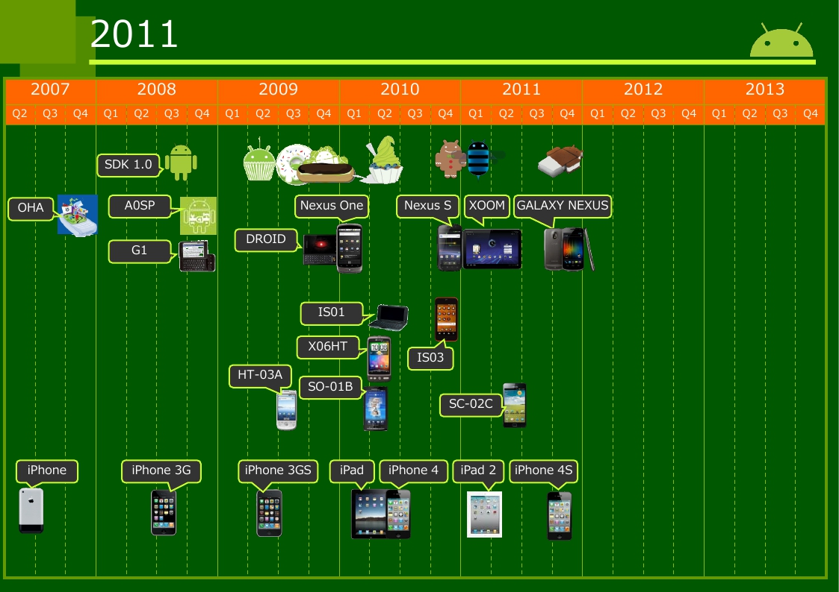

Slide 35

2012.06.27 4.1 Jelly Bean
2012.11.13 4.2
2013.07.24 4.3
4.1, 4.2
Available USB Audio
Support i18n(Internationalization)
Support Vibration for Input Device
Support Miracast
Support Writing Vertically
Support RenderScript
Change Android Market to Google Play
Linux: 3.1.10
4.3
Support OpenGL/ES 3.0
Support Bluetooth LE
Support Wi-Fi Location
Linux: 3.4.0

Slide 36
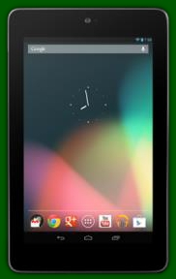
Nexus 7
Name | Nexus7
Vendor | Google(ASUS)
Release Date | 2012.07.13
OS | Android4.1
Screen | 7inchi 1280x800
Size | 120x198.5x10.45mm
Weight | 340g
Camera | Front：1.2M
CPU | NVIDIA Tegra3T3QL 1.2GHz QuadCore
RAM | 1GB
Storage | 8G/16G/32G
24

Slide 37

Nexus 4
Name | Nexus4
Vendor | Google(LG)
Release Date | 2012.11.13
OS | Android4.2
Screen | 4.7inchi 1280x768
Size | 68.7x133.9x9.1mm
Weight | 139g
Camera | Rear：8M Front：1.3M
CPU | Qualcomm SnapdragonS4 1.5GHzQuadCore
RAM | 2GB
Storage | 8G/16G
26

Slide 38
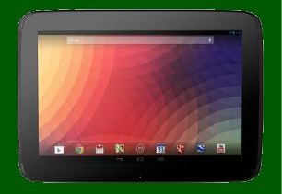
Nexus 10
Name | Nexus10
Vendor | Google(Samsung)
Release Date | 2012.11.13
OS | Android4.2
Screen | 10.055inchi 2560x1600
Size | 263.9x177.6x8.9mm
Weight | 603g
Camera | Rear：5M Front：1.9M
CPU | Samsung Exynos5250 1.7GHzDualCore
RAM | 2GB
Storage | 16G/32G
27

Slide 39
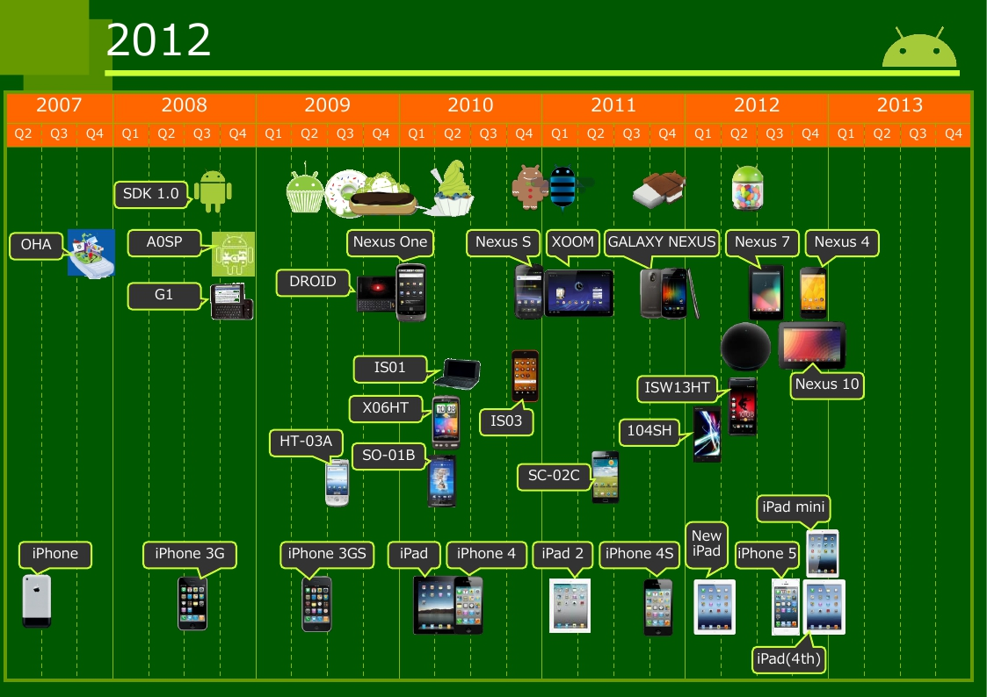

Slide 40
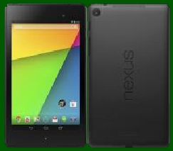
Nexus 7 (2013)
Name | Nexus7(2013)
Vendor | Google(ASUS)
Release Date | 2013.07.30
OS | Android4.3
Screen | 7inchi 1920x1200
Size | 114x200x8.65mm
Weight | 290g
Camera | Rear：5M Front：1.2M
CPU | Qualcomm SnapdragonS4 ProAPQ80641.5GHz QuadCore
RAM | 2GB
Storage | 16G/32G
31

Slide 41

2013.10.31 4.4 KitKat
Available Printing Framework
Support Poor Device(512MB DRAM)
Support Host Card Emulation in NFC
Support Batch Processing for Hardware Sensors
Support Full Screen Mode
Support C++ API for RenderScript
Change WebView to Chromium 30 base
Linux: 3.4.0

Slide 42
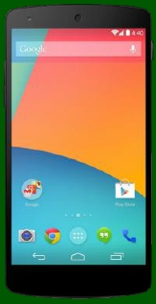
Nexus 5
Name | Nexus5
Vendor | Google(LG)
Release Date | 2013.10.31
OS | Android4.4
Screen | 4.95inchi 1920x1080
Size | 69.17x137.84x8.59mm
Weight | 130g
Camera | Rear：8M Front：1.2M
CPU | Qualcomm Snapdragon800 2.3GHzQuadCore
RAM | 2GB
Storage | 16G/32G
34

Slide 43
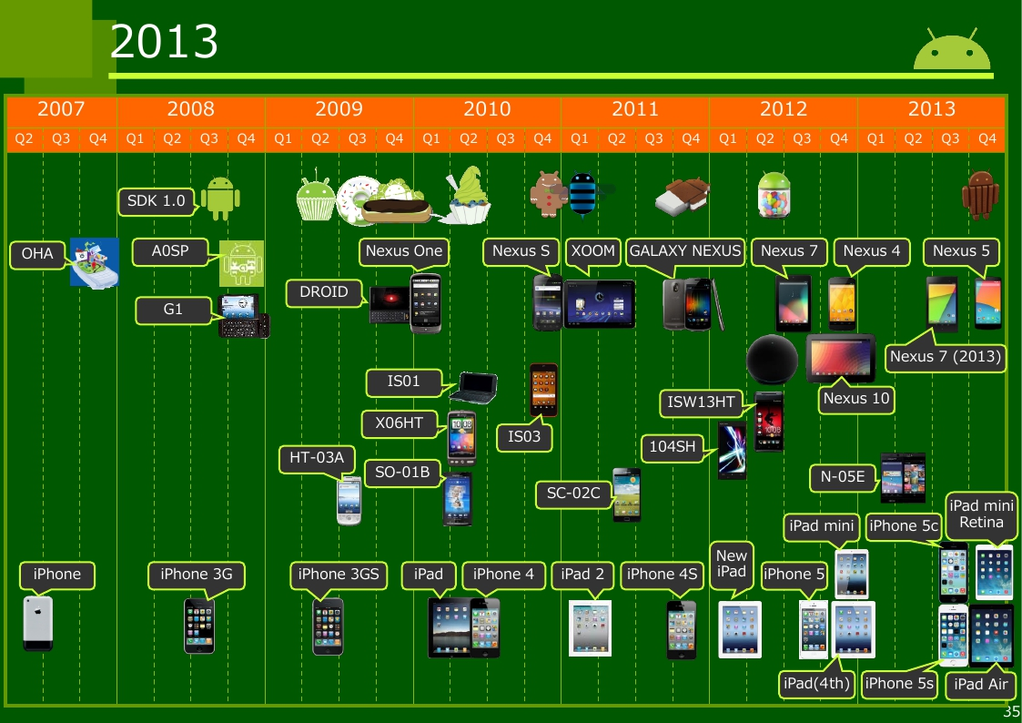

Slide 44
Appendix -Date
2003.10
2005.08
2007.11.05
2007.11.06
2008.02.13
2008.03.03
2008.08.13
2008.09.23
2008.10.21
2008.10.22
2009.02.09
2009.04.29
2009.04.30
2009.09.15
2009.10.26
2009.11.06
2009.12.03
2009.01.02
2010.01.05
2010.05.20
2010.12.06
2010.12.16
Startup Android inc.
Google acquired
Android Released
OHA Organized
m5-rc14
m5-rc15
0.9
1.0
AOSP OSS
T-Mobile G1
1.1
HTC Magic
1.5 Cupcake
1.6 Donut
2.0 Eclair
Motorola Droid/Milestone
2.0.1
2.1
Nexus One
2.2 Froyo
2.3 Gingerbread
Nexus S
2011.02.09 2.3.3
2011.02.22 3.0 Honeycomb
2011.05.10 3.1
2011.07.15 3.2
2011.02.24 MOTOROLA XOOM
2011.10.19 4.0 IceCreamSandwich
2011.12.16 4.0.3
2011.11.17 GALAXY NEXUS
2012.06.27 4.1 Jelly Bean
2012.06.27 Nexus Q
2012.07.13 Nexus 7
2012.11.13 4.2
2012.11.13 Nexus 4
2012.11.13 Nexus 10
2013.03.13 Sundar Pichai CEO
2013.07.24 4.3
2013.07.26 Nexus 7 (2013)
†KeyLimePie
2013.10.31 4.4
2013.11.01 Nexus 5
2007.06.29
2008.07.11
2009.06.19
2010.04.03
2010.06.24
2011.03.11
2011.10.14
2012.03.16
2012.09.21
2012.11.02
2012.11.02
2013.09.20
2013.09.20
2013.10.22
2013.11.12
iPhone
iPhone 3G
iPhone 3GS
iPad
iPhone 4
iPad 2
iPhone 4S→4s
iPad (3rd)
iPhone 5
iPad (4th)
iPad mini
iPhone 5s
iPhone 5c
iPad Air
iPad mini Retina
36

Slide 45
World Share of SmartPhone
 | Total | Android | iOS | Symbian | RIM | Bada | Microsoft | Others
2009Q2 | 40,971,800 | 1.8% | 13.0% | 51.0% | 19.0% |  | 9.3% | 5.8%
2009Q3 | 41,093,300 | 3.5% | 17.1% | 44.6% | 20.7% |  | 7.9% | 6.2%
2009Q4 | N/A | N/A | N/A | N/A | N/A |  | N/A | N/A
2010Q1 | 54,505,500 | 9.6% | 15.3% | 44.2% | 19.7% |  | 6.8% | 4.4%
2010Q2 | 62,058,100 | 17.2% | 14.1% | 40.9% | 18.7% | 0.9% | 4.9% | 3.2%
2010Q3 | 81,132,600 | 25.3% | 16.6% | 36.3% | 15.4% | 1.1% | 2.7% | 2.5%
2010Q4 | 101,150,300 | 30.5% | 15.8% | 32.3% | 14.6% | 2.0% | 3.4% | 1.5%
2011Q1 | 99,775,000 | 36.4% | 16.9% | 27.7% | 13.0% | 1.9% | 2.6% | 1.5%
2011Q2 | 107,740,400 | 43.4% | 18.2% | 22.1% | 11.7% | 1.9% | 1.6% | 1.0%
2011Q3 | 115,185,400 | 52.5% | 15.0% | 16.9% | 11.0% | 2.2% | 1.5% | 0.9%
2011Q4 | 149,041,800 | 50.9% | 23.8% | 11.7% | 8.8% | 2.1% | 1.9% | 0.8%
2012Q1 | 144,391,700 | 56.1% | 22.9% | 8.6% | 6.9% | 2.7% | 1.9% | 0.9%
2012Q2 | 153,686,100 | 64.1% | 18.8% | 5.9% | 5.2% | 2.7% | 2.7% | 0.6%
2012Q3 | 169,178,600 | 72.4% | 13.9% | 2.6% | 5.3% | 3.0% | 2.4% | 0.4%
2012Q4 | 207,662,400 | 69.7% | 20.9% | 1.2% | 3.5% | 1.3% | 3.0% | 0.3%
Source: Gartner (http://www.gartner.com/)

Slide 46
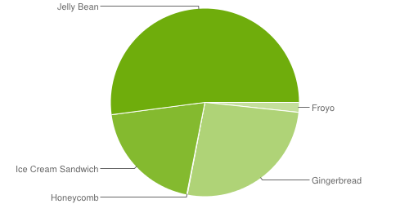
Android Usage
Version | Code name | Release date | API level | Distribution
4.4 | KitKat | October 31, 2013 | 19 | 0%
4.3.x | Jelly Bean | July 24, 2013 | 18 | 2.3%
4.2.x | Jelly Bean | November 13, 2012 | 17 | 12.5%
4.1.x | Jelly Bean | July 9, 2012 | 16 | 37.3%
4.0.3–4.0.4 | Ice Cream Sandwich | December 16, 2011 | 15 | 19.8%
3.2 | Honeycomb | July 15, 2011 | 13 | 0.1%
3.1 | Honeycomb | May 10, 2011 | 12 | 0%
2.3.3–2.3.7 | Gingerbread | February 9, 2011 | 10 | 26.3%
2.3–2.3.2 | Gingerbread | December 6, 2010 | 9 | 0%
2.2 | Froyo | May 20, 2010 | 8 | 1.7%
2.0–2.1 | Eclair | October 26, 2009 | 7 | 0%
1.6 | Donut | September 15, 2009 | 4 | 0%
1.5 | Cupcake | April 30, 2009 | 3 | 0%
November 1, 2013
http://developer.android.com/about/dashboards/index.html

Slide 47
Structure of Android

Slide 48
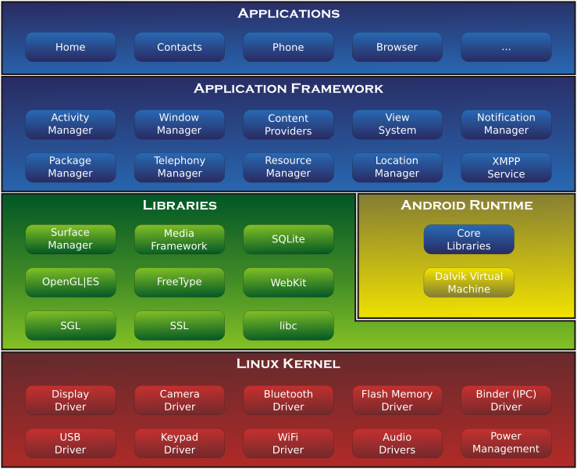
About Android
Android Framework has 3 Layer Stack for SmartPhone & Tablet PC.
Application Framework Layer (Java)
Library Layer (Linux C/C++)
Kernel/Driver Layer (Linux Kernel C/ASM)

Slide 49
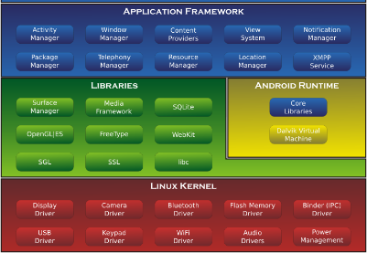
Application Framework Layer
APIs
App Components
User Interface
App Resources
Animation and Graphics
Computation
Media and Camera
Location and Sensors
Connectivity
Text and Input
Data Storage
Administration
Web Apps
Best Practices

Slide 50
Application Framework Layer
Packages by Android Framework
android.accessibilityservice
android.accounts
android.animation
android.app
android.app.admin
android.app.backup
android.appwidget
android.bluetooth
android.content
android.content.pm
android.content.res
android.database
android.database.sqlite
android.drm
android.gesture
android.graphics
android.graphics.drawable
android.graphics.drawable.shapes
android.graphics.pdf
android.hardware
android.hardware.display
android.hardware.input
android.hardware.location
android.hardware.usb
android.inputmethodservice
android.location
android.media
android.media.audiofx
android.media.effect
android.mtp
android.net
android.net
android.net.http
android.net.nsd
android.net.rtp
android.net.sip
android.net.wifi
android.net.wifi.p2p
android.net.wifi.p2p.nsd
android.nfc
android.nfc.cardemulation
android.nfc.tech
android.opengl
android.os
android.os.storage
android.preference
android.print
android.print.pdf
android.printservice
android.provider
android.renderscript
android.sax
android.security
android.service.dreams
android.service.notification
android.service.textservice
android.service.wallpaper
android.speech
android.speech.tts
android.support.v13.app
android.support.v4.accessibilityservice
android.support.v4.app
android.support.v4.content
android.support.v4.content.pm
android.support.v4.database
android.support.v4.graphics.drawable
android.support.v4.hardware.display
android.support.v4.media
android.support.v4.net
android.support.v4.os
android.support.v4.print
android.support.v4.text
android.support.v4.util
android.support.v4.view
android.support.v4.view.accessibility
android.support.v4.widget
android.support.v7.app
android.support.v7.appcompat
android.support.v7.gridlayout
android.support.v7.media
android.support.v7.mediarouter
android.support.v7.view
android.support.v7.widget
android.support.v8.renderscript
android.telephony
android.telephony.cdma
android.telephony.gsm
android.test
android.test.mock
android.test.suitebuilder
android.text
android.text.format
android.text.method
android.text.style
android.text.util
android.transition
android.util
android.view
android.view.accessibility
android.view.animation
android.view.inputmethod
android.view.textservice
android.webkit
android.widget
dalvik.bytecode
dalvik.system

Slide 51
Application Framework Layer
Packages by Java Framework
java.awt.font
java.beans
java.io
java.lang
java.lang.annotation
java.lang.ref
java.lang.reflect
java.math
java.net
java.nio
java.nio.channels
java.nio.channels.spi
java.nio.charset
java.nio.charset.spi
java.security
java.security.acl
java.security.cert
java.security.interfaces
java.security.spec
java.sql
java.text
java.util
java.util.concurrent
java.util.concurrent.atomic
java.util.concurrent.locks
java.util.jar
java.util.logging
java.util.prefs
java.util.regex
java.util.zip
javax.crypto
javax.crypto.interfaces
javax.crypto.spec
javax.microedition.khronos.egl
javax.microedition.khronos.opengles
javax.net
javax.net.ssl
javax.security.auth
javax.security.auth.callback
javax.security.auth.login
javax.security.auth.x500
javax.security.cert
javax.sql
javax.xml
javax.xml.datatype
javax.xml.namespace
javax.xml.parsers
javax.xml.transform
javax.xml.transform.dom
javax.xml.transform.sax
javax.xml.transform.stream
javax.xml.validation
javax.xml.xpath
junit.framework
junit.runner
org.json
org.w3c.dom
org.w3c.dom.ls
org.xml.sax
org.xml.sax.ext
org.xml.sax.helpers
org.xmlpull.v1
org.xmlpull.v1.sax2
org.apache.http
org.apache.http.auth
org.apache.http.auth.params
org.apache.http.client
org.apache.http.client.entity
org.apache.http.client.methods
org.apache.http.client.params
org.apache.http.client.protocol
org.apache.http.client.utils
org.apache.http.conn
org.apache.http.conn.params
org.apache.http.conn.routing
org.apache.http.conn.scheme
org.apache.http.conn.ssl
org.apache.http.conn.util
org.apache.http.cookie
org.apache.http.cookie.params
org.apache.http.entity
org.apache.http.impl
org.apache.http.impl.auth
org.apache.http.impl.client
org.apache.http.impl.conn
org.apache.http.impl.conn.tsccm
org.apache.http.impl.cookie
org.apache.http.impl.entity
org.apache.http.impl.io
org.apache.http.io
org.apache.http.message
org.apache.http.params
org.apache.http.protocol
org.apache.http.util

Slide 52
Library Layer
Linux Software & Linux Library
aac
android-clat
android-mock
ant-glob
antlr
apache-harmony
apache-http
apache-qp
apache-xml
arduino
bison
blktrace
bluetooth
bouncycastle
bsdiff
bzip2
ceres-solver
checkpolicy
chromium
chromium-libpac
chromium-trace
chromium_org
clang
compiler-rt
dexmaker
dhcpcd
dnsmasq
doclava
droiddriver
dropbear
e2fsprogs
easymock
eclipse-basebuilder
eclipse-windowbuilder
eigen
elfutils
embunit
emma
esd
expat
eyes-free
fdlibm
flac
freetype
fsck_msdos
ganymed-ssh2
gcc-demangle
genext2fs
giflib
google-diff-match-patch
grub
gtest
guava
hamcrest
harfbuzz
harfbuzz_ng
hyphenation
icu4c
iproute2
ipsec-tools
iptables
iputils
tinycompress
tinyxml
tinyxml2
tremolo
v8
valgrind
webp
webrtc
wpa_supplicant_8
xmlwriter
xmp_toolkit
yaffs2
zlib
zxing
jack
javasqlite
javassist
jdiff
jhead
jmdns
jmonkeyengine
jpeg
jsilver
jsr305
junit
kernel-headers
libcap-ng
libffi
libgsm
liblzf
libmtp
libnfc-nci
libnfc-nxp
libnl-headers
libogg
libpcap
libphonenumber
libpng
libppp
libselinux
libsepol
libusb
libusb-compat
libvorbis
libvpx
libxml2
libxslt
libyuv
linux-tools-perf
littlemock
llvm
lzma
marisa-trie
markdown
mdnsresponder
mesa3d
mksh
mockito
mockwebserver
mp4parser
mtpd
naver-fonts
netcat
netperf
neven
nist-pkits
nist-sip
noto-fonts
oauth
objenesis
okhttp
open-vcdiff
opencv
openfst
openssh
openssl
oprofile
pixman
ppp
proguard
protobuf
qemu
qemu-pc-bios
regex-re2
replicaisland
robolectric
safe-iop
scrypt
sepolicy
sfntly
sil-fonts
skia
smack
smali
sonivox
speex
sqlite
srec
srtp
stlport
strace
stressapptest
svox
tagsoup
tcpdump
timezonepicker-support
tinyalsa

Slide 53
Kernel/Driver Layer
Android Source Tree
Ex. Nexus7(2013)
Device
Asus
flo
flo-kernel
Hardware
Qcom
audio
bt
camera
display
keymaster
media
msm8960
msm8x74
power
sensors
wlan

Slide 54





License
Google Proprietary
Google Android
3 Types License
Apache 2.0
All Application Framework
Some Libraries
Bionic
GPL
Almost Libraries
Linux Kernel
Google Proprietary
Google Applications from Play Store
How to Get Play Store?
Pass CTS
AOSP
(Android Open Source Project)
Apache 2.0
GPL

Slide 55
How to Develop?
ADT
Standard Android Application
Only Java on Application Framework Layer
Advantage
Use All Android Tools
Many Docs from Google Developer Site & Blogs
Call Stack
APK File(Your Application)
(Java)
Call as Java API
Application Framework
Layer (Java)
Call as JNI(C/C++)
Library Layer
(C/C++)
Call as SysCall(C/ASM)
Kernel/Driver Layer
(C/ASM)

Slide 56
How to Develop?
NDK w/ADT
Standard Android Application for C/C++
Java on Application Framework Layer
C/C++ on Limited Library Layer
Advantage
Use Java&C/C++
Dis-Advantage
Must Use UI Framework on Java Layer
Call Stack
APK File(Your Application)
(Java & C/C++)
Call as Java API
Application Framework
Layer (Java)
Call as JNI(C/C++)
Library Layer
(C/C++)
Call as SysCall(C/ASM)
Kernel/Driver Layer
(C/ASM)

Slide 57
How to Develop?
NDK wo/ADT
Standard Android Application for C/C++
Only C/C++ on Limited Library Layer
Advantage
Only C/C++
DirectCall C/C++ API
Dis-Advantage
Use a few Android Tools
A few Docs from Google Developer Site & Blogs
Call Stack
APK File(Your Application)
(C/C++)
Call as C/C++ APIs
Library Layer
(C/C++)
Call as SysCall(C/ASM)
Kernel/Driver Layer
(C/ASM)

Slide 58
How to Develop?
As Linux Application
Non-Standard Android Application
Full Linux C/C++ on Library Layer
Advantage
Use Other Linux Libs
Dis-Advantage
Must Modify Android System
How to Modify on next Lecture
Call Stack
ELF File(Your Application)
(C/C++)
Call as C/C++ APIs
Library Layer + Linux Libs
(C/C++)
Call as SysCall(C/ASM)
Kernel/Driver Layer
(C/ASM)

Slide 59
Development Tips

Slide 60
Android SDK Tools
Tools Help | Android Developers
http://developer.android.com/tools/help/index.html
jet
android
ant
apps/SdkController
ddms
dmtracedump
draw9patch
emulator
etc1tool
hierarchyviewer
hprof-conv
layoutopt
jobb
lint
mksdcard
monitor
monkey
monkeyrunner
proguard
sqlite3
systrace
traceview
uiautomatorviewer
zipalign

Slide 61
Android SDK Tools
jet
Making Music File for JetPlayer
JetPlayer | Android Developers
http://developer.android.com/reference/android/media/JetPlayer.html
android
Manage Project, SDK, Android Virtual Devices
android | Android Developers
http://developer.android.com/tools/help/android.html
ant
Apache Ant
http://ant.apache.org/

Slide 62
Android SDK Tools
apps/SdkController
Virtual Hardware for Emulator
Emulate Sensors, Multi Touch
ddms (Dalvik Debug Monitor Server)
Debugger
Using DDMS | Android Developers
http://developer.android.com/tools/debugging/ddms.html
Deprecated
Android Device Monitor

Slide 63
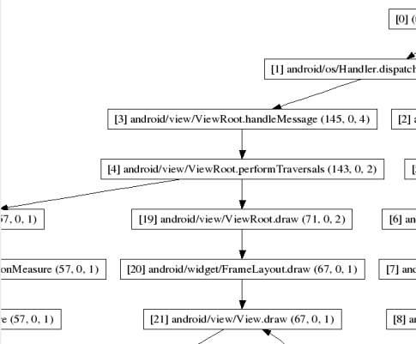
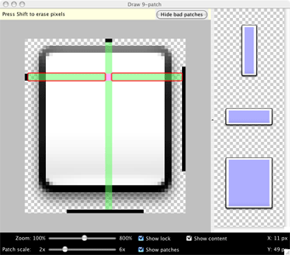
Android SDK Tools
dmtracedump
Create Graphical Diagram from SysTrace Data
dmtracedump | Android Developers
http://developer.android.com/tools/help/dmtracedump.html
draw9patch
Editor for making 9patch Image File
Draw 9-patch | Android Developers
http://developer.android.com/tools/help/draw9patch.html

Slide 64
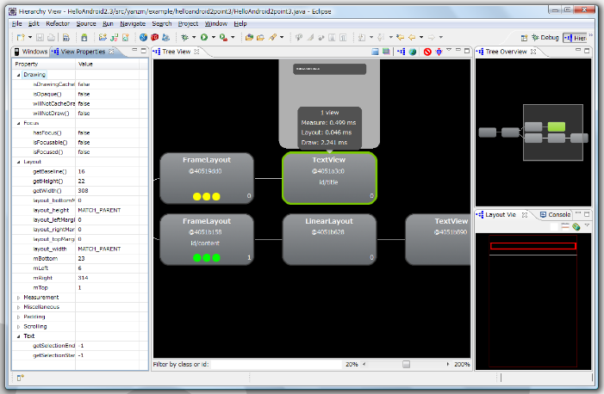
Android SDK Tools
emulator
Android Emulator
Android Emulator | Android Developers
http://developer.android.com/tools/help/emulator.html
etc1tool
Create Open GL Texture File(ETC1)
etc1tool | Android Developers
http://developer.android.com/tools/help/etc1tool.html
hierarchyviewer
Editor for Android UI
Hierarchy Viewer | Android Developers
http://developer.android.com/tools/help/hierarchy-viewer.html

Slide 65
Android SDK Tools
hprof-conv
Convert Android Original Format Heap Memory Dump to Standard Format. Ex. Eclipse Memory Analyzer (MAT)
HPROF Converter | Android Developers
http://developer.android.com/tools/help/hprof-conv.html
layoutopt
Optimize Layout. But lint is better.
layoutopt | Android Developers
http://developer.android.com/tools/help/layoutopt.html

Slide 66
Android SDK Tools
jobb
Create OBB(Opaque Binary Blob) File. You can use it as APK expansion File.
Android Application File Size Limit is 50MB. If bigger, you MUST use APK expansion File.
JOBB | Android Developers
http://developer.android.com/tools/help/jobb.html
APK Expansion Files | Android Developers
http://developer.android.com/google/play/expansion-files.html

Slide 67
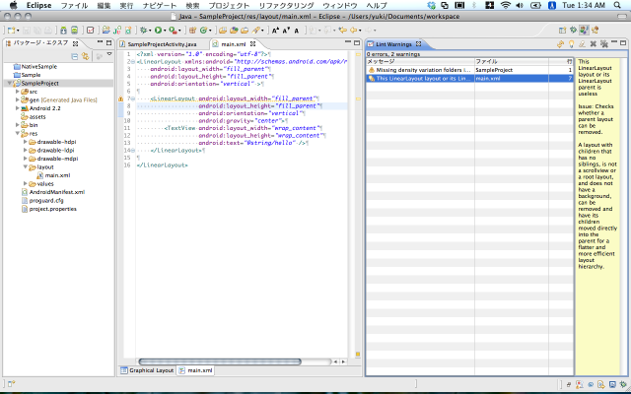
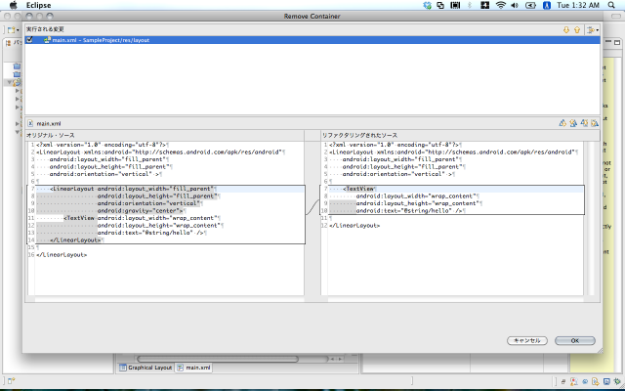
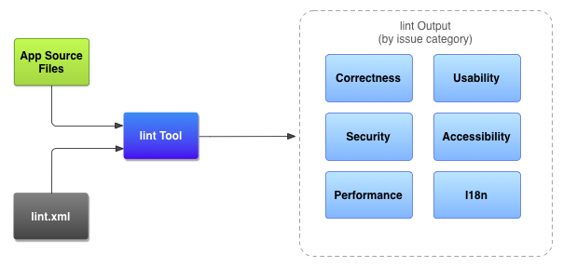
Android SDK Tools
lint
Optimize Android Applications.
lint | Android Developers
http://developer.android.com/tools/help/lint.html

Slide 68
Android SDK Tools
mksdcard
Make SD Card Image for Emulator
mksdcard | Android Developers
http://developer.android.com/tools/help/mksdcard.html
monitor
Android Device Monitor
GUI Standalone Tool for Debug&Profiling
Including Tools
DDMS
Tracer for OpenGL ES
Hierarchy Viewer
Traceview
Pixel Perfect magnification viewer
Device Monitor | Android Developers
http://developer.android.com/tools/help/monitor.html

Slide 69
Android SDK Tools
monkey
Monkey Testing Tool for Android UI.
UI/Application Exerciser Monkey | Android Developers
http://developer.android.com/tools/help/monkey.html
monkeyrunner
Control monkey by Python Script.
monkeyrunner | Android Developers
http://developer.android.com/tools/help/monkeyrunner_concepts.html
proguard
Make Obfuscated code.
ProGuard | Android Developers
http://developer.android.com/tools/help/proguard.html

Slide 70
Android SDK Tools
sqlite3
SQLite Management Tool
SQLite Home Page
http://www.sqlite.org/
Systrace
Profiling Tool. Use with Android Device Monitor.
Analyzing Display and Performance with Systrace | Android Developers
http://developer.android.com/tools/debugging/systrace.html
traceview
Show Graphical View from Systrace Data
Traceview | Android Developers
http://developer.android.com/tools/help/traceview.html
deprecated
Android Device Monitor

Slide 71
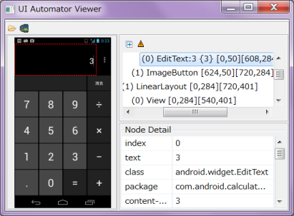
Android SDK Tools
uiautomator/uiautomatorviewer
UI Testing Tool by scenario file
UI Testing | Android Developers
http://developer.android.com/tools/testing/testing_ui.html#uianalysis
zipalign
Optimize APK File
zipalign | Android Developers
http://developer.android.com/tools/help/zipalign.html

Slide 72
Important Tools
Profiling
Systrace/TraceView
Bottleneck
hprof-conv
Heap Memory
lint
Useless of Source Code
Debug/Analyze
Monitor (Android Device Monitor)
DDMS
Tracer for OpenGL ES
Hierarchy Viewer
Pixel Perfect magnification viewer

Slide 73
adb(Android Debug Bridge)
Functions
Shell on Android Device
adb shell
Show Connected Android Devices
adb devices
Install/Uninstall APK File
adb install/uninstall [App Name]/[Package Name]
Send/Get File to/from Android Device
adb push/pull [from File Path] [to File Path]
Show Log (DDMS)
adb logcat

Slide 74
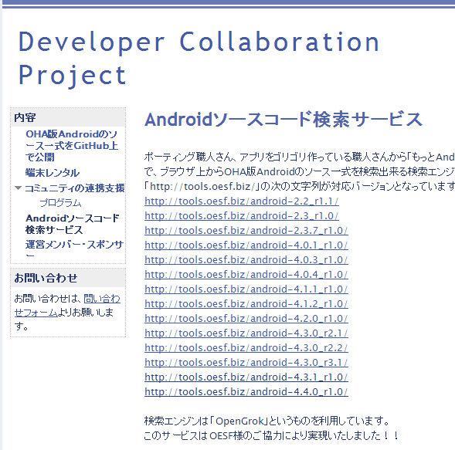
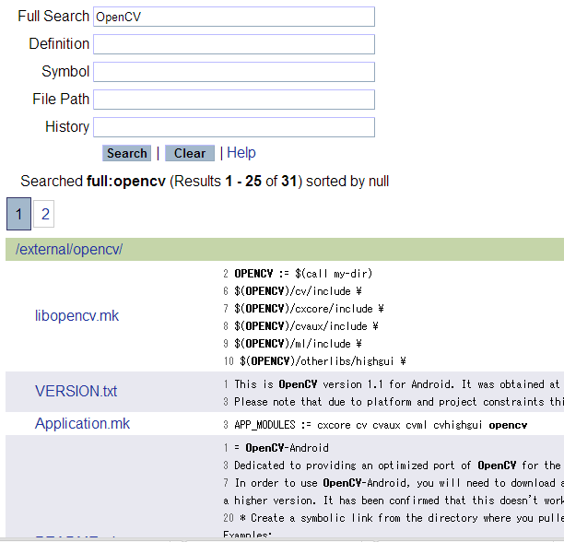
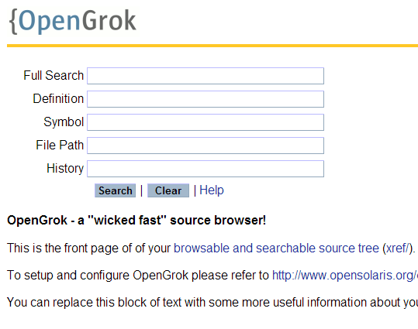
Source Code Search
If you get an incomprehensible bug And want to fix it, you should read Android Framework Source Code.
Because like that bug is Android Framework’s Bug☺
Android Source Code Search Engine Service
http://tools.oesf.biz

Slide 75
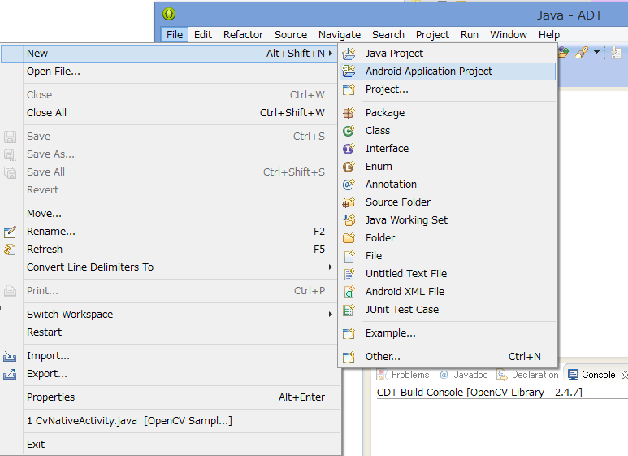
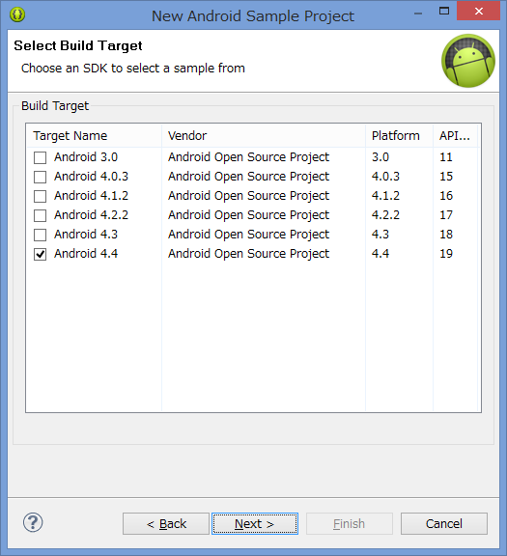
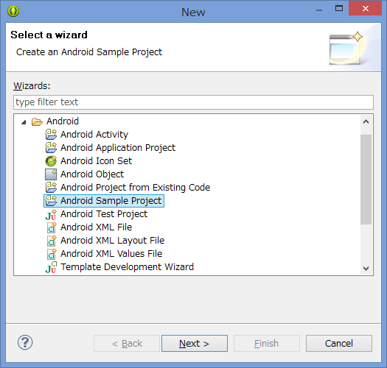
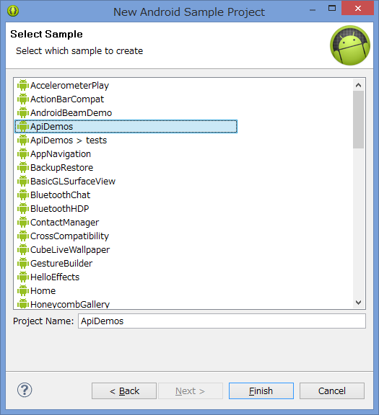
SDK Sample (API Demo)
If you have API you want to use,
First you should check SDK Sample.

Slide 76
Hands On

Slide 77
Setup Android Environment for Java
Target
OpenCV 2.4.7 for Android
http://opencv.org/platforms/android.html
http://sourceforge.net/projects/opencvlibrary/files/opencv-android/2.4.7/OpenCV-2.4.7-android-sdk.zip/download
Required
Java SE 6
http://www.oracle.com/technetwork/java/javase/downloads/java-archive-downloads-javase6-419409.html
ADT (Eclipse + Android SDK)
http://developer.android.com/sdk/index.html
Android NDK
http://developer.android.com/tools/sdk/ndk/index.html

Slide 78
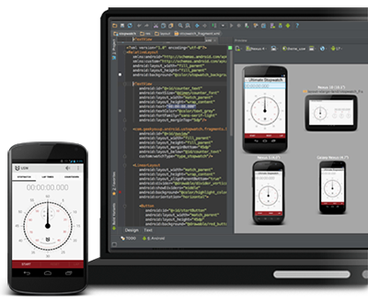
Tips
Android Studio
http://developer.android.com/sdk/installing/studio.html
What’s this?
Next Generation Android Development Environment
InteliJ based IDE
Non-Stable
Has many many bugs…

Slide 79
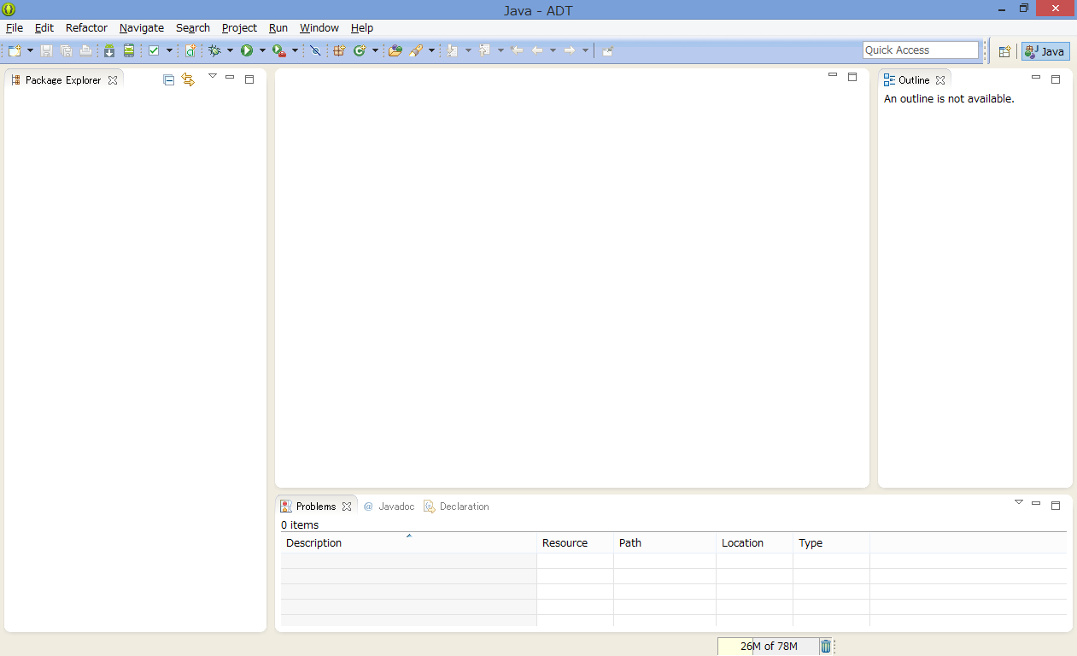
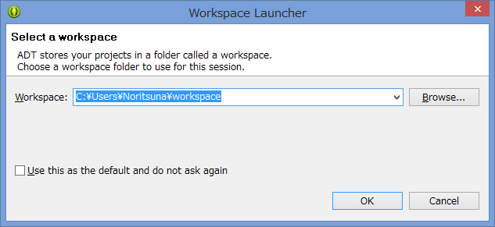
Setup ADT
This is IDE for Android that is made by
Eclipse Java&C/C++ & Android SDK.
Setup WorkSpace

Slide 80
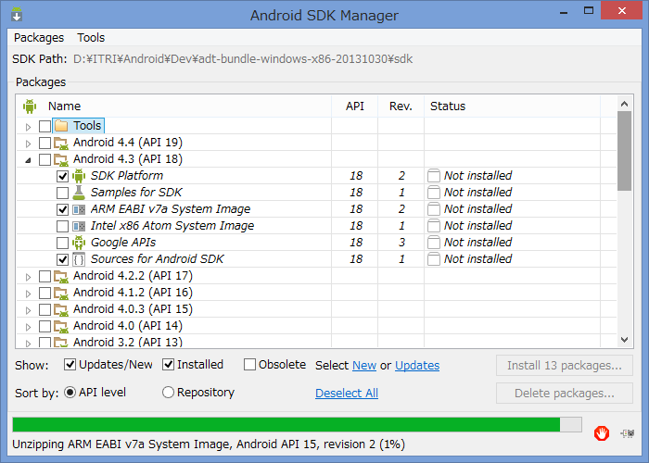

Setup Android SDK & USB Driver
Current ADT has only 4.4 SDK.
Setup other version SDK
Windows doesn’t have USB Driver for Real Device
Setup Google USB Driver for Android Device

Slide 81

Setup NDK Path for Android
Preferences -> Android -> NDK
Add NDK Location=[NDK Path]

Slide 82

Setup NDK Path for C/C++
Preferences -> C/C++ -> Build -> Environment
Add Variable=NDKROOT, Value=[NDK Path]

Slide 83



Import OpenCV File
File -> Import
General -> Existing Projects into Workspace
Input [OpenCV Path] in “Select root directory”

Slide 84

Modefy OpenCV Pref
OpenCV’s Default Android Version
Android 3.0 (API Level 11)
But it doesn’t work…
You MUST change upper Android 4.0 (API Level 14)

Slide 85

Setup OpenCV Manager
OpenCV Apps need OpenCV Manager.
Install from PlayStore or adb
PlayStore
https://play.google.com/store/apps/details?id=org.opencv.engine
adb
[OpenCV SDK Path]/apk/OpenCV_2.4.7_Manager_2.14_armv7a-neon.apk
[ADT Path]/sdk/platform-tools/adb

Slide 86

Run OpenCV App
Run -> Run As -> Android Application

Slide 87
What’s Android App?

Slide 88





What’s Android App?
Android App is “Activity” … Maybe ☺
Android is Stack Screen Type OS.
1 Screen, 1 Application
Android App has one Activity.
Activity has one View(Screen).
Excluding Service.

Slide 89

LifeCycle Diagram
Activity is Event Driven Arch
Main Event
onCreate()
Start Activity
Initialize Objects
onStart()
Finish Initialized
onPause()
Other Activity Start
onResume()
Back from Other Activity
onStop()
Don’t back long time

