Slide 1
What’s Making Android?
Noritsuna Imamura
noritsuna@siprop.org

Slide 2
Agenda
What’s Android System?
Kinds of Android Devices
Kinds of Android Type
Android Source Code
Inside Android
Boot Sequence
About init File
Hands On
Nexus7
Pandaboard
How to Debug
Appendix
How to Build Android Source Code for Other Devices
Notes:
という形で進める

Slide 3
Kinds of Android Device
Smart Phone
Tablet
Mini PC
Note PC
Car Navigation
Set Top Box
Smart Watch
Smart Glass
Camera
Game Console
Audio System
Micro Wave
Refrigerator
Cut Board
EVB
If you get today’s knowledge,
You can customize these devices yourself!!!

Slide 4
Why Customize it?
More Functions
Add Other Library
Add Other Software
Attach Other Device
Add Driver
So Slow(Ex. Old PC)
Modify Bottleneck Software
Delete needless Software & Library
Useless
Customized UI/UX Software

Slide 5
Kinds of Android Type
Android | Kernel | More Functions | Attach Other Device | So Slow | Useless
No Source | No Source | × | × | × | ×
No Source | w/Source | × | △ No-Use as Android App | △ | ×
w/Source | No Source | ○ | × | ○ Almost Bottleneck In Here | ○ UI/UX Engine In Here
w/Source | w/Source | ◎ Use Kernel Level Driver | ○ | ◎ | ○

Slide 6

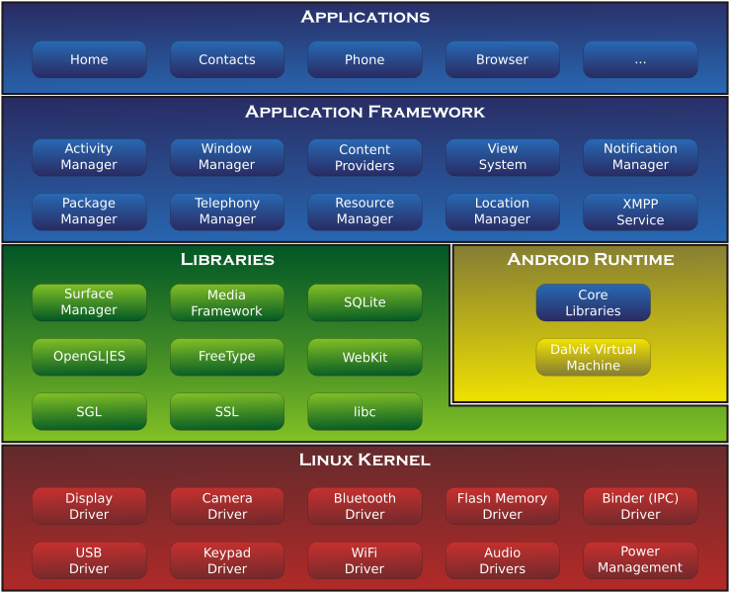
About Android
Android Framework has 3 Layer Stack for SmartPhone & Tablet PC.
Application Framework Layer (Java)
Library Layer (Linux C/C++)
Kernel/Driver Layer (Linux Kernel C/ASM)

Slide 7
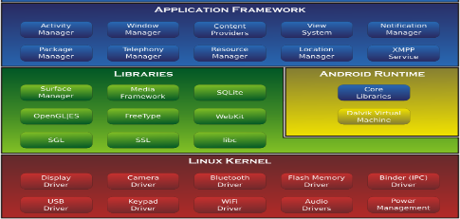

About Android Source Code
packages
App for Android
frameworks
Lib for Android Apps
system
Sys Lib for Framework
docs
Java Doc for Android
developers
Sample, Demos
build
Tool for Android Build
prebuilts
Toolchain
sdk
Android SDK
ndk
Native SDK
pdk
for 3rd Party SDK
cts
Compatibility Test
tools
Tools for External

Slide 8





About Android Source Code
external
Linux Lib
libcore
Lib for Android
bionic
libc for Android
libnativehelper
Helper for JNI
abi
Application Binary Interface
dalvik
Java VM
art
Next Generation VM
device
Diff for Devices
hardware
Drivers
bootable
BootLoader

Slide 9





License
Google Proprietary
Google Android
3 Types License
Apache 2.0
All Application Framework
Some Libraries
Bionic
GPL
Almost Libraries
Linux Kernel
Google Proprietary
Google Applications from Play Store
How to Get Play Store?
Pass CTS
AOSP
(Android Open Source Project)
Apache 2.0
GPL

Slide 10
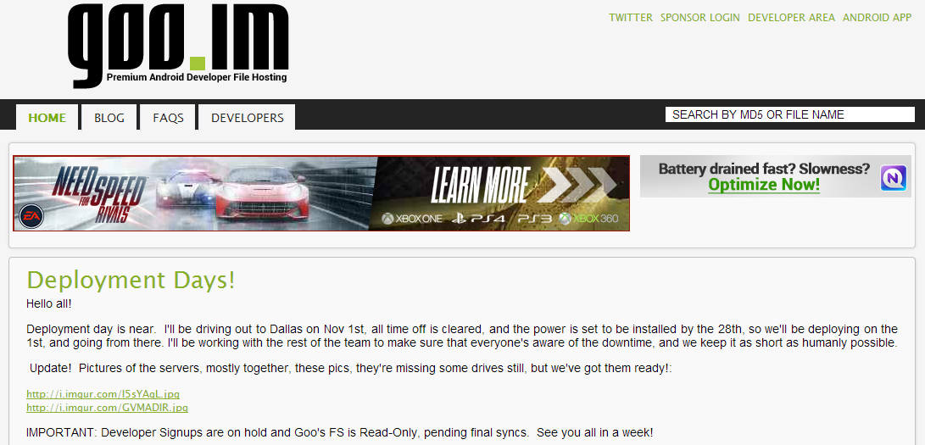
GApp
Goo.im – Premium Android Developer File Hosting
This Site hosts Google Proprietary Apps!!!
http://goo.im/home
You can use Google Proprietary Apps on your Device.
However it’s illegal…

Slide 11
Feature Matrix of ARM Chips
 | AllWinner | RockChip | MediaTek | Freescale | TI | Samsung | Qualcomm
Chip Name | A31 | RK3188 | MT6589 | i.MX6Q | OMAP5432 | Exynos5 | Krait400
CPU Type | A7 Quad | A9 Quad | A7 Quad | A9 Quad | A15 Dual | A15 Quad | A15 Quad
Device Type | Tablet | Mini PC | Smart Phone | EVB | EVB | EVB | Tablet
Used Area | Cheap Device | Cheap Device | Cheap Phone | N/A | Customized Device | N/A | 3G/LTE Device
Official Source Code | Kernel | Kernel | Some Android Kernel | Full Android Kernel | Full Android Kernel | Full Android Kernel | Full Android Kernel
Support | × | △ | × | ○ | ◎ | ◎ | ○
Availability | ○ | ○ | ？ | ◎ | ◎ | ？ | ×
Promising | ○ | ◎ | ○ | × | × | ○ | △
Reason | Cheapest | Better chip | RF chip |  | Dev team is gone |  | Expensive
Notes:
机能[jīnéng]
图表[túbiǎo]
正式zhèngshì
源代碼
支持zhīchí
[有用性]yǒuyòngxìng
有前途yǒu qiántú

Slide 12
Inside Android
Notes:
共通gòngtōng
安装ānzhuāng

Slide 13
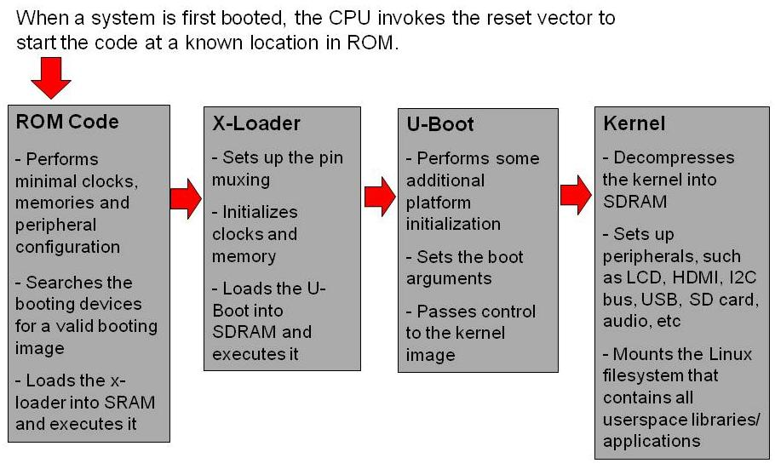
Boot Up Flow CPU～Kernel
Ex. x-loader&u-boot

Slide 14
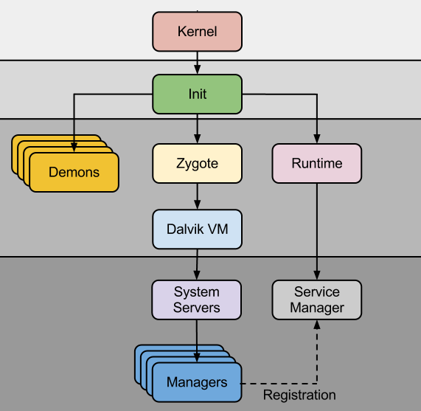
Boot Up Flow Kernel～Android System
Init
Set Permission
Mount Disks
Load Driver
Demons
Linux App
Zygote
Sharing JavaResource Manager
Runtime
Linux SO
Driver

Slide 15
About init File
What’s works?
Prepare dir, file for Service
Run Services(Demon), Runtime
Setup Permission
on post-fs-data
mkdir /data/media 0770 media_rw media_rw
setprop vold.post_fs_data_done 1
mkdir /data/misc/dhcp 0770 dhcp dhcp
chown dhcp dhcp /data/misc/dhcp
mkdir /data/misc/wifi/sockets 0770 wifi wifi
service dhcpcd_wlan0 /system/bin/dhcpcd -ABKL
disabled
oneshot
#for V4L
/dev/video0 0666 system system
/dev/video1 0666 system system

Slide 16
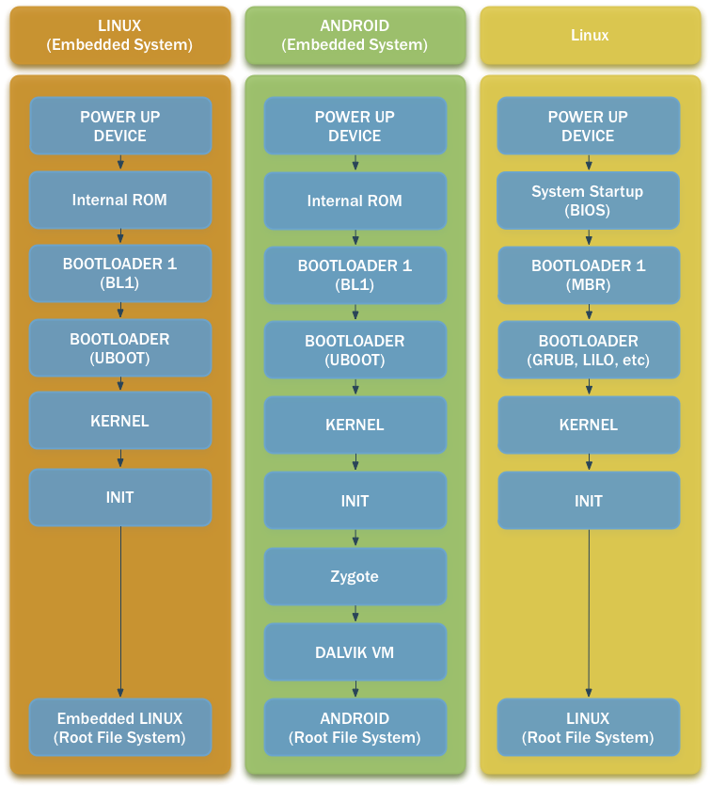
Difference of Between Linux to Android

Slide 17
Sorry!!!
About SMP(Multi Core) Compile
Next Week!

Slide 18
Hands On
Notes:
共通gòngtōng
安装ānzhuāng

Slide 19
Setup 2 Kinds of Android
SmartPhone
Nexus7 (2013)
Android 4.3
Released by Community
Non-Driver(BSP)
EVB
Pandaboard
Android 4.4
Released by Google
All Softwares

Slide 20
Building Environment
CPU
Core i7
4core – 8thread
Memory
8GB
OS
Ubuntu12.04 64bits
Notes:
编译[biānyì]
记忆jìyì
螢幕(ying mu)

Slide 21
Common Setup
Notes:
共通gòngtōng
安装ānzhuāng

Slide 22
Common Setup 1/2
Setup Build Tools
sudo apt-get install
bison build-essential curl flex git-core gnupg gperf libesd0-dev libncurses5-dev libsdl1.2-dev libwxgtk2.8-dev libxml2 libxml2-utils lzop openjdk-6-jdk openjdk-6-jre pngcrush schedtool squashfs-tools xsltproc zip zlib1g-dev
g++-multilib gcc-multilib lib32ncurses5-dev lib32readline-gplv2-dev lib32z1-dev
Setup Build Tools for ARM
sudo apt-get install
uboot-mkimage
Notes:
共通gòngtōng
安装ānzhuāng
工具gōngjù

Slide 23
Common Setup 2/2
Setup Build Tools for Android
curl http://commondatastorage.googleapis.com/git-repo-downloads/repo > ~/bin/repo
chmod a+x ~/bin/repo
export PATH=$PATH:~/bin/repo
sudo add-apt-repository ppa:nilarimogard/webupd8
sudo apt-get update
sudo apt-get install android-tools-fastboot
Notes:
下载xiàzài

Slide 24
Nexus7

Slide 25
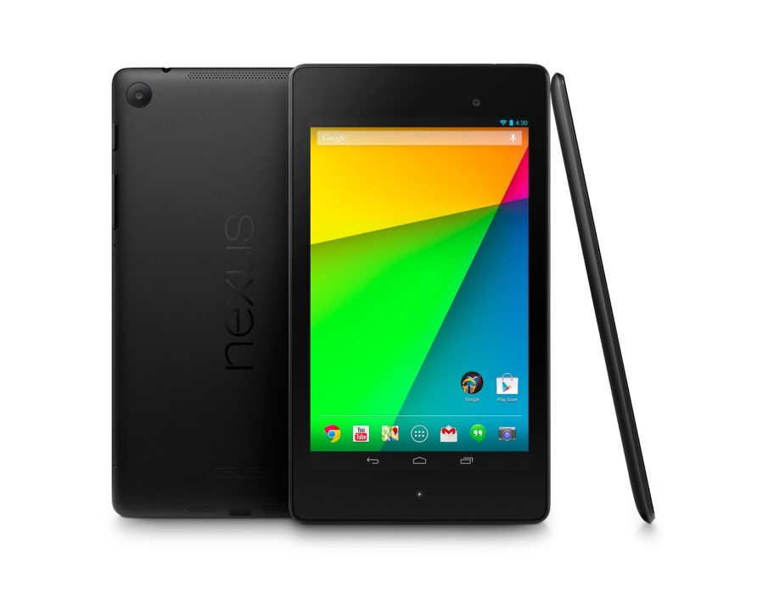
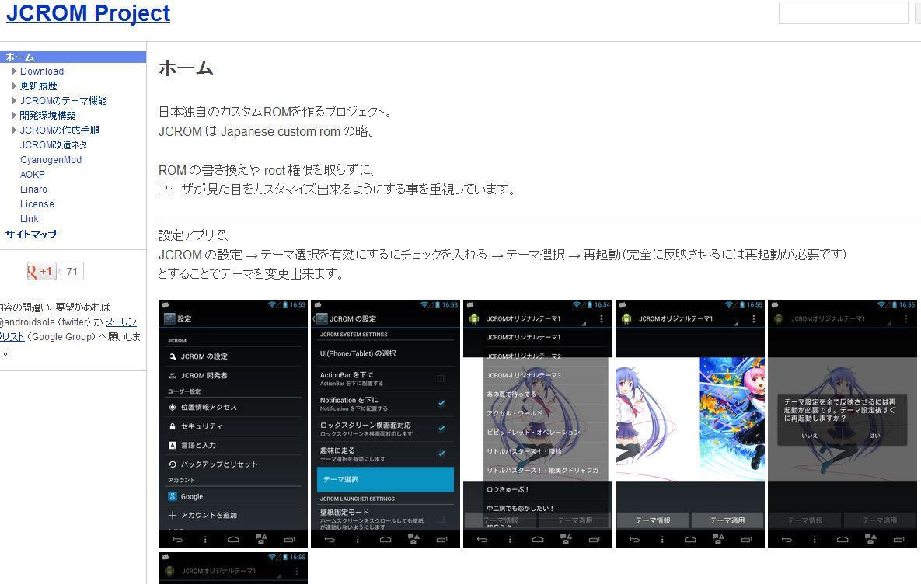
What’s Nexus7?
Target
Tablet
Nexus7(2013)
http://www.google.com/nexus/7/
OS
JCROM
With Build Manual
https://sites.google.com/site/jcromproject/

Slide 26
Check Points
How to Customize Community Source Code
How did they get them?
They don’t have BSP(Driver).
How about Android System.
eMMC, OTA-Package
You can Customize GUI(HOME)
What can you Customize Android System?
UI System, Settings

Slide 27
How to Build
Setup Process
Download Source Code
Download BSP from site & your real device
Download & Build kernel
Make OTA image
Write new OTA image

Slide 28
Download Source Code
Download from JCROM’s repository
repo init -u https://bitbucket.org/sola/jcrom_manifest -m jcrom_jb-4.3-master.xml
repo sync

Slide 29
Download BSP from site & your real device 1/2
Register your board to udev.
Add the following line to ‘/etc/udev/rules.d/51-android.rules’
Restart ‘udev’ service
SUBSYSTEM=="usb", ATTR{idVendor}=="18d1", ATTR{idProduct}=="4e40", MODE="0666" # Bootloader
SUBSYSTEM=="usb", ATTR{idVendor}=="18d1", ATTR{idProduct}=="d001", MODE="0666" # Recovery
SUBSYSTEM=="usb", ATTR{idVendor}=="18d1", ATTR{idProduct}=="4e43", MODE="0666" # PTP media, USB debug off
SUBSYSTEM=="usb", ATTR{idVendor}=="18d1", ATTR{idProduct}=="4e44", MODE="0666" # PTP media, USB debug on
SUBSYSTEM=="usb", ATTR{idVendor}=="18d1", ATTR{idProduct}=="4e41", MODE="0666" # MTP media, USB debug off
SUBSYSTEM=="usb", ATTR{idVendor}=="18d1", ATTR{idProduct}=="4e42", MODE="0666" # MTP media, USB debug on
SUBSYSTEM=="usb", ATTR{idVendor}=="18d1", ATTR{idProduct}=="4ee2", MODE="0666" # MTP media, USB debug on

Slide 30
Download BSP from site & your real device 2/2
Download BSPs from Real Device & Internet
*This version uses Internet only.
Use adb
If your system doesn’t have adb, please do:
sudo apt-get install android-tools-fastboot
cd ~/nexus_work/android/device/asus/flo
./download-blobs.sh
cd ~/nexus_work/android/jcrom/asus/flo/proprietary/
./extract-files.sh
Notes:
吸出xīchū,抽出chōuchū

Slide 31
Download & Build kernel
Download & Build kernel
cd ~/nexus_work
export ARCH=arm
export CROSS_COMPILE=~/nexus_work/android/prebuilts/gcc/linux-x86/arm/arm-eabi-4.6/bin/arm-eabi-
git clone https://android.googlesource.com/kernel/msm.git -b android-msm-flo-3.4-jb-mr2 kernel/nexus72
cd kernel/nexus72
make flo_defconfig
make
cp arch/arm/boot/zImage ~/nexus_work/android/device/asus/flo-kernel/kernel

Slide 32
Make OTA image
Make OTA image
This OTA image is update image for Android.
This file name is
aosp_flo-ota-eng.[your Linux’s User name].zip
cd ~/nexus_work/android/
source build/envsetup.sh
lunch aosp_flo-user
make otapackage

Slide 33
build/envsetup.sh
Helper Command Lib for Android Build
m
Build from Top Dir
mm
Build from Current Dir
mmm [Target Dir]
Build from Target Dir
croot
Change Top Dir
cgrep
Grep for C/C++ Source Code
jgrep
Grep for Java Source Code
resgrep
Grep for XML Source Code
lunch
Choose Target Build

Slide 34
What’s Android OTA-Package
OTA = Over-The-Air (Update)
Android OTA-Package has ROM images.
boot.img
Kernel, Init, Minimam Linux
cache.img
Temporary Area
recovery.img
Recovery Manager Program
system.img
Android System
userdata.img
User Data

Slide 35
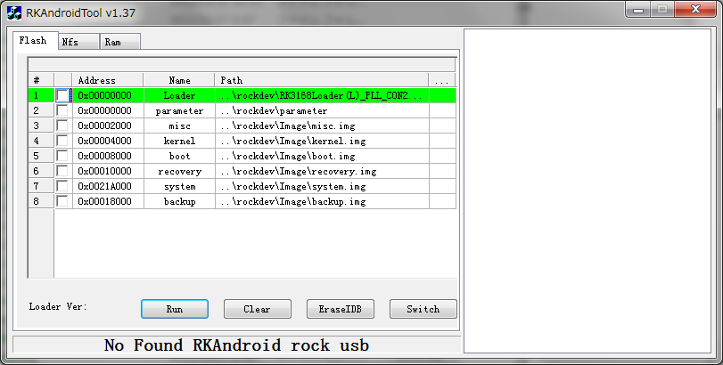
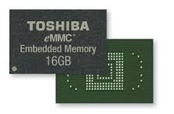
What’s Fastboot?
Fastboot is ROM Manager for eMMC.
eMMC is managed by Address in Low Lovel.
When you write your Kernel, you MUST point kernel address.
If you mistake kernel address, your system is broken…
Separated by Address

Slide 36
What’s Inside of Image File?
It’s ramdisk
boot.img-ramdisk.gz
If your new kernel has new functions, please modify ramdisk files.
Ex. .ko file, new init file, etc.
mkdir ramdisk
cd ramdisk
gunzip -c ../boot.img-ramdisk.gz | cpio –I
Notes:
打開

Slide 37
Write new OTA image 1/3
If your phone has OEM lock, please unlock it.
Change Recovery image.
※Connect your N7 to PC
adb reboot bootloader
fastboot oem unlock
wget http://download2.clockworkmod.com/recoveries/recovery-clockwork-6.0.4.3-flo.img
fastboot flash recovery recovery-clockwork-6.0.4.3-flo.img
fastboot boot recovery-clockwork-6.0.4.3-flo.img

Slide 38
Write new OTA image 2/3
Push your new OTA image to your N7
If you want to use Google Apps
※Connect your N7 to PC
adb push ~/nexus_work/android/out/target/product/flo/aosp_flo-ota-eng.[your Linux's User name].zip /sdcard/
wget http://goo.im/gapps/gapps-jb-20130813-signed.zip
adb push gapps-jb-20130813-signed.zip /sdcard/

Slide 39
Write new OTA image 3/3
Turn off your phone
Volume Up & Power
Wipe data/factory reset
Install zip from sdcard
Choose zip from sdcard
aosp_flo-ota-eng.[your Linux's User name].zip
Choose zip from sdcard
gapps-jb-20130813-signed.zip
+++++Go Back+++++
Reboot system now

Slide 40
Boot up Your Nexus7!

Slide 41
Pandaboard

Slide 42
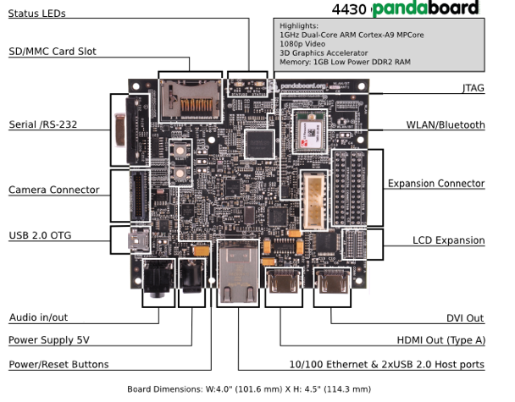
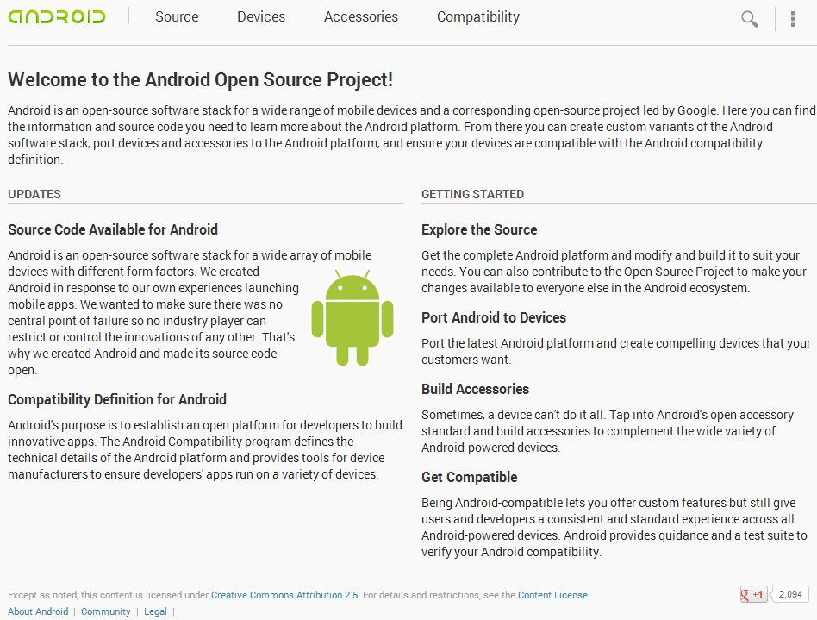
What’s Pandaboard?
Target
EVB
Pandaboard
http://www.pandaboard.org/
OS
Official Kernel & Android
With Build Manual
http://source.android.com/source/downloading.html

Slide 43
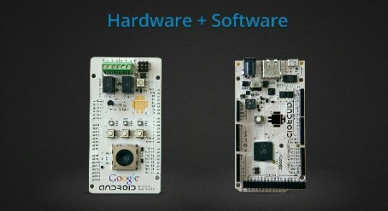
How to Use Peripherals?
ADK (Accessory Development Kit)
http://developer.android.com/tools/adk/index.html
Advantage
Develop on ADT
Pin like Arduino
Dis-Advantage
So Slow…
9600bps

Slide 44
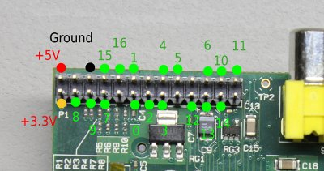
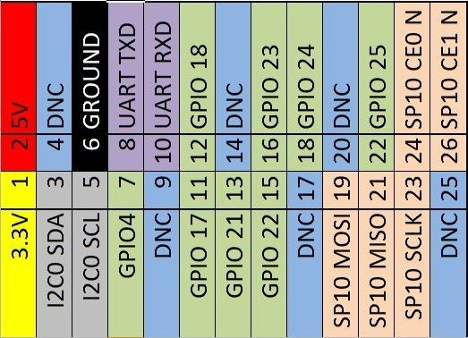
How to Use Peripherals?
GPIO(General Purpose Input/Output)
I2C(Inter-Integrated Circuit)
SPI(Serial Peripheral Interface)
UART(Serial)
Fast: SPI > I2C
Pin Num: SPI(4Pins) > I2C(3Pins)
GPIO can use Registers.
Advantage
Bus Speed
Connect All Peripheral
Dis-Advantage
Required Hardware Knowledge
Like Assembler for Hardware

Slide 45
How to Build
Setup Process
Download Source Code
Download BSP from Google
Download & Build Boot Loaders
Build Android
Setup SD Card

Slide 46
Download 4.4 Source Code
Download from AOSP(Google)’s repository
mkdir ~/panda_work
cd ~/panda_work
mkdir mydroid
cd mydroid
repo init -u https://android.googlesource.com/platform/manifest -b android-4.4_r1.1
repo sync

Slide 47
Download BSP from Google
Download BSPs(Driver)
cd ~/panda_work/mydroid
wget https://dl.google.com/dl/android/aosp/imgtec-panda-20130603-539d1ac3.tgz
tar zxvf imgtec-panda-20130603-539d1ac3.tgz
./extract-imgtec-panda.sh
git clone https://github.com/sola-dolphin1/sola_device_ti_panda.git -b kitkat device/ti/panda
Notes:
吸出xīchū,抽出chōuchū

Slide 48
Download Toolchain
Required Android Toolchain for Panda’s Source
cd ~/panda_work
git clone https://android.googlesource.com/platform/prebuilt
export ARCH=arm
export CROSS_COMPILE=$PWD/prebuilt/linux-x86/toolchain/arm-eabi-4.4.3/bin/arm-eabi-
Notes:
吸出xīchū,抽出chōuchū

Slide 49
Download & Build x-loader
First Boot Loader for Pandaboard
cd ~/panda_work
git clone git://git.omapzoom.org/repo/x-loader.git
cd x-loader
git checkout -b omap4_dev origin/omap4_dev
make omap4430panda_config
make ift
cp -a MLO ~/panda_work/mydroid/device/ti/panda/xloader.bin
Notes:
吸出xīchū,抽出chōuchū

Slide 50
Download & Build u-boot
Second Boot Loader for Pandaboard
cd ~/panda_work
git clone git://git.omapzoom.org/repo/u-boot.git
cd u-boot
git checkout -b omap4_dev origin/omap4_dev
wget http://android-development-environment.googlecode.com/files/0001-change-bootarges.patch
git apply 0001-change-bootarges.patch
make omap4430panda_config
make
cp -a u-boot.bin ~/panda_work/mydroid/device/ti/panda/bootloader.bin
Notes:
吸出xīchū,抽出chōuchū

Slide 51
Download & Build kernel
Kernel for Pandaboard
cd ~/panda_work
git clone https://android.googlesource.com/kernel/omap.git kernel
cd kernel
git checkout -b android-omap-panda-3.0 origin/android-omap-panda-3.0
make panda_defconfig
make
cp -a arch/arm/boot/zImage ~/panda_work/mydroid/device/ti/panda/kernel
Notes:
吸出xīchū,抽出chōuchū

Slide 52
Build Android
Build Android
cd ~/panda_work/mydroid
source build/envsetup.sh
lunch aosp_panda-userdebug
make
Notes:
吸出xīchū,抽出chōuchū

Slide 53
Setup SD Card
Make Partition for Android on SD Card
boot
system
cache
userdata
media
wget http://www.noritsuna.com/download/mksdcard_pandaboard.sh
chmod a+x mksdcard_pandaboard.sh
LANG=C sudo ./mksdcard_pandaboard.sh /dev/sdX ~/panda_work/mydroid
Notes:
吸出xīchū,抽出chōuchū

Slide 54
Boot up Your Pandaboard!

Slide 55

But……… TI support until 4.2
2012.06.27 4.1 Jelly Bean
2012.11.13 4.2
2013.07.24 4.3
4.1, 4.2
Available USB Audio
Support i18n(Internationalization)
Support Vibration for Input Device
Support Miracast
Support Writing Vertically
Support RenderScript
Change Android Market to Google Play
Linux: 3.1.10
4.3
Support OpenGL/ES 3.0
Support Bluetooth LE
Support Wi-Fi Location
Linux: 3.4.0

Slide 56
How to Build
Setup Process
Download Source Code
Download BSP from Google
Download & Build Boot Loaders
Build Android
Setup SD Card

Slide 57
Download 4.2 Source Code
Download from AOSP(Google)’s repository
mkdir ~/panda_work
cd ~/panda_work
mkdir mydroid
cd mydroid
repo init -u https://android.googlesource.com/platform/manifest -b android-4.2.1_r1
repo sync

Slide 58
Download BSP from Google
Download BSPs(Driver)
Get some Patches
cd ~/panda_work/mydroid
wget https://dl.google.com/dl/android/aosp/imgtec-panda-20120807-c4e99e89.tgz
tar zxvf imgtec-panda-20120807-c4e99e89.tgz
./extract-imgtec-panda.sh
cd ~/panda_work/mydroid/build/
wget http://sola-dolphin-1.net/data/Panda/0001-panda-jb4.2_build.patch
git apply 0001-panda-jb4.2_build.patch
cd ~/panda_work/mydroid/device/ti/panda/
wget http://sola-dolphin-1.net/data/Panda/0001-panda-jb4.2_device-ti-panda.patch
git apply 0001-panda-jb4.2_device-ti-panda.patch
cd ~/panda_work/mydroid/hardware/ti/omap4xxx/
wget http://sola-dolphin-1.net/data/Panda/0001-panda-jb4.2_hardware-ti-omap4xxx.pah
git apply 0001-panda-jb4.2_hardware-ti-omap4xxx.patch
cd ~/panda_work/mydroid/hardware/ti/wpan/
wget http://sola-dolphin-1.net/data/Panda/0001-panda-jb4.2_hardware-ti-wpan.patch
git apply 0001-panda-jb4.2_hardware-ti-wpan.patch
Notes:
吸出xīchū,抽出chōuchū

Slide 59
Download Toolchain
Required Android Toolchain for Panda’s Source
cd ~/panda_work
git clone https://android.googlesource.com/platform/prebuilt
export ARCH=arm
export CROSS_COMPILE=$PWD/prebuilt/linux-x86/toolchain/arm-eabi-4.4.3/bin/arm-eabi-
Notes:
吸出xīchū,抽出chōuchū

Slide 60
Download & Build x-loader
First Boot Loader for Pandaboard
cd ~/panda_work
git clone git://git.omapzoom.org/repo/x-loader.git
cd x-loader
git checkout -b omap4_dev origin/omap4_dev
make omap4430panda_config
make ift
cp -a MLO ~/panda_work/mydroid/device/ti/panda/xloader.bin
Notes:
吸出xīchū,抽出chōuchū

Slide 61
Download & Build u-boot
Second Boot Loader for Pandaboard
cd ~/panda_work
git clone git://git.omapzoom.org/repo/u-boot.git
cd u-boot
git checkout -b omap4_dev origin/omap4_dev
wget http://android-development-environment.googlecode.com/files/0001-change-bootarges.patch
git apply 0001-change-bootarges.patch
make omap4430panda_config
make
cp -a u-boot.bin ~/panda_work/mydroid/device/ti/panda/bootloader.bin
Notes:
吸出xīchū,抽出chōuchū

Slide 62
Download & Build kernel
Kernel for Pandaboard
cd ~/panda_work
git clone https://android.googlesource.com/kernel/omap.git kernel
cd kernel
git checkout -b android-omap-panda-3.0 origin/android-omap-panda-3.0
make panda_defconfig
make
cp -a arch/arm/boot/zImage ~/panda_work/mydroid/device/ti/panda/kernel
Notes:
吸出xīchū,抽出chōuchū

Slide 63
Build Android
Build Android
cd ~/panda_work/mydroid
source build/envsetup.sh
lunch aosp_panda-userdebug
make
Notes:
吸出xīchū,抽出chōuchū

Slide 64
Setup SD Card
Make Partition for Android on SD Card
boot
system
cache
userdata
media
wget http://www.noritsuna.com/download/mksdcard_pandaboard.sh
chmod a+x mksdcard_pandaboard.sh
LANG=C sudo ./mksdcard_pandaboard.sh /dev/sdX ~/panda_work/mydroid
Notes:
吸出xīchū,抽出chōuchū

Slide 65
Extra Stage

Slide 66
How to Use JTAG-ICE

Slide 67
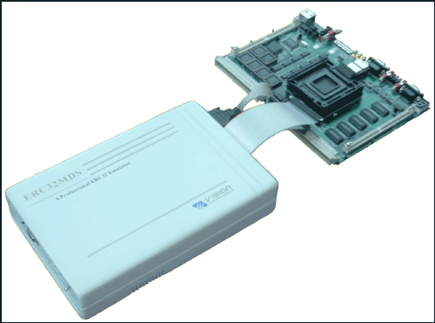
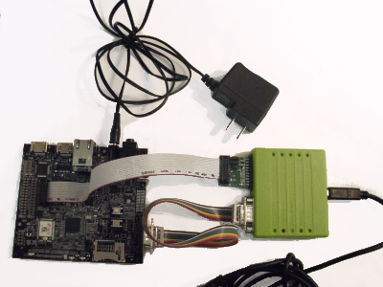
Debugging by ICE(In Circuit Emulator)
Full ICE
This has CPU&CPU Debugging Func.
When you use it, you change Real CPU to This CPU.
JTAG ICE
Real CPU has Debugging Func.
JTAG is Control Pin for CPU Debugging Func,

Slide 68
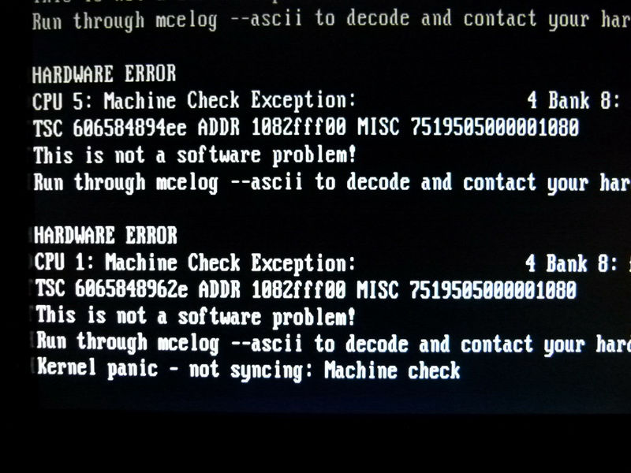
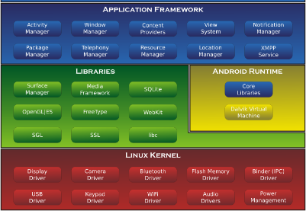
Why Need?
Soft Level Debugger can debug
their managed apps only.
Ex. Kernel Panic: Console Log Only
Ex. DDMS: Android Framework
managed Linux Lib

Slide 69
How to Setup JTAG-ICE

Slide 70
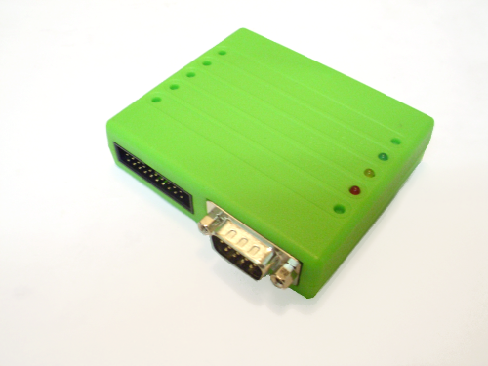
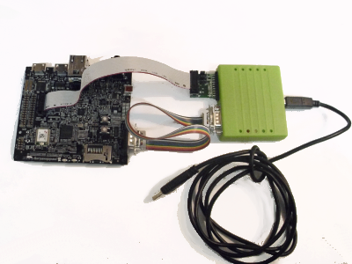
Flyswatter2 Pandaboard
One of Cheapest JTAG-ICE.
Today, getting popular under $300USD.
Old one is Over $3000USD

Slide 71
Setup udev
Register your board to udev.
Add the following line to ‘/etc/udev/rules.d/51-android.rules’
Restart ‘udev’ service
# usbboot protocol on panda (PandaBoard)
SUBSYSTEM=="usb", ATTR{idVendor}=="0451", ATTR{idProduct}=="d00f", MODE="0666", OWNER="<username>"
# usbboot protocol on panda (PandaBoard ES)
SUBSYSTEM=="usb", ATTR{idVendor}=="0451", ATTR{idProduct}=="d010", MODE="0666", OWNER="<username>"
SUBSYSTEM=="usb", ATTR{idVendor}=="0451", ATTR{idProduct}=="d022", MODE="0666", OWNER="<username>"

Slide 72
Add Debug Information to Source Code
What’s Debug Information?
Executed File(Compiled File) is machine code.
Human can NOT read it…
Ex. gcc (DWARF)
-g(n)
Debug Option. n=Debug Level
–O0
Optimized Option & Level. 0=non-optimized. Always use “3”.
I/DEBUG ( 3037): pid: 3233, tid: 3234 >>> /system/bin/netd <<<
I/DEBUG ( 3037): signal 11 (SIGSEGV), fault addr deadbaad
I/DEBUG ( 3037): r0 00001728 r1 100ffd7c r2 00000027 r3 00000000
I/DEBUG ( 3037): r4 afd42328 r5 00000000 r6 00000000 r7 00011000
I/DEBUG ( 3037): r8 00100000 r9 aef01cad 10 10000000 fp 40008008
I/DEBUG ( 3037): ip ffffffff sp 100ffd68 lr deadbaad pc afd11ca4 cpsr 40000030
I/DEBUG ( 3037): d0 3d454d414e564544 d1 6164732f7665642f

Slide 73
Change KGDB Config
Turn On Kernel Config
Kernel hacking
Compile the kernel with debug info
KGDB： kernel degugger
KGDB: user kgdb over the serial console (NEW)
cd ~/panda_work/kernel
make menuconfig
make
Notes:
吸出xīchū,抽出chōuchū

Slide 74
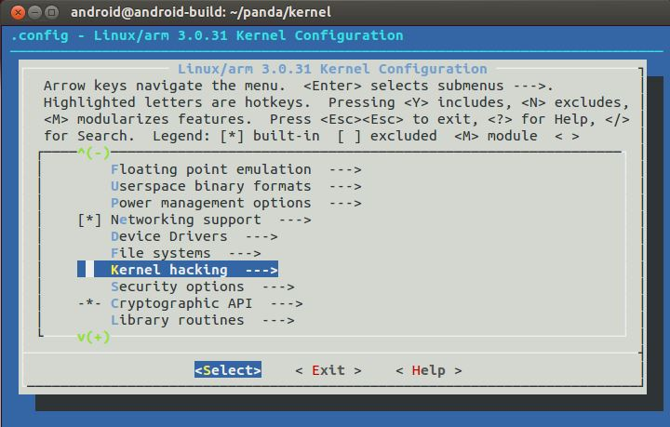
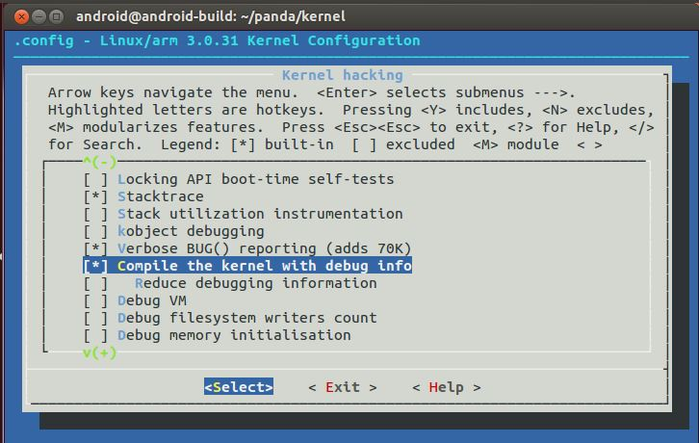
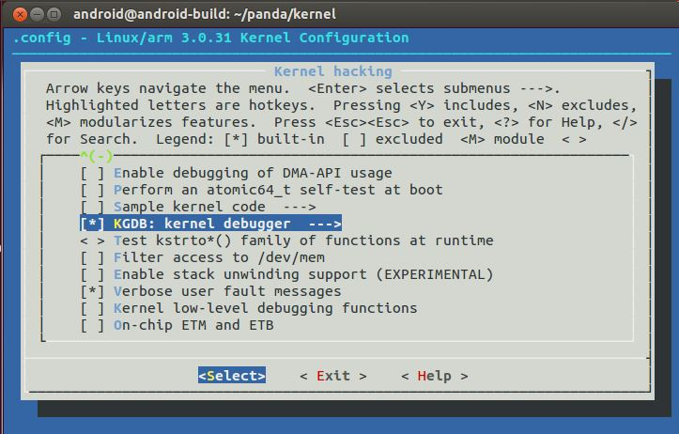
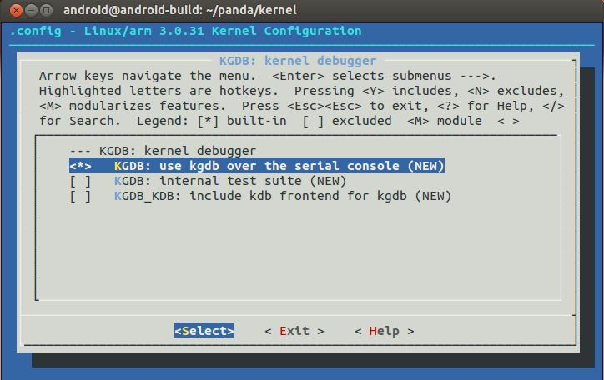
Change KGDB Config

Slide 75
Change u-boot
Need Boot Option for KGDB
“kgdboc=ttyO2,115200” in “bootargs” section
wget http://www.noritsuna.com/download/0001-change-bootarges.patch
git apply 0001-change-bootarges.patch
make
cp -a u-boot.bin ~/panda_work/mydroid/device/ti/panda/bootloader.bin
Notes:
吸出xīchū,抽出chōuchū

Slide 76
Old u-boot
Different Point
cd ~/panda_work
git clone git://git.omapzoom.org/repo/u-boot.git
cd u-boot
git checkout -b omap4_dev origin/omap4_dev
wget http://android-development-environment.googlecode.com/files/0001-change-bootarges.patch
git apply 0001-change-bootarges.patch
make omap4430panda_config
make
cp -a u-boot.bin ~/panda_work/mydroid/device/ti/panda/bootloader.bin
Notes:
吸出xīchū,抽出chōuchū

Slide 77
Setup Debugging Software
Why Need?
How do you debug it???
If your code has DWARF(Debug Info), you can use “objdump” command.
arm-eabi-objdump -S -C libc.so |less
-S Show de-assembler source code
-C Show C/C++ function name of source code
bionic/libc/unistd/abort.c
#00 pc 00011ca4 /system/lib/libc.so
11ca4: f005 ff25 bl 11c40 <abort>

Slide 78
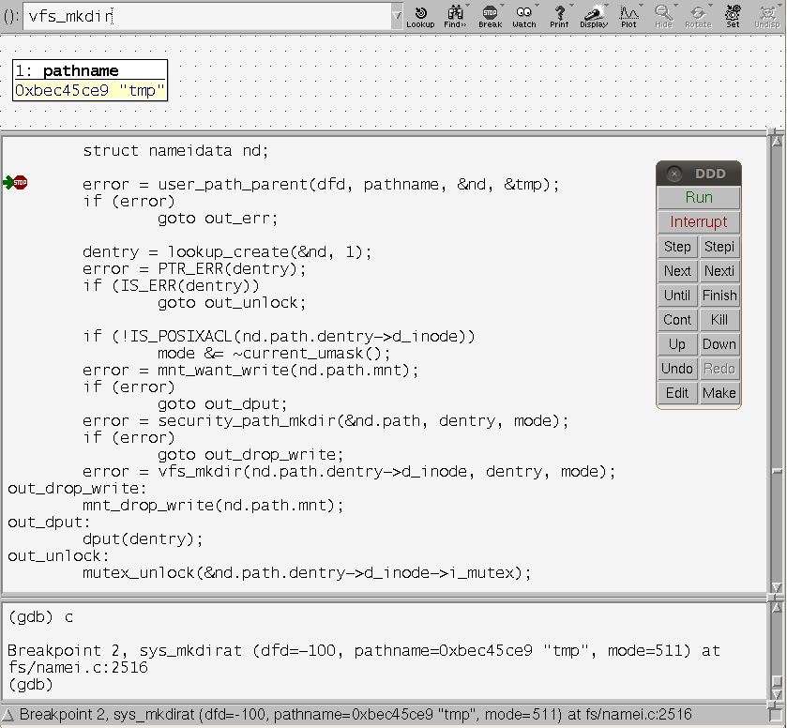
Setup Debugging Software

Slide 79
Setup FTDI Driver (Serial)
cd ~/panda_work
wget http://www.intra2net.com/en/developer/libftdi/download/libftdi-0.19.tar.gz
tar zxfv libftdi-0.19.tar.gz
cd ~/panda_work/libftdi-0.19/src
sudo cp ftdi.h /usr/include
cd /usr/local/include
sudo ln -s /usr/include/ftdi.h ftdi.h
cd ~/panda_work/libftdi-0.19
./configure
make
sudo make install
cd /usr/lib
sudo ln -s /usr/local/lib/libftdi.a libftdi.a
sudo ln -s /usr/local/lib/libftdi.la libftdi.la
sudo ln -s /usr/local/lib/libftdi.so.1.19.0 libftdi.so.1.19.0
sudo ln -s /usr/local/lib/libftdi.so.1.19.0 libftdi.so
sudo ln -s /usr/local/lib/libftdi.so.1.19.0 libftdi.so.1
Notes:
吸出xīchū,抽出chōuchū

Slide 80
Setup OpenODC(On-Chip Debugging)
This Debugger is Software for JTAG Debugger.
Hardware JTAG Debugger get “RAW Data” only.
cd ~/panda_work
wget http://downloads.sourceforge.net/project/openocd.berlios/openocd-0.5.0.tar.gz
tar zxfv openocd-0.5.0.tar.gz
cd ~/panda_work/openocd-0.5.0
wget http://www.tincantools.com/w/images/5/5d/Tincantools-openocd-b0.12.patch
patch -p1 -i Tincantools-openocd-b0.12.patch
sudo ./configure --disable-werror --enable-ft2232_libftdi
sudo make
sudo make install
Notes:
吸出xīchū,抽出chōuchū

Slide 81
Prepare JTAG Tools
JTAG Commands
cd ~/panda_work
mkdir openocd-bin
cd ~/panda_work/openocd-0.5.0/tcl
cp -r * ~/panda_work/openocd-bin
cd ~/panda_work/openocd-0.5.0/src
cp openocd ~/panda_work/openocd-bin
export PATH=$PATH:~/panda_work/openocd-bin
Notes:
吸出xīchū,抽出chōuchū

Slide 82
Connect Cables

Slide 83
Connect JTAG Debugger
This tool uses telnet command.
cd ~/panda_work/openocd-bin
sudo ./openocd -f interface/flyswatter2.cfg -f board/ti_pandaboard.cfg
telnet localhost 4444
Notes:
吸出xīchū,抽出chōuchū

Slide 84
JTAG Commands
reset, halt, resume
Use for Break Point
reg
reg
Show register
reg [entry]
Show entry register
reg [entry] [value]
Set value to entry register

Slide 85
Setup DDD(Data Display Debugger)
GUI Debugger
sudo apt-get install ddd

Slide 86
How to Use Debugger
Start OpenOCD
Connect Console, And exec “halt”
Start DDD
sudo ./openocd -f interface/flyswatter2.cfg -f board/ti_pandaboard.cfg
telnet localhost 4444
> halt
$ ddd --debugger arm-eabi-gdb
GDB Console
(gdb) file vmlinux
(gdb) target remote localhost:3333

Slide 87
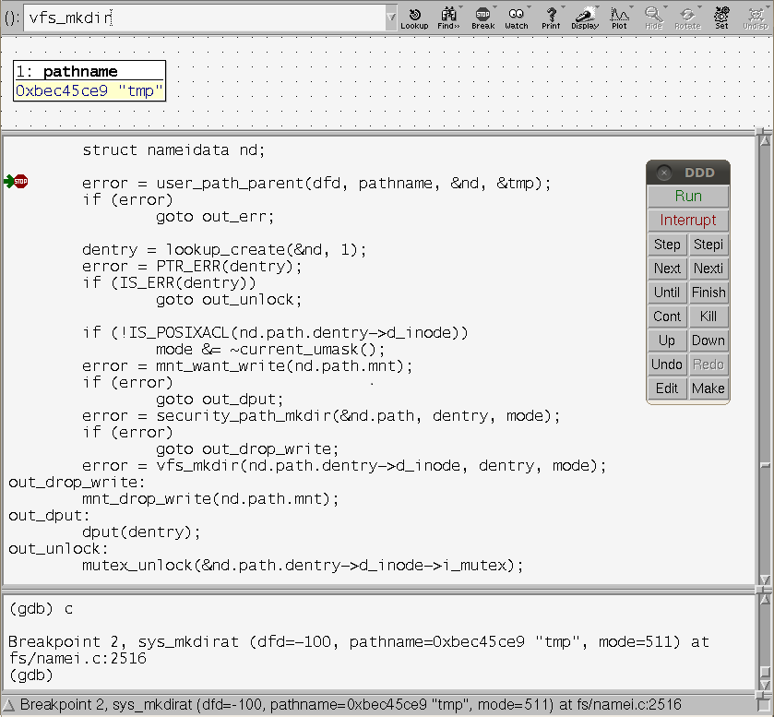
Ex. Break Point
Stop
"resume" command on telnet
Do exec
"c" command on DDD GDB Console

Slide 88
Appendix: How to Build Others
Notes:
共通gòngtōng
安装ānzhuāng

Slide 89
AllWinner - A31 (Cortex-A7 Quad)

Slide 90

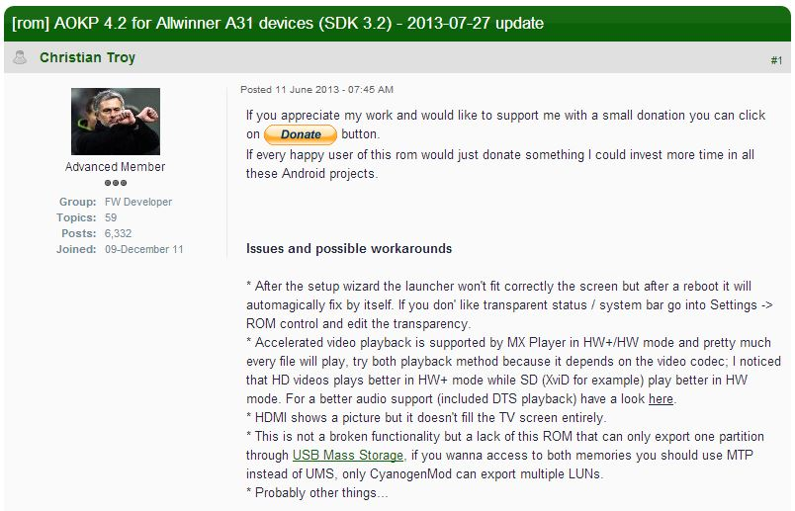
AllWinner - A31 (Cortex-A7 Quad)
Target
Tablet
Onda V973 (v2)
http://www.onda.cn/Tablet/ProductInfo.aspx?ProductId=250
OS
Android
UnOfficial CyanogenMod
http://www.slatedroid.com/topic/77481-rom-aokp-42-for-allwinner-a31-devices-sdk-32-2013-07-27-update/

Slide 91

AllWinner - A31 (Cortex-A7 Quad)
Notes:
取消qǔxiāo
[到手]dàoshǒu

Slide 92
RockChip - RK3188 (Cortex-A9 Quad)

Slide 93
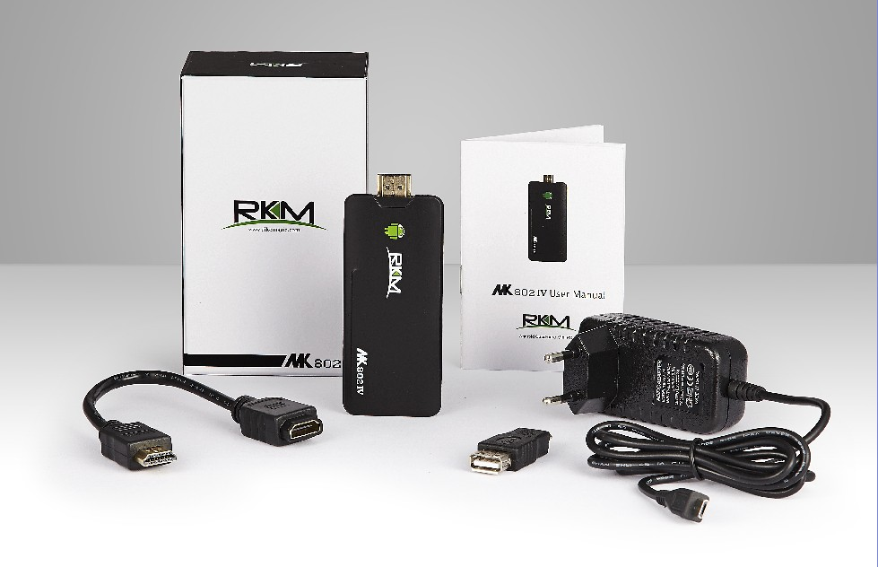
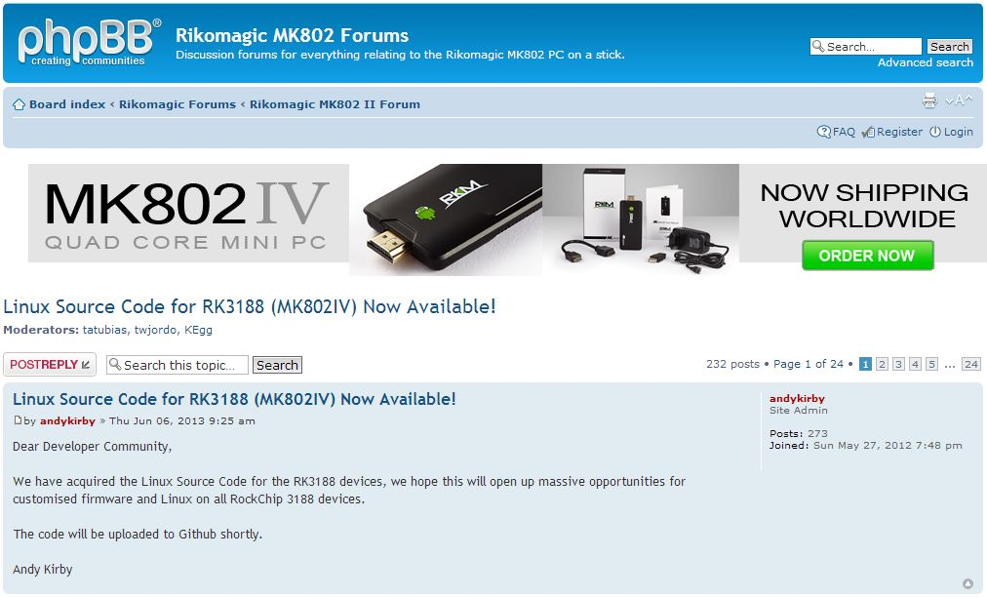
RockChip - RK3188 (Cortex-A9 Quad)
Target
Mini PC
MK802IV
http://www.cloudsto.com/android-mini-pc-s/rikomagic-quad-core-mk802iv-8gb-flash-bluetooth-dhl-express-shipping-detail.html
OS
Official Kernel
(But No Android&Ubuntu)
http://www.rikomagic.co.uk/forum/viewtopic.php?f=6&t=4696

Slide 94
RockChip - RK3188 (Cortex-A9 Quad)
Setup Process
Put Serial Connector on board.
Customize kernel
Make boot-image
Write new boot-image
Notes:
安装ānzhuāng
连接liánjiē
定制dìngzhì,改造gǎizào,改组gǎizǔ
注上zhùshàng

Slide 95
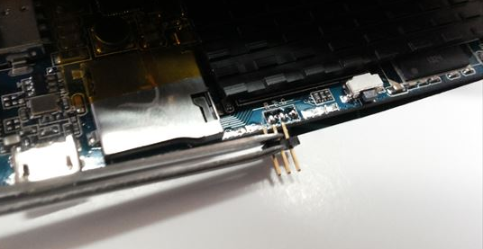
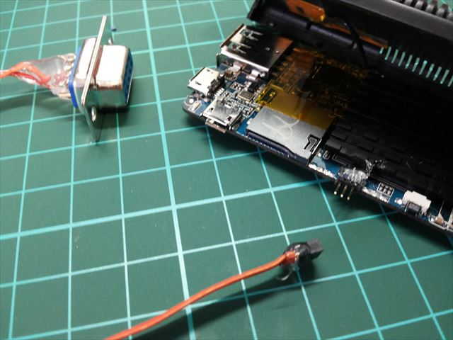
Put Serial Connector on board
This connect is TTL level Serial.
Notes:
连接liánjiē
连接器liánjiēqì
[焊料]hànliào

Slide 96
Customize kernel
Almost Official Kernel doesn’t work…
naobsd released customized kernel.
https://github.com/linux-rockchip/rockchip-3.0/tree/reference/mk802iv-ap6210
Build this kernel
git clone https://github.com/linux-rockchip/rockchip-3.0.git
cd rockchip-3.0
git checkout wip/rockchip-3.0-mk802iv-ap6210
make rk3188_mk802iv_ap6210_defconfig
make CROSS_COMPILE=../prebuilts/gcc/linux-x86/arm/arm-eabi-4.6/bin/arm-eabi- kernel.img
make CROSS_COMPILE=../prebuilts/gcc/linux-x86/arm/arm-eabi-4.6/bin/arm-eabi- zImage

Slide 97
Make boot-image 1/4
Get Original Firmware
http://www.rikomagic.co.uk/support.html
This firmware has firmware image file & writing tool.
Unpack Firmware
https://github.com/naobsd/rkutils
wget https://raw.github.com/naobsd/rkutils/master/rkunpack.c
gcc -o rkunpack rkunpack.c
./rkunpack IV_AP6210_20130905_1080P.img
Notes:
原物yuánwù
[固件]gùjiàn
打開
包裝

Slide 98
Make boot-image 2/4
Unpack boot-image
https://github.com/naobsd/cm_system_core/tree/ics/mkbootimg
wget https://raw.github.com/naobsd/cm_system_core/ics/mkbootimg/unpackbootimg.c
wget https://raw.github.com/naobsd/cm_system_core/ics/mkbootimg/bootimg.h
gcc -o unpackbootimg unpackbootimg.c –lcrypto
./unpackbootimg -i boot.img
※boot.img-base, boot.img-cmdline, boot.img-pagesize, boot.img-ramdisk.gz, boot.img-zImage
Notes:
打開

Slide 99
Make boot-image 3/4
Unpack ramdisk
boot.img-ramdisk.gz
If your new kernel has new functions, please modify ramdisk files.
Ex. .ko file, new init file, etc.
mkdir ramdisk
cd ramdisk
gunzip -c ../boot.img-ramdisk.gz | cpio –I
Notes:
打開

Slide 100
Make boot-image 4/4
Re-pack ramdisk & boot-image
https://github.com/naobsd/cm_system_core/tree/ics/mkbootimg
find . | cpio -o -H newc | gzip ../newramdisk.cpio.gz
cd ../
wget https://raw.github.com/naobsd/cm_system_core/ics/mkbootimg/mkbootimg.c
gcc -o mkbootimg mkbootimg.c –lcrypto
./mkbootimg --kernel zImage --ramdisk newramdisk.cpio.gz -o mynewboot.img
※zImage is your new kernel
Notes:
包裝

Slide 101
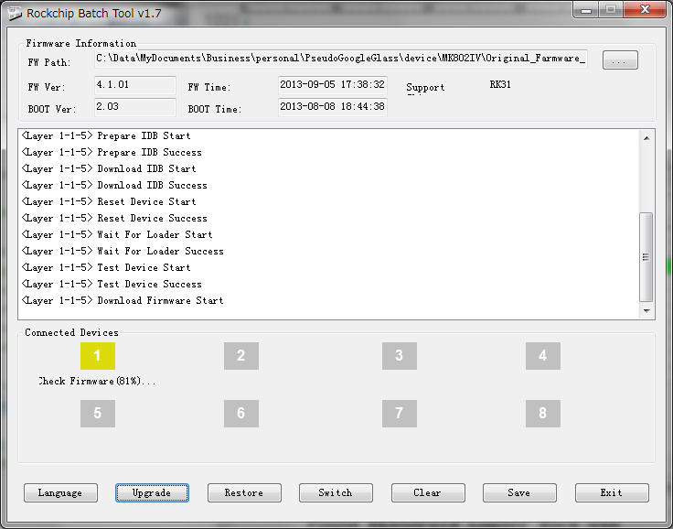
Write new boot-image 1/4
Setup driver for Windows
Execute “DriverInstall.exe”
Update firmware to new firmware
Execute “RKBatchTool.exe”
Notes:
驅動器
[更新]gēngxīn
执行[zhíxíng]

Slide 102
Write new boot-image 2/4
Use RockChip writing tool
Download writing tool
http://www.filecrop.com/RKAndroidTool-1.37.html
Execute “RKAndroidTool.exe”
Default Boot Address is “0x00008000”
Notes:
地址dìzhǐ

Slide 103
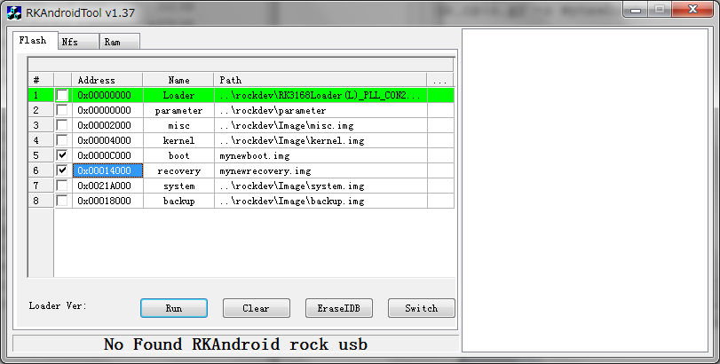
Write new boot-image 3/4
Execute “RKAndroidTool.exe”
Change Boot Address “0x0000C000”

Slide 104
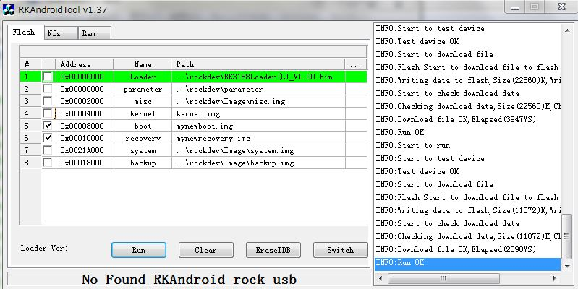
Write new boot-image 4/4

Slide 105
MediaTek - MT6589 (Cortex-A7 Quad)

Slide 106

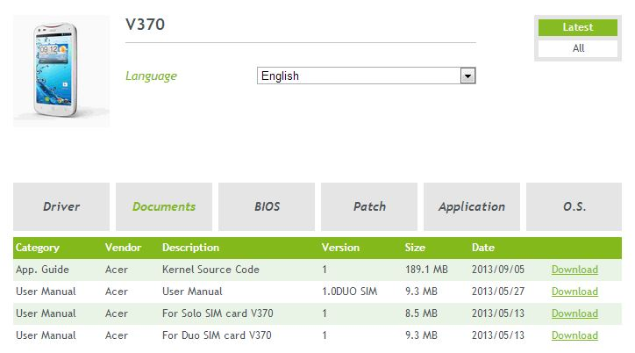
MediaTek - MT6589 (Cortex-A7 Quad)
Target
Smart Phone
Acer Liquid E2
http://www.acer.com.tw/ac/zh/TW/content/model/HM.HC5TA.001
OS
Official Kernel & Android
(But patch only)
http://us.acer.com/ac/en/US/content/drivers
Notes:
修補
修改[xiūgǎi]

Slide 107
MediaTek - MT6589 (Cortex-A7 Quad)
Setup Process
Get kernel source code & patch for Android-4.2.1
Merge AOSP & this patch
Build kernel
Copy drivers for Android
Modify Android source code
Build Android image
Write Android image to your phone
Notes:
[合并]hébìng
修補
修改[xiūgǎi]

Slide 108
Get kernel source code & patch for Android-4.2.1
Download Acer's source code
wget
http://global-download.acer.com/GDFiles/Document/App.%20Guide/App.%20Guide_Acer_1.0_A42J_A.zip?acerid=635013347354221361&Step1=Smartphone&Step2=Liquid%20E2&Step3=V370&OS=---&LC=en&BC=Acer&SC=EMEA_8
Acer_AV061_V370_1.007.00_WW_GEN1_opensource.tar.gz
http://global-download.acer.com/GDFiles/Document/App.%20Guide/App.%20Guide_Acer_1.0_A_A.zip?acerid=635139433116342519&Step1=SMARTPHONE&Step2=LIQUID%20E2&Step3=V370&OS=ALL&LC=en&BC=ACER&SC=PA_6
C11_opensource_20130903.tar
Notes:
[下载]xiàzǎi
打開
现xiàn
修補
修改[xiūgǎi]

Slide 109
Marge AOSP & this patch
Download source tree of android JB from AOSP
Marge source
Over-write external,system,bootable,bionic dirs
from Acer_AV061_V370_1.007.00_WW_GEN1_opensource.tar.gz
Add mediatek, kernel dirs
from C11_opensource_20130903.tar
repo init -u https://android.googlesource.com/platform/manifest -b android-4.2.1_r1.2
repo sync
Notes:
[合并]hébìng
[复制]fùzhì
重寫
修補
修改[xiūgǎi]

Slide 110
Build kernel
Build kernel for MT6589
export PATH=[your android dir for MT6589]/prebuilts/gcc/linux-x86/arm/arm-linux-androideabi-4.6/bin:$PATH
cd [your android dir for MT6589]/kernel
TARGET_PRODUCT=simcom89_wet_jb2 MTK_ROOT_CUSTOM=../mediatek/custom/ make
Notes:
建立

Slide 111
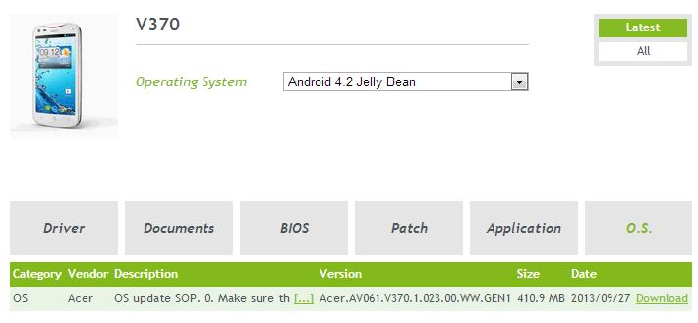
Copy drivers for Android
Some source code & driver aren’t released.
Copy them from update image
wget http://global-download.acer.com/GDFiles/OS/OS/OS_Acer_Acer.AV061.V370.1.023.00.WW.GEN1_A42J_A.zip?acerid=635158485778733078&Step1=SMARTPHONE&Step2=LIQUID%20E2&Step3=V370&OS=ALL&LC=en&BC=ACER&SC=PA_6
OS_Acer_Acer.AV061.V370.1.023.00.WW.GEN1_A42J_A.zip
Copy system/vendor, system/lib dirs to Android device dir

Slide 112
Modify Android source code 1/2
Delete libcustom_prop
./external/webkit/Android.mk
./external/webkit/Source/WebCore/loader/FrameLoader.cpp
LOCAL_C_INCLUDES += mediatek/frameworks/base/custom/inc
LOCAL_STATIC_LIBRARIES += libcustom_prop
#include "custom_prop.h“
※And “m_customXWapProfile” functions
Notes:
删掉shāndiào,删除shānchú

Slide 113
Modify Android source code 2/2
Delete libcustom_prop
./external/webkit/Source/WebCore/platform/network/android/SocketStreamHandle.h
./external/webkit/Source/WebCore/css/CSSComputedStyleDeclaration.cpp
./external/webkit/Source/WebCore/css/CSSParser.cpp
./external/webkit/Source/WebCore/loader/appcache/ApplicationCacheHost.cpp
./external/webkit/Source/WebCore/websockets/WebSocket.cpp
./external/webkit/Source/WebCore/xml/XMLHttpRequest.cpp
./external/webkit/Source/WebCore/websockets/WebSocketHandshake.cpp
./external/webkit/Source/WebKit/android/WebCoreSupport/WebViewClientError.cpp
./external/webkit/Source/WebCore/websockets/WebSocketChannel.cpp
./external/webkit/Source/WebKit/android/WebCoreSupport/SocketStreamHandleAndroid.cpp
./external/webkit/Source/WebKit/android/WebCoreSupport/SocketStreamHost.cpp
#include <cutils/xlog.h>
※And “XLOG” functions
Notes:
删掉shāndiào,删除shānchú

Slide 114
Build Android image
. build/envsetup.sh
choosecombo
Build type choices are:
1. release
2. debug
Which would you like? [1] 1
Which product would you like? [full] full
Variant choices are:
1. user
2. userdebug
3. eng
Which would you like? [eng] 3
make dist
out/dist/full-target_files-eng.[your user name].zip
Notes:
建立

Slide 115
Write Android image to your phone
adb push out/dist/full-target_files-eng.[your user name].zip /sdcard/
Turn off your phone
Volume Up & Power
Wipe data/factory reset
Install zip from sdcard
Choose zip from sdcard
full-target_files-eng.[your user name].zip
+++++Go Back+++++
Reboot system now
Notes:
推tuī
關機
删掉shāndiào,删除shānchú
[安装]ānzhuāng
[取向]qǔxiàng
[重新启动]chóngxīn qǐdòng

Slide 116
Freescale - i.MX6Q (Cortex-A9 Quad)

Slide 117
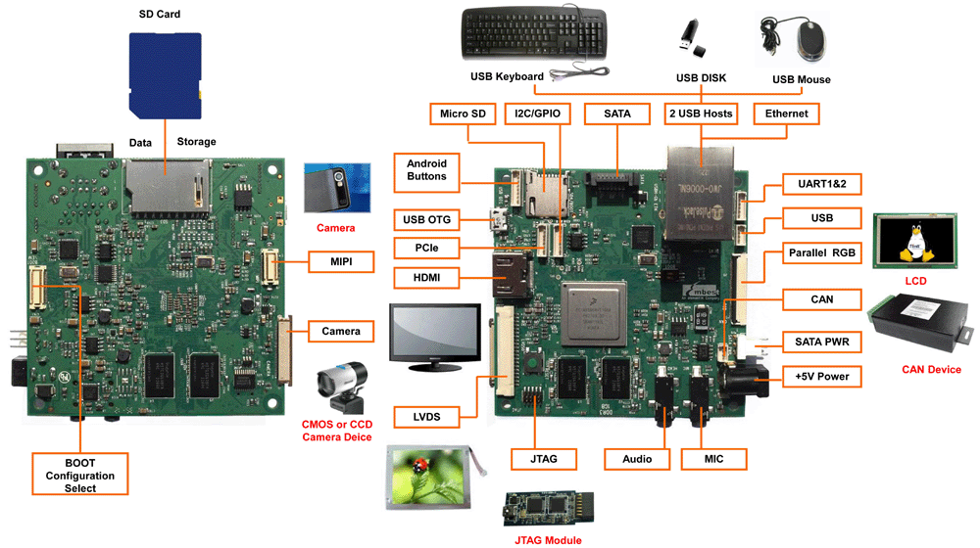
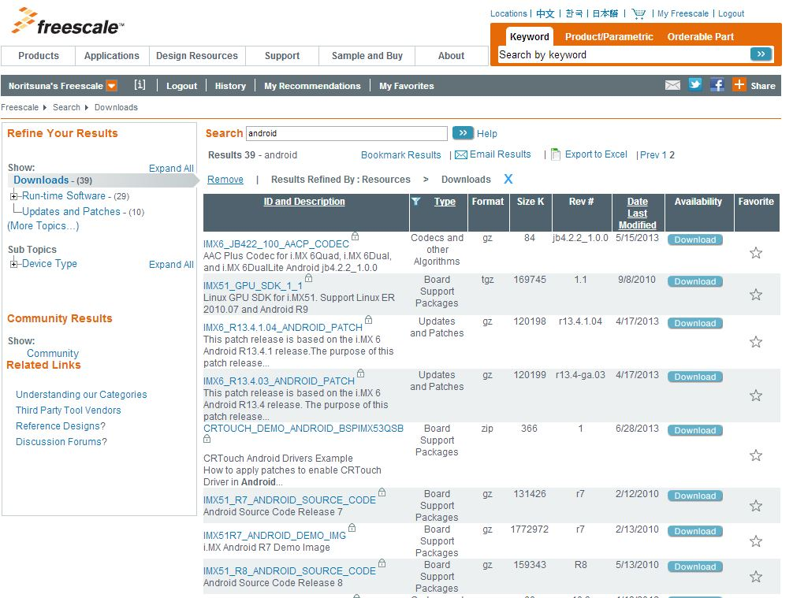
Freescale - i.MX6Q (Cortex-A9 Quad)
Target
EVB
i.MX6Q SABRA Lite
http://www.cloudsto.com/android-mini-pc-s/rikomagic-quad-core-mk802iv-8gb-flash-bluetooth-dhl-express-shipping-detail.html
OS
Official Kernel & Android
With Setup Manual
http://www.freescale.com/webapp/search/Serp.jsp?QueryText=android&assetIdResult=&attempt=0&lastQueryText=android&isFromFlex=false&getResult=false&assetLockedForNavigation=false&pageNum=2&iteration=2&fsrch=1&isComparison=false&showAllCategories=false&sessionChecker=cTqD1ZGIFEqGCbd9lV29IKvJ.ebiz_ms2&getTree=false&fromTrng=false&fromPSP=false&getFilter=false&assetLocked=false&fromCust=false&showCustomCollateral=false&pageSize=25&RELEVANCE=true&SelectedAsset=Downloads&fromWebPages=false&fromASP=false&fromMobile=false&isAdvanceSearch=false&isTree=false&fromDAP=false&isResult=false

Slide 118
Freescale - i.MX6Q (Cortex-A9 Quad)
Setup Process
Download Source Code from Official Site
Patch to Android Source Code
Modify Android Source Code for SD Card
Fix 32bit files
Build Source Codes
Android
u-boot
boot-image
Setup SD Card
Notes:
改修ɡǎixiū

Slide 119
Download Source Code from Official Site
Download Android
Download Kernel
repo init -u https://android.googlesource.com/platform/manifest -b android-4.2.2_r1
repo sync
git clone git://git.freescale.com/imx/linux-2.6-imx.git kernel_imx
cd kernel_imx
git checkout jb4.2.2_1.1.0-ga
Notes:
下载xiàzài

Slide 120
Download Source Code from Official Site
Download bootloader
Download Patch
https://www.freescale.com/webapp/Download?colCode=IMX6_JB422_110_ANDRD_SRC_BSP&appType=license&location=null&fpsp=1&WT_TYPE=Board%20Support%20Packages&WT_VENDOR=FREESCALE&WT_FILE_FORMAT=gz&WT_ASSET=Downloads&sr=38&Parent_nodeId=from%20search&Parent_pageType=from%20search
android_jb4.2.2_1.1.0-ga.tar.gz
cd ../bootable
cd bootloader
git clone https://github.com/ldnunes/uboot-imx.git uboot-imx
cd uboot-imx
git checkout jb4.2.2_1.1.0-ga
Notes:
下载xiàzài
修補
修改[xiūgǎi]

Slide 121
Patch to Android Source Code
Patch
cd [your Android dir]
tar zxfv android_jb4.2.2_1.1.0-ga.tar.gz
tar zxfv android_jb4.2.2_1.1.0-ga_source.tar.gz
cd android_jb4.2.2_1.1.0-ga_source/code/
tar zxfv jb4.2.2_1.1.0-ga.tar.gz
cd ../../
source android_jb4.2.2_1.1.0-ga_source/code/jb4.2.2_1.1.0-ga/and_patch.sh
c_patch android_jb4.2.2_1.1.0-ga_source/code/jb4.2.2_1.1.0-ga imx_jb4.2.2_1.1.0-ga
Notes:
修補
修改[xiūgǎi]

Slide 122
Modify Android Source Code for SD Card
device/fsl/imx6/etc/fstab.freescale
Create New File(Please delete it, if exist.)
/dev/block/mmcblk1p5 /system ext4 ro wait
/dev/block/mmcblk1p4 /data ext4 nosuid,nodev,nodiratime,noatime,nomblk_io_submit,noauto_da_alloc,errors=panic wait
/dev/block/mmcblk1p6 /cache ext4 nosuid,nodev,nomblk_io_submit wait
/dev/block/mmcblk1p7 /device ext4 ro,nosuid,nodev wait

Slide 123
Modify Android Source Code for SD Card
device/fsl/sabresd_6dq/recovery.fstab
Create New File(Please delete it, if exist.)
/boot emmc /dev/block/mmcblk1p1
/recovery emmc /dev/block/mmcblk1p2
/system ext4 /dev/block/mmcblk1p5
/cache ext4 /dev/block/mmcblk1p6
/data ext4 /dev/block/mmcblk1p4 reserved=32768
/misc emmc /dev/block/mmcblk1p8
/sdcard vfat /dev/block/mmcblk1p1

Slide 124
Modify Android Source Code for SD Card
device/fsl/sabresd_6dq/vold.fstab b/device/fsl/sabresd_6dq/vold.fstab
Modify it:
@@ -26,7 +26,7 @@
#used for all usb host
dev_mount udisk /mnt/udisk auto /devices/platform/fsl-ehci
#mount SDHC4 SD card /mnt/sdcard as primary storage for MX6Q SABER_LITE RevC
-dev_mount extsd /mnt/extsd auto /devices/platform/sdhci-esdhc-imx.2/mmc_host/mmc1
+dev_mount extsd /mnt/extsd auto /devices/platform/sdhci-esdhc-imx.1/mmc_host/mmc2
#mount SDHC3 TF card to /mnt/extsd as external storage forMX6Q SABER_LITE RevC
#dev_mount sdcard /mnt/sdcard 4 /devices/platform/sdhci-esdhc-imx.3/mmc_host/mmc0

Slide 125
Fix 32bit files 1/4
Setup files
sudo apt-get install
uuid uuid-dev zlib1g-dev liblz-dev liblzo2-2 liblzo2-de
Download 32bits files
wget https://community.freescale.com/servlet/JiveServlet/download/312916-255326/liblzo2-2_2.05-1_i386.deb.zip
wget https://community.freescale.com/servlet/JiveServlet/download/312916-255325/liblzo2-dev_2.05-1_i386.deb.zip
wget https://community.freescale.com/servlet/JiveServlet/download/312916-255364/mtd-utils.tgz
wget https://community.freescale.com/servlet/JiveServlet/download/312916-258740/uuid-dev_2.20.1-1ubuntu3_i386.deb.zip

Slide 126
Fix 32bit files 2/4
Setup 32bits files
Install liblzo2 & uuid
unzip liblzo2-2_2.05-1_i386.deb.zip
unzip liblzo2-dev_2.05-1_i386.deb.zip
unzip uuid-dev_2.20.1-1ubuntu3_i386.deb.zip
sudo mkdir /usr/lib/liblzo2_i386
sudo mkdir /usr/lib/uuid-dev_i386
sudo dpkg -x liblzo2-dev_2.05-1_i386.deb /usr/lib/liblzo2_i386/
sudo dpkg -x liblzo2-2_2.05-1_i386.deb /usr/lib/liblzo2_i386/
sudo dpkg -x uuid-dev_2.20.1-1ubuntu3_i386.deb /usr/lib/uuid-dev_i386/

Slide 127
Fix 32bit files 3/4
Setup 32bits files
Re-link liblzo2 & uuid
sudo rm liblzo2.a
sudo rm liblzo2.so
sudo rm liblzo2.so.2
sudo ln -s liblzo2_i386/usr/lib/liblzo2.a liblzo2.a
sudo ln -s liblzo2_i386/usr/lib/liblzo2.so.2.0.0 liblzo2.so
sudo ln -s liblzo2_i386/usr/lib/liblzo2.so.2.0.0 liblzo2.so.2
sudo ln -s uuid-dev_i386/usr/lib/i386-linux-gnu/libuuid.a libuuid.a
sudo ln -s uuid-dev_i386/usr/lib/i386-linux-gnu/libuuid.so libuuid.so

Slide 128
Fix 32bit files 4/4
Modify
external/mtd-utils/mkfs.ubifs/Android.mk
LOCAL_LDFLAGS +=-L /usr/lib/
LOCAL_C_INCLUDES +=/usr/lib/uuid-dev/usr/include/
LOCAL_C_INCLUDES +=/usr/lib/liblzo2_i386/usr/include

Slide 129
Build Source Codes 1/3
Build Android
cd [your Android dir]
source build/envsetup.sh
lunch sabresd_6dq-user
make

Slide 130
Build Source Codes 2/3
Build u-boot
cd [your Android dir]/bootable/bootloader/uboot-imx
export ARCH=arm
export CROSS_COMPILE=[your Android dir]/prebuilts/gcc/linux-x86/arm/arm-eabi-4.6/bin/arm-eabi-
make distclean
make mx6q_sabresd_android_config
make

Slide 131
Build Source Codes 3/3
Build kernel
Build boot-image
export ARCH=arm
export CROSS_COMPILE=[your Android dir]/prebuilts/gcc/linux-x86/arm/arm-eabi-4.6/bin/arm-eabi-
make imx6_android_defconfig
make uImage
cd [your Android dir]
source build/envsetup.sh
lunch sabresd_6dq-user
make bootimage

Slide 132
Setup SD Card
If you want to boot from SD Card, you have to make a special sector for this board.
This script can make the special sector.
cd [your Android dir]
cp ./out/target/product/sabresd_6dq/*.img .
chmod +x ./device/fsl/common/tools/fsl-sdcard-partition.sh
sudo ./device/fsl/common/tools/fsl-sdcard-partition.sh /dev/sdX
※X is your SD Card device name

Slide 133
TI - OMAP5432 (Cortex-A15 Dual)

Slide 134
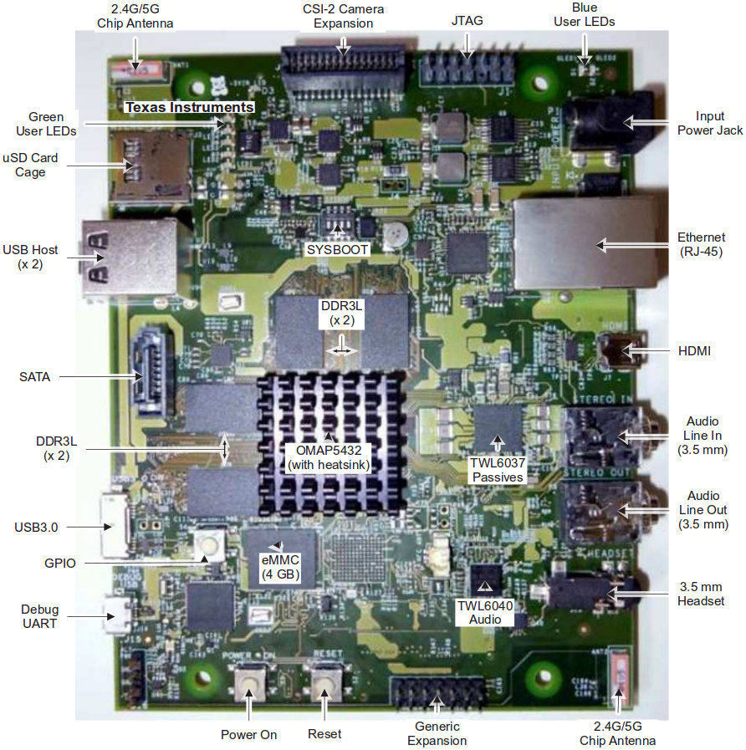
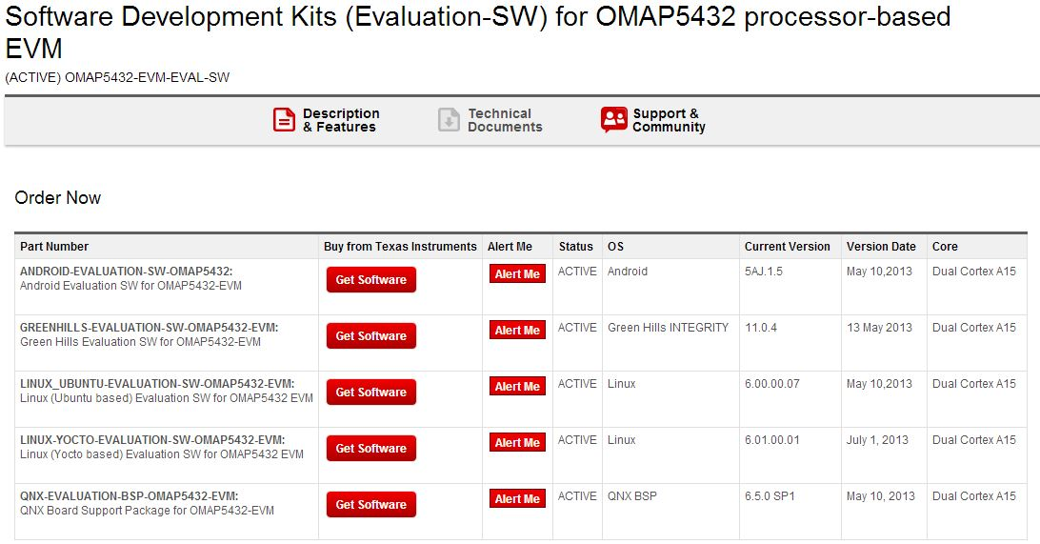
TI - OMAP5432 (Cortex-A15 Dual)
Target
EVB
OMAP5432-EVM
http://www.ti.com/tool/omap5432-evm?DCMP=omap-5432evm-130521&HQS=omap-5432evm-b-sw
OS
Official Kernel & Android
With Build Manual&Data Sheet
http://www.ti.com/tool/omap5432-evm-eval-sw
http://omapedia.org/wiki/Panda5AJ.1.5_Release_Notes

Slide 135
TI - OMAP5432 (Cortex-A15 Dual)
Setup Process
Download Android Source Code
Build Android Source Code
Download kernel Source Code
Build kernel Source Code
Download u-boot Source Code
Build u-boot Source Code
Build fastboot image
Write fastboot images to eMMC

Slide 136
Download Android Source Code
Download Android
cd [your Panda5 dir]
mkdir -p mydroid
cd mydroid
export MYDROID=`pwd`
repo init -u git://git.omapzoom.org/platform/omapmanifest.git -b 5AJ.x -m RLS_panda5AJ.1.5.xml
repo sync

Slide 137
Build Android Source Code
Build Android system
. build/envsetup.sh
lunch 25
make clean
make

Slide 138
Download kernel Source Code
Download kernel
cd [your Panda5 dir]
mkdir kernel
git clone git://git.omapzoom.org/kernel/omap.git kernel/android-3.4
cd kernel/android-3.4
git checkout 499e8d5a5aa8a271bf9c4ae404ad234b7fb22b9f

Slide 139
Build kernel Source Code 1/2
Build kernel
export PATH=$PATH:${MYDROID}/prebuilts/gcc/linux-x86/arm/arm-eabi-4.6/bin/
export CROSS_COMPILE=${MYDROID}/prebuilts/gcc/linux-x86/arm/arm-eabi-4.6/bin/arm-eabi-
cd [your Panda5 dir]/kernel/android-3.4
make ARCH=arm mrproper
make ARCH=arm android_omap_defconfig
make ARCH=arm uImage modules

Slide 140
Build kernel Source Code 2/2
Build Wi-Fi Driver
export KERNEL_DIR=[your Panda5 dir]/kernel/android-3.4
export KLIB=${KERNEL_DIR}
export KLIB_BUILD=${KERNEL_DIR}
cd ${MYDROID}/hardware/ti/wlan/mac80211/compat_wl18xx/
make ARCH=arm

Slide 141
Download u-boot Source Code
Download u-boot
cd [your Panda5 dir]
git clone git://git.omapzoom.org/repo/omapboot.git usbboot
cd usbboot
git checkout 33af7cb409b603cf7988306ab2ea70f052a9a02b

Slide 142
Build u-boot Source Code
Build u-boot
cd [your Panda5 dir]/usbboot
make MACH=omap5 BOARD=omap5uevm clean
make MACH=omap5 BOARD=omap5uevm

Slide 143
Build fastboot image 1/2
Copy kernel to OTA image dir
Copy Wi-Fi Drivers to OTA image dir
cd $MYDROID
cp -v [your Panda5 dir]/kernel/android-3.4/arch/arm/boot/zImage device/ti/panda5/kernel
cd $MYDROID/out/target/product/panda5
mkdir -p system/lib/modules; cd system/lib/modules
cp -fp ${MYDROID}/hardware/ti/wlan/mac80211/compat_wl18xx/compat/compat.ko .
cp -fp ${MYDROID}/hardware/ti/wlan/mac80211/compat_wl18xx/net/wireless/cfg80211.ko .
cp -fp ${MYDROID}/hardware/ti/wlan/mac80211/compat_wl18xx/net/mac80211/mac80211.ko .
cp -fp ${MYDROID}/hardware/ti/wlan/mac80211/compat_wl18xx/drivers/net/wireless/ti/wl12xx/wl12xx.ko .
cp -fp ${MYDROID}/hardware/ti/wlan/mac80211/compat_wl18xx/drivers/net/wireless/ti/wl18xx/wl18xx.ko .
cp -fp ${MYDROID}/hardware/ti/wlan/mac80211/compat_wl18xx/drivers/net/wireless/ti/wlcore/wlcore*.ko .
Notes:
拷贝[kǎobèi]

Slide 144
Build fastboot image 2/2
ReBuild Android System
cd $MYDROID
. build/envsetup.sh
lunch 25
rm out/target/product/panda5/*img
rm out/target/product/panda5/obj/PACKAGING/systemimage_intermediates/system.img
make

Slide 145
Write fastboot images to eMMC 1/6
Copy fastboot images to working dir
cd [your Panda5 dir]
mkdir emmc_files
cp -v ${MYDROID}/out/target/product/panda5/*img emmc_files
cp -v ${MYDROID}/device/ti/omap5sevm/boot/fastboot.sh emmc_files
cp -v ${MYDROID}/out/host/linux-x86/bin/{simg2img,make_ext4fs,mkbootimg,fastboot,adb} emmc_files
cp -v [your Panda5 dir]/kernel/android-3.4/arch/arm/boot/zImage emmc_files/kernel
cp -v [your Panda5 dir]/usbboot/out/omap5uevm/omap5uevm_GP_ES2.0_MLO emmc_files
cp -v [your Panda5 dir]/usbboot/out/omap5uevm/usbboot emmc_files

Slide 146
Write fastboot images to eMMC 2/6
Register your board to udev.
Add the following line to ‘/etc/udev/rules.d/51-android.rules’
Restart ‘udev’ service
SUBSYSTEM=="usb", ATTRS{idVendor}=="0451", ATTRS{idProduct}=="d011", MODE="0666"
Notes:
补记bǔjì

Slide 147
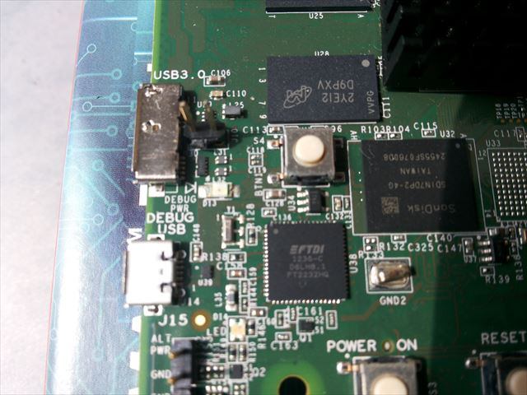
Write fastboot images to eMMC 3/6
Connect 2 Cables to PC
Serial Connecter
This connecter is MicroUSB.
USB Connecter for ADB
This port is USB3.0 connecter.
Connect USB2.0 Cable.

Slide 148
Write fastboot images to eMMC 4/6
Run fastboot program on your PC
cd [your Panda5 dir]/emmc_files
sudo ./usbboot –f
“waiting for device..”

Slide 149
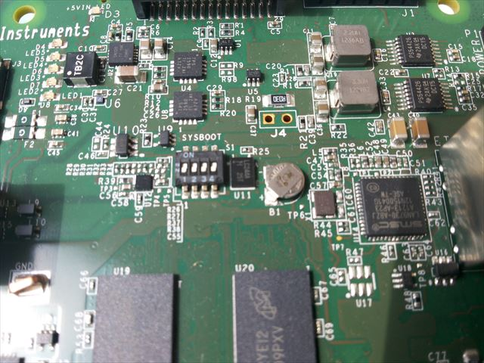
Write fastboot images to eMMC 5/6
Boot-up your board from eMMC
Change boot-up dip switch to SW1-4=OFF
Notes:
转换zhuǎnhuàn

Slide 150
Write fastboot images to eMMC 6/6
Write All Images to eMMC
sudo ./fastboot.sh

Slide 151
Samsung - Exynos5 (Cortex-A15 Quad and Cortex-A7 Quad)

Slide 152
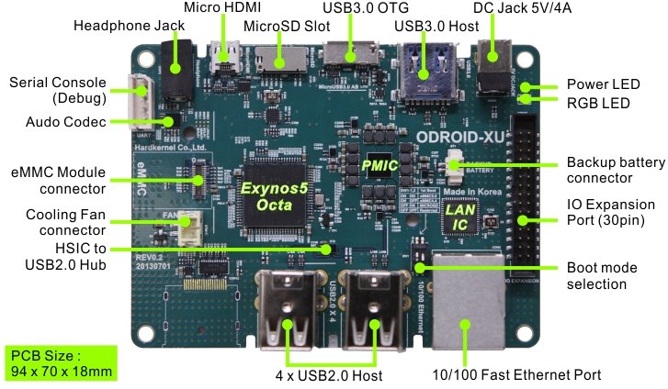

Samsung - Exynos5 (Cortex-A15 Quad and Cortex-A7 Quad)
Target
EVB
ODROID-XU
http://www.hardkernel.com/renewal_2011/products/prdt_info.php?g_code=G137510300620
OS
Official Kernel & Android
With Build Manual&Data Sheet
http://odroid.com/dokuwiki/doku.php?id=en:odroid-xu

Slide 153
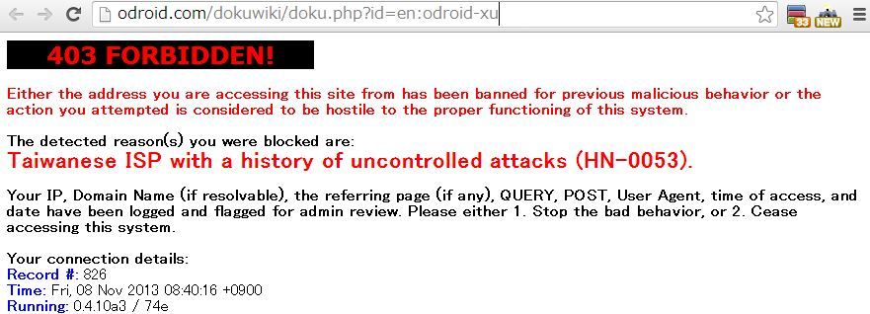
Samsung - Exynos5 (Cortex-A15 Quad and Cortex-A7 Quad)
OS
Official Kernel & Android
With Build Manual&Block Fig
http://odroid.com/dokuwiki/doku.php?id=en:odroid-xu
Notes:
拒绝jùjué

Slide 154
Samsung - Exynos5 (Cortex-A15 Quad and Cortex-A7 Quad)
Setup Process
Build u-boot
Build kernel
Build Android
Setup eMMC
Write fastboot images to eMMC

Slide 155
Build u-boot 1/2
Setup Toolchains
Setup Paths
wget http://dn.odroid.com/ODROID-XU/compiler/arm-eabi-4.4.3.tar.gz
mkdir [your toolchain dir]
cp arm-eabi-4.4.3.tar.gz [your toolchain dir]
cd [your toolchain dir]
tar zxvf arm-eabi-4.4.3.tar.gz
export PATH=${PATH}:[your toolchain dir]/arm-eabi-4.4.3/bin
export CROSS_COMPILE=arm-eabi-

Slide 156
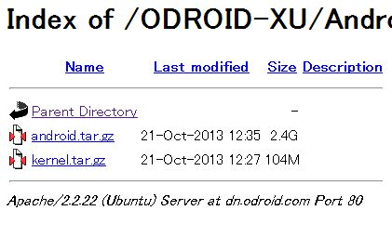
Build u-boot 2/2
Get Source Code with kernel & Android
http://dn.odroid.com/ODROID-XU/Android_bsp/
Please get latest Source Code from there.
Build u-boot
cd uboot
make distclean
make smdk5410_config
make

Slide 157
Build kernel
Setup Toolschain & Get Source Code
Same with u-boot. Please see u-boot section.
Build kernel
cd kernel
make distclean
make odroidxu_android_defconfig
make

Slide 158
Build Android
Run Build Script
If you get compile error, please do the following:
sudo ln -s /usr/lib/i386-linux-gnu/mesa/libGL.so.1 /usr/lib/i386-linux-gnu/libGL.so
./build.sh odroidxu platform

Slide 159
Setup eMMC 1/4
This board doesn’t have boot loader on eMMC.
Setup boot loader to eMMC from SD Card.
Setup Steps
Download eMMC setup image for SD Card.
It’s disk image file for SD Card.
Write this image to SD Card.
Boot-up your board from SD Card.
Setup boot loader to eMMC automatically.

Slide 160
Setup eMMC 2/4
Download eMMC setup image for SD Card.
It’s disk image file for SD Card.
Write this image to SD Card.
Boot-up your board from SD Card.
Setup boot loader to eMMC automatically.

Slide 161
Setup eMMC 3/4
Download eMMC setup image for SD Card
And unzip.
Write this image to SD Card
/dev/sdX ‘s X is your SD Card device name.
wget http://dn.odroid.com/ODROID-XU/Recovery_0.4/emmc_installer.zip
dd if=./emmc_installer.img of=/dev/sdX

Slide 162
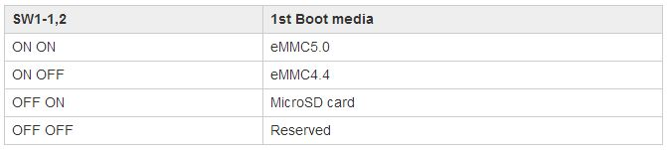
Setup eMMC 4/4
Boot-up your board from SD Card
Change boot-up dip switch to SW1=OFF, SW2=ON.
Setup boot loader to eMMC automatically
Put SD Card on your board.
Turn on power.
Wait a minute.
Notes:
转换zhuǎnhuàn
[重启]chóngqǐ

Slide 163
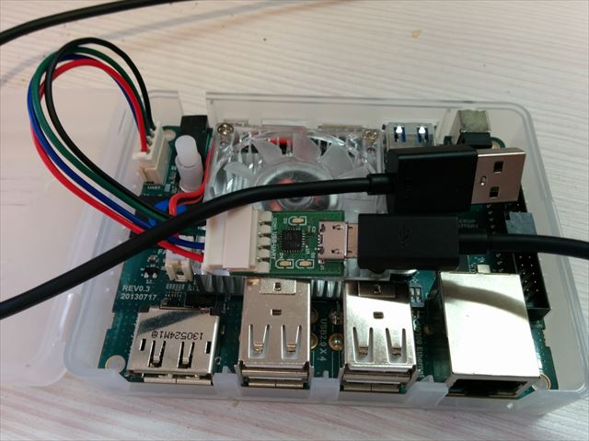
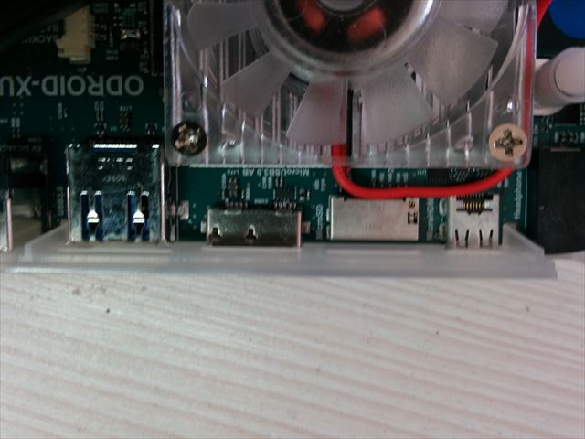
Write fastboot images to eMMC 1/5
Connect 2 Cables to PC
Serial Connecter
This cable is optional parts.
If you want it, you should buy with board.
USB Connecter for ADB
This port is USB3.0 connecter.
Connect USB2.0 Cable.

Slide 164
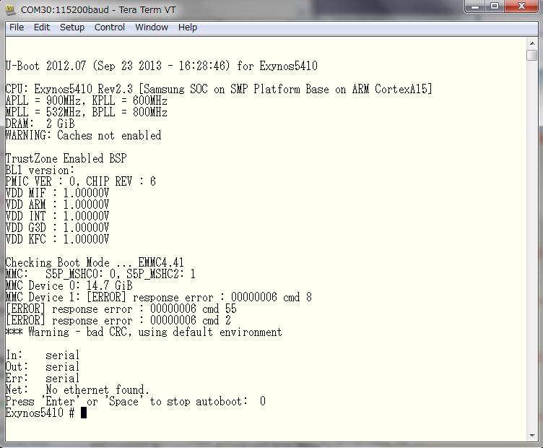
Write fastboot images to eMMC 2/5
Change fastboot mode.
Show “Press ‘Enter’ or ‘Space’ to stop auto boot”
Press Enter’ or ‘Space’
Notes:
推tuī

Slide 165

Write fastboot images to eMMC 3/5
Change fastboot mode.
Input “fastboot”
Notes:
输入

Slide 166
Write fastboot images to eMMC 4/5
Register your board to udev.
Add the following line to ‘/etc/udev/rules.d/51-android.rules’
Restart ‘udev’ service
SUBSYSTEM=="usb", ATTRS{idVendor}=="18d1", MODE="0666"

Slide 167
Write fastboot images to eMMC 5/5
Put your systems to your board.
Use fastboot
If your system doesn’t have fastboot, please do:
sudo apt-get install android-tools-fastboot
fastboot flash xloader uboot/MLO
fastboot flash bootloader uboot/u-boot.bin
fastboot flash kernel kenel/arch/arm/boot/zIamge ※If you write boot partition, it doesn't need.
fastboot flash boot out/target/product/odroidxu/boot.img
fastboot flash system android/out/target/product/odroidxu/system.img

