Slide 1
Quick Explanation of Pandaboard
Noritsuna Imamura
noritsuna@siprop.org

Slide 2
Today’s Topic
All Things which were Lectured will be Connected!!!
You will Understand why I explain about that.

Slide 3
Agenda
About Pandaboard
How to Build Android System
How to Debug Android System on Pandaboard
Customize Android System
Add Own API to Android System
Make Own SDK
How to Use NDK
Build OpenCV
Only C/C++ World on Android

Slide 4
Pandaboard
（Pick Up Important Point）

Slide 5
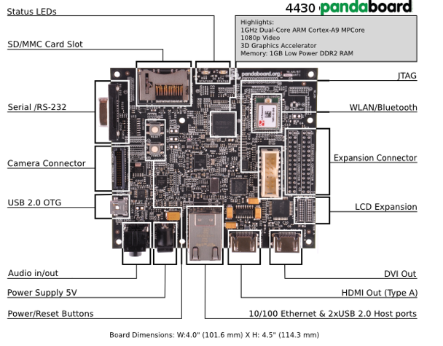
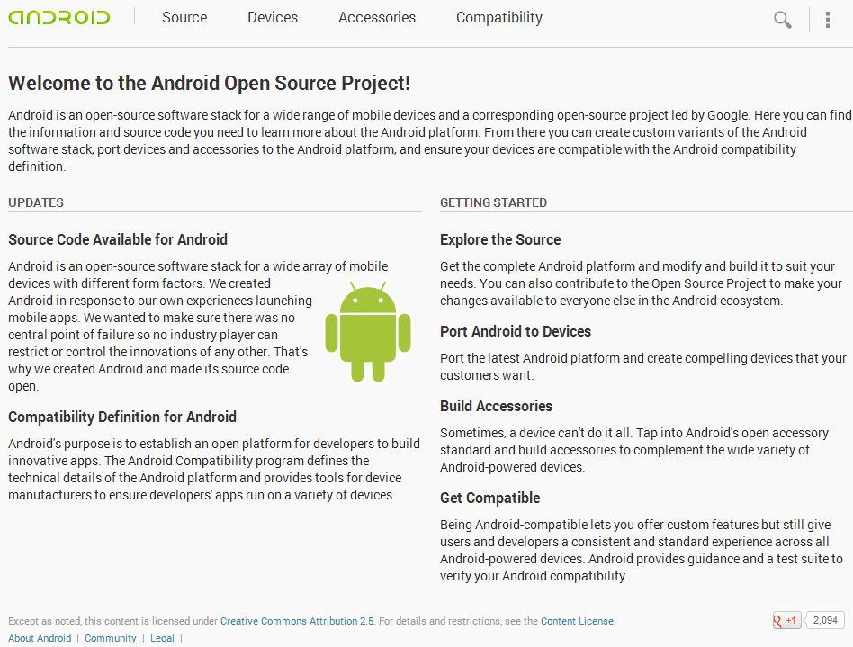
What’s Pandaboard?
Target
EVB
Pandaboard
http://www.pandaboard.org/
OS
Official Kernel & Android
With Build Manual
http://source.android.com/source/downloading.html

Slide 6
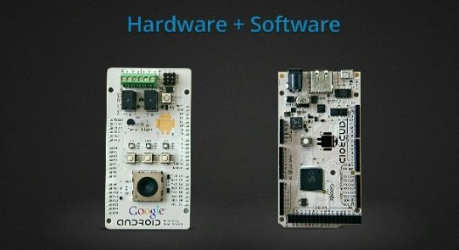
How to Use Peripherals?
ADK (Accessory Development Kit)
http://developer.android.com/tools/adk/index.html
Advantage
Develop on ADT
Pin like Arduino
Dis-Advantage
So Slow…
9600bps

Slide 7
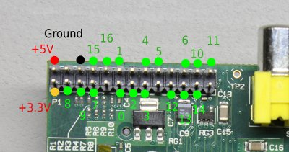
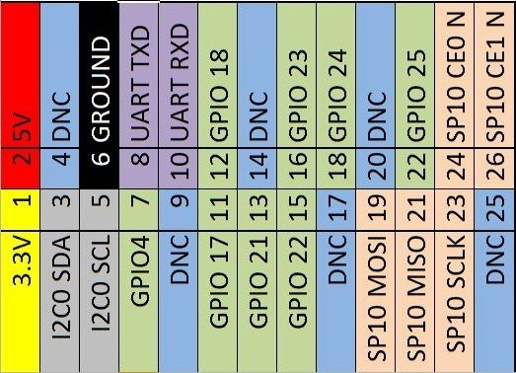
How to Use Peripherals?
GPIO(General Purpose Input/Output)
I2C(Inter-Integrated Circuit)
SPI(Serial Peripheral Interface)
UART(Serial)
Fast: SPI > I2C
Pin Num: SPI(4Pins) > I2C(3Pins)
GPIO can use Registers.
Advantage
Bus Speed
Connect All Peripheral
Dis-Advantage
Required Hardware Knowledge
Like Assembler for Hardware

Slide 8
Download & Build u-boot
Second Boot Loader for Pandaboard
cd ~/panda_work
git clone git://git.omapzoom.org/repo/u-boot.git
cd u-boot
git checkout -b omap4_dev origin/omap4_dev
wget http://android-development-environment.googlecode.com/files/0001-change-bootarges.patch
git apply 0001-change-bootarges.patch
make omap4430panda_config
make
cp -a u-boot.bin ~/panda_work/mydroid/device/ti/panda/bootloader.bin
Notes:
吸出xīchū,抽出chōuchū

Slide 9
About boot.scr
Patch Contents
--- a/include/configs/omap4430panda.h
+++ b/include/configs/omap4430panda.h
@@ -147,8 +147,7 @@
" ip=dhcp"
#else
-#define CONFIG_BOOTARGS "console=ttyO2,115200n8 mem=512M" \
- " init=/init vram=32M omapfb.vram=0:16M androidboot.console=ttyO2"
+#define CONFIG_BOOTARGS "kgdboc=ttyO2,115200 console=ttyO2,115200n8 mem=1G androidboot.console=ttyO2"

Slide 10
About boot.scr
Sample of boot.scr: File Name=boot.txt
How to Make
mkimage -A arm -T script -O linux -C none -a 0 -e 0 -n "boot.scr" -d boot.scr.txt boot.scr
setenv fdt_high "0xffffffff"
setenv bootcmd "fatload mmc 0:1 0x80200000 uImage; fatload mmc 0:1 0x81600000 uInitrd; fatload mmc 0:1 0x815f0000 board.dtb; bootm 0x80200000 0x81600000 0x815f0000"
setenv bootargs "console=ttyO2,115200n8 rootwait ro earlyprintk fixrtc nocompcache vram=48M omapfb.vram=0:24M,1:24M mem=456M@0x80000000 mem=512M@0xA0000000 init=/init androidboot.console=ttyO2 omapfb.mode=dvi:1280x800MR-24@60 consoleblank=0"

Slide 11
Common Setup 1/2
Setup Build Tools
sudo apt-get install
bison build-essential curl flex git-core gnupg gperf libesd0-dev libncurses5-dev libsdl1.2-dev libwxgtk2.8-dev libxml2 libxml2-utils lzop openjdk-6-jdk openjdk-6-jre pngcrush schedtool squashfs-tools xsltproc zip zlib1g-dev
g++-multilib gcc-multilib lib32ncurses5-dev lib32readline-gplv2-dev lib32z1-dev
Setup Build Tools for ARM
sudo apt-get install
uboot-mkimage
Notes:
共通gòngtōng
安装ānzhuāng
工具gōngjù

Slide 12






But……… TI support until 4.2
2012.06.27 4.1 Jelly Bean
2012.11.13 4.2
2013.07.24 4.3
4.1, 4.2
Available USB Audio
Support i18n(Internationalization)
Support Vibration for Input Device
Support Miracast
Support Writing Vertically
Support RenderScript
Change Android Market to Google Play
Linux: 3.1.10
4.3
Support OpenGL/ES 3.0
Support Bluetooth LE
Support Wi-Fi Location
Linux: 3.4.0

Slide 13
How to Use JTAG-ICE

Slide 14
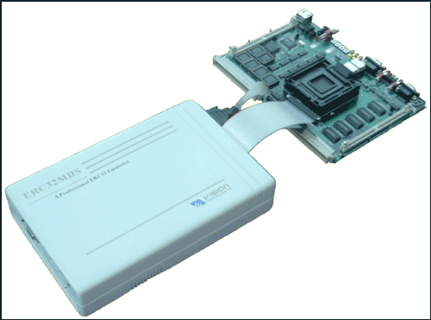
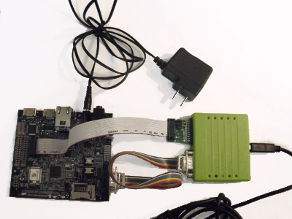
Debugging by ICE(In Circuit Emulator)
Full ICE
This has CPU&CPU Debugging Func.
When you use it, you change Real CPU to This CPU.
JTAG ICE
Real CPU has Debugging Func.
JTAG is Control Pin for CPU Debugging Func,

Slide 15
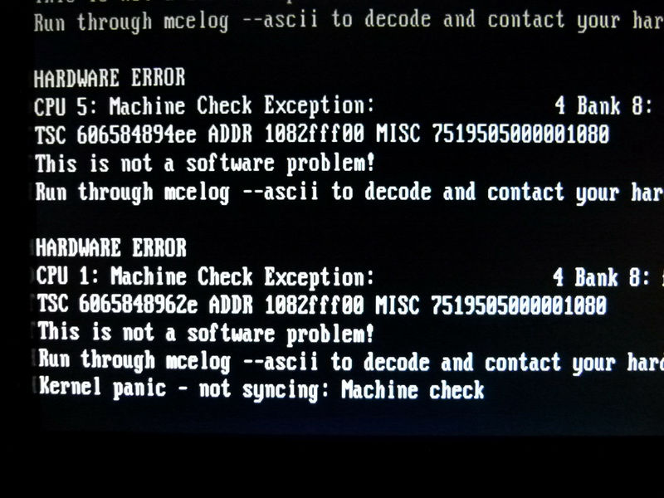
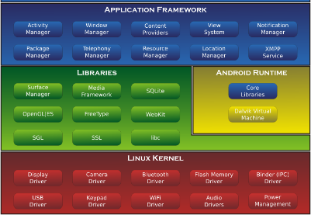
Why Need?
Soft Level Debugger can debug
their managed apps only.
Ex. Kernel Panic: Console Log Only
Ex. DDMS: Android Framework
managed Linux Lib

Slide 16
How to Setup JTAG-ICE

Slide 17
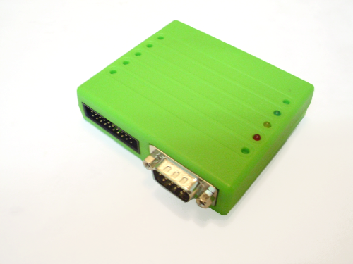
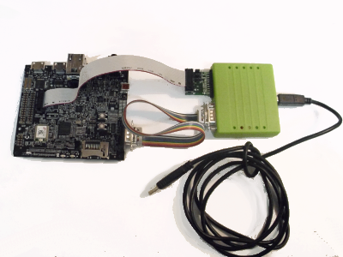
Flyswatter2 Pandaboard
One of Cheapest JTAG-ICE.
Today, getting popular under $300USD.
Old one is Over $3000USD

Slide 18
Add Debug Information to Source Code
What’s Debug Information?
Executed File(Compiled File) is machine code.
Human can NOT read it…
Ex. gcc (DWARF)
-g(n)
Debug Option. n=Debug Level
–O0
Optimized Option & Level. 0=non-optimized. Always use “3”.
I/DEBUG ( 3037): pid: 3233, tid: 3234 >>> /system/bin/netd <<<
I/DEBUG ( 3037): signal 11 (SIGSEGV), fault addr deadbaad
I/DEBUG ( 3037): r0 00001728 r1 100ffd7c r2 00000027 r3 00000000
I/DEBUG ( 3037): r4 afd42328 r5 00000000 r6 00000000 r7 00011000
I/DEBUG ( 3037): r8 00100000 r9 aef01cad 10 10000000 fp 40008008
I/DEBUG ( 3037): ip ffffffff sp 100ffd68 lr deadbaad pc afd11ca4 cpsr 40000030
I/DEBUG ( 3037): d0 3d454d414e564544 d1 6164732f7665642f

Slide 19
Change KGDB Config
Turn On Kernel Config
Kernel hacking
Compile the kernel with debug info
KGDB： kernel degugger
KGDB: user kgdb over the serial console (NEW)
cd ~/panda_work/kernel
make menuconfig
make
Notes:
吸出xīchū,抽出chōuchū

Slide 20
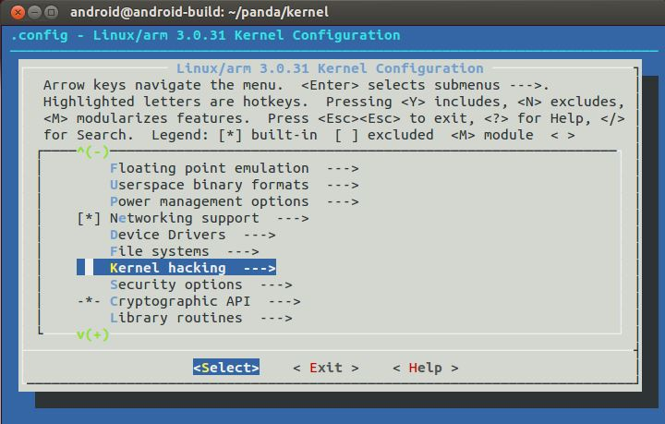
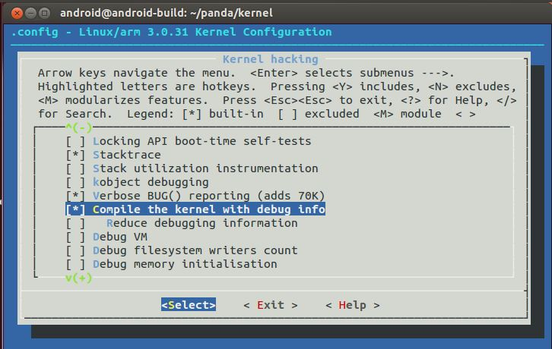
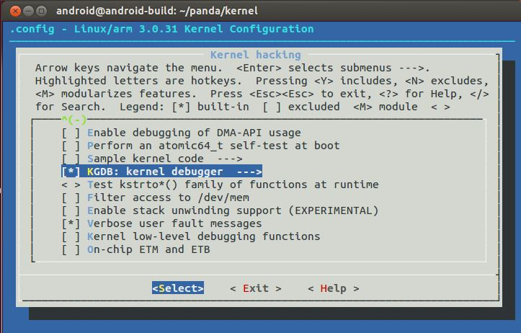
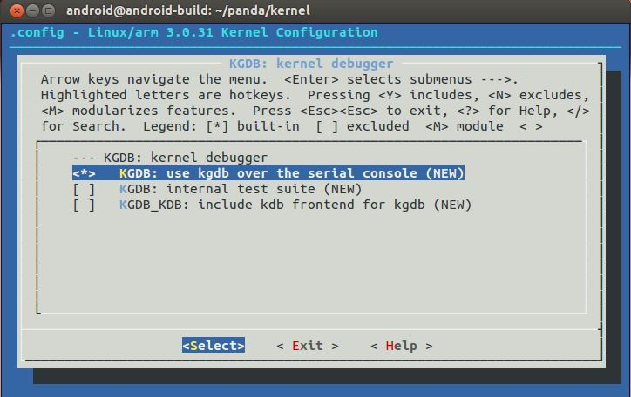
Change KGDB Config

Slide 21
Change u-boot
Need Boot Option for KGDB
“kgdboc=ttyO2,115200” in “bootargs” section
wget http://www.noritsuna.com/download/0001-change-bootarges.patch
git apply 0001-change-bootarges.patch
make
cp -a u-boot.bin ~/panda_work/mydroid/device/ti/panda/bootloader.bin
Notes:
吸出xīchū,抽出chōuchū

Slide 22
Setup Debugging Software
Why Need?
How do you debug it???
If your code has DWARF(Debug Info), you can use “objdump” command.
arm-eabi-objdump -S -C libc.so |less
-S Show de-assembler source code
-C Show C/C++ function name of source code
bionic/libc/unistd/abort.c
#00 pc 00011ca4 /system/lib/libc.so
11ca4: f005 ff25 bl 11c40 <abort>

Slide 23
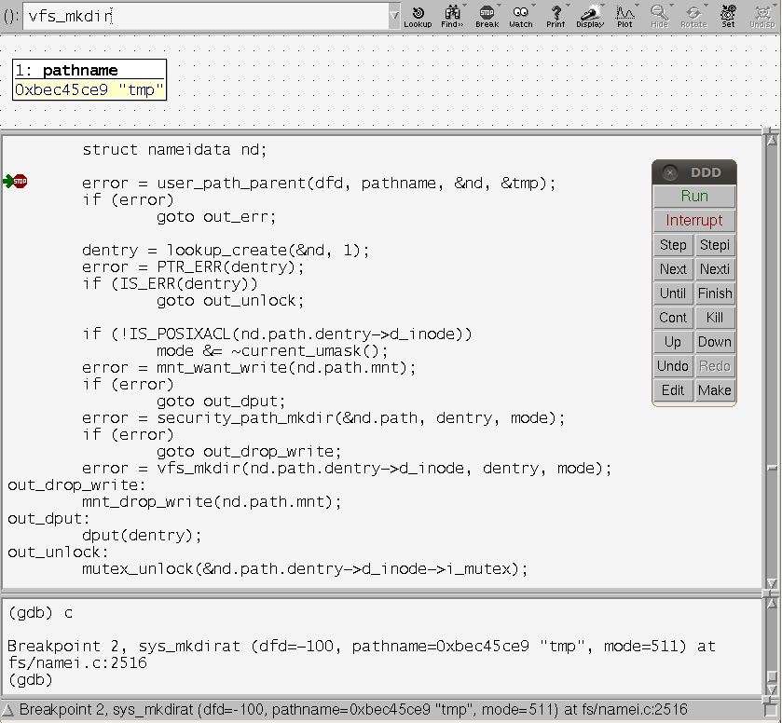
Setup Debugging Software

Slide 24
JTAG Commands
reset, halt, resume
Use for Break Point
reg
reg
Show register
reg [entry]
Show entry register
reg [entry] [value]
Set value to entry register

Slide 25
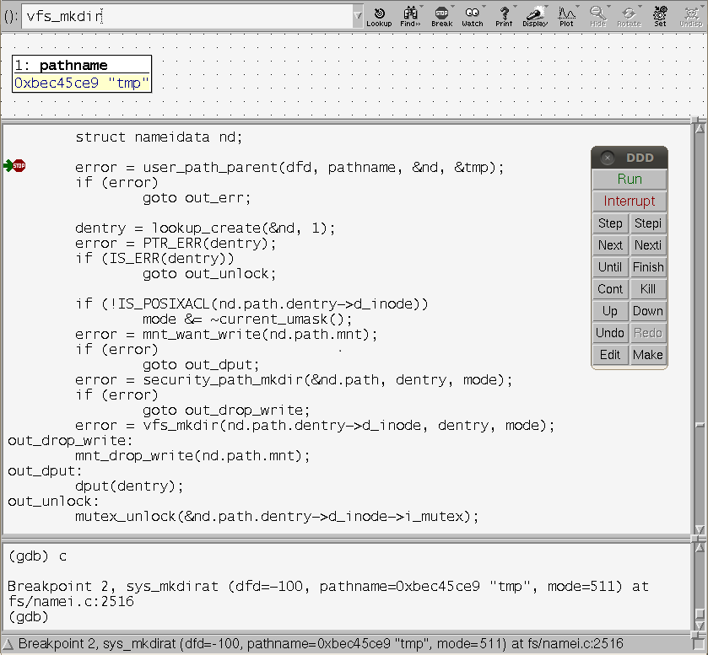
Ex. Break Point
Stop
"resume" command on telnet
Do exec
"c" command on DDD GDB Console

Slide 26
Customize Android System with NDK
Noritsuna Imamura
noritsuna@siprop.org

Slide 27

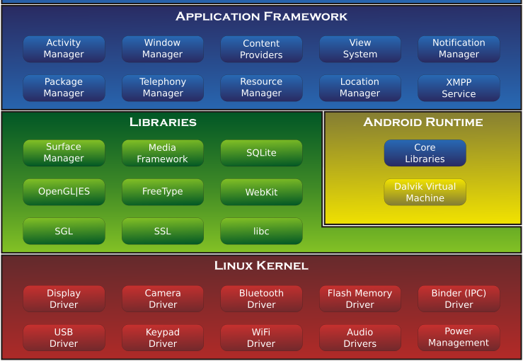
About Android
Android Framework has 3 Layer Stack for SmartPhone & Tablet PC.
Application Framework Layer (Java)
Library Layer (Linux C/C++)
Kernel/Driver Layer (Linux Kernel C/ASM)

Slide 28
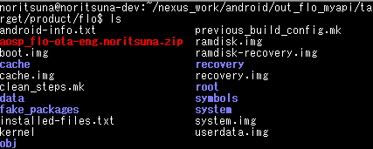
Structure of out dir
target/common/obj/
APPS
APK
JAVA_LIBRARIES
API
PACKAGING
Files Nothing...
target/product/flo/
boot.img
kernel
ramdisk.img
root
ramdisk-recovery.img
recovery.img
recovery
system.img
system
userdata.img
data
cache.img
cache

Slide 29
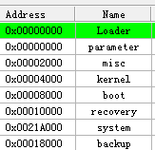
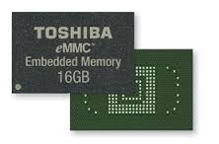
What’s Fastboot?
Fastboot is ROM Manager for eMMC.
eMMC is managed by Address in Low Lovel.
When you write your Kernel, you MUST point kernel address.
If you mistake kernel address, your system is broken…
Separated by Address

Slide 30
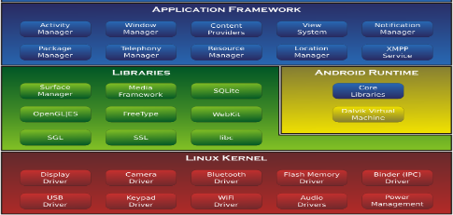

About Android Source Code
packages
App for Android
frameworks
Lib for Android Apps
system
Sys Lib for Framework
docs
Java Doc for Android
developers
Sample, Demos
build
Tool for Android Build
prebuilts
Toolchain
sdk
Android SDK
ndk
Native SDK
pdk
for 3rd Party SDK
cts
Compatibility Test
tools
Tools for External

Slide 31
About Android Source Code
external
Linux Lib
libcore
Lib for Android
bionic
libc for Android
libnativehelper
Helper for JNI
abi
Application Binary Interface
dalvik
Java VM
art
Next Generation VM
device
Diff for Devices
hardware
Drivers
bootable
BootLoader

Slide 32
Customized Android System(ROM)

Slide 33
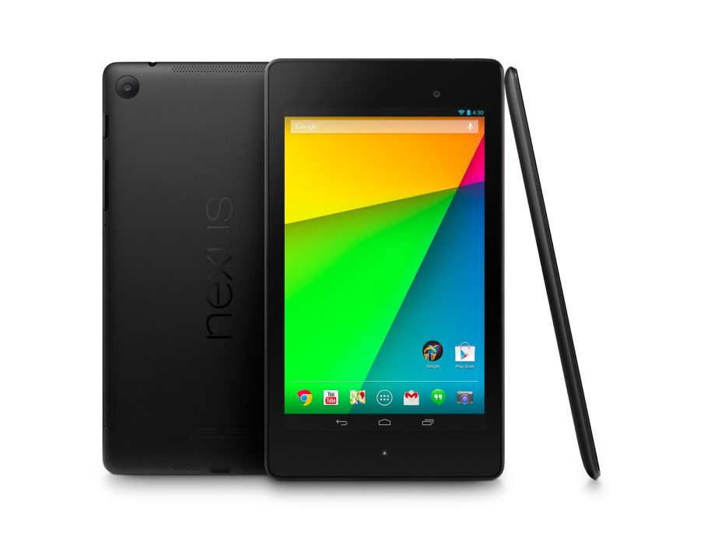
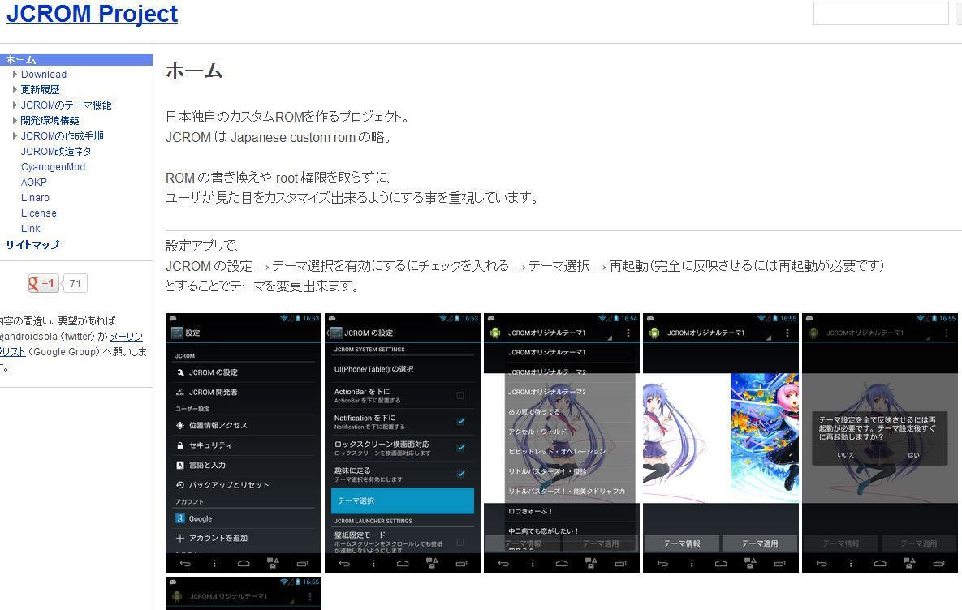
What’s Nexus7?
Target
Tablet
Nexus7(2013)
http://www.google.com/nexus/7/
OS
JCROM
With Build Manual
https://sites.google.com/site/jcromproject/

Slide 34
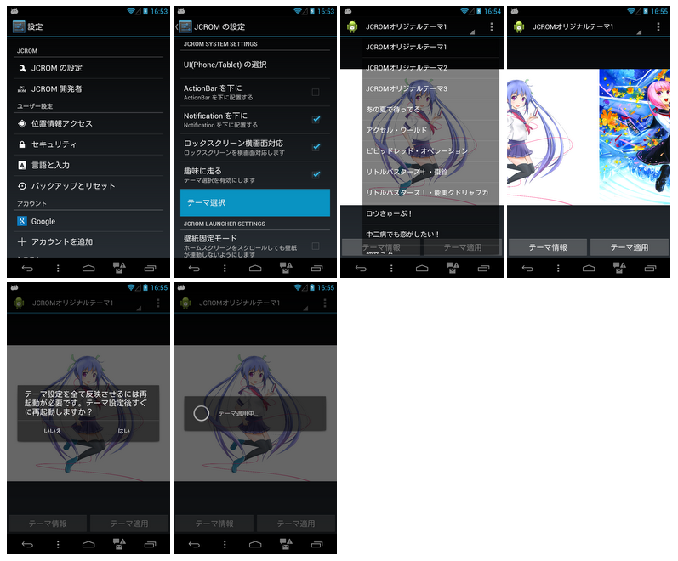
Customized UI/UX
Modify Android System
View
Animation
SystemUI
Home
Widget
Notification
Settings
etc…

Slide 35
Application Framework Layer
APIs
App Components
User Interface
App Resources
Animation and Graphics
Computation
Media and Camera
Location and Sensors
Connectivity
Text and Input
Data Storage
Administration
Web Apps
Best Practices

Slide 36
How to Develop?
ADT
Standard Android Application
Only Java on Application Framework Layer
Advantage
Use All Android Tools
Many Docs from Google Developer Site & Blogs
Call Stack
APK File(Your Application)
(Java)
Call as Java API
Application Framework
Layer (Java)
Call as JNI(C/C++)
Library Layer
(C/C++)
Call as SysCall(C/ASM)
Kernel/Driver Layer
(C/ASM)

Slide 37
How to Develop?
NDK w/ADT
Standard Android Application for C/C++
Java on Application Framework Layer
C/C++ on Limited Library Layer
Advantage
Use Java&C/C++
Dis-Advantage
Must Use UI Framework on Java Layer
Call Stack
APK File(Your Application)
(Java & C/C++)
Call as Java API
Application Framework
Layer (Java)
Call as JNI(C/C++)
Library Layer
(C/C++)
Call as SysCall(C/ASM)
Kernel/Driver Layer
(C/ASM)

Slide 38
How to Add New APIs

Slide 39
Application Framework Layer
Packages by Android Framework
android.accessibilityservice
android.accounts
android.animation
android.app
android.app.admin
android.app.backup
android.appwidget
android.bluetooth
android.content
android.content.pm
android.content.res
android.database
android.database.sqlite
android.drm
android.gesture
android.graphics
android.graphics.drawable
android.graphics.drawable.shapes
android.graphics.pdf
android.hardware
android.hardware.display
android.hardware.input
android.hardware.location
android.hardware.usb
android.inputmethodservice
android.location
android.media
android.media.audiofx
android.media.effect
android.mtp
android.net
android.net
android.net.http
android.net.nsd
android.net.rtp
android.net.sip
android.net.wifi
android.net.wifi.p2p
android.net.wifi.p2p.nsd
android.nfc
android.nfc.cardemulation
android.nfc.tech
android.opengl
android.os
android.os.storage
android.preference
android.print
android.print.pdf
android.printservice
android.provider
android.renderscript
android.sax
android.security
android.service.dreams
android.service.notification
android.service.textservice
android.service.wallpaper
android.speech
android.speech.tts
android.support.v13.app
android.support.v4.accessibilityservice
android.support.v4.app
android.support.v4.content
android.support.v4.content.pm
android.support.v4.database
android.support.v4.graphics.drawable
android.support.v4.hardware.display
android.support.v4.media
android.support.v4.net
android.support.v4.os
android.support.v4.print
android.support.v4.text
android.support.v4.util
android.support.v4.view
android.support.v4.view.accessibility
android.support.v4.widget
android.support.v7.app
android.support.v7.appcompat
android.support.v7.gridlayout
android.support.v7.media
android.support.v7.mediarouter
android.support.v7.view
android.support.v7.widget
android.support.v8.renderscript
android.telephony
android.telephony.cdma
android.telephony.gsm
android.test
android.test.mock
android.test.suitebuilder
android.text
android.text.format
android.text.method
android.text.style
android.text.util
android.transition
android.util
android.view
android.view.accessibility
android.view.animation
android.view.inputmethod
android.view.textservice
android.webkit
android.widget
dalvik.bytecode
dalvik.system

Slide 40
Goal
Add “Calculator” API into Android System
Package Name: itri.lecture
Class Name: Cal
Method
int add(int, int)
int sub(int, int)
Android System
Nexus7
AOSP based Android 4.3.1

Slide 41
Source Code of MyAPI
Java
itri.lecture.Cal.java
Main Program
package.html, package-info.java
Appoint about Build Target Dir
package itri.lecture;
public class Cal {
public Cal() {}
public static int add(int a, int b) {return a+b;}
public int sub(int a, int b) {return a-b;}
}
<HTML><BODY>
MyAPI Test Class.
</BODY></HTML>
package itri.lecture;

Slide 42
Makefile of MyAPI
Android.mk
Makefile for Android
BUILD_JAVA_LIBRARY => Make .jar Package
BUILD_SHARED_LIBRARY => Make .so Package
BUILD_STATIC_LIBRARY => Make .a file
BUILD_EXECUTABLE => Make ELF file (Executable file)
BUILD_DROIDDOC => Make JavaDoc
LOCAL_PATH := $(call my-dir)
include $(CLEAR_VARS)
LOCAL_SRC_FILES := $(call all-java-files-under, src)
LOCAL_NO_STANDARD_LIBRARIES := true
LOCAL_JAVA_LIBRARIES := core framework
LOCAL_JAVACFLAGS := $(local_javac_flags)
LOCAL_MODULE := myapi
include $(BUILD_JAVA_LIBRARY)

Slide 43
Makefile of MyAPI
Common.mk
Used by Other .mk file besides MyAPI’s .mk .
Ex. Framework Base’s Android.mk
CleanSpec.mk
Newer Clean steps must be at the end of the list.
# List of source to build into the myapi
#
core-myapi-files := \
src/itri/lecture/Cal.java
# List of junit javadoc source files for Android public API
#
# $(1): directory for search (to support use from frameworks/base)
define myapi_to_document
$(core-myapi-files)
endef

Slide 44
build/envsetup.sh
Helper Command Lib for Android Build
m
Build from Top Dir
mm
Build from Current Dir
mmm [Target Dir]
Build from Target Dir
croot
Change Top Dir
cgrep
Grep for C/C++ Source Code
jgrep
Grep for Java Source Code
resgrep
Grep for XML Source Code
lunch
Choose Target Build

Slide 45

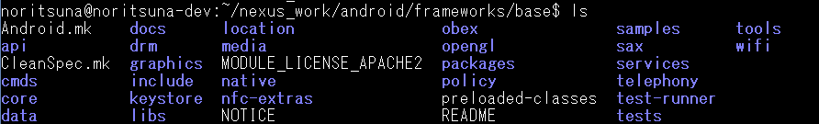
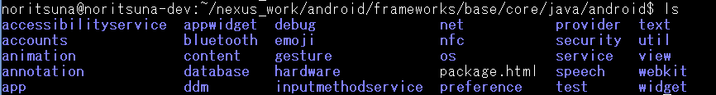
Setup Source Code of MyAPI
Copy to “framework” Directory
“framework/base” Directory
“framework/base/core” Directory

Slide 46
Application Framework Layer
Packages by Android Framework
android.accessibilityservice
android.accounts
android.animation
android.app
android.app.admin
android.app.backup
android.appwidget
android.bluetooth
android.content
android.content.pm
android.content.res
android.database
android.database.sqlite
android.drm
android.gesture
android.graphics
android.graphics.drawable
android.graphics.drawable.shapes
android.graphics.pdf
android.hardware
android.hardware.display
android.hardware.input
android.hardware.location
android.hardware.usb
android.inputmethodservice
android.location
android.media
android.media.audiofx
android.media.effect
android.mtp
android.net
android.net
android.net.http
android.net.nsd
android.net.rtp
android.net.sip
android.net.wifi
android.net.wifi.p2p
android.net.wifi.p2p.nsd
android.nfc
android.nfc.cardemulation
android.nfc.tech
android.opengl
android.os
android.os.storage
android.preference
android.print
android.print.pdf
android.printservice
android.provider
android.renderscript
android.sax
android.security
android.service.dreams
android.service.notification
android.service.textservice
android.service.wallpaper
android.speech
android.speech.tts
android.support.v13.app
android.support.v4.accessibilityservice
android.support.v4.app
android.support.v4.content
android.support.v4.content.pm
android.support.v4.database
android.support.v4.graphics.drawable
android.support.v4.hardware.display
android.support.v4.media
android.support.v4.net
android.support.v4.os
android.support.v4.print
android.support.v4.text
android.support.v4.util
android.support.v4.view
android.support.v4.view.accessibility
android.support.v4.widget
android.support.v7.app
android.support.v7.appcompat
android.support.v7.gridlayout
android.support.v7.media
android.support.v7.mediarouter
android.support.v7.view
android.support.v7.widget
android.support.v8.renderscript
android.telephony
android.telephony.cdma
android.telephony.gsm
android.test
android.test.mock
android.test.suitebuilder
android.text
android.text.format
android.text.method
android.text.style
android.text.util
android.transition
android.util
android.view
android.view.accessibility
android.view.animation
android.view.inputmethod
android.view.textservice
android.webkit
android.widget
dalvik.bytecode
dalvik.system

Slide 47
Add MyAPI’s Source Code Path
frameworks/base/Android.mk
Base System for Framework(API)
# Common sources for doc check and api check
common_src_files := \
$(call find-other-html-files, $(html_dirs)) \
$(addprefix ../../libcore/, $(call libcore_to_document, $(LOCAL_PATH)/../../libcore)) \
$(addprefix ../../external/junit/, $(call junit_to_document, $(LOCAL_PATH)/../../external/junit)) \
$(addprefix ../../frameworks/myapi/, $(call myapi_to_document, $(LOCAL_PATH)/../../frameworks/myapi))
# include definition of junit_to_document
include external/junit/Common.mk
# include definition of myapi_to_document
include frameworks/myapi/Common.mk

Slide 48
Set Target Product
build/target/product/mini.mk
build/target/product/core.mk
# Base modules (will move elsewhere, previously user tagged)
PRODUCT_PACKAGES += \
20-dns.conf \
95-configured \
am \
myapi \

Slide 49
Set Class Path
system/core/rootdir/init.rc
build/core/dex_preopt.mk
export BOOTCLASSPATH /system/framework/core.jar:/system/framework/core-junit.jar:/system/framework/bouncycastle.jar:/system/framework/ext.jar:/system/framework/framework.jar:/system/framework/telephony-common.jar:/system/framework/voip-common.jar:/system/framework/mms-common.jar:/system/framework/android.policy.jar:/system/framework/services.jar:/system/framework/apache-xml.jar:/system/framework/myapi.jar
# TODO: replace it with device's BOOTCLASSPATH
DEXPREOPT_BOOT_JARS := core:core-junit:bouncycastle:ext:myapi:framework:

Slide 50
Make OTA image
Make OTA image
This OTA image is update image for Android.
This file name is
aosp_flo-ota-eng.[your Linux’s User name].zip
cd ~/nexus_work/android/
source build/envsetup.sh
lunch aosp_flo-user
make otapackage

Slide 51
What’s Android OTA-Package
Android OTA-Package has ROM images.
boot.img
Kernel, Init, Minimam Linux
recovery.img
Recovery Manager Program
system.img
Android System
userdata.img
User Data
Separated by Address

Slide 52
How to Use New APIs

Slide 53
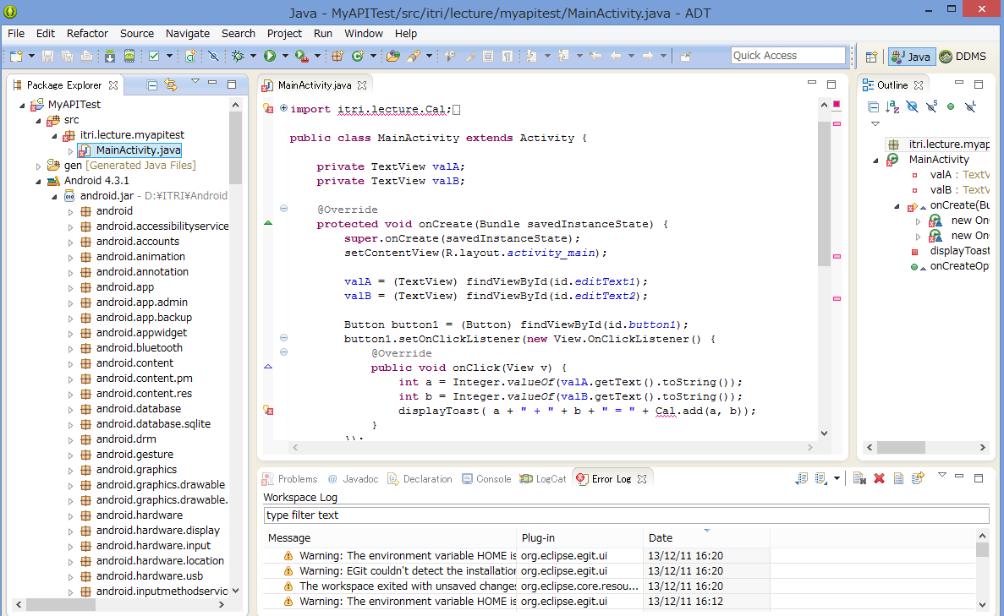
No API on SDK…

Slide 54
Setup API Version for MyAPI 1/2
development/sdk/api-versions.xml
<class name="itri/lecture/Cal" since="18">
<method name="&lt;init>()V" />
<method name="add(II)I" />
<method name="sub(II)I" />
</class>

Slide 55
Setup API Version for MyAPI 2/2
prebuilts/sdk/api/18.txt
package itri.lecture {
public class Cal {
ctor public Cal();
method public int add(int, int);
method public static int sub(int, int);
}
}

Slide 56
Setup JavaDoc
build/core/droiddoc.mk
ifneq ($(LOCAL_SDK_VERSION),)
ifeq ($(LOCAL_SDK_VERSION)$(TARGET_BUILD_APPS),current)
# Use android_stubs_current if LOCAL_SDK_VERSION is current and no TARGET_BUILD_APPS.
LOCAL_JAVA_LIBRARIES := android_stubs_current $(LOCAL_JAVA_LIBRARIES)
else
LOCAL_JAVA_LIBRARIES := sdk_v$(LOCAL_SDK_VERSION) $(LOCAL_JAVA_LIBRARIES)
endif
else
LOCAL_JAVA_LIBRARIES := core ext framework myapi $(LOCAL_JAVA_LIBRARIES)
endif # LOCAL_SDK_VERSION

Slide 57
Make MySDK
Make MySDK
This file name is
android-sdk_eng.[your Linux’s User name]_linux-x86.zip
cd ~/nexus_work/android/
source build/envsetup.sh
lunch sdk-eng
make sdk

Slide 58
How to Use New APIs

Slide 59
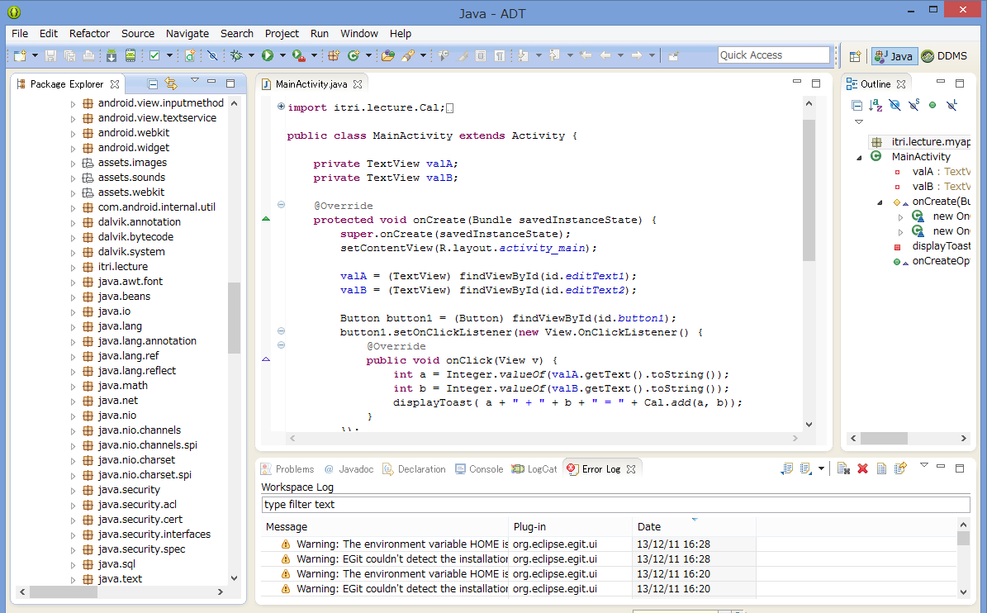
Copy SDK to your Environment
“sdk/platforms/android-4.3.1”
to your “sdk/platforms/”

Slide 60
How to Add New Library

Slide 61
Library Layer
Linux Software & Linux Library
aac
android-clat
android-mock
ant-glob
antlr
apache-harmony
apache-http
apache-qp
apache-xml
arduino
bison
blktrace
bluetooth
bouncycastle
bsdiff
bzip2
ceres-solver
checkpolicy
chromium
chromium-libpac
chromium-trace
chromium_org
clang
compiler-rt
dexmaker
dhcpcd
dnsmasq
doclava
droiddriver
dropbear
e2fsprogs
easymock
eclipse-basebuilder
eclipse-windowbuilder
eigen
elfutils
embunit
emma
esd
expat
eyes-free
fdlibm
flac
freetype
fsck_msdos
ganymed-ssh2
gcc-demangle
genext2fs
giflib
google-diff-match-patch
grub
gtest
guava
hamcrest
harfbuzz
harfbuzz_ng
hyphenation
icu4c
iproute2
ipsec-tools
iptables
iputils
tinycompress
tinyxml
tinyxml2
tremolo
v8
valgrind
webp
webrtc
wpa_supplicant_8
xmlwriter
xmp_toolkit
yaffs2
zlib
zxing
jack
javasqlite
javassist
jdiff
jhead
jmdns
jmonkeyengine
jpeg
jsilver
jsr305
junit
kernel-headers
libcap-ng
libffi
libgsm
liblzf
libmtp
libnfc-nci
libnfc-nxp
libnl-headers
libogg
libpcap
libphonenumber
libpng
libppp
libselinux
libsepol
libusb
libusb-compat
libvorbis
libvpx
libxml2
libxslt
libyuv
linux-tools-perf
littlemock
llvm
lzma
marisa-trie
markdown
mdnsresponder
mesa3d
mksh
mockito
mockwebserver
mp4parser
mtpd
naver-fonts
netcat
netperf
neven
nist-pkits
nist-sip
noto-fonts
oauth
objenesis
okhttp
open-vcdiff
opencv
openfst
openssh
openssl
oprofile
pixman
ppp
proguard
protobuf
qemu
qemu-pc-bios
regex-re2
replicaisland
robolectric
safe-iop
scrypt
sepolicy
sfntly
sil-fonts
skia
smack
smali
sonivox
speex
sqlite
srec
srtp
stlport
strace
stressapptest
svox
tagsoup
tcpdump
timezonepicker-support
tinyalsa

Slide 62
How to Develop?
NDK wo/ADT
Standard Android Application for C/C++
Only C/C++ on Limited Library Layer
Advantage
Only C/C++
DirectCall C/C++ API
Dis-Advantage
Use a few Android Tools
A few Docs from Google Developer Site & Blogs
Call Stack
APK File(Your Application)
(C/C++)
Call as C/C++ APIs
Library Layer
(C/C++)
Call as SysCall(C/ASM)
Kernel/Driver Layer
(C/ASM)

Slide 63
How to Build OpenCV for Android

Slide 64
Download OpenCV & NDK tool
wget https://github.com/Itseez/opencv/archive/2.4.7.tar.gz
tar zxfv 2.4.7.tar.gz
mkdir ~/android/
cd ~/android/
wget http://dl.google.com/android/android-sdk_r22.3-linux.tgz
wget http://dl.google.com/android/ndk/android-ndk-r8e-linux-x86_64.tar.bz2
tar zxfv android-sdk_r22.3-linux.tgz
tar jxfv android-ndk-r8e-linux-x86_64.tar.bz2

Slide 65
Edit Setup File
Add Android Source Code directory.
~/opencv-2.4.7/platforms/scripts/cmake_android_service.sh
-DANDROID_SOURCE_TREE=~/nexus_work/android/
cmake -DCMAKE_TOOLCHAIN_FILE=../android/android.toolchain.cmake -DANDROID_TOOLCHAIN_NAME="arm-linux-androideabi-4.4.3" -DANDROID_STL=stlport_static -DANDROID_STL_FORCE_FEATURES=OFF -DBUILD_ANDROID_SERVICE=ON -DANDROID_SOURCE_TREE=~/Projects/AndroidSource/ServiceStub/ $@ ../..

Slide 66
Set Path to SDK/NDK
export ANDROID_NDK=~/android/android-ndk-r8e
export ANDROID_SDK=~/android/android-sdk-linux

Slide 67
Make Version File
Require “AndroidCamera” Func.
Edit Version Number
cp -v ~/nexus_work/android/development/sdk/platform_source.prop_template ~/nexus_work/android/development/sdk/platform_source.properties
Platform.Version=4.3.1

Slide 68
Copy some haeder files & so Libs
Require “AndroidCamera” Func.
cp -aR ~/android/android-ndk-r8e/platforms/android-14/arch-arm/usr/include/EGL ~/opencv-2.4.7/modules/androidcamera/include/
cp -v ~/nexus_work/android/out/target/product/flo/system/lib/libbinder.so $(ANDROID_NDK)/platforms/android-8/arch-arm/usr/lib/
cp -v ~/nexus_work/android/out/target/product/flo/system/lib/libutils.so $(ANDROID_NDK)/platforms/android-8/arch-arm/usr/lib/
cp -v ~/nexus_work/android/out/target/product/flo/system/lib/libandroid_runtime.so $(ANDROID_NDK)/platforms/android-8/arch-arm/usr/lib/

Slide 69
Modify Compile Option
~/opencv-2.4.7/modules/androidcamera/CMakeLists.txt
function(replace_compiler_option var old new)
# Replaces a compiler option or switch old in var by new.
# If old is not in var, appends new to var.
# Example: replace_compiler_option(CMAKE_CXX_FLAGS_RELEASE "-O3" "-O2")
# If the option already is on the variable, don't add it:
if( "${${var}}" MATCHES "(^| )${new}($| )" )
set(n "")
else()
set(n "${new}")
endif()
if( "${${var}}" MATCHES "(^| )${old}($| )" )
string( REGEX REPLACE "(^| )${old}($| )" " ${n} " ${var} "${${var}}" )
else()
set( ${var} "${${var}} ${n}" )
endif()
set( ${var} "${${var}}" PARENT_SCOPE )
endfunction(replace_compiler_option)
replace_compiler_option(CMAKE_CXX_FLAGS "-frtti" "-fno-rtti")
status("camera_wrapper C++ flags):" ${CMAKE_CXX_FLAGS})

Slide 70
Include new Include File Dir
Android 4.3’s Include File Dir was separated.
~/opencv-2.4.7/platforms/android/service/engine/CMakeLists.txt
include_directories(SYSTEM "${ANDROID_SOURCE_TREE}/frameworks/base/include" "${ANDROID_SOURCE_TREE}/system/core/include") "${ANDROID_SOURCE_TREE}/frameworks/native/include/"

Slide 71
Delete "DetectTegra“ Func
This Android System doesn't have "Tegra“.
~/opencv-2.4.7/platforms/android/service/engine/jni/BinderComponent/TegraDetector.h
int DetectTegra(){};
↓
int DetectTegra(){return NOT_TEGRA;};

Slide 72
Make Define Log Func
Android Logging System was Changed…
Make 『FakeLog.h』 file
~/opencv-2.4.7/platform/android/service/engine/jni/include/
#ifndef __FAKE_LOG_H__
#define __FAKE_LOG_H__
#define LOGD ALOGD
#define LOGI ALOGI
#define LOGE ALOGE
#endif

Slide 73
Include Fake Log Header
~/opencv-2.4.7/platform/android/service/engine/jni/
BinderComponent/BnOpenCVEngine.h
BinderComponent/HardwareDetector.h
JNIWrapper/JavaBasedPackageManager.h
JNIWrapper/OpenCVLibraryInfo.h
#include "FakeLog.h"

Slide 74
Execute Auto Config & make
This Script make Makefile for OpenCV.
In “~/opencv-2.4.7/platforms/scripts/build_android_service”
Make !!!
cd ~/opencv-2.4.7/platforms/scripts/
./cmake_android_service.sh
cd ~/opencv-2.4.7/platforms/scripts/build_android_service/
make

Slide 75
Where are Made Files?
OpenCV Libs.
In “~/opencv-2.4.7/platforms/build_android_service/lib”
highgui
core
etc...
3rd Party Libs for OpenCV.
In “~/opencv-2.4.7/platforms/build_android_service/3rdparty/lib”
libIlmImf
libjasper
libjpeg
libpng
libtiff

Slide 76
How to Use OpenCV for Android

Slide 77
Native Application
NDK wo/ADT
Standard Android Application for C/C++
Only C/C++ on Limited Library Layer
Advantage
Only C/C++
DirectCall C/C++ API
Dis-Advantage
Use a few Android Tools
A few Docs from Google Developer Site & Blogs
Call Stack
APK File(Your Application)
(C/C++)
Call as C/C++ APIs
Library Layer
(C/C++)
Call as SysCall(C/ASM)
Kernel/Driver Layer
(C/ASM)

Slide 78
Use NativeActivity of OpenCV
This Sample uses Only C/C++ Code.
~/opencv-2.4.7/samples/android/native-activity
Structure of NativeActivity
AndroidManifest.xml <- Property File for Android
res <- Directory that has Resource file(Image,Voice)
jni <- Directory that has files for NDK
Android.mk <- make file of NDK
Application.mk <- property file of NDK
native.cpp <- Sample App
Other Files/Dir, don’t use.

Slide 79
Edit AndroidManifest.xml
Replace “application” Section
<application android:label="@string/app_name" android:hasCode="false">
<activity android:name="android.app.NativeActivity"
android:label="@string/app_name"
android:configChanges="orientation|keyboardHidden">
<!-- Tell NativeActivity the name of or .so -->
<meta-data android:name="android.app.lib_name"
android:value="native_activity" />
<intent-filter>
<action android:name="android.intent.action.MAIN" />
<category android:name="android.intent.category.LAUNCHER" />
</intent-filter>
</activity>
</application>

Slide 80
About AndroidManifest.xml
API Level
Permission
<!-- This is the platform API where NativeActivity was introduced. -->
<uses-sdk android:minSdkVersion=“9" />
<uses-permission android:name="android.permission.CAMERA"/>

Slide 81
Edit jni/Application.xml
Change STL Lib
API Level
APP_STL := gnustl_static
↓
APP_STL := stlport_static
APP_PLATFORM := android-9

Slide 82
Edit jni/Android.mk 1/8
Delete
Set OpenCV Libs
include ../../sdk/native/jni/OpenCV.mk
OPENCV_MODULES:=contrib legacy ml stitching objdetect ts videostab video photo calib3d features2d highgui imgproc flann core androidcamera

Slide 83
Edit jni/Android.mk 2/8
Make Loading OpenCV Libs Function
define add_opencv_module
include $(CLEAR_VARS)
LOCAL_MODULE:=opencv_$1
LOCAL_SRC_FILES:=../../opencv-2.4.7/platforms/build_android_service/lib/armeabi-v7a/libopencv_$1.a
include $(PREBUILT_STATIC_LIBRARY)
endef
$(foreach module,$(OPENCV_MODULES),$(eval $(call add_opencv_module,$(module))))

Slide 84
Edit jni/Android.mk 3/8
Set 3rd Party Libs for OpenCV
OPENCV_3RDPARTY_COMPONENTS:=libjpeg libpng libtiff libjasper IlmImf

Slide 85
Edit jni/Android.mk 4/8
Make Loading OpenCV Libs Function
define add_opencv_3rdparty_component
include $(CLEAR_VARS)
LOCAL_MODULE:=$1
LOCAL_SRC_FILES:=../../opencv-2.4.7/platforms/build_android_service/3rdparty/lib/armeabi-v7a/lib$1.a
include $(PREBUILT_STATIC_LIBRARY)
endef
$(foreach module,$(OPENCV_3RDPARTY_COMPONENTS),$(eval $(call add_opencv_3rdparty_component,$(module))))

Slide 86
Edit jni/Android.mk 5/8
Set AndroidCamera Libs for OpenCV
OPENCV_CAMERA_MODULES:= native_camera_r2.2.0 native_camera_r2.3.3 native_camera_r3.0.1 native_camera_r4.0.0 native_camera_r4.0.3 native_camera_r4.1.1 native_camera_r4.2.0 native_camera_r4.3.0

Slide 87
Edit jni/Android.mk 6/8
Make Loading AndroidCamera Libs Function
define add_opencv_camera_module
include $(CLEAR_VARS)
LOCAL_MODULE:=$1
LOCAL_SRC_FILES:=../../opencv-2.4.7/platforms/build_android_service/lib/armeabi-v7a/lib$1.so
include $(PREBUILT_SHARED_LIBRARY)
endef
$(foreach module,$(OPENCV_CAMERA_MODULES),$(eval $(call add_opencv_camera_module,$(module))))

Slide 88
Edit jni/Android.mk 7/8
Add Magic Word for Reset
Set Include Dir
include $(CLEAR_VARS)
OPENCV_INCLUDE_DIR:=$(LOCAL_DIR)/../opencv-2.4.7/include
LOCAL_C_INCLUDES+=$(OPENCV_INCLUDE_DIR)/opencv $(OPENCV_INCLUDE_DIR)/opencv2 ../opencv-2.4.7/modules/stitching/include ../opencv-2.4.7/modules/objdetect/include ../opencv-2.4.7/modules/photo/include ../opencv-2.4.7/modules/flann/include ../opencv-2.4.7/modules/core/include ../opencv-2.4.7/modules/ts/include ../opencv-2.4.7/modules/highgui/include ../opencv-2.4.7/modules/contrib/include ../opencv-2.4.7/modules/video/include ../opencv-2.4.7/modules/imgproc/include ../opencv-2.4.7/modules/legacy/include ../opencv-2.4.7/modules/ocl/include ../opencv-2.4.7/modules/features2d/include ../opencv-2.4.7/modules/calib3d/include ../opencv-2.4.7/modules/ml/include ../opencv-2.4.7/modules/videostab ../opencv-2.4.7/modules/nonfree/include ../opencv-2.4.7/modules/androidcamera/include

Slide 89
Edit jni/Android.mk 8/8
Add Loading Lib & OpenCV Lib
LOCAL_LDLIBS
-lc -ldl -lz
LOCAL_STATIC_LIBRARIES
$(foreach mod, $(OPENCV_MODULES), opencv_$(mod)) $(OPENCV_3RDPARTY_COMPONENTS)
LOCAL_LDLIBS += -lm -llog -landroid -lc -ldl -lz
LOCAL_STATIC_LIBRARIES := android_native_app_glue $(foreach mod, $(OPENCV_MODULES), opencv_$(mod)) $(OPENCV_3RDPARTY_COMPONENTS)

Slide 90
Setup/Make Build.xml 1/2
Making Setting File for Android using ANT
Today, Development on CUI Only!!!
Don’t use Eclipse!
android list target
Available Android targets:
----------
id: 1 or "android-9"
Name: Android 2.3.1
Type: Platform
API level: 9
Revision: 2
Skins: WQVGA400, QVGA, HVGA, WVGA800 (default), WVGA854
ABIs : armeabi
----------
id: 2 or "android-18"
Name: Android 4.3
Type: Platform
API level: 18
Revision: 2
Skins: WXGA800, WQVGA400, QVGA, WQVGA432, WXGA800-7in, WVGA800 (default), HVGA, WXGA720, WSVGA, WVGA854
ABIs : armeabi-v7a
----------

Slide 91
Setup/Make Build.xml 2/2
Make Build.xml
android update project --path . --target 2

Slide 92
Build NativeActivity
Build C/C++ Source Codes
Make APK File
ndk-build [clean all]
ant [debug|release]

Slide 93
Install NativeActivity.apk
Install APK File
UnInstall APK File
Show Log
adb install bin/NativeActivity-debug.apk
adb uninstall com.example.native_activity
adb logcat

Slide 94
adb(Android Debug Bridge)
Functions
Shell on Android Device
adb shell
Show Connected Android Devices
adb devices
Install/Uninstall APK File
adb install/uninstall [App Name]/[Package Name]
Send/Get File to/from Android Device
adb push/pull [from File Path] [to File Path]
Show Log (DDMS)
adb logcat

Slide 95
How About NativeActivity

Slide 96
Quick Explanation to NativeActivity
How to Use Camera
struct Engine
{
android_app* app;
cv::Ptr<cv::VideoCapture> capture;
};
（snip）
cv::Mat drawing_frame;
(snip)
engine.capture->retrieve(drawing_frame, CV_CAP_ANDROID_COLOR_FRAME_RGBA);
char buffer[256];
sprintf(buffer, "Display performance: %dx%d @ %.3f", drawing_frame.cols, drawing_frame.rows, fps);
cv::putText(drawing_frame, std::string(buffer), cv::Point(8,64),
cv::FONT_HERSHEY_COMPLEX_SMALL, 1, cv::Scalar(0,255,0,255));
engine_draw_frame(&engine, drawing_frame);

Slide 97
Quick Explanation to NativeActivity
Event Driven Code for Android
static void engine_handle_cmd(android_app* app, int32_t cmd)
{
Engine* engine = (Engine*)app->userData;
switch (cmd)
{
（snip）
void android_main(android_app* app)
{
Engine engine;
// Make sure glue isn't stripped.
app_dummy();
size_t engine_size = sizeof(engine);
memset((void*)&engine, 0, engine_size);
app->userData = &engine;
app->onAppCmd = engine_handle_cmd;
engine.app = app;
（snip）

Slide 98
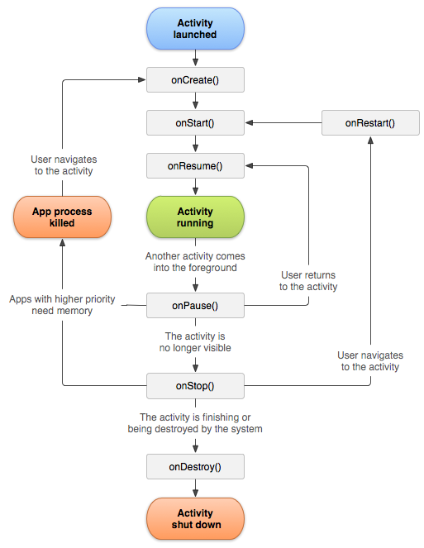
LifeCycle Diagram
Activity is Event Driven Arch
Main Event
onCreate()
Start Activity
Initialize Objects
onStart()
Finish Initialized
onPause()
Other Activity Start
onResume()
Back from Other Activity
onStop()
Don’t back long time

Slide 99
But…
Some Android Camera doesn’t work…
#if !defined(ANDROID_r2_2_0) &&
!defined(ANDROID_r2_3_3) &&
!defined(ANDROID_r3_0_1) &&
!defined(ANDROID_r4_0_0) &&
!defined(ANDROID_r4_0_3) &&
!defined(ANDROID_r4_1_1) &&
!defined(ANDROID_r4_2_0) &&
!defined(ANDROID_r4_3_0)
# error Building camera wrapper for your version of Android is not supported by OpenCV.\
You need to modify OpenCV sources in order to compile camera wrapper for your version of Android.
#endif

Slide 100
Android Camera for Java
android.hardware.Camera
Android Framework’s Class
libcameraservice.so
libcamera_client.so
Absorption for Camera
CameraHardwareInterface
Hardware Camera
android.hardware.Camera
(Java)
Call as Android API
libCameraService.so
(C/C++)
Call as Shared Lib
libCamera_Client.so
(C/C++)
Call as ko Lib
CameraHardwareInterface
(C/ASM)

Slide 101
Android Camera for OpenCV
Directly Call
Libcamera_client.so
Maybe Because…
They avoid overhead in
libcameraservice.so
libcamera_client.so
However…
Their Coding is original,
Some Devices don’t work.
native_camera_rx.x.x.so
(C/C++)
Call as Shared Lib
libCamera_Client.so
(C/C++)
Call as ko Lib
CameraHardwareInterface
(C/ASM)

Slide 102
How to Add New Driver

Slide 103
Kernel/Driver Layer
Android Source Tree
Ex. Nexus7(2013)
Device
Asus
flo
flo-kernel
Hardware
Qcom
audio
bt
camera
display
keymaster
media
msm8960
msm8x74
power
sensors
wlan

Slide 104
How to Add V4L for OpenCV

Slide 105

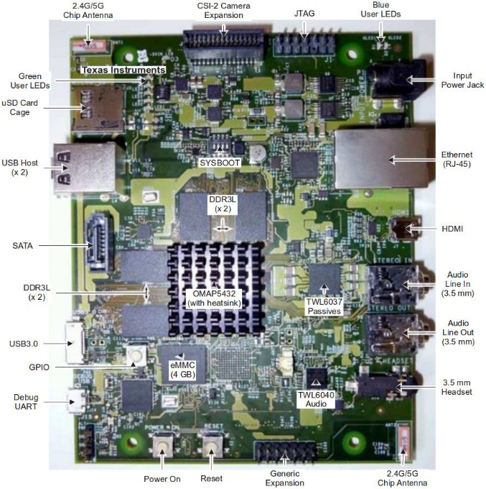
Why?
OpenCV for Android doesn’t have “V4L”.
It use Android build-in Camera.
Except Phone/Table don’t have Camera…
You MUST customize OpenCV for Android.

Slide 106
Add New UVC Driver
drivers/media/video/uvc/uvc_driver.c
Add after “static struct usb_device_id uvc_ids[] = {“
/* Etron Tech */
{ .match_flags = USB_DEVICE_ID_MATCH_DEVICE
| USB_DEVICE_ID_MATCH_INT_INFO,
.idVendor = 0x1e4e,
.idProduct = 0x0104,
.bInterfaceClass = USB_CLASS_VIDEO,
.bInterfaceSubClass = 1,
.bInterfaceProtocol = 0,
.driver_info = UVC_QUIRK_PROBE_MINMAX },

Slide 107
Download & Build kernel
Download & Build kernel
cd ~/nexus_work
export ARCH=arm
export CROSS_COMPILE=~/nexus_work/android/prebuilts/gcc/linux-x86/arm/arm-eabi-4.6/bin/arm-eabi-
git clone https://android.googlesource.com/kernel/msm.git -b android-msm-flo-3.4-jb-mr2 kernel/nexus72
cd kernel/nexus72
make flo_defconfig
make menuconfig
make
cp arch/arm/boot/zImage ~/nexus_work/android/device/asus/flo-kernel/kernel

Slide 108
Change Permission
android/device/asus/flo/ueventd.flo.rc
Change “/dev/video*” Permission
/dev/video* 0666 system camera

Slide 109
Re-Make OTA image
Re-Make OTA image
Require “clean”, because “init.*” doesn’t update.
This file name is
aosp_flo-ota-eng.[your Linux’s User name].zip
cd ~/nexus_work/android/
source build/envsetup.sh
lunch aosp_flo-user
make clean
make otapackage

Slide 110
How to Build OpenCV for V4L
Almost Same in “for Android”
Same Pages are Gray Out

Slide 111
Download OpenCV & NDK tool
wget https://github.com/Itseez/opencv/archive/2.4.7.tar.gz
tar zxfv 2.4.7.tar.gz
mkdir ~/android/
cd ~/android/
wget http://dl.google.com/android/android-sdk_r22.3-linux.tgz
wget http://dl.google.com/android/ndk/android-ndk-r8e-linux-x86_64.tar.bz2
tar zxfv android-sdk_r22.3-linux.tgz
tar jxfv android-ndk-r8e-linux-x86_64.tar.bz2

Slide 112
Edit Setup File
Add Android Source Code directory.
~/opencv-2.4.7/platforms/scripts/cmake_android_service.sh
-DANDROID_SOURCE_TREE=~/nexus_work/android/
cmake -DCMAKE_TOOLCHAIN_FILE=../android/android.toolchain.cmake -DANDROID_TOOLCHAIN_NAME="arm-linux-androideabi-4.4.3" -DANDROID_STL=stlport_static -DANDROID_STL_FORCE_FEATURES=OFF -DBUILD_ANDROID_SERVICE=ON -DANDROID_SOURCE_TREE=~/Projects/AndroidSource/ServiceStub/ $@ ../..

Slide 113
Set Path to SDK/NDK
export ANDROID_NDK=~/android/android-ndk-r8e
export ANDROID_SDK=~/android/android-sdk-linux

Slide 114
Make Version File
Require “AndroidCamera” Func.
Edit Version Number
cp -v ~/nexus_work/android/development/sdk/platform_source.prop_template ~/nexus_work/android/development/sdk/platform_source.properties
Platform.Version=4.3.1

Slide 115
Copy some haeder files & so Libs
Require “AndroidCamera” Func.
cp -aR ~/android/android-ndk-r8e/platforms/android-14/arch-arm/usr/include/EGL ~/opencv-2.4.7/modules/androidcamera/include/
cp -v ~/nexus_work/android/out/target/product/flo/system/lib/libbinder.so $(ANDROID_NDK)/platforms/android-8/arch-arm/usr/lib/
cp -v ~/nexus_work/android/out/target/product/flo/system/lib/libutils.so $(ANDROID_NDK)/platforms/android-8/arch-arm/usr/lib/
cp -v ~/nexus_work/android/out/target/product/flo/system/lib/libandroid_runtime.so $(ANDROID_NDK)/platforms/android-8/arch-arm/usr/lib/

Slide 116
Include new Include File Dir
Android 4.3’s Include File Dir was separated.
~/opencv-2.4.7/platforms/android/service/engine/CMakeLists.txt
include_directories(SYSTEM "${ANDROID_SOURCE_TREE}/frameworks/base/include" "${ANDROID_SOURCE_TREE}/system/core/include") "${ANDROID_SOURCE_TREE}/frameworks/native/include/"

Slide 117
Delete "DetectTegra“ Func
This Android System doesn't have "Tegra“.
~/opencv-2.4.7/platforms/android/service/engine/jni/BinderComponent/TegraDetector.h
int DetectTegra(){};
↓
int DetectTegra(){return NOT_TEGRA;};

Slide 118
Make Define Log Func
Android Logging System was Changed…
Make 『FakeLog.h』 file
~/opencv-2.4.7/platform/android/service/engine/jni/include/
#ifndef __FAKE_LOG_H__
#define __FAKE_LOG_H__
#define LOGD ALOGD
#define LOGI ALOGI
#define LOGE ALOGE
#endif

Slide 119
Include Fake Log Header
~/opencv-2.4.7/platform/android/service/engine/jni/
BinderComponent/BnOpenCVEngine.h
BinderComponent/HardwareDetector.h
JNIWrapper/JavaBasedPackageManager.h
JNIWrapper/OpenCVLibraryInfo.h
#include "FakeLog.h"

Slide 120
Comment Out AndroidCamera 1/2
OpenCV for Android ONLY use AndroidCamera.
~/opencv-2.4.7/modules/highgui/CMakeLists.txt
Change:
Delete:
ocv_add_module(highgui opencv_imgproc OPTIONAL opencv_androidcamera)
↓
ocv_add_module(highgui opencv_imgproc)
list(APPEND highgui_srcs src/cap_android.cpp)

Slide 121
Comment Out AndroidCamera 2/2
OpenCV for Android ONLY use AndroidCamera.
~/opencv-2.4.7/modules/androidcamera/CMakeLists.txt
Delete:
ocv_module_disable(androidcamera)

Slide 122
Comment in V4L 1/2
Enabel V4L in highgui.
~/opencv-2.4.7/modules/highgui/CMakeLists.txt
Add:
~/opencv-2.4.7/modules/highgui/src/cap.cpp
Add in under Functions:
“CV_IMPL CvCapture * cvCreateCameraCapture (int index)”
list(APPEND highgui_srcs src/cap_libv4l.cpp)
list(APPEND highgui_srcs src/cap_v4l.cpp)
return cvCreateCameraCapture_V4L (index);

Slide 123
Comment in V4L 2/2
-DWITH_V4L=ON doesn't work...
~/opencv-2.4.7/modules/highgui/src/cap.cpp
~/opencv-2.4.7/modules/highgui/src/cap_libv4l.cpp
#define HAVE_CAMV4L
#define HAVE_CAMV4L2
#define HAVE_LIBV4L

Slide 124
Copy V4L Header Files
cp -v /usr/include/libv4l1.h ~/opencv-2.4.7/modules/highgui/include/
cp -v /usr/include/libv4l2.h ~/opencv-2.4.7/modules/highgui/include/
cp -v /usr/include/libv4lconvert.h ~/opencv-2.4.7/modules/highgui/include/
cp -v /usr/include/libv4l1-videodev.h ~/opencv-2.4.7/modules/highgui/include/

Slide 125
Delete Java Lib
This Lib require AndroidCamera
rm -fr ~/opencv-2.4.7/modules/java/

Slide 126
Execute Auto Config & make
This Script make Makefile for OpenCV.
In “~/opencv-2.4.7/platforms/scripts/build_android_service”
Make !!!
cd ~/opencv-2.4.7/platforms/scripts/
./cmake_android_service.sh
cd ~/opencv-2.4.7/platforms/scripts/build_android_service/
make

Slide 127
Where are Made Files?
OpenCV Libs.
In “~/opencv-2.4.7/platforms/build_android_service/lib”
highgui
core
etc...
3rd Party Libs for OpenCV.
In “~/opencv-2.4.7/platforms/build_android_service/3rdparty/lib”
libIlmImf
libjasper
libjpeg
libpng
libtiff

Slide 128
How to Use OpenCV for V4L
Almost Same in “for Android”
Same Pages are Gray Out

Slide 129
Use NativeActivity of OpenCV
This Sample uses Only C/C++ Code.
~/opencv-2.4.7/samples/android/native-activity
Structure of NativeActivity
AndroidManifest.xml <- Property File for Android
res <- Directory that has Resource file(Image,Voice)
jni <- Directory that has files for NDK
Android.mk <- make file of NDK
Application.mk <- property file of NDK
native.cpp <- Sample App
Other Files/Dir, don’t use.

Slide 130
Edit AndroidManifest.xml
Replace “application” Section
<application android:label="@string/app_name" android:hasCode="false">
<activity android:name="android.app.NativeActivity"
android:label="@string/app_name"
android:configChanges="orientation|keyboardHidden">
<!-- Tell NativeActivity the name of or .so -->
<meta-data android:name="android.app.lib_name"
android:value="native_activity" />
<intent-filter>
<action android:name="android.intent.action.MAIN" />
<category android:name="android.intent.category.LAUNCHER" />
</intent-filter>
</activity>
</application>

Slide 131
About AndroidManifest.xml
API Level
Permission
<!-- This is the platform API where NativeActivity was introduced. -->
<uses-sdk android:minSdkVersion=“9" />
<uses-permission android:name="android.permission.CAMERA"/>

Slide 132
Edit jni/Application.xml
Change STL Lib
API Level
APP_STL := gnustl_static
↓
APP_STL := stlport_static
APP_PLATFORM := android-9

Slide 133
Edit jni/Android.mk 1/8
Delete
Set OpenCV Libs
include ../../sdk/native/jni/OpenCV.mk
OPENCV_MODULES:=contrib legacy ml stitching objdetect ts videostab video photo calib3d features2d highgui imgproc flann core androidcamera

Slide 134
Edit jni/Android.mk 2/8
Make Loading OpenCV Libs Function
define add_opencv_module
include $(CLEAR_VARS)
LOCAL_MODULE:=opencv_$1
LOCAL_SRC_FILES:=../../opencv-2.4.7/platforms/build_android_service/lib/armeabi-v7a/libopencv_$1.a
include $(PREBUILT_STATIC_LIBRARY)
endef
$(foreach module,$(OPENCV_MODULES),$(eval $(call add_opencv_module,$(module))))

Slide 135
Edit jni/Android.mk 3/8
Set 3rd Party Libs for OpenCV
OPENCV_3RDPARTY_COMPONENTS:=libjpeg libpng libtiff libjasper IlmImf

Slide 136
Edit jni/Android.mk 4/8
Make Loading OpenCV Libs Function
define add_opencv_3rdparty_component
include $(CLEAR_VARS)
LOCAL_MODULE:=$1
LOCAL_SRC_FILES:=../../opencv-2.4.7/platforms/build_android_service/3rdparty/lib/armeabi-v7a/lib$1.a
include $(PREBUILT_STATIC_LIBRARY)
endef
$(foreach module,$(OPENCV_3RDPARTY_COMPONENTS),$(eval $(call add_opencv_3rdparty_component,$(module))))

Slide 137
Edit jni/Android.mk 7/8
Add Magic Word for Reset
Set Include Dir
include $(CLEAR_VARS)
OPENCV_INCLUDE_DIR:=$(LOCAL_DIR)/../opencv-2.4.7/include
LOCAL_C_INCLUDES+=$(OPENCV_INCLUDE_DIR)/opencv $(OPENCV_INCLUDE_DIR)/opencv2 ../opencv-2.4.7/modules/stitching/include ../opencv-2.4.7/modules/objdetect/include ../opencv-2.4.7/modules/photo/include ../opencv-2.4.7/modules/flann/include ../opencv-2.4.7/modules/core/include ../opencv-2.4.7/modules/ts/include ../opencv-2.4.7/modules/highgui/include ../opencv-2.4.7/modules/contrib/include ../opencv-2.4.7/modules/video/include ../opencv-2.4.7/modules/imgproc/include ../opencv-2.4.7/modules/legacy/include ../opencv-2.4.7/modules/ocl/include ../opencv-2.4.7/modules/features2d/include ../opencv-2.4.7/modules/calib3d/include ../opencv-2.4.7/modules/ml/include ../opencv-2.4.7/modules/videostab ../opencv-2.4.7/modules/nonfree/include ../opencv-2.4.7/modules/androidcamera/include

Slide 138
Edit jni/Android.mk 8/8
Add Loading Lib & OpenCV Lib
LOCAL_LDLIBS
-lc -ldl -lz
LOCAL_STATIC_LIBRARIES
$(foreach mod, $(OPENCV_MODULES), opencv_$(mod)) $(OPENCV_3RDPARTY_COMPONENTS)
LOCAL_LDLIBS += -lm -llog -landroid -lc -ldl -lz
LOCAL_STATIC_LIBRARIES := android_native_app_glue $(foreach mod, $(OPENCV_MODULES), opencv_$(mod)) $(OPENCV_3RDPARTY_COMPONENTS)

Slide 139
Setup libv4l for Android
Download libv4l Lib for Android
Set libv4l Lib to NDK
UnPacked & Copy to:
wget http://www.noritsuna.com/download/libv4l_for_android.tar.gz
$(ANDROID_NDK)/source/opencv/

Slide 140
Edit jni/Android.mk Ext-1
Add libv4l Lib in:
Add import-module Func in Last Line
LOCAL_STATIC_LIBRARIES := android_native_app_glue $(foreach mod, $(OPENCV_MODULES), opencv_$(mod)) $(OPENCV_3RDPARTY_COMPONENTS) opencv_libv4l
$(call import-module,opencv/libv4l)

Slide 141
Edit jni/Android.mk Ext-2
If you edited about “AndroidCamera” Libs,
Please Delete it!
Delete AndroidCamera Libs for OpenCV
OPENCV_CAMERA_MODULES:= native_camera_r2.2.0 native_camera_r2.3.3 native_camera_r3.0.1 native_camera_r4.0.0 native_camera_r4.0.3 native_camera_r4.1.1 native_camera_r4.2.0 native_camera_r4.3.0

Slide 142
Edit jni/Android.mk Ext-3
Delete Loading AndroidCamera Libs Function
define add_opencv_camera_module
include $(CLEAR_VARS)
LOCAL_MODULE:=$1
LOCAL_SRC_FILES:=../../opencv-2.4.7/platforms/build_android_service/lib/armeabi-v7a/lib$1.so
include $(PREBUILT_SHARED_LIBRARY)
endef
$(foreach module,$(OPENCV_CAMERA_MODULES),$(eval $(call add_opencv_camera_module,$(module))))

Slide 143
Setup/Make Build.xml 1/2
Making Setting File for Android using ANT
Today, Development on CUI Only!!!
Don’t use Eclipse!
android list target
Available Android targets:
----------
id: 1 or "android-9"
Name: Android 2.3.1
Type: Platform
API level: 9
Revision: 2
Skins: WQVGA400, QVGA, HVGA, WVGA800 (default), WVGA854
ABIs : armeabi
----------
id: 2 or "android-18"
Name: Android 4.3
Type: Platform
API level: 18
Revision: 2
Skins: WXGA800, WQVGA400, QVGA, WQVGA432, WXGA800-7in, WVGA800 (default), HVGA, WXGA720, WSVGA, WVGA854
ABIs : armeabi-v7a
----------

Slide 144
Setup/Make Build.xml 2/2
Make Build.xml
android update project --path . --target 2

Slide 145
Build NativeActivity
Build C/C++ Source Codes
Make APK File
ndk-build [clean all]
ant [debug|release]

Slide 146
Install NativeActivity.apk
Install APK File
UnInstall APK File
Show Log
adb install bin/NativeActivity-debug.apk
adb uninstall com.example.native_activity
adb logcat

Slide 147
How to Add New Native App

Slide 148
How to Develop?
As Linux Application
Non-Standard Android Application
Full Linux C/C++ on Library Layer
Advantage
Use Other Linux Libs
Dis-Advantage
Must Modify Android System
How to Modify on next Lecture
Call Stack
ELF File(Your Application)
(C/C++)
Call as C/C++ APIs
Library Layer + Linux Libs
(C/C++)
Call as SysCall(C/ASM)
Kernel/Driver Layer
(C/ASM)

Slide 149
Make Execute File
Make Dir
hello-exe/
hello-exe/jni
Make Source Code: hello-exe/jni/hello-exe.c
#include <stdio.h>
int main(int argc, char ** argv) {
printf("Hello, world!\n");
return 0;
}

Slide 150
Make Execute File
Make Android.mk
jni/Android.mk
LOCAL_PATH := $(call my-dir)
include $(CLEAR_VARS)
LOCAL_MODULE := hello-exe
LOCAL_SRC_FILES := hello-exe.c
include $(BUILD_EXECUTABLE)

Slide 151
Build Execute File
Build C/C++ Source Codes
Setup & Execute Execute File
Required “root permission”
ndk-build [clean all]
adb push obj/local/armeabi/hello-exe /bin/
adb shell
$ cd bin
$ chmod +x hello-exe
./hello-exe

Slide 152
Setup Exe File with OTA-Build
init.*.rc in Nexus7(2013)
~/nexus_work/android/device/asus/flo/init.flo.rc
Copy your program to OTA-Package
~/nexus_work/android/build/target/product/mini.mk
PRODUCT_COPY_FILES += \
[local program path]:[system path]
Ex.
PRODUCT_COPY_FILES += \
external/myapp/bin/myapp:system/usr/bin/myapp

Slide 153
Init Script on Android
init.*.rc
Auto Run on Boot Format:
service [program name] [program path] [program option]…
[service option]
.
Ex:
service irsc_util /system/bin/logwrapper /system/bin/irsc_util "/etc/sec_config"
class main <- service group
user root <- run user or [group xxx]
oneshot <- run once
Change user/group/permission
chown/chmod
Ex:
chmod 0777 /bin/myapp

Slide 154
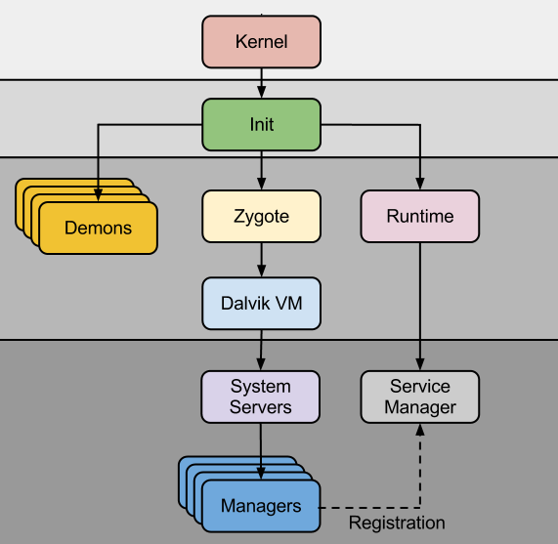
Boot Up Flow Kernel～Android System
Init
Set Permission
Mount Disks
Load Driver
Demons
Linux App
Zygote
Sharing JavaResource Manager
Runtime
Linux SO
Driver

Slide 155
Appendix: How to Setup so File
If you want to use your so file.
How to Setup:
Copy so file to:
PRODUCT_COPY_FILES += \
external/myso/bin/libmyso.so:system/lib/libmyso.so
How to Use:
With NDK. In “Android.mk”:
LOCAL_LDLIBS := -lmyso

