Slide 1
How to Make Android Native Application
Noritsuna Imamura
noritsuna@siprop.org

Slide 2
Agenda
How to Make NativeActivity Application
NativeActivityGlue
How to Draw Something
How to Use Library(OpenCV)
How to Debug NativeActivity Application
Debug
Profiling

Slide 3
How to Make Native Application
with Eclipse

Slide 4
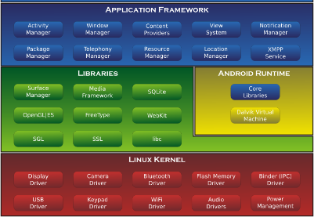





Native Application
NDK wo/ADT
Standard Android Application for C/C++
Only C/C++ on Limited Library Layer
Advantage
Only C/C++
DirectCall C/C++ API
Dis-Advantage
Use a few Android Tools
A few Docs from Google Developer Site & Blogs
Call Stack
APK File(Your Application)
(C/C++)
Call as C/C++ APIs
Library Layer
(C/C++)
Call as SysCall(C/ASM)
Kernel/Driver Layer
(C/ASM)

Slide 5
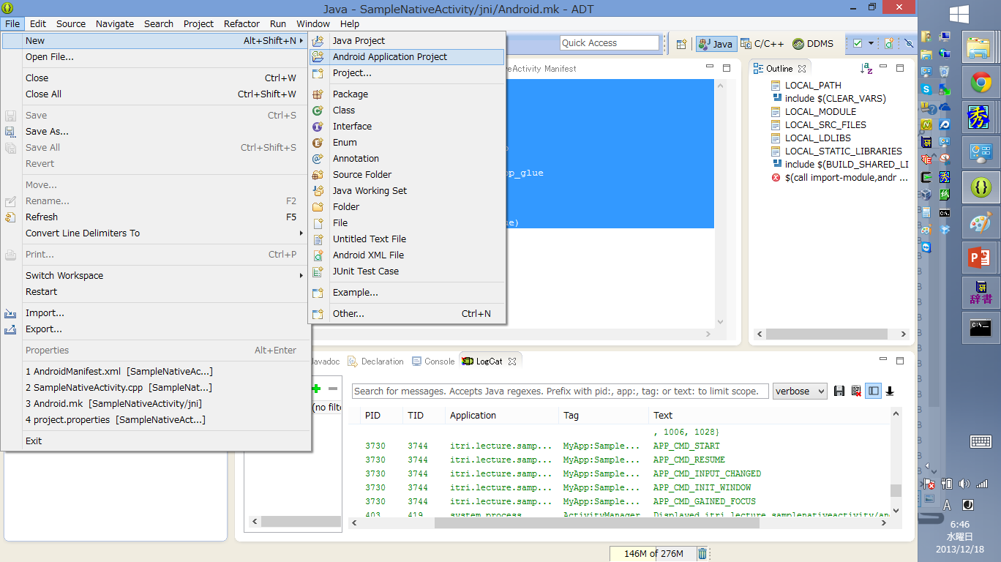
Make Android Project

Slide 6
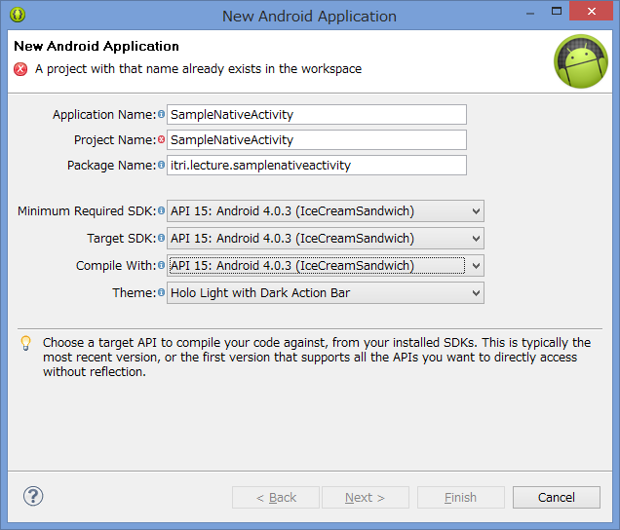
Setup App Name & Target API

Slide 7
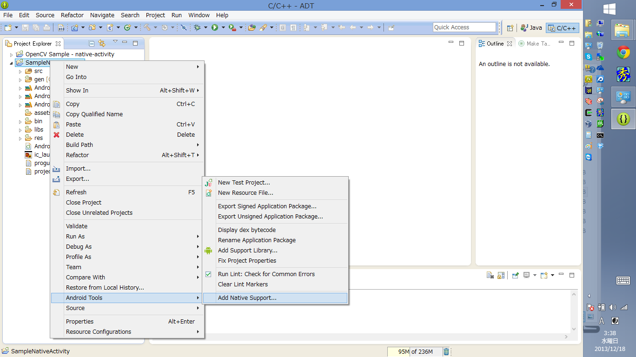
Enable JNI

Slide 8
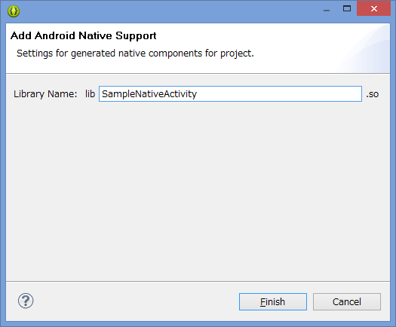
Enable JNI

Slide 9
SampleNativeActivity.cpp
#include <jni.h>

Slide 10
Android.mk
LOCAL_PATH := $(call my-dir)
include $(CLEAR_VARS)
LOCAL_MODULE := SampleNativeActivity
LOCAL_SRC_FILES := SampleNativeActivity.cpp
include $(BUILD_SHARED_LIBRARY)

Slide 11
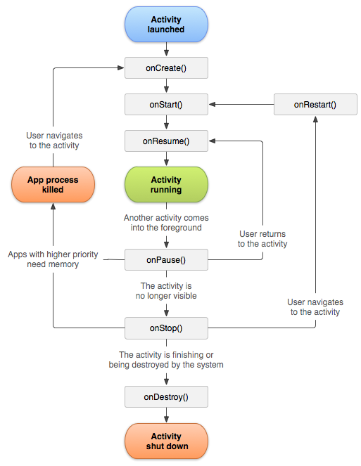
LifeCycle Diagram
Activity is Event Driven Arch
Main Event
onCreate()
Start Activity
Initialize Objects
onStart()
Finish Initialized
onPause()
Other Activity Start
onResume()
Back from Other Activity
onStop()
Don’t back long time

Slide 12
LifeCycle in NativeActivity
[ndk dir]/platforms/android-19/arch-arm/usr/include/android
native-activity.h
typedef struct ANativeActivityCallbacks {
void (*onStart)(ANativeActivity* activity);
void (*onResume)(ANativeActivity* activity);
void* (*onSaveInstanceState)(ANativeActivity* activity, size_t* outSize);
void (*onPause)(ANativeActivity* activity);
void (*onStop)(ANativeActivity* activity);
void (*onDestroy)(ANativeActivity* activity);

Slide 13
NativeActivity CallBacks
NativeActivity | Effect
onStart | = Activity.onStart()
onResume | = Activity.onResume()
onSaveInstanceState | = Activity.onSaveInstanceState()
onPause | = Activity.onPause()
onStop | = Activity.onStop()
onDestroy | = Activity.onDestroy()
onWindowsFocusChanged | Focus of Window was Changed
onNativeWindowCreated | Native Windows was Created
onNativeWindowResized | Native Window was Re-sized
onNativeWindowRedrawNeeded | Native Window was Required Re-Draw
onNativeWindowDestroyed | Native Window was Destroyed
onInputQueueCreated | InputQueue was Created
onInputQueueDestroyed | InputQueue was Destroyed
onContentRectChanged | Drawable Area was Changed (Ex.Keyboard)
onConfiguratinChanged | System Configuration was Changed
onLowMemory | System Memory was Low

Slide 14
Problem Point
You MUST write it as Non-Block Function.
In other word, you MUST use “Thread”.
Thread Programing is sooooo hard…
Why? Go to Next Page!

Slide 15
NativeActivityGlue CallBacks
NativeActivity | NativeActivityGlue
onStart | APP_CMD_START
onResume | APP_CMD_RESUME
onSaveInstanceState | APP_CMD_SAVE_STATE
onPause | APP_CMD_PAUSE
onStop | APP_CMD_STOP
onDestroy | APP_CMD_DESTROY
onWindowsFocusChanged | APP_CMD_GAINED_FOCUS APP_CMD_LOST_FOCUS
onNativeWindowCreated | APP_CMD_INIT_WINDOW
onNativeWindowResized | APP_CMD_WINDOW_RESIZED
onNativeWindowRedrawNeeded | APP_CMD_WINDOW_REDRAW_NEEDED
onNativeWindowDestroyed | APP_CMD_TERM_WINDOW
onInputQueueCreated onInputQueueDestroyed | APP_CMD_INPUT_CHANGED
onContentRectChanged | APP_CMD_CONTENT_RECT_CHANGED
onConfiguratinChanged | APP_CMD_CONFIG_CHANGED
onLowMemory | APP_CMD_LOW_MEMORY

Slide 16
NativeActivityGlue
[NDK dir]/sources/android/native_app_glue
void android_app_pre_exec_cmd(struct android_app* android_app, int8_t cmd) {
switch (cmd) {
case APP_CMD_INPUT_CHANGED:
LOGV("APP_CMD_INPUT_CHANGED\n");
pthread_mutex_lock(&android_app->mutex);
if (android_app->inputQueue != NULL) {
AInputQueue_detachLooper(android_app->inputQueue);
}
android_app->inputQueue = android_app->pendingInputQueue;
if (android_app->inputQueue != NULL) {
LOGV("Attaching input queue to looper");
AInputQueue_attachLooper(android_app->inputQueue,
android_app->looper, LOOPER_ID_INPUT, NULL,
&android_app->inputPollSource);
}
pthread_cond_broadcast(&android_app->cond);
pthread_mutex_unlock(&android_app->mutex);
break;

Slide 17
Sample of NativeActivityGlue
Don’t Need to Use “thread” Funcs.
static void engine_handle_cmd(android_app* app, int32_t cmd) {
Engine* engine = (Engine*)app->userData;
switch (cmd) {
case APP_CMD_INIT_WINDOW:
if (app->window != NULL)
LOGI("APP_CMD_INIT_WINDOW");
break;
case APP_CMD_TERM_WINDOW:
LOGI("APP_CMD_TERM_WINDOW");
break;

Slide 18
Functions that you CAN USE
Build-in Libs: How to Use: -lxx
[NDK DIR]/platforms/android-19/arch-arm/usr/lib
libandroid.so
NativeActivity Lib
libc.so
libstdc++.so
libc
libdl.so
Dynamic Load Lib
libEGL.so
libGLESv1_CM.so
libGLESv2.so
libGLESv3.so
libjnigraphics.so
Graphic Funcs
liblog.so
Logging
libm.so
Math Lib
libOpenMAXAL.so
Media Lib
libOpenSLES.so
Sound Lib
libthread_db.so
thread
libz.so
Zip Lib

Slide 19
Edit jni/Android.mk 8/8
Add Loading Lib & OpenCV Lib
LOCAL_LDLIBS
-lc -ldl -lz
LOCAL_STATIC_LIBRARIES
$(foreach mod, $(OPENCV_MODULES), opencv_$(mod)) $(OPENCV_3RDPARTY_COMPONENTS)
LOCAL_LDLIBS += -lm -llog -landroid -lc -ldl -lz
LOCAL_STATIC_LIBRARIES := android_native_app_glue $(foreach mod, $(OPENCV_MODULES), opencv_$(mod)) $(OPENCV_3RDPARTY_COMPONENTS)

Slide 20
Edit jni/Android.mk 4/8
Make Loading OpenCV Libs Function
define add_opencv_3rdparty_component
include $(CLEAR_VARS)
LOCAL_MODULE:=$1
LOCAL_SRC_FILES:=../../opencv-2.4.7/platforms/build_android_service/3rdparty/lib/armeabi-v7a/lib$1.a
include $(PREBUILT_STATIC_LIBRARY)
endef
$(foreach module,$(OPENCV_3RDPARTY_COMPONENTS),$(eval $(call add_opencv_3rdparty_component,$(module))))

Slide 21
Edit jni/Android.mk 6/8
Make Loading AndroidCamera Libs Function
define add_opencv_camera_module
include $(CLEAR_VARS)
LOCAL_MODULE:=$1
LOCAL_SRC_FILES:=../../opencv-2.4.7/platforms/build_android_service/lib/armeabi-v7a/lib$1.so
include $(PREBUILT_SHARED_LIBRARY)
endef
$(foreach module,$(OPENCV_CAMERA_MODULES),$(eval $(call add_opencv_camera_module,$(module))))

Slide 22
How to Use NativeActivityGlue

Slide 23
Edit AndroidManifest.xml
Replace “application” Section
<application android:label="@string/app_name" android:hasCode="false">
<activity android:name="android.app.NativeActivity"
android:label="@string/app_name"
android:configChanges="orientation|keyboardHidden">
<!-- Tell NativeActivity the name of or .so -->
<meta-data android:name="android.app.lib_name"
android:value=”SampleNativeActivity" />
<intent-filter>
<action android:name="android.intent.action.MAIN" />
<category android:name="android.intent.category.LAUNCHER" />
</intent-filter>
</activity>
</application>

Slide 24
CPP Code of Basicary Format
#include <android_native_app_glue.h>
void android_main() {
// Init Parameters
// Loop
while(1) {
//Do your Program Code
//Drawing to Android Display
if(finish == TRUE) {
// Processing closing
return;
}
}
}

Slide 25
Show Android Event
jni/SampleNativeActivity.cpp
#include <android_native_app_glue.h>
#include <android/log.h>
#define LOG_TAG "MyApp:SampleNativeActivity"
#define LOGD(...) __android_log_print(ANDROID_LOG_DEBUG,LOG_TAG,__VA_ARGS__)
#define LOGI(...) __android_log_print(ANDROID_LOG_INFO,LOG_TAG,__VA_ARGS__)
#define LOGW(...) __android_log_print(ANDROID_LOG_WARN,LOG_TAG,__VA_ARGS__)
#define LOGE(...) __android_log_print(ANDROID_LOG_ERROR,LOG_TAG,__VA_ARGS__)

Slide 26
Show Android Event
jni/SampleNativeActivity.cpp
struct Engine {
struct android_app* app;
};
void android_main(android_app* app) {
// Init Parameters
struct Engine engine;
// It's magic func for NativeActivityGlue.
app_dummy();
// Set UserData
memset(&engine, 0, sizeof(engine));
app->userData = &engine;
app->onAppCmd = engine_handle_cmd;
engine.app = app;

Slide 27
Show Android Event
jni/SampleNativeActivity.cpp
// Loop
while(1) {
// Read all pending events.
int ident;
int events;
android_poll_source* source;
// Process system events
while ((ident=ALooper_pollAll(0, NULL, &events, (void**)&source)) >= 0) {
// Process this event.
if (source != NULL) {
source->process(app, source);
}
//Do your Program Code
//Drawing to Android Display
}
}
}

Slide 28
Show Android Event
jni/SampleNativeActivity.cpp
static void engine_handle_cmd(android_app* app, int32_t cmd) {
Engine* engine = (Engine*)app->userData;
switch (cmd) {
case APP_CMD_START:
LOGI("APP_CMD_START");
break;
case APP_CMD_RESUME:
LOGI("APP_CMD_RESUME");
break;
case APP_CMD_SAVE_STATE:
LOGI("APP_CMD_SAVE_STATE");
break;
case APP_CMD_PAUSE:
LOGI("APP_CMD_PAUSE");
break;
case APP_CMD_STOP:
LOGI("APP_CMD_STOP");
break;
case APP_CMD_DESTROY:
LOGI("APP_CMD_DESTROY");
break;

Slide 29
Show Android Event
Add the Red Lines to Android.mk
LOCAL_PATH := $(call my-dir)
include $(CLEAR_VARS)
LOCAL_MODULE := SampleNativeActivity
LOCAL_SRC_FILES := SampleNativeActivity.cpp
LOCAL_LDLIBS += -llog -landroid
LOCAL_STATIC_LIBRARIES := android_native_app_glue
include $(BUILD_SHARED_LIBRARY)
$(call import-module,android/native_app_glue)

Slide 30
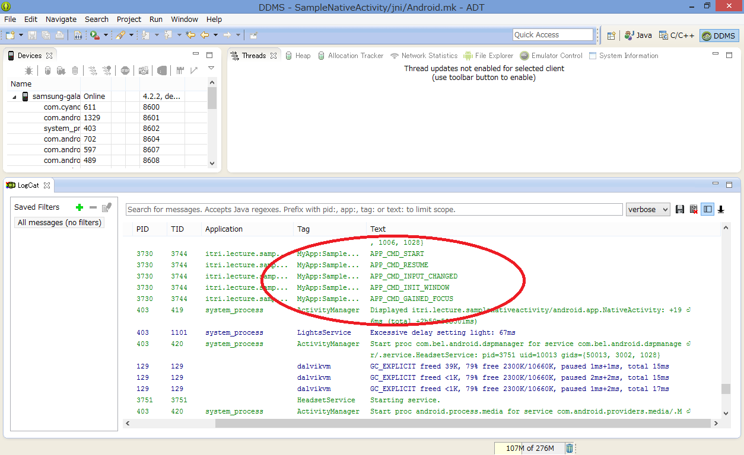

Slide 31
How to Draw Text

Slide 32
How to Draw Text?
NDK doesn’t have this function!!!
You CAN USE Bitmap File Only!!!
Use Open GL/ES
Use OpenCV .

Slide 33
How to Draw Text with OpenCV

Slide 34
Setup OpenCV Libs
Libs
libs_opencv
include Files
jni/include

Slide 35
Edit jni/Android.mk 1/5
After “LOCAL_PATH := $(call my-dir)” Line
include $(CLEAR_VARS)
OPENCV_MODULES:=contrib legacy ml stitching objdetect ts videostab video photo calib3d features2d highgui imgproc flann core
OPENCV_3RDPARTY_COMPONENTS:=tbb libjpeg libpng libtiff libjasper IlmImf

Slide 36
Edit jni/Android.mk 2/5
define add_opencv_module
include $(CLEAR_VARS)
LOCAL_MODULE:=opencv_$1
LOCAL_SRC_FILES:=../libs_opencv/libopencv_$1.a
include $(PREBUILT_STATIC_LIBRARY)
endef
define add_opencv_3rdparty_component
include $(CLEAR_VARS)
LOCAL_MODULE:=$1
LOCAL_SRC_FILES:=../libs_opencv/lib$1.a
include $(PREBUILT_STATIC_LIBRARY)
endef

Slide 37
Edit jni/Android.mk 3/5
include $(CLEAR_VARS)
LOCAL_MODULE:=opencv_info
LOCAL_SRC_FILES:=../libs_opencv/libopencv_info.so
include $(PREBUILT_SHARED_LIBRARY)
$(foreach module,$(OPENCV_MODULES),$(eval $(call add_opencv_module,$(module))))
$(foreach module,$(OPENCV_3RDPARTY_COMPONENTS),$(eval $(call add_opencv_3rdparty_component,$(module))))

Slide 38
Edit jni/Android.mk 4/5
OPENCV_INCLUDE_DIR:=$(LOCAL_DIR)/include
LOCAL_C_INCLUDES+=$(OPENCV_INCLUDE_DIR)

Slide 39
Edit jni/Android.mk 5/5
Add Loading Lib & OpenCV Lib
LOCAL_LDLIBS
-lm -lc -ldl -lz
LOCAL_STATIC_LIBRARIES
$(foreach mod, $(OPENCV_MODULES), opencv_$(mod)) $(OPENCV_3RDPARTY_COMPONENTS)
LOCAL_LDLIBS += -llog -landroid –lm -lc -ldl -lz
LOCAL_STATIC_LIBRARIES := android_native_app_glue $(foreach mod, $(OPENCV_MODULES), opencv_$(mod)) $(OPENCV_3RDPARTY_COMPONENTS)

Slide 40
Application.mk
Create “Application.mk”
APP_STL := gnustl_static
APP_CPPFLAGS := -frtti -fexceptions
APP_ABI := armeabi-v7a
APP_PLATFORM := android-15

Slide 41
SampleNativeActivity.cpp
Init Buffer
case APP_CMD_INIT_WINDOW:
LOGI("APP_CMD_INIT_WINDOW");
{
int view_width = ANativeWindow_getWidth(app->window);
int view_height = ANativeWindow_getHeight(app->window);
// Init Framebuffer
if (ANativeWindow_setBuffersGeometry(app->window, view_width,
view_height, WINDOW_FORMAT_RGBA_8888) < 0) {
LOGE("Cannot set pixel format!");
return;
}
LOGI("cv::Mat initialized at resolution %dx%d", view_width, view_height);
}
break;

Slide 42
SampleNativeActivity.cpp
New Engine
struct Engine {
struct android_app* app;
int init_window;
};

Slide 43
SampleNativeActivity.cpp
static void engine_draw_frame(struct Engine* engine, const cv::Mat& frame) {
if (engine->app->window == NULL) {
// No window.
return;
}
ANativeWindow_Buffer buffer;
if (ANativeWindow_lock(engine->app->window, &buffer, NULL) < 0) {
LOGW("Unable to lock window buffer");
return;
}
{
uint16_t* pixels = (uint16_t*)buffer.bits;
for( int y = 0; y < frame.size().height; y ++ ) {
for( int x = 0; x < frame.size().width; x ++ ) {
cv::Vec3b bgr = frame.at< cv::Vec3b >( y, x );
pixels[x] = make565( bgr[2], bgr[1], bgr[0] );
}
pixels = (uint16_t*)pixels + buffer.stride;
}
}
ANativeWindow_unlockAndPost(engine->app->window);
}

Slide 44
SampleNativeActivity.cpp
// Loop
while(1) {
// Read all pending events.
int ident;
int events;
android_poll_source* source;
// Process system events
while ((ident=ALooper_pollAll(0, NULL, &events, (void**)&source)) >= 0) {
// Process this event.
if (source != NULL) {
source->process(app, source);
}
}
}

Slide 45
SampleNativeActivity.cpp
//Do your Program Code
if (engine.init_window) {
// Init Mat
int view_width = ANativeWindow_getWidth(app->window);
int view_height = ANativeWindow_getHeight(app->window);
cv::Mat img =
cv::Mat::zeros(view_width, view_height, CV_8UC3);
char buffer[256];
sprintf(buffer, "Show Display Size: %dx%d", img.cols, img.rows);
cv::putText(img, std::string(buffer), cv::Point(256,128),
cv::FONT_HERSHEY_COMPLEX_SMALL, 1, cv::Scalar(255,255,255));
//Drawing to Android Display
engine_draw_frame(&engine, img);
}
}

Slide 46
How to Camera with OpenCV

Slide 47
AndroidManifest.xml
Add “Camera” Permissions
<uses-permission android:name="android.permission.CAMERA"/>
<uses-feature android:name="android.hardware.camera" android:required="false"/>
<uses-feature android:name="android.hardware.camera.autofocus" android:required="false"/>
<uses-feature android:name="android.hardware.camera.front" android:required="false"/>
<uses-feature android:name="android.hardware.camera.front.autofocus" android:required="false"/>

Slide 48
Edit jni/Android.mk 1/5
After “LOCAL_PATH := $(call my-dir)” Line
OPENCV_CAMERA_MODULES:= native_camera_r2.2.0 native_camera_r2.3.3 native_camera_r3.0.1 native_camera_r4.0.0 native_camera_r4.0.3 native_camera_r4.1.1 native_camera_r4.2.0 native_camera_r4.3.0
define add_opencv_camera_module
include $(CLEAR_VARS)
LOCAL_MODULE:=$1
LOCAL_SRC_FILES:=../libs_opencv/lib$1.so
include $(PREBUILT_SHARED_LIBRARY)
endef

Slide 49
Edit jni/Android.mk 3/5
LOCAL_SRC_FILES:=../libs_opencv/libopencv_info.so
include $(PREBUILT_SHARED_LIBRARY)
$(foreach module,$(OPENCV_MODULES),$(eval $(call add_opencv_module,$(module))))
$(foreach module,$(OPENCV_3RDPARTY_COMPONENTS),$(eval $(call add_opencv_3rdparty_component,$(module))))
$(foreach module,$(OPENCV_CAMERA_MODULES),$(eval $(call add_opencv_camera_module,$(module))))

Slide 50
SampleNativeActivity.cpp
case APP_CMD_INIT_WINDOW:
LOGI("APP_CMD_INIT_WINDOW");
if (app->window != NULL)
{
LOGI("APP_CMD_INIT_WINDOW");
engine->capture = new cv::VideoCapture(0);
union {double prop; const char* name;} u;
u.prop = engine->capture->get(CV_CAP_PROP_SUPPORTED_PREVIEW_SIZES_STRING);
int view_width = ANativeWindow_getWidth(app->window);
int view_height = ANativeWindow_getHeight(app->window);
cv::Size camera_resolution;
if (u.name)
camera_resolution = calc_optimal_camera_resolution(u.name, 640, 480);
else
{
LOGE("Cannot get supported camera camera_resolutions");
camera_resolution = cv::Size(ANativeWindow_getWidth(app->window),
ANativeWindow_getHeight(app->window));
}
Init Camera

Slide 51
SampleNativeActivity.cpp
if ((camera_resolution.width != 0) && (camera_resolution.height != 0))
{
engine->capture->set(CV_CAP_PROP_FRAME_WIDTH, camera_resolution.width);
engine->capture->set(CV_CAP_PROP_FRAME_HEIGHT, camera_resolution.height);
}
float scale = std::min((float)view_width/camera_resolution.width,
(float)view_height/camera_resolution.height);
if (ANativeWindow_setBuffersGeometry(app->window, (int)(view_width/scale),
int(view_height/scale), WINDOW_FORMAT_RGBA_8888) < 0)
{
LOGE("Cannot set pixel format!");
return;
}
LOGI("Camera initialized at resolution %dx%d", camera_resolution.width, camera_resolution.height);
}
break;
Init Camera

Slide 52
SampleNativeActivity.cpp
New Engine
struct Engine {
struct android_app* app;
cv::Ptr<cv::VideoCapture> capture;
};

Slide 53
SampleNativeActivity.cpp
cv::Mat drawing_frame;
// Loop
while(1) {
// Read all pending events.
int ident;
int events;
android_poll_source* source;
// Process system events
while ((ident=ALooper_pollAll(0, NULL, &events, (void**)&source)) >= 0) {
// Process this event.
if (source != NULL) {
source->process(app, source);
}
}
//Do your Program Code
// Capture frame from camera and draw it
if (!engine.capture.empty()) {
if (engine.capture->grab())
engine.capture->retrieve(drawing_frame, CV_CAP_ANDROID_COLOR_FRAME_RGBA);
engine_draw_frame(&engine, drawing_frame);
}
}

Slide 54
How to Use Debugger

Slide 55
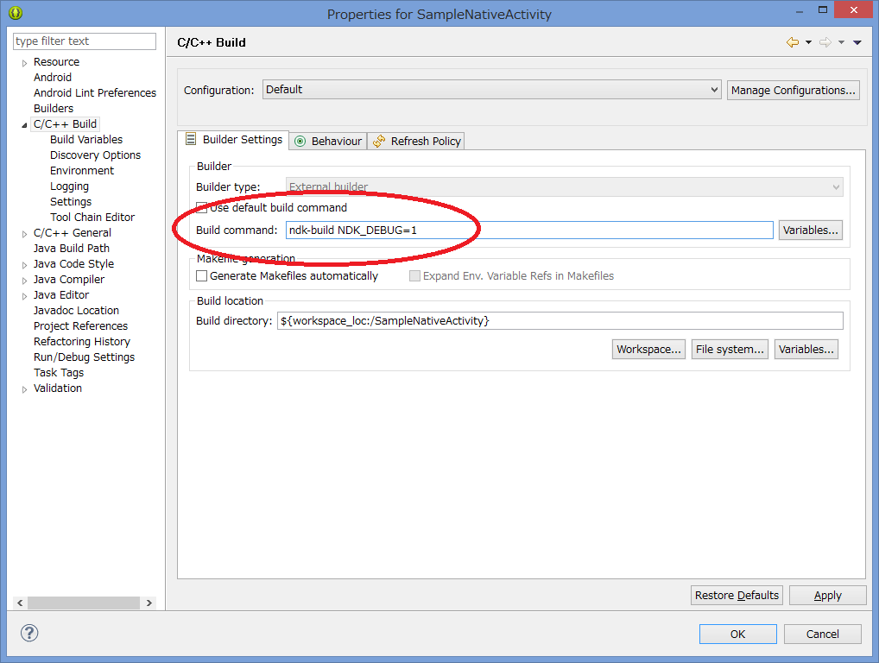
Setup Debug Option

Slide 56
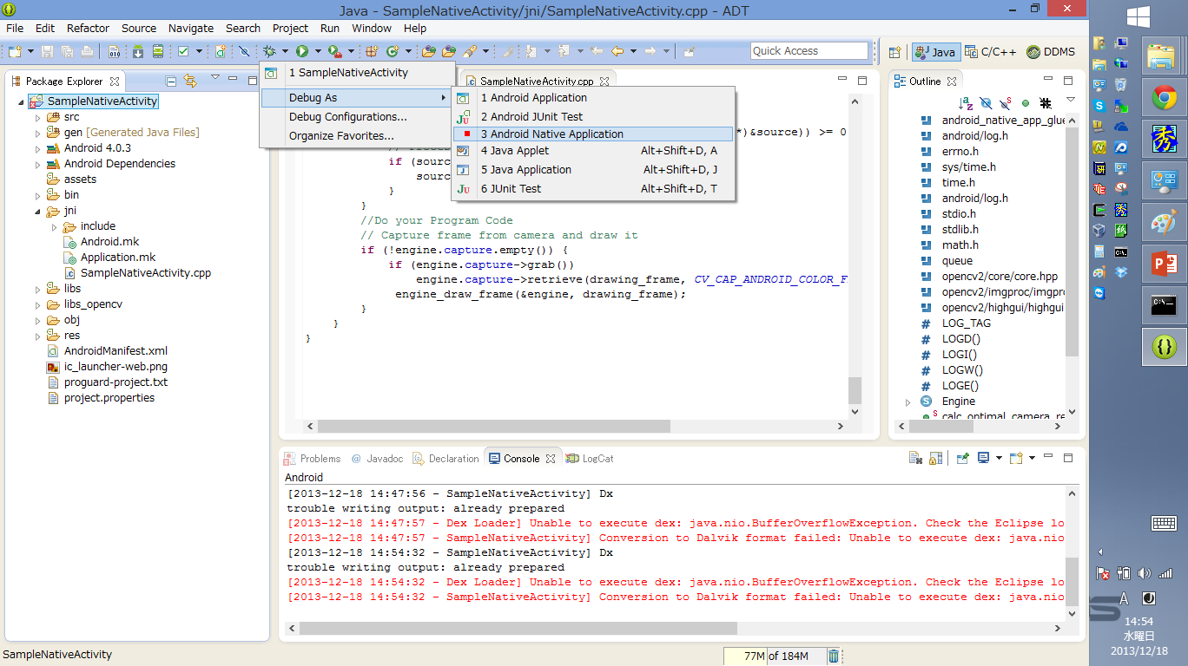
Build as Debug Mode

Slide 57
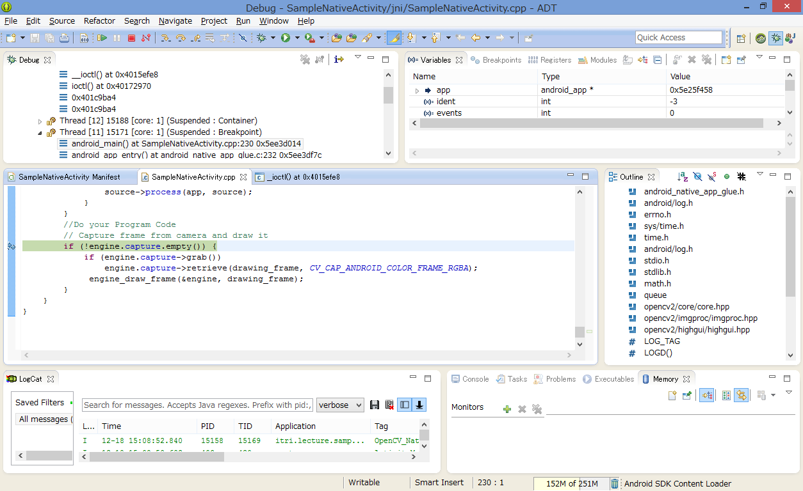
Enjoy Debugging!

Slide 58
How to Use Profiler

Slide 59
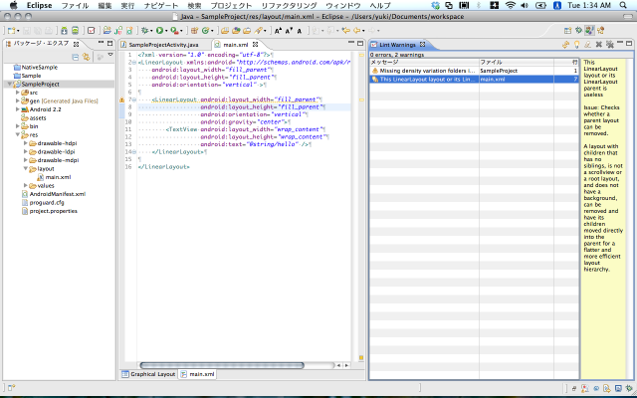
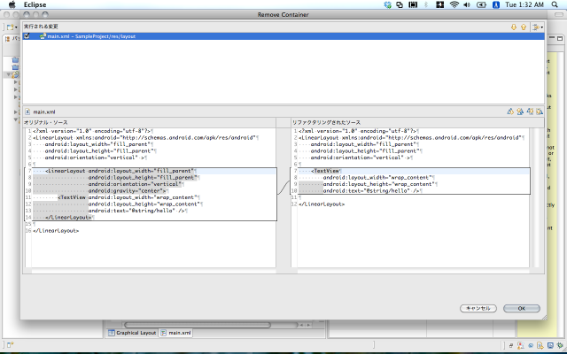
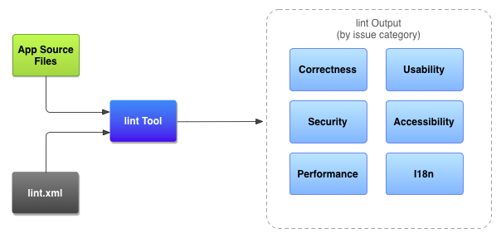
Android SDK Tools 8/12
lint
Optimize Android Applications.
lint | Android Developers
http://developer.android.com/tools/help/lint.html

Slide 60
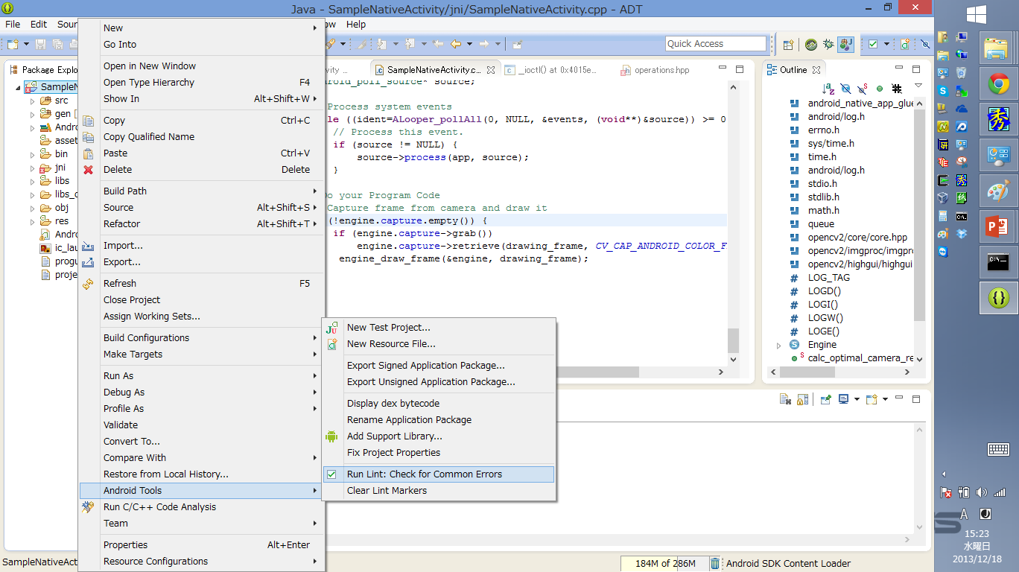
Run lint

Slide 61
Android SDK Tools 6/12
hprof-conv
Convert Android Original Format Heap Memory Dump to Standard Format. Ex. Eclipse Memory Analyzer (MAT)
HPROF Converter | Android Developers
http://developer.android.com/tools/help/hprof-conv.html

Slide 62
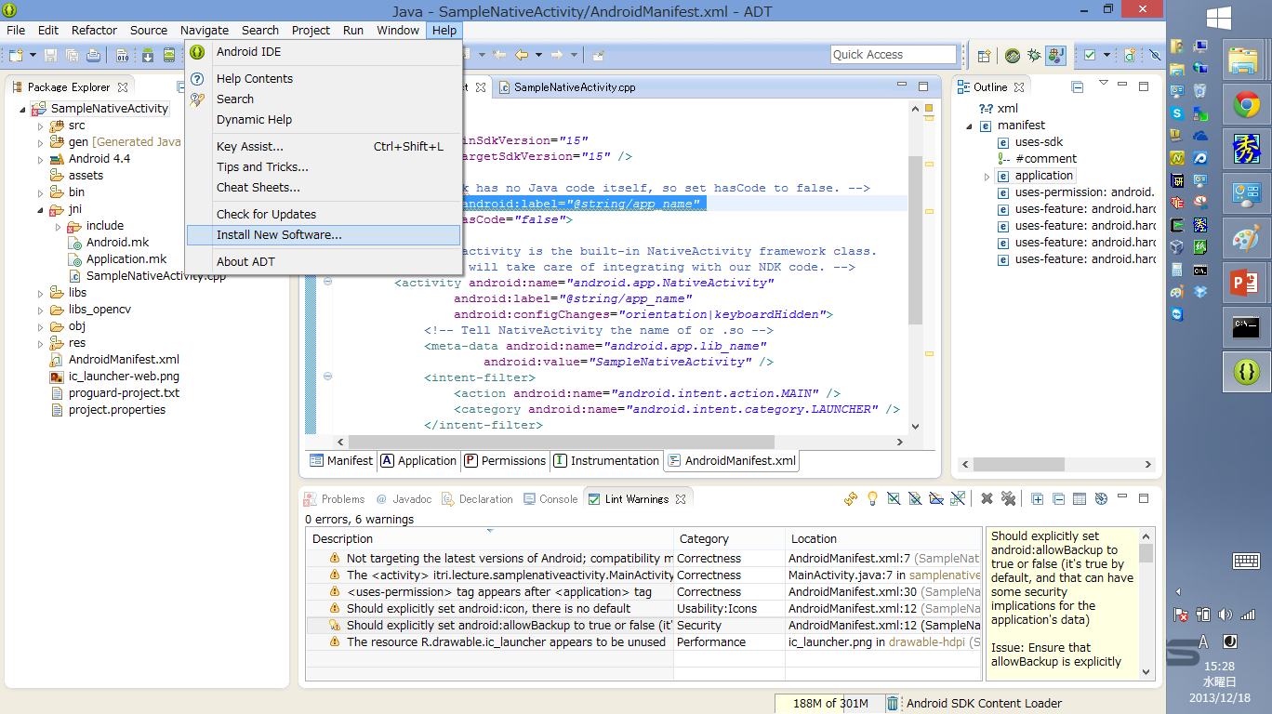
Setup Eclipse Memory Analyzer (MAT)

Slide 63
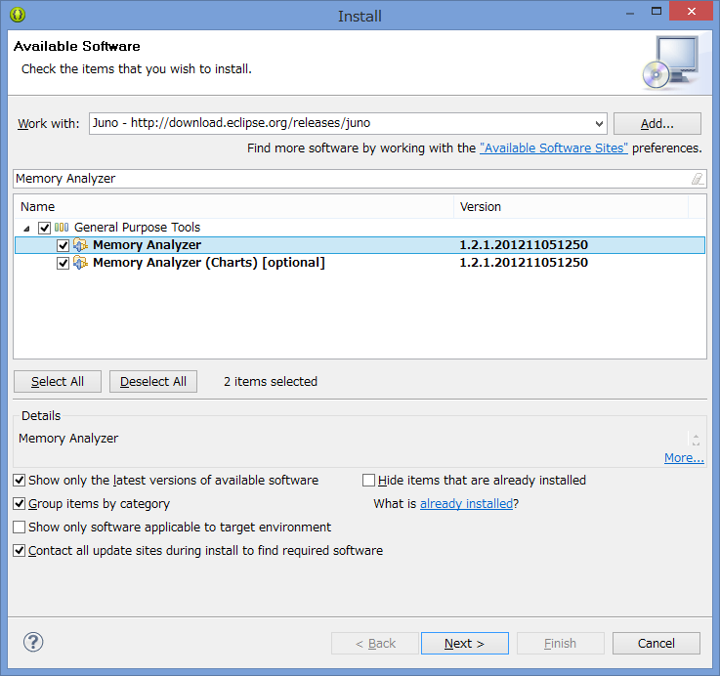
Setup Eclipse Memory Analyzer (MAT)

Slide 64
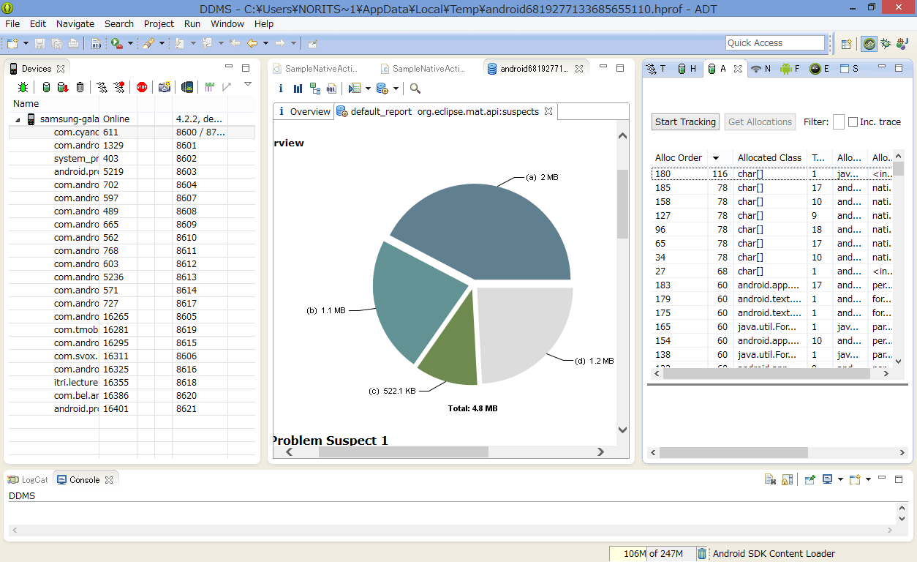
Show HeapMemory

Slide 65
Add Memory Leak Code
char *str = (char *)malloc(10000);
if(engine.counter < 65535) {
engine.leak[engine.counter] = (int)str;
LOGW("Leak Memory!!! %d", (int)str);
} else {
engine.counter = 0;
}

Slide 66
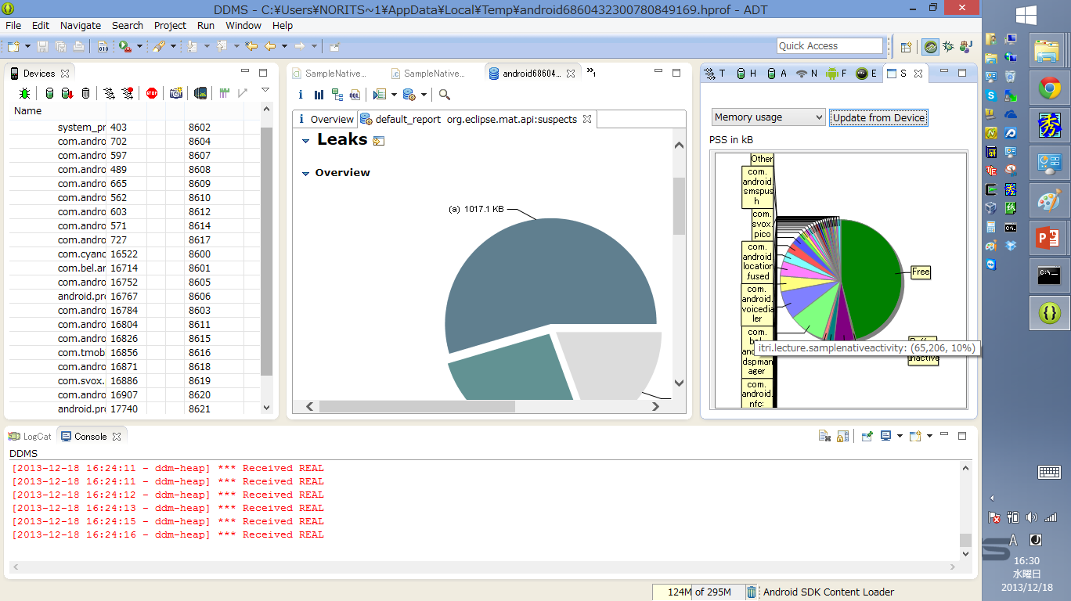
But,,,Java Heap Only

Slide 67
Android SDK Tools 11/12
Systrace
Profiling Tool. Use with Android Device Monitor.
Analyzing Display and Performance with Systrace | Android Developers
http://developer.android.com/tools/debugging/systrace.html
traceview
Show Graphical View from Systrace Data
Traceview | Android Developers
http://developer.android.com/tools/help/traceview.html
deprecated
Android Device Monitor

Slide 68
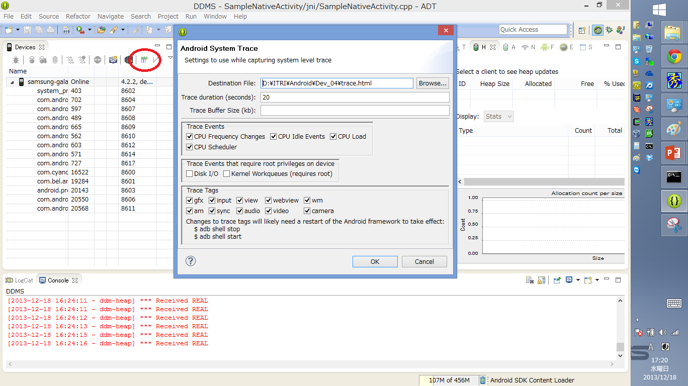
Systrace & TraceView

Slide 69
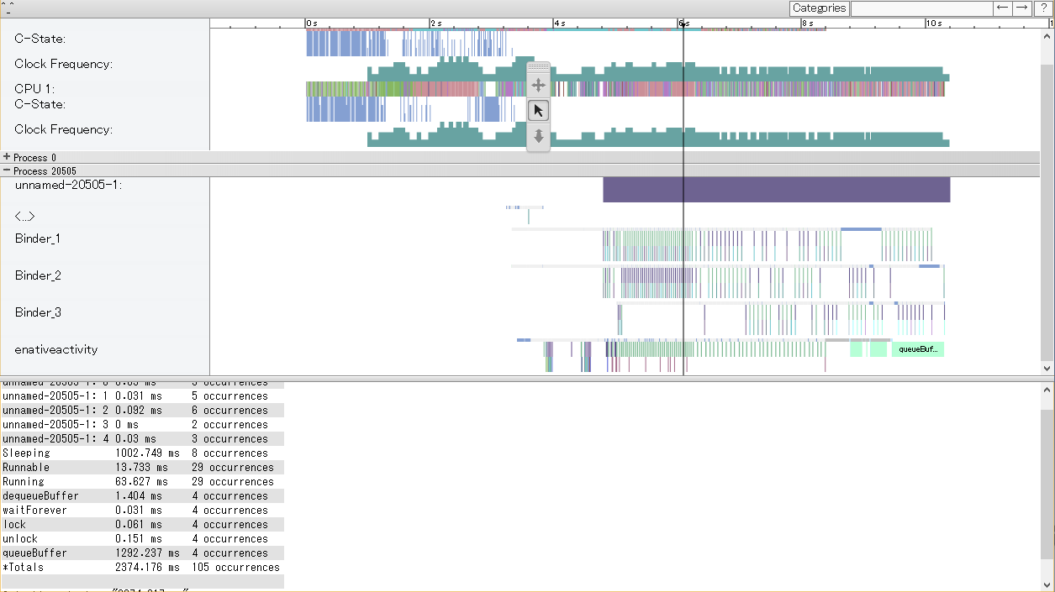
View from Traceview

Slide 70
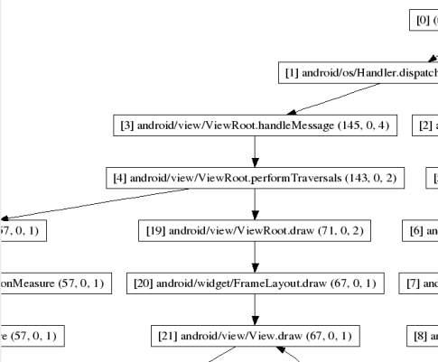
Android SDK Tools 4/12
dmtracedump
Create Graphical Diagram from SysTrace Data
dmtracedump | Android Developers
http://developer.android.com/tools/help/dmtracedump.html

Slide 71
Setup More Tools
Python
http://www.python.org/
Graphviz
http://www.graphviz.org
sudo apt-get install graphviz

Slide 72
How to Use
sdk/tools
dmtracedump
-g [Graph Image Name] [Trace Data]

Slide 73
sdk/platform-tools/systrace/systrace.py
Options
--time=[s]
4.2 and lower
--cpu-freq
--cpu-idle
--cpu-load
--no-cpu-sched
--set-tags=<TAGS>
gfx - Graphics
input - Input
view - View
webview - WebView
wm - Window Manager
am - Activity Manager
sync – Synchronization
audio - Audio
video - Video
camera - Camera
4.3 and Upper
--list-categories
gfx - Graphics
input - Input
view - View
webview - WebView
wm - Window Manager
am - Activity Manager
audio - Audio
video - Video
camera - Camera
hal - Hardware Modules
res - Resource Loading
dalvik - Dalvik VM
rs - RenderScript
sched - CPU Scheduling
freq - CPU Frequency
membus - Memory Bus
Utilization
idle - CPU Idle
disk - Disk input and
output
load - CPU Load
sync - Synchronization
Manager
workq - Kernel
Workqueues

Slide 74
How to User on 4.2
./systrace.py
--cpu-freq --cpu-idle --cpu-load --no-cpu-sched --set-tags=gfx,input,view,webview,wm,am,sync,audio,video,camera
adb shell stop
adb shell start
./systrace.py --time=10 -o mynewtrace.html

Slide 75
If it doesn’t work…
Check these Configuration
kernel config
Kernel hacking ---> Tracers ---> Scheduling Latency Tracer
init.trace.rc
mount debugfs /sys/kernel/debug /sys/kernel/debug

