Slide 1
How to Make Hand Detector
Noritsuna Imamura
noritsuna@siprop.org

Slide 2
Agenda
Preparing
Benchmark
How to Load Files on NativeActivity
How to Make Hand Detector
Calculate Histgram of Skin Color
Detect Skin Area from CapImage
Calculate the Largest Skin Area
Matching Histgrams

Slide 3
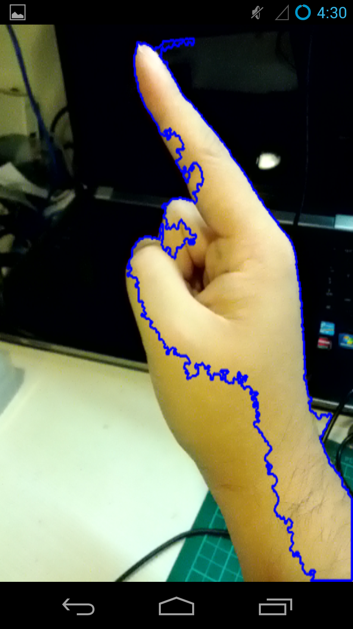
Hand Detector

Slide 4
Chart of Hand Detector
Histgram
Labeling
Convex Hull
Feature Point Distance
Calc Histgram of Skin Color
Detect Skin Area from CapImage
Calc the Leargest Skin Area
Match Histgrams

Slide 5
Mat vs IplImage
Benchmark

Slide 6
About Mat & IplImage
cv::Mat
Version 2.x and Upper
Written by C++
Advantage
Easy to Use
Faster
IplImage
Version 1.x and Upper
Written by C
Advantage
Many Documents
IplImage* img;
for(int h = 0; h < img->height; h++) {
for(int w = 0; w < img->width; w++){
img->imageData[img->widthStep * h + w * 3 + 0]=0;//B
img->imageData[img->widthStep * h + w * 3 + 1]=0;//G
img->imageData[img->widthStep * h + w * 3 + 2]=0;//R
}
}
cv::Mat_<cv::Vec3b> img;
for (int r = 0; r < img.rows; r++ ) {
for(int c = 0; c < img.cols; c++ ) {
cv::Vec3b &v = img.at<cv::Vec3b>(r,c);
v[0] = 0;//B
v[1] = 0;//G
v[2] = 0;//R
}
}

Slide 7
Benchmark on Android
Gray Scale

Slide 8
How to Load File on NativeActivity

Slide 9
AssetManager
“assets” dir is your resource file dir on Android
“res”(resource) dir is also same. But the file that is there is made “Resource ID” by R file.
Ex. I18n
How to Use
NDK with Java
AAssetManager Class (C++)
NativeActivity
No Way……

Slide 10
libassetmanager
assetmanager.h
int setupAsset(const char *package_name);
Copy "assets" directory from APK file to under "/data/data/[Package Name]" directory.
int loadAseetFile(const char *package_name, const char *load_file_name);
Copy File of "load_file_name" from APK file to under "/data/data/[Package Name]/assets" directory.
createAssetFile("assets/images/skincolorsample.jpg");
sprintf(file_path, "%s/%s/%s", DATA_PATH, PACKAGE_NAME, "assets/images/skincolorsample.jpg");
skin_color_sample = cvLoadImage(file_path);

Slide 11
How to Make Hand Detector

Slide 12
Hand Detector

Slide 13
Chart of Hand Detector
Histgram
Convex Hull
Labeling
Feature Point Distance
Calc Histgram of Skin Color
Detect Skin Area from CapImage
Calc the Largest Skin Area
Matching Histgrams

Slide 14
Calculate Histgram of Skin Color

Slide 15
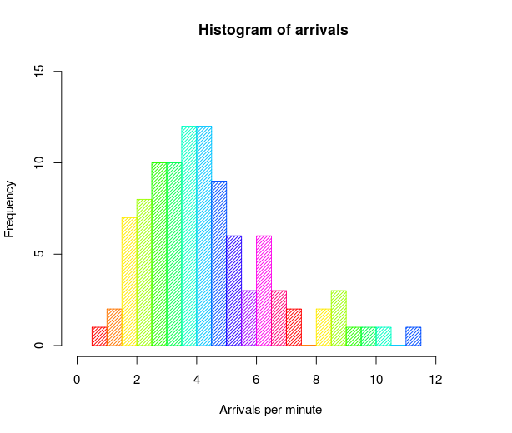

What’s Histgram?
Frequency Distribution Chart.
Why Use it?
For Checking Skin Color.
Each people’s Skin Color
is NOT same.
One of Leveling algorithm.

Slide 16
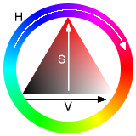
Step 1/2
Convert RGB to HSV
RGB color is changed by Light Color.
Hue
Saturation/Chroma
Value/Lightness/Brightness
cvCvtColor( src, hsv, CV_BGR2HSV );
IplImage* h_plane = cvCreateImage( size, IPL_DEPTH_8U, 1 );
IplImage* s_plane = cvCreateImage( size, IPL_DEPTH_8U, 1 );
IplImage* v_plane = cvCreateImage( size, IPL_DEPTH_8U, 1 );

Slide 17
Step 2/2
cvCreateHist();
Prameter
Dimension of Histgram
Size
Type
Range of limit
Over limit Use or Not
IplImage* planes[] = { h_plane, s_plane };
*hist = cvCreateHist(2,
hist_size,
CV_HIST_ARRAY,
ranges,
1);
cvCalcHist( planes, *hist, 0, 0 );
cvMinMaxLoc(v_plane, vmin, vmax);

Slide 18
Detect Skin Area from CapImage

Slide 19
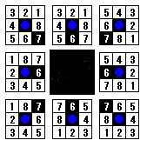
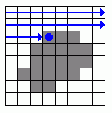
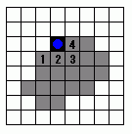
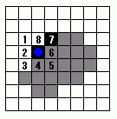
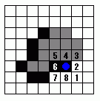
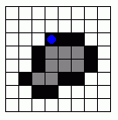
How to Get Skin Area?
Use “Convex Hull” algorithm
Check Image From Left-Top.
Found Black Color Pixel is Start Point.
Search Black Pixel by Right Image.
Go to Black Pixel that First Found, this is next point.
Do 2-4 again, if back to Start Point, get Convex Hull.
※Convert to Black-White Image

Slide 20
Step 1/3
Delete V(Lightness/Brightness) Color
Calculate Back Project Image by Skin Color Histgram.
Threshold by V(Lightness/Brightness) Color.
And Operation between Mask and Back Project.
Threshold to Back Project. (Adjustment)
cvCalcBackProject(planes, backProjectImage, hist);
cvThreshold(v_plane, maskImage, *v_min, *v_max, CV_THRESH_BINARY);
cvAnd(backProjectImage, maskImage, backProjectImage);
cvThreshold(backProjectImage, dstImage, 10, 255, CV_THRESH_BINARY);

Slide 21
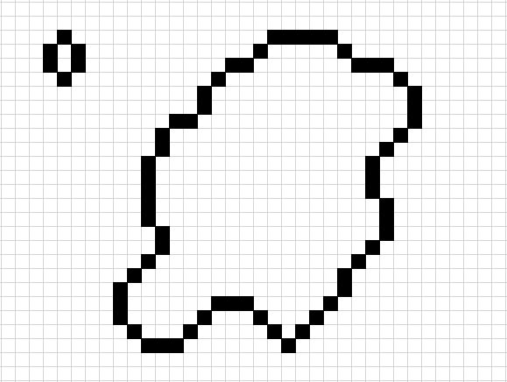
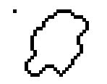
Step 2/3
Noise Reduction
Erode (scale-down)
Dilate (scale-up)
1/4
cvErode(dstImage, dstImage, NULL, 1);
cvDilate(dstImage, dstImage, NULL, 1);

Slide 22
Step 3/3
Convex Hull
cvFindContours();
Source Image
Convex that is detected
First Convex Pointer that detected
cvFindContours(dstImage, storage, &contours);

Slide 23
Calculate the Largest Skin Area

Slide 24
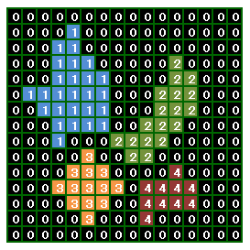
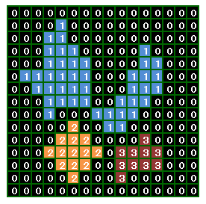
What’s Labeling?
Labeling
Area Marking Algorithm.
4-Connection
8-Connection

Slide 25
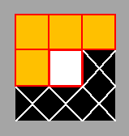
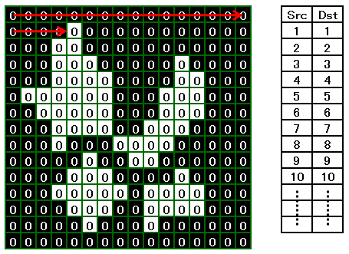
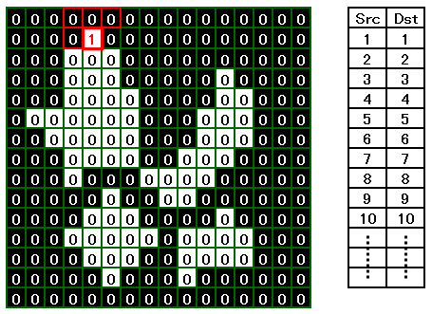
Labeling Algorithm 1/4
1, Scan Image by Raster
2, If you got a White Pixel,
1, Check Right Image Pixels
2, All “0”, Put the Latest Number + 1 in Pixel

Slide 26
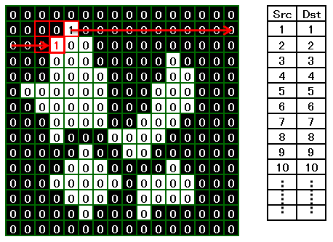
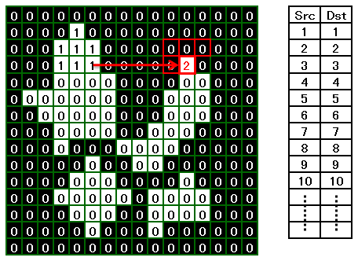
Labeling Algorithm 2/4
1, If you got a White Pixel,
1, Check Right Image Orange Pixels
2, Not “0”,
The Lowest Orange Pixels Number in Pixel

Slide 27
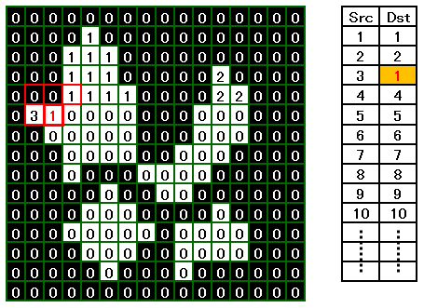
Labeling Algorithm 3/4
1, If got 2 more Number in Orange Pixeles,
1, Put The Lowest Number in Pixel,
Change Other Numbers’ “Look up table”
to The Lowest Number.

Slide 28
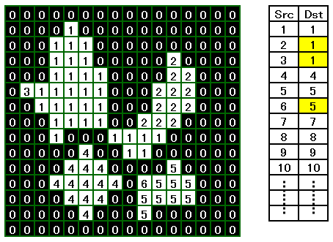
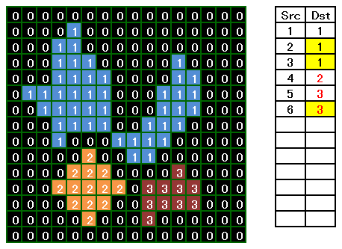
Labeling Algorithm 4/4
1, After finish, Check “Look up Table”.
1, If Dst is NOT Serial Number,
Change to Serial Number
2, Src is changed Dst Number.

Slide 29
Get Area Size
cvContourArea();
for (CvSeq* c= contours; c != NULL; c = c->h_next){
double area = abs(cvContourArea(c, CV_WHOLE_SEQ));
if (maxArea < area) {
maxArea = area;
hand_ptr = c;
}
}

Slide 30
Matching Histgrams

Slide 31
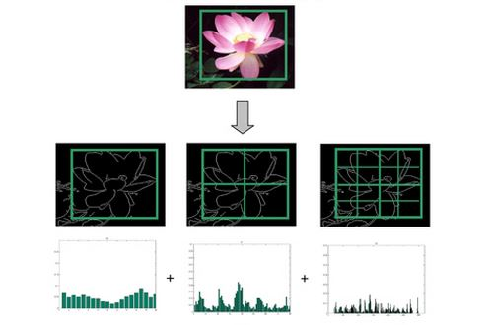
Matching Histgrams
Histgram of Oriented Gradients (HoG)
Split Some Area, And Calc Histgram of each Area.

Slide 32
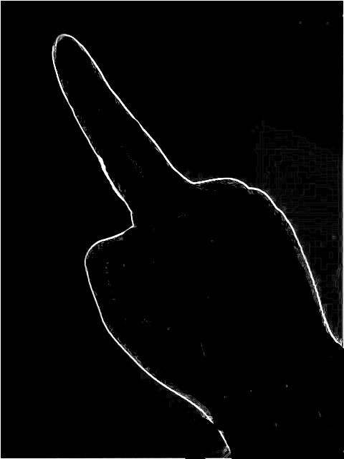
Why Use HoG?
Matching Hand Shape.
Use Feature Point Distance with Each HoG.

Slide 33

Step 1/3
Calculate each Cell (Block(3x3) with Edge Pixel(5x5))
luminance gradient moment
luminance gradient degree=deg
for(int y=0; y<height; y++){
for(int x=0; x<width; x++){
if(x==0 || y==0 || x==width-1 || y==height-1){
continue;
}
double dx = img->imageData[y*img->widthStep+(x+1)] - img->imageData[y*img->widthStep+(x-1)];
double dy = img->imageData[(y+1)*img->widthStep+x] - img->imageData[(y-1)*img->widthStep+x];
double m = sqrt(dx*dx+dy*dy);
double deg = (atan2(dy, dx)+CV_PI) * 180.0 / CV_PI;
int bin = CELL_BIN * deg/360.0;
if(bin < 0) bin=0;
if(bin >= CELL_BIN) bin = CELL_BIN-1;
hist[(int)(x/CELL_X)][(int)(y/CELL_Y)][bin] += m;
}
}

Slide 34
Step 2/3
Calculate Feature Vector of Each Block
(Go to Next Page)
for(int y=0; y<BLOCK_HEIGHT; y++){
for(int x=0; x<BLOCK_WIDTH; x++){
//Calculate Feature Vector in Block
double vec[BLOCK_DIM];
memset(vec, 0, BLOCK_DIM*sizeof(double));
for(int j=0; j<BLOCK_Y; j++){
for(int i=0; i<BLOCK_X; i++){
for(int d=0; d<CELL_BIN; d++){
int index = j*(BLOCK_X*CELL_BIN) + i*CELL_BIN + d;
vec[index] = hist[x+i][y+j][d];
}
}
}

Slide 35
Step 3/3
(Continued)
Normalize Vector
Set Feature Vector
//Normalization of Vector
double norm = 0.0;
for(int i=0; i<BLOCK_DIM; i++){
norm += vec[i]*vec[i];
}
for(int i=0; i<BLOCK_DIM; i++){
vec[i] /= sqrt(norm + 1.0);
}
//Put feat
for(int i=0; i<BLOCK_DIM; i++){
int index = y*BLOCK_WIDTH*BLOCK_DIM + x*BLOCK_DIM + i;
feat[index] = vec[i];
}
}
}

Slide 36
How to Calc Approximation
Calc HoG Distance of each block
Get Average.

Slide 37
Step 1/1
Calulate Feature Point Distance
double dist = 0.0;
for(int i = 0; i < TOTAL_DIM; i++){
dist += fabs(feat1[i] - feat2[i])*fabs(feat1[i] - feat2[i]);
}
return sqrt(dist);

