Slide 1
About OpenGL/ES
Noritsuna Imamura
noritsuna@siprop.org

Slide 2
Agenda
What’s OpenGL?
Kind of OpenGL
Vertions
Hello 3D World
World
Polygon
Projection
Lighting
Texture
Hands on
Use OpenGL/ES 2.0
Shader Programming

Slide 3

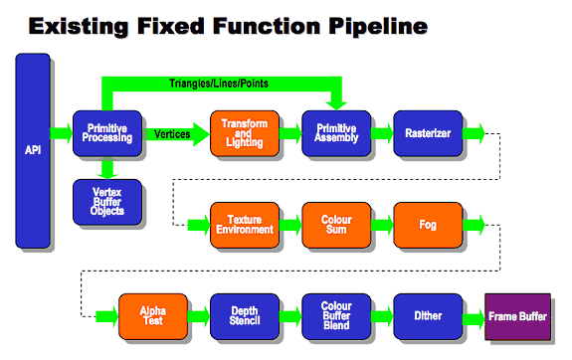
What’s OpenGL?
OpenGL is 3D Graphic API.
Made by SGI
Since: 1992
Current Version: 4.4
Architecture: PIPE Line Process

Slide 4
What’s OpenGL/ES?
OpenGL is 3D Graphic API for Embedded.
Subset from OpenGL
Since: 2003
Current Version: 3.0
Android Version | Android API Level | OpenGL/ES
1.0(Apple Pie) | 1 | 1.0, 1.1
2.2(Froyo) | 8 | 2.0
4.3(JerryBeans) | 18 | 3.0

Slide 5

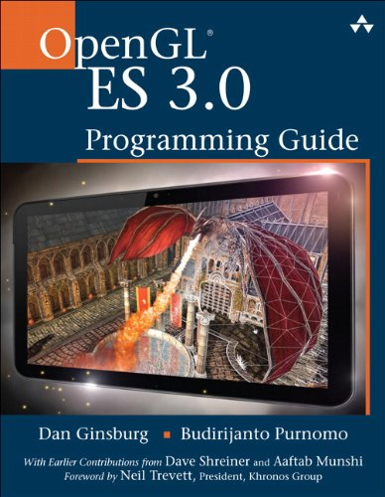
Bible of OpenGL/ES
OpenGL/ES 2.0 Programming Guide
http://www.amazon.com/dp/0321502795/
OpenGL/ES 3.0 Programming Guide
http://www.amazon.com/dp/0321933885/

Slide 6
Function | 1.0/1.1 | 2.0 | 3.0
Compatibility | ー | ー | 2.0
Programmable Shader | ー | GLSL ES 1.0 | GLSL ES 3.0
Transform Feedback | ー | ー | Supported
Geometry | glNormal glVertexPointer glNormalPointer glTexCordPointe | glVertexAttribPointer | glVertexAttribPointer
Matrix | glMatrixMode glLoadIdentity glPushMatrix | ー | ー
Lighting | glLight/glMaterial | ー | ー
Fog | glFog | ー | ー
Alpha Test | glAlphaFunc | ー | ー
Point Stripe | glTexEnv | ー | ー
User Clip | glClipPlane | ー | ー
Logic Operation | glLogicOp | ー | ー
FrameBuffer Object | Option | Supported | Supported Multi-Buffer

Slide 7
Hello 3D World!!!

Slide 8
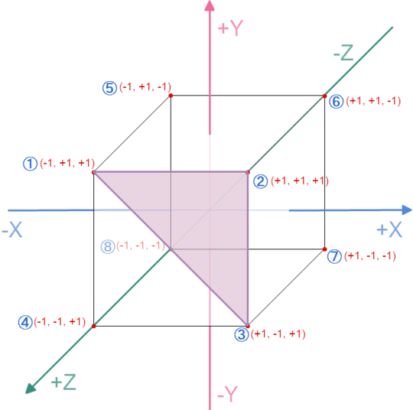
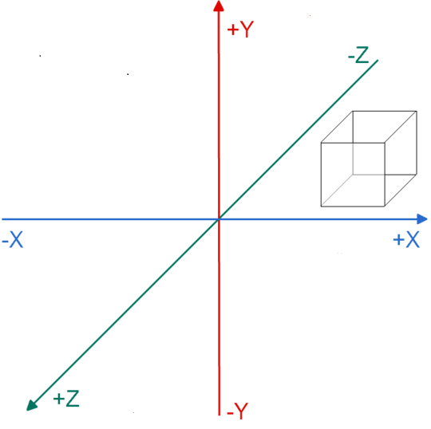





What’s 3D World?
Frame of Reference
World
Model(Object)
Coordinates
Vertex
Index

Slide 9
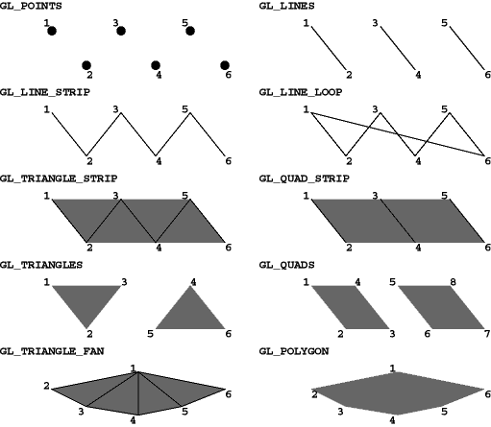
How to Draw Polygon?
TRIANGLE_STRIP
Joint 2 Points
TRIANGLES
Draw each Triangle
TRIANGLE_FAN
Joint 2 Points, but MUST use 1st Point
QUAD_STRIP
Joint 2 Points
QUAD
Draw each Square
POLYGON
Draw as Polygon

Slide 10
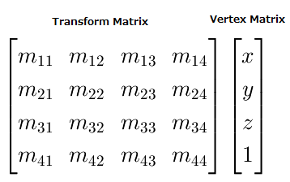
How to Set in the World?
After Making Model, Set it to the World Frame.
Affine Transform

Slide 11
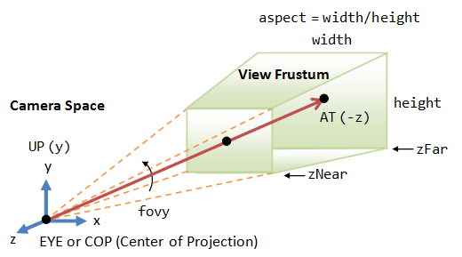
Where is your Viewpoint(Viewport)?
Perspective Projection
zNear
Minimum Viewpoint of Z-Axis
zFar
Maximum Viewpoint of Z-Axis
fovy
Angle of view of Y-Axis
aspect
Width/height of RealWindow

Slide 12
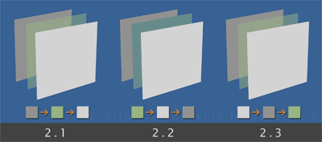
Can you see them?
Z-Buffer
ON => Draw by Z-Axis
OFF => Draw by Sort of Drawing
Alpha Blending
ON => Color is Blended with Back Model
OFF => No See

Slide 13
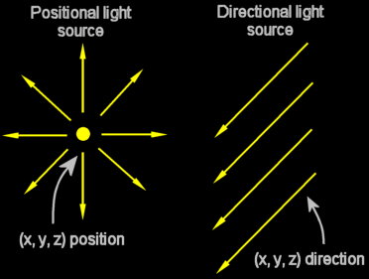
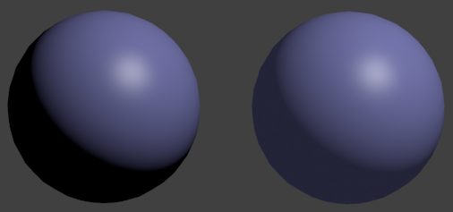
There is Dark…
Positional Light
Radiate in all directions
Directional Light
Parallel in all directions

Slide 14


Bad Surface…
Put Texture Image to Model.
UV-Mapping (U-horizontal, V-vertical)
Set Relation Between Texture Pixel and Model Vertex.

Slide 15
How to Programing?
Use Fixed Function Pipeline in OpenGL/ES 1.1
glScale(x, y, z),
glRotate(Angle, x_moment, y_moment, z_moment)
glTranslate(x, y, z)

Slide 16
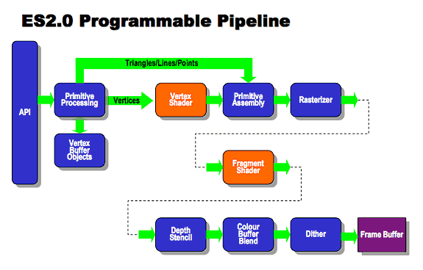
How to Programing in 2.0or3.0?
Use Programmable Pipeline
VertexShader
FragmentShader

Slide 17
Function | 1.0/1.1 | 2.0 | 3.0
Compatibility | ー | ー | 2.0
Programmable Shader | ー | GLSL ES 1.0 | GLSL ES 3.0
Transform Feedback | ー | ー | Supported
Geometry | glNormal glVertexPointer glNormalPointer glTexCordPointe | glVertexAttribPointer | glVertexAttribPointer
Matrix | glMatrixMode glLoadIdentity glPushMatrix | ー | ー
Lighting | glLight/glMaterial | ー | ー
Fog | glFog | ー | ー
Alpha Test | glAlphaFunc | ー | ー
Point Stripe | glTexEnv | ー | ー
User Clip | glClipPlane | ー | ー
Logic Operation | glLogicOp | ー | ー
FrameBuffer Object | Option | Supported | Supported Multi-Buffer

Slide 18
What’s Programmable Shader?
Shader(Renderer) that use GLSL (OpenGL Shading Language).
Vertex Shader
Convert Model Information to World Frame
Geometry Shader (Primitive Shader)
Convert Primitive Data
Pixel Shader (Fragment Shader)
Effect to Each Pixels
Ex. Fogging, Shadowing, …

Slide 19
Hello 3D Programming World!!!

Slide 20
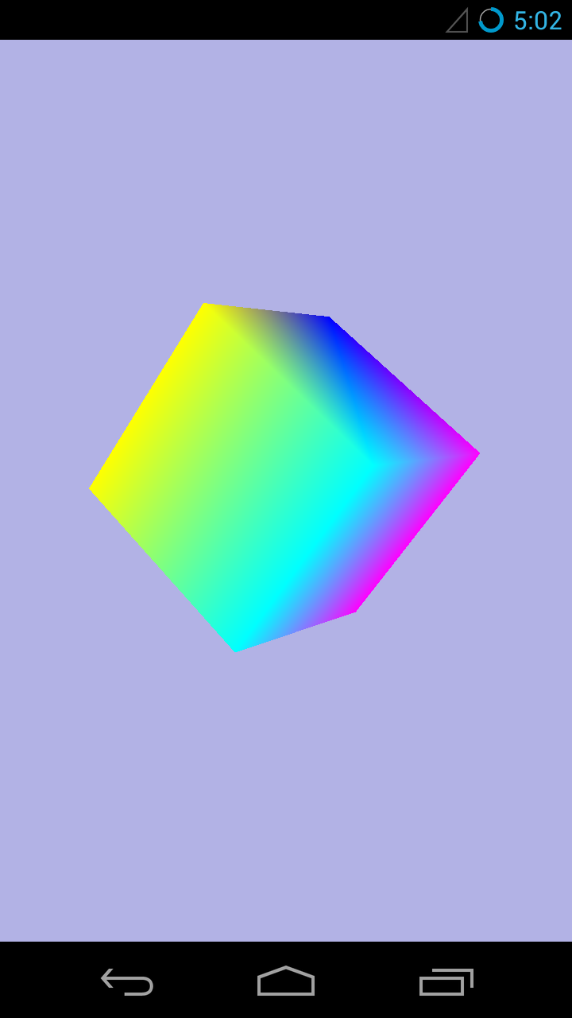
Today’s Target

Slide 21
Naming Rule of Functions
glXXX
OpenGL Func
eglXXX
OpenGL/ES Func
gluXXX
GUI Tools of Func
AGL, GLX, WGL
glutXXX
GLUT Func
GLUT is GUI Tools of 3rd Party
yyXXXf
float
yyXXXd
double
yyXXXi
int
yyXXX2d
2D of Double
yyXXX3d
3D of Double

Slide 22
Setting Files
AndroidManifest.xml
jni/Android.mk
<uses-feature android:glEsVersion="0x00020000"/>
LOCAL_LDLIBS += -lm -llog -lc -ldl -lz -landroid -lEGL -lGLESv2

Slide 23
Init EGL World(System) 1/2
Configuration
const EGLint attribs[] = {
// Uset Open GL ES 2.0
EGL_RENDERABLE_TYPE, EGL_OPENGL_ES2_BIT,
// Set Surface Type as Double Buffer
EGL_SURFACE_TYPE, EGL_WINDOW_BIT,
// Minimum Frame Size of Blue
EGL_BLUE_SIZE, 8,
// Minimum Frame Size of Green
EGL_GREEN_SIZE, 8,
// Minimum Frame Size of Red
EGL_RED_SIZE, 8,
// Size of Depth Buffer
EGL_DEPTH_SIZE, 16,
// Terminator
EGL_NONE
};

Slide 24
Init EGL World(System) 2/2
Init & Create
// Get EGL Display Connection
EGLDisplay display = eglGetDisplay(EGL_DEFAULT_DISPLAY);
// Init Display
eglInitialize(display, 0, 0);
// Choose Frame Buffer List
eglChooseConfig(display, attribs, &config, 1, &numConfigs);
// Get Frame Buffer Setting
eglGetConfigAttrib(display, config, EGL_NATIVE_VISUAL_ID, &format);
// Set Frame Buffer to NativeActivity
ANativeWindow_setBuffersGeometry(engine->app->window, 0, 0, format);
// Get Window Surface
surface = eglCreateWindowSurface(display, config, engine->app->window, NULL);
// Get Rendering Context
const EGLint attrib_list[] = { EGL_CONTEXT_CLIENT_VERSION, 2, EGL_NONE };
context = eglCreateContext(display, config, NULL, attrib_list);
// Attach Rendering Context to Window Surface
eglMakeCurrent(display, surface, surface, context);

Slide 25
Init Cube Data
Create Programmable Shader!
glMyModel.cpp -> initCube()
// Create Shader Program
glProgram_Cube = createProgram(gVertexShader_cube, gFragmentShader_cube);
// Bind Vertex to "Position" in VertexShader Program
glBindAttribLocation(glProgram_Cube, ATTRIB_VERTEX, "Position");
// Bind Color to "SourceColor" in VertexShader Program
glBindAttribLocation(glProgram_Cube, ATTRIB_COLOR, "SourceColor");
// Set program
glUseProgram(glProgram_Cube);

Slide 26
Setting of Programmable Shader
Write Shader Program using GLSL ES
Vertex Shader Source Code
// Vertex Shader Program
static const char gVertexShader_cube[] =
"attribute vec4 Position; \n"
"attribute vec4 SourceColor; \n"
"varying vec4 DestinationColor;\n"
"uniform mat4 Projection; \n"
"uniform mat4 Modelview; \n"
"void main() {\n"
" gl_Position = Projection * Modelview * Position; \n"
" DestinationColor = SourceColor; \n"
"}\n";

Slide 27
Setting of Programmable Shader
Fragment Shader Source Code
// FragmentShader of Color
static const char gFragmentShader_cube[] =
"varying lowp vec4 DestinationColor; \n"
"void main() {\n"
"gl_FragColor = DestinationColor;\n"
"}\n";

Slide 28
About GLSL: Type
Type | Meaning
void | Same in C Lang
bool | Same in C++ Lang
int | Same in C Lang
float | Same in C Lang
vecX | Vector Type
bvecX | Logical Vector Type
ivecX | Int Vector Type
matX | Matrix Type
samplerXD | Handler of Texture
sampleCube | Handler of Cubic Texture
samplerXDShadow | Handler of Depth Texture
http://www.opengl.org/registry/doc/GLSLangSpec.4.20.8.clean.pdf

Slide 29
About GLSL: Value
Value | Meaning
const | Same in C Lang
uniform | Global Value
in(Varying) | Input Value
out(Varying) | Output Value
inout(Varying) | Input/Output Value

Slide 30
About GLSL: Built-in Function
Function Name | Meaning
radians() | degrees to radians
degrees() | radians to degrees
sin() | Sine
cos() | Cosine
tan() | Tangent
texture() | Set Texture
texture3D() | Set 3D Texture
imageLoad() | Load Image File
imageStore() | Store Image File

Slide 31
About GLSL: Built-in Value
Value Name | Type | Meaning
gl_Vertex | vec4 | Vertex Coordinates
gl_Normal | vec3 | Vertex Normal vector
gl_Color | Vec4 | Vertex Color
gl_ModelViewMatrix | mat4 | ModelView Matrix
gl_ProjectionMatrix | mat4 | Projection Matrix
gl_FrontColor | Vec4 | Front Color
gl_BackColor | Vec4 | Back Color
gl_TextCoord[] | Vec4 | Texture Coordinates
gl_Position | Vec4 | Vertex Position
gl_FragColor | Vec4 | Color Frag
gl_FlagDepth | float | Depth Frag

Slide 32
Check createProgram() Func
glPGShaderTools.cpp
NOT built-in Function. Everyone write same way.
GLuint createProgram(const char* pVertexSource, const char* pFragmentSource) {
GLuint vertexShader = loadShader(GL_VERTEX_SHADER, pVertexSource);
if (!vertexShader)
return 0;
GLuint pixelShader = loadShader(GL_FRAGMENT_SHADER, pFragmentSource);

Slide 33
Set Projection
glPGShaderTools.cpp -> prepareFrame()
getPerspective() is NOT built-in…
OpenGL/ES Version… All Built-in…
GLint projectionUniform = glGetUniformLocation(glProgram, "Projection");
mat4 projectionMatrix = getPerspective(45, (float) width / height, 0.5f, 500);
glUniformMatrix4fv(projectionUniform, 1, 0, projectionMatrix.Pointer());
glMatrixMode(GL_PROJECTON);
glLoadIdentity();
gluPerspective(45, (float)width / height, 0.5f, 500);

Slide 34
Where is your Viewpoint(Viewport)?
Perspective Projection
zNear
Minimum Viewpoint of Z-Axis
zFar
Maximum Viewpoint of Z-Axis
fovy
Angle of view of Y-Axis
aspect
Width/height of RealWindow

Slide 35
Draw Cube! 1/2
glMyModels.cpp -> drawCube()
Check Matrix.hpp & Vertex.hpp
They have “Affine Transform” Code…
Affine Transform Built-in Func is in OpenGL/ES 1.1…
// Pose for Cube
mat4 rotationX = mat4::RotateX(engine->angleX);
mat4 rotationY = mat4::RotateY(engine->angleY);
mat4 rotationZ = mat4::RotateZ(engine->angleZ);
mat4 scale = mat4::Scale(1.0);
mat4 translation = mat4::Translate(0, 0, -10);
mat4 modelviewMatrix = scale * rotationX * rotationY * rotationZ *translation;
// Set pose
int modelviewUniform = glGetUniformLocation(glProgram_Cube, "Modelview");
glUniformMatrix4fv(modelviewUniform, 1, 0, modelviewMatrix.Pointer());

Slide 36
Draw Cube! 2/2
Draw Cube Polygon
// Set Vertex Array
glVertexAttribPointer(ATTRIB_VERTEX, 3, GL_FLOAT, GL_FALSE, 0, cubeVertices);
// Set Color Array
glVertexAttribPointer(ATTRIB_COLOR, 4, GL_FLOAT, GL_FALSE, 0, cubeColors);
//Enabled
glEnableVertexAttribArray(ATTRIB_VERTEX);
glEnableVertexAttribArray(ATTRIB_COLOR);
// Draw
glDrawElements(GL_TRIANGLE_STRIP, 14, GL_UNSIGNED_SHORT, cubeIndices);

Slide 37
Vertex of Cube
Draw Cube Polygon
// Vertex List of Cube
const GLfloat cubeVertices[] = {
/* x y z */
-1.0, -1.0, 1.0, //0
1.0, -1.0, 1.0, //1
-1.0, 1.0, 1.0, //2
1.0, 1.0, 1.0, //3
-1.0, -1.0, -1.0, //4
1.0, -1.0, -1.0, //5
-1.0, 1.0, -1.0, //6
1.0, 1.0, -1.0, //7
};

Slide 38
How to Draw Polygon?
TRIANGLE_STRIP
Joint 2 Points
TRIANGLES
Draw each Triangle
TRIANGLE_FAN
Joint 2 Points, but MUST use 1st Point
QUAD_STRIP
Joint 2 Points
QUAD
Draw each Square
POLYGON
Draw as Polygon

Slide 39
Today’s Target

Slide 40
What’s Multi Core Compiler?
Noritsuna Imamura
noritsuna@siprop.org

Slide 41
Today’s Topic
Compiler
≠ Not Thread Programming

Slide 42
Agenda
Parallel Compiler
OpenMP
NEON

Slide 43
What’s Parallelizing Compiler?
Automatically Parallelizing Compiler
Don’t Need “Multi-Core” programming,
Compiler automatically modify “Multi-Core” Code.
Intel Compiler
Only IA-Arch
OSCAR(http://www.kasahara.elec.waseda.ac.jp)
Not Open
Hand Parallelizing Compiler
Need to Make “Multi-Core” programming,
But it’s easy to Make “Multi-Core” Code.
“Multi-Thread” Programming is so Hard.
Linda
Original Programming Language
OpenMP

Slide 44
OpenMP

Slide 45

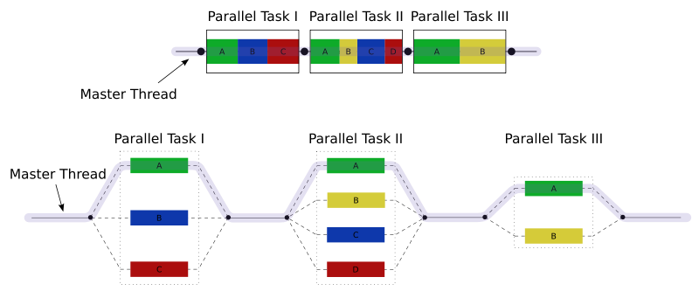
What’s OpenMP?
Most Implemented Hand Parallelizing Compiler.
Intel Compiler, gcc, …
※If you use “parallel” option to compiler, OpenMP compile Automatically Parallelizing.
Model: Join-Fork
Memory: Relaxed-Consistency
Documents
http://openmp.org/
http://openmp.org/wp/openmp-specifications/

Slide 46
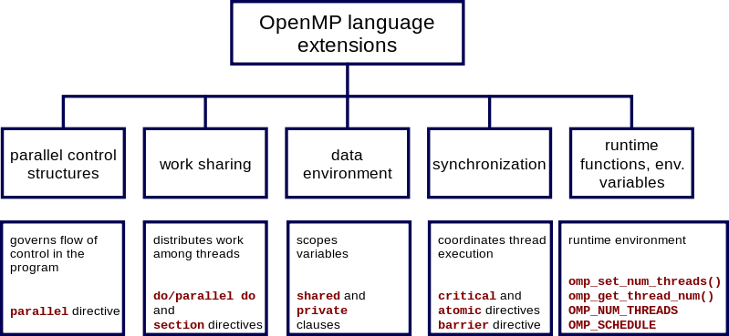
OpenMP Extensions
Parallel Control Structures
OpenMP Statement
Work Sharing, Synchronization
Thread Controlling
Data Environment
Value Controlling
Runtime
Tools

Slide 47
OpenMP Syntax & Behavor
OpenMP Statements
parallel
single
Do Only 1 Thread
Worksharing Statements
for
Do for by Thread
sections
Separate Statements & Do Once
single
Do Only 1 Thread
Clause
if （scalar-expression）
if statement
private（list）
{first|last}private（list）
Value is used in sections only
shared（list）
Value is used Global
reduction（{operator | intrinsic_procedure_name}： list）
Combine Values after All Thread
schedule（kind[, chunk_size]）
How about use Thread

Slide 48
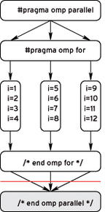
How to Use
“#pragma omp” + OpenMP statement
Ex. “for” statement parallelizing.
#pragma omp parallel for
for(int i = 0; i < 1000; i++) {
// your code
}
int cpu_num = step = omp_get_num_procs();
for(int i = 0; i < cpu_num; i++) {
START_THREAD {
FOR_STATEMENT(int j = i; j < xxx; j+step);
}
}

Slide 49
IplImage Benchmark by OpenMP
IplImage
Write 1 line only
Device
Nexus7(2013)
4 Core
IplImage* img;
#pragma omp parallel for
for(int h = 0; h < img->height; h++) {
for(int w = 0; w < img->width; w++){
img->imageData[img->widthStep * h + w * 3 + 0]=0;//B
img->imageData[img->widthStep * h + w * 3 + 1]=0;//G
img->imageData[img->widthStep * h + w * 3 + 2]=0;//R
}
}

Slide 50
Hands On

Slide 51
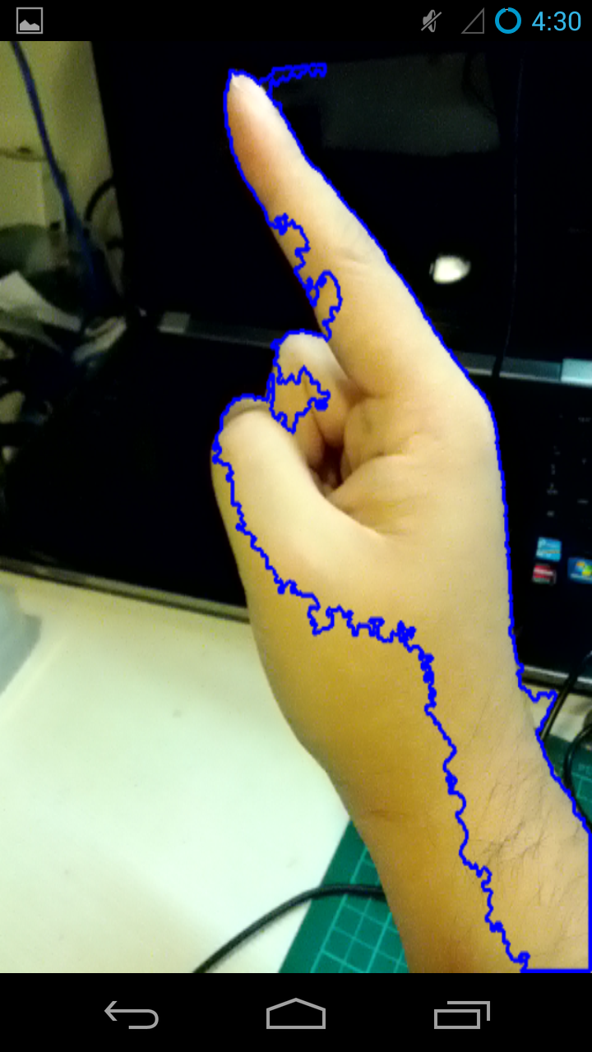
Hand Detector

Slide 52
Chart of Hand Detector
Calc Histgram of Skin Color
Detect Skin Area from CapImage
Calc the Largest Skin Area
Matching Histgrams
Histgram
Convex Hull
Labeling
Feature Point Distance

Slide 53
Android.mk
Add C & LD flags
LOCAL_CFLAGS += -O3 -fopenmp
LOCAL_LDFLAGS +=-O3 -fopenmp

Slide 54

Why Use HoG?
Matching Hand Shape.
Use Feature Point Distance with Each HoG.

Slide 55
Step 1/3
Calculate each Cell (Block(3x3) with Edge Pixel(5x5))
luminance gradient moment
luminance gradient degree=deg
#pragma omp parallel for
for(int y=0; y<height; y++){
for(int x=0; x<width; x++){
if(x==0 || y==0 || x==width-1 || y==height-1){
continue;
}
double dx = img->imageData[y*img->widthStep+(x+1)] - img->imageData[y*img->widthStep+(x-1)];
double dy = img->imageData[(y+1)*img->widthStep+x] - img->imageData[(y-1)*img->widthStep+x];
double m = sqrt(dx*dx+dy*dy);
double deg = (atan2(dy, dx)+CV_PI) * 180.0 / CV_PI;
int bin = CELL_BIN * deg/360.0;
if(bin < 0) bin=0;
if(bin >= CELL_BIN) bin = CELL_BIN-1;
hist[(int)(x/CELL_X)][(int)(y/CELL_Y)][bin] += m;
}
}

Slide 56
Step 2/3
Calculate Feature Vector of Each Block
(Go to Next Page)
#pragma omp parallel for
for(int y=0; y<BLOCK_HEIGHT; y++){
for(int x=0; x<BLOCK_WIDTH; x++){
//Calculate Feature Vector in Block
double vec[BLOCK_DIM];
memset(vec, 0, BLOCK_DIM*sizeof(double));
for(int j=0; j<BLOCK_Y; j++){
for(int i=0; i<BLOCK_X; i++){
for(int d=0; d<CELL_BIN; d++){
int index = j*(BLOCK_X*CELL_BIN) + i*CELL_BIN + d;
vec[index] = hist[x+i][y+j][d];
}
}
}

Slide 57
How to Calc Approximation
Calc HoG Distance of each block
Get Average.

Slide 58
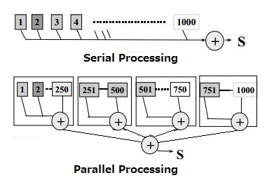

Step 1/1
$\sum_{i=0}^{TOTAL_DIM}{{|(feat1\left[i\right]−feat2\left[i\right])}^{2}|}$
double dist = 0.0;
#pragma omp parallel for reduction(+:dist)
for(int i = 0; i < TOTAL_DIM; i++){
dist += fabs(feat1[i] - feat2[i])*fabs(feat1[i] - feat2[i]);
}
return sqrt(dist);

Slide 59
However…
Currently NDK(r9c) has Bug…
http://recursify.com/blog/2013/08/09/openmp-on-android-tls-workaround
libgomp.so has bug…
Need to Re-Build NDK…
or Waiting for Next Version NDK☺
double dist = 0.0;
#pragma omp parallel for reduction(+:dist)
for(int i = 0; i < TOTAL_DIM; i++){
dist += fabs(feat1[i] - feat2[i])*fabs(feat1[i] - feat2[i]);
}
return sqrt(dist);

Slide 60
How to Build NDK 1/2
Download Linux Version NDK on Linux
cd [NDK dir]
Download Source Code & Patches
./build/tools/download-toolchain-sources.sh src
wget http://recursify.com/attachments/posts/2013-08-09-openmp-on-android-tls-workaround/libgomp.h.patch
wget http://recursify.com/attachments/posts/2013-08-09-openmp-on-android-tls-workaround/team.c.patch

Slide 61
How to Build NDK 2/2
Patch to Source Code
cd & copy patches to ./src/gcc/gcc-4.6/libgomp/
patch -p0 < team.c.patch
patch -p0 < libgomp.h.patch
cd [NDK dir]
Setup Build-Tools
sudo apt-get install texinfo
Build Linux Version NDK
./build/tools/build-gcc.sh --verbose $(pwd)/src $(pwd) arm-linux-androideabi-4.6

Slide 62
How to Build NDK for Windows 1/4
Fix Download Script “./build/tools/build-mingw64-toolchain.sh”
run svn co https://mingw-w64.svn.sourceforge.net/svnroot/mingw-w64/trunk$MINGW_W64_REVISION $MINGW_W64_SRC
↓
run svn co svn://svn.code.sf.net/p/mingw-w64/code/trunk/@5861 mingw-w64-svn $MINGW_W64_SRC
MINGW_W64_SRC=$SRC_DIR/mingw-w64-svn$MINGW_W64_REVISION2
↓
MINGW_W64_SRC=$SRC_DIR/mingw-w64-svn$MINGW_W64_REVISION2/trunk
※My Version is Android-NDK-r9c

Slide 63
How to Build NDK for Windows 2/4
Download MinGW
32-bit
./build/tools/build-mingw64-toolchain.sh --target-arch=i686
cp -a /tmp/build-mingw64-toolchain-$USER/install-x86_64-linux-gnu/i686-w64-mingw32 ~
export PATH=$PATH:~/i686-w64-mingw32/bin
64-bit
./build/tools/build-mingw64-toolchain.sh --force-build
cp -a /tmp/build-mingw64-toolchain-$USER/install-x86_64-linux-gnu/x86_64-w64-mingw32 ~/
export PATH=$PATH:~/x86_64-w64-mingw32/bin

Slide 64
How to Build NDK for Windows 3/4
Download Pre-Build Tools
32-bit
git clone https://android.googlesource.com/platform/prebuilts/gcc/linux-x86/host/i686-linux-glibc2.7-4.6 $(pwd)/../prebuilts/gcc/linux-x86/host/i686-linux-glibc2.7-4.6
64-bit
git clone https://android.googlesource.com/platform/prebuilts/tools $(pwd)/../prebuilts/tools
git clone https://android.googlesource.com/platform/prebuilts/gcc/linux-x86/host/x86_64-linux-glibc2.7-4.6 $(pwd)/../prebuilts/gcc/linux-x86/host/x86_64-linux-glibc2.7-4.6

Slide 65
How to Build NDK for Windows 4/4
Build Windows Version NDK
Set Vars
export ANDROID_NDK_ROOT=[AOSP's NDK dir]
32-bit
./build/tools/build-gcc.sh --verbose --mingw $(pwd)/src $(pwd) arm-linux-androideabi-4.6
64-bit
./build/tools/build-gcc.sh --verbose --mingw --try-64 $(pwd)/src $(pwd) arm-linux-androideabi-4.6

Slide 66
NEON

Slide 67
Today’s Topic
Compiler
≠ Not Thread Programming

Slide 68
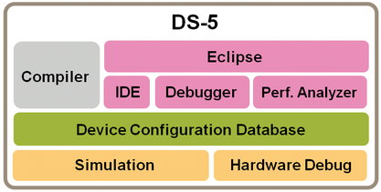
Parallelizing Compiler for NEON
ARM DS-5 Development Studio
Debugger for Linux/Android™/RTOS-aware
The ARM Streamline system-wide performance analyzer
Real-Time system model Simulators
All conveniently Packaged in Eclipse.
http://www.arm.com/products/tools/software-tools/ds-5/index.php

Slide 69
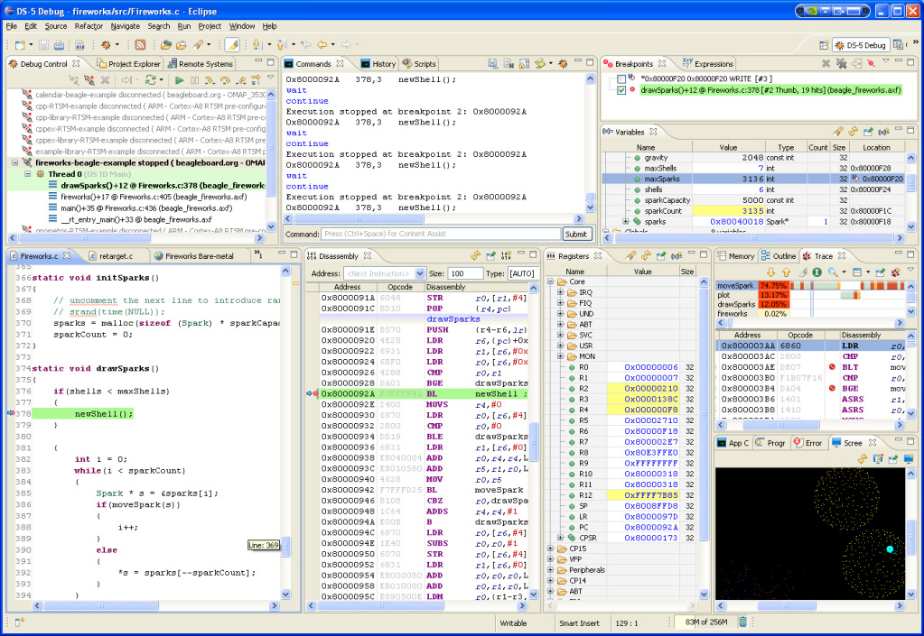
IDE

Slide 70
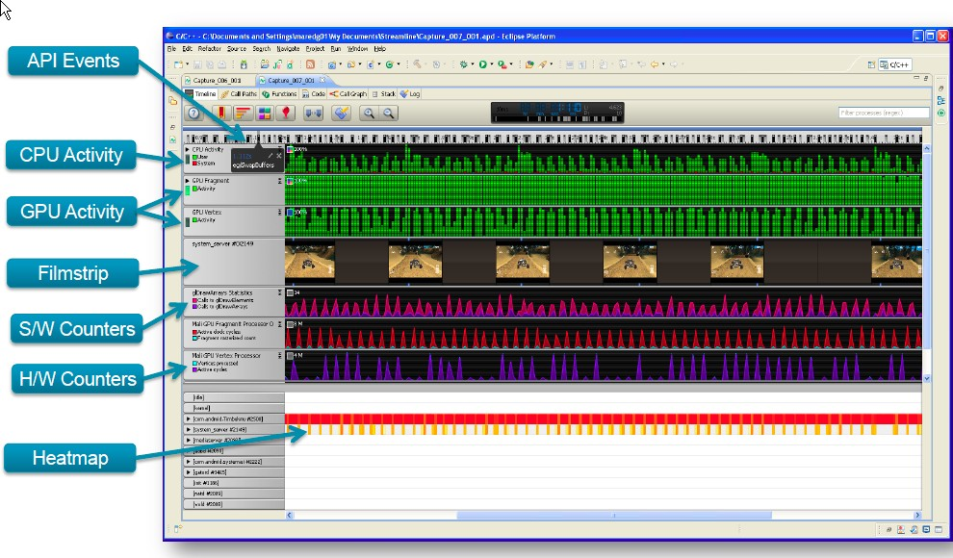
Analyzer

Slide 71
Parallelizing Compiler for NEON No.2
gcc
Android uses it.
How to Use
Android.mk
Supported Arch
LOCAL_CFLAGS += -O3 -ftree-vectorize -mvectorize-with-neon-quad
APP_ABI := armeabi-v7a

