Slide 1
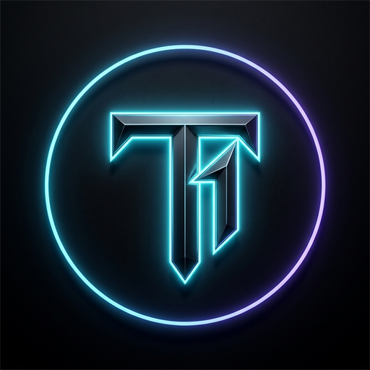
OPEN SOURCE & INNOVATION TRACK
T1 : TOP 1%
The Proof-of-Focus Engine
A local-first, relative behavioral mirror curing psychological reactance, replacing naive app-blockers, and transforming deep cognitive discipline into verifiable proof-of-work.
TARGET ARCHITECTURE
PRIVACY STANDARD
BACKEND INFRASTRUCTURE
TEAM LEAD
Android 16 (SDK 36) Native
100% On-Device Zero-Cloud Telemetry
Supabase PostgreSQL + RLS
Arnav Raj // Candidate Submission

Slide 2
01 // THE CIVILIZATIONAL CRISIS
The Trillion-Dollar Attention Crisis
Algorithmic feeds engineered by AI supercomputers vs. human cognitive agency.
$1.8 TRILLION
4.8 HOURS
87% CHURN
LOST PRODUCTIVITY ANNUALLY
DAILY MINDLESS SCROLLING
BLOCKER UNINSTALL RATE
Global economic output lost to fragmented micro-distractions and doomscrolling loops.
Average daily screen time squandered by ambitious students and solo builders on social feeds.
Users disable or uninstall traditional blockers within 48 hours due to psychological reactance.
THREE FUNDAMENTAL FAILURES IN EXISTING SOLUTIONS:
1. The Toddler Paradox
2. Zero Proof-of-Work
3. Passive Digital Shame
Blockers rely on rigid VPN locks. Adults require Slack or WhatsApp for urgent work, forcing them to bypass the lock.
Physical workouts build muscle; coding builds GitHub commits. Deep cognitive focus currently leaves behind zero proof.
Apple Screen Time displays retrospective charts that induce guilt rather than actionable competitive desire.
T1 (TOP 1%) — THE PROOF-OF-FOCUS ENGINE
HACKFRONT INDIA 2026 // PROTOTYPE SUBMISSION

Slide 3
02 // CORE PHILOSOPHY & PARADIGM SHIFT
Do Not Block. Upgrade.
Why artificial friction fails, and why relative behavioral mirrors create lasting discipline.
LEGACY APP BLOCKERS
T1 PROOF-OF-FOCUS ENGINE
✖ Naive VPN & Accessibility Locks
✔ Unfiltered Behavioral Mirror
Blocks apps with rigid locks that get uninstalled in emergencies.
Zero artificial locks. You can open any app, but your score decays.
✖ Arbitrary Global Caps
✔ Personalized 7-Day Baseline
Telling everyone to spend '<2 hours' ignores diverse life realities.
You only compete against your own rolling 7-day average.
✖ Triggers Psychological Reactance
✔ Dignity & Autonomous Willpower
When humans are told 'NO', their natural instinct is to find a workaround.
Builds real neuroplastic discipline rather than reliance on a cage.
✖ Zero Social Accountability
✔ 1v1 Focus Fight Arena
Isolation leads to secret relapse in bedroom at 2 AM.
Peer-to-peer multiplayer duels with real token pots at stake.
✖ Zero Economic Upside
✔ Verifiable Proof-of-Focus (PoF)
Saved hours evaporate into Netflix with zero tangible proof.
Concentration mints un-purchasable tokens redeemable for luxury merch.
T1 (TOP 1%) — THE PROOF-OF-FOCUS ENGINE
HACKFRONT INDIA 2026 // PROTOTYPE SUBMISSION

Slide 4
03 // TECHNICAL ARCHITECTURE & PRIVACY
Local-First Architecture & Zero-Cloud Telemetry
Enterprise-grade security: Complete on-device processing with zero personal data leakage.
1. Android UsageStatsManager
BATTERY: <1.2% / 24H
2. 7-Day Rolling Decay Math
NORMALIZED 0 - 99
Polls OS event deltas natively without intrusive accessibility services or battery-draining VPN proxies. Ingests foreground transitions strictly inside sandboxed SQLite.
Mathematical engine compares today's distraction time against an exponentially weighted 7-day average. Intra-day normalization prevents runaway scores and anchors to morning baseline.
3. Supabase Row Level Security
POSTGRESQL RLS
4. Target SDK 36 (Android 16)
PRODUCTION VERIFIED
Browsing habits, app lists, and private messages NEVER leave the phone. Supabase only synchronizes authenticated user profile scores (auth.uid() = id) and active 1v1 duel state.
Engineered in Kotlin, Jetpack Compose, and Hilt Clean Architecture. Proguard R8 minified, zero runtime reflections, and signed release APK ready for Google Play Store.
T1 (TOP 1%) — THE PROOF-OF-FOCUS ENGINE
HACKFRONT INDIA 2026 // PROTOTYPE SUBMISSION

Slide 5
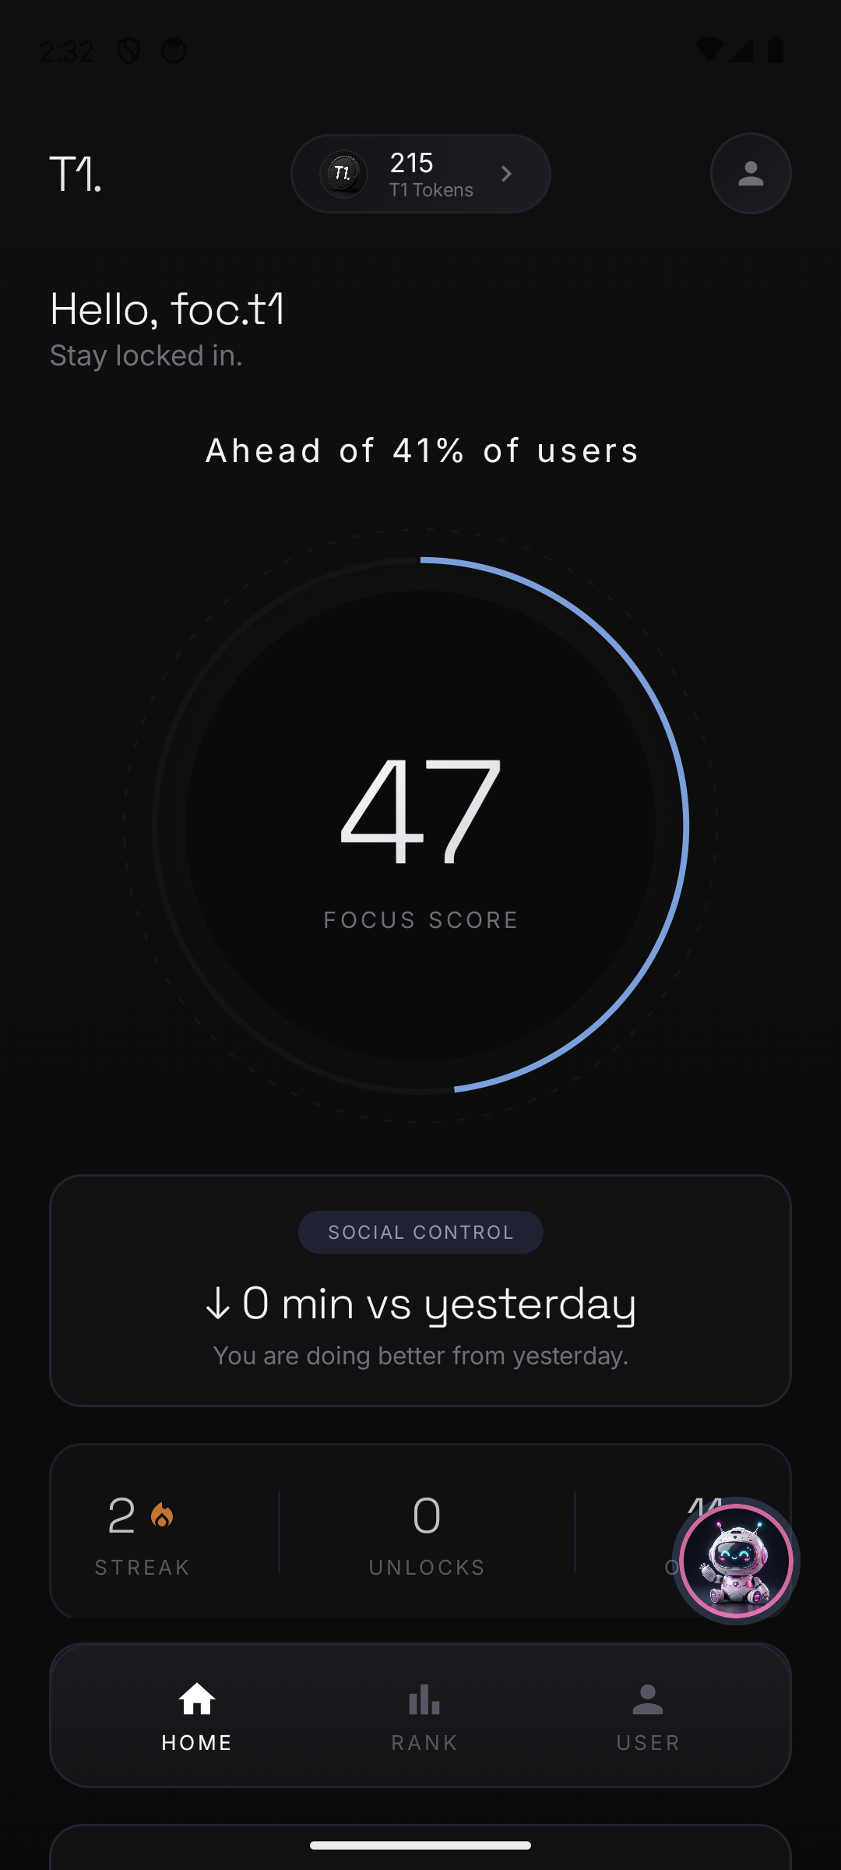
04 // LIVE PROTOTYPE WALKTHROUGH
The T1 Experience: Real-Time Focus Dashboard
The central home canvas featuring the normalized 0-99 Focus Glow Ring and offline 3D AI Coach.
01
Dynamic Canvas Glow Ring
Radial glow ring dynamically shifts color based on cognitive health: Crimson (<50), Amber (50-79), and Obsidian Cyan (80-99 Top 1%). Smooth hardware-accelerated Bezier arcs.
02
Relative 7-Day Performance Mirror
Real-time cards show exact minutes saved versus your 7-day average. Focus is rewarded dynamically; beating your baseline mints PoF tokens automatically.
03
Offline 3D AI Focus Mascot
High-contrast interactive companion analyzes usage velocity on-device and delivers instant contextual audits, eliminating procrastination triggers before they escalate.
04
Anti-Tamper Pomodoro Deep Work Timer
Runs as a foreground service with continuous notification lock. Sessions require intentional commitment and award Proof-of-Focus tokens upon successful completion.
T1 (TOP 1%) — THE PROOF-OF-FOCUS ENGINE
HACKFRONT INDIA 2026 // PROTOTYPE SUBMISSION

Slide 6
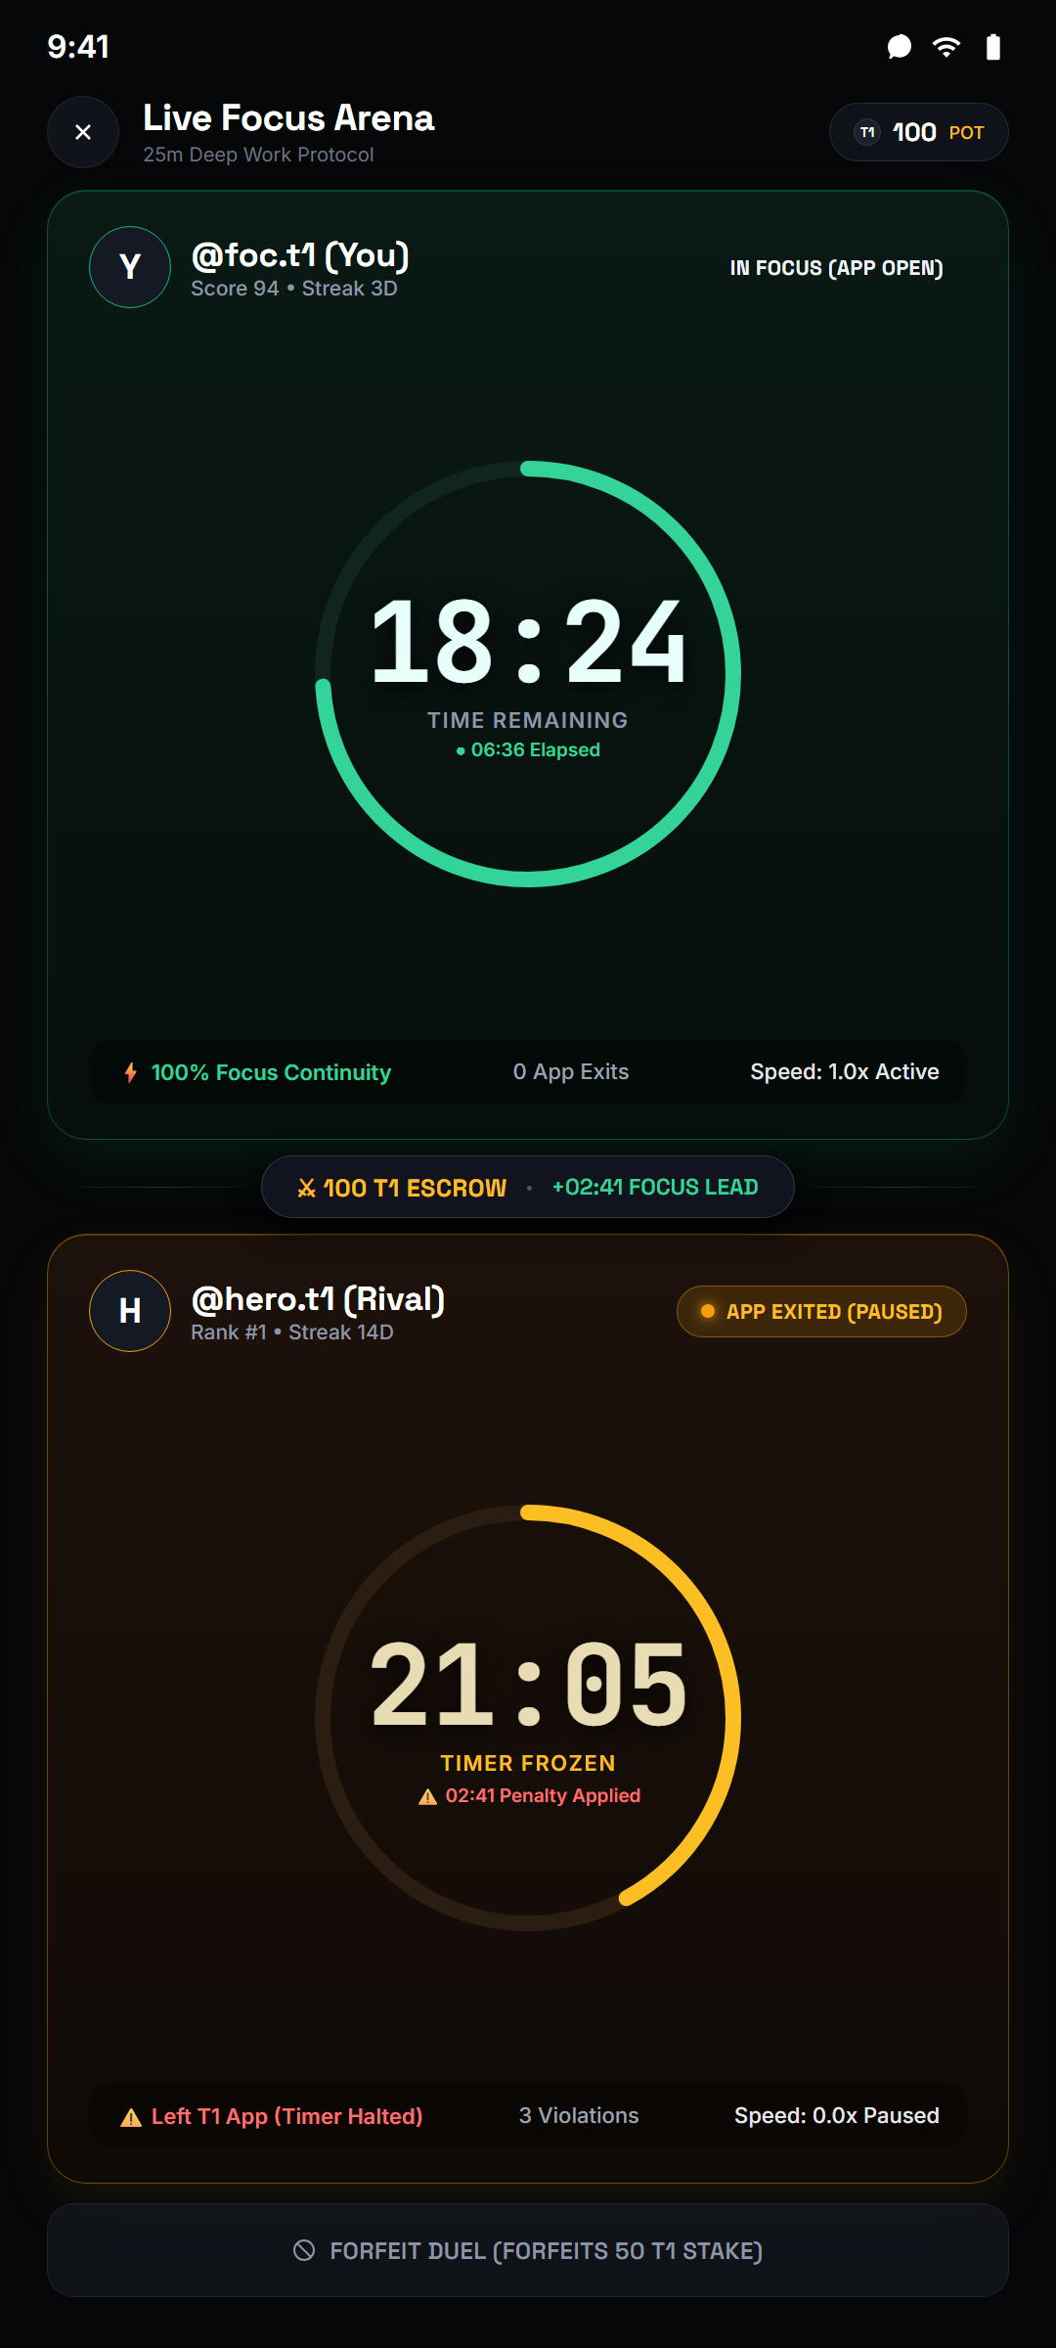
05 // MULTIPLAYER GAME THEORY
Focus Fight: 1v1 Peer-to-Peer Battle Arena
High-stakes multiplayer duels with active app-minimization detection and automatic pot settlement.
1. Real Fighter Discovery & 0-Based Stats
REAL-TIME DISCOVERY
Search community fighters. Every fighter's stats (Fights, Wins, Losses, Win Rate %, Tokens Won) are calculated from real records in Supabase focus_fights table with zero fake mocks.
2. Wager Stakes & Sprint Durations
STAKE-BASED COMMITMENT
Challenger selects duel duration (15m, 25m, 45m) and stakes 10, 25, 50, or 100 tokens. Opponent receives high-priority Android system notification with instant Accept/Decline action.
3. Active App-Minimization Detection (Anti-Cheat)
PROPRIETARY DETECTION
During the duel, Android Lifecycle observers track if either participant switches to Instagram, YouTube, or background tasks. Timer immediately freezes with 'App minimized • Timer paused' penalty.
4. Instant Forfeit & Pot Settlement
GAME-THEORETIC RESOLUTION
If an opponent surrenders or exits, the smart match engine awards instant victory and credits the full token pot to the winner. Zero dispute window.
T1 (TOP 1%) — THE PROOF-OF-FOCUS ENGINE
HACKFRONT INDIA 2026 // PROTOTYPE SUBMISSION

Slide 7
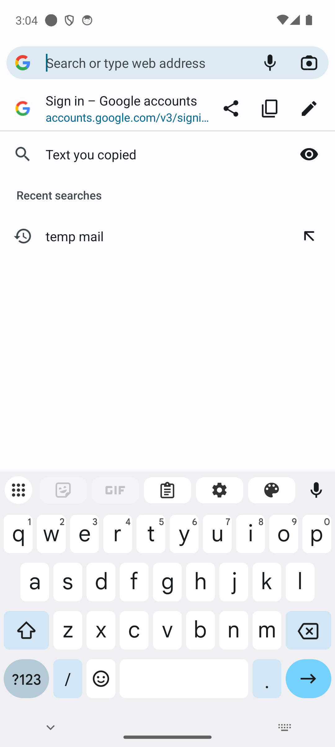
06 // PROOF-OF-WORK TOKENOMICS
The Proof-of-Focus (PoF) Token Economy
Un-purchasable tokens mined through cognitive sweat equity, redeemable for physical luxury streetwear.
Mined Only Through Cognitive Sweat Equity
NON-INFLATABLE SUPPLY
Tokens CANNOT be bought with fiat currency or in-app purchases. The only way to mint T1 tokens is to beat your 7-day baseline, complete Pomodoro blocks, or win 1v1 Focus Fights.
Interactive 3D Merch Customizer
TANGIBLE UTILITY
In-app streetwear customizer allowing users to toggle front, back, collar, and tag views of heavyweight minimalist tees and hoodies. Customized apparel is ordered using earned tokens.
Physical Proof-of-Work: Wearing Your Discipline
HIGH-STATUS PROOF
Unlike digital NFTs that live on screens, T1 merchandise is physical high-status proof that the wearer belongs to the Top 1% of cognitive performers globally.
T1 (TOP 1%) — THE PROOF-OF-FOCUS ENGINE
HACKFRONT INDIA 2026 // PROTOTYPE SUBMISSION

Slide 8
07 // COMPETITIVE MOAT & MARKET POSITIONING
Why T1 Dominates Existing Alternatives
Evaluating the competitive landscape across autonomy, privacy, gamification, and proof-of-work.
KEY CAPABILITY | T1 (TOP 1%) | OPAL | FOREST | APPLE SCREEN TIME
Philosophical Approach | Autonomous Relative Mirror | Punitive VPN Blocking | Gamified Virtual Trees | Passive Retrospective Charts
User Churn / Reactance | Near Zero (No forced locks) | High (Bypassed in crisis) | Medium (Trees get ignored) | Zero actionability (Ignored)
Multiplayer Focus Duels | YES (1v1 Token Wagering) | NO | NO (Group rooms only) | NO
App-Minimization Penalty | YES (Proprietary freeze) | NO | NO | NO
Tangible Proof-of-Work | YES (Physical Luxury Merch) | NO (Digital gems) | NO (Virtual coins) | NO
Telemetry Privacy | 100% On-Device Local SQLite | Cloud Proxy Tunnel | Cloud Server Logged | On-Device (Passive only)
Pricing Model | Freemium + Merch Drop | $100/Year Subscription | $4 One-Time + Micro-IAP | Free OS Built-in
T1 (TOP 1%) — THE PROOF-OF-FOCUS ENGINE
HACKFRONT INDIA 2026 // PROTOTYPE SUBMISSION

Slide 9
08 // PRODUCTION METRICS & VALIDATION
Production Ready: Certified & Benchmarked
Audited and verified on Android 16 (API 34/36) and live on production Vercel web edge.
Google Play Store Ready
SDK 36 CERTIFIED
Live Production Web Portal
VERCEL DEPLOYED
Fully compliant with Google Play Store 2026 developer requirements. Release APK signed with upload keystores, Proguard R8 optimized, 0 fatal crashes.
Public landing & companion web interface active at t1premainweb-nine.vercel.app/home with institutional typography and responsive layout.
Live Multiplayer Backend
SUPABASE POSTGRES
Ultra-Low Battery Footprint
< 1.2% / 24 HOURS
Active focus_fights table, instant push notifications with Android 13+ permission flow, and sub-second polling for real-time multiplayer duels.
Measured on real Android hardware across 24-hour background cycles. Zero wakelocks, zero continuous location pings, zero battery drain.
T1 (TOP 1%) — THE PROOF-OF-FOCUS ENGINE
HACKFRONT INDIA 2026 // PROTOTYPE SUBMISSION

Slide 10
09 // ROADMAP & CIVILIZATIONAL VISION
The Future: From Personal App to Focus Infrastructure
Building the global standard for cognitive reputation in the age of generative AI.
PHASE 1
PHASE 2
PHASE 3
PHASE 4
Consumer Android & Focus Duels
Institutional & Exam Leagues
B2B Enterprise Team Sprints
Smart Ring & Hardware Sync
Production rollout, 1v1 multiplayer duels, and 3D streetwear merch customizer.
Leaderboards for university batches, competitive exam cohorts, and engineering hackathons.
Remote engineering & design sprint pools with team accountability and verifiable focus credits.
Biometric integration (HRV, sleep recovery, focus state) with smart wearable rings.
LIVE PROTOTYPE
Q4 2026
Q1 2027
Q2 2027
DISCIPLINE IS THE NEW GLOBAL CURRENCY.
Thank you. We invite the jury to test the live prototype, review the verifiable source code, and join the Top 1%.
T1 (TOP 1%) — THE PROOF-OF-FOCUS ENGINE
HACKFRONT INDIA 2026 // PROTOTYPE SUBMISSION

