Slide 1

Term project Fundamentals of Data Science
Made by Asja Bašović

Slide 2
TABLE OF CONTENTS
01
02
03
04
05
06
About my dataset
Exploring the dataset
Visualization
Outliers
Basic statistics measures
Linear regression

Slide 3
01
About my dataset
There are 21613 observations and 21 variables in the dataset.

Slide 4
Variables
sqft_above - Living area above ground level in square feet •
sqft_basement - Basement area in square feet •
yr_built - Year property was built •
yr_renovated - Year property was last renovated (0 if never)
zipcode - Property location zip code
lat - Latitude coordinate of property location
long - Longitude coordinate of property location
sqft_living15 - Living area size of 15 nearest properties in square feet
sqft_lot15 - Lot size of 15 nearest properties in square feet
id -Unique identifier for each property •
date - Date of property listing
price - property price in currency •
bedrooms - Number of bedrooms
bathrooms -Number of bathrooms •
sqft_living - Living area size in square feet
sqft_lot - Total lot size in square feet •
floors - Number of floors
waterfront - Indicates if property has waterfront view (0 for no, 1 for yes).
view – Quality level of property view (0 to 4) •
condition - overall condition rating (1 to 5)
grade - Overall grade rating (1 to 13) •

Slide 5

Exploring the dataset
price float64
bedrooms int64
bathrooms float64
sqft_living int64
sqft_lot int64
floors float64
waterfront int64
view int64
condition int64
grade int64
sqft_above int64
sqft_basement int64
yr_built int64
sqft_living15 int64
sqft_lot15 int64 ************************************** price int32
bedrooms int64
bathrooms float64
sqft_living int64
sqft_lot int64
floors float64
waterfront int64
view int64
condition int64
grade int64
sqft_above int64
sqft_basement int64
yr_built datetime64[ns]
sqft_living15 int64
sqft_lot15 int64
No null values
Unique values ->
price 4029
bedrooms 13
bathrooms 30
sqft_living 1038
sqft_lot 9782
floors 6
waterfront 2
view 5
condition 5
grade 12
sqft_above 946
sqft_basement 306
yr_built 116
sqft_living15 777
sqft_lot15 8689

Slide 6

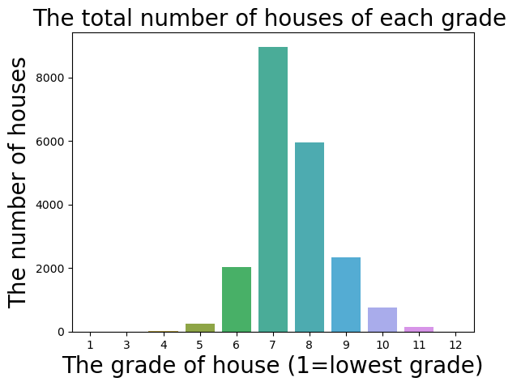
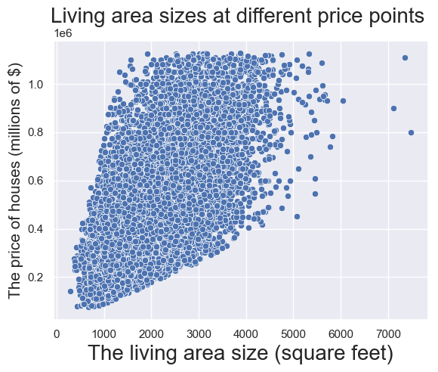


VISUALIZATION
James Hill
Kaliyah Harris
You can speak a bit about this person here
You can speak a bit about this person here

Slide 7

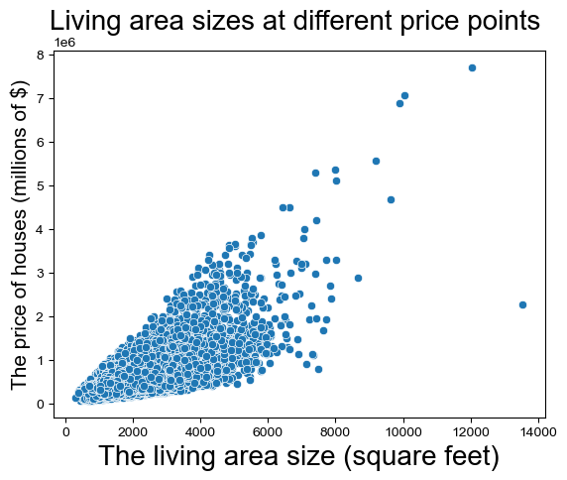
Outliers
Used the IQR method for detection and removal.
Only the ‘price’ column was used to remove outliers.
1 146 outliers removed.

Slide 8

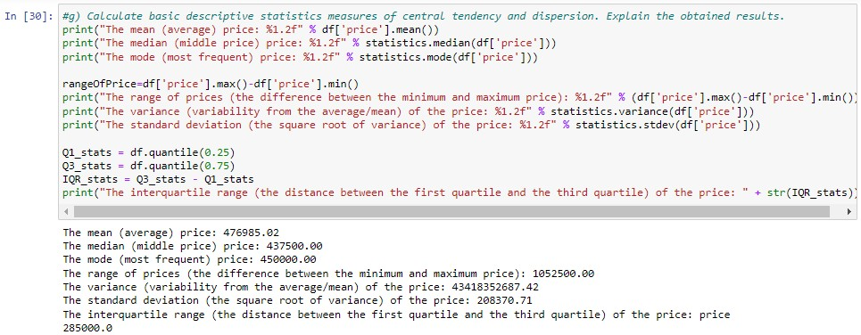
Basic statistics measures
Mars
Venus
Mars is actually a very cold place
Venus has extremely high temperatures
Jupiter
Saturn
Jupiter is the biggest planet of them all
Saturn is a gas giant and has several rings

Slide 9

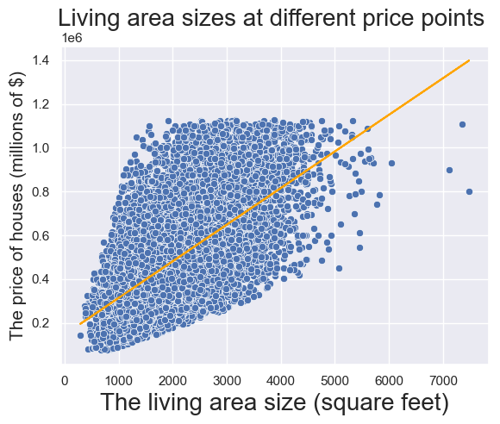
Linear regression
R-squared: 0.387
slope: 167.3596
-rate of change.
-for every additional 1 square foot of living area, the price of the property increases by approximately $167.36.
intercept: 1.464e+05 or 146 400
-the estimated price of the property when the living area size is zero square feet.
-baseline value.

Slide 10
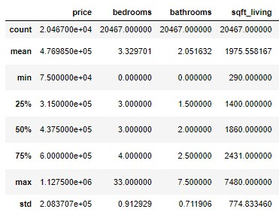
Linear regression
Predicted price for a lot size of 6000 sqft_living: 1150557.6
#checking if value is in the dataframe
result = df[df['sqft_living'] == 6000]
print(result)
new_x = 6000
predicted_y = slope*new_x+intercept
print(f"Predicted price for a lot size of {new_x} sqft_living: {predicted_y}")

