Slide 1
VAD | Embedder | Clustering | Window length | DER (PyanNote)
silero-vad | Titanet-l.nemo | Google_spectral | 1 | 1.332307
silero-vad | ECAPA_TDNN_pretrained | Google_spectral | 1 | 1.365307
 | 0.0323 | 0.947 | 1
silero-vad | ECAPA_TDNN_pretrained_singaporean | Google_spectral | 1 | 1.4556117
Pyannote diarization baseline 0.0003 0.775 0 0.0003 0.775 0 0.0003 0.775 0 0.0003 0.775 0 0.0003 0.775 0 0.0003 0.775 0 0.0003 0.775 0 0.0003 0.775 0 | 0.0003 | 0.775 | 0 | 1.475113 (Before edit)
ERROR DUE TO INCORRECT ANSWER KEY (MISSING DECIMAL POINT AND MISSING AUDIO SEGMENTS) 0.0006 0.886 0 0 0.0006 0.886 0 0 0.0006 0.886 0 0 0.0006 0.886 0 0 0.0006 0.886 0 0 0.0006 0.886 0 0 0.0006 0.886 0 0 0.0006 0.886 0 0 | 0.0006 | 0.886 | 0 | 0

Slide 2
VAD | Embedder | Clustering | Window length | DER (PyanNote)
Pyannote diarization baseline (4074) |  |  |  | 0.778 (Before edit)
Pyannote diarization baseline (4074) |  |  |  | 0.626 (After edit)

Slide 3
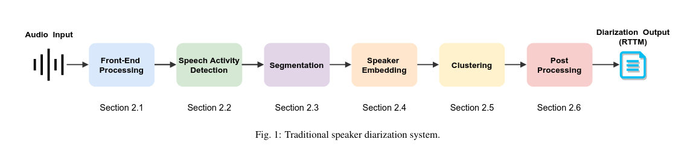
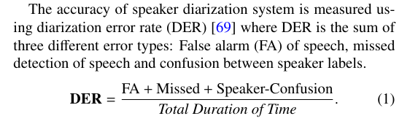

Slide 4
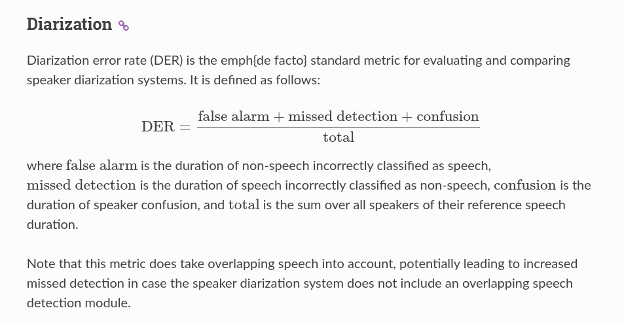
1. False alarm is the duration of non-speech incorrectly classified as speech
2. Missed detection is the duration of speech incorrectly classified as non-speech
3. Confusion is the duration of speaker confusion (Wrong speaker at wrong time)

Slide 5
VAD | Embedder | Clustering | Window length (sec) | DER | DER 1 STD noised | DER CHATTER
silero-vad | Titanet-l.nemo | Google_spectral | 1 | 0.318168 | 0.5369003 | 0.356873
silero-vad | ECAPA_TDNN_pretrained | Google_spectral | 1 | 0.349163 | 0.5760701 | 0.463694
silero-vad | ECAPA_TDNN_pretrained_singaporean | Google_spectral | 1 | 0.475219 | 0.6725947 | 0.581269
Pyannote diarization baseline |  |  |  | 0.389766 | 0.4530732 | 0.4538524
Details: - 102 CALLHOME audio ranging from 15min to 30min audio - Only segments of each audio is used since the labeled data on each audio clip is incomplete - DER does not include overlapping audio |  |  |  |  | I’m an idiot, these results are all wrong HAHAHAHA

Slide 6
VAD | Embedder | Clustering | Window length (sec) | DER | DER 1 STD noised | DER CHATTER
silero-vad | Titanet-l.nemo | Google_spectral | 1 | 0.23141234 | 0.47967116 | 0.2857853
silero-vad | ECAPA_TDNN_pretrained | Google_spectral | 1 | 0.2652686 | 0.52132592 | 0.39762557
silero-vad | ECAPA_TDNN_pretrained_singaporean | Google_spectral | 1 | 0.398177933 | 0.621599918 | 0.5225389
Pyannote diarization baseline |  |  |  | 0.279712351 | 0.3734865 | 0.3710125
NEMO Base Diarization model (without training) |  |  |  | 0.014915949 | 0.10103716 | 0.034337117
NEMO NeuralDiarizer Diarization model (without training) |  |  |  | 0.1104532324 | 0.208816105 | 0.138652918
Details: - 102 CALLHOME audio ranging from 15min to 30min audio - Only segments of each audio is used since the labeled data on each audio clip is incomplete - DER does not include overlapping audio |  |  |  |  | Correct Error Rate | 1. Find out clustering 2. Train diazer 3. Try to Train titanet

Slide 7
VAD | Embedder | Clustering | Window length (sec) | DER | DER 1 STD noised | DER CHATTER
silero-vad | Titanet-l.nemo | Google_spectral | 1 | 23.1% | 48% | 28.5%
silero-vad | ECAPA_TDNN_pretrained | Google_spectral | 1 | 26.5% | 52.1% | 39.8%
silero-vad | ECAPA_TDNN_pretrained_singaporean | Google_spectral | 1 | 39.8% | 62.1% | 52.3%
Pyannote diarization baseline |  |  |  | 27.9% | 37.3% | 37.1%
NEMO Base Diarization model (without training) |  |  |  | 0.014915949 | 0.10103716 | 0.034337117
NEMO NeuralDiarizer Diarization model (without training) |  |  |  | 0.1104532324 | 0.208816105 | 0.138652918
Details: - 102 CALLHOME audio ranging from 15min to 30min audio - Only segments of each audio is used since the labeled data on each audio clip is incomplete - DER does not include overlapping audio |  |  |  |  | Correct Error Rate | 1. Find out clustering 2. Train diazer 3. Try to Train titanet

Slide 8
VAD | Embedder | Clustering | Window length (sec) | DER | DER 1 STD noised | DER CHATTER
silero-vad | Titanet-l.nemo | Google_spectral | 1 | 0.23141234 | 0.47967116 | 0.2857853
silero-vad | Titanet-l.nemo | Google_spectral | 0.5 | 0.443004699 | 0.59436701 | 0.50431798
silero-vad | Titanet-l.nemo | Google_spectral | 2 | 0.494438442 | 0.57932959 | 0.504317980
Pyannote diarization baseline |  |  |  | 0.279712351 | 0.3734865 | 0.3710125
Details: - 102 CALLHOME audio ranging from 15min to 30min audio - Only segments of each audio is used since the labeled data on each audio clip is incomplete - DER does not include overlapping audio |  |  |  |  | Correct Error Rate

Slide 9
VAD | Embedder | Clustering | Window length (sec) | DER | DER 1 STD noised | DER CHATTER
silero-vad | Titanet-l.nemo | Google_spectral | 1 | 23.1% | 48% | 28.6%
silero-vad | Titanet-l.nemo | Google_spectral | 0.5 | 44.3% | 59% | 50.4%
silero-vad | Titanet-l.nemo | Google_spectral | 2 | 49.4% | 57.9% | 50.4%
Pyannote diarization baseline |  |  |  | 27.9% | 37.3% | 37.1%
Details: - 102 CALLHOME audio ranging from 15min to 30min audio - Only segments of each audio is used since the labeled data on each audio clip is incomplete - DER does not include overlapping audio |  |  |  |  | Correct Error Rate

Slide 10
VAD | Embedder | Clustering | Window length (sec) | DER | DER 1 STD noised | DER CHATTER
silero-vad | Titanet-l.nemo | Google_spectral | 1 | 0.23141234 | 0.47967116 | 0.2857853
silero-vad | Titanet-l.nemo | hdbscan | 1 | 0.517266667 | 0.565496528 | 0.51851348
silero-vad | Titanet-l.nemo | Agglomerative | 1 | 0.2329622515 | 0.617857386 | 0.51291458
Details: - 102 CALLHOME audio ranging from 15min to 30min audio - Only segments of each audio is used since the labeled data on each audio clip is incomplete - DER does not include overlapping audio |  |  |  |  | Correct Error Rate

Slide 11
VAD | Embedder | Clustering | Window length (sec) | DER | DER 1 STD noised | DER CHATTER
silero-vad | Titanet-l.nemo | Google_spectral | 1 | 23.1% | 48% | 28.6%
silero-vad | Titanet-l.nemo | hdbscan | 1 | 51.7% | 56.5% | 51.9%
silero-vad | Titanet-l.nemo | Agglomerative | 1 | 23.3% | 61.7% | 51.3%
Details: - 102 CALLHOME audio ranging from 15min to 30min audio - Only segments of each audio is used since the labeled data on each audio clip is incomplete - DER does not include overlapping audio |  |  |  |  | Correct Error Rate

Slide 12
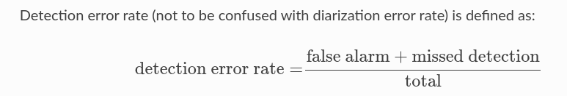
VAD Test | DER | DER 1 STD noised | DER CHATTER
Silero-vad (threshold = 0.1) | 0.161243355 | 0.2838990007 | 0.1836580364
Silero-vad (threshold = 0.2) | 0.155182998 | 0.37727395 | 0.18376753
Silero-vad (threshold = 0.3) | 0.151481979 | 0.47150402 | 0.185485125
Pyannote | 0.108452143 | 0.170501699 | 0.1596173285
Pyannote (larger margin) | 0.329101185 | 0.2938612 | 0.26297474
Pyannote (smaller margin) | 0.37517602 | 0.3779496 | 0.2873545
Details:
 |  | 1. Fine-tune VAD silero (try) (Not supported) 2. Look into clustering 3. Fine Tune on CALLHOME embedding → Speech brain | https://github.com/NVIDIA/NeMo/blob/main/tutorials/speaker_tasks/Speaker_Identification_Verification.ipynb

Slide 13
VAD Test | DER | DER 1 STD noised | DER CHATTER
Silero-vad (threshold = 0.1) | 16.1% | 28.3% | 18.4%
Silero-vad (threshold = 0.2) | 15.5% | 37.7% | 18.2%
Silero-vad (threshold = 0.3) | 15.1% | 47.2% | 18.5%
Pyannote | 10.8% | 17.1% | 16%
Details:
 |  | 1. Fine-tune VAD silero (try) (Not supported) 2. Look into clustering 3. Fine Tune on CALLHOME embedding → Speech brain | https://github.com/NVIDIA/NeMo/blob/main/tutorials/speaker_tasks/Speaker_Identification_Verification.ipynb

Slide 14
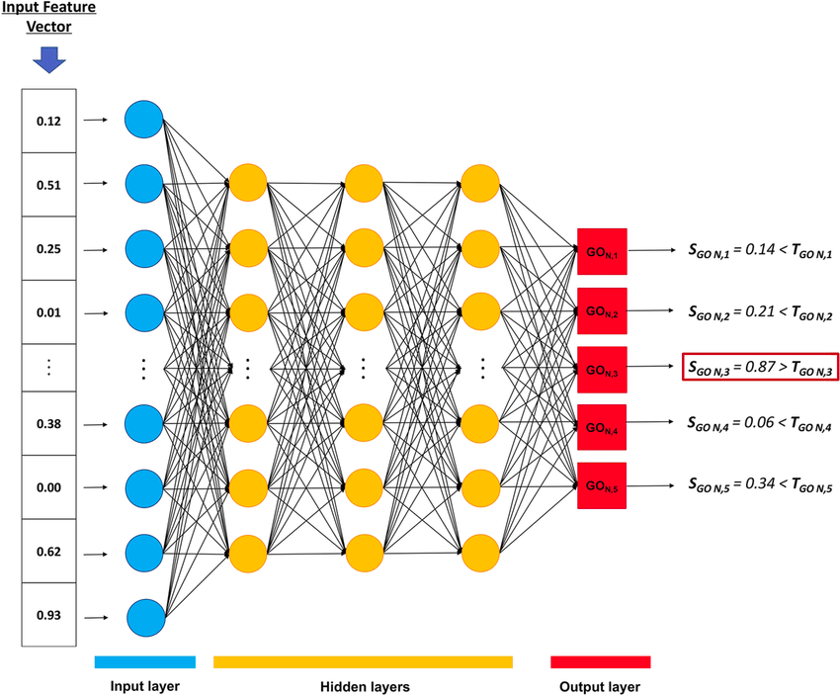
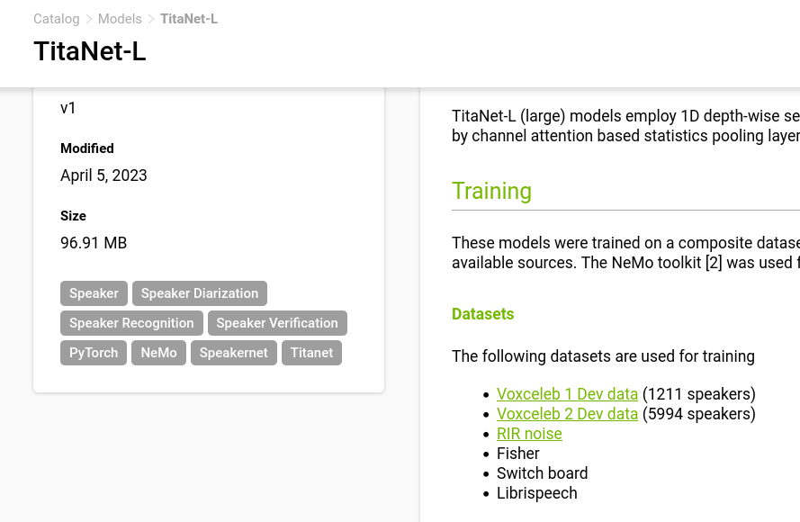
Embedding

Slide 15
VAD | Embedder | Clustering | Window length (sec) | DER | DER 1 STD noised | DER CHATTER
NEMO Base Diarization model (without training) |  |  |  | 0.014915949 | 0.10103716 | 0.034337117
NEMO NeuralDiarizer Diarization model (without training) |  |  |  | 0.1104532324 | 0.208816105 | 0.138652918
NEMO NeuralDiarizer Diarization model (50epoch)(Loss = 27.97312) |  |  |  | 0.112732556 | 0.195910126 | 0.1342934454
NEMO NeuralDiarizer Diarization model embedder trained (200epoch)(Loss = 46.03) |  |  |  | 0.353934968 | 0.353934968 | 0.340754047
Details: - 102 CALLHOME audio ranging from 15min to 30min audio - Only segments of each audio is used since the labeled data on each audio clip is incomplete - DER does not include overlapping audio |  |  |  |  | Correct Error Rate

Slide 16
VAD | Embedder | Clustering | Window length (sec) | DER | DER 1 STD noised | DER CHATTER
NEMO Base Diarization model (without training) |  |  |  | 1.49% | 10.1% | 3.43%
NEMO NeuralDiarizer Diarization model (without training) |  |  |  | 11% | 20.9% | 13.9%
NEMO NeuralDiarizer Diarization model (50epoch)(Loss = 27.97312) |  |  |  | 11.3% | 19.6% | 13.4%
NEMO NeuralDiarizer Diarization model embedder trained (200epoch)(Loss = 46.03) |  |  |  | 35.4% | 35.4% | 34.0%
Details: - 102 CALLHOME audio ranging from 15min to 30min audio - Only segments of each audio is used since the labeled data on each audio clip is incomplete - DER does not include overlapping audio |  |  |  |  | Correct Error Rate

