Slide 1



Sentiment Analysis
ReviewSense
83% Accuracy
From raw reviews to real intelligence
Category Clustering
BERTopic + GPT-4o-mini
DistilBERT
BERTopic
GPT-4o-mini
Streamlit
NLP Project · May 2025
Review Summarizer
Map-Reduce Pipeline

Slide 2




Project Journey
Part 1 of 2 · From idea to sentiment model
GitHub Repo & Project Plan
Created milestones, planned sprints with Claude, structured 3 tasks
EDA on HuggingFace Dataset
Discovered heavy positive skew in ratings — foreshadowed class imbalance
First Sentiment Model — 95%
DistilBERT on review text only. High accuracy but terrible F1 on Neg & Neu
Problem: Class Imbalance
Research → 3 options: larger dataset, class weights, or downsampling

Slide 3

Project Journey
Part 2 of 2 · From clustering to deployment
Fix: Larger Dataset + Downsampling
1.7L reviews, balanced to smallest class → equal Pos/Neu/Neg representation
Final Sentiment Model — 83%
Added review title + text as input. Balanced F1 across all 3 classes ✓
BERTopic + K-Means + GPT-4o-mini
K-Means alone forced balance. BERTopic put products where they truly belong
Summarizer + Streamlit Deploy
Map-reduce GPT pipeline using helpful_vote & verified_purchase weighting

Slide 4
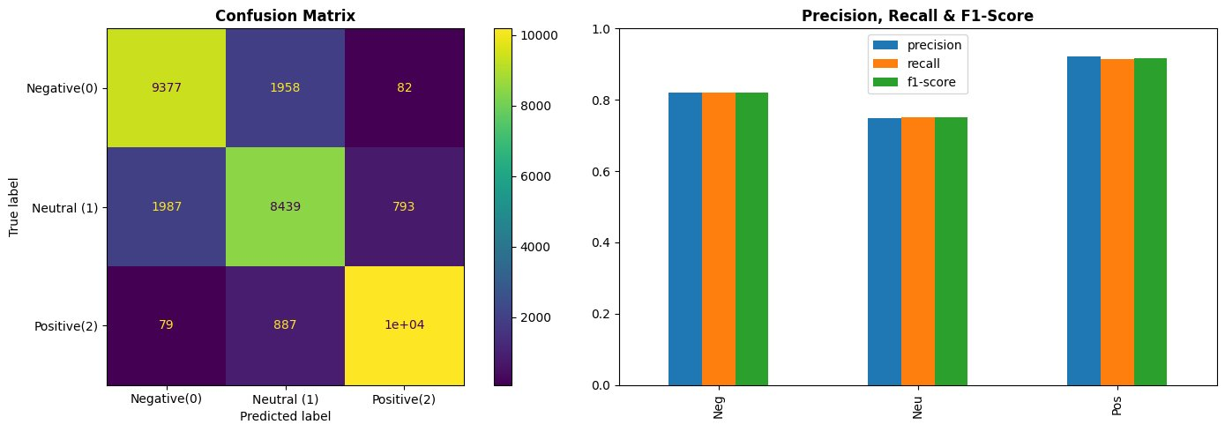
Final Model Performance
Sentiment
Analyzer
Task 1
Model Config
Model: distilbert-base-uncased
Labels: 3 (Pos / Neu / Neg)
Input: Title + Review text
83%
0.75
0.82
0.92
Dataset: 1.7L reviews
Strategy: Downsampled balanced
Overall Accuracy
Neutral F1
Negative F1
Positive F1

Slide 5

Why BERTopic over standalone K-Means?
Approach | K-Means Alone | BERTopic + K-Means
Balance | Forces equal clusters | Natural groupings
Naming | Manual / TF-IDF | GPT-4o-mini labels
Outliers | Hidden in clusters | Explicit -1 class
Result | Misleading categories | Semantically correct
Category
Clustering
Task 2
Pipeline Config
Embedding: distilbert-nli-stsb
Clustering: BERTopic + K-Means
Key Insight
Naming: GPT-4o-mini
One category held 70% of products — alarming at first, but cross-checking confirmed it was semantically correct. K-Means was forcing false balance; BERTopic put products where they truly belong.
Input: Product name
Output: 4-6 meta-categories

Slide 6
3-Step Generation Pipeline
1
2
3
Review
Summarizer
Curate
Summarize Product
Write Article
8 reviews per star (1–5)
Verified + helpful first
Rating prefix per review
GPT call per product →
Sentiment, Top 3 Pros,
Top 3 Cons, Best For
Top 10 summaries → GPT
writes full 'Best of'
article + Winner + Guide
Task 3
Article Output Structure
Pipeline Config
Top 10 products in the category ranked by rating & volume
Per-product: Overall Sentiment · Top 3 Pros · Top 3 Cons · Best For
Category Winner — the single best pick
Buying Guide — how to choose between products
LLM: GPT-4o-mini
Strategy: Curate → Summarize → Article
Weighting: helpful_vote +
verified_purchase
Balanced: 8 reviews / star rating

Slide 7
Deployment
Streamlit — Amazon-style product review showcase
🏠 Home
🔍 Sentiment Analyzer
🗂️ Categories
Project overview, pipeline diagram, dataset stats
Paste any review → live DistilBERT prediction
Grid of BERTopic meta-categories
🛍️ Product Page
📰 Buying Guide
Amazon-style: images, ratings, paginated reviews,
sentiment badges, live GPT-4o-mini summary
AI-generated articles rendered per category

Slide 8

Takeaways & Challenges
Key Takeaways
Challenges Faced
Class imbalance kills model quality — fix the data before tuning the model
First model at 95% acc but poor F1 — deceptively good number
BERTopic semantics > K-Means geometry for product categorization
K-Means clustering gave same top words across all clusters — pivot to BERTopic
Adding review title to DistilBERT input gave a meaningful accuracy jump
BERTopic with default settings put 70%+ products in outlier class (-1)
helpful_vote + verified_purchase weighting improves LLM summary quality
Category noise — 'Nail Art' contained sticker labels, 'Skincare' contained toothbrushes
Per-product summaries then a single article call gives better structure than end-to-end generation
Streamlit session state navigation + Amazon image URL quote escaping in HTML
Next Step: Generalise into a pipeline that accepts any McAuley Amazon dataset and produces results automatically

