Slide 1
Evaluating Classification Methods
CSC 535 Final Project
Normandy Bryson
11/25/2019

Slide 2
The data set
Blood Transfusion Service Center Data Set
https://archive.ics.uci.edu/ml/datasets/Blood+Transfusion+Service+Center
Y
Citation:
Yeh, I-Cheng, Yang, King-Jang, and Ting, Tao-Ming, "Knowledge discovery on RFM model using Bernoulli sequence, "Expert Systems with Applications, 2008,

Slide 3
Examining the dataset
4 features/attributes consisting of real numbers and 1 class label with binary options
R (Recency - months since last donation),
F (Frequency - total number of donation),
M (Monetary - total blood donated in c.c.),
T (Time - months since first donation), and
a binary variable representing whether he/she donated blood in March 2007 (1 stand for donating blood; 0 stands for not donating blood).

Slide 4
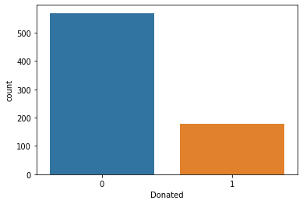
Before we begin
Here is the distribution
of class outcomes
3 to 1 difference
570 to 178 to be exact
Is this imbalanced?

Slide 5
The details
-Utilized a 80/20 for train/test split
-No preprocessing really required other than taking a .data file and making it a .txt file and then import that into excel and making sure the columns were correctly separated.
-StandardScaler normalized the data only for SVM (actually used all three but only reporting on one)
-Also tried shuffle but decreased accuracy on all classification methods selected (should I have done this?)
:When should you use shuffle

Slide 6
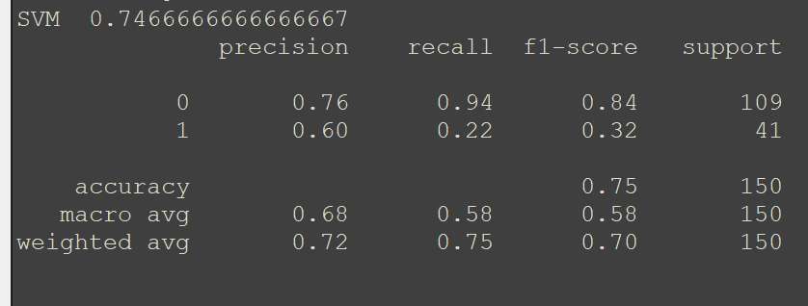
Results - SVM unscaled

Slide 7
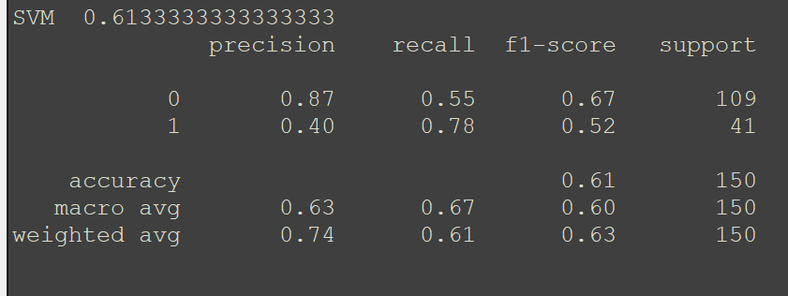
Results - SVM scaled

Slide 8
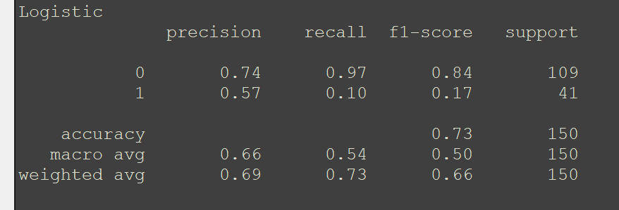
Results - Logistic Regression

Slide 9
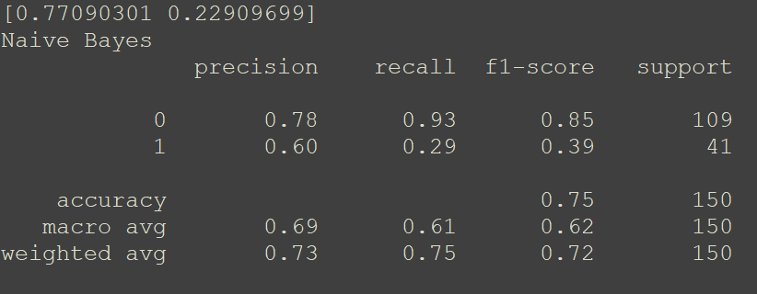
Results - Naive Bayes

Slide 10
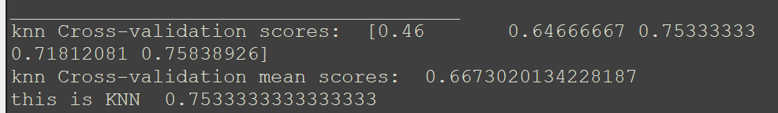
Results - KNN

Slide 11
Which one is best?
Depends on the metric.
Overall each method performs similar in terms of accuracy around 73%-75%
But why might accuracy not be the best choice of performance metric for this data?
Why might it be?
Don’t forget this isn’t an exhaustive list of possible methods to solve this problem but it is interesting to see methods converge to similar accuracy scores with the differences in the details (precision, recall, f1 score, support)
Don’t forget we also have other metrics, which I will be discussing in my paper, as given by the confusion metric such as false positive rate, ROC, and AUC

