Slide 1
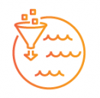




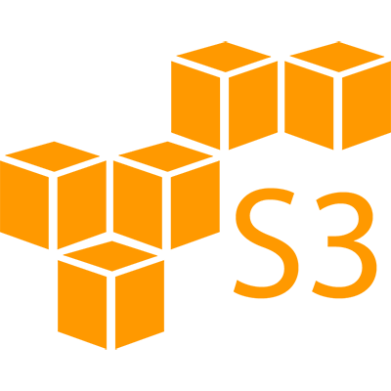





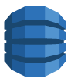
Extract
Transform and Load
Consume
Lake Formation
Crawler
AWS Data Catalog
Airflow DAG
Airflow DAG
JDBC Connection
Landing
Zone
RDS
Clean
Zone
Redshift
Curated
Zone
DynamoDB
DBMS in AWS

Slide 2




Extract
Transform and Load
Consume
Crawler
AWS Data Catalog
Lake Formation
JDBC Connection
Landing
Zone
Airflow DAGs
RDS
Airflow DAG
Clean
Zone
Redshift
Curated
Zone
DynamoDB
DBMS in AWS

Slide 3
Extract
Lake Formation
Landing
Zone
Airflow DAG
Clean
Zone
Curated
Zone

Slide 4
Transform and Load
Crawler
AWS Data Catalog
Lake Formation
JDBC Connection
Landing
Zone
Airflow DAGs
RDS
Clean
Zone
Redshift
Curated
Zone
DynamoDB
DBMS in AWS

Slide 5
Consume
Crawler
AWS Data Catalog
JDBC Connection
RDS
Redshift
DynamoDB
DBMS in AWS

Slide 6
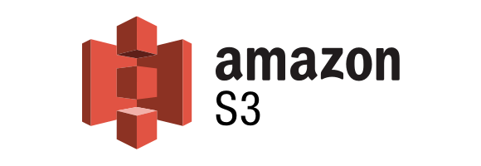

Extract
Load
Transform
Consume
Crawler
Lake Formation
AWS Data Catalog
Crawler
Landing
Zone
Airflow DAGs
Connection
RDS
Airflow DAG
Clean
Zone
Connection
Redshift
Curated
Zone
save/
backup files as needed
DynamoDB
DBMS in AWS

Slide 7
Extract
Load
Transform
Consume
Crawler
AWS Data Catalog
Lake Formation
JDBC Connection for RDS/Redshift
Landing
Zone
Airflow DAGs
RDS
Airflow DAG
Clean
Zone
Redshift
Curated
Zone
save/
backup files as needed
DynamoDB
DBMS in AWS

Slide 8
AWS Data Catalog
Landing
Zone

Slide 9
Extract
Load
Lake Formation
Landing
Zone
Airflow DAG
Clean
Zone
Curated
Zone

Slide 10
Load
Transform
Crawler
Lake Formation
JDBC Connection
Landing
Zone
Airflow DAGs
RDS
Clean
Zone
Redshift
Curated
Zone
DynamoDB
DBMS in AWS

Slide 11
Load
Transform
Lake Formation
Landing
Zone
Airflow DAGs
RDS
RDS
Clean
Zone
Redshift
Redshift
Curated
Zone
DynamoDB
DynamoDB
DBMS in AWS
DBMS in AWS

Slide 12
Transform
Crawler
JDBC Connection
RDS
Redshift
DynamoDB
DBMS in AWS

Slide 13
Transform
Consume
Crawler
AWS Data Catalog
JDBC Connection
RDS
Redshift
DynamoDB
DBMS in AWS

Slide 14
Transform
Consume
Crawler
AWS Data Catalog
JDBC Connection
RDS
Redshift
DynamoDB
DBMS in AWS

Slide 15
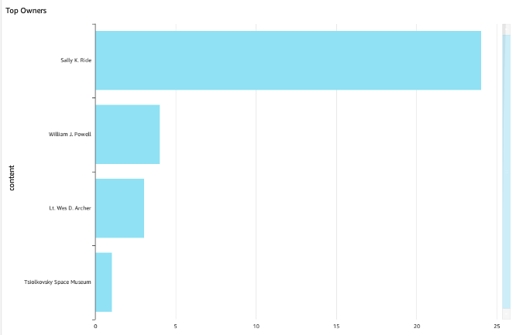
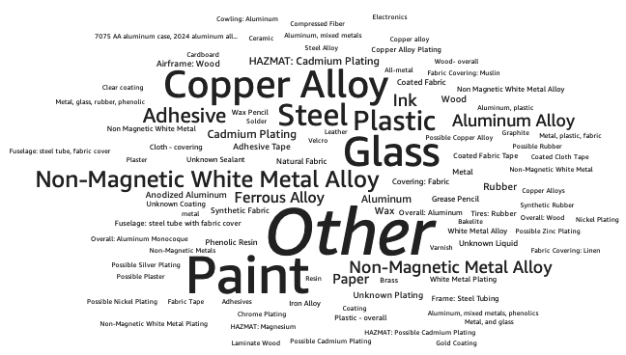

Slide 16
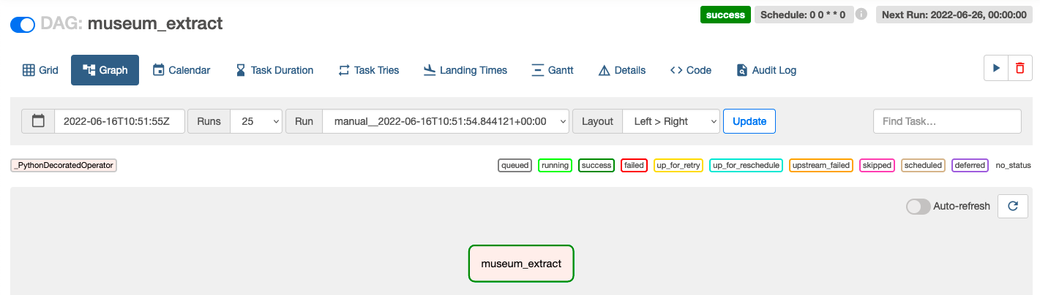
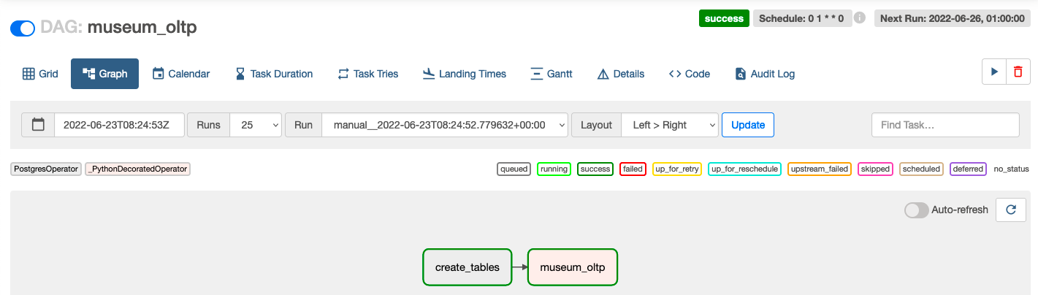

Slide 17
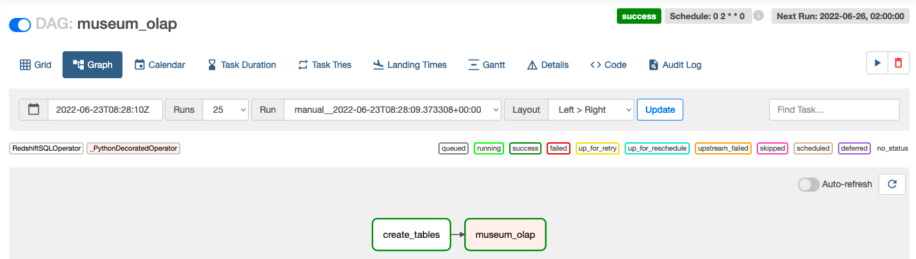
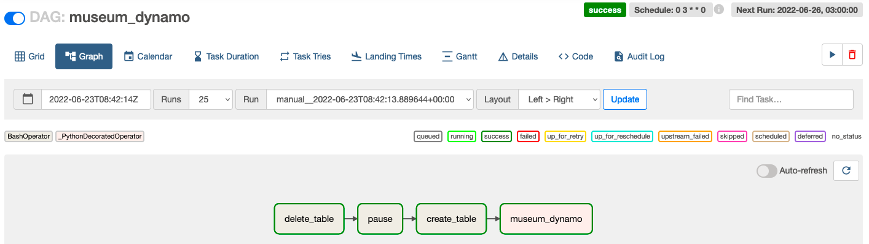

Slide 18
