Slide 1
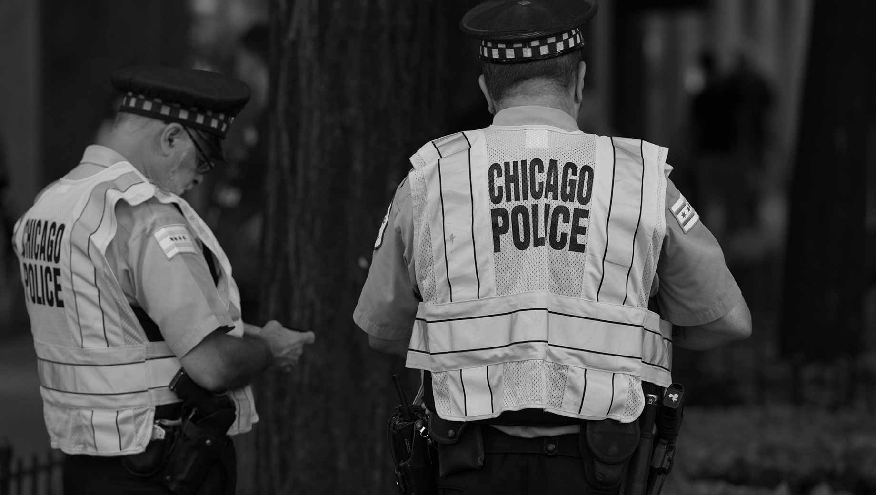
Trust in Law Enforcement:
Understanding the Drivers of Police Sentiment Scores
by Norman Lapid

Slide 2

Case File #ML1
Objective:
Build a model to predict the degree to which police are trusted by members of their community.
Location: Chicago, IL, USA
ML1

Slide 3



Lay the groundwork. Investigation requires thorough research.
Case Learning #1:
Illinois Department of Public Health (IDPH)
Chicago
Metropolitan
Agency for
Planning
(CMAP)
Socio-
Economic
data
Demographic
data
Public
Health
indicators
U.S. Census Bureau
Crime reports
Chicago Police Department
Geographic data
Target variable:
Police
Sentiment Scores
Chicago
Police Department
&
Elucd
Wikipedia
Design Matrix

Slide 4
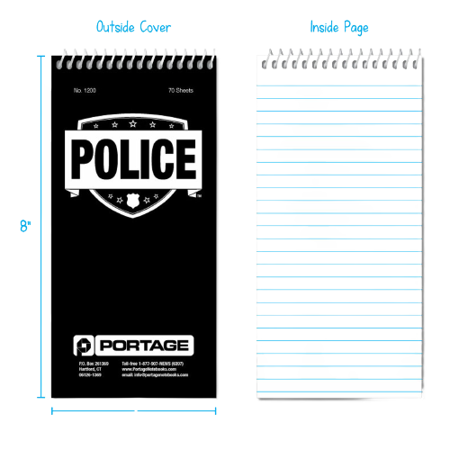



Case Learning #2:
LeaveOneOut:
R² → Error
Kfold(n_splits=10):
R² = -42%
Kfold(n_splits=6):
R² = 16%
RepeatedKFold
(n_splits=10, n_repeats=10):
R² = 62%
RepeatedKFold
(n_splits=6, n_repeats=10):
R² = 71%
✘
✘
Make the most of limited resources.
✘
✓
Reminder:
Check
Robust Scaling
vs
Standard Scaling
✓✓

Slide 5




Case Learning #3:
Follow proper procedure.
Construct a Pipeline
Apply transforms (scaling)
Apply an estimator (regression)
Define grid search parameters
Instantiate cross-validator
Apply GridSearchCV

Slide 6

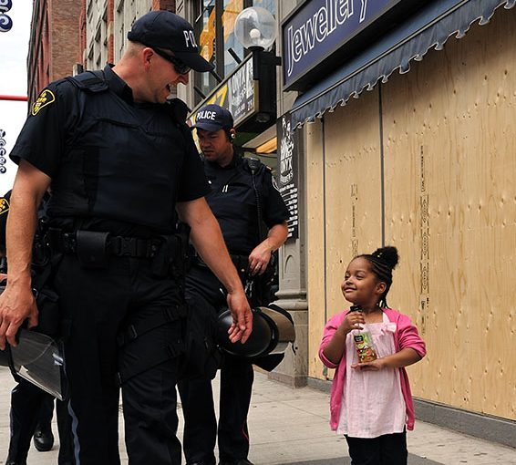

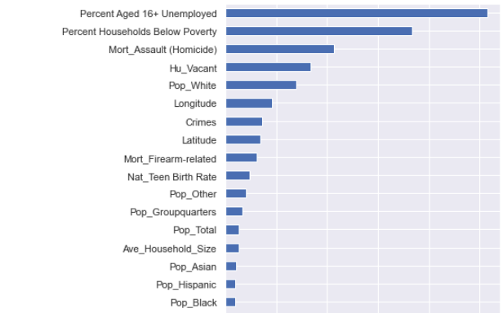
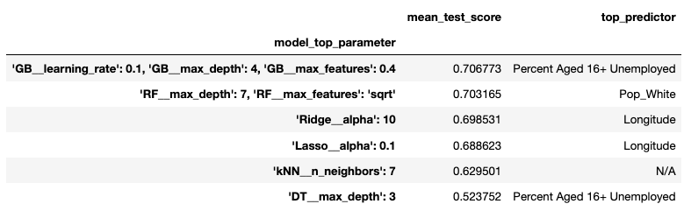
To build trust with the public, interpretability is key.
Case Learning #4:
Model: Gradient Boosting Method
✘

Slide 7

Top Suspects:
Unemployment
Race (% of white population)
Urban decay/Vacant housing
Per Capita Deaths from Homicide

Slide 8

ML1
Thank you.

