Slide 1
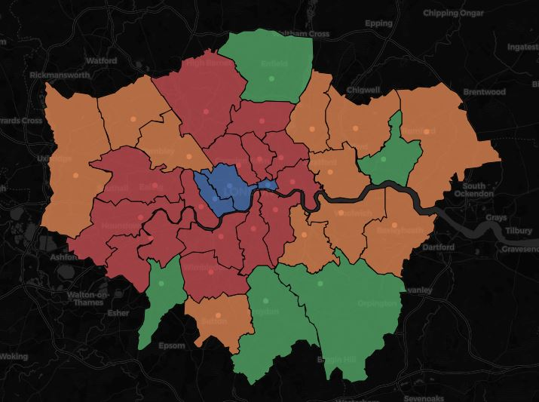
IBM Coursera Capstone Project
Clustering Neighbourhoods

Slide 2
Introduction
One of the most common type of traveling is a business or non-business city trip,
Travellers are in need of quick orientation in an unknown metropolis with its overwhelming impressions, opportunities, venues and wide variety of unique districts with their individual characters.
Solution: a clustering system for neighbourhoods of each individual city based on several dimensions of up-to-date information

Slide 3
Data
Data used in the project to build a a meaningful and characteristic feature set for each neighbourhood of a specific city:
Airbnb listings data (from http://insideairbnb.com/index.html) - Airbnb price level as a price indicator per neighbourhood - Airbnb room type data
Foursquare API for analyzing venue data for the neighbourhoods of a specific city.

Slide 4
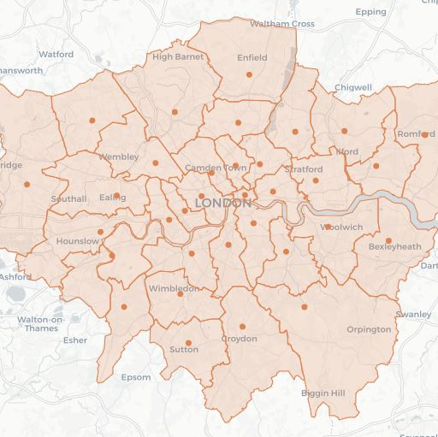
London
We will use data for the city of London for an example workflow

Slide 5
Clustering
After building our feature set we apply K-Means and gain 5 clusters for London’s neighbourhoods:

Slide 6
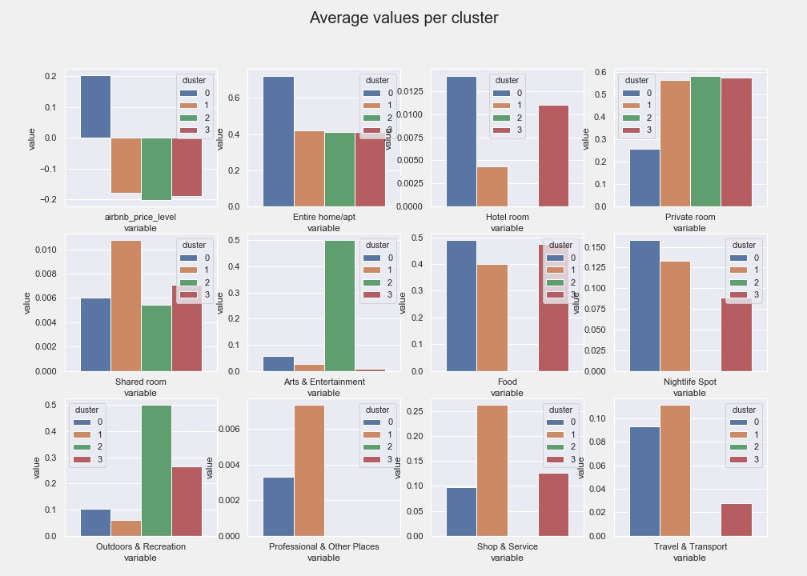
Cluster Profiles

Slide 7
Cluster Profiles
Cluster 0 (e.g. Westminster, City of London): high price level, few private rooms, many restaurants
Cluster 1 (e.g. Brent, Newham): relatively low price level, many private rooms, many shops
Cluster 2 (e.g. Bromley, Croydon): low price level, many private rooms, many outdoors & recreation venues
Cluster 3 (e. g. Camden, Islington): moderate price level, many private rooms, many nightlife venues

