Slide 1
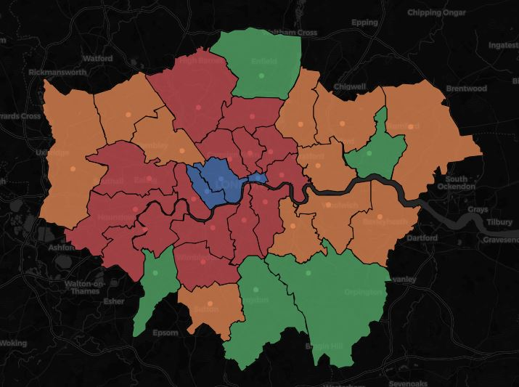
IBM Coursera Capstone Project
Clustering Neighbourhoods

Slide 2
Introduction
City trips growing trend
Travellers in need of quick orientation to

