Slide 1


Project Matchablcks
Norman Nguyen
University of Advancing Technology
(Game Programming), SIP404

Slide 2
Technical Field & Background Information
Focuses on the design and technical field of game programming.
This was inspired by the early educational games that were on the early PC games and simulation interactive games.

Slide 3
Project Description
The project is a 3D puzzle game that utilized a visual representation of data structures in a fun yet understanding way by giving them set of mini games and challenges.

Slide 4
Innovation Claim
Innovation claim is To teach complex programming concepts to teens (13-18 year old) in a fun and engaging way in order to achieve greater retention of the concepts.

Slide 5
Arrays and Linked List
Arrays | Array Functions | Linked List | Linked List
Fixed Size | Showing them via a fixed map generator | Dynamic Size | Having customized size with a modified map generator
Insertion and Deletion is inefficient | Have moving objects one at a time. | Insertion and Deletion is efficient | Having objects spawned and delete like a bin.
Random Access |  | No Random Access
No memory waste if limit | Have a limit counter that reaches and spawn the destroyer | Memory allocated | Incinerator is everywhere and anytime.
No Pointers | No Teleportation since Arrays are | Pointers | Teleportation

Slide 6
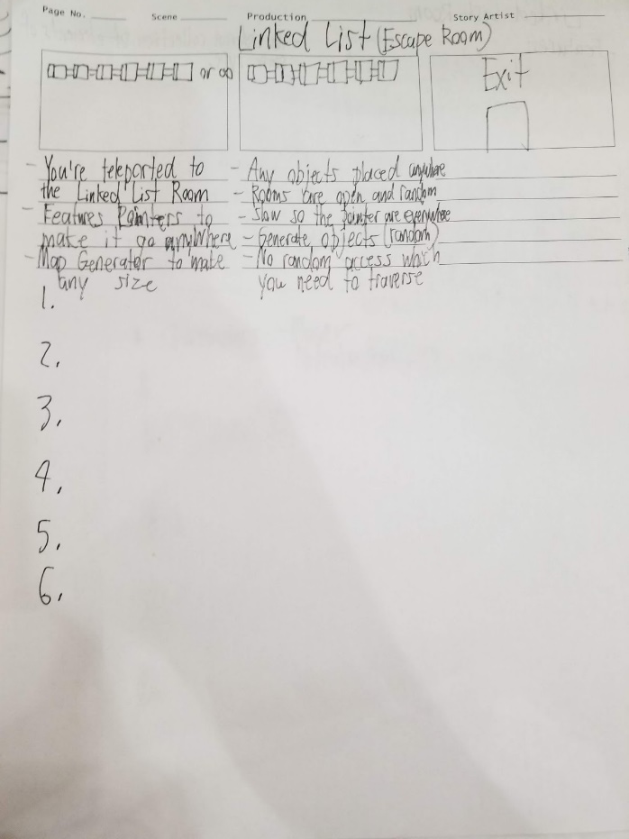
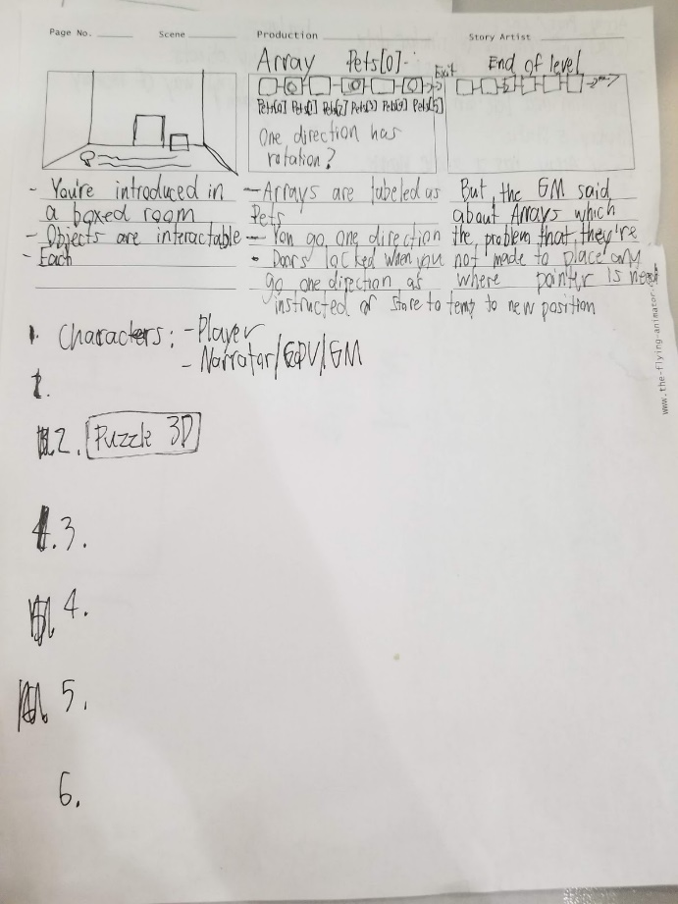
-Game Design Document that includes a storyboard for each scenario for Array and Linked List.
-Each storyboard has a different scenario of how an Array works and Linked List work.

Slide 7
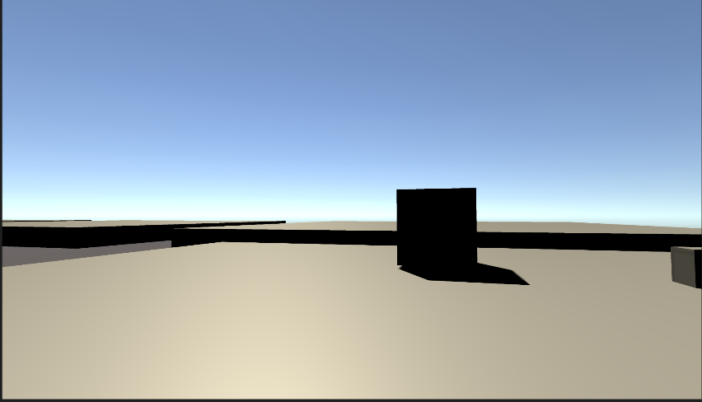
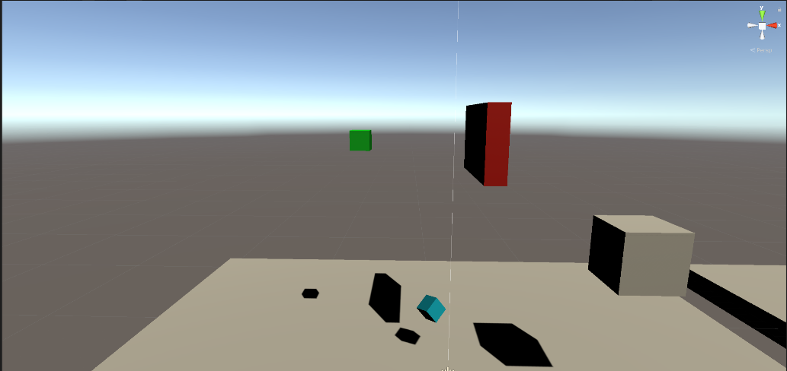
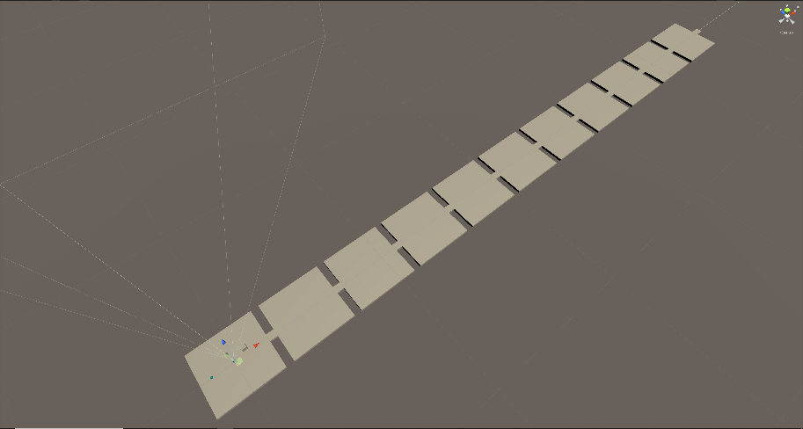
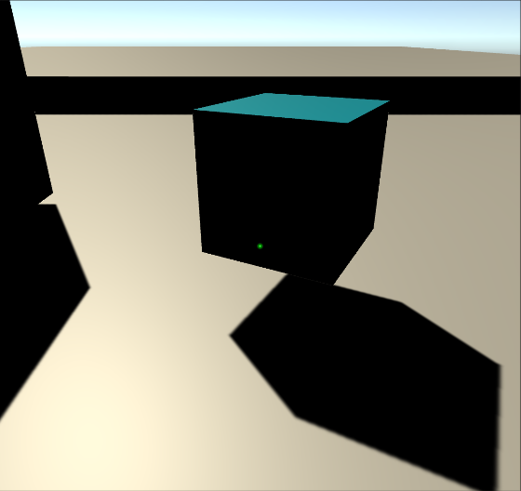
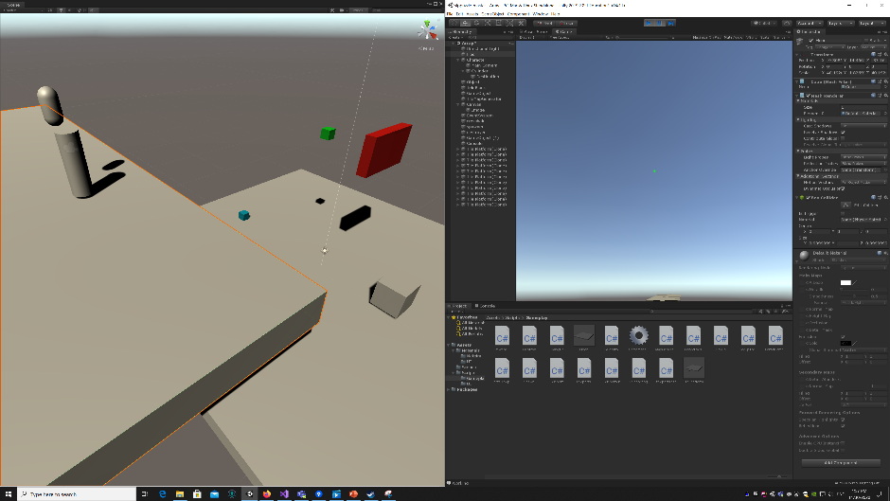
Screenshots and Design
3D Puzzle First-Person
Insertion and Deletion (Spawn and Destroy)
Map Generation of Array and Linked List
Pick Up Objects/Memory Blocks
Teleporters/Pointers

Slide 8
Target Market
This project focus on educational yet fun games similar to the Humongous Entertainment games but giving it a new kind of edge of getting into Data Structure to get teenagers and upcoming people to get used to it.

Slide 9
Prior Art
Swift Playgrounds (iPad App) https://www.apple.com/swift/playgrounds/
Humongous Entertainment Games http://humongous.com/
Portal https://store.steampowered.com/app/400/Portal/
Human Resources Machine

Slide 10
Recap
-Innovation: Innovation claim is To teach complex programming concepts to teens (13-18 year old) in a fun and engaging way in order to achieve greater retention of the concepts.
-Represent Array and Linked List
-Map Generator
-Pick up objects as memory blocks
-Objectives given from the game to utilized and play under the rules of Data Structure.
-Pointers Teleportation
Future:
-Objectives
-UI for players to recognized or count blocks and rooms
-Working level

Slide 11
Q&A
Norman Nguyen - Game Programming
To teach complex programming concepts to teens (13-18 year old) in a fun and engaging way in order to achieve greater retention of the concepts.

