Slide 1


Project Matchablcks
Norman Nguyen
University of Advancing Technology
(Game Programming), SIP404

Slide 2


How it all started?
It all started of a conversation with an uncle about giving an idea of educational games. It happen when I see programming as a tough subject even for beginners. But there are many people to this day that don’t know much of other programming aspects.

Slide 3
Technical Field & Background Information
Focuses on the design and technical field of game programming.
This was inspired by the early educational games that were on the early PC games and simulation interactive games.

Slide 4
Project Description
The project is a 3D puzzle game that utilized a visual representation of data structures in a fun yet understanding way by giving them set of mini games and challenges.

Slide 5
Innovation Claim
Innovation claim is To teach complex programming concepts to teens (13-18 year old) in a fun and engaging way in order to achieve greater retention of the concepts.

Slide 6
Arrays and Linked List
Why using Arrays and Linked List?
Array | Linked List
Fixed Size meaning it’s static as each rooms is next to each other | Dynamic Size as it allows to allocate more memory. Meaning you can access newer rooms that Arrays don’t in game
Easier to access | More ease of insertion and deletion
Contagious memory location. | Complex to access, imagine of doing ideas back and forth.
Access is easier which you can see pathways | Requires Pointers that are display as teleporters thus all doors are closed (key feature)

Slide 7
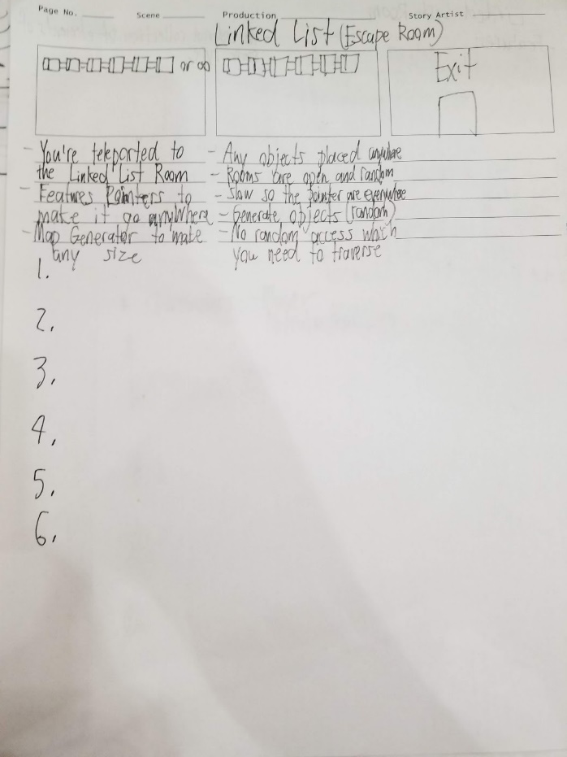
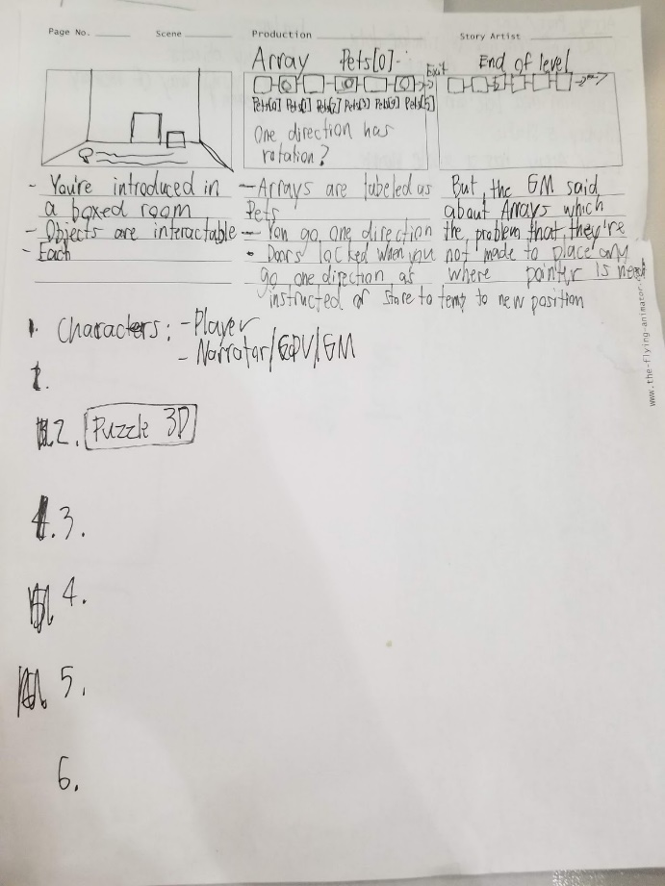
-Game Design Document that includes a storyboard for each scenario for Array and Linked List.
-Each storyboard has a different scenario of how an Array works and Linked List work.

Slide 8
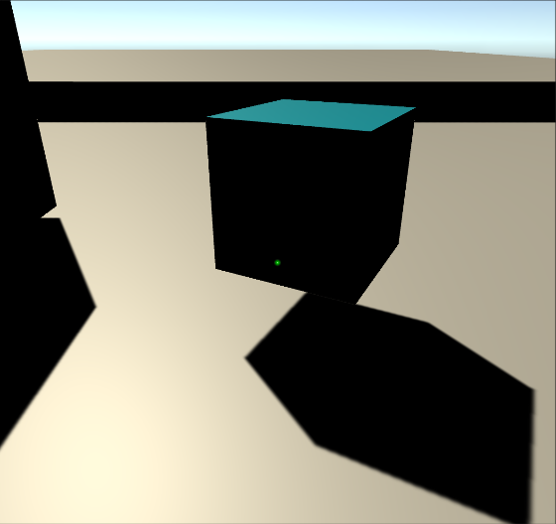
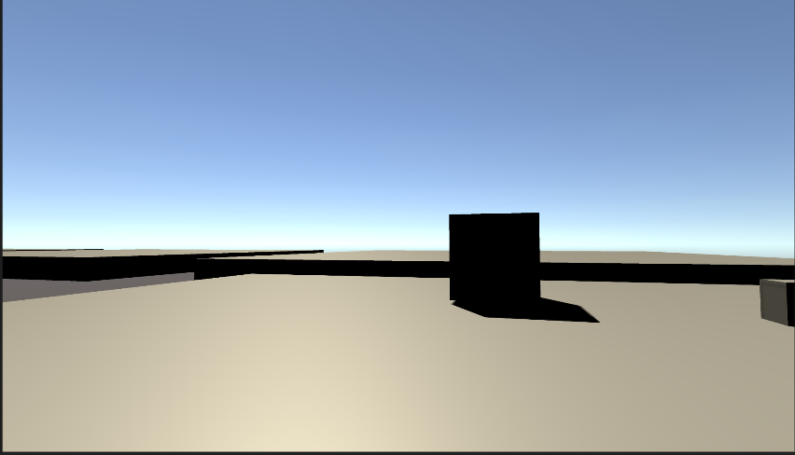
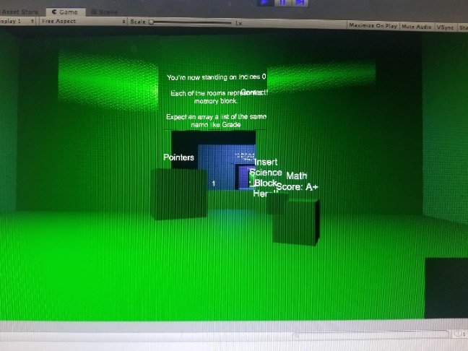
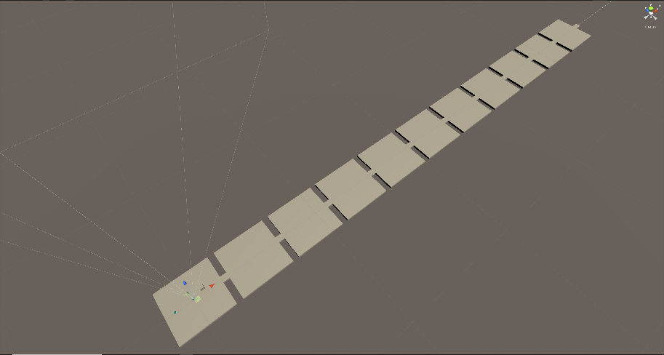
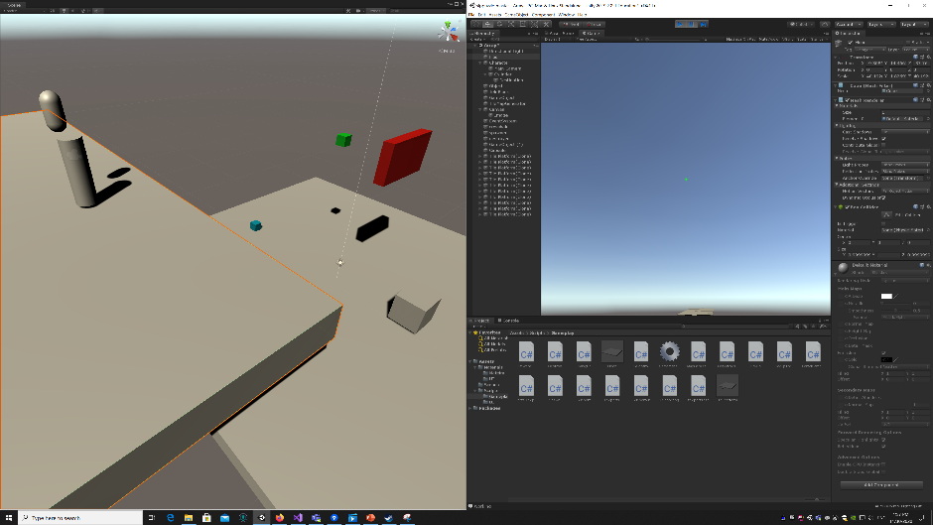
Screenshots and Design
Pick Up Objects/Memory Blocks
3D Puzzle First-Person
Instructions and playthrough with sense of humor to have the fun feel.
Map Generation of Array and Linked List
Teleporters/Pointers

Slide 9
Target Market
This project focus on educational yet fun games similar to the Humongous Entertainment games but giving it a new kind of edge of getting into Data Structure to get teenagers and upcoming people to get used to it.

Slide 10
Prior Art
Swift Playgrounds (iPad App) https://www.apple.com/swift/playgrounds/
Humongous Entertainment Games http://humongous.com/
Portal https://store.steampowered.com/app/400/Portal/
Human Resources Machine Stanley Parable

Slide 11
Recap
-Innovation: Innovation claim is To teach complex programming concepts to teens (13-18 year old) in a fun and engaging way in order to achieve greater retention of the concepts.
-Represent Array and Linked List
-Pick up objects as memory blocks
-Objectives given from the game to utilized and play under the rules of Data Structure.
-Pointers Teleportation
-Objectives and walkthrough tutorials when playing

